Slide 1
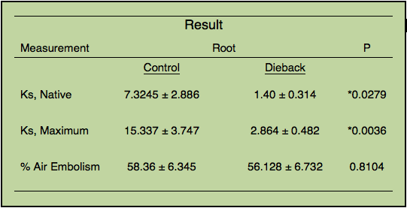
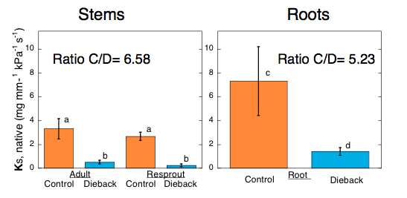
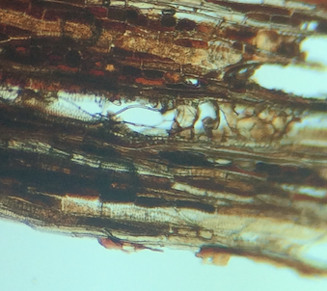
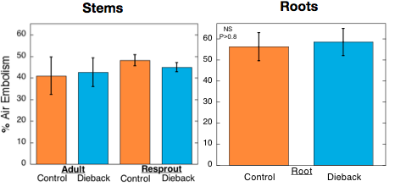
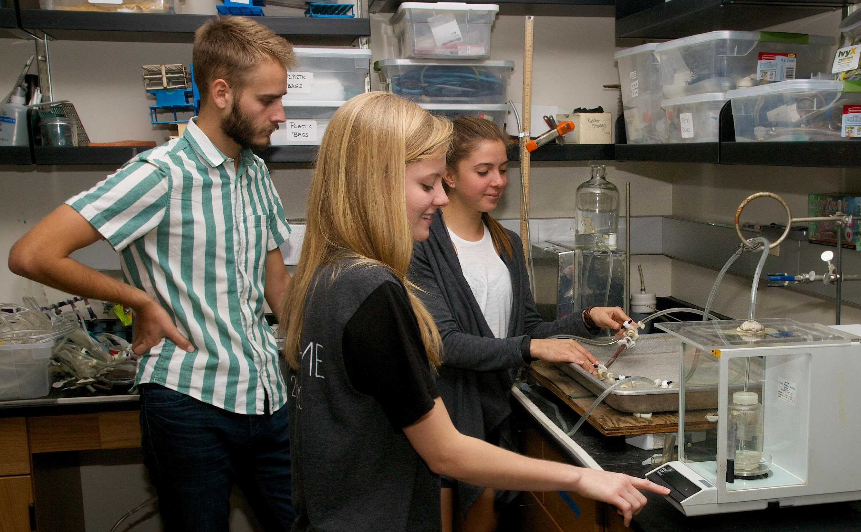
Root Hydraulic Conductance in Laurel Sumac Experiencing Severe Dieback in the Santa Monica Mountains
Natalie M. Aguirre, Avery N. Davis, Sarah B. Nelson
Biology 390, Plant Physiology, Fall 2015
Pepperdine University Malibu, California 90263
Abstract
Results
Conclusion
Malosma laurina (laurel sumac) is a dominant species in coastal chaparral ecosystems, extending its roots down to an average of 40 feet in rocky, sandy soils. The deep root systems of M. laurina provide structural support for the steep Santa Monica Mountains. The roots also allow M. laurina to draw from the deep water table, increasing its drought tolerance. M. laurina dieback is prevalent in coastal exposures of the Santa Monica Mountains presumably due to historic drought predisposing plant tissues to infection by the fungal pathogen Botryosphaeria dothidea. In ecosystems that experience annual dry periods, a high hydraulic conductance in roots is necessary to provide plants with sufficient water to sustain them until the next rainfall. A recent study has examined the effect of Botryosphaeria on the hydraulic conductance of M. laurina stems, but no research has been performed on roots. This study looks at the effect of the fungus Botryosphaeria on the root system of infected M. laurina plants compared to uninfected, well-irrigated control plants. Our focus was on the roots’ ability to transport water to the shoot. We collected root samples of both infected plants experiencing severe dieback as well as healthy plants and tested the hydraulic conductivity (Kh), water movement through each root. We then calculated the specific conductivity per unit xylem area (Ks). We found significantly lower Ks in infected plants (mean of 2.3 mg • mm • s-1 • kPa-1) than in the healthy, control M. laurina (17.2 mg • mm • s-1 • kPa-1). The data supports the hypothesis that Botryosphaeria greatly reduces water transport function in the roots of Malosma laurina. Furthermore, the greater hydraulic conductance in well-irrigated controls indicates that water stress increases proliferation of Botryosphaeria infection in Malosma laurina.
Our results allow us to conclude that there is a significant difference in the amount of physical blockage in the roots of healthy control versus dieback M. laurina plants. We conclude that there is no physical blockage in the roots of healthy plants. Additionally, our investigation of the root cross-sections confirms our hypothesis that this blockage is at least partially due to physical (fungal) infection. Further research is necessary to determine the extent and species of the fungal infection. With more time and funding, we would like to culture the fungal hyphae found in the dieback roots. Our results also point toward the detrimental effects that the drought has had on the hardy chaparral shrubs of Southern California. This agrees with Venturas et al., who have shown that the recent droughts have begun to alter the chaparral based ecosystem in Southern California.
Table 1. Mean values are 土 one standard error, n = 18 for adult roots approximately 8 mm in diameter. Native values represent hydraulic conductance (Ks, mg・mm・sec⁻¹・kPa⁻¹) through the root as found in nature. Maximum values represent the hydraulic conductance (Ks, mg・mm・sec⁻¹・kPa⁻¹) maximum potential the roots have once removing air embolism. Percent air embolism (Ks Max - Ks Native)/(Ks Max). A Student’s t-test with unpaired unequal variance at α=0.05 was used for statistical analysis for Maximum and % Air Embolism. A one-way Student’s t-test with unpaired unequal variance at α=.05 was used for statistical analysis for Ks, Native.
Xylem Specific Conductivity, Ks
Materials and Methods
We conducted our experiment by first collecting root samples. Our control root samples were obtained from an irrigated area on Pepperdine’s Malibu campus, and our experimental root samples were obtained from a dry location above Pepperdine’s campus that was experiencing extreme dieback. We obtained root samples by digging with screwdrivers and trowels under M. laurina plants, approximately 5 to 10 cm away from the base. We dug out a trough around each root, which we then filled with water. Roots could then be cut underwater, thus eliminating the possibility of artificially inducing air emboli into the conduits. After collecting the roots, we transported them to the lab, keeping them submerged in water.
In the lab, we prepared the roots to be tested for conductivity by cutting them to a uniform length of 10cm, again underwater. We also measured and recorded xylem area before testing roots so that we could calculate Ks (conductivity/xylem area). We tested the conductivity of each root using a Sperry apparatus. This apparatus consists of a series of tubes that connect a reservoir of KCl solution to the root, which is then connected to an electronic balance. The KCl solution was chosen to mimic the mineral content delivered to roots in a natural setting. The system is gravity-driven, and a computer is used to calculate the rate at which the solution passes through the each root. After testing each root once, we placed the roots in a vacuum for 1 hour to remove air emboli from the roots. This allowed us to test the same roots again, using the Sperry apparatus , and compare our results with the previous tests to asses the amount of physical blockage present in each root.
Introduction
Malosma laurina plays an important ecological role in the Santa Monica Mountains. Its deep roots, which are able to tap the water table and provide drought tolerance, also provide important structural soil support. In the past year, however, M. laurina has been experiencing dramatic dieback, which could deeply affect the ecology and community structure of the Santa Monica Mountains. Dieback has been attributed to the fungal pathogen Botryosphaeria dothidea, which may invade as a result of major water stress. M. laurina dieback is significant as it is one of the remaining keystone species in the Santa Monica Mountains, as other species, such as Ceanothus crassifolis has experienced dieback as a result of drought and wildfire (Davis et al., 2002). Research has been performed on the effect of infection on stem hydraulic conductance in M. laurina, but no study has examined the effect of the fungus on root hydraulic conductance. Impaired root function may be devastating to the plant, as it relies on its deep taproot to provide water and nutrients to its shoot and post-wildfire resprouts. We hypothesized (1) that root hydraulic function will be greatly reduced in individuals experiencing high levels of shoot dieback, compared to irrigated control plants, and (2) that decreased hydraulic conductance will be due to physical blockage rather than air embolism. Testing of native and maximum xylem-specific hydraulic conductance in roots (Sperry et al., 1998) will give us an idea of the amount of physical (potentially fungal) blockage in the root xylem.
% Air Embolism
Figure 1. A cross section of a dieback M. laurina root under a light microscope showing Fungal hyphae in the conduits. Only one root was examined.
Figure 2. Sarah, Avery, and Natalie analyzing root hydraulic conductivity using the Sperry apparatus.
Works Cited
Brooks, F. E., & Ferrin, D. M. (January 01, 1994). Branch Dieback of Southern California Chaparral Vegetation Caused by Botryosphaeria dothidea. Phytopathology New York and Baltimore Then St Paul-, 84, 1, 78.
Davis, S. D., Kimberly, A. P., Michelle, C. C., Ewers, F. W., Sperry, J. S., & Adams, G. C. (May 01, 2002). Shoot Dieback during Prolonged Drought in Ceanothus (Rhamnaceae) Chaparral of California: A Possible Case of Hydraulic Failure. American Journal of Botany, 89, 5, 820-828.
Palmeri, G. N., (2015). Malosma laurina dieback is associated with Fungal induces loss of hydraulic conductivity.
Sinclair, W. A., & Lyon, H. H. (2005). Diseases of trees and shrubs. Ithaca: Comstock Pub. Associates.
Sperry JS, Donnelly JR, Tyree MT. "A method for measuring hydraulic conductivity and embolism in xylem." Plant Cell & Environment 11.1 (1988): 35-40.
Venturas MD, MacKinon ED, Jacobsen AL, Pratt RB. “Excising stem samples underwater at native tension does not induce xylem cavitation.” Plant, cell & environment 38.6 (2015)1060-1068.
Venturas M.D., MacKinnon E.D., Dario H.L., Jacobsen A.L., Pratt B.R., Davis S.D., (2015). “Chaparral shrub hydraulic traits, size, and life history types relate to species mortality during California’s historic drought of 2014. Personal Contact.
Hypotheses
Acknowledgments
H1: Root hydraulic conductance will be higher in healthy control plants than dieback plants.
H2: Decreased hydraulic conductance will be due to physical blockage rather than air embolism.
Our research was funded by the Natural Science Division of Pepperdine University, Seaver college. We would like to thank Dr. Davis for providing us with the knowledge necessary to ask questions worthy of scientific research. We would also like to thank our classmates for helping us dig up roots on several occasions.

