Slide 1
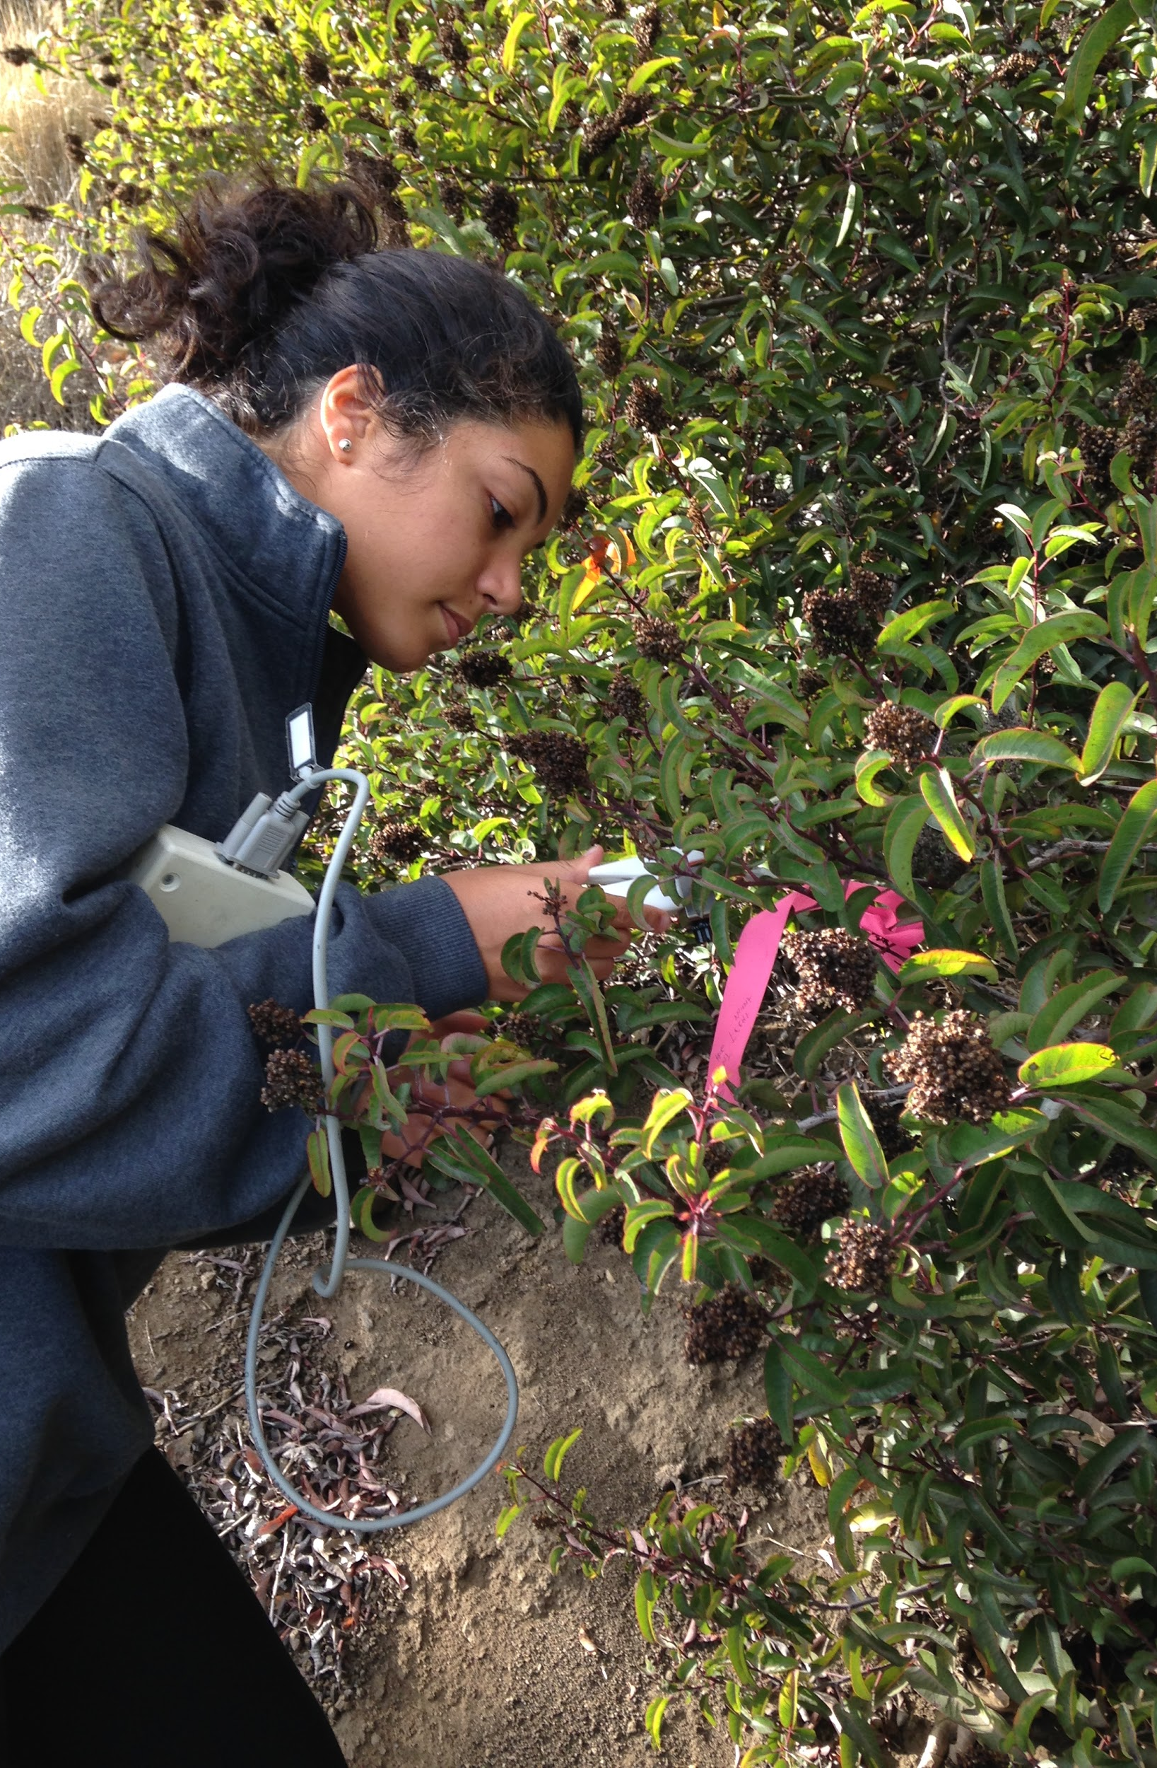
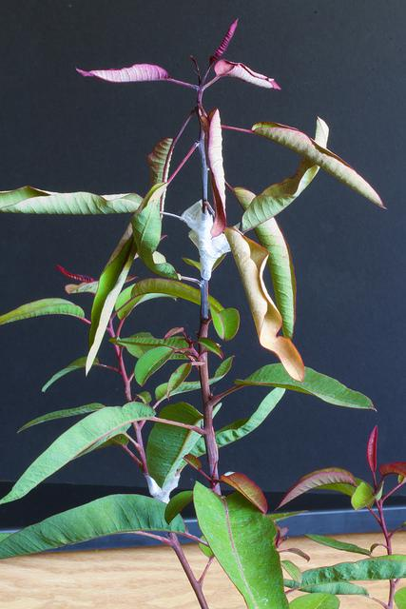
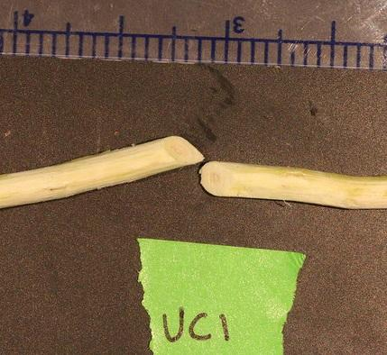
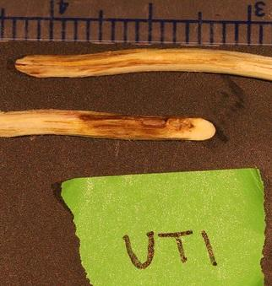
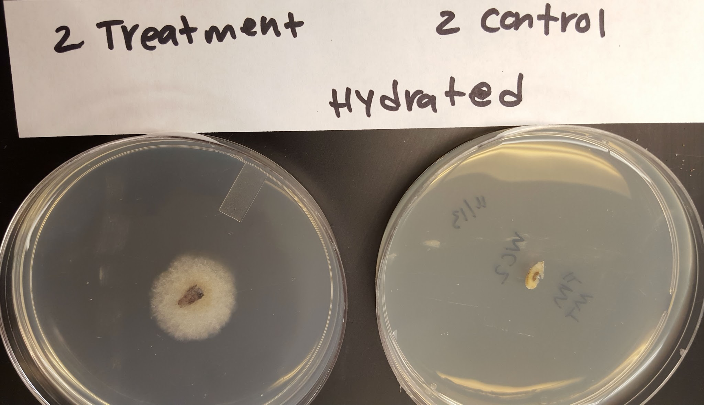
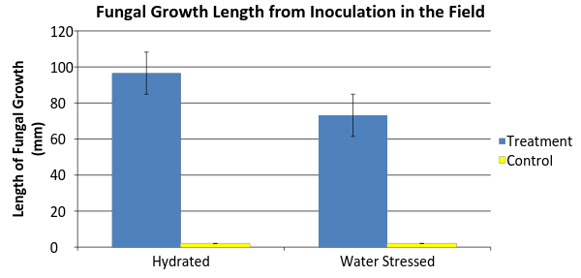
Recent Dieback in a Keystone Chaparral Species is
Caused by a Fungal Pathogen, Botryosphaeria dothidea
Frida Morales and Mariah Taylor
Pepperdine University, 90263
Abstract
Due to the recent drought in Southern California, the abundance of a keystone species within the Santa Monica Mountains (SMM) has been dwindling. This species, Malosma laurina, has an average root depth of 40 feet, so it has little difficulty tapping into the watershed. Recently, this species has undergone extensive dieback, which is potentially attributed to the unprecedented drought and the introduction of the fungus B. dothidea. While this fungi appears to be innocuous to M. laurina when the plant is healthy, it is more susceptible to invasion under water stress due to the dry heated conditions of the drought. Following Koch’s postulate to identify that a pathogen was the cause of disease, we set out to determine whether this fungus was the causative agent of the recent dieback. We analyzed fungal dieback in the field at two differently hydrated sites. We took samples of the fungi in twenty four plants located in an area of heavy dieback, grew them in pure culture, inoculated them in situ, and tested the growth to see if the fungi had invaded the xylem after thirty days of exposure. Then, at the two field sites, we inoculated 12 branches, one for each plant, and left 12 branches as controlled samples to compare. We found that both water stressed and hydrated plants were significantly affected by the fungus. We, however, were not able to replicate Koch’s postulate in full. It was concluded that the fungus B. dothidea was the major cause of the recent M. laurina dieback within the Santa Monica Mountains.
Methods
To begin the experiment, we isolated the fungal pathogen, B. dothidea, from the xylem of 12 different M. laurina plants in the field and grew them in potato dextrose agar (PDA) plates. To isolate the pathogen, we cut branches in the field that exhibited fungal growth, wrapped them in a wet paper towel, and placed them in Ziploc bags in a cooler. A two meter section of the branch was isolated and sterilized for one minute in 70% ethanol then for 10 minutes in 10% bleach. A razor was used to cut a thin sample of the infected xylem and this sample was placed on a plate of sterile PDA and grown for one week. We used one of these plates to inoculate 6 M. laurina in an area that was frequently watered and 6 M. laurina from an area that had been affected by the drought. The stems that were inoculated were cut at an angle through the xylem, a healthy area of growth from the fungus was placed into the freshly cut xylem, and then Parafilm was wrapped around the inoculation to keep the spread of the fungus centralized. From the same tree we used the same methods on a branch used as a control but instead of inoculating the fungus, the xylem was inoculated with only PDA. Steady State Leaf Diffusion Porometer Model SC-1measurements were taken each subsequent week to determine stomatal conductance of the leaves over time. At the end of four weeks, the branches of each inoculated stem were cut and a section of the xylem was isolated and grown on PDA plates for four days. Photos were taken of the inoculated sites of the xylem, the total length of fungal growth was measured with calipers, and a thin section of the xylem was re-plated on PDA plates*. After four days the plates between control and treated of the watered sites and less frequently watered sites were compared. *Aseptic technique was not adhered to when re-plating the re-isolated fungal pathogen.
Discussion
M. laurina that were found in the hydrated and water stressed locations both were able to incorporate the fungus into their xylem, so there was no indication that a well hydrated plant was not susceptible to the fungus. This is foundational to our study because it showed that all M. laurina located within the SMM are able to be infected by this pathogen regardless of whether or not the plant has a weakened immune system. The fungi taken from treatment samples in the field were not aseptically re-isolated and so it could not be determined from this experiment whether or not Koch’s postulates proved that this pathogen was the causative agent of the disease affecting M. laurina. After the first week of measurements, the results from the porometer showed that stomata from the leaves of the treatment samples were higher than the controlled samples. This was due to the fungi forcing the stomata opened in order to bring in more carbon dioxide so that it can sequester the carbon which provides a food source for the fungus and allows it to grow. This experiment allowed the researchers to theorize that week 2 of water vapor diffusion measurements is indicative of the peak of fungal infection in treated M. laurina. The fungus caused an observable change in the treatment samples allowing a darkening of the xylem which is representative of a blockage in the xylem. This is important to note because if these spores are aerosol transmissible then this could cause serious damage to the chaparral community within the SMM. In order to pursue the reasons why M. laurina is so easily invaded, further research could be utilized to compare this plant species susceptibility to another chaparral species’ susceptibility to this particular fungus.
Figure 1: 12
M. laurina were inoculated using aseptic technique and were measured with a porometer each consecutive week.
Figure 2: Porometer readings were taken to measure the water vapor diffusion of the control and the treatment branches in the field.
Figure 3.
The photo on the left shows an image of a treatment sample inoculated with B. dothidea where the foliage is dying due to the fungal growth. The right hand image shows a control sample where the leaves are healthy and not infected by the fungus.
Introduction
Malosma laurina is a keystone species within the SMM coastal chaparral community. M. laurina dominates coastal exposures and its success is highly attributed to the deep tap roots of the plant that is able to access groundwater and provides crucial slope stability to the hillsides. These characteristics make M. laurina’s health of deep ecological importance (Palmeri, 2015; Reese, 2015).
As of this year, NASA reported that 2014 was the warmest year in modern record. Southern California is currently experiencing the most severe drought it has seen in 1,200 years (Griffin and Anchukaitis, 2014). The increased temperatures and decreased water table is of particular importance to the future performance of M. laurina in the SMM. Particularly because when plants are water stressed, they are more susceptible to disease (Schoeneweiss, 1981). Widespread M. laurina dieback is occurring throughout the SMM and are currently experiencing the environmental stressors that allow fungal hyphae to successfully colonize within its xylem conduits (Palmeri, 2015). This invasion of pathogenic fungus, Botryosphaeria dothidea, identified by Pepperdine students, will perhaps worsen with the predicted winter El Niño rain (Palmeri, 2015). Therefore, it is important to see if higher accessibility to water and rainfall after a long dry drought period will lead to increased fungal growth within M. laurina xylem conduits.
Koch’s postulates state that the causative agent must be present in all cases of disease and that the speculated pathogen can be isolated from the diseased host and grown in pure culture, which then can be used to cause the disease when inoculated into a healthy host, where the pathogen needs to be re-isolated from the new host and shown to be the same as the originally inoculated pathogen (Koch, 1876). Utilizing this reasoning, this study imitates Koch postulate methodology by aseptically inoculating M. laurina both in vivo. Furthermore, in order to see what affects El Niño rains would have on drought-stressed dieback M. laurina, the inoculated plants included a group of M. laurina were hydrated regularly and those that were not. We predict that the consistently hydrated M. laurina will experience significantly more fungal growth than its less hydrated counterparts.
Results
In order to compare M. laurina living in an area that is experiencing drought to an area experiencing no water stress, an unpaired student’s t-test using equal variances was used. Through this data analysis it was found that there was significant difference in comparing the fungal growth both proximally and distally from the site of inoculation in the treatment group as compared with the control group for both the water stressed and the hydrated area. Stomatal conductance for the treatment group was on average higher than the control group, and for every week, except for the first, both the water stressed and the hydrated lawns showed a higher stomatal conductance for the treatment group than it did the control group. The re-isolated fungus had not been aseptically isolated and so the fungal plates had a high degree of contamination. In the attempt to replicate Koch’s postulate, our PDA plates had contamination in 1 of the control water-stressed xylem isolates and 4 of the control hydrated xylem isolates. Even though we were able to attain 2 uncontaminated PDA control plates from the hydrated xylem and 4 from the water stressed xylem, due to the error describes we were unable to demonstrate Koch’s postulate in full. All treatment xylem isolates did show fungal growth, with the exception of hydrated treatment 5 isolate and water stressed treatment 6 isolate. The treatment plates also had contamination, occurring in 2 of the hydrated xylem isolates and 3 of the water-stressed xylem isolates.
Conclusions:
B. dothidea was identified as the disease causing agent that produced dieback in fungus-containing M. laurina
The fungi initiated a darkened xylem in every fungi inoculated treatment branch, whereas no fungi was found in any of the control samples
Hydrated M. laurina did not experience significantly more fungal growth than its less hydrated counterparts
There was no significant difference between water stressed M. laurina and water stable plants’ susceptibility to the fungi or differences in water vapor diffusion
References
Griffin, Daniel, and Kevin J. Anchukaitis. "How unusual is the 2012–2014 California drought?" Geophysical Research Letters 41 (2014): 9017–9023.
Koch, R. (1876). "Untersuchungen über Bakterien: V. Die Ätiologie der Milzbrand-Krankheit, begründet auf die Entwicklungsgeschichte des Bacillus anthracis" Cohns Beitrage zur Biologie der Pflanzen 2 (2): 277–310.
Palmeri, G. (2015, July). Malosma laurina Dieback is Associated with Fungal Induced Loss in Hydraulic Conductivity. Poster session presented at Pepperdine University Summer Undergraduate Research in Biology Poster Session, Malibu CA.
Reese, S. (2015, July). Comparative Photosynthesis and Transpiration Between Healthy and Dieback Malosma laurina. Poster session presented at Pepperdine University Summer Undergraduate Research in Biology Poster Session, Malibu CA.
Schoeneweiss DF. "The Role of Environmental Stress in Diseases of Woody Plants." Plant Disease 65.4 (1981): 308-314.
Figure 4: Field grown M. laurina affected by the fungal pathogen. Necrosis and discoloration can be observed proximally from the site of contamination.
Figure 5: These photos are taken from different branches on the same tree in a water stressed lawn. The photo on the left is a control sample where the xylem was inoculated and the photo on the right is the treatment sample. The discoloration seen in the photo on the right shows where the fungus invaded. The consistent coloration in the sample on the left shows a healthy xylem displaying no sign of fungal growth.
Figure 6: The PDA plate on the right shows a section of stem without growth of the fungal pathogen, whereas the left-hand photo displays a section of xylem from the stem that was inoculated with the pathogen.
Stomatal Conductance (mmol/m²s)
 | Watered Trees |  | Unwatered Trees
 | Control | Treatment | Control | Treatment
Week 1 | 112.2 | 83.17 | 52.35 | 72.28
Week 2 | 24.27 | 24.68 | 50.06 | 55.76
Week 3 | 57.77 | 89.73 | 40.94 | 52.18
Week 4 | 38.72 | 59.82 | 31.74 | 70.52
Average | 58.24 | 64.35 | 43.7725 | 62.685
Figure 7: The total length that the fungus spread in plants in the field over four weeks. The length of control growth was significantly different from treated growth. There was no difference in growth length between hydrated and water stressed individuals.
Figure 8: Using a student’s t-test was no significant difference found between watered and unwatered trees for weeks 1, 3, and 4. Week 2 showed significant difference when comparing watered to water stressed M. laurina. On average the branches that were inoculated with the fungi had a higher stomatal conductance than the branches inoculated with PDA.
Acknowledgements
This project was completed thanks to the Natural Science Division of Pepperdine University, with special thanks given to Daphne Green, Marissa Kaak, and our faculty mentor Dr. Stephen Davis.

