Slide 1
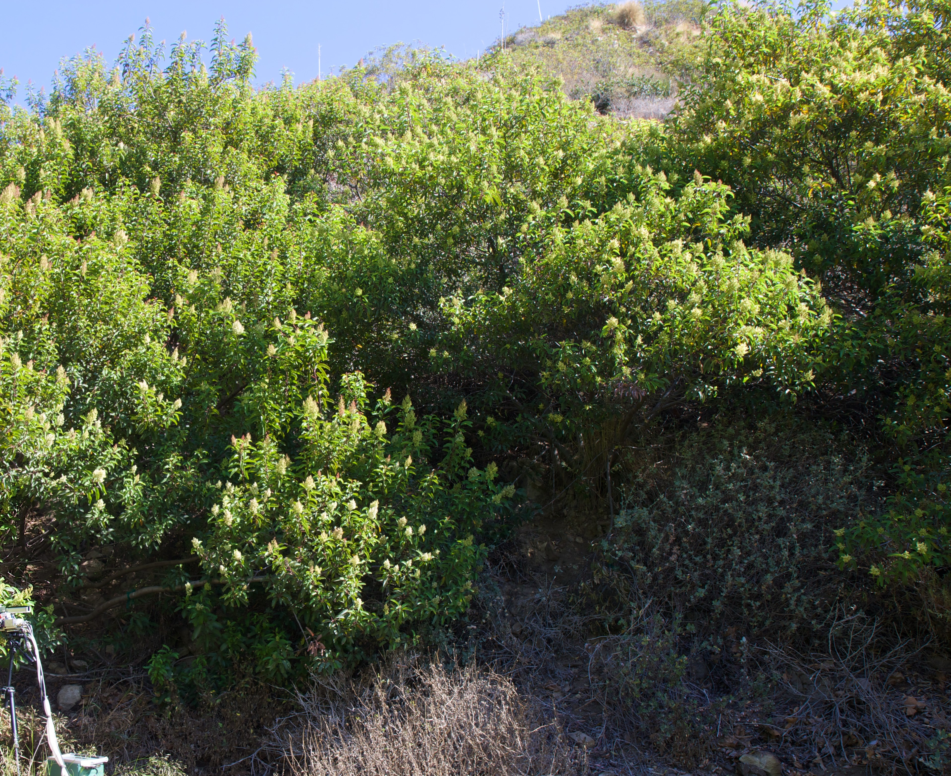
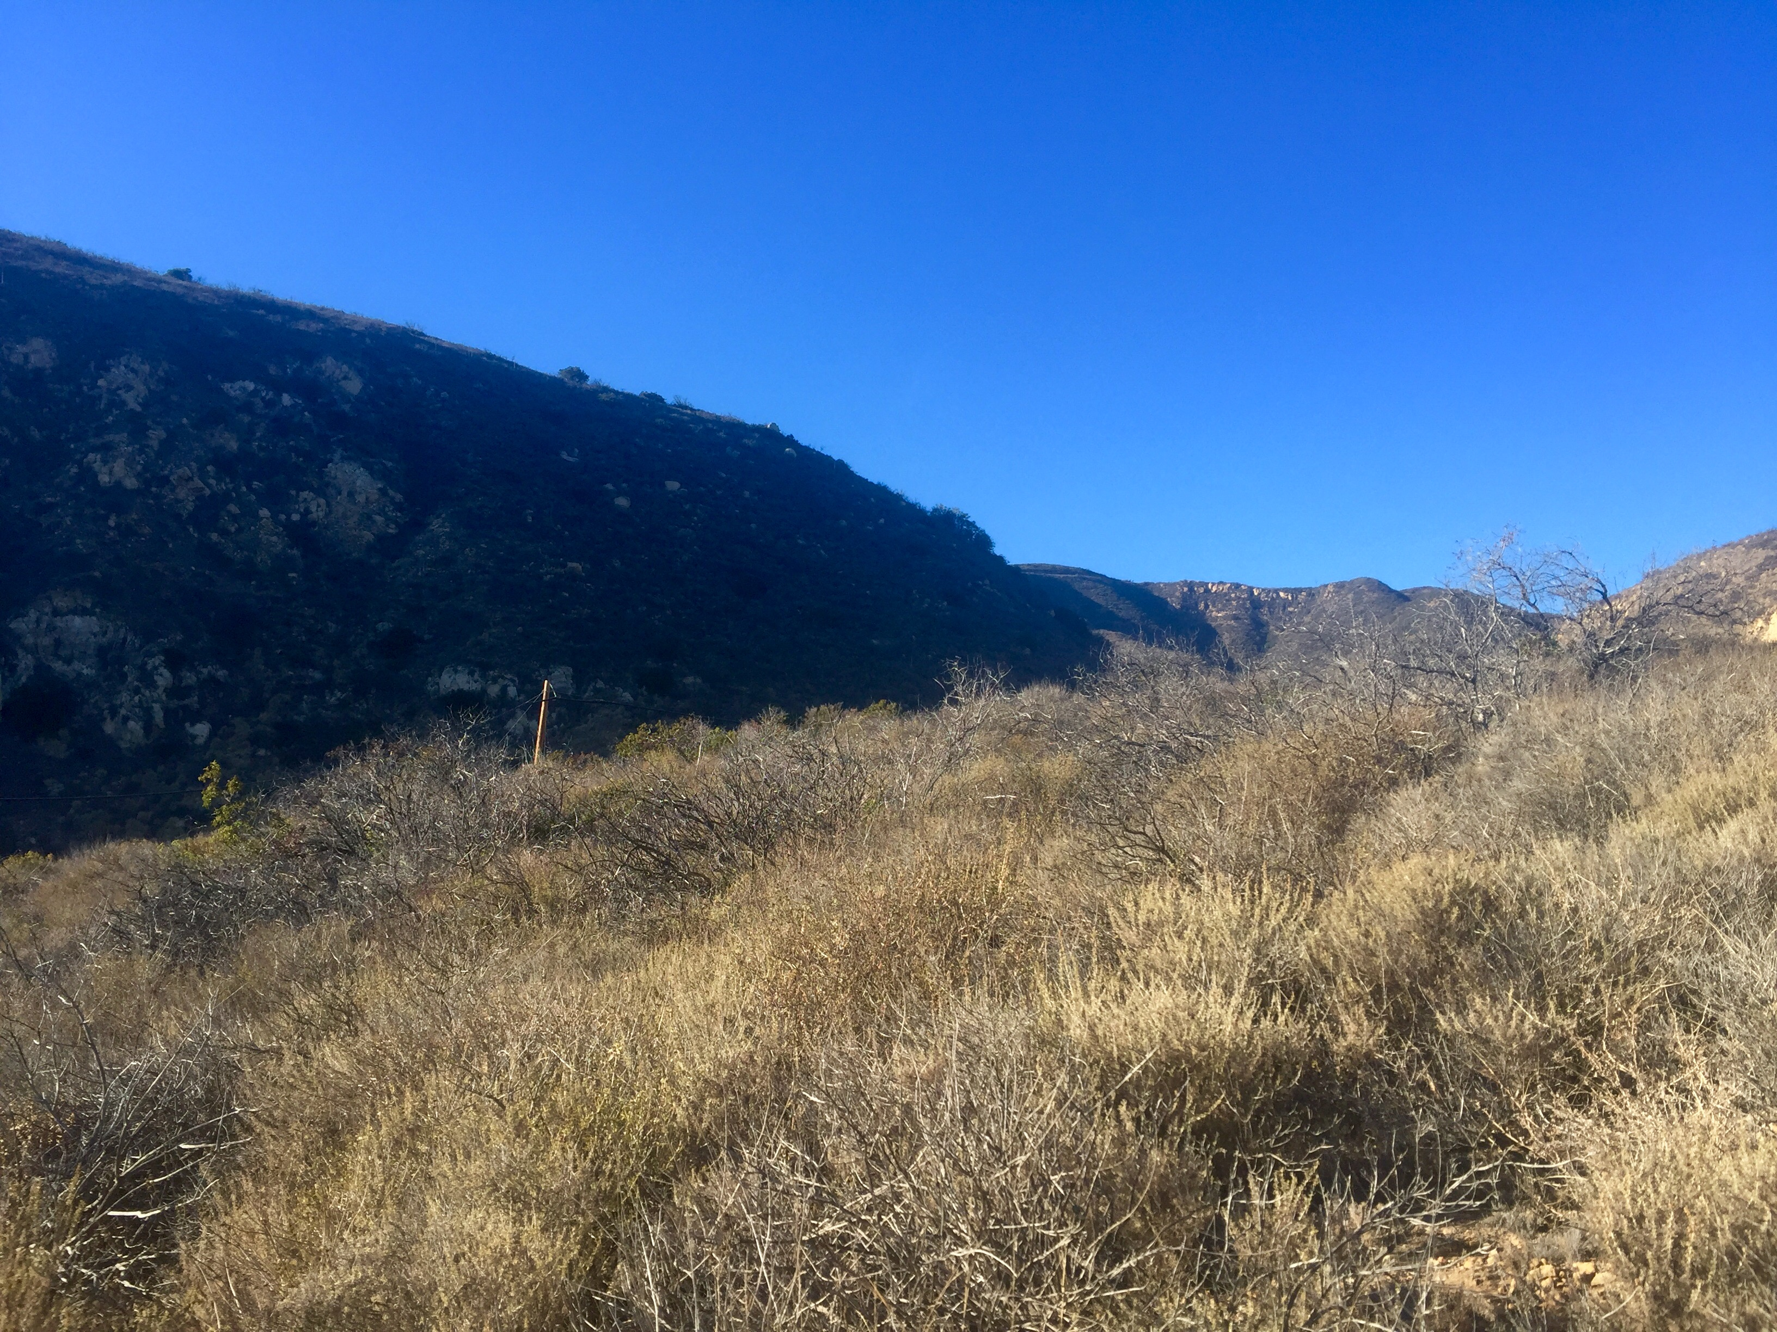
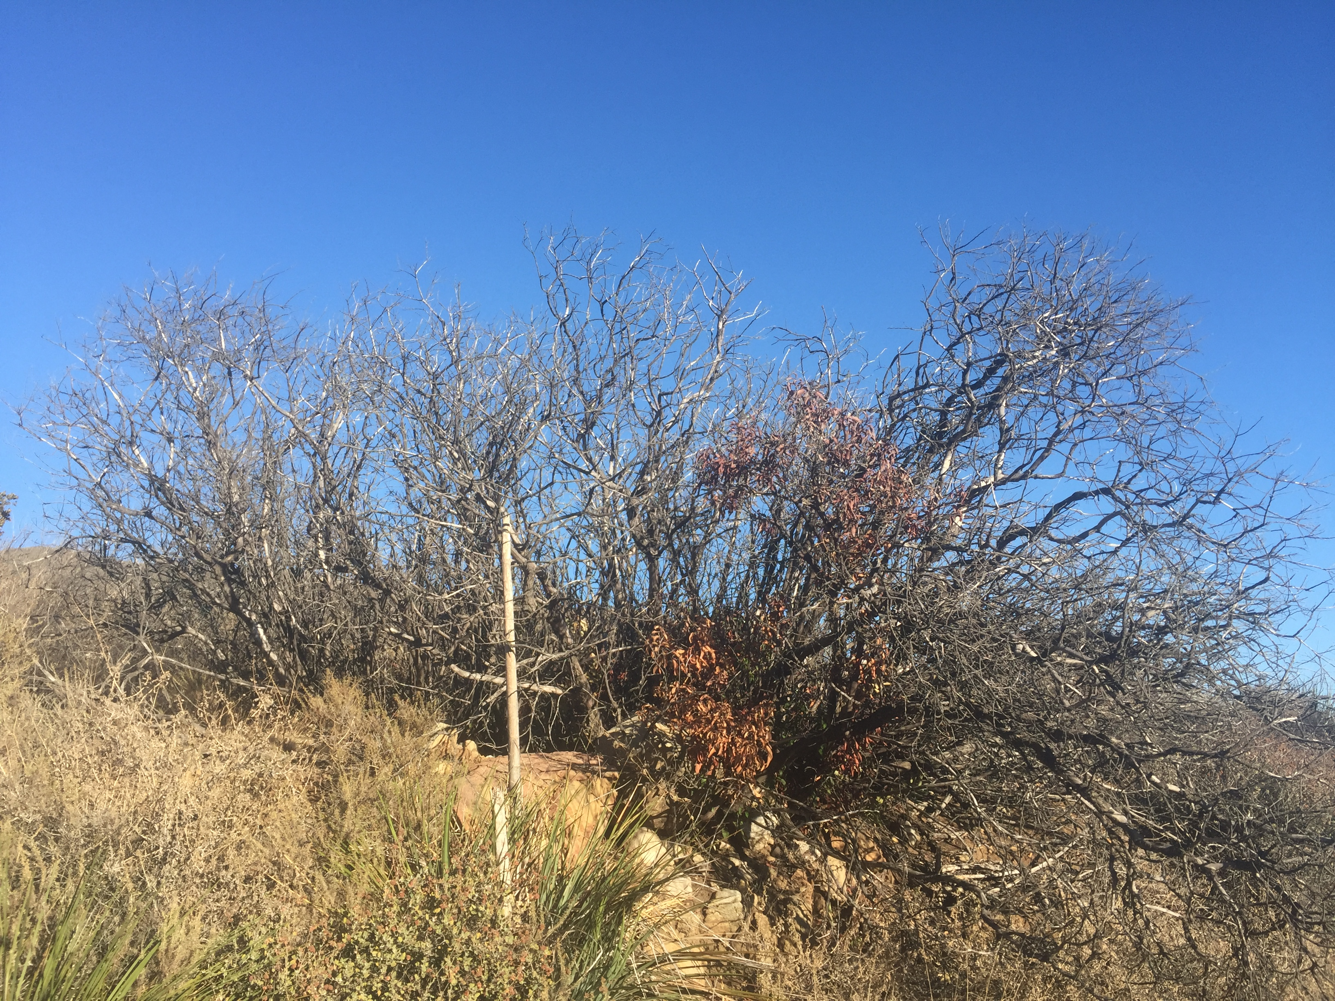
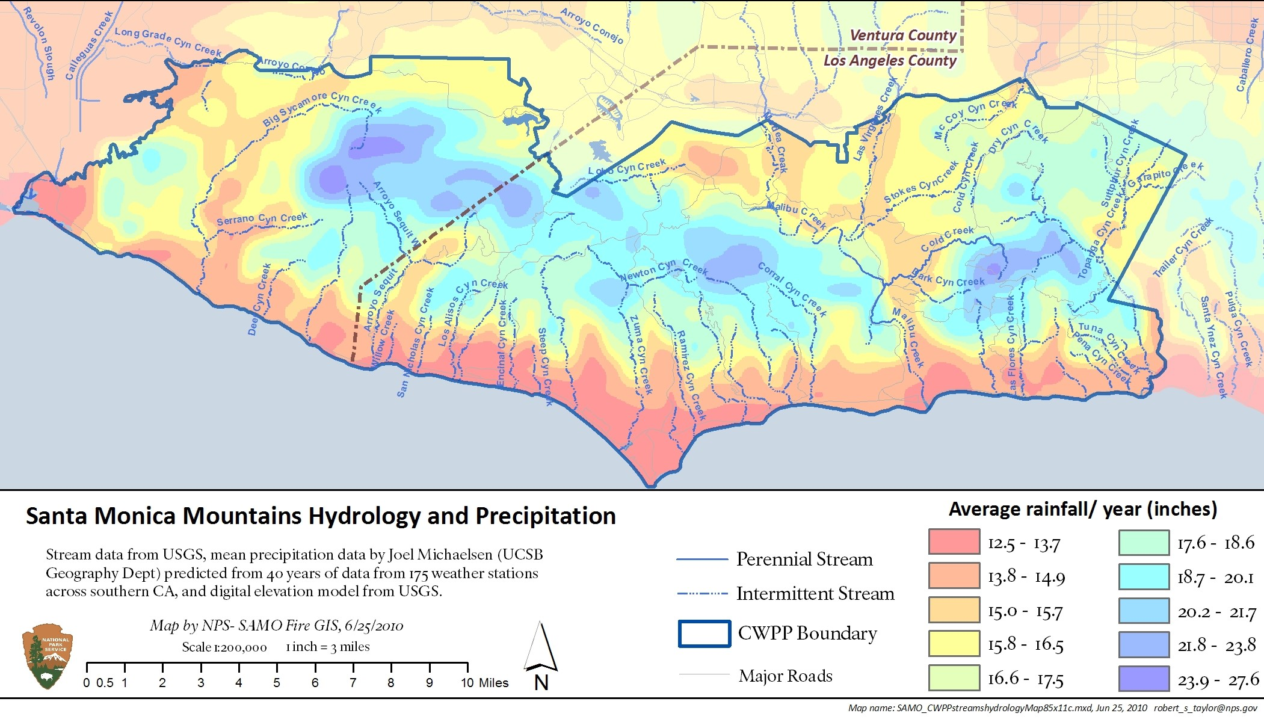
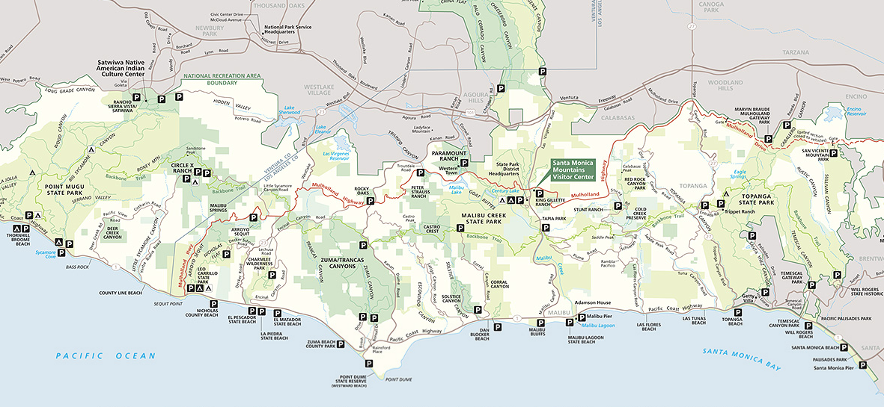
Extensive Dieback in Malosma laurina in Coastal Exposures of the Santa Monica
Mountains Associated with Unprecedented Drought in California
Gina S. Gilderman, Kaitlyn E. Sauer, Gabriella N. Palmeri
Pepperdine University, Malibu, CA 90263
Abstract
Throughout coastal exposures of the Santa Monica Mountains (SMM) there is a recent emergence of widespread dieback in Laurel Sumac (Malosma laurina). M. laurina is a keystone species of chaparral that dominates the SMM. A significant trait of M. laurina is an extensive root system exceeding 12 m in depth. We hypothesized that M. laurina was weakened by unprecedented drought in California (2013-2015) and predisposed to fungal pathogens. An initial study conducted in the summer of 2015 revealed all stem samples taken from dieback adult M. laurina plants were infected with Botryosphaeria dothidea, while zero stem samples taken from healthy adult plants contained the fungus. A survey of dieback in M. laurina was undertaken at 10 microsites along coastal exposures of the SMM between elevations between 60 to 300 m. Plants were scored on a scale of 1 to 5 based on the percentage of dieback a plant was experiencing, and for each of the microsites surveyed, the % adult mortality and canopy dieback did not differ significantly among the microsites. Mean score values for the 10 microsites were 1.19 for dieback plants compared to 3.0 for control plants; these predominantly healthy sites and plants possessed greater access to water. Sample sizes (n) at each microsite varied between 30 and 90 plants. From these results, it is clear that the M. laurina dieback is extensive, but may partially recover if the events surrounding El Niño, specifically rainfall, materialize this coming winter.
Methods
A survey of healthy and dieback Malosma laurina plants was taken at 10 different microsites along the Santa Monica Mountains (SMM), ranging from Tuna Canyon to the Los Angeles County Line. Dr. Robert Taylor, a phytogeographer for the National Park Services, provided details of microsites with prevalent numbers of M. laurina. Plants were scored on a scale of 1 to 5, with a score of 1 meaning the plant is experiencing 80-100% dieback (total death), and a score of 5 meaning the plant is experiencing 0-20% dieback (healthy) (Figure 4). The following variables were also recorded for each plant: number of branches with green leaves and location of leaves, number of main branches, number of both alive and dead resprouts, number of branches with recent death, GPS location in UTM, and elevation in meters. Photos of control versus dieback plants along with scoring system to quantify the extent of dieback are as follows:
Discussion
Our data collected in the Santa Monica Mountains exhibits a pattern of fungal-induced dieback associated with lower elevations of 60 to 300 meters (dieback) than higher elevations of greater than 300 meters (control, 430 m). This pattern corresponds to the hydrology map (Figure 5) as the areas with the least amount of precipitation correspond to coastal exposures throughout the SMM, where the study sites were surveyed. Figure 5 also indicates that higher elevations, located more inland, receive more rain than coastal exposures, and this difference in precipitation between these two regions suggests there is higher mortality in M. laurina in coastal exposures (60 to 300 meters) of the SMM due to severe drought. Of the 10 sites sampled, there is a significant impact on mean adult mortality. The control sites show about 9.4% average mortality, while the dieback sites exhibit up to 43% mortality. The mean score of these ten sites averaged at about 1.20, demonstrating that shoot dieback is between 70-80%. Of all dieback plants surveyed, 75.8% had alive resprouts, while 81.5% of all control plants surveyed had alive resprouts. Similarly, 2.3% of the dieback plants showed flowering, while the control plants exhibited 45.4% flowering. Reproductive success of these plants is associated with flowering; if flowering does not occur frequently or is absent, the seeds are not able to disperse as well, leading to loss of community structure. Thus, this data indicates that the driving force behind this extensive dieback is due to severe drought and fungal infection, both causing high mortality in chaparral. According to DF Schoenweiss, drought predisposes deeply-rooted chaparral plants to fungal infection; performing Koch’s postulate on inoculated Botryosphaeria dothidea in M. laurina plants clearly exhibits that this particular fungus is the causing agent of dieback. With the coming of El Niño, it is probable that M. laurina infected for a long period of time throughout coastal exposures of the SMM will not recover.
Score | Dieback
1 | 80-100%
2 | 60-80%
3 | 40-60%
4 | 20-40%
5 | 0-20%
Figure 1: Control (healthy) M. laurina dieback plants were surveyed at high elevation/rainfall sites above Decker Canyon. Dieback score of 5.
Figure 2: M. laurina dieback plants were surveyed at various microsites along the SMM, such as low elevation/rainfall in Decker Canyon.
Figure 3: An individual example of a typical dieback plant of M. laurina in Decker Canyon site. Dieback score of 1.
Figure 4. Scoring system used at all 10 study sites.
Results
Introduction
Laurel Sumac (Malosma laurina) is a keystone chaparral species that dominates chaparral shrub communities in coastal exposures of the Santa Monica Mountains. M. laurina has an extensive root system extending below 12 m in depth that serves to stabilize steep slopes against major erosion events and landslides. M. laurina is well adapted to wildfire because nearly 100% of the adults burned in fires vigorously resprout and these individuals persist through repeating fire cycles. M. laurina is becoming even more significant to the sustainability of natural resources of the Santa Monica Mountains because of anthropogenic increases in fire frequency that have reduced the numbers of co-dominant chaparral shrub species such as Big Pod Ceanothus and Green Bark Ceanothus.
However, it now appears that M. laurina was recently weakened by unprecedented drought in California (2013-2015), which has compromised its immune system, allowing a fungal pathogen to invade and spread. This has greatly reduced canopy cover and even population numbers (e.g. 52% recent adult mortality in the natural landscape of the Malibu Campus). This summer Botryosphaeria dothidea, an aggressive fungal pathogen, was isolated; in 100% of dieback species examined compared to 0% isolated in healthy control plants (individuals receiving supplemental irrigation, avoiding severe water stress, maintaining immune function, all preventing fungal infection). Our preliminary data suggest the fungal pathogen invades both the xylem and phloem of branches, cutting off water transport to leaves and branches and also carbohydrate transports from leaves to roots via the phloem. The range of infection appears to be rapidly expanding to higher elevations, presumably because lower elevations (60 meters to 300 meters) receive less rain and are drier (Figure 5), and therefore are immune-compromised to permit initial infection that is now spreading to moist microsites. Thus, the formulated hypotheses for this study were that observed dieback is not localized to Pepperdine University’s Malibu campus, but extends throughout coastal exposures of the SMM, and that plants at higher elevations with more precipitation have less dieback than plants at lower elevations with less precipitation (Figure 5).
1
2
3
4
5
6
7
8
9
10
Figure 5. Hydrology map of the Santa Monica Mountains (SMM) located in Southern California.
Figure 6. Map of 10 study sites located in the SMM of Southern California; Malibu campus of Pepperdine University is located at study site 8.
Conclusions:
There is high mortality in M. laurina in coastal exposures (between 60 and 300 meters) due to severe water stress, or drought. Additionally, this promotes fungal-induced dieback.
Dieback is extensive along the full length of the SMM; this may impact soil stability as soil moisture is depleted with severe water stress, and it could potentially cause landslides during El Niño events.
After El Niño, it is highly likely M. laurina will not recover because of the severity of the fungus within affected plants.
Study Site | # | Mean Score | n
County Line | 1 | 1.07 | 43
Leo Carrillo | 2 | 1.01 | 59
Decker Cyn | 3 | 1.04 | 57
Encinal Cyn | 4 | 1.36 | 46
Zuma Cyn | 5 | 1.37 | 31
Escondido Cyn | 6 | 1.49 | 34
Corral Cyn | 7 | 2.10 | 26
Malibu Campus | 8 | 1.01 | 354
Tuna Cyn | 9 | 1.42 | 38
Big Rock Dr | 10 | 1.18 | 59
Control [Decker Cyn] | 3 | 3.72 | 32
Control [Arroyo Sequit] | 11 | 1.50 | 36
Control [Circle X Ranch] | 12 | 3.66 | 40
Study Site | County Line | Leo Carrillo | Decker Canyon | Encinal Canyon | Zuma Canyon | Big Rock | Tuna Canyon | Escondido Canyon
% Mortality | 48.8 | 44.1 | 96.5 | 39.1 | 38.7 | 47.5 | 26.3 | 17.6
Table 2. Mean mortality at seven dieback sites of adult M. laurina.
Study Site | Decker Canyon | Arroyo Sequit | Circle X Ranch
% Mortality | 3.1 | 25.0 | 0.0
References
Palmeri, G.N. (2015). Malosma laurina Dieback is Associated with Fungal Induced Loss in Hydraulic Conductivity. Poster session presented at Pepperdine University Summer Undergraduate Research in Biology, Malibu CA.
Schoeneweiss, D.F. (1981) The Role of Environmental Stress in Diseases of Woody Plants. Plant Disease 65: 308-314.
Table 3. Mean mortality at three control sites of adult M. laurina.
Category |  | Dieback |  |  | Control
 | Dead | Resprouts | Flowering | Dead | Resprouts | Flowering
% | 42.7 | 75.8 | 2.3 | 0.1 | 81.5 | 45.4
Acknowledgements
This research was funded by the National Science Foundation, Research Experience for Undergraduates, REU-Site Grant, #DBI-1062721, and the Natural Science Division of Pepperdine University. We would like to thank Daphne Green, colleagues Natalie Aguirre and Ala Mahmoud, and a very special thank you to our faculty mentor, Dr. Stephen D. Davis, for his endless support and dedication to this project.
Table 1. Ten study sites, their corresponding number, mean score, and sample sizes (n).
Table 4. Average percent dead plants, alive resprouts, and flowering of dieback and control M. laurina; n = 393 for dieback, n = 108 for control.

