Slide 1
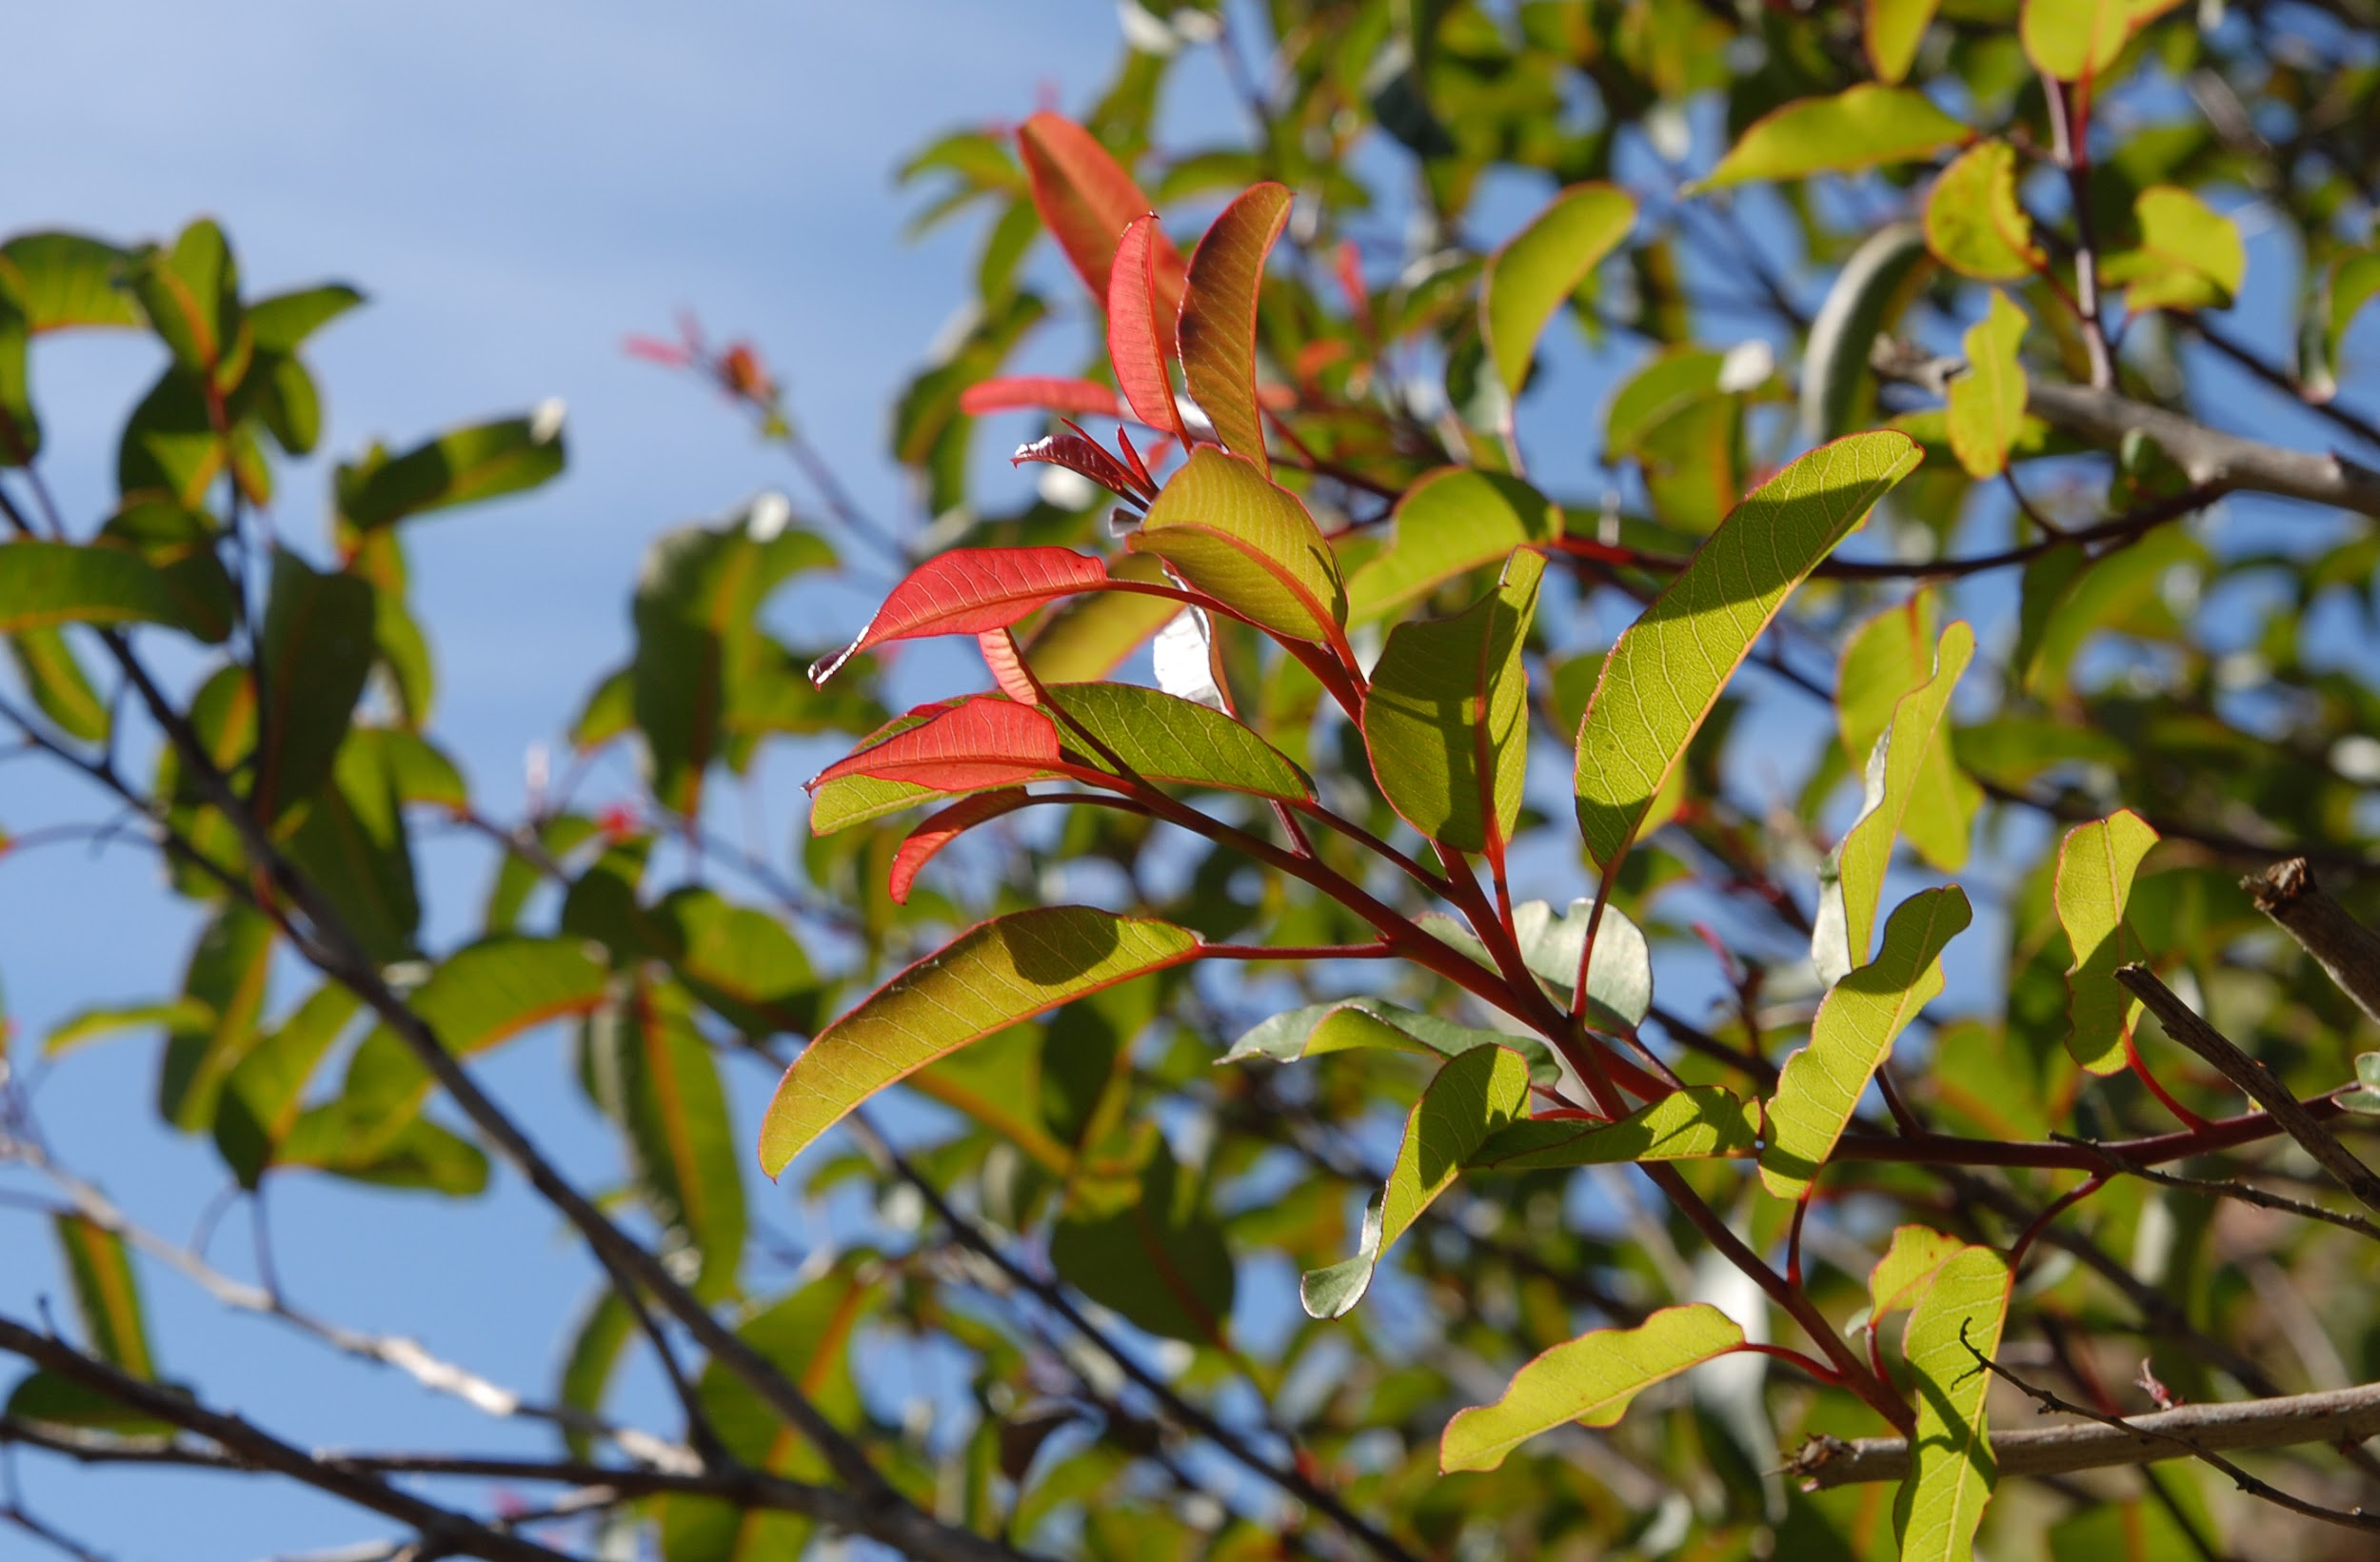
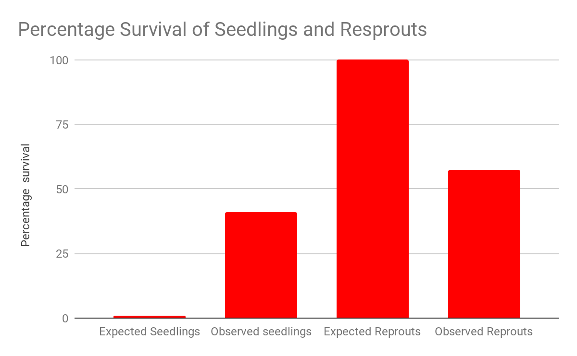
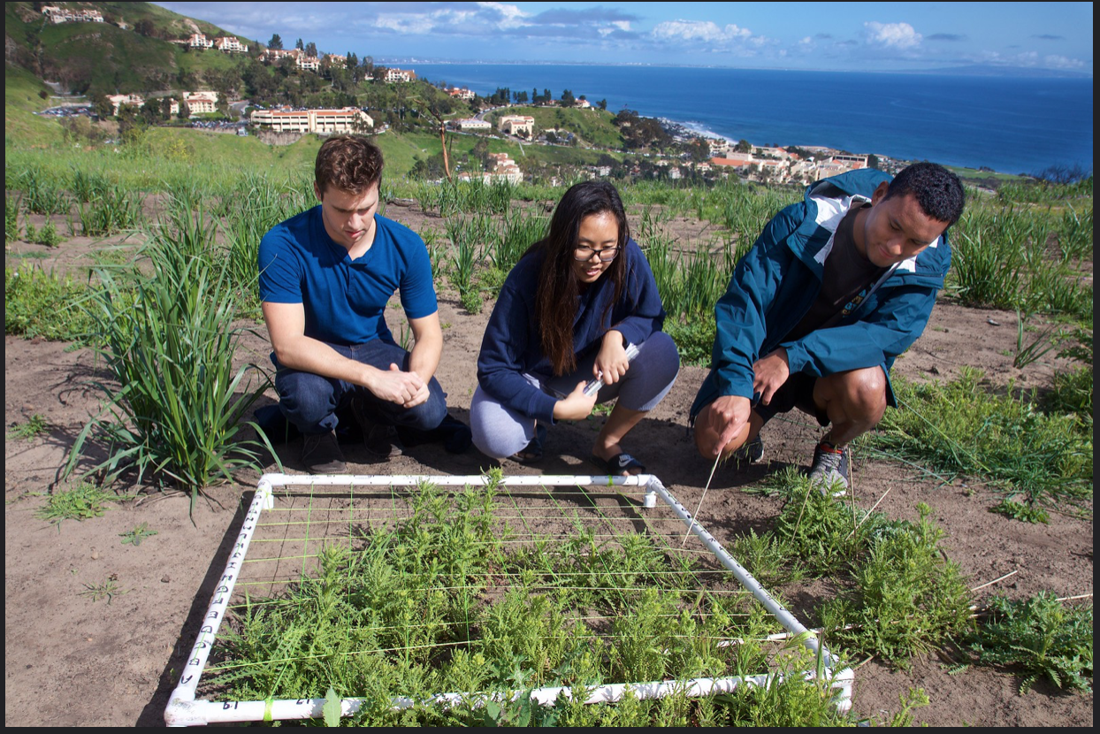
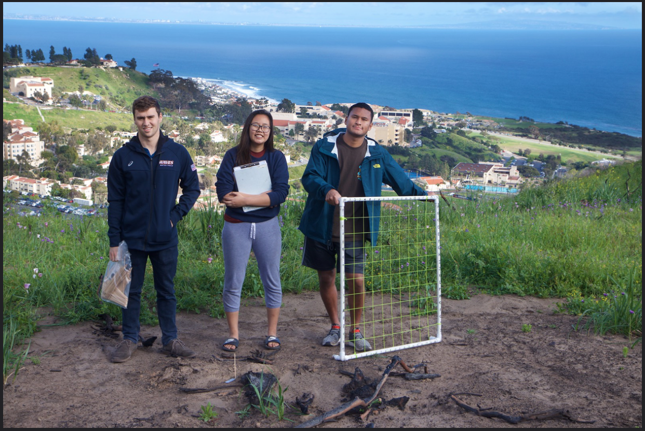
Post fire seedling and resprout survival of Melasma laurina
Matthew Sturtevant and Gil So
Pepperdine University, Malibu, CA
Previous studies have examined the resprout percentage and seedling survivorship of Malosma Laurina post fire in the Santa Monica Mountains. In previous years, seedling survivorship was reported to be less than 1% after one year, and resprout percentage had 100% resprout success with a 99% survivorship after seven years (Lucas et al. 2017). The purpose of this research is to examine if climate change and the recent severe drought has impacted the fecundity of malosma laurina and its dominance in the Santa Monica Mountains. We hypothesize that due to the severe drought both the resprout percentage and seedling survivorship rates will decrease. This will be tested by counting root crowns and examining how many show resprouts and tracking seedlings within grids.
For this research project we set out to see how seedling and resprout survival rate of melasma laurina would fare in the post fire environment found around pepperdine. The expected seedling survival was set to be 1% and the resprout survival was at 100%. From our field research we found that the the seedling survival was 41% and the resprout 57.3%. By using a T-test we had a p value < 0.001 for both data sets, this means that our data deviated greatly from our expected data and meant that we had to reject our hypothesis.
Introduction
Abstract
Discussion
Results
The seedling survivorship was far greater than the historical survivorship percentage of close to 1%. Meanwhile, the resprout percentage was significantly lower for a chaparral that predominantly relies on resprouts for survival. The results indicates the impact of the severe drought in California on malosma laurina. We hypothesize that the reason why resprout survivorship was so low was due to the drought effectually killing off most of the adult malosma laurina, so when the fires came it totally destroyed the root crowns, and thus making it impossible to resprout. The high seedling survivorship is indicative of the heavy rains that followed the fire, and thus keeping the seedlings from drying out.
For the seedling that survived the data was, 31 survived out of 78 accounted for seedlings. The expected percentage of seedling survival would be 1% so this means that we only expected to have 7 to 8 survive. For the resprout survival we found that 172 out 300 of the resprouts survived, the survival rate has been reported to be 100% so we expected 300 of the reports to survive. Our alpha for both tests was 0.05 and our p values for both were less than 0.001, this means that both set of our data didn’t follow the percentages show up in the hypothesis.
The findings of this research project indicates the ultimate impacts of climate change on the native plants in the Santa Monica Mountains. Climate change exacerbated the annual fires by causing prolonged and incredibly dry seasons, and thus reduced the amount of resprouts typically seen in malosma laurina`. This additional evidence can hopefully add to the urgency with which climate change is viewed and action is taken.
Conclusion
Method
There were 21 1 meter^2 transects set up in different areas of the hill. A grid system was used to mark the location of each seedling which was recorded on a replica grid. Each seedling was barked with kebab sticks to make sure the seedling was not recounted. After every week the grids would be examined to see how many seedlings survived. If a seedling did die then the stake would be removed and the seedling would be marked dead.
In a 30 meter wide swaft of the hill, all the reports were marked with a labeled stake in the ground. Every week the stakes were examined and the dead reprout were accounted for and the stake was removed.
For data we used two unpaired t tests for the seedling and sprout survival. These two test would show if there was a significant difference between the data. If the difference was significant that this means that our data didn't follow the percentages presented in the hypothesis. Is the data shows no significant difference then this means that out data follows the percentages show in the hypothesis.
Literature Cited
Lucas, T.A, R.A. Dona, W.Jiang, G.C. Johns, D.J. Mann, C.N. Seubert, N.B.C. Webster, C.H. Willens, S.D. Davis. 2017. An Individual-Based Model of Chaparral Vegetation Response to Frequent Wildfires. Theoretical Ecology 10:217-233
Acknowledgments
Thank you to Dr. Stephen Davis and the Pepperdine University Natural Science Division

