Slide 1
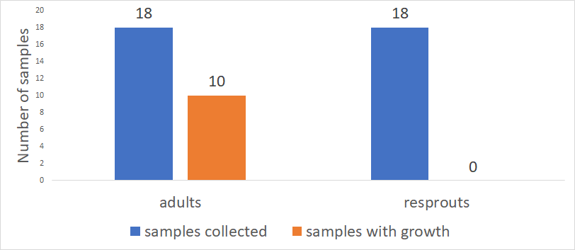
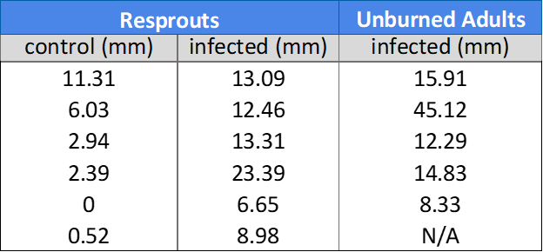
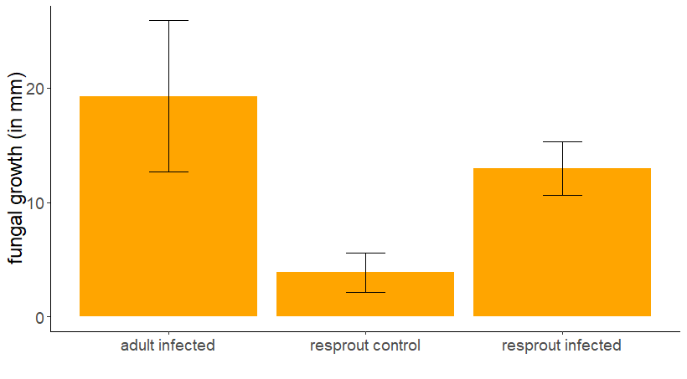
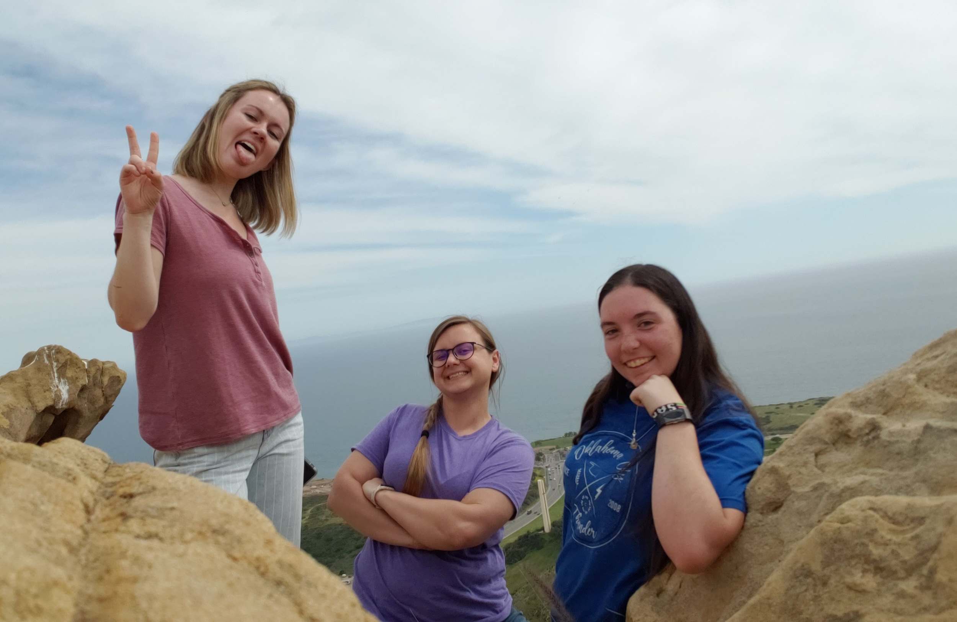
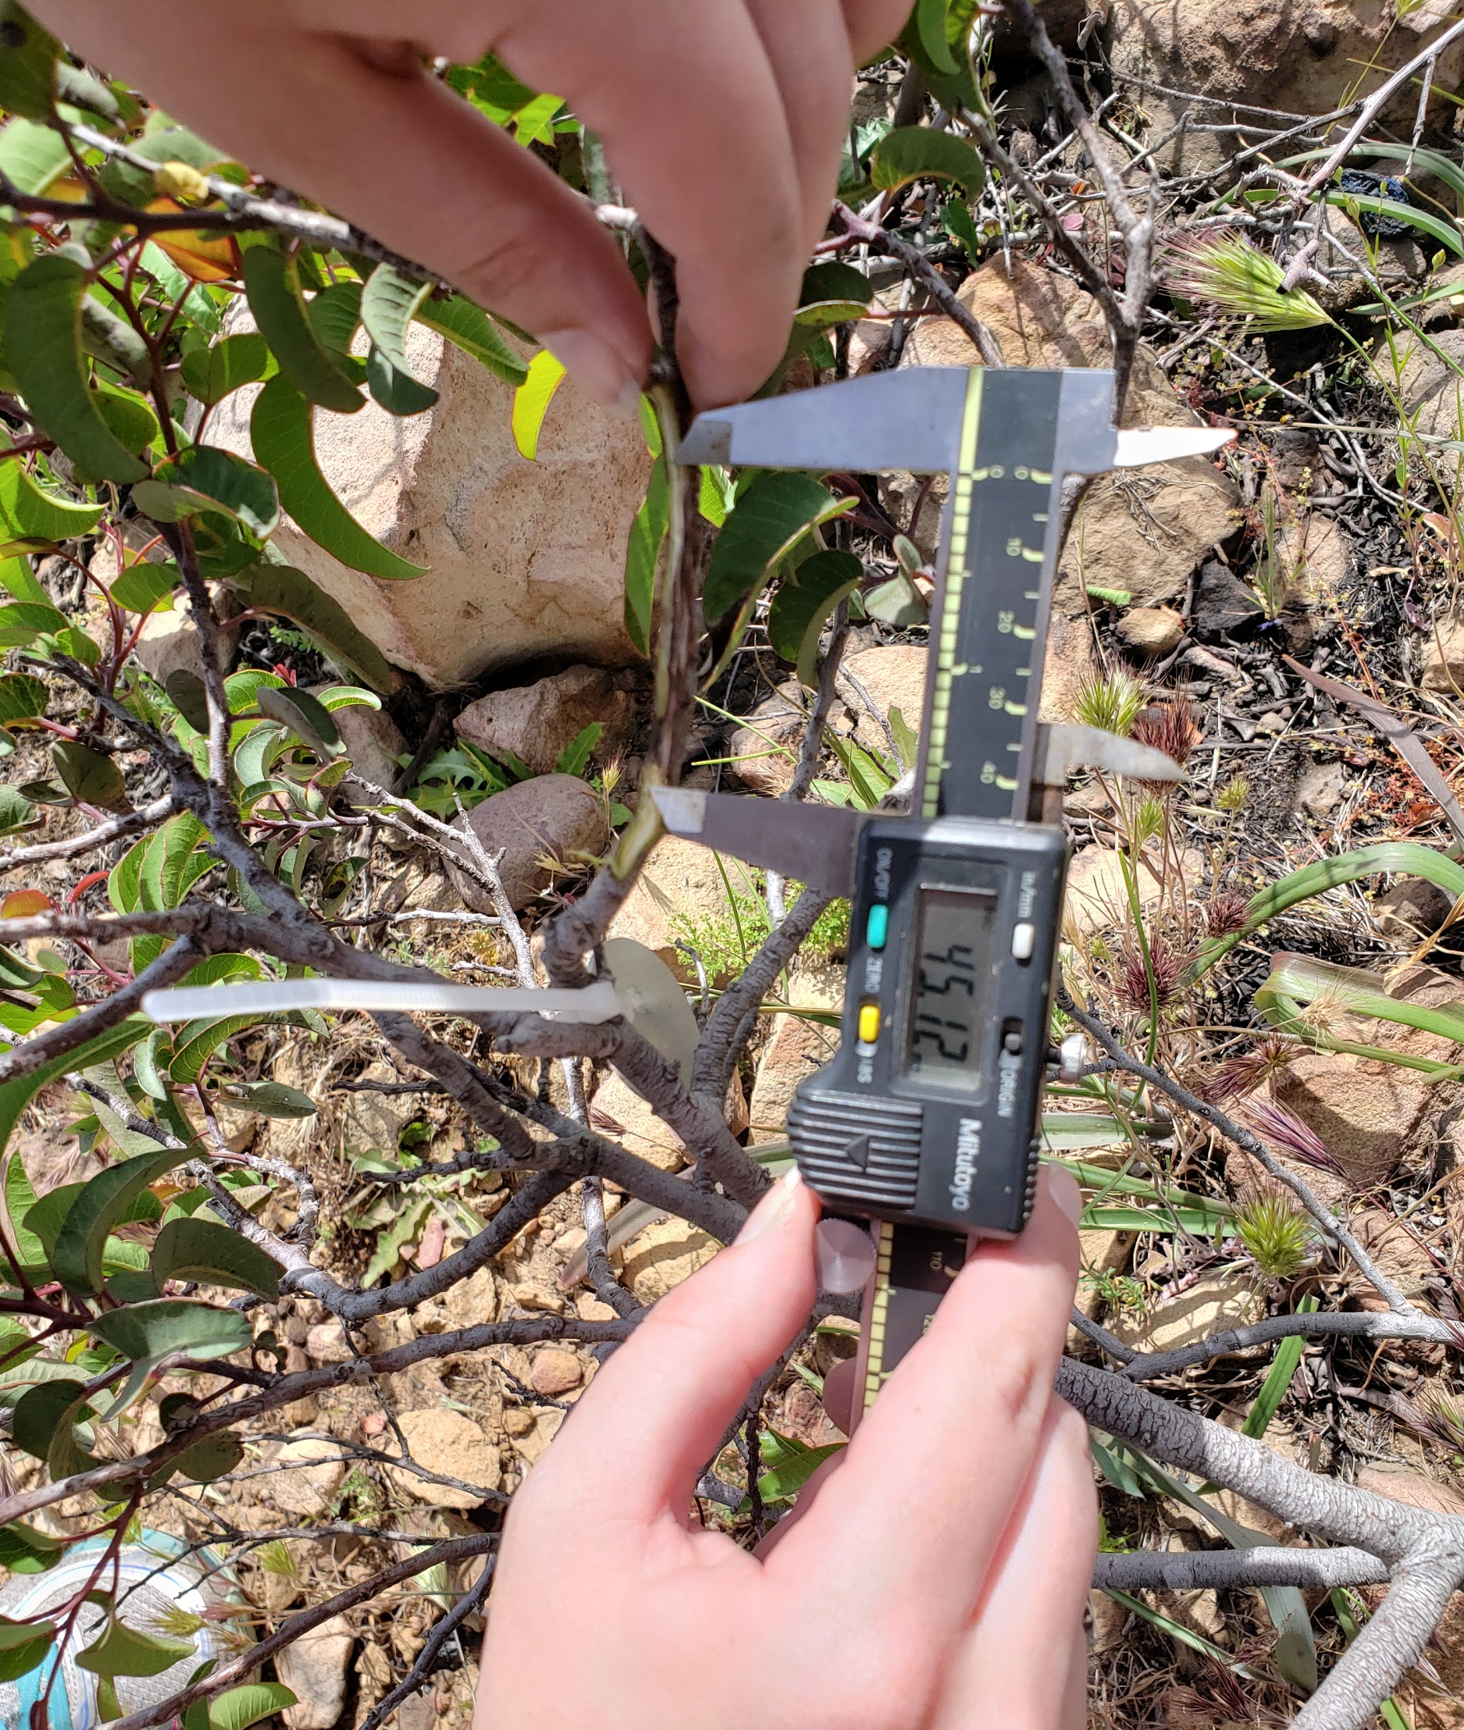
The Presence of Fungal Pathogen, Botryosphaeria dothidea,
in Post-fire Malosma laurina Resprouts
Georgiana Gibson, Sarah Parker, and Lauren Van Tress
Pepperdine University Malibu, California 90263
Abstract
Data / Results
Discussion
Botryosphaeria dothidea is an opportunistic fungal pathogen that infects plants, causing cankers to form on branches and stems, ultimately causing cell cavitation and embolism in the plant. Botyrosphaeria dothidea was found in much of the chaparral vegetation present in the Santa Monica Mountains prior to the November 2018 fire. In this study, we focused on the presence of Botryosphaeria dothidea in the chaparral plant Malosma laurina on Pepperdine University’s campus in 2 different populations: unburned and resprouts. We looked at whether the November 2018 fires had eliminated the pathogen from post-fire Malosma laurina resprouts, using the unburned Malosma laurina population as a control group. We hypothesized that the unburned population would have a higher amount of fungal growth than the resprouts. Furthermore, we tested the resilience of resprouts vs. adults by performing field inoculations using an aseptic technique. We determined that the resprouts demonstrated significantly less amount of growth of the fungal pathogen than unburned plants. Also, infected resprouts still showed a significantly higher amount of growth than in our uninfected control populations, showing that the process of inoculation was not the cause of our results.These results are consistent with our initial hypothesis.
Figure 5. B. dothidea presence in M. laurina samples
As 10 of the 18 sampled unburned adult plates and 0 of the 18 sampled resprout plates grew the fungus, our hypothesis was supported because the resprouts did show less fungal growth. In part, this may be due to the increased water availability as there were frequent rains throughout this experiment, meaning the resprouts would have been less susceptible to the fungal pathogen as Malosma laurina has not shown signs of fungal infection until chronic drought conditions are reached.
The inoculation process was conducted to test the resilience of adults and resprouts and to determine if the lack of the fungus was just due to a lack of opportunity for the fungus to enter the resprouts or if the resprouts were better at fighting off the fungus than the adults. It was found that the resprouts demonstrated statistically significant less growth of the fungal pathogen from the inoculation point then the adults as the p-value was <0.05. The resprouts infected with the fungus had significantly greater growth than the controls, as the p-value was <0.05, which demonstrated that the infected resprouts showed statistically significant more growth then the control resprouts meaning the blackened xylem was not only caused by the procedure itself. Again, this may be due to the increased water availability as the adult plants are still recovering from the chronic drought and are thus more susceptible to fungal infection. In addition, the adults may already be infected in an additional region and thus have less resistance to a new infection site. It is also interesting to note that two of the resprouts had significantly less weeds around them and those two also had the least amount of fungal growth. This suggests that the weeds may be weakening the resprouts resistance to fungal pathogens, possibly because of competition for resources such as nutrients and water.
After plating samples from 18 adult plants and 18 resprouts, it was found that none of the resprouts were infected with the fungus, while 55.56% of adults were infected. All adult samples were taken from a canker, which is a visual sign of the fungus, meaning all 18 adults should have grown fungal cultures. This means that the method was only accurate about 55% of the time. Regardless, since none of the resprout samples grew fungal cultures, it is likely that the fungus was not present in any of the resprouts.
Introduction
We know that the fungal plant pathogen Botryosphaeria dothidea infects chaparral vegetation in the Santa Monica Mountains, specifically causing dieback in Malosma laurina [1]. However, after the November 2018 fire that burned much of the chaparral vegetation in the Santa Monica Mountains, and which was followed by a long period of heavy rains, it remained unknown whether the pathogen would persist in the resprouts of Malosma laurina in burned areas. Malosma laurina has a moderately high drought resistance, but it also thrives in a post-fire climate, where it is able to resprout [2]. For this reason, we hypothesized that we would see less fungal growth in the resprouts of Malosma laurina in post-fire areas of the Botryosphaeria dothidea pathogen infecting the chaparral shrub Malosma laurina. Importantly, research has demonstrated that this pathogen has a general maximum sporulation temperature of 24°C, indicating that under fire conditions, Botryosphaeria dothidea would not be able to effectively sporulate and grow [3]. We tested for the growth of the pathogen by plating field samples using Natalie Aguirre’s aseptic technique. We checked to make sure our results were caused by our methods by inoculating 6 resprouts (and 6 adults) with the fungal pathogen and inoculating 6 more resprouts with just the agar as a control.
Table 1. B. dothidea growth in inoculated
M. laurina individuals
Figure 6. B. dothidea growth in inoculated
M. laurina individuals
*
*
*
Conclusion
*
In conclusion, the resprouts of Malosma laurina showed significantly less growth of the fungus Botryosphaeria dothidea both in terms of plate growth and measurements of the xylem after inoculation compared to the adults. This may be due to increased water availability or the already weakened defense systems of the adults. More research is still needed, possibly focusing on the impacts of weeds and fungal susceptibility of the resprouts. Ultimately, these results are important because we can see a significant decrease in the presence of Botryosphaeria dothidea in the post-fire resprout population, potentially giving scientists a means by which we can protect plants from this pathogen in the future.
Research has also demonstrated that the presence of B. dothidea can remain latent in healthy plants until the host undergoes some form of stress [4]. As a follow-up to this project, looking at the growth impact of Botryosphaeria dothidea in these burned areas after a long period of heat and/or drought would be very important. Our results can only determine immediate results, but what will happen a year from now remains unseen.
Methods and Materials
Table 1 and figure 6 show that there is a difference in the size of fungal growth in resprouts and adults. A green star denotes a significant difference of p=0.013 between the control and infected resprouts through a Mann-Whitney test, while a red star denotes a significant difference of p=0.0315 between in infected resprouts and infected adults through a Wilcoxon-Sign Rank test..
To test for the presence of Botryosphaeria dothidea, stem samples from 18 resprouts of Malosma laurina at Baxter drive, on Pepperdine’s campus, were taken with a pair of shears. The resprouts selected were ones that appeared to have signs of insect herbivory such as chewed leaves or die-back (figure 1), as these individuals were the most likely to be infected with the fungus. Samples from 18 unburned adults were also taken as controls. The adult branches selected also showed signs of die-back, as well as oozing cankers (open areas of branch; figure 2), as these were the adults most likely infected.
After samples were taken, the protocol of Natalie Aguirre was followed. Meaning, each sample was sterilized by placing them in ethanol for 1 minute and then bleach for 10 minutes. Then, a 1 mm by 1 mm sample of the xylem was taken and placed in the middle of a prepared potato agar plate (plates were poured according to the directions on the bottle of potato agar).The plates were then left to incubate at 25°C for about a week at which point the plates were examined for growth.
One plate with growth was then selected and used to inoculate 6 resprout stems and 6 adults. In addition, 6 stems from the same resprouts were inoculated with just the potato agar as a control. In this process, a section of the stem was peeled back with a razor, a 1mm by 1mm chunk of agar was then placed on the xylem and the bark was put back and wrapped in parafilm (figure 3) to prevent insects or other spores from entering. After two weeks, a razor was used to cut back the bark to reveal the xylem and the black of the fungal pathogen’s growth in the xylem was measured with a calliper (figure 4). Statistical analyses were then performed.
Figure 1.
Chewed leaf
Figure 2. Oozing branch
Figure 7. Oozing inoculated woody stem.
Figure 3.
Inoculation set-up
It is worth noting that there was one individual adult where the inoculation occured on a woody branch (pictured), while the others were inoculated into a new growth, flexible stem. This individual gave us the largest fungal growth by far, at over 45mm. Also, the last individual could not be measured because the entire stem past the inoculation site was dead and broke off from the rest of the stem.
Literature
Acknowledgements
1. Aguirre, N. M., Palmeri, G. N., Ochoa, M. E., Holmlund, H. I., Reese, S. R., Pierce, E. R., … Adams, G. C. (2018). First Report of Botryosphaeria dothidea Causing Stem Canker and Plant Death in Malosma laurina in Southern California . Plant Disease. https://doi.org/10.1094/pdis-08-17-1322-pdn
2. Guo, Q. (2001). Early post-fire succession in California chaparral: Changes in diversity, density, cover and biomass. Ecological Research. https://doi.org/10.1046/j.1440-1703.2001.00410.x
3. Copes, W. E., & Hendrix, F. F. (2007). Effect of Temperature on Sporulation of Botryosphaeria dothidea, B. obtusa , and B. rhodina . Plant Disease. https://doi.org/10.1094/pdis.2004.88.3.292
4. Marsberg, A., Kemler, M., Jami, F., Nagel, J. H., Postma-Smidt, A., Naidoo, S., … Slippers, B. (2017). Botryosphaeria dothidea: a latent pathogen of global importance to woody plant health. Molecular Plant Pathology. https://doi.org/10.1111/mpp.12495
Figure 4.
Fungal growth measurement with callipers
This research project was funded by the Natural Science Division of Pepperdine University. Special thanks to Dr. Steve Davis for his assistance and expertise and to Natalie Aguirre for her aseptic technique in isolating this pathogen from plant stems.

