Slide 1
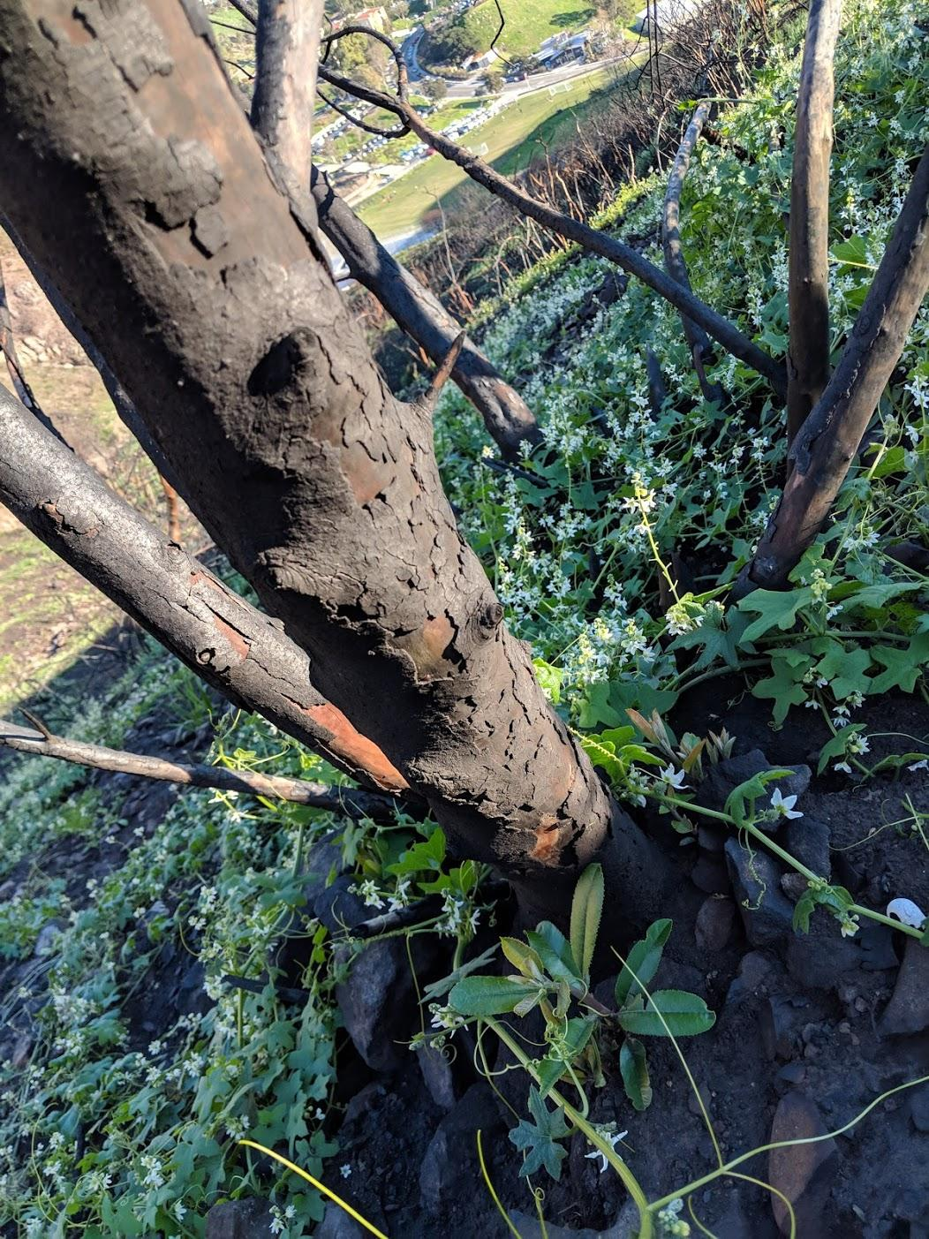
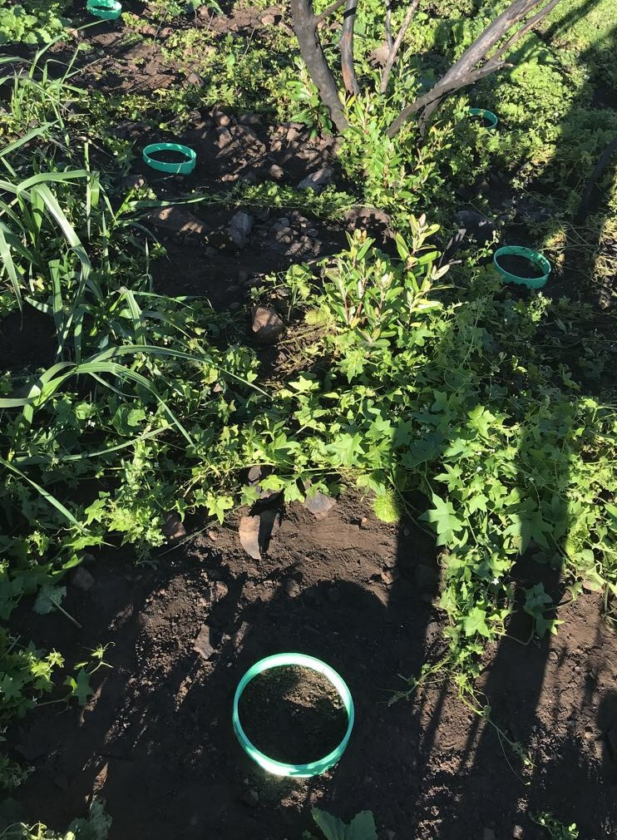
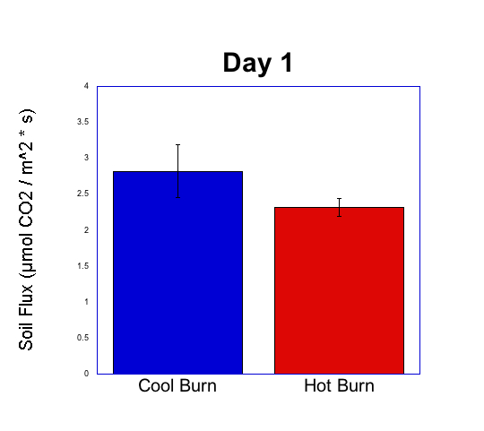
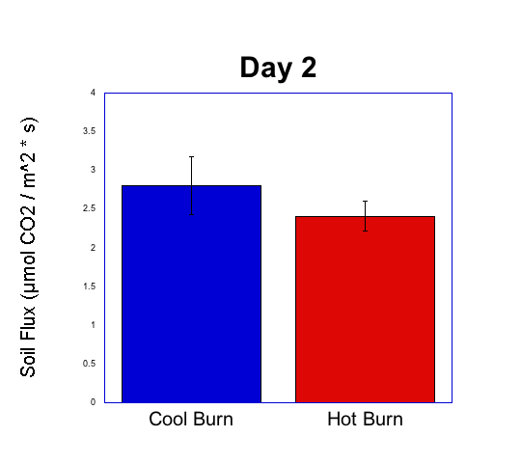
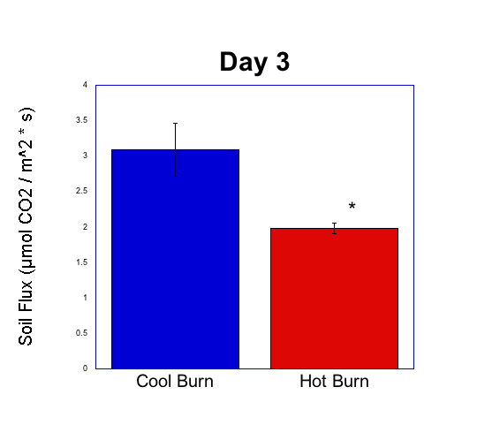
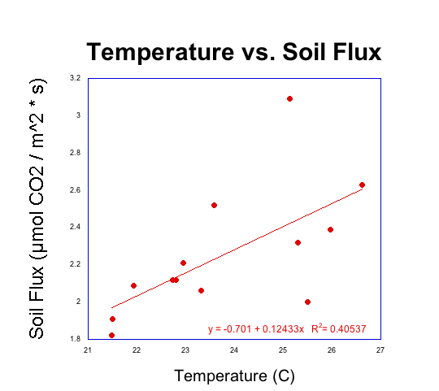
Heteromeles arbutifolia associated Post-Fire Soil Microbiome Recovery and Respiration
in a Chaparral Ecosystem
ó
Gabrielle Boeger, Lauren Dedmon, Emma Thomsen, and Alexander Soloniuk
Mentors: Dr. Stephen Davis and Grace Palmer Pepperdine University, 24255 Pacific Coast Highway, Malibu, CA,90263
Abstract
Study Sites
Discussion
The purpose of this post-Woolsey Fire project is to examine the relationship between soil respiration in areas of cool burns and hot burns relative to individuals of Heteromeles Arbutifolia. It was hypothesized that the soil subjected to a cooler burn would have greater respiration rates due to increased survival of microorganisms compared to a hotter burn. An Li-6800 CO2 Flux Chamber was used to collect measurements for several replicates. Significance was detected in the “Day 3” data, with the soil respiration higher at the cool burn site. Temperature and soil flux also varied directly. In the future experiments including increasingly comprehensive data are recommended for further investigation on the success of soil respiration.
We found a significant difference in mean soil flux between the cool burn and hot burn areas on day three of our data collection. The cool burn areas had higher soil flux than the hot burnt areas in a Heteromeles arbutifolia-associated area on all three days, but this interaction was only found to be significant on one of the days we tested. This result correlates with the literature findings that soil respiration in unburnt areas was higher than those in burnt areas (D’Ascoli et. al., 2005). A hypothesized reason for this is a differential microbiome composition between the hot and cool burn areas. The heat of the fires would have killed the vast majority of the microorganisms in the burn zones. The subsequent recruitment of microorganism species or the differing survival of microorganisms between the zones depending on various different factors could reasonably lead to different microbiome compositions and densities, and thus result in different soil flux rates. There are more plants in the cool burn zone due to the survival of weed seeds creating more opportunity for symbiosis and creating more advantageous soil conditions for microorganism proliferation and survival. Thus, respiration from the microbes would be higher in the cool burn areas than hot burn. This significance was only apparent on day three of our data collection. More replicates in the future would further clarify the relationship or lack thereof in all cases.
We also see a linear correlation between temperature and soil flux in hot burn zones specifically. This could mean that temperature is affecting the rate at which microbes are metabolizing or proliferating in hot burn zones. We do not see this relationship in cool burn areas, thus this is an interesting lead for future research surrounding the interactions between microbiota and various environmental abiotic factors such as temperature.
Introduction
Figure 2. A cool burn site located near the Drescher campus of Pepperdine.
Figure 3. A soil collar at the hot burn site.
Figure 4. H. arbutifolia and an overall view of the study site.
Increases in the frequency, duration, and severity of drought and heat stress associated with climate change could fundamentally alter the composition, structure, and biogeography in many regions (Allen et al., 2010). In addition, several studies have suggested that the consequences of anthropogenic climate change are also leading to the drought-induced dieback of native plant species. As a result, fires are burning hotter and covering more area. This increase in fire frequency has affected been shown to affect plant community structure (Jacobsen and Davis, 2004).
The Woolsey fire in November of 2018 destroyed 88% of the Santa Monica Regional Mountains, burning over 90,000 acres and it is of great interest how these new environmental factors, coupled with a fire of this magnitude will influence the recovery of native plant species in the area.
Soil respiration is a known indicator of plant health. The bacteria and fungi present in the soil are essential for maintaining steady nutrient composition. They also increase plant fitness by developing symbiotic relationships with roots of plants (Hart et. al., 2005). Fire affects the process of soil respiration via the heat-induced mortality of these microorganisms. This was demonstrated in a study conducted in a similar mediterranean-type climate, in which soil respiration was shown to be less efficient in burned areas than areas that the fire did not come into contact with (D’Ascoli et. al., 2005).
Wildfires are inevitable and are actually essential to the chaparral ecosystem, especially for species that sprout only after fire. However, we are interested in post-fire recovery of native species in cool burn areas and hot burn areas because of the impact climate change has had on fire temperature and intensity. Specifically, the impacts of cool and hot burns on the soil respiration were explored around Heteromeles arbutifolia, a species native to Southern California.
Results
A
B
Soil Flux (μmol CO₂ / m² · sec)
Soil Flux (μmol CO₂ / m² · sec)
Conclusion
We found that soil respiration is greater in a cool burn area than a hot burn area. This is significant because it tells us about post-fire recovery for plants that are resprouting in areas of a cool burn and in areas of a hot burn. We can learn about the ability for plants to germinate in these conditions after a fire by knowing characteristics of the soil in which they are growing. Although we did not find a strong difference in the two types of soil on two of our data collection days, perhaps we would have if we took more replicates at each site.
In the future, we would like to return to H. arbutifolia individuals to assess their fitness and see if there is a correlation between their health and the soil in which they are growing. We would also like to look at soil respiration from this heavy rainfall year and compare it to soil respiration when the area is experiencing chronic drought.
C
D
Materials and Methods
Soil Flux (μmol CO₂ / m² · sec)
Soil Flux (μmol CO₂ / m² · sec)
Works Cited
Figure 1. In February of 2019, six soil collars were mechanically placed around two H. arbutifolia individuals with a 2.5 cm offset a week prior to data collection. Soil CO2 Flux was measured using the Li-6800, and three replicates per collar, with two dates of data collection. The Stevens HydraProbe measured soil temperature and moisture.
Allen, C. D., et al. (2010). A global overview of drought and heat-induced tree mortality reveals emerging climate change risks for forests. Forest ecology and management, 259(4), 660-684.
D’Ascoli, R., Rutigliano, F. A., De Pascale, R. A., Gentile, A., & De Santo, A. V. (2005). Functional diversity of the microbial community in Mediterranean maquis soils as affected by fires. International Journal of Wildland Fire, 14(4), 355-363.
Hart, S. C., DeLuca, T. H., Newman, G. S., MacKenzie, M. D., & Boyle, S. I. (2005). Post-fire vegetative dynamics as drivers of microbial community structure and function in forest soils. Forest Ecology and Management, 220(1-3), 166-184.
Jacobsen, A. L., Davis, S. D., & Fabritius, S. L. (2004). Fire frequency impacts non-sprouting chaparral shrubs in the Santa Monica Mountains of southern California. Ecology, conservation and management of mediterranean climate ecosystems. Millpress, Rotterdam, Netherlands.
Malanson, G. P., & O'Leary, J. F. (1982). Post-fire regeneration strategies of Californian coastal sage shrubs. Oecologia, 53(3), 355-358.
Figure 5. A, B and C) Comparison between Soil CO₂ Flux (μmol CO₂ / m² · sec) between cool burn and hot burn study sites on three different study dates. Each sample was replicated three times and the measurements were used to perform a two-way ANOVA with Tukey’s multiple comparison post-hoc test. Error bars are calculated as standard error of sample means. Significance is represented by * at p < 0.05. Several data point values from hot burn study site were dropped from calculations due to confounding variables of root respiration. D) Linear regression of Temperature (°C) vs. Soil CO₂ Flux (μmol CO₂ / m² · sec) for hot burn sites only. The linear relationship was found to be significant with p < .02 by Student’s t-test. No significance was found in cool burn sites.

