Slide 1
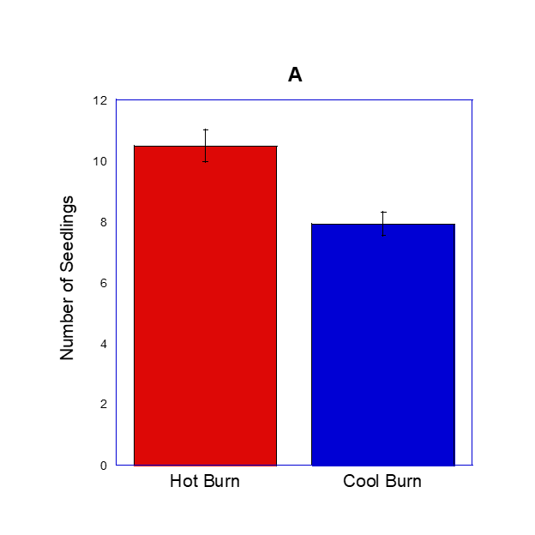
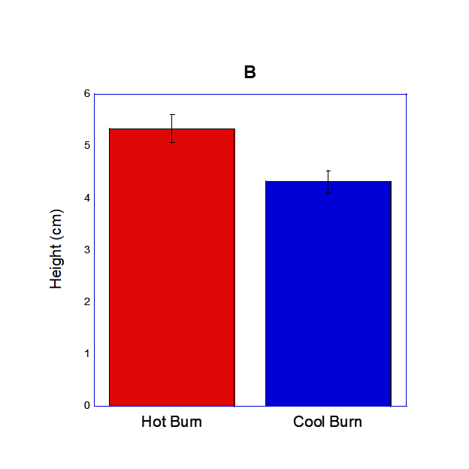
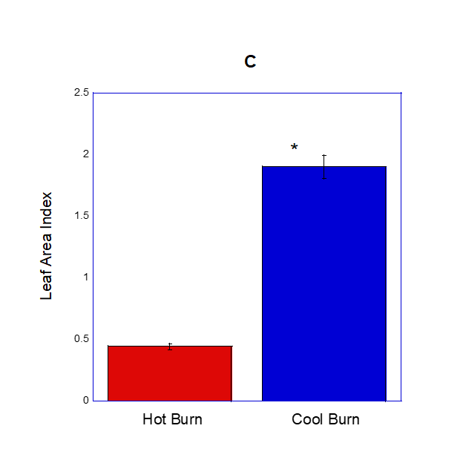
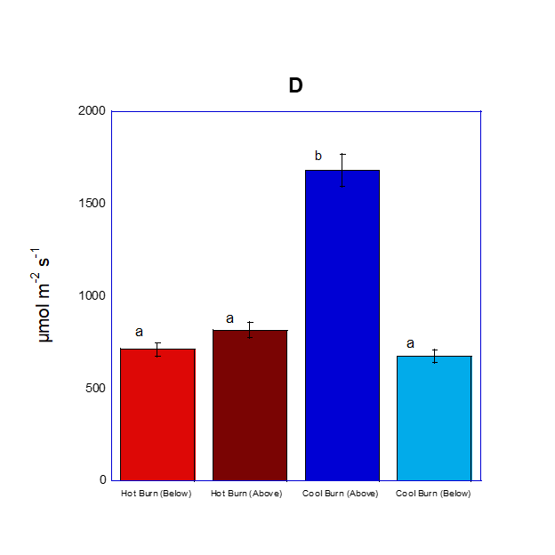
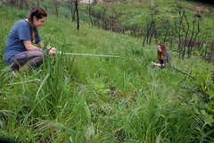
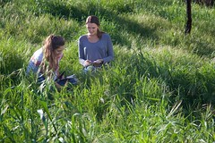
Post-Fire Competition Between Native Ceanothus spinosus and Exotic Grasses
Katarina Carter and Nina Duchild
Natural Science Division, Pepperdine University, Malibu, California, USA
Abstract
Results
Discussion
In our experiment, we investigated the post-fire competition between native Ceanothus spinosus and exotic grasses in low and high-density fuel sites. We hypothesized that C. spinosus seedlings in the high-density fuel site would be larger and more numerous than seedlings in the low-density fuel site, due to differences in competition from exotics. Our results showed that there was no significant difference in seedling height of C. spinosus in the high-density fuel site (5.33 ± 0.55 cm) and in the low-density fuel site (4.31 ± 0.51 cm). There was also no significant difference in the average number of seedlings in the high-density fuel site compared to the low-density fuel site (7.93 ± 1.04). However, Leaf Area Index (LAI) in the high-density fuel site was lower ( 0.44 ± 0.03) than the LAI in low-density fuel sites (1.90 ± 1.9), which indicated that although initially, C. spinosus did not face competition from exotics, the rapid overgrowth of the exotics will likely out-compete C. spinosus in the future.
Analysis of our results shows that the number of seedlings and their heights are not significantly different between the hot and cool burn areas, which suggests that seedling success is not impacted by competition from exotic grasses, because they grew in the same frequency and the same amount in both areas. However, the LAI in the hot burn was significantly lower than in the cool burn, and this indicates more coverage by exotic grasses in the cool burn area. The PAR above the plants in the cool burn area was significantly higher than below the plants in the same area, and this indicates that C. spinosus seedlings, which are closer to the ground, have significantly less light available to them to photosynthesize. Although there seems to be a disparity in these conclusions, the lack of significant difference in C. spinosus number and height is likely due to the fact that when the number and height data were taken, the grasses in the cool burn area were not as tall and dense as when the LAI and PAR data were taken. According to a study by Dickens et al., observation throughout a whole growing season, instead of a few months, shows that exotic species out-compete and slow recovery of native species.⁴ More coverage by exotic grasses will lead to a decrease in available resources for the less numerous C. spinosus seedlings, and will lead to an increased mortality rate of seedlings in the cool burn site, which would be consistent with our original hypothesis. This would be significant because it shows that firstly, a native species is unable to out-compete exotic species, and secondly, it supports the trend that an alteration in fire patterns causes natural selection against native species ⁵ . Because climate change has been disrupting the natural fire patterns of the Santa Monica Mountains, native species will be greatly impacted. Our preliminary results, along with previous data cited, suggest that the presence of exotic grasses could decimate the native Ceanothus spinosus.
Introduction
The chaparral ecosystem of the Santa Monica Mountains is well known for its resistance to extreme levels of environmental stress, specifically drought and fire. However, human-instigated climate change has changed the typical drought and fire patterns to which the chaparral is adapted.¹ The recent Southern California Woolsey Fire exemplified the severity of these new weather patterns. Following this fire, it is essential to investigate its effects on native chaparral species, and particularly how human interference contributes to results that may occur. On the Pepperdine University campus, areas around residences and other structures are landscaped to remove native plants to reduce the amount of fuel available for potential fires. During the Woolsey Fire, this landscaping caused the fire to burn cooler in the landscaped areas (low-density fuel site), and hotter in the non-landscaped areas (high-density fuel site). In the high-density fuel site, the seeds of exotic grasses were burned and thus could not populate the area, but Ceanothus spinosus seeds germinated because of the fire.³ However, the fire did not burn hot enough in the low-density site to destroy the seeds of the exotic species, so after the fire, both C. spinosus and the weeds were co-occurring. These exotics, which grow more rapidly, have the potential to outcompete a slow-growing native species such as C. spinosus.²
A. Number of seedlings in hot burn vs. cool burn site, no significant difference as determined by student t-test, p value = 0.2929, t value = 1.0734. Error bars represent ± 2.1579 for the hot burn and ± 1.0402 for the cool burn.
B. Seedling height in hot burn vs. cool burn site, no significant difference as determined by student t-test, p value = 0.1858, t value = 1.359. Error bars represent ± 0.5530 cm for the hot burn and ± 0.5115 cm for the cool burn.
C. LAI in hot burn vs cool burn sites, significant difference indicated by an asterisk as determined by student t-test, p value < 0.0001, t value = -5.2521. Error bars represent ± 0.0340 for the hot burn and 0.2755 for the cool burn.
D. PAR in hot burn vs cool burn sites, significant difference between Cool Burn (Above) and the other bars indicated by letters a and b as determined by one way ANOVA test, p value < 0.0001. Error bars from left to right represent ± 47.5433, ± 44.9595, ± 67.8813, and ± 83.5147 µmol m⁻²s⁻¹.
Conclusions
Southern California recently experienced one of the most devastating wildfires in its history, the Woolsey Fire of 2018. The unusual severity of this fire raised questions of how native chaparral plants would be affected. Invasive species can often make it more difficult for native species such as Ceanothus spinosus to grow and survive following catastrophic events such as wildfires due to competition for resources. Initially, we hypothesized that the height and number of C. spinosus seedlings would be larger in hot burn sites. However, our data concluded that there were no significant differences between these factors. While the initial data does not indicate difference in survival of seedlings in the two locations, future research would focus on the long term effects of competition with invasive species. Early shading of slow-growing native seedlings by faster-growing invasive weeds in the cool burn locations can prevent light from reaching the leaves of C. spinosus, therefore reducing the photosynthesis. Future experimentation would include testing photosynthetic rates in seedlings in the cool burn and hot burn locations with an LI-6400XT portable gas exchange system.
Methods
To conduct this study, we first set up twenty-eight 1m x 1m sampling grids in our study site, with half in the hot burn area and half in the cool burn area. C. spinosus seedlings in each grid were counted and recorded. Measurements of seedling height were taken using a ruler. Photosynthetically Active Radiation (PAR) and Leaf Area Index (LAI) was measured with Sunfleck Ceptometer. To record PAR, we positioned the Sunfleck Ceptometer north, south, east, and west and took a data point for each direction, and this was done to determine the amount of sunlight hitting the grid that the plants could use for photosynthesis. To record LAI, we positioned the Ceptometer above all the plants in the quadrant and took a data point, then below all the plants, near the ground, and this was done to obtain a ratio of leaf surface area compared to ground surface area.
Study Site
Our study site was located on the Drescher campus of Pepperdine University in Malibu, CA. The low-density and high-density fuel sites were adjacent to each other, near residence areas.
References
1. Montenegro, G., Ginocchio, R., Segura, A. , Keely, J. E., & Gomez, M. (2004). Fire regimes and vegetation responses in two Mediterranean-climate regions. Revista chilena de historia natural, 77(3), 455-464.
2.Keeley, J. E., & Zedler,P.H. (1978). Reproduction of Chaparral Shrubs after fire: a comparison of sprouting and seeding strategies. American Midland Naturalist, 142-161.
3. Keeley, J. E., Franklin, J., & D’Antonio, C. (2011). Fire and invasive plants on California landscapes. In The landscape ecology of fire (pp. 193-221). Springer, Dordrecht.
4. Dickens, S. J. M., and E. B. Allen. “Exotic Plant Invasion Alters Chaparral Ecosystem Resistance and Resilience Pre- and Post-Wildfire.” SpringerLink, Springer International Publishing, 22 Oct. 2013, link.springer.com/article/10.1007/s10530-013-0566-0#Sec19.
5. Keeley, Jon E., et al. “ALIEN PLANT DYNAMICS FOLLOWING FIRE IN MEDITERRANEAN‐CLIMATE CALIFORNIA SHRUBLANDS.” Ecological Applications, John Wiley & Sons, Ltd, 1 Dec. 2005, esajournals.onlinelibrary.wiley.com/doi/pdf/10.1890/04-1222.
Acknowledgements
We would like to thank the Natural Science Division at Pepperdine University, Dr. Stephen Davis, and Samantha Fiallo for contributing to this research.

