Slide 1
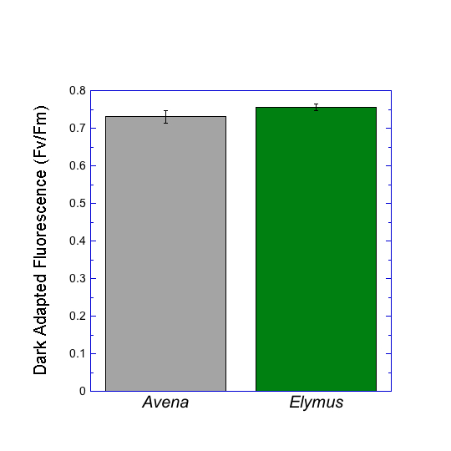
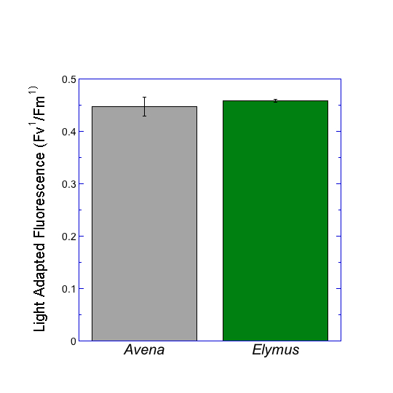
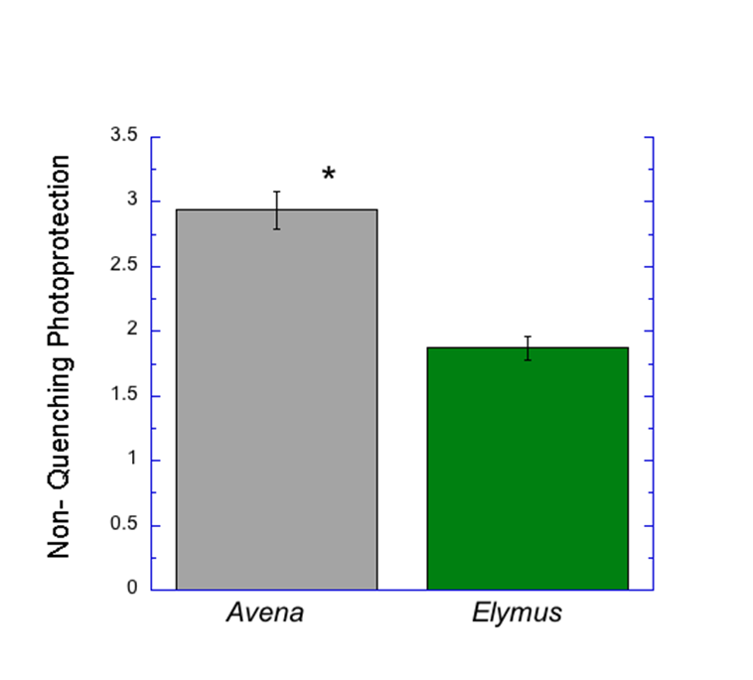
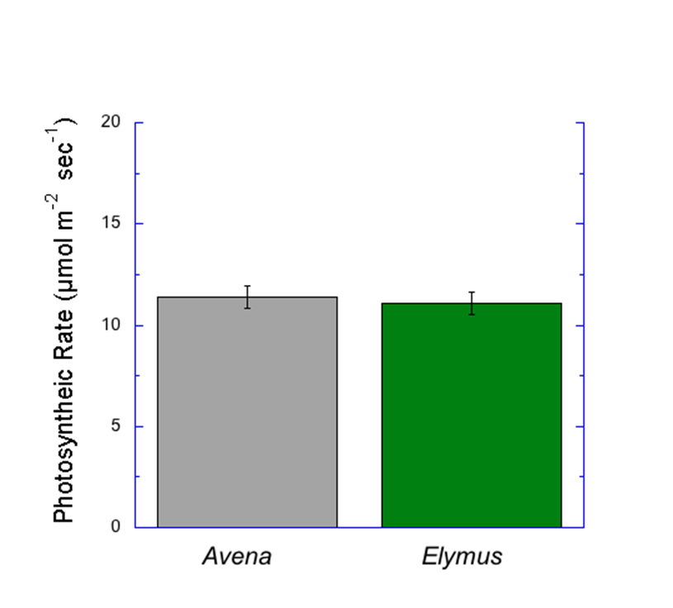
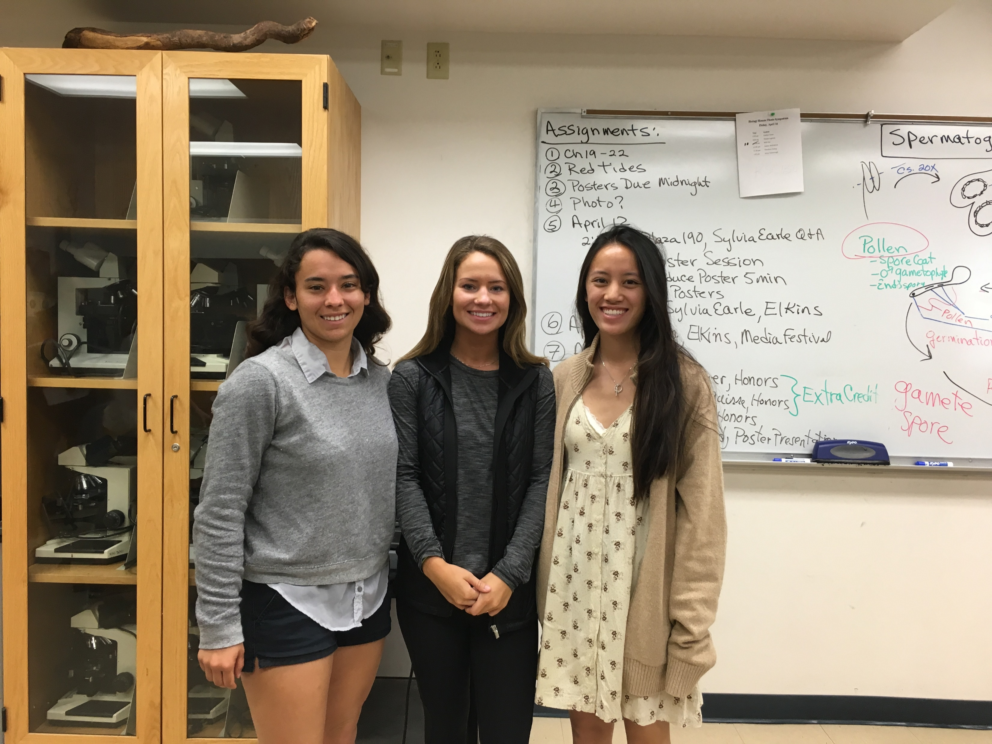
A Comparison of Photoprotection in C₃ Plants between a Native and an Invasive Species
Cao, T., Field, M., and Godon, K.
Department of Biology, Pepperdine University
24255 Pacific Coast Highway, Malibu, CA 90263
Abstract
Data and Graphs
Now more so than ever with the increasing demands placed upon plant species as a direct result of climate change, competition between native and invasive species determines which species are able to survive and reproduce. Biologically the two species, native and invasive, carry out the same functions yet it is in how they carry out said functions that they differ. Prior to the commencement of the study the belief was held that the invasive species (here Avena) would contain increased photoprotection than the native species (here Elymus) for it to possess a competitive advantage. Testing of the stated hypothesis including measuring photoprotection, two measures of fluorescence, and photosynthetic rate to obtain data and associated statistics on four markers of photoprotection. Use of a Student’s t-test showed a significant difference only for photoprotection (Qn) values.
Figure 1. Comparison of dark adapted fluorescence (Fv/Fm) of Avena and Elymus. Error bars are included on the mean values and indicate a ± 1 SE with a sample size (n) of 9 Avena and 9 Elymus. There is no significant difference between the dark adapted fluorescence of Avena and Elymus at P < 0.05 by Student’s t-test.
Figure 2. Comparison of light adapted fluorescence (Fv¹/Fm¹) of Avena and Elymus. Error bars are included on the mean values and indicate a ± 1 SE with a sample size (n) of 9 Avena and 9 Elymus. There is no significant difference between the light adapted fluorescence of Avena and Elymus at P < 0.05 by Student’s t-test.
Introduction
Boundaries are drawn, not to divide, but to originate. Plants within a specific set of boundaries are said to be native and the same goes for each area. Yet the areas are not isolated, barring locales subjected to extreme conditions. What this means is that, rather than having a solitary set of native species growing in a plot, there will be a mixing of a myriad of species, some native and others invasive. Intrinsically, invasive species must be able to either outperform native species in photosynthetic rate or nutrient uptake, or they must better endure the prevailing conditions. Referring to the latter, research conducted Spain found that native and invasive species have different photoprotective strategies with invasive species having greater phenotypic plasticity than native species (Fenollosa, Munné-Bosch, & Pintó-Marijuan; 2017). Of interest to the research presented here was the variance in photoprotective strategies utilized which when coupled to the necessary characteristic of an invasive species led to the formulated hypothesis. Extrapolation of the above research led to focus on photosystem II which as defined by Takahashi and Badger is the chief site of photodamage and of photoinhibition (Takahashi & Badger; 2011). Both photodamage accrued and photoinhibition caused manifest in diminished photosynthetic rates, expanding the scope of the here presented research from solely non-quenching photoprotection (Qn) to photosynthetic rate and fluorescence. Fluorescence was included as it is considered an accurate estimation of photosystem II efficiency (Baker & Oxborough; 2008).
Figure 3. Comparison of non-quenching photoprotection (Qn) of Avena and Elymus. Error bars are included on the mean values and indicate a ± 1 SE with a sample size (n) of 9 Avena and 9 Elymus. There is a significant difference between the levels of photoprotection of Avena and Elymus at P < 0.05 by Student’s t-test.
Figure 4. Comparison of photosynthetic rate (Pn) of Avena and Elymus. Error bars are included on the mean values and indicate a ± 1 SE with a sample size (n) of 9 Avena and 9 Elymus. There is no significant difference between the photosynthetic rates of Avena and Elymus at P < 0.05 by Student’s t-test.
Discussion
Conclusions
Avena data collected yielded a significantly higher Qn value, which is in direct support of the theory that Avena possesses greater photo-protection than Elymus as it is the invasive species and hence would have to be capable to actively compete with the native species for sunlight and nutrients. An additional point of support for this finding is the proliferation of Avena observed within the last month. The Fv/Fm, Fv¹/Fm¹, and the photosynthetic rate analysis, however, yielded no significant difference between the two grasses. The discrepancy between the significance of the results suggests that, while Avena does possess greater photo-protection mechanisms, there is no significant difference between the native and nonnative grass fitness. We can speculate, therefore, that Avena and Elymus have equal fitness. For future study of interest, it would be prudent to compare the relative fitness of the two species, as was done here, throughout an extended period of time such as two calendar seasons. The extended period of observation would allow for the testing of the plasticity of photoprotection of invasive species as proposed by the study conducted in Spain which was presented in the introduction. Regarding the study presented here, improvements could have been made by accounting for the presence of a tree near to several of the specimen observed.
No significant difference at the p < 0.05 confidence level was found for dark adapted fluorescence.
No significant difference at the p < 0.05 confidence level was found for light adapted fluorescence.
Avena (invasive species) was found to have a significantly higher level of non-quenching photoprotection (Qn) than Elymus (native species).
No significant difference at the p < 0.05 confidence level was found for photosynthetic rate.
Methods and Materials
Dark-adapted fluorescence (Fv/Fm) and photosynthetic rates (Qn, Pn, Fv’/Fm’) were collected at midday sun using the Li-6200 Portable Photosynthesis System.
Elymus’s larger surface area of leaves were able to be measured directly and accurately at a flow of 400. However, Avena has a much thinner and smaller leaf, therefore we measured the widths of each Avena leaf recorded and compared it to the diameter of the cuvette in the LiCor gas exchange system. In order to get accurate results, we lowered the flow to 100 and found the area of the cuvette and compared the leaf widths and areas which were substantially less. We multiplied the recorded photosynthetic rate values of Avena, which were initially very low, by whichever missing value we calculated in order to increase the values as if the leaf were a normal size and covered the whole cuvette.
Literature Cited
Acknowledgements
Description of Study Site
Baker, N. R., & Oxborough, K. (2008). Chlorophyll Fluorescence as a Probe of Photosynthetic Productivity. Chlorophyll a Fluorescence Advances in Photosynthesis and Respiration, 59(89), 113th ser., 65-82. doi:10.1007/978-1-4020-3218-9_3
Fenollosa, E., Munné-Bosch, S., & Pintó-Marijuan, M. (2017). Contrasting phenotypic plasticity in the photoprotective strategies of the invasive species Carpobrotus edulis and the coexisting native species Crithmum maritimum. Physiologia Plantarum. doi:10.1111/ppl.12542
Takahashi, S., & Badger, M. R. (2011). Photoprotection in plants: a new light on photosystem II damage. Trends in Plant Science, 16(1), 53-60. doi:10.1016/j.tplants.2010.10.001
This research was funded by Pepperdine University.
The study site utilized was a portion of land located on the side of a service road. The area specifically utilized was a moderate distance from the road in an effort to minimize any anthropomorphic influence or damage. Topographically, the area was on a gradual incline and under direct sunlight.

