Slide 1
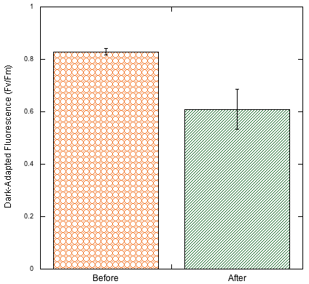
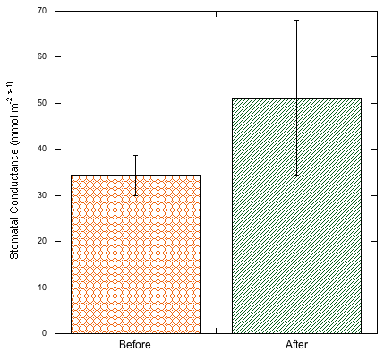
Dark-adapted fluorescence and stomatal conductance after DCMU (3-(3,4-dichlorophenyl)-1, 1-dimethylurea)) exposure on Malva parviflora plants
Piueti Maka, Mia Bryant, Isabelle Sarwono
Pepperdine University, Malibu, CA
Abstract
Methods
Discussion
The purpose of this experiment was to determine the disturbance effect of indirect exposure to DCMU (3-[3,4-dichlorophenyl]-1,1-dimethylurea), a popular herbicide, on dark adapted fluorescence and stomatal conductance in Malva parviflora plants. We utilized a test site exposed to sunlight and free from other external interference. Two main apparatuses were used to collect data; stomatal conductance was measured by a leaf porometer, and dark-adapted fluorescence (Fv/Fm) was measured using a Pulse Modulated Fluorometer. Our data yielded significant comparison results for dark-adapted fluorescence (P<0.05); however, the difference in stomatal conductance before and after disturbance was insignificant with a Student’s t-test (P>0.05). Additionally, observations six days after disturbance showed a drastic presence of hollyhock rust (Puccinia malvacearum) and aphids (Aphidoidea sp.) that may have contributed to the significance seen in dark-adapted fluorescence. The combination of the weed killer, rust, and aphids prove to be feasible methods in controlling spread of Malva parviflora.
A plot of Malva parviflora plants were selected at Pepperdine University. Leaves of ten plants were dark adapted for 10 minutes and then dark-adapted fluorescence was measured using the Pulse Modulated Fluorometer. Stomatal conductance was also measured using the Leaf Porometer for the same ten plants. DCMU was sprayed on an area adjacent to the plot of Malva parvoflora plants the next day. Six days after exposure to DCMU, dark adapted fluorescence and stomatal conductance measurements were taken again in the same manner. A Student’s t-test was used for analysis.
The weed killer was sprayed on an area not directed toward the Malva parviflora plants, yet the effects of the weed killer showed to affect the health of the plants as they were adjacent to the area being sprayed. For dark-adapted fluorescence, there was a significant difference, P < 0.05. The average Fv/Fm was significantly lower after the disturbance than before the disturbance. Thus, it can be understood from the data that plants were under stress. There was also a high, unexpected presence of hollyhock rust (Puccinia malvacearum) and aphids (Aphidoidea sp.) that was not seen in initial observations and measurements seven days prior. Hollyhock rust is a fungal disease which commonly affects plants of the Malvaceae family. The infection causes reddish-brown or greyish-black coloured pustules on the leaves and stems, along with early leaf drop and overall wilting (Fox, 175). The infection of the hollyhock rust could also heavily account for the plant stress as seen with the Fv/Fm data. Aphids are pests to the Malva parviflora plants that thrive during spring season, as seen in the experiment. The presence of the aphids on the Malva parviflora plants cause direct, physical damage due to sap feeding. Furthermore, they can also encourage fungal growth due to their excretion of honeydew which may explain the presence of dense populations of hollyhock rust (Morison, 1989). The aphids along with the hollyhock rust and weed killer may have each had an important role in causing plant stress. Stomatal conductance data was taken before and after disturbance, and there was no significant difference between the averages. Disturbance by weed killer, hollyhock rust, and aphids had no effect on stomatal conductance.
Results
Figure 1: Comparison of average dark-adapted fluorescence (Fv/Fm) before and after disturbance by DCMU in Malva parviflora plants. An asterisk indicates significant difference between before and after at P <0.05 (P=0.01) by Student’s t-test. Error bars on mean values represent ± 1 SE, n = 10.
*
Dark Adapted Fluorescence
(Fv/Fm)
Introduction
Herbicides are an important commodity in agriculture and gardening as it removes invasive weeds that would otherwise outcompete other plants for resources. Herbicides contain major photosynthetic inhibitors and act by disrupting plastoquinone in the electron chain transport for light dependent reactions; disruption becomes detrimental to the photosynthetic rates of the plants. Once the electron flow to Photosystem II are blocked, there is an overall decline in plant health (Mauseth 2016). It has been found that stomata respond minimally to carbon dioxide concentration, but the photoreceptors response to light is limited due the inhibition of an herbicide (Rashke, 1981). While herbicides are known to directly affect plants upon which they are sprayed, they may also affect other plants in the vicinity. Thus, herbicides can decrease plant yield and quality on non-target plants (Obrigawitch, 1998). We hypothesize that exposure to DCMU (3-(3,4-dichlorophenyl)-1,1-dimethylurea) among the Malva parviflora plants causes a decrease in dark-adapted fluorescence and stomatal conductance.
Before After
Figure 2: Comparison of average stomatal conductance (m⁻² s⁻¹) before and after disturbance by DCMU in Malva parviflora plants.
P >0.05 (P=0.34) by Student’s t-test. Error bars on mean values represent ± 1 SE, n = 10.
Stomatal Conductance
(m⁻² s⁻¹)
Conclusion
Disturbance from DCMU caused a significant decrease in dark-adapted fluorescence, P<0.05; no significant difference was detected for stomatal conductance, P>0.05. As Malva parviflora plants are invasive weeds, the disturbance of indirect spray of weed killer along with further disturbance of hollyhock rust and aphids provide feasible methods to control growth and spread. Further investigation on the efficacy of hollyhock rust and aphids as a weed control or exterminator could have important environmental effects in decreasing the amount of chemicals sprayed in the environment.
Before After
Using a Student’s t-test, dark-adapted fluorescence was significantly different for before and after disturbance by DCMU, P <0.05, with after being lower. The null hypothesis was rejected. Stomatal conductance was not significantly different, P>0.05. The null hypothesis was not rejected.
References
Fox, R. 2015. The Gardener’s Book of Pests and Diseases. New York: Pavilion Books Company Limited.
Mauseth, James D. 2016. Botany: An Introduction to Plant Biology. Burlington: Jones & Bartlett Learning. Print.
Morison, J.I.L. & Spence, R.A. 1989. Warm spring conditions and aphid infestations. Weather, 44(9): 374-381.
Obrigawitch, T. T., Cook, G., & Wetherington, J. 1997. Assessment of Effects on Non-target Plants from Sulfonylurea Herbicides Using Field Approaches. Pestic. Sci, 52:199-217.
Sharkey, T.D. & Raschke, K. 1981. Effect of Light Quality on Stomatal Opening in Leaves of Xanthium strumarium L. Plant Physiol, 68: 1170-1174.
Acknowledgements
We thank Dr. Davis for his guidance and assistance, N. Aguirre for equipment help and continuous guidance throughout the project, and Pepperdine University for funding.

