Slide 1


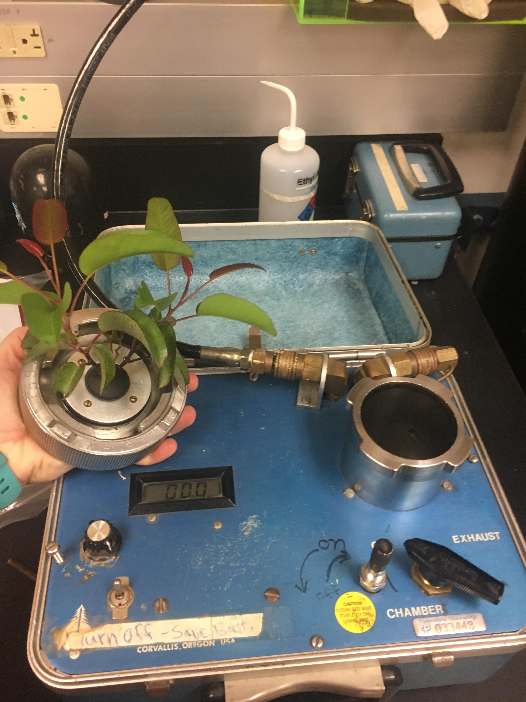
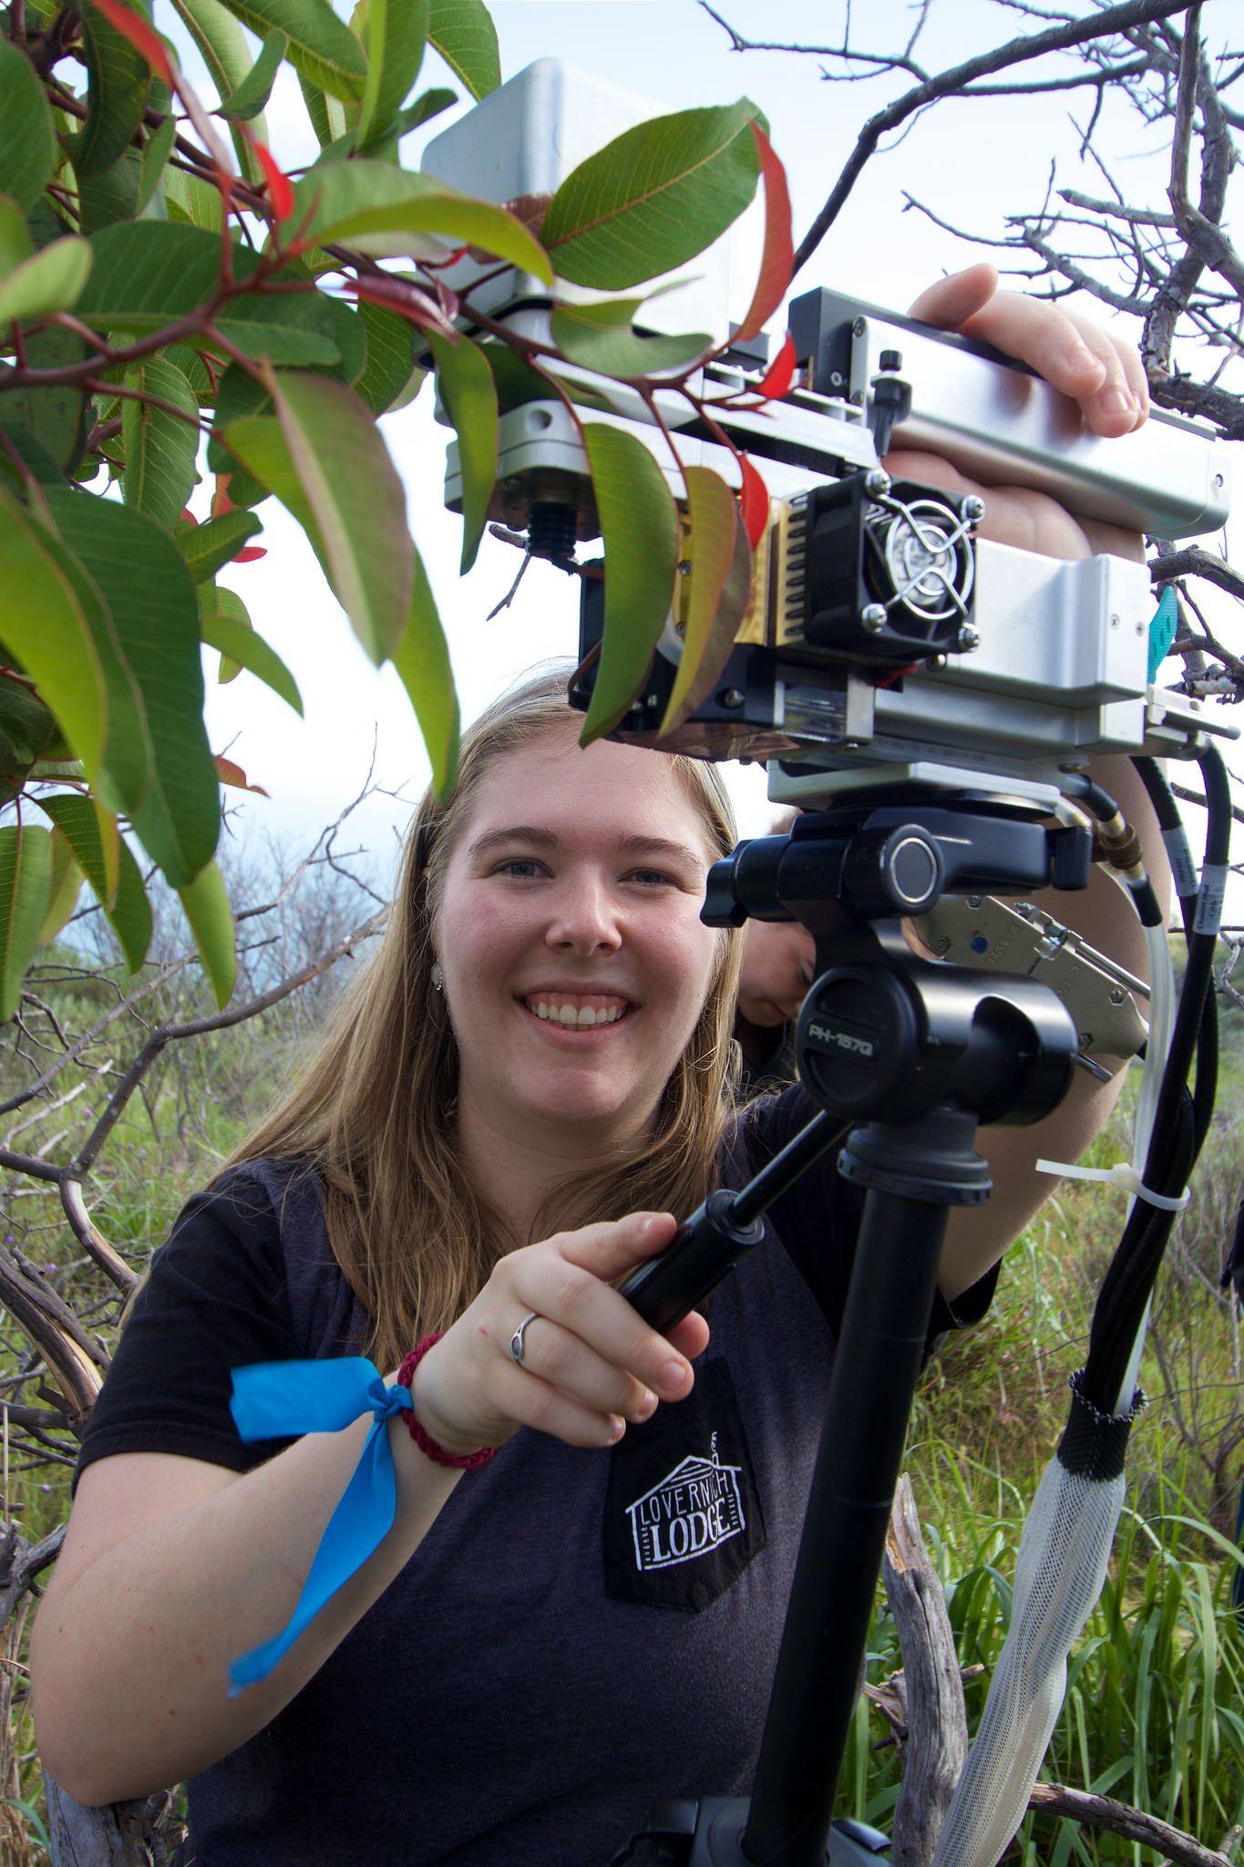
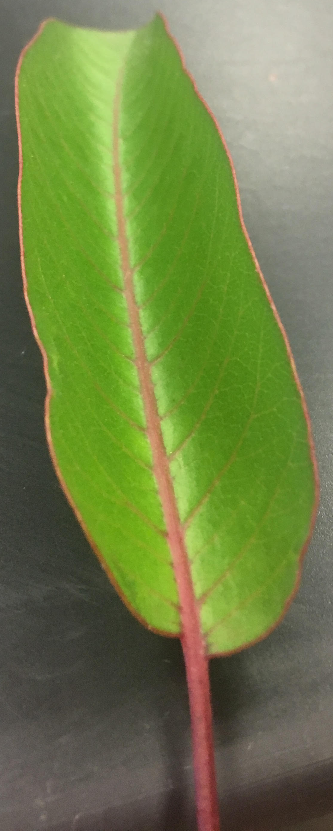
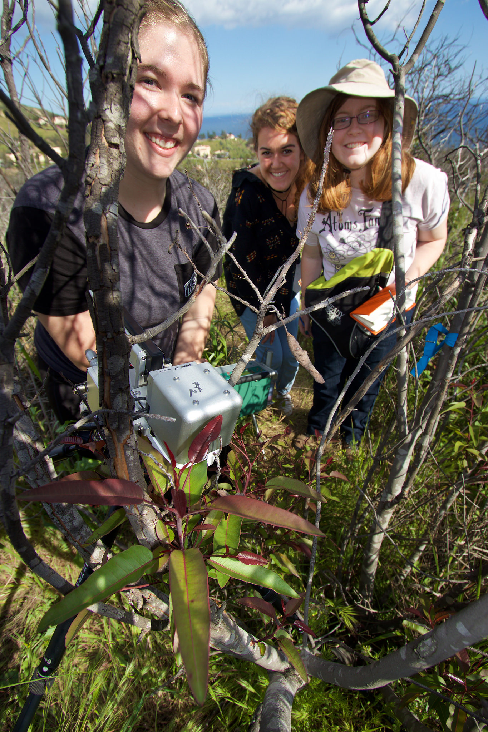
Comparison of Physiological Measurements and Water Potential of Malosma laurina During and after the Drought in Southern California
Nicolette Jessen, Kirstin Van Fleet, Rachel White
Mentors: Dr. Stephen Davis and Natalie Aguirre
Pepperdine University, Malibu, CA 90263
Abstract
After 5 years of drought, southern California has recently experienced increases in precipitation. Malosma laurina is a chaparral shrub that displays vulnerability to fungal infection during severe drought conditions, particularly in its adult branches, resulting in severe dieback throughout the Santa Monica Mountains. M. laurina is known to produce resprout leaves during times of environmental stress that are less affected by the fungus based on its ability to maintain water status and thus are more capable of displaying resilience in more favorable environmental conditions. We hypothesize that the increase in rain will not be enough to alter the vitality of the resprout leaves of M. laurina, as determined through physiological values and water potential. To test this hypothesis, we measured the rate of photosynthesis, ETR, Φ_{PSII}, and water potential of adult and resprout M. laurina and compared our data to measurements taken in 2015. We found that the physiological measurements obtained using Li 6400 XT and the water potential obtained using a Scholander Pressure Chamber were both significantly different from 2015 measurements. With these results, we rejected our hypothesis and concluded that the rain has had a positive effect in increasing the vitality of the resprout plants.
Methods
Discussion
Since December 2016, 17.71 inches of rain relieved Southern California’s historic drought and prompted us to question whether the rain had a physiological effect on dieback populations of Malosma laurina. After comparing the dieback resprouts of 2015 to 2017, we have found some significant results. The resprouts of 2017 had significantly higher Φ_{PSII} and ETR (Figure 1A and 1B, p<0.05). Both ETR and Φ_{PSII} give insight into the efficiency and well being of the light reaction of photosynthesis. ETR refers to the rate of electrons being transported in the light reaction and ΦPS-II refers to quantum yield which is amount of carbon dioxide absorbed per photon of light absorbed (Hogewoning et al., 2012). With a higher Φ_{PSII} , ETR should also be higher, as seen in our results. As more carbon dioxide is absorbed for fixation, more water will be split and electrons will be transported at a quicker rate. More water is probably able to be split because there is more water available to the plant. The photosynthetic rates were significantly higher in 2017 (Figure 2, p<0.05). This tells us the rate at which the leaf is assimilating carbon dioxide into sugar (dark reaction). We hypothesized that there would be no difference in the physiological measurements between resprouts of 2015 and 2017. While we have received a lot of rain compared to previous drought years, we did not think it would be enough to make a difference. However, according to our results, our hypothesis was incorrect.
We were also interested in looking at the water potential between 2015 and 2017 resprouts. We hypothesized that there would be no difference between the two for both predawn and midday because the rain is not enough to make a difference. The results for predawn and midday were both significantly different, with the 2017 resprouts having a less negative water potentials which means our hypothesis was incorrect (Figure 3, p<0.05). This could be explained by the plant’s 40 foot tap root because it is very efficient at absorbing water for the plant (DeSouza et al., 1986). Water potential is a measurement of how likely it is for water to move from one part of the plant to another (Papendrick and Caprell, 1981). Another way to think about it is water status. If the water potential is very negative, the plant is in drought conditions with little water. We also decided to compare the water potential between 2015 and 2017 adults. Our results show that there was a significant difference (p<0.05) for both predawn and midday. This simply means that the water status of the adults is higher than in 2017 because of the large amount of rain received.
Based on our results, the physiological measurements and water potential for dieback resprouts were significantly different between 2015 and 2017, and this may be due to the rain we have received. This relatively small amount of rain received could have been important in making the water potential less negative and easier for water to move around as well as improving the physiological health of the plant. Our experimental design could have had some confounding factors related to the time we took the measurements and the samples we took. Our data was taken in Spring of 2017, while the 2015 data was taken in the Summer. Another possible issue is that some of our samples were in shade more than others which could have affected the data. We would recommend taking more data on a larger sample of plants in the Summer 2017 to observe if Malosma laurina continues to differ from Summer 2015 measurements.
Water potential was measured at predawn and midday with a Scholander-Hammel Pressure Chamber. One resprout and one adult branch from each marked plant were removed with shears, placed in a plastic bag and stored on ice until the measurement was taken. The outermost layer of each branch containing resin canals was removed down to the level of the first petiole attached to it before being placed in the chamber. Water potential was defined as the pressure at which white foam completely covered the top of each branch.
The photosynthetic rate, ETR and Φ_{PSII} of resprout and adult leaves were measured with a Li-6400 XT at midday. Cuvette conditions were set at a light level of 2200 µmol/m²s and a temperature of 22ºC. Atmospheric conditions, such as CO₂ and humidity, were measured with an IRGA and automatically matched within the cuvette. We sampled leaves that were at least six leaves down from the top most leaf on a branch.
Introduction
Malosma laurina is a chaparral shrub that demonstrates a predisposition to fungal infection in extreme conditions despite its innate drought-resistance. Evidence of fungal infection in M. laurina has been frequently observed in the Santa Monica Mountains and, consequently, dieback occurs due to the historic drought in southern California. The fungus enters through wounds on adult branches of M. laurina and prevents water transport throughout the branch, thus decreasing vitality. These branches are rendered incapable of conducting water and incapable of surviving (Aguirre et al., 2016). During environmental stress, M. laurina produces resprout branches to counteract the death of its adult branches. These resprouts maintain the ability to conduct water and thus can reflect direct responses to current, changing environmental conditions. Although the fungus also affects the resprout branches, their ability to maintain a high water potential allows for continued growth during changing environmental conditions (Palmeri et al., 2016). Due to a lower number of extraneous factors and controllers, water potential measures are often more accurate at predawn than at midday (Wright et al., 2015). California has been in a progressive drought since 2012, but recent months have seen drastic changes in precipitation patterns (Asner et al., 2016). In December 2017, Malibu received 4.33 inches of rain, followed by 7.36 inches in January 2017, followed by 6.02 inches in February 2017 (Los Angeles Department of Public Works 2017). The physiological values and water potential of the resprout leaves indicate the resilience of Malosma laurina and how quickly the plants respond to the increases in rainfall.
We predict that there will not be a difference in physiological measurements between resprout leaves of current dieback plants and summer 2015 dieback plants. We predict there will be a difference in water potential between adults and resprout dieback M. laurina for both predawn and midday measurements. We also predict there will not be a difference in predawn and midday water potential between resprout leaves of current dieback plants and 2015 dieback plants. To test these hypotheses, we utilize a Li-Cor6400XT and a pressure chamber to determine the physiological values and water potential of resprout and adult leaves of six M. laurina plants. This data is compared to previous data collected in the summer of 2015.
Study Site: Six Malosma laurina plants with both adult and resprout leaves growing in the dieback region of the Dresher campus of Pepperdine University were marked and used for measurements.
Comparison and Analysis: We compared these measurements to data taken in 2015 by Gabriella Palmeri and Shaquetta Reese. Kaleidagraph software was used to perform statistical s and create figures.
Results
1A
1B
ETR (μmol e⁻/m²s)
Φ_{PSII}
Figure 1A: Electron transport rates (ETR) for Malosma laurina: dieback resprouts in Summer 2015 and Spring 2017 during midday. The asterisk indicates a significant difference (p<0.05) between 2015 and 2017 data for ETR values an unpaired, non-directional Student’s t-test. Figure 1B: Φ_{PSII} for Malosma laurina: dieback resprouts in Summer 2015 and Spring 2017. The asterisk indicates a significant difference (p<0.05) between 2015 and 2017 data for Φ_{PSII} values an unpaired, non-directional Student’s t-test. The error bars on mean values are ± 1 SE, n=6-17 for 2A and 2B.
Conclusions
The photosynthetic rates, ETR, and ΦPS-II were higher for the 2017 resprout leaves, indicating an increase in vitality since 2015 in M. laurina.
The water potential was less negative for 2017 resprout leaves which also indicates more hydrated, vital plants since 2015.
Ψ (MPa)
References
Aguirre, N. M. (2016). The Effect of Water Stress on the Growth of a Fungal Pathogen, Botryosphaeria dothidea.
Asner, G. P;, Brodrick, P. G., Anderson, C. B., Vaughn, N., Knapp, D. E., & Martin, R. E. (2015). Progressive forest canopy water loss during the 2012-2015 California drought. Proceedings of the National Academy of Sciences of the United States of America, 113(2), E249-E255.
DeSouza, J., Silka, P. A., and Davis, S. D. (1986). Comparative physiology of burned and unburned Rhus laurina after chaparral wildfire. Oecologia. 71: 63-68.
Palmeri, G. N., Sauer, K. E., Holmlund, H. I., and Reese, S. (2016). Drought-Induced Fungal Infection Causes Severe Dieback in Malosma laurina in the Santa Monica Mountains. Poster session presented at: Summer Undergraduate Research in Biology. Session C.
Hogewoning SW, Wientjes E, Douwstra P, et al. Photosynthetic Quantum Yield Dynamics: From Photosystems to Leaves. (2012). The Plant Cell. 24(5):1921-1935.
Los Angeles County Department of Public Works. (2017). Daily precipitation 10-01-2016 to 03-12-2017 (129). Malibu: Osorio, Miguel.
Papendick, R., & Camprell, G. (1981). Theory and measurement of water potential. Soil Science Society of America: Water Potential Relations in Soil Microbiology. 1-22.
Wright, A., Schnitzer, S. A., & Reich, P. B. (2015). Daily environmental conditions determine the competition--facilitation balance for plant water status. Journal of Ecology, 103(3), 648-656.
Figure 2: Photosynthetic rates for Malosma laurina: dieback resprouts in Summer 2015 and Spring 2017 during midday. The asterisks indicate a significant difference (p<0.05) based on an unpaired, non-directional Student’s t-test. The error bars on mean values are ± 1 SE, n=6-17.
Figure 3: Water potential of Malosma laurina: dieback resprouts in Summer 2015 and Spring 2017. The asterisks indicate a significant difference (p<0.05) between 2015 and 2017 data based on two unpaired, non-directional Student’s t-tests. The error bars on all mean values are ± 1 SE, n=5-17. This same analysis was done on the adult plants, and the same trends occurred. The 2017 adults at predawn and midday were less negative than in 2015.
Acknowledgements
We would like to thank the Natural Science Division of Pepperdine University for funding this research. Also, we want to thank our research advisors, Dr. Davis and Natalie Aguirre.
Notes:
ABSTRACT/INTRO SEE RED

