Slide 1
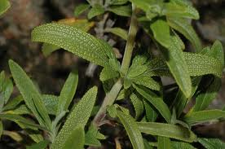
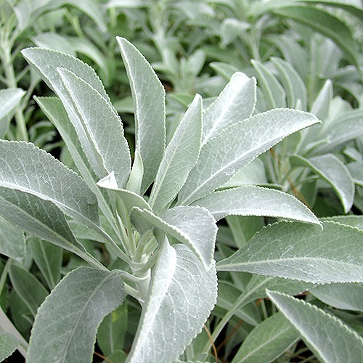
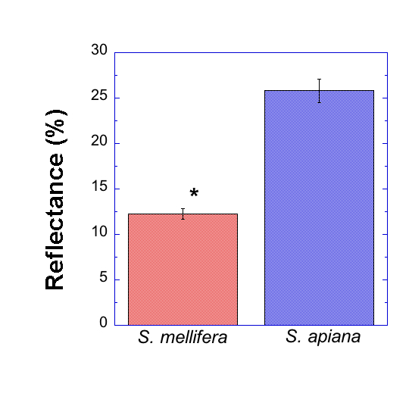
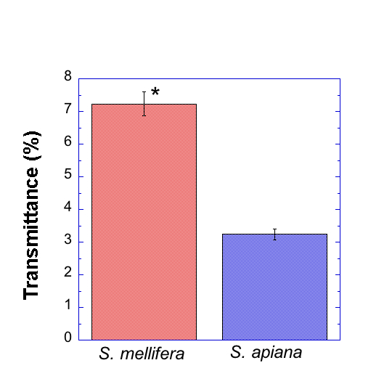
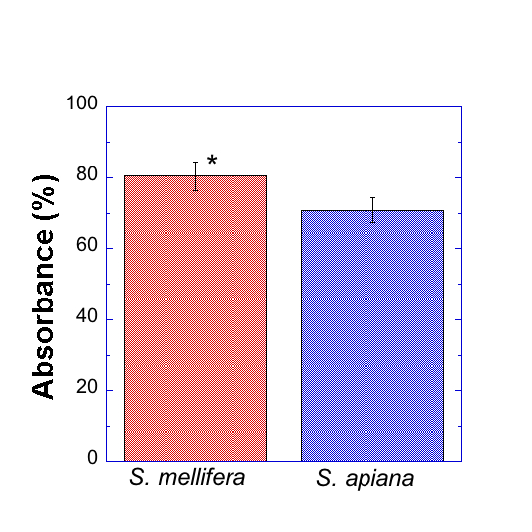
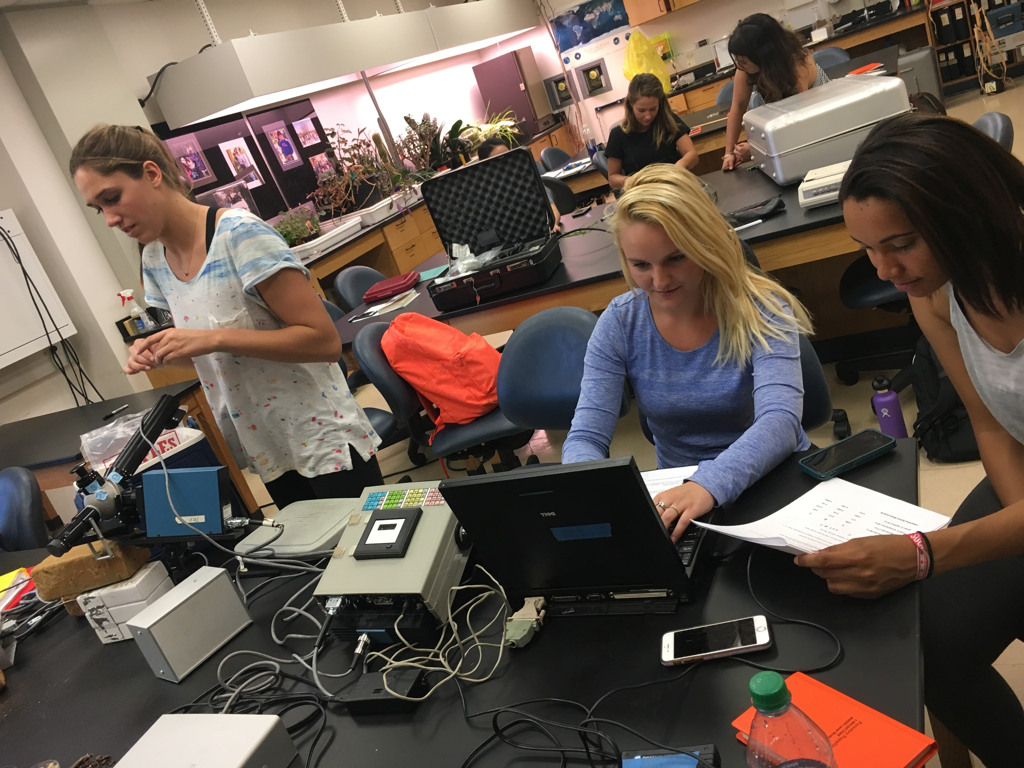
Reflectance, Transmittance, and Absorbance Values in Salvia apiana Result in Better Performance than Salvia mellifera in Drought- like Conditions Haley Bekins, Caroline Boone, Kristen Hardin Pepperdine University Malibu CA, 90263
Abstract
Salvia apiana, due to the physically lighter color and thickness of the leaves, will have higher reflectance values, lower transmittance values, and lower absorbance values than Salvia mellifera. These measurements exemplify characteristics of a better adapted species for droughts, and then the absorption values can be used to calculate more information on the species like ERT. We measured transmittance and reflectance of six leaves from randomly selected plants of both species through the use of an integrating sphere. After obtaining the R and T value of each plant, we calculated the leaf absorbance,α. This was done by using the equation α = 1 - R - T. We found the S. mellifera had a lower reflectance value with a mean around 12% compared to the S. apiana that had a mean around 25%. The S. mellifera had a transmittance around 7% while the S. apiana was only around 3%. The absorbance values were closer than expected. The S. mellifera mean was 80% while the S. apiana was 70%. All of our data was found significant by a Student’s t-test, and this allowed us to accept our hypothesis that Salvia apiana is better adapted for drought.
Salvia mellifera
Salvia apiana
Introduction
Results
Discussion
The plant species Salvia mellifera and Salvia apiana are native to the chaparral vegetation type. Our aim for this experiment was to compare the transmittance and reflectance of six leaves from randomly selected plants of both species through the use of an integrating sphere. We hypothesized that Salvia apiana, due to the physically lighter color and thickness of the leaves, will have higher reflectance and lower transmittance and therefore survive better than Salvia mellifera in drought conditions. We related our findings to the drought that California has been experiencing and how each species would preform in these conditions. The abundance of stomata on the upper surfaces of the leaves prove to be statically different between both Salvia mellifera and Salvia apiana which could also be attributed to why one would preform better than the other in drought-like conditions (Webb and Carlquist et al. 1964). Growth is terminated with high temperatures which can be related to our study because with drought and higher temperatures being seen in the near future, there is a likely chance that development in these plants could decline. (Minnich and Dezzani et al. 1998).
Based on our data of S. mellifera and S. apiana, each measurement of each species was significantly different by a Student’s t-test. The S. mellifera had a lower reflectance value with a mean around 12% compared to the S. apiana that had a mean around 25%. This difference in reflection is due to the S.apiana having a lighter leaf color compared to the darker green of the S. mellifera. This is important because this ability to reflect more light allows this species to reflect excess light in desert conditions. We noticed the S. apiana seemed to have little hairs on the leaf. Literature supports that leaves with light colored trichomes (hairs on leaves) are able to reflect more light because the surface area is greater than leaves without hairs (McClendon et al. 1984). However, the S. mellifera had a transmittance around 7% while the S. apiana was only around 3%. This is likely due to the thickness of the S. apiana leaf which is a characteristic of a species adapted and more resilient to draught conditions. It has been concluded that leaves of plants with thick epidermises would have less internal damage to inner tissues of their mesophylls by UV-B radiation than leaves with thinner epidermises; however, UV-B radiation may damage the epidermis itself (Gausman, Rodrigues, and Escobar et al. 1975). Lastly, the absorbance values were closer than expected. The S. mellifera mean was 80% while the S. apiana was 70%. Our group expected that there would be a greater difference than merely 10%. This smaller difference might be due to the measurements being taken in the wet season. If we had taken our measurements in the dry season, the species would have shown a larger difference in absorbance. Literature supports that the reduction in the photosynthetic rate is caused by decreased light absorption (Ehleringer et al. 1976). Since S. mellifera absorbed more light, it will have a higher photosynthetic rate which provides more energy for the plant in normal conditions. However, Ehleringer suggests that since S. apiana has a lower absorption rate, it has adapted to the drought conditions and is more likely to survive in drought conditions. Lower absorption rates help avoid stress by limiting solar radiation thus reducing leaf temperatures and transpiration rates. Another reason absorption values are important is because other instruments that are used in botany (LI-cor6400xt) assume the absorption values automatically. When this machine calculates ERT it is assumed that the absorbance is 0.84. This value did not overlap with any of our data points. This is a problem because it is not accurate, so this ERT is not an accurate calculation.
Figure 1: Comparison of leaf reflectance (%) between Salvia mellifera and Salvia apiana. Error bars on mean values represent + 1 SE, n = 6. The mean values were found significant at P < 0.05 by a Student’s t-test.
Materials and Methods
Description of Study Site
The location of our study site was along the street Via Pacifica near the Pepperdine Drescher graduate campus and apartments in Malibu, California. Our data was collected during late March and early April. The average temperature of this time and location this year has been about 60° F. The Malibu area has experienced an unusual heavy rain season this year which we believe effected our results.
Experimental Set-Up
In this experiment, in order to test our hypothesis we used an integrating sphere to find the transmittance and reflectance of Salvia mellifera and Salvia apiana. To begin our tests, we set up the Integrating Sphere to measure a Standard, which was a white reflecting material, BaSO₄. This is done to measure the true reflectance and transmittance of a leaf by normalizing the data to a standard.
Data Collection
We collected one leaf of each species from six randomly selected plants around Drescher campus. Each leaf was placed inside the Integrating sphere. The reflectance of the leaves was displayed by a graph showing the percent reflectance of each leaf. Using this information, we divided the average reflectance by the standard giving us the R value. Following this, we used the same leaves to measure the transmittance. The T value was calculated by dividing the average transmittance of the leaves by the standard.
Data Calculation
After obtaining the R and T value of each plant, we calculated the leaf absorbance,α. This was done by using the equation α = 1 - R - T. A Student’s T-test was performed to compare the absorbance, transmittance, and reflectance of each plant species. This test showed that our results are statistically significant.
Figure 2: Comparison of leaf transmittance(%) between Salvia mellifera and Salvia apiana. Error bars on mean values represent + 1 SE, n = 6. The mean values were found significant at P < 0.05 by a Student’s t-test.
Conclusion
We accept our hypothesis that Salvia apiana, due to the physically lighter color and thickness of the leaves, will have higher reflectance and lower transmittance, but since we took measurements in the wet season we cannot conclude that it survives better in the drought
It is important to know the reflectance, transmittance, and absorbance values of leaves in order to predict their behavior in stressed environments
For a more accurate comparison, a control, dry season data, and wet season data should all be taken
References
Figure 3:Comparison of leaf absorbance (%) between Salvia mellifera and Salvia apiana. Error bars on mean values represent + 1 SE, n = 6. The mean values were found significant at P < 0.05 by a Student’s t-test.
1. Ehleringer, J., Björkman, O. and Mooney, H.A., 1976. Leaf pubescence: effects on absorptance and photosynthesis in a desert shrub. Science, 192(4237), pp.376-377.
2.Gausman, H. W., R. R. Rodriguez, and D. E. Escobar. 1975. Ultraviolet Radiation Reflectance, Transmittance, and Absorptance by Plant Leaf Epidermises1. Agron. J. 67:720-724.
3. McClendon, J.H., 1984. The micro-optics of leaves. I. Patterns of reflection from the epidermis. American Journal of Botany, pp.1391-1397.
4. Minnich, R.A. and Dezzani, R.J., 1998. Historical decline of coastal sage scrub in the Riverside-Perris Plain, California. Western Birds, 29(4), pp.366-391.
5. Webb, A.A. and Carlquist, Sherwin., 1964. Leaf anatomy as an indicator of Salvia apiana-mellifera introgression. Aliso, 5, pp.437-449.

