Slide 1
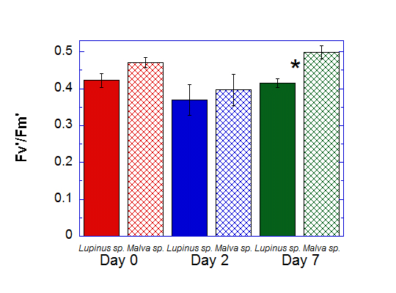
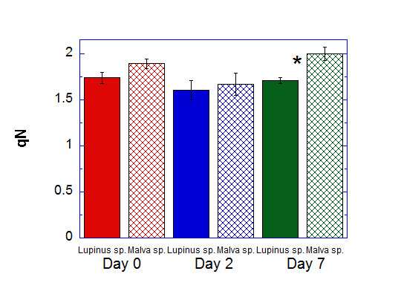
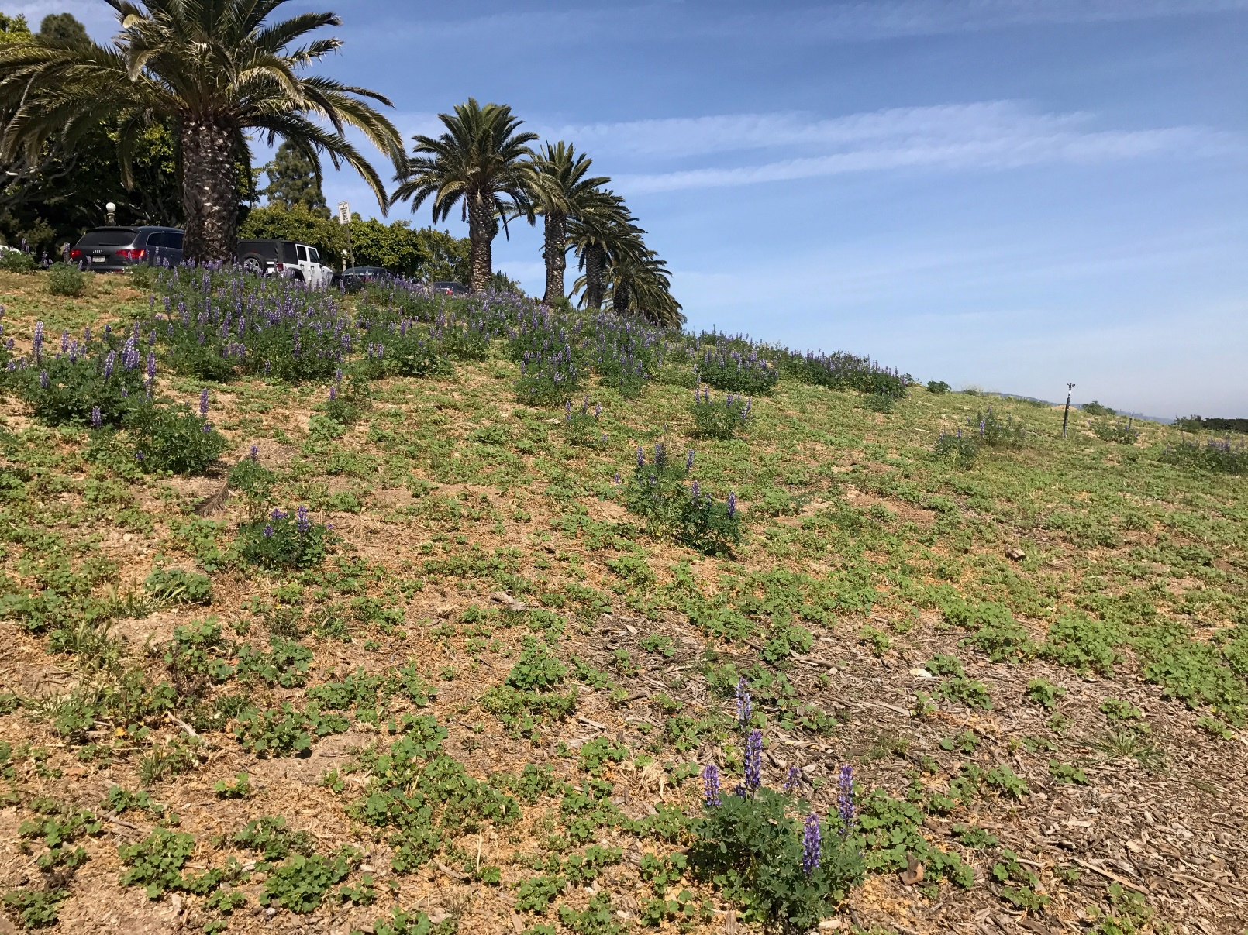
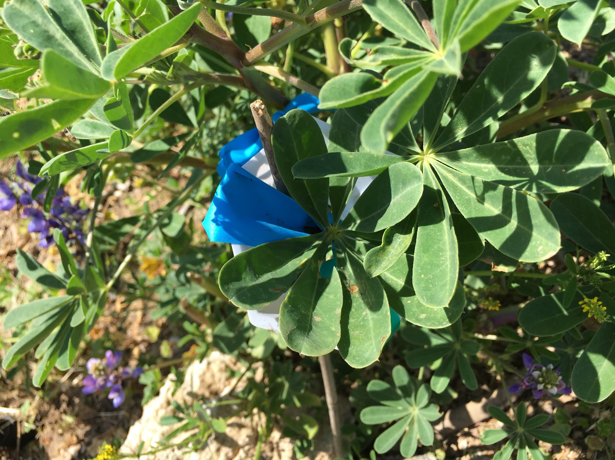
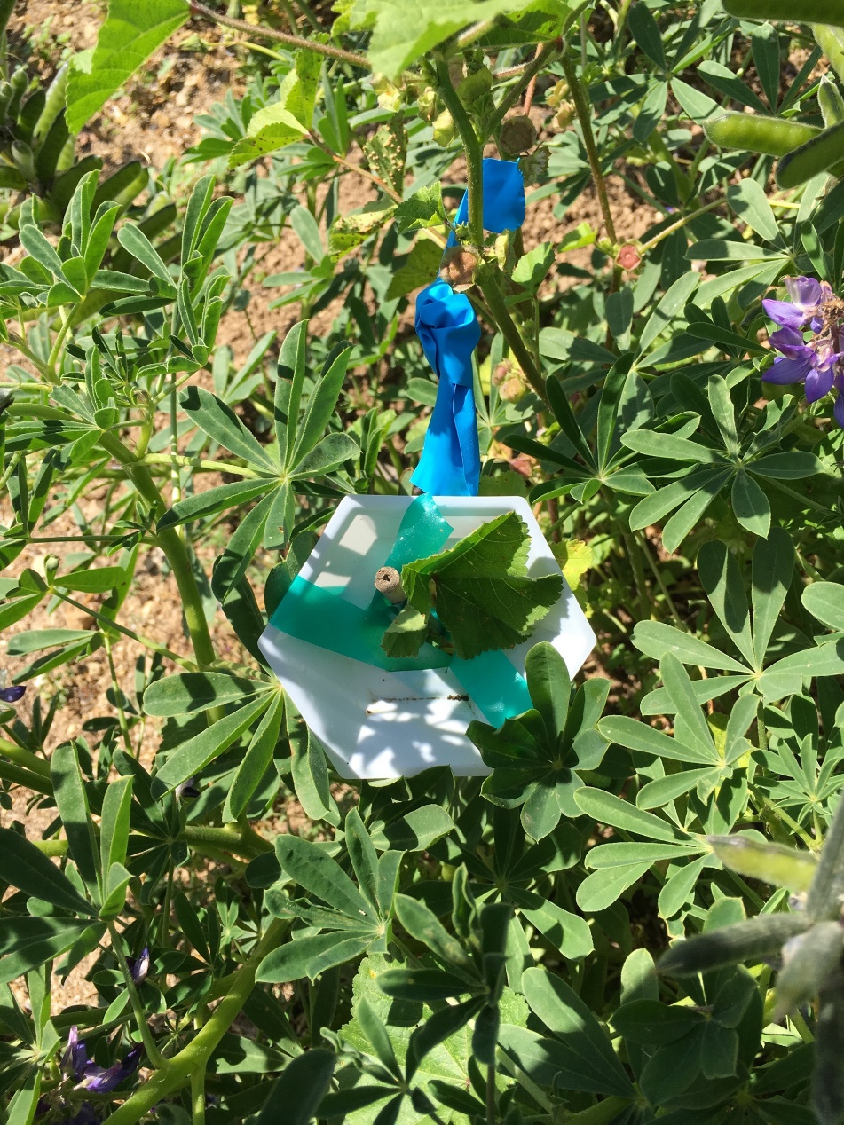
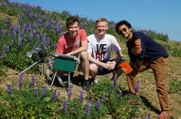
Comparison of Photoprotection Adaptiveness in Native (Lupinus succulentus) and Invasive (Malva parviflora) Heliotropic Plants Joseph Davidson, Cameron Juarez, and Collin Scott Pepperdine University Malibu CA, 90263
Abstract
Addressed here is the question of whether invasive heliotropic plants can adapt better than native heliotropic plants, to conditions in which their solar tracking capabilities are hindered. In order to test this, a heliotropic species native to Southern California (Lupinus succulentus) was compared to a weedy heliotropic species invasive to Southern California (Malva parviflora). We hypothesized that the photoprotection mechanisms of M. parviflora would adapt better to being restrained as it is an invasive species and it was more abundant in the area. Values of Fv’/Fm’ and qN were measured in order to compare the efficacy of photoprotection mechanisms between the two species. The differences in photoprotection mechanisms of the two species were determined to not be significantly different when the species were allowed to solar track. After a week of the plants being restrained, it was determined that M. parviflora’s photoprotection mechanisms showed greater efficacy than did those of L. succulentus. However, further research should be conducted in order to confirm the accuracy of these results.
Introduction
Results
Discussion
The plant species Lupinus succulentus and Malva parviflora are both heliotropic. L. succulentus is native to the Santa Monica Mountains, where we conducted our study (Dale 2000). M. parviflora, native to the Mediterranean region, grows abundantly as an invasive weedy species and is well suited for the environment (Dale 2000). The purpose of this experiment was to see the differences in the two plants photoprotective capabilities when both were restrained and prevented from solar tracking. In order to test this, three plants of each species were chosen and one leaf was restrained on each. Data was collected on their non-photochemical quenching (qN) and their fluorescence (Fv'/Fm') before they were restrained and after they had been restrained after two and seven days respectively. Higher values of qN and Fv'/Fm' indicate higher functioning of the plant's photoprotective capabilities. We expected to find higher values in M. parviflora than in L. succulentus.
Solar tracking is an adaptation that increases plants efficiency with the light they receive throughout the day (Ehleringer and Forseth 1980). Photoprotection should fluctuate with the amount of light that a plant is receiving (Ruban and Horton 1995). This means that heliotropic plants, likely would not have as much variation in their photoprotection, as they face the sun constantly. A plant like this would have to fluctuate its photoprotection more when not solar tracking, because photoprotection would block the energy going to photosynthesis (Ruban and Horton 1995). Our data showed that the changes over time in photoprotection were not significant. M. parviflora had higher photoprotection values than L. Succulentus every day, but this difference was only significant after seven days of restraint. This suggests that M. parviflora was better able to adjust it's photoprotection as it continued to be restrained for an extended period of time.
At the end of the seven days the leaves of the L. succulentus and M. parviflora that had been restrained had many more holes and sun spots or burns than those that were free to move around them.
L. succulentus and M. parviflora were about the only plants found along the hillside we studied. This could result from the solar tracking plants outcompeting all other species. In addition, the M. parviflora seemed to be more abundant. On the first day of research, much of the M. parviflora had been removed via weeding and the remaining M. parviflora surrounded the L. succulentus. At the end of the research, the hillside was almost completely covered with M. parviflora again. This suggests that the M. parviflora is better suited to survival in this environment.
L. succulentus is a legume (Dale 2000). Other legumes, like soybeans, are also solar tracking (Schmalstig 1997). The functioning of plants when they are not allowed to solar track (eg. How well they are able to adjust photoprotection) is significant to farmers because some crops are reliant on solar tracking.
Some possible sources of error could have come from the fact that one of our M. parviflora leaves slipped out of its restraints before day 2 and another of the M. parviflora plants was ripped out completely by day 7.
Description of Study Site
Figure 1: Comparison of Fv’/Fm’ between Lupinus succulentus and Malva parviflora 0 days, 2 days, and 7 days after being restrained. Error bars on mean values represent ±1 SE, n = 2-3. An asterisk indicates significant differences between Fv’/Fm’ values for L. succulentus and M. parviflora on that day at P < 0.05 by Student’s t-test.
The Lupinus succulentus and Malva parviflora individuals analyzed were growing on the south-facing slope on the north side of Alumni Park at Pepperdine University’s Malibu Campus. Both species were found growing amongst each other at this location. At the beginning of the experiment much of the M. parviflora had been removed, but grew back within the two week.
Materials and Methods
Figure 2: Comparison of qN between Lupinus succulentus and Malva parviflora 0 days, 2 days, and 7 days after being restrained. Error bars on mean values represent ±1 SE, n = 2-3. An asterisk indicates significant differences between qN values for L. succulentus and M. parviflora on that day at P < 0.05 by Student’s t-test..
Three plants from each species were selected at random to be analyzed. Before restraining the plants, baseline measurements of Fv’/Fm’ and qN were taken of each plant using a LI-COR LI-6400XT portable photosynthesis system. The plants were then restrained by tying them to bamboo reeds using green tape and were supported by white weigh boats with the bottom removed (examples of restraints pictured below). Then measurements of Fv’/Fm’ and qN were taken again using a LI-COR LI6400XT portable photosynthesis system two and seven days after the plants were restrained. Plants which came loose from their restraints or were uprooted were excluded from data analysis.
Acknowledgements
Conclusion
- Under normal conditions, L. succulentus and M. parviflora growing in the wild do not differ significantly in the efficacy of their photoprotection mechansims
- If both species are restrained, M. parviflora will exhibit significantly greater efficacy in its photoprotection mechanisms than L. succulentus as time goes on.
This research was funded by the Natural Science Division of Pepperdine University. We would like to thank Dr. Stephen Davis and Natalie Aguirre for their support and guidance in our research.
Literature Cited
Dale, N. 2000. Flowering Plants : The Santa Monica Mountains, Coastal & Chaparral Regions of Southern California. Sacremento, California Native Plant Society.
Ehleringer, J. and Forseth, I., 1980. Solar tracking by plants. Science, 210(4474), pp.1094-1098.
Ruban, A.V. and Horton, P., 1995. Regulation of non-photochemical quenching of chlorophyll fluorescence in plants. Functional Plant Biology, 22(2), pp.221-230.
Schmalstig, J., 1997. Light perception for sun-tracking is on the lamina in Crotalaria pallida (Fabaceae). American Journal of Botany, 84(3), pp.308-308.

