Slide 1
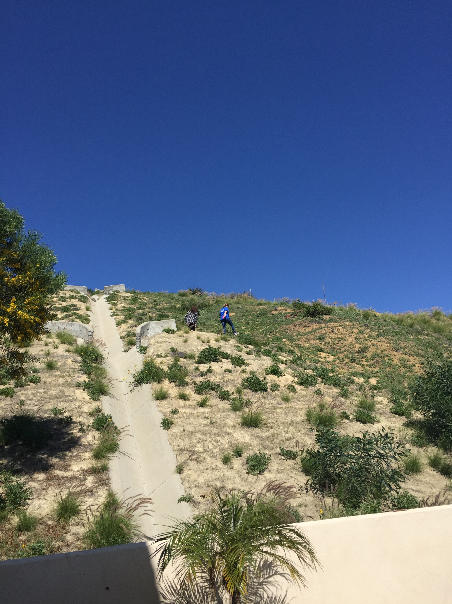
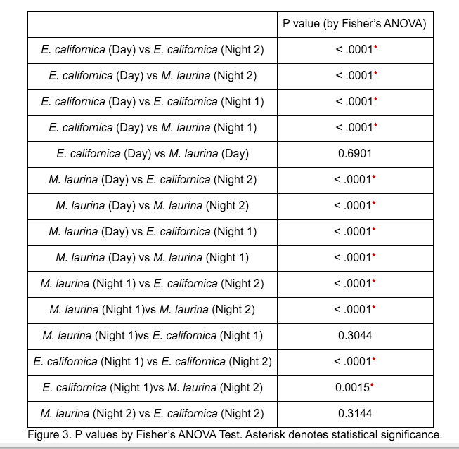
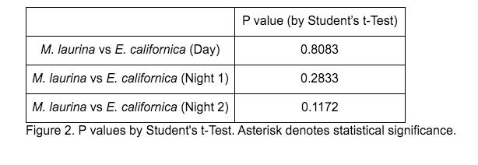
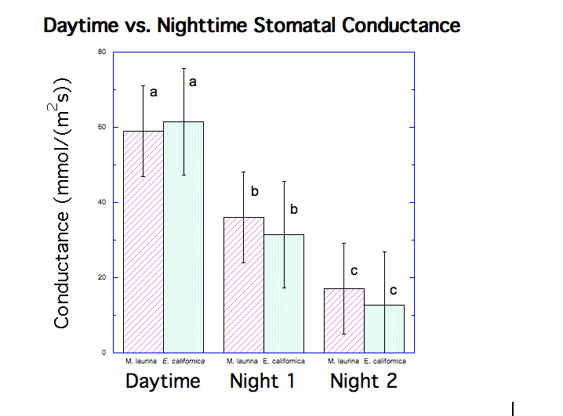
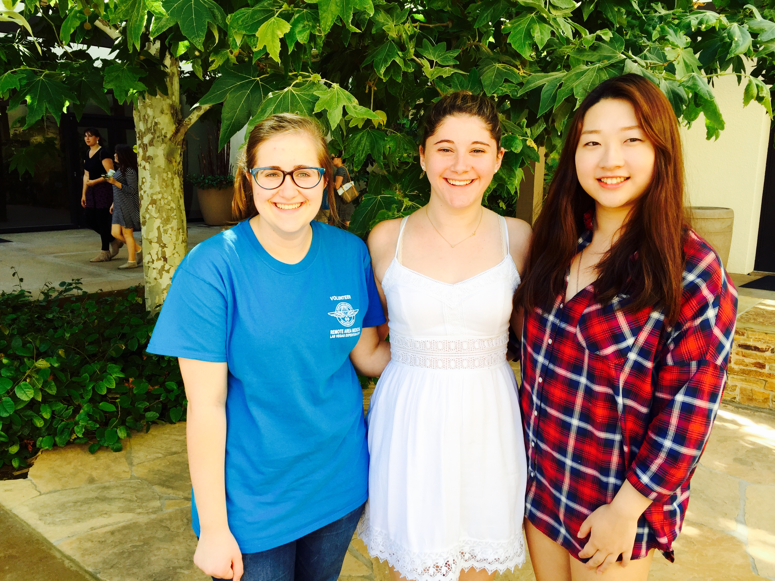
Comparison of Nighttime Stomatal Conductance in Malosma laurnia and Encelia californica
Stephanie R. Kaplan, Jessica T. Gash, and Hannah H. Ziegler
ABSTRACT
The experiment aimed to look at the comparison between the nighttime stomatal conductance of Malosma laurina and Encelia californica. Through the use of leaf porometry and subsequent data analysis, it was determined that there was no statistical differnce between either species, due to the fact that the Malosma laurina was a resprouted species, that needed significantly less water than a fully mature M. laurina plant would have needed.
DISCUSSION
Looking at our results, we can see that there is no significance difference in nighttime stomatal conductance between M. laurina and E. californica. There was, however, a significant difference in conductance between nights. This unexpected result can be attributed to many different factors. According to Caird, it was discovered that nighttime conductance correlates with water stress. Nighttime conductance tends to increase in response to higher water status, while lower nighttime conductance is associated with decreased water availability, in order to minimize water loss (Caird et al., 2007). On any given night, the plants have access to different amounts of water due to wind, humidity, and soil conditions. In addition, our measurements were taken during the rainy winter season. Differences between chaparral and coastal sage plants can be assumed to increase during the drier fall season, when the plants have less access to water (Davis, 2016).
We did, however, see our predicted result when comparing daytime stomatal conductance to nighttime stomatal conductance although the nighttime conductance was higher than expected. In M. laurina, Night 1’s average conductance consisted of 60.97% of average daytime conductance, while Night 2 was measured as 29.10%. E. californica had average nighttime conductances consisting of 51.31% and 20.86% compared to average daytime stomatal conductance. These data differ from Caird’s findings that stomatal conductance at night is 5-15% of daytime rates (Caird et al., 2007) because we used resprout plants. These resprout plants have a large root system compared to the shoot size and have access to more water than what is normally available to plants of this age in our study site. These plants were resprouts because of yearly residential clearing. This was particularly significant for M. laurina because the water requirement of regrowth plants of this size is comparable to the water requirement of the typically smaller Encelia californica. Once we discovered that we had used resprout plants, our data’s deviation from our hypothesis made logical sense.
One complication of our experiment was data restriction. We were only able to take two night measurements, and were unable to take more because two of the three team members were allergic to our specimens. Daytime measurements were restricted because of time constraints. We would recommend that more measurements be taken in future studies, and the appropriate precautions be taken to avoid reacting to the plants. An additional factor in our experiment was an unidentified beetle that we found on M. laurina. The bugs appeared to be more prevalent on the second night than on the first night, although no quantitative measurements were taken. The bugs ate large parts of the leaves, and could have affected measurements.
Our experiment, despite its complications, is significant because we believe that this is the first experiment that has used chaparral and coastal sage vegetation types to measure nighttime stomatal conductance. Further studies on nighttime stomatal conductance in other vegetation types can be seen in Caird’s research.
Introduction
According to recent records, California has been experiencing extreme drought, the past few years reaching the hottest and driest instrumental record by far (Mann and Gleick, 2015). Water loss is a serious problem for both plants and people in this current climate, so we decided to get a simple indication of this through stomatal conductance. Research pertaining to our study indicates that chaparral has lower daytime stomatal conductance than coastal stage (Kolb and Davis, 1994). Because stomatal conductance in plants is known to be strongly influenced by environmental conditions (Kröber et al., 2015), measuring stomatal conductance is essential to keeping track of our changing environment.
The picture of stomatal conductance, is not complete, however, without measurements at night as well as during the day. Recent studies state that incomplete stomatal closure at night is observed in C3 as well as C4 species, including annuals, perennials, monocots, herbaceous dicots, shrubs, and trees. Nighttime leaf conductance rates typically range from 5% to 15% of daytime rates (Caird et al., 2007). These studies lead us to believe that there will be stomatal conductance at night in chaparral and coastal sage plants, which are Malosma laurina and Encelia californica, respectively, in our experiment. We also believe that Malosma laurina will have a higher nighttime stomatal conductance than Encelia californica because of its lower daytime conductance. All of this can be tested using a SC1-Leaf Porometer.
DATA AND RESULTS
CONCLUSION
We believed that there would be stomatal conductance in both chaparral and coastal sage plants, and that chaparral would have higher nighttime stomatal conductance. We proposed to test this using a porometer and the species M. laurina and E. californica. We can conclude from our data that there was nighttime stomatal conductance in both M. laurina and E. californica, as predicted. Our data also indicated that there was no significant difference in nighttime conductance between M. laurina and E. californica. It was determined however, that the plants that were tested were resprout plants, which were significantly smaller, and took up far less water than a fully grown M. laurina would have needed. This would have accounted for the lack of statistical significance between the two species. We would recommend further studies be taken during fall, when the water level is lower, and that the studies carry out more measurements than time and allergies allowed us. An interesting direction for further research would be to measure the effect of potato bugs on nighttime stomatal conductance in M. laurina as we believe the bugs may have been a confounding factor in our experiment.
DESCRIPTION OF STUDY SITE
For our experiment, we used the hill adjacent to 24737 Laurel Ridge Dr, Malibu, CA 90265. This hill is part of the Santa Monica Mountains. We conducted our night trials on March 21st and 23rd, and our day trial on March 30th. The hill is home to chaparral, coastal sage, and weed plants. We chose Malosma laurina and Encilia californica. The M. laurina had qualitatively few anthocyanins, and was less red than many other M. laurina we had seen in areas within a few miles of our study site. The E. californica was ubiquitous, and we were able to choose plants from these two species that were quite close to each other. We accessed our plants by use of a storm drain, which we climbed until we were about 20 feet high on the hill. Our plants were about 0-7 feet up from the storm drain. Most of the plants in our area of study were less than a year old because the hill is clear-cut 200ft once a year.
References:
Caird MA, Richards JH, Donovan LA (2007) Nighttime stomatal conductance and transpiration in C3 and C4 plants. Plant Physiol 143: 4–10.
Davis, Stephen. Personal interview. 5 April 2016.
Howard AR. Donovan LA. Helianthus nighttime conductance and transpiration respond to soil water but not nutrient availability. Plant Physiol. 2007;143:145–155.
Kröber W, Plath I, Heklau H, Bruelheide H. Relating Stomatal Conductance to Leaf Functional Traits. Journal of Visualized Experiments : JoVE. 2015;(104):52738. doi:10.3791/52738.
Kolb, K. J., & Davis, S. D.. (1994). Drought Tolerance and Xylem Embolism in Co-Occurring Species of Coastal Sage and Chaparral. Ecology, 75(3), 648–659.
Mann ME, Gleick PH. Climate change and California drought in the 21st century. Proceedings of the National Academy of Sciences of the United States of America. 2015;112(13):3858-3859. doi:10.1073/pnas.1503667112.
Notes:
Cite- chapparal have lower conducatance during the day
Cite- donnovan make sure it fits our research
Cite- water level in plants is lower during the day

