Slide 1


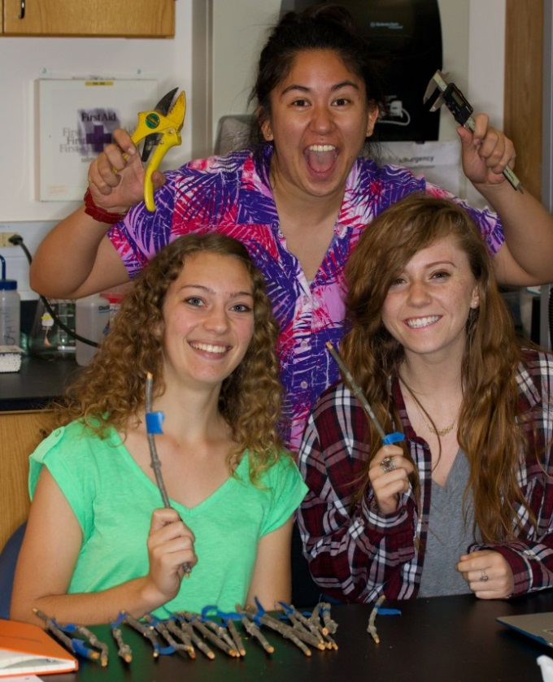

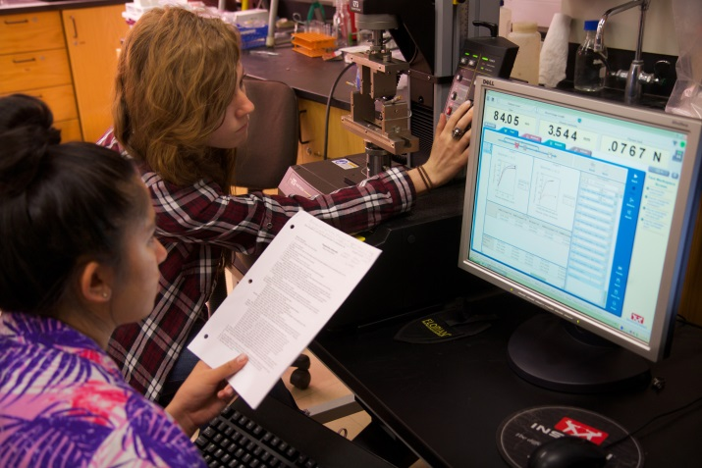
Nodes Alter Stem Mechanical Strength
in Heteromeles arbutifolia
Gabriella E. Chan, Caleigh A. Howard, & Callie E. Shelley
Pepperdine University, Malibu, CA, 90263
Abstract
Results
Materials and Methods
Our thesis was that the presence of nodes in stems of Heteromeles arbutifolia plants would increase the mechanical strength of the xylem and the bark, allowing the stems to be better protected against harsh weather conditions during the severe California drought. We conducted research on two sample groups, one with nodes and one without nodes. An Instron machine tested the mechanical strength by bending the stems until the xylem broke. Values for MOR (modulus of rupture) and MOE (modulus of elasticity) were measured to determine the overall strength of both groups. We found that the xylem of the stems was stronger with nodes than without nodes. However, the inclusion of bark reduced the strength of the stems with nodes. The xylem results supported the idea that nodes would increase the stems’ mechanical strength, whereas the bark results suggested an alternate effect of nodes on the strength of stems.
We performed four different Student’s t-tests to determine if the stems had any significant differences (P < 0.05). After comparing MOR in stems with bark, we found that P = 0.00084. Thus, the stems had a significant difference. The MOE in stems with bark also had a significant difference where P < 0.00010.
Figure 1. MOR and MOE values of stems with bark. Graph a summarizes results for MOR values and Graph b summarizes results for MOE values. Values were compared between stems with and without nodes.
Furthermore, additional Student’s t-tests show that MOR and MOE values in stems without bark also had significant differences (P < 0.05). The results showed that for MOR, P = 0.00095 and for MOE, P = 0.01033.
Figure 2. MOR and MOE values of stems without bark. Graph a summarizes results for MOR values and Graph b summarizes results for MOE values. Values were compared between stems with and without nodes.
We collected branches from Heteromeles arbutifolia plants located in Marie Canyon in Malibu, California. We cut 20 stem samples with nodes and 20 stem samples without nodes. A node was identified as the location of lateral growth that was not covered with bark. The stem samples with nodes had 3 to 11 nodes. The branches were cut from the tree at the desired length using Florian pruners. All stem samples were measured at 22 cm long and ranged from 6 mm to 10 mm thick using a ruler and a Vernier caliper. Lateral branches were removed from the stems. A small section of the bark was removed from each end to expose the xylem. Data was collected for the number of nodes, width of the center, and width of the xylem and pith at both ends. Each branch was placed in the Instron Mechanical Testing machine and bent until the graph on the screen leveled out, indicating the stems’ mechanical failure. The MOR and MOE values were compared between stems with and without nodes and with and without bark.
Introduction
Conclusion
One of the main factors essential for a plant to survive and thrive in nature involves the vital presence of a plant’s mechanical strength. Without a certain level of strength, plants would collapse under harsh weather conditions and environmental stresses, unable to protect themselves from these antagonistic circumstances. As an example, California is in the midst of a historic drought, leading to the death of a large portion of local chaparral and leaving the rest to struggle for resources. Therefore, in this study, the focus was to examine the mechanical strength between stems containing nodes compared to stems with no nodes in the local chaparral Heteromeles arbutifolia. This particular chaparral is known for exhibiting enhanced water stress resistance especially during summer stress periods, and it has been theorized it may be due to shoot architecture (Valladares and Pearcy 1997).
The original question of this study was if there is a significant difference in the stem strength corresponding to the number of nodes present on a stem. According to prior research done on bamboo shoots between node and internode areas, the internode samples showed increased MOR while node tissue in bamboo significantly reduced the consolidation and mechanical properties (Semple et al. 2015). Additionally, the effect of mechanical strength and water conductance was also taken into account, since stems are strongly characterized by positive associations between mechanical strength and water transport safety. Because of this, greater ability of xylem to store water is strongly linked with reduced mechanical strength (Pratt et al. 2007). Therefore, the question was narrowed down to inquiring if bark and xylem strength could differ in their support of the stem as a whole, and prior studies show that the bark contributes significantly to the ability of the stem segments to resist bending (Niklas 1999). On the other hand, for plants it is desirable to build stems out of tissues that have high density-specific strength. Accordingly, primary vascular tissue system of vascular plants influence how much growth can be achieved by conferring added mechanical strength (Niklas 1994). With this information, the hypothesis derived for this study was that if the presence of nodes alter mechanical strength, then stems with nodes increase the strength of the xylem and bark compared to stems without nodes.
To test this hypothesis, the use of an Instron Mechanical Testing machine was implemented for four-point bending to find MOR and MOE of stems with and without bark. Samples of Heteromeles arbutifolia of two groups, 20 stems with nodes (three or more) and 20 stems without nodes were tested. Additionally, stems were measured with and without bark as well, giving results of MOR and MOE with and without bark. With this data, a series of statistical tests were conducted to find significant differences in mechanical strength to interpret the findings.
Stem mechanical strength was indeed altered by the presence of nodes. However, the prediction that the presence of nodes would strengthen both xylem and bark was only partially true, for the presence of nodes only increased the strength of the xylem.
These findings indicate that the presence of nodes actually produces a disadvantage for Heteromeles arbutifolia, for it weakens the overall mechanical strength of the stem. It provides a breaking point that could potentially harm the fitness of the species, and in the case of environmental stresses such as harsh Santa Ana winds or water stress, this could prove deadly with the creation of ruptures on the plant through the loss of branches, making it susceptible to invasion of antagonistic predators or fungi.
In order to further this study, an extension of these tests to include a variety of chaparral species could determine if the presence of nodes strengthens the xylem in other stems while simultaneously weakening the bark.
Additionally, another way to further this study could be to directly measure the contributions of xylem and bark to overall stem strength and examine which of the two factors contributes more.
Literature Cited
Niklas, Karl J. “The Allometry of Safety-Factors for Plant Height.” American Journal of Botany. 81.3 (1994): 345-351.
Niklas, Karl J. “The Mechanical Role of Bark.” American Journal of Botany 86.4 (1999): 465–469.
Pratt, R. B., et al. “Relationships Among Xylem Transport, Biomechanics and Storage in Stems and Roots of Nine Rhamnaceae Species of the California Chaparral.” New Phytologist 174.4 (2007): 787-798.
Semple, K. E., P. K. Zhang, M Smola, and G. D. Smith. “Hybrid Oriented Strand Boards Made from Moso Bamboo (Phyllostachys pubescens Mazel) and Aspen (Populus tremuloides Michx.): Uniformly Mixed Single Layer Uni-Directional Boards.” European Journal of Wood and Wood Products: Holz Als Roh Und Werkstoff. 73.4 (2015): 515-525.
Valladares, F. and R. W. Pearcy. “Interactions between Water Stress, Sun-Shade Acclimation, Heat Tolerance and Photoinhibition in the Sclerophyll Heteromeles arbutifolia.” Plant, Cell & Environment. 20.1 (1997): 25-36.
Discussion
Our results demonstrated that MOR and MOE were correlated to each other because the pattern was similar between tests. We interpreted our results based on the Student’s t-test because it allowed us to determine if the difference in values was significant between two unpaired groups, stems with nodes and stems without nodes. Stems with bark represented the overall strength, while stems without bark represented the strength of the xylem. For the tests with bark, the stems with nodes had significantly lower MOR (Figure 1a) and MOE (Figure 1b) values than the stems without nodes. Therefore, the overall mechanical strength of the stems with nodes was lower. For the tests without bark, the stems with nodes had significantly higher values for MOR (Figure 2a) and MOE (Figure 2b) than stems without nodes. Therefore, the xylem was mechanically stronger in the stems with nodes.
While the xylem acts as a source of growth, the bark is where most of the strength comes from (Niklas 1999). Therefore, we concluded that only part of our hypothesis was correct. Nodes did not make the overall stems stronger. This corresponded with previous results that node tissue is weaker overall and will reduce mechanical properties (Semple et al. 2015). On the other hand, nodes made the xylem stronger. The positive correlation between mechanical strength and xylem functions was supported by previous studies (Pratt et al. 2007). Plants with greater xylem density were also found to have greater stem mechanical strength. Our findings were surprising because we expected the relationship to be the same for the bark and the xylem. Since stems are strengthened by high-density surfaces, the nodes may have decreased the bark density and increased the xylem density (Niklas 1994).
Acknowledgements
This research was funded by the Natural Science Division of Pepperdine University. We are grateful for the opportunity to conduct a research study as undergraduate students. We would like to thank our mentor, Dr. Stephen Davis, for his knowledge, encouragement, support, and oversight of this study.
Notes:
For the tests with bark, the stems with nodes had significantly lower MOR (Figure 1.a) and MOE (Figure 1.b) values than the stems without nodes. Therefore, the overall mechanical strength of the stems with nodes was lower. For the tests without bark, the stems with nodes had significantly higher values for MOR (Figure 2.a) and MOE (Figure 2.b) than without nodes. Therefore, the xylem was mechanically stronger in the stems with nodes.

