Slide 1
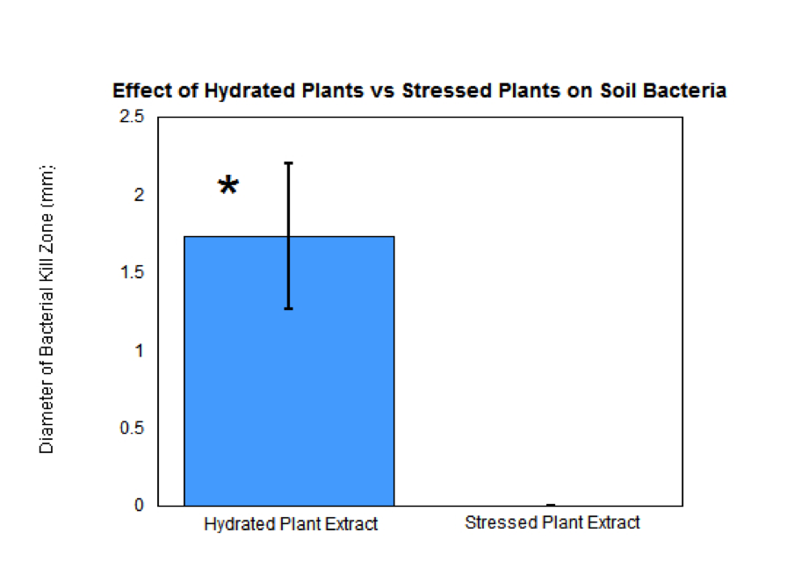
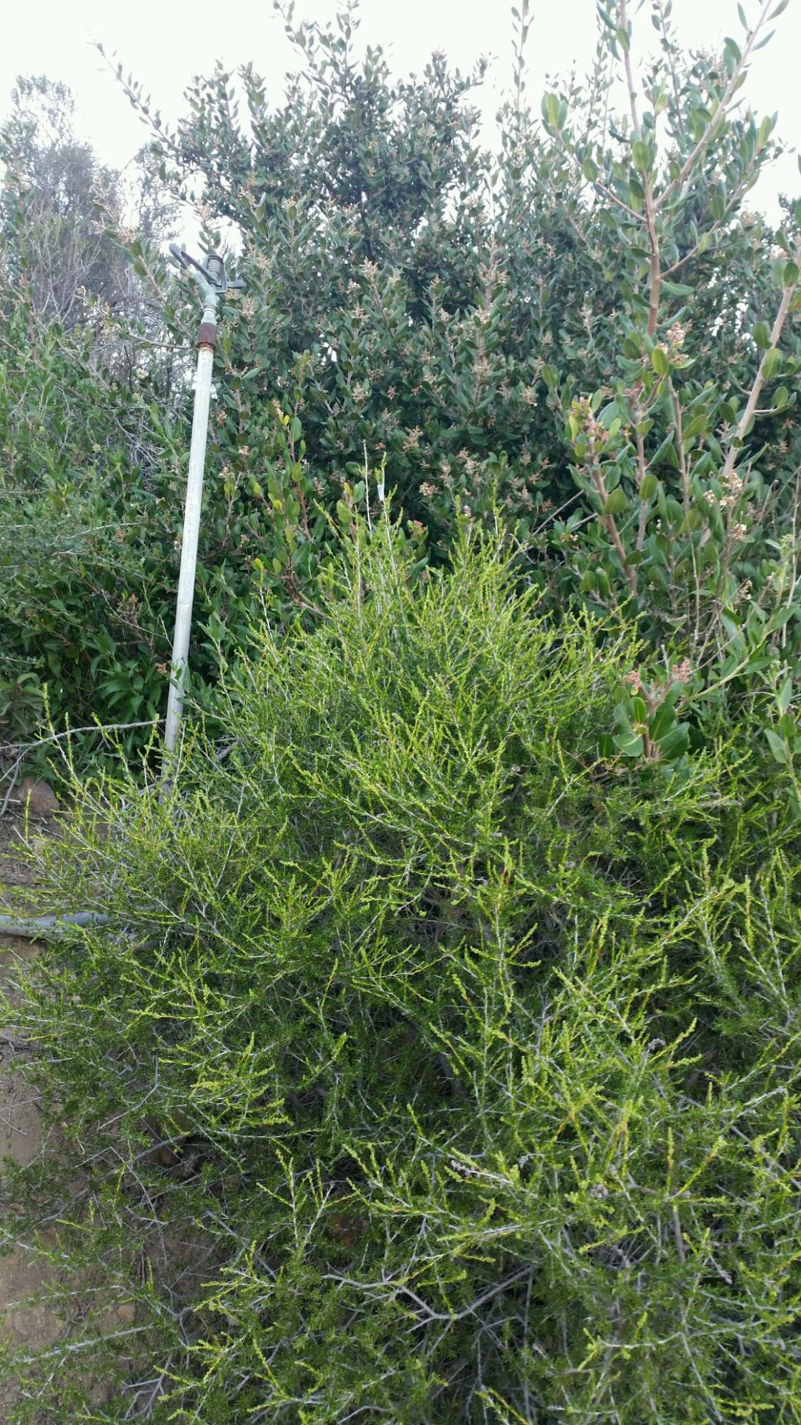
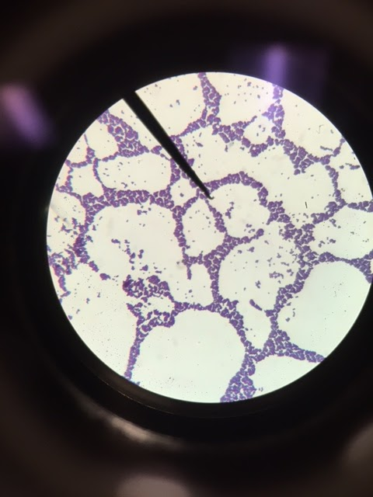
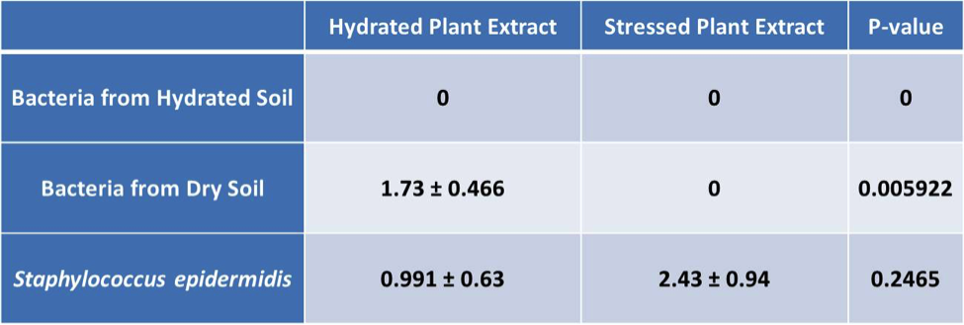
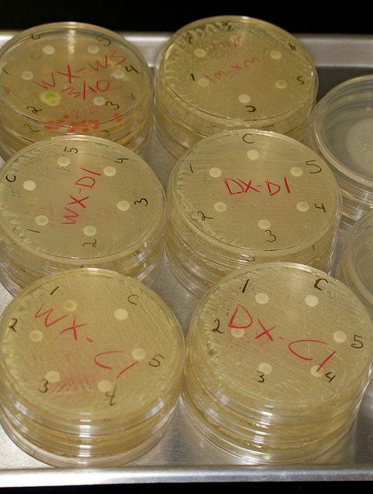
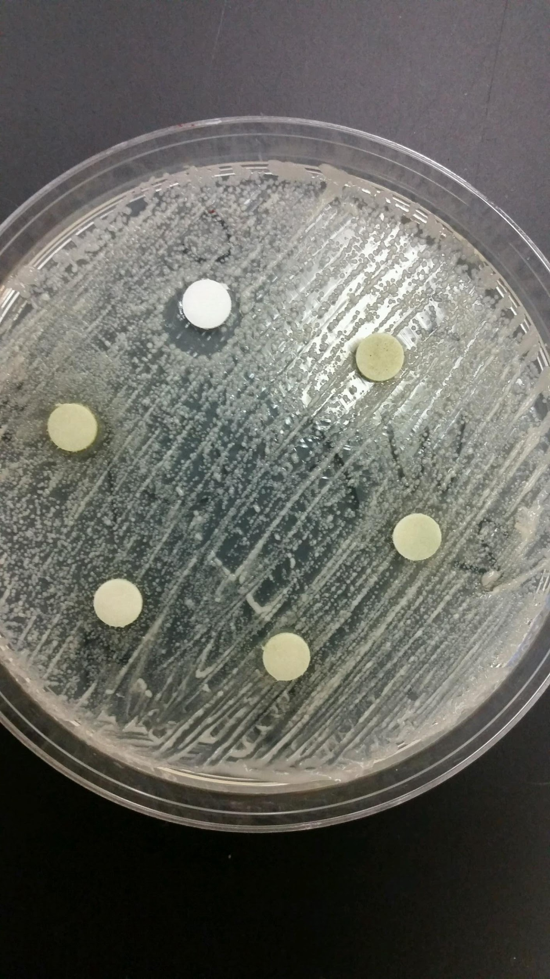
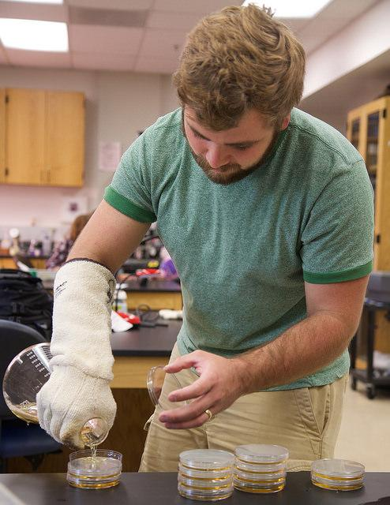
Effects of Drought on Antimicrobial
Properties of a Chaparral Indicator Species
— Adenostoma fasciculatum
Andrew Shute, Jennifer Duff, Salina Pearce-Harris
Biology 213: Botany, Spring 2016, Dr. Stephen D. Davis
Pepperdine University. Malibu, CA 90263
Abstract
Results
Discussion
The dominant plant type of Pepperdine’s Malibu campus is chaparral, of which an important indicator species is Adenostoma fasciculatum. It is known that A. fasciculatum produces compounds that are deadly to many bacteria. However, California is currently experiencing unprecedented drought, which is pushing plants well beyond their normal stress levels. In this study, we investigated the effect of drought stress on the ability of A. fasciculatum to inhibit growth of bacteria. We hypothesized that extract from drought-stressed plants would be better able to kill bacteria than hydrated ones, because the plant would be induced to produce more antimicrobial compounds under stress. To test our hypothesis, we collected samples from regularly-watered and drought-stressed A. fasciculatum plants. We then took soil samples from the hydrated collection site and the drought-stressed site. We created extract by mixing leaves from each sample and soaking them in ethanol. We then cultured bacteria from both soil types and picked 3 strains from each plate to represent the bacterial population. We isolated those strains and used the Kirby-Bauer method to examine the plant’s ability to inhibit bacterial growth. Additionally, we used the same methods to test Staphylococcus epidermidis to investigate the plant’s abilities to kill totally foreign bacteria. Our data showed that drought-stressed plants were unable to kill any soil bacteria, but hydrated plants were capable of inhibiting growth of bacteria cultured from dry soil. Moreover, both drought-stressed and healthy plants were able to inhibit growth of S. epidermidis. These results went against our original hypothesis, demonstrating that drought-stressed A. fasciculatum are less resistant to bacteria than healthy plants.
Ethanol extract from drought stressed Adenostoma fasciculatum leaf matter was found to have no effect on bacteria isolates from subcanopy soil samples from both well hydrated and drought stressed plants. Interestingly, plant extracts from regularly watered plants had no effect on subcanopy soil bacteria from a hydrated plant, but had a significant growth inhibition on subcanopy soil bacteria from a drought stressed plant. Although the entire sample set is not represented here, the statistically significant results indicate that drought stress will not only impact the delicate relationship between soil bacteria and Adenostoma fasciculatum but also the plants ability to produce known allelopathic and antimicrobial compounds.
It was hypothesized that allelopathic and antimicrobial compounds produced by, Adenostoma fasciculatum, would be present in greater quantities under chronic drought stress. Although much of the data was not usable due to the antimicrobial effects of the control ethanol on many of the bacterial cultures, the significant results indicate the opposite to be true. This indicates that when healthy, this plant will produce allelopathic and antimicrobial compounds in greater quantity than if chronically drought stressed.
Toxins in soil and leaf litter under the canopy of this plant—the soil from which studied bacteria were cultured—have been shown to be denatured and dispersed during dry seasons (1971, J. McPherson et Al). This indicates that soil bacteria under drought stressed plants were not exposed to as high a concentration of toxic compounds as those cultured from soil under hydrated plants. Therefore, soil bacteria under hydrated plants that were inhibited by phenolic and other toxic compounds presumably would have been pre-selected against, and thus only bacteria resistant to phenolic and toxic compounds present in the soil would have been present in the soil culture. Our significant results support this. Although the control soil bacteria cultures taken from a barren field appeared to have greater bacterial growth inhibition, the control ethanol exposure produced a zone of inhibition as well, thereby negating the data.
If repeated with water extract or water leachate, this investigation would likely yield much more compelling results (1964, B. Haines et Al). It is proposed that in future research, a water leachate, as described in McPherson et Al, or water extract would provide more representative results. This would be expected to better adhere to field conditions, as the compounds discussed are usually washed off by rainfall or dew, and by not by ethanol. Another future method could be to completely dessicate an ethanol extract and reconstitute the extract with distilled water, thereby removing the antimicrobial ethanol. It was also determined that a larger sample size of all tested variables as well as a greater diversity of test sites would yield results more representative of natural conditions.
The US Forest Service lists Adenostoma fasciculatum as a significant ethnobotanical and medicinal plant, for its historical use in the treatment of Syphilis by the Chumash Tribe of Southern California. This sparked additional interest in the possible treatment of other human bacterial infections with Adenostoma fasciculatum. Isolates of Staphylococcus epidermidis were exposed to extracts of both hydrated and drought stressed plant extracts, revealing l growth inhibition by both extracts. Surprisingly, the inhibitory effect of hydrated extract on the bacteria was less than that of the hydrated extract. However, the difference was not statistically significant. Additional studies may reveal similar antimicrobial effects in other pathogenic bacteria.
Interestingly, it has been suggested that the allelopathic effects of A. fasciculatum may be due less to the antimicrobial properties of the plant itself and more due to what may actually be a symbiotic relationship between the soil bacteria and the plant (1981, R. Kaminsky). Therefore, further research is needed to investigate whether the allelopathic properties of Adenostoma fasciculatum stem from its ability to produce antimicrobial compounds or from a symbiotic relationship with soil microbes (1999, O. Barazani; J. Friedman).
Introduction
Figure 1. Significant growth inhibition in drought stressed soil bacteria.
Figure 3. Image of healthy Adenostoma fasciculatum growing next to irrigation system below Pepperdine University’s Theme Tower.
Adenostoma fasciculatum is a chaparral indicator species found on coastal ridgelines of the Santa Monica Mountain range. This particular plant is commonly referred to as ‘Chamise’ or ‘Greasewood’, and it has been known to possess allelopathic and antimicrobial properties. For example, Native Americans have traditionally used A. fasciculatum to treat syphilis (1990, McMurray, Nancy E.) We presumed that there would be larger kill zones from plants under drought conditions because it was believed that the increase in stress would signal the plant to produce more antimicrobial compounds as a survival technique. Therefore, we hypothesized that the allelopathic and antimicrobial compounds produced by a chaparral indicator species, Adenostoma fasciculatum, would be present in greater quantities in response to chronic drought stress. In this study we cultured bacteria from wet and dry soils as well as Staphylococcus epidermidis. Then, we utilized the Kirby-Bauer method to spot extracts from hydrated and drought stressed plants onto bacterial lawns. We then measured the size of the kill zones using an electronic caliper. Finally, we analyzed the difference between hydrated and drought-stressed extracts in their ability to produce a kill zone on the bacterial lawns.
Average Size of Bacterial Kill Zones and P-Values
Materials and Methods
Figure 5. Microscope view of Staphylococcus epidermidis at 1,000x magnification with oil immersion.
Figure 2. Hydrated plant extract showed significant inhibition of drought stressed bacteria soil growth. Inhibition was also seen in S. epidermidis.
To begin this study our research team identified two growth sites of Adenostoma fasciculatum on Pepperdine University’s campus. The first growth site of A. fasciculatum was regularly watered by a sprinkler system located under the Theme Tower off Seaver Drive. Samples of the plant were also taken from a separate vegetation site that was exposed to drought conditions on the Dana Martel trail. We took branch samples from five A. fasciculatum plants from the hydrated site and five from the dry site. We also took a sample of soil from the watered collection site and the dry collection site. We then created extracts for each of our ten plants by stripping our samples of leaves, cutting the leaves with a razor blade, and soaking the leaves in seventy percent ethanol overnight. Then, we prepared petri dishes with a standard nutrient agar for our bacterial lawns. We added water to each of our soil samples to create a mud paste, then spread the mud on the agar plates to culture bacteria from each soil type. We isolated three strains of bacteria from each soil type and created lawns on the agar plates. We maintained a sterile environment throughout, using a ceramic loop sterilizer to sanitize loops before and after each plate. We then used the Kirby-Bauer method to spot ten microliters of extract from each of our plants onto plates of both soil bacteria types. We also included a control disc spotted with ten microliters of seventy percent ethanol on each plate. We incubated the plates for forty-eight hours, then measured bacterial inhibition zones around the disc for each extract using an electronic caliper. We measured the diameter of the kill zones at the widest point, then subtracted out the diameter of the disc to obtain the diameter of the kill zone alone. Additionally, we cultured bacteria swabbed from human skin and isolated Staphylococcus epidermidis. We then spotted extract on plates containing S. epidermidis lawns and measured the diameter of the resulting kill zones using the same methods stated above. We used a student t test to analyze significance of our data.
We analyzed our data using the student t test to evaluate significance. We found that extract from stressed plants was unable to kill any bacteria cultured from soil samples. The data also show that, while extract from hydrated plants was unable to kill bacteria taken from hydrated soil in the plant’s vicinity, they were capable of inhibiting growth of bacteria taken from dry, foreign soil (refer to Fig. 1). Moreover, there was a significant difference between the ability of the hydrated plant extracts and the stressed plant extracts to kill bacteria cultured from dry soil (see Fig. 2). Additionally, we found that both hydrated plants and stressed plants were able to inhibit growth of Staphylococcus epidermidis cultured from human skin (refer to Fig. 1).
Figure 4. Two photographs of inoculated petri dishes with visible kill zones.
Works Cited
Barazani, O.; Friedman, J. (1999) “Allelopathic Bacteria” Principles and Practices in Plant Ecology, Allelochemical Interactions. Vol. 1, Issue no. 10, pp: 149 - 163.
Haines, B.L.; Muller, C.H.; Muller, W.H. Department of Biological Sciences, University of California, Santa Barbara.(1964 Jan 31) “Volatile Growth Inhibitors Produced by Aromatic Shrubs” American Association from the Advancement of Science, Chemical Plant Competition. Vol. 143, Issue no. 3605, pp: 471 - 473.
Kaminsky, R.; The Ecological Society of America, (1981) “The Microbial Origin of the Allelopathic potential of Adenostoma fasciculatum H & A” Ecological Monographs. Department of Biological Sciences, University of California, Santa Barbara. Vol. 51, Issue no. 3, pp: 365 - 382.
McPherson, J.K. Department of Botany and Plant Pathology, Oklahoma State University. (1971) “Allelopathic Constituents of the Chaparral Shrub Adenostoma fasciculatum” Phytochemistry. Vol. 10, Issue no. 12, pp: 2925 - 2933.
McMurray, N. E. (1990) “Adenostoma fasciculatum”. In: Fire Effects Information System. U.S. Department of Agriculture, Forest Service, Rocky Mountain Research Station, Fire Sciences Laboratory. Web Accessed: April 6, 2016.
Conclusion
We found that both hydrated and drought-stressed plants are able to inhibit growth of S. epidermidis. Although drought-stressed plants are capable of killing foreign bacteria, we found that they are ineffective at killing bacteria found in the soil. In contrast, hydrated plants are capable of inhibiting growth of bacteria taken from dry soil. Thus, we concluded that drought conditions appear to diminish the ability of A. fasciculatum to kill soil bacteria in comparison to plants that are routinely hydrated. Additionally, the fact that A. fasciculatum produced an inhibitory effect on S. epidermidis opens the door to potential ethnobotanical implications. Further research in this area is required to fully address this possibility.
Acknowledgements
Figure 6. Photograph of Salina and Jennifer using micropipettes to apply extract to the petri dishes.
Figure 7. Photograph of Andrew preparing petri dishes with agar.
We would like to express our gratitude to Dr. Matthew Joyner, Dr. Jay Brewster, and Dr. Stephen Davis for the guidance and inspiration that our research group received from them. Furthermore, we would like to thank Pepperdine University’s Natural Science Division for their overall support and funding of this study.

