Slide 1


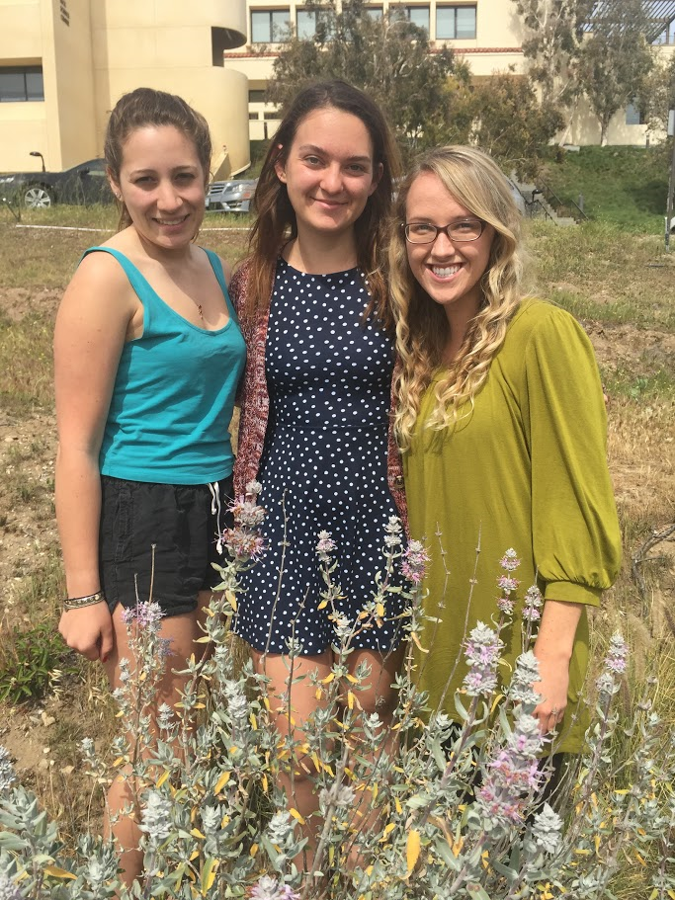

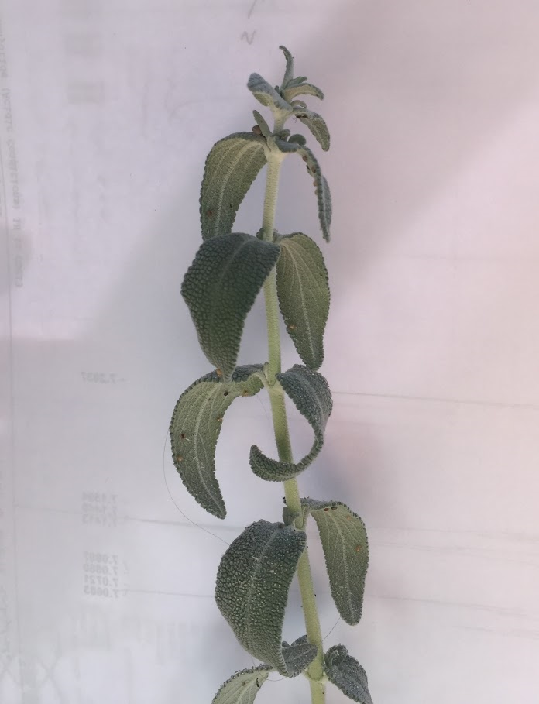
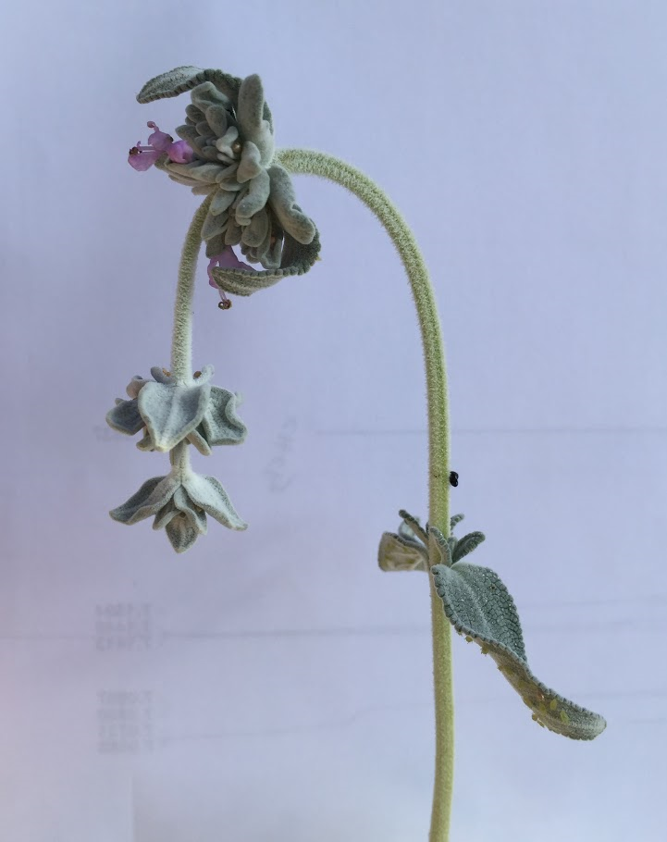
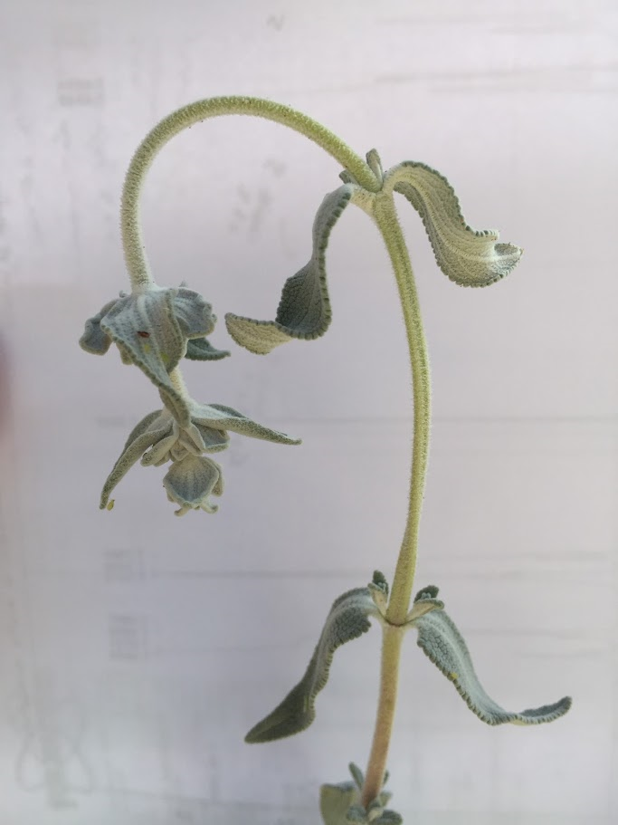
The Effect of Water Deficit on Photosynthetic Properties of Salvia leucophylla
Presented by: Brianna Scott, Theadora Ordog, and Alexis Lordi
Abstract
Results
Discussion
California has been in a severe drought in recent years due to anthropogenic warming, and it has had a major effect on chemical and physical properties of native plants. Salvia leucophylla, a common plant in Southern California, has evolved an adaptation to water stress through losing its leaves, known as a drought deciduous plant. Considering the increase of CO2 in the atmosphere, it is absolutely essential for leaves to retain their ability to photosynthesize to maintain the health of the environment through CO2 sequestration. The objective of this experiment was to see how drought levels affect the physical and chemical properties of Salvia leucophylla, also known as purple sage. Our prediction is that drought conditions will compromise the plant’s photosynthetic rate and stomatal conductance. We investigated this issue by creating three treatments: a control watered every other day, and two manipulated groups watered weekly and none at all. After two weeks, we measured the photosynthetic rate, stomatal conductance, ETR, qN and qP, Fv’/Fm’, and leaf temperature. Our results showed that there was a significant decrease of photosynthetic rate (p<0.0001), stomatal conductance (p=0.00239), and electron transport rate (p<0.0001) in the experimental plants. Thus, we were able to demonstrate the detrimental effects of drought conditions on native plants, providing evidence to the harmful consequences of climate change on plant function.
Salvia leucophylla is a native, C3 plant of California and has been able to adapt to the harsh conditions that come along with being in an environment that receives low amounts of rainfall. The data suggest that if water is limited, not only do the plants tend to lose more leaves but the rate at which plants photosynthesize decreases significantly (Figure 1). The extent of this pattern is observed most prominently in the droughted plant as the photosynthetic rate becomes negative as the plant shifts to photorespiration. These plants are releasing more carbon dioxide than oxygen. With an increase in carbon dioxide in the atmosphere, the greenhouse effect is enhanced, playing a major role in the climate change. Furthermore, the data show that stomatal conductance (Figure 2) and electron transport rate (Figure 3) decrease significantly when water is limited, as was the case for our two treatments of limited water. The decrease in qN suggests that the severe dehydration causes a great decline in the photoprotective abilities of the plant. This could possibly be due to the fact that this extent of dehydration has caused the plant to degrade its mechanisms. We observed an increase in leaf temperature as water was withheld from the plant, suggesting that the leaf is transpiring less, and cannot regulate its temperature properly. In addition to this, the stomata are opening less as water is increasingly limited because the plant is forced to adapt to reduce energy wastage. This will constitute a lower electron transport rate because the plant receives fewer photons when the stomata are more closed, therefore decreasing the electron transport activity necessary to carry out photosynthesis. These results are supported by a previous study (Poole ad Miller, 1975) that found that these plants had lower water potential and photosynthetic rates during the drought season. Our qualitative results showed a physiological difference between the treatments as shown in pictures in our results, as there is less turgor pressure in the plants that were denied water, causing wilting of the stem that is characteristic of a water-stressed plant. There are other physiological factors, including conduit diameter, that change an individual’s likelihood of experiencing drought-induced embolism (Hargrave, 1994). When compared to other species native to the Santa Monica Mountains, specifically the dominant chaparral, sage scrub has been shown to have a greater loss in hydraulic conductivity, as a part of the strategy for survival of extended drought periods, which decreases the individual’s short-term fitness but increases the individual’s likelihood of surviving the entirety of the drought (Kolb and Davis, 1994). Overall, our study provides evidence for the drastic effects that drought conditions, brought about both by natural and anthropogenic sources, can have on native plants and their ability to photosynthesize. Our results suggest that this damage to plants can further propagate the climate issue through the release carbon dioxide to the atmosphere through this specie’s mechanism of survival. Therefore, it is absolutely essential that humans respond to the issues of climate change in order to protect the health of the environment and maintain the synchrony of life essential for survival. Different types of plants have different mechanisms for surviving our harsh climate that will in turn have an effect on climate change itself.
A
Figure 1: Comparison of photosynthetic rates between control and treated plants. The One-Way ANOVA showed that there is a significant difference in photosynthetic rates (umol/m²s) among the three treatments (p<0.0001, df=17). Further post-hoc studies found that there is a significant difference between the control and droughted plants (p<0.0001) , and the control and weekly watered plants (p<0.0001). There is no significant difference between the weekly and droughted plants (p=0.514). The averages for the control, weekly, and droughted plants are 14.67, 0.159, and -1.03 respectively. Each bar represents the average value for the six plants in each treatment.
B
B
Introduction
Figure 2: Comparison of stomatal conductance between control and treated plants. The One-Way ANOVA showed that there is a significant difference in stomatal conductance (mmol/m²s) among the three treatments (p=0.00239, df=17). Further post-hoc studies found that there is a significant difference between the control and droughted plants (p=0.0017) , and the control and weekly watered plants (p=0.0025). There is no significant difference between the weekly and droughted plants (p=0.8483). The averages for the control, weekly, and droughted plants are 0.171, 0.0131, and 0.00457 respectively. Each bar represents the average value for the six plants in each treatment.
One of the biggest climate problems facing Southern California today is drought. Currently, thirty-five percent of California (including the majority of Los Angeles county) is facing exceptional drought, the most severe ranking of drought (Rippey, 2016), the worst drought California has experienced since 1901, caused primarily by low precipitation and anthropogenic warming (Williams et al, 2015). Many studies have been done to see how the native plants will respond to the water stress that the current drought has brought and will bring about in the future. In this experiment, we chose to focus on purple sage, Salvia leucophylla, as coastal sage plants have a strategy for dealing with water stress different from most of the plants native to the Santa Monica Mountains. S. leucophylla and most other coastal sage species are facultative drought deciduous, meaning that a plant will lose its leaves in response to water stress (Westman, 1981). Coastal sage is typically found at lower elevations than chaparral species, where lower levels or rainfall is experienced (Harrison et al, 1971). This strategy makes Salvia species extremely tolerant to drought and tissue dehydration (Kolb and Davis, 1994), although more sensitive to drought compared to other types of native plants in terms of decreased water potential and photosynthetic rates (Poole and Miller, 1975). Although this is a good strategy for longer-lived droughts (Harrison et al, 1971), it remains unclear exactly how long these plants are able to survive in this way, as the plants are typically only dormant for shorter dry seasons (Harrison et al, 1971). This may have an effect on the net carbon sequestration of the ecosystem, as each individual plant would have less of a capacity to photosynthesize and fix carbon dioxide. We predicted that drought conditions will affect the photosynthetic properties of Salvia leucophylla, in particular, drought conditions will compromise the plant’s photosynthetic rate and stomatal conductance, as the mechanisms the plant takes to survive the drought will cause a decrease in the plant’s fitness. We tested this by simulating two different drought conditions on potted individuals and comparing several factors relating to the plant’s fitness and ability to photosynthesize and fix carbon.
A
B
B
A
Figure 3: Comparison of electron transport rates between control and treated plants. The One-Way ANOVA showed that there is a significant difference in electron transport rates (mmol/m²s) among the three treatments (p<0.0001, df=17). Further post-hoc studies found that there is a significant difference between the control and droughted plants (p<0.0001) , and the control and weekly watered plants (p=0.0001). There is no significant difference between the weekly and droughted plants (p=0.316). The averages for the control, weekly, and droughted plants are 234.574, 85.319, and 55.334 respectively. Each bar represents the average value for the six plants in each treatment.
B
B
Treatment | Leaf Temperature (°C) | Fv'/Fm' | qP | qN
Control | 24.91 | 0.561 | 0.538 | 3.173
Weekly | 26.32 | 0.476 | 0.227 | 2.066
Droughted | 29 | 0.421 | 0.124 | 1.729
Table 1: Physiochemical measurements of S. leucophylla. This table represents the average values among the six plants in each treatment for each measurement. Overall, there is an increasing trend in leaf temperature with decreasing Fv’/Fm’, qP, and qN for the consecutive control, weekly, and droughted treatments.
Methods & Materials
In order to test the effect of drought conditions on Salvia leucophylla, we manipulated the water availability for the plant over a period of two weeks. We purchased 18 plants from a local nursery, which were randomly assigned to one of three treatments, and set up in the greenhouse at Pepperdine University three treatments with six plants for each variable. The first plant treatment was not watered over the study period (droughted), the second treatment was watered weekly, and the third treatment acted as our control by watering the plant every other day as the nursery had done. We watered the plants until the water filled to the top of the pot and then drained out of the bottom of the pot. At the end of the two-week period, we used the LI-6400 Portable Photosynthesis System to measure photosynthetic rate, stomatal conductance, electron transport rate, leaf temperature, photosynthetic quenching (qP and qN), and Fv’/Fm’. This was performed on a sunny day at 8am, and we tested one leaf per plant for a total of 18 measurements. We analyzed our results using Kaliedograph to perform a One-Way ANOVA test for our treatments, and plotted our results.
Physical changes in rigidity of stems due to drought
Conclusion
-The low and non-irrigated plants had a significant decrease in photosynthesis and stomatal conductance due to the closing of their stomata from water stress
-Increase in CO₂ levels with lower photosynthesis propagates the severity of climate change
Citations and Acknowledgements
H. A. Mooney, Harrison, A. T., & Small, E. (1971, September). Drought Relationship and Distribution of Two Mediterranean-Climate California Plant Communities. Ecology, 52(5), 869-875.
Hargrave, K. R., Kolb, K. J., & Davis, S. D. (1994, April). Conduit Diameter and Drought-Enduced Embolism in Salvia Mellifera Greene (Labiatae). Botany, 126(4), 695-705.
Kolb, K. J., & Davis, S. D. (1994, April). Drought Tolerance and Xylem Embolsim in Co-Occurring Species of Coastal Sage and Chaparral. Ecology, 75(3), 648-659.
Poole, D. K., & Miller, P. C. (1975, Summer). Water Relations of Selected Species of Chaparral and Coastal Sage Communities. Ecology, 56(5), 1118-1128.
Rippey, B. (2016). U.S. Drought Monitor- California. Lincoln, NE: National Drought Mitigation Center.
Westman, W. E. (1981, February). Diversity Relations and Succession in California Coastal Sage Scrub. Ecology, 62(1), 170-184.
Williams, A. P., Seager, R., Abatzoglou, J. T., Cook, B. I., Smerdon, J. E., & Cook, E. R. (2015, August). Contribution of Anthropogenic Warming to California Drought During 2012-2014. Geophysical Research Letters, 42(16), 6819-6828.
We would like to thank the Department of Natural Science at Pepperdine University for the use of their laboratory facilities, laboratory equipment, and funding. We would also like to thank Dr. Stephen Davis and Natalie Aguirre for their guidance and expertise.
Control
Watered once per week
Droughted

