Slide 1
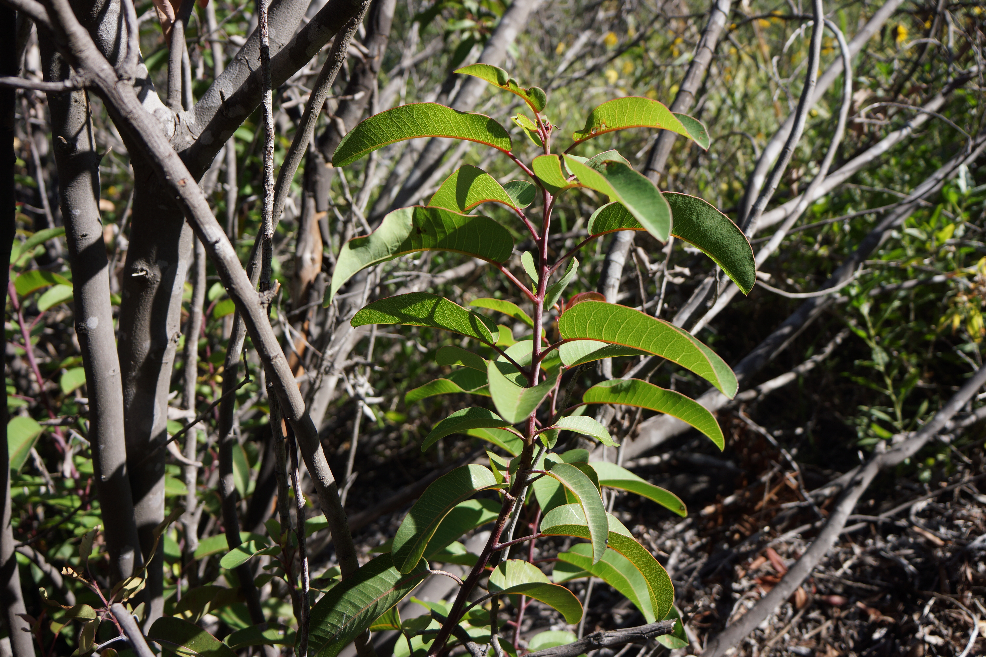
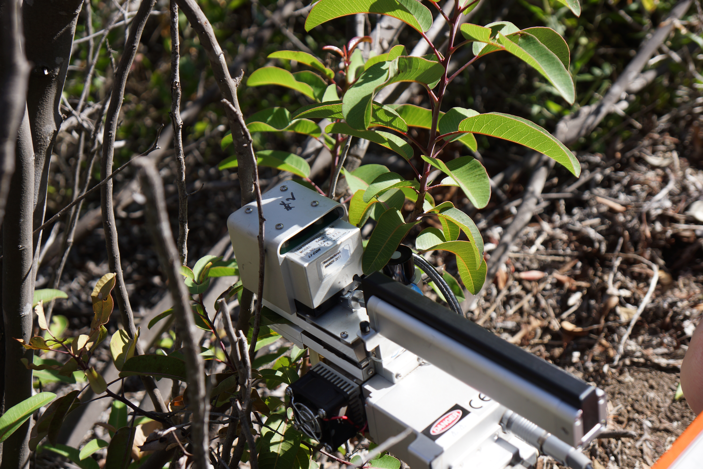

Effects of Drought on Malosma laurina Leaves
Suk Ho (Josh) Chang, Jingyi Chen, and Sarah B. Nelson
Natural Science Division, Pepperdine University, Malibu, CA 90263
Abstract
Results
Drought induced deformations in the chaparral plant Malosma laurina were observed following the lack of water availability during the years of 2013 and 2014. We hypothesized that the middle leaves grown during the drought would have the lowest productivity, the top post-drought leaves would have the highest productivity, and the bottom pre-drought leaves would have an intermediate level of productivity. We used a sample size of n = 6, representing 6 unique M. laurina plants. To obtain our data, we used the LI-6400 gas exchange system. In our comparisons of photosynthetic rate, stomatal conductance, and photosynthetic quenching of the top, middle, and bottom leaves of the M. laurina, we found no statistically significant difference between the different types of leaves. Contrary to our prediction, the middle leaf grown during the drought did not have the lowest level of productivity. Instead, our results showed that a decrease in plant productivity was correlated with the increase in leaf age, regardless of whether or not the leaf was grown during the drought.
In our analysis, we tested for statistical significance at the 95% confidence level (P ≤ 0.05). Photosynthetic rates (Pn rates) increased from bottom leaves to top leaves, as illustrated in Figure 1. The differences in Pn rate between each leaf had no statistical significance. Similarly, stomatal conductance increased from bottom leaves to top leaves, as illustrated by Figure 2. The difference in stomatal conductance was only statistically significant between the bottom and top leaves, as indicated by Figure 2. Photosynthetic quenching also increased from bottom leaves to top leaves and showed no statistical significance. Conversely, nonphotosynthetic quenching decreased from bottom leaves to top leaves and showed no statistical significance. These data are illustrated in Figure 3.
B
Conclusion
AB
M. laurina plants are known for their resistance to drought, with root systems that extend >40m below ground to tap into deep water reserves. The results of our gas exchange analysis of drought leaves vs. pre-drought and post-drought leaves suggest that drought does not have a significant effect on the productivity of individual leaves. Our results also suggest that the effects of age on a leaf are greater than the effects of drought. This adds to the findings of previous studies that have revealed the ability of M. laurina to survive and thrive in extreme conditions, such as drought or fire.
Future research might explore the effects of drought on gas exchange rates during, rather than after the drought. This research might also include the leaf-areas of drought vs. non-drought leaves in order to calculate the full impact of drought on the entire plant, rather than individual leaves alone.
A
Introduction
Recent escalations in global temperature have raised concerns regarding plant productivity in changing climate conditions. California was no exception to these abrupt temperature changes, especially during the years of 2013 and 2014. Along with unusually warm temperatures, the statewide accumulated precipitation was recorded to be less than 34%, and California was declared to be in a state of drought emergency (Swain et al.). As a result of the climate change and subsequent decrease in water availability, physical leaf deformations in the chaparral plant, Malosma laurina, have been observed over the past few years. Leaves grown during the drought period exhibit a wrinkled leaf texture as well as a decrease in the overall size of the leaf in comparison to leaves grown before and after the drought. In order to explore the effects of the drought on the plant productivity of M. laurina, our group set out to observe the gas exchange levels of the drought leaves in comparison to the pre-existing and newly formed leaves. We hypothesized that the effects of the drought would cause the leaves formed during the drought to be less productive than those formed either before or after the drought.
Figure 1: Photosynthetic rate of bottom, middle, and top leaves in M. Laurina. Error bars represent ±1 SE, n= 6. Using ANOVA, P=0.1469 for top vs. bottom leaves, P=0.5599 for top vs. middle leaves, and P=0.3654 for middle vs. bottom leaves.
Figure 2. Stomatal conductance in bottom, middle, and top leaves of M. Laurina. Error bars represent ±1 SE, n= 6. Using ANOVA., P=0.016 for top vs. bottom leaves, P=0.0904 for top vs. middle leaves, and P=0.3796 for middle vs. bottom leaves. Difference in letters indicates significant difference at P <0.05.
A
B
Literature Cited
Field, C. and Mooney, H. A. (1983). Leaf age seasonal effects on light, water, and
nitrogen use efficiency in a California shrub. Oecologia. 5.2-3:348-355.
Swain, D., Tsiang, M., Haugen, M., Singh, D., Charland, A.,Rajaratnam, B., and
Diffenbaugh, N.S (2014). The extraordinary California drought of 2013-2014:
character, context, and the role of climate change. Bull Am Meteorol Soc. 95.7: S3-
S7.
Acknowledgements
This research was supported by funding from the Natural Science Division of Pepperdine University.
Materials and Methods
Figure 3. A. Photosynthetic quenching (Qp) of bottom, middle, and top leaves for M. Laurina. Error bars represent ±1 SE, n= 6. Using ANOVA, P=0.2107 for top vs. bottom leaves, P=0.2782 for top vs. middle leaves, and P=0.8577 for middle vs. bottom leaves. B. Nonphotosynthetic quenching (Qnp) of bottom, middle, and top leaves for M. Laurina. Error bars represent ±1 SE, n= 6. Using ANOVA, P=0.3806 for top vs. bottom leaves, P=0.6783 for bottom vs. middle leaves, and P=0.6379 for middle vs. top leaves.
Our study was conducted on six different specimens of Malosma laurina along the Dana Martel Trail at Pepperdine University. Each specimen exhibited a pronounced difference between leaves produced during a drought period and leaves produced before and after the drought. The leaves exhibited a pattern of big-small-big corresponding to the water availability during leaf production (where big leaves were produced during higher water availability and small leaves were produced during drought).
A LI-COR 6400 Gas Exchange System was used to measure gas exchange rates and other properties of each leaf, including photosynthetic rate, stomatal conductance, CO2 internal, leaf temperature, VPD, fluorescence, photosynthetic quenching, and non-photosynthetic quenching. Three separate leaves were measured for each specimen, including one big pre-drought leaf (bottom), one small drought leaf (middle), and one big post-drought leaf (top). The measurements obtained by the LI-COR 6400 were then interpreted by statistical analysis using KaleidaGraph systems.
Discussion
Although most of our data hold no statistical significance, they present a pattern that gives insight into the effects of drought on M. laurina. The data we obtained through our experiment show a clear distinction between the productivities of pre-drought, drought, and post-drought leaves. The pre-drought leaves are least productive with the lowest average Pn rate, Qp, and stomatal conductance. The drought leaves are the second best producers, with the second best average Pn rate, Qp, and stomatal conductance. The post-drought leaves are the most productive, with the highest average Pn rate and Qp as well as a stomatal conductance that is significantly greater than that of the bottom leaves. The trend that our research presents matches that of a plant not subjected to drought, in which leaf productivity correlates inversely with leaf age (Field et al.).
These findings contradict our hypothesis that drought leaves are the least productive leaves in a plant that had undergone severe drought. However, the data we obtained provide new insight into the resilience of Malosma laurina, which is already known to be a highly drought tolerant plant. Although these data suggest that drought does not affect overall plant productivity, other variables are important to take into account. For instance, the drought leaves of M. laurina are both smaller and thicker than the pre-drought and post-drought leaves. The size and thickness of leaves both affect the amount of light energy that a leaf can convert into chemical energy via photosynthesis, so both of these factors would need to be taken into account in order to fully understand the effects of drought on a plant like M. laurina.

