Slide 1

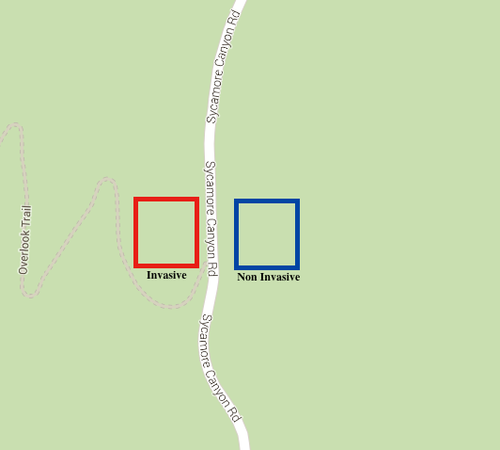
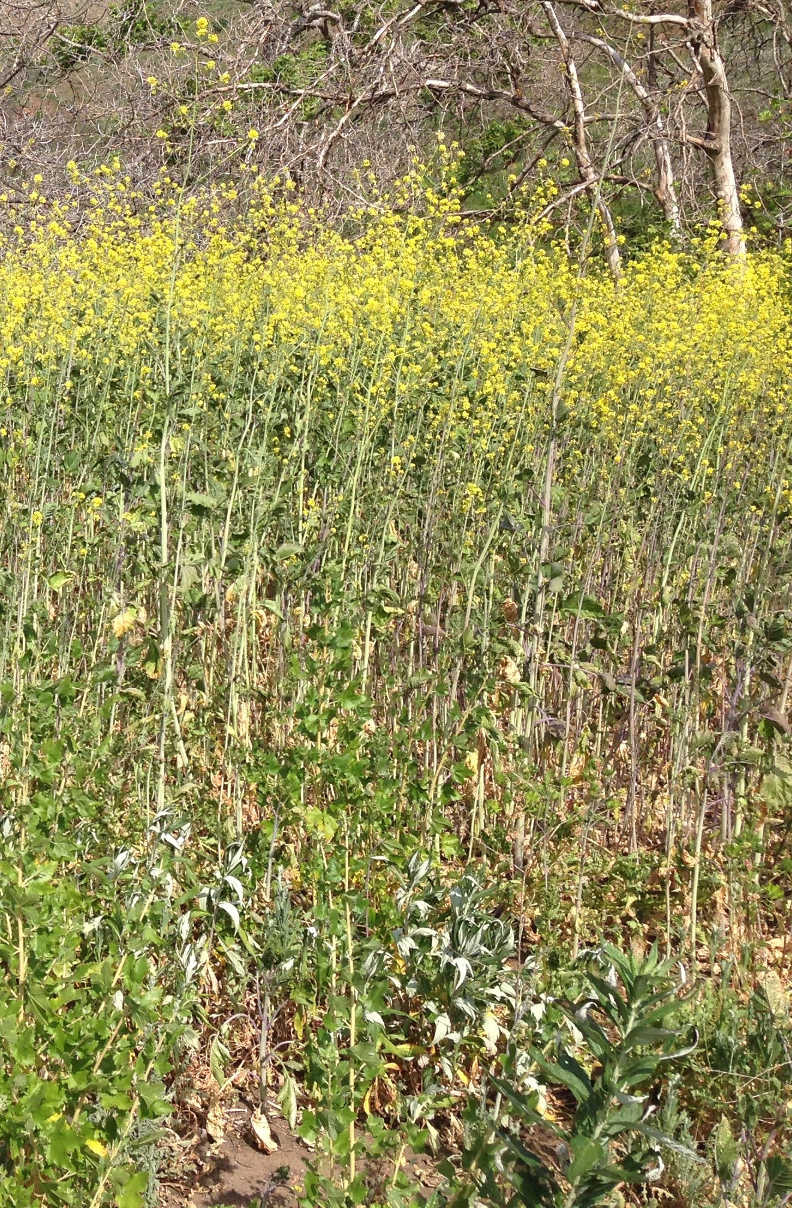
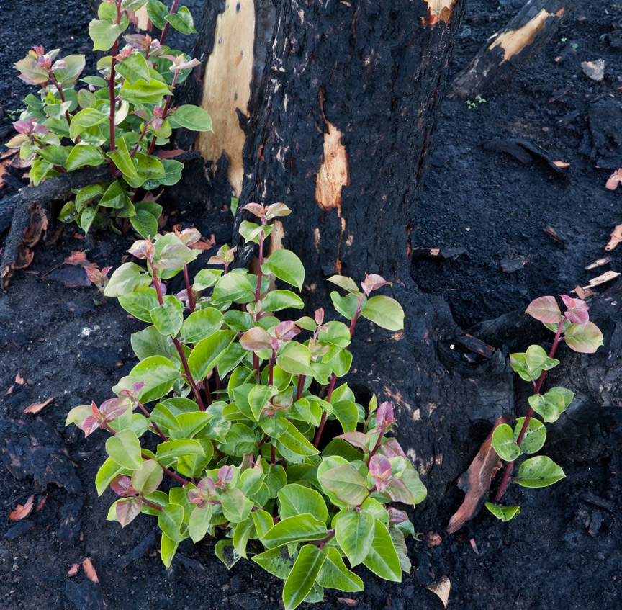
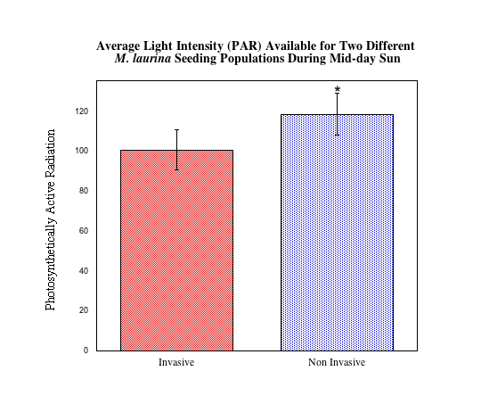
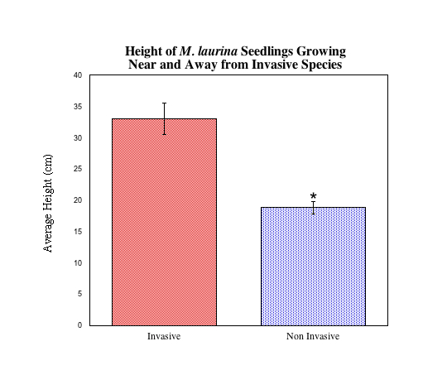
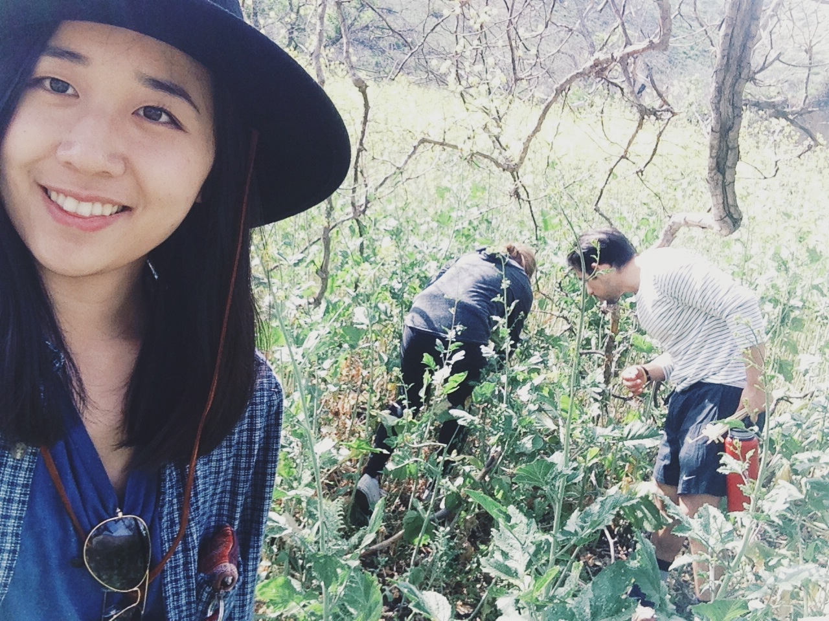
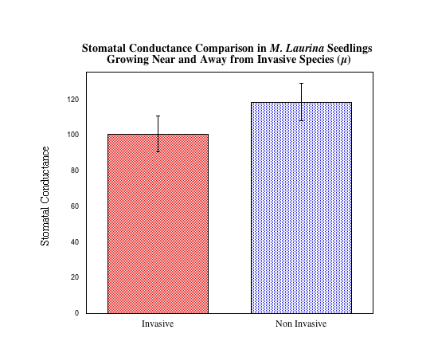
Fitness Parameters in Malosma laurina Seedlings
Growing Near and Away from Invasive Brassica nigra
Natalie M. Aguirre, Agustin Vargas, Phoebe Shin
Natural Science Division
Pepperdine University, Malibu California 90263
Abstract
Results
Conclusion
In this study we aim to assess the photosynthetic rate of native Malosma laurina (M. laurina) seedling, in comparison to M. laurina seedlings growing amongst several hundred B. nigra invasive plants. We predicted that there will be a difference in the stomatal conductance of each population. We measured photosynthetically active radiation (PAR), seedling height, and stomatal conductance of two isolated populations of M. laurina seedlings. One population grows near B. nigra, an invasive specie, and the other only grows amongst native plants. We found that M. laurina seedlings growing near weeds was significantly taller than the population of M. laurina growing away from any invasive weeds. Seedling heights were directly correlated to a statistically significant (*ɑ=0.05, P-value < 0.0001) different amount of light they were exposed to. There was no significant difference (ɑ=0.05, P-value < 0.2221) in stomatal conductance between the two populations. M. laurina seedlings compensate for a lack of light exposure when grown amongst invasive species by allocating more resources to extend their shoot length.
Figure 1
Figure 2
Figure 3
Invasive species, such as the Black Mustard, limits resources for its neighboring, native plants. This study shows how a significantly less amount of light received by M. laurina seedlings, growing amongst weeds, causes the seedlings to allocate more energy to lengthening shoot height. The two populations surveyed in this study have a significantly different average shoot height, due to a dramatic change of light availability, in order to produce the same amount of stomatal conductance. The results provide insight of one example in which an invasive specie of plant can affect the overall growth of a native population. Other factors affecting native plant growth, in addition to that of light availability to seedlings, may include: the increased competition for minerals, and water availability to seedlings in the presence of weeds. These factors play a large role in a plant population overall fitness and photosynthetic rates. Ultimately, the presence of an invasive species causes a difference in the allocation of energy and resources by a native population. The results suggest that landscapes composed of large populations of invasive species, out-competing native species, may have more clear understanding to why native species are not performing or growing as they should. In order to broaden this understanding, future studies may measure photosynthetic rate as well as dry root mass to better understand where the plant is expending energy.
Figure 1: This image depicts the site where the study was performed. The site was chosen because it contained a particularly interesting population dynamic. On the right side of the road, the majority of the M. laurina seedlings were either isolated from all other plants, or growing along side mature M. laurina. On the left side of the road, the seedlings were growing along side B. nigra.
Introduction
Figures 2 & 3: The images above depict the sites of study showing the two different groups of samples. Figure 2 shows the M. laurina seedlings alongside B. nigra. Figure 3 shows an M. laurina growing along side nothing else.
The Mediterranean climates of California; dry summers, wet winders, and various fires, make it so that Chaparral shrubs can thrive (Halsey, 2007). Chaparral is composed of drought tolerant plant species adapted for sprouting after fire. Sycamore Canyon, located in the coastal mountain range of the Santa Monica Mountains, is diverse in vegetation types as it is home to both invasive and native plants such as Brassica nigra (B. nigra) and Chaparral shrubs. In fact, 21% of North American flora is composed of invasive species that are in direct competition with native plants (Rejmanek, 2000).
In the early 1900’s an increase in international trade paralleled an increase of accidental and intentional introduction of exotic invasive species into the U. S. (Keane, 2002). Black mustard, B. nigra, was introduced to California by the Spanish who used the weed to identify marked paths as they explored the new lands. Often times, invasive species become successful in new environments and can outcompete native plants. One of the reasons being is that they are better able to thrive in new environments that lack predatory herbivores because they expend less energy to herbivory deterrents which can then be invested in seedling growth.
The study of invasive species first began with Elton’s 1958, The Ecology of Invasive Animals and Plants (Rejmanek, 2000). Since then, there is increasing evidence and theories to suggest invasive species are effecting the non-native lands they are being introduced to. There are three leading theories that describe the success of invasive plants (Doorduin 2011). These theories differ in the reasoning as to how invasive species grow and succeed rapidly. However, all three theories agree on that rapid growth of invasive species may potentially lead to a change in the population of an ecosystem. The introduction of invasive plant species in an ecosystem is often a cause for a shift in growing of the native plant population due to the success of invasive plants. Much like the introduction of B. nigra into California, many invasive plant species have altered the competitiveness of native plant survival throughout much of California.
In this study we aim to assess the photosynthetic rate of native Malosma laurina (M. laurina) seedling, in comparison to M. laurina seedlings growing amongst several hundred B. nigra invasive plants. We predicted that there will be a difference in the photosynthetic rate of each population. The study site, located in Sycamore Canyon in the Santa Monica Mountains, contains two populations of M. laurina seedlings separated by a dirt road. The measurements recorded for analysis on the two populations were stomatal conductance of leaves, heights of seedlings, and photosynthetically active radiation (PAR) at seedling height level.
Acknowledgments
Figure 4: Average light intensity was measured using the ACCUPAR LP80. It was shown that the sample population of M. laurina seedlings growing near invasive species of B. nigra were exposed to less amounts of light than the population of M. laurina seedlings growing away from B. nigra. The mean was graphed and a Student’s t-test showed a statistically significant difference between both populations (*ɑ=0.05, P-value < 0.0001).
Figure 5: Average height (cm) of each population was measured from the ground to the tip of the shoot apical meristem. The data collected showed a significantly larger height of M. laurina seedlings population growing near invasive B. nigra weeds in comparison to a control population of M. laurina seedlings. The mean was graphed and a Student’s t-test was performed and showed a statistically significant difference between the average shoot height of each population of (*ɑ=0.05, P-value < 0.0001).
Our research was funded by the Natural Science Division of Pepperdine University, Seaver college. We would like to thank Dr. Davis for providing us with the knowledge necessary to ask questions worthy of scientific research. We would also like to thank our Lab assistant, Lorelle Knight for driving us out to sycamore canyon for the first time. Lastly, we would like to thank each of our researchpartners that committed to the journey of science together.
Works Cited
Doorduin L.J., Vrieling K. (2011). A review of the phytochemical support for the shifting defence hypothesis. Phytochemistry Reviews. doi: 10. 1007/s11101-010-9195-8.
Dolferus R., (2014). To grow or not to grow: A stressful decision for plants. Plant Science. 229: 247-261.
Halsey. R. H., (2007). Chaparral: Pure california. Fremontia. 35(4):2-7.
Keane R. M, M. J. Crawley, (2002). Exotic plant invasions and the enemy release hypothesis. Trends in Ecology and Evolution. 17(4):164-170.
Kurepin L.V., Pharis R.P., (2014). Light signaling and the phytohormonal regulation of shoot growth. Plant Science. 229: 280–289.
Rejmanek M., (2000). Invasive plants: approaches and predictions. Austral Ecology. 25:497–506.
Figure 6: Average stomatal conductance (μmol/m2s) was measured using the SC-1 porometer and measurements were recorded in Sycamore Canyon at midday. It was shown that both M. laurina populations, growing near and away from invasive B. nigra, have no significant difference of stomatal conductance. The mean of the data was graphed and a Student’s t-test was performed showing no statistical difference in stomatal conductance (ɑ=0.05, P-value < 0.2221).

