Slide 1
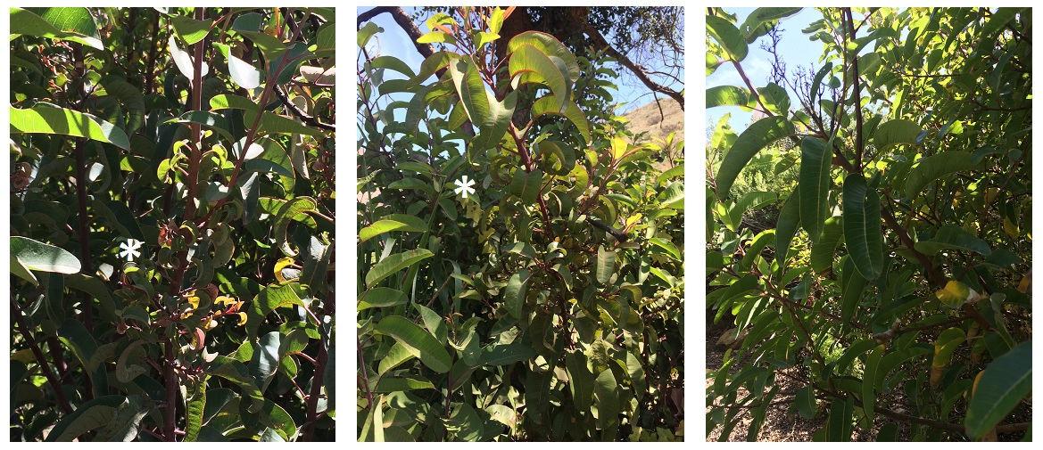
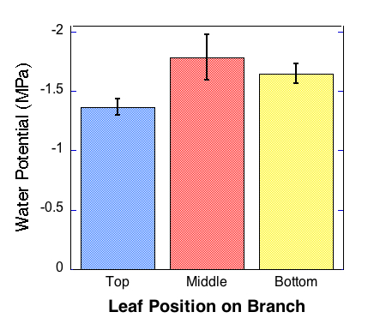
Morphological Changes in Malosma laurina Due to Prolonged Drought in the Santa Monica Mountains
Grace S. M. Bae, Majie C. Foster, MaryElizabeth S. Stein, Mariah K. Taylor
Pepperdine University, Natural Science Division, 24255 Pacific Coast Highway, Malibu CA 90263
Abstract:
Observations of Malosma laurina seedlings in Sycamore Canyon, Malibu, CA, exhibit abnormally small and wrinkled leaves. We propose that the prolonged drought in California’s Santa Monica Mountains has lead to physical malformations indicative of water strain in the leaves of M. laurina plants. In this experiment, we tested water relations of six M. laurina plants found on Pepperdine University’s Malibu campus showing similar leaf patterns to those found in Sycamore Canyon. Six M. laurina plants devoid of the abnormal leaf growth patterns functioned as our control group. Stomatal conductance, water potential, and leaf mass to area data was gathered using LI-1600 Steady State Porometer, Scholander-Hammel Pressure Chamber, LI-3100 Area Meter, and enclosed scale measurements. ANOVA and Student’s t-Test reports indicate a significant difference in total stomatal conductance between control and test plants, (93% confidence level). Our tests furthermore indicate a statistical difference in total stomatal conductance between abnormal leaves compared to relatively normal leaves on the same branch of experimental plants, (P = 0.014). Water potential in wrinkled leaves is more negative than mature leaves closer to the apical meristem of the same branch, (P = 0.02). Leaf mass to area ratios show no statistical differences but reflect normal thickness trends. Evidence supports our conclusion that prolonged drought has caused abnormal leaf growth in M. laurina plants within the Santa Monica Mountains.
Study Site:
In this experiment, identified test subjects were located along the Dana Martell Trail within the Pepperdine University campus, Malibu, CA, and were not located near a steady water source. Control plants were located in a steadily irrigated landscape within Pepperdine University’s Malibu campus. Leaf samples were extracted from test and control plants and studied in the Pepperdine University, Seaver campus, Natural Science Division laboratory facility.
Discussion:
There was no significant difference in total stomatal conductance among control M. laurina leaves. However, there was a statistical difference in total stomatal conductance between normal and wrinkled plants, (Figure 2), and leaf samples at different positions on the branches of wrinkled M. laurina. The higher total stomatal conductance in control plants indicates that they are healthier than wrinkled subjects. This is most likely due to their steady access to water through irrigation. ANOVA comparisons between the positions of leaves on wrinkled M. laurina show that the total stomatal conductance of the small wrinkled leaves is significantly higher than those above and below the wrinkled region on the branch. This may be due to a greater number of stomatal openings, as McCree and Davis’s 1974 study suggests that cell growth during drought is smaller and more compact than growth in wet seasons. Dietmar et al. suggested that drought signals cause abscisic acid to stimulate closure of stomata, (2011). An alternative explanation for the higher total stomatal conductance in wrinkled leaves as compared to leaves above and below the wrinkled region on the branch, may be the influence of abscisic acid. Exposure to abscisic acid for long periods of time, such as an extended drought, may impact the rate or size of leaf cell growth. If this is the case, the higher stomatal conductance in the small wrinkled leaves may indicate that there is an advantage to the leaf distortion during prolonged drought.
Water potential of wrinkled leaves compared to the relatively normal leaves in position 1 was significantly more negative in M. laurina test plants, (Figure 3). Negative water potentials indicate reduced water availability and water stress on the plant, (Poole and Miller 1975). This supports our hypothesis that the presence of wrinkled leaves indicates stress on M. laurina plants due to drought conditions.
There was no statistical difference in leaf mass to area ratios between leaf positions on test M. laurina plants, (Figure 4). This may contradict the suggestion that there are more stomatal openings on the small wrinkled leaves of test plants. The general trend in leaf mass to area ratios between leaf positions on control and wrinkled M. laurina specimens, indicates that leaves are denser as distance from the apical meristem increases. This is a typical trend, as mature leaves are exposed to UV radiation longer than new growth.
Figure 1. Malosma laurina. (left to right): Sycamore Canyon, Malibu, CA, post fire seedlings; Pepperdine University, Dana Martell Trail, Malibu, CA, test specimens; Pepperdine University, Malibu, CA, irrigated (control) specimens. Asterisk signifies presence of abnormal (small and wrinkled) leaves.
Stomatal Conductance:
Figure 2. Total Stomatal Conductance M. laurina. Comparison of stomatal conductance (g_{s}) between the uncharacteristic “wrinkled” leaves and “normal” leaves observed at different branch positions of the native chaparral shrub, Malosma laurina, along the Dana Martell Trail at Pepperdine University, Malibu campus. Mean values, + 1 SE, n = 6. Student’s t-Tests indicate that control leaves averaged > 0.11 mmol*s⁻¹ greater in total stomatal conductance compared to those of M. laurina (93% confidence level). A One-Way ANOVA test revealed that total stomatal conductance in “wrinkled,” middle leaves averaged 0.078 mmol*s⁻¹ lower than those of above and below the wrinkled leaf region, P = 0.014.
Introduction:
Malosma laurina, a native species to California’s Santa Monica Mountains, is distinguished by its deep tap root that can reach depths greater than 12 m, (DeSouza et al. 1986). This characteristic aids M. laurina in resistance to drought while facilitating continual growth, (Watkins and DeForest 1941). Normal M. laurina leaves are 1.57 cm - 2.36 cm in length and smooth, (Quinn et al. 2006). However, recent observations of M. laurina seedlings in Sycamore Canyon, Malibu, CA showed unusual growth patterns. Regions of abnormally small and wrinkled leaves were located between regions of normal leaf growth, (Figure 1). This pattern was likewise observed in M. laurina plants that had been growing away from irrigation on Pepperdine University’s Malibu campus, (Figure 1). Irrigated M. laurina on Pepperdine University’s Malibu campus did not show the pattern, (Figure 1). Currently, Southern California is experiencing one of its worst droughts in history, (Mann and Gleick 2015). We suspected the abnormalities in M. laurina leaf appearances to be a result of the severe drought.
In this experiment, we demonstrate that distortion in the M. laurina leaves is due to the extensive drought that has induced water stress on the species. Despite this species’ exceptionally deep tap root system, physiological abnormalities in growth may be indicative of a drop in the water table below historic levels.
Water Potential:
Figure 3. Water Potential in Wrinkled M. laurina. A bar graph comparing water potential and hydration status of M. laurina leaves at different characteristic regions of their branches. Mean values, + 1 SE, n = 6. ANOVA and Fisher’s LSD tests show a significant difference in the water potential between leaves at position 1 and 2 of wrinkled test plants of - 2.5 bars, P = 0.02.
Methods and Materials:
We analyzed six control and six treatment Malosma laurina specimens. Control plants were located near an irrigation system, which provided a steady water supply during drought conditions. Treatment plants were located away from irrigation systems throughout the drought. Three positions were studied on a single branch of each selected plant. All leaf distances were measured from the apical meristem in the following position ranges:
Position 1: First adult leaf between apical meristem to 0.94 cm.
Position 2: 0.98 cm - 2.17 cm
Position 3: > 2.20 cm from the apical meristem.
Field data was collected at midday for all specimens. Using an LI-1600 Steady State Porometer, data points were taken for temperature, relative humidity, light levels, transpiration rate, stomatal conductance, and flow rate for each target leaf. Leaf surface temperature was measured using an Extech-600 IR Thermal Condensation Scanner. Once these measurements were taken, target leaves were clipped at the petiole closest to the stem, placed in plastic bags with trapped exhaled air, and transported in an ice chest to the laboratory. In laboratory examination, we removed phloem from leaf petioles by scraping with a sharp edge. We then found leaf water potential utilizing a Scholander-Hammel Pressure Chamber. Petioles were then clipped, and leaf area was measured using an LI-3100 Area Meter. Finally each leaf was placed in a separate envelope and incubated at 60°C for approximately 48 hours. Dehydrated leaf masses were found using an enclosed scale. Data was analyzed using the KaleidaGraph program.
Conclusions:
Significant statistical differences were seen in the total stomatal conductance and water potential of wrinkled leaves compared to normal leaves in M. laurina test plants.
There was no statistical difference in leaf mass to area ratios among M. laurina plants.
Further studies should investigate whether stress on the M. laurina of Santa Monica Mountains reflected in the appearance and water pressure of wrinkled leaves is due to the duration of the drought or a depression of water tables.
Further studies should also explore the effect of abscisic acid on leaf growth during prolonged drought as a possible mechanism to support McCree and Davis’s 1974 study.
Leaf Mass to Area Ratio:
Figure 4. Leaf Mass to Area Ratio M. laurina. Comparison of leaf mass to area ratios (Specific Mass Area) between the experimental and the control leaves of M. laurina. Student t-Tests and One-Way ANOVA tests indicate no significant statistical difference in both experimental and control comparisons as well as leaf mass to area ratios among leaf positions on branches. A visual, upward trend in mass to area ratio is, however, suggestive of leaves with increasing thickness and densities, from top to bottom positions.
Acknowledgements and References:
We would like to thank the Department of Natural Science at Pepperdine University for the use of their laboratory facilities, transportation necessities, and laboratory equipment. We would also like to thank Dr. Stephen Davis and Lorelle Knight for their guidance and expertise.
DeSouza J, PA Silka and SD Davis. 1986. Comparative physiology of burned and unburned Rhus laurina after chaparral wildfire. Oecologia. 71.1: 63-68.
Dietmar G, T Maierhofer, KAS Al-Rasheid, S Scherzer, P Mumm, A Liese, P Ache, C Wellmann, I Marten, E Grill, T Romeis, and R Hedrich. 2011. Stomatal closure by fast abscisic acid signaling is mediated by guard cell anion channel SLAH3 and the receptor RCAR1. Science Signal 4.173: ra32.
Mann ME and PH Gleick. 2005. Climate change and California drought in the 21st century. Proceedings of the National Academy of Sciences of the United States of America 133.13: 3858-3859.
McCree KJ and SD Davis. 1974. Effect of water stress and temperature on leaf size and on size and number of epidermal cells in grain sorghum. Crop Science 14.5: 751-755.
Quinn RD and SC Kelley. 2006. Introduction to California chaparral. Berkeley and Los Angeles: University of California Press: 47-121.
Poole D and PC Miller. 1975. Water relations of selected species of chaparral and coastal sage communities. Ecology 56.5: 1118-1128.
Watkins VM and H DeForest. 1941. Growth in some chaparral shrubs of California. Ecology 22.1: 79-83.

