Slide 1

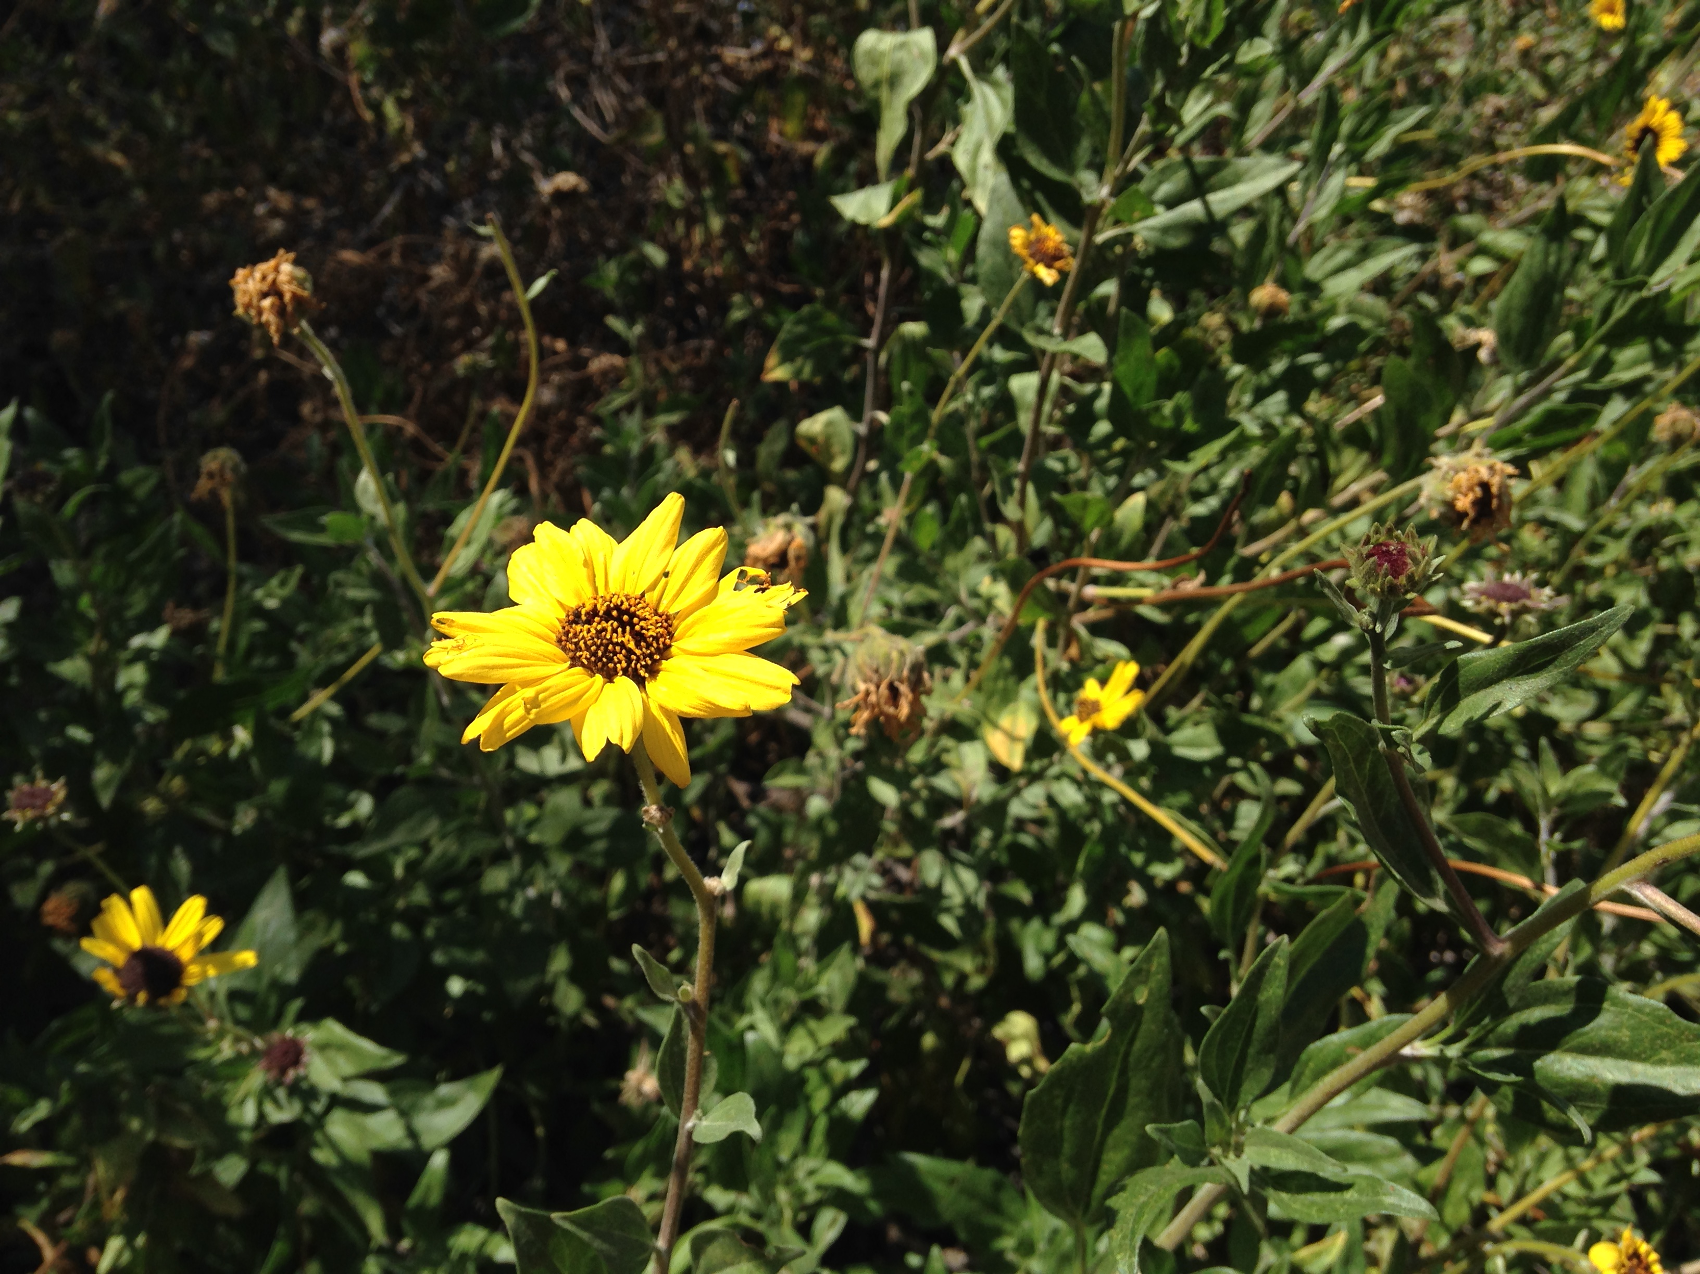
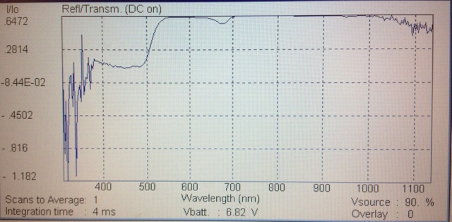
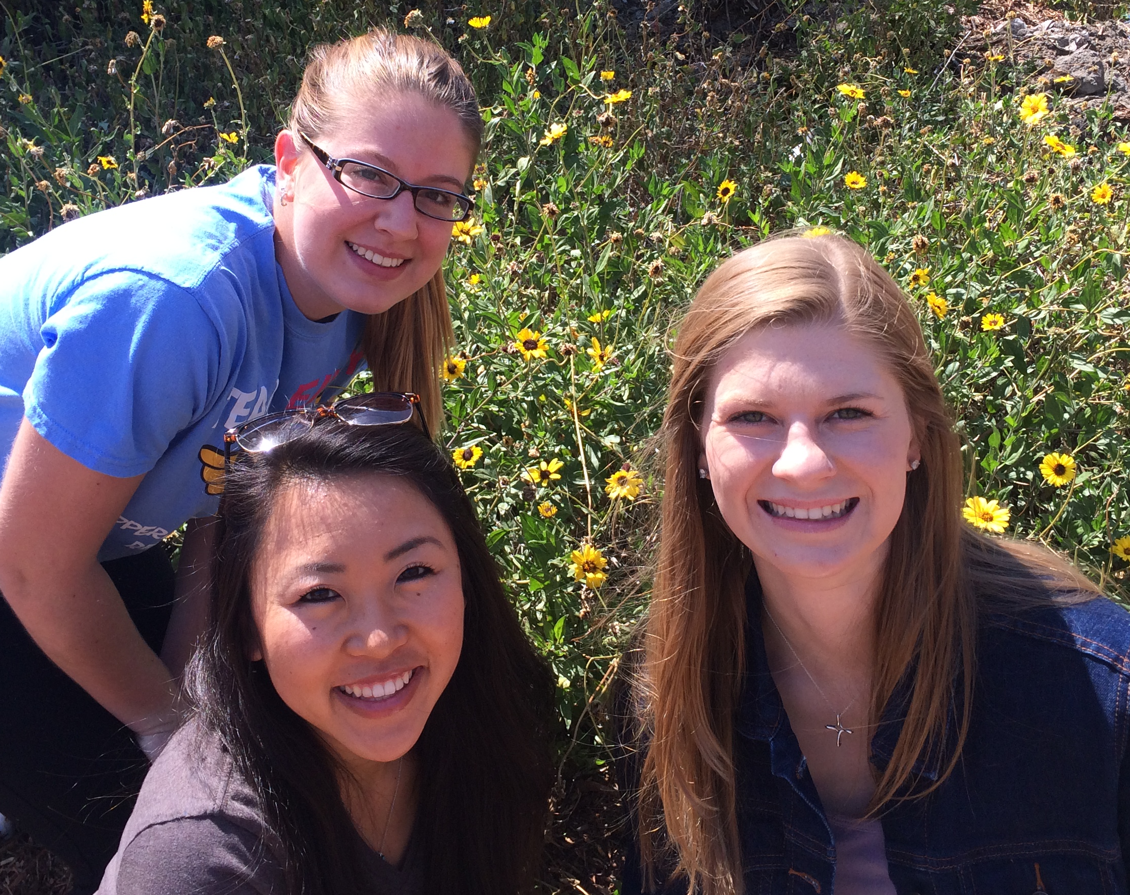
Correlation between Hydration and Reflectance
of Yellow Petals on Encelia californica
Jayci M. Givens, Kaylee A. Nussbaum, Caitin R. Kawata
Pepperdine University Malibu CA, 90263
Abstract
It is known that the NDVI can be used as a measure of hydration in plants because of the variation in pigments due to xanthophyll cycling (Schmitz et al., 2013). Flower petals can also exhibit variations in petal reflectance invisible to the naked eye (Fam & Espinoza, 2013). It was hypothesized that overall hydration levels of a plant would correlate to a difference in the pigments produced for petal color, and thus differences in hydration levels would correlate to differences in petal reflectance. To test this hypothesis, three flowers and two stems were collected from ten different E. californica plants, and tested for petal reflectance using a UniSpec spectrophotometer, as well as water potential using the Scholander-Hammel Pressure Chamber. The reflectance was analyzed using a created JCK index, measuring wavelength ranges from 590-610 nm and 680-720 nm. The plant groups were separated into a “high hydration” group and a “low hydration” group with a significant difference in hydration levels, which was determined by a Student’s t-test. A comparison of the JCK index values for these two hydration groups did not support the hypothesis that there would be a difference in reflectance for the two groups. These results are meaningful because of the role of wavelength reflectance on pollinator attraction.
Results
Study Site
This study was conducted at the base of the Dana Martell Trail on Pepperdine University’s Malibu Campus. Ten plants of E. californica were sampled in an area that measured approximately 1000 sq. ft. All plant specimens were collected on 1 April 2015.
Discussion
After measuring the reflectance of the petals using the JCK index and hydration levels of the stems of E. californica, it was found that there is no correlation between petal reflectance and hydration levels. The plants were separated into two groups: more hydrated and less hydrated. Between these two groups, the hydration levels of the two groups were significantly different (p < 0.01, student t-Test). However, the JCK index values of the two groups were not significantly different (p > 0.05, student t-Test). Therefore, we concluded that the data do not support our hypothesis.
Previous studies suggest that yellow petals of flowers, such as E. californica, have reflectances that are significantly different from yellow petals of other species (Fam et al., 2013). Due to this proven color variation, we hypothesized that a significant difference within the species would be found, despite the fact that the human eye cannot detect a difference. However, the data show that there is no significant difference among the reflectance of the flowers of the same species. Additionally, previous studies suggest that NDVI can be a measure of a plants hydration (Schmitz et al., 2013) . We hypothesized that if NDVI of leaves differs to indicate hydration levels, the JCK index for yellow petal reflectance would indicate this as well. The data show that there is no correlation between reflectance and hydration levels. This is indicated by a small R² value.
While it is possible that there is no natural relation between hydration and petal pigment reflectance between plants of the same species, further testing is necessary for this hypothesis because of the fact that the specimens were collected and tested after the peak of their blooming season. Though the most healthy appearing flowers were selected, the overall vitality of the petals could have been compromised. It is possible that the hydration effects would be seen in petals that are young and growing as opposed to beginning to senesce.
If the results of this experiment are confirmed by further testing, it would show that individual species each occupy one niche in wavelength reflectance for pollinators, but it remains to be determined how hydration affects other aspects of plant fitness with regard to pollination competition. It would be beneficial to explore the implications of hydration on factors such as nectar reward production, seed or pollen viability, volatile chemical signals, and flower diameter, among numerous other possibilities. In conditions of unprecedented drought in California, it is vital to understand how dehydration conditions will affect plant reproduction.
Figure 1. The reflectance spectrum of an example flower petal given as a function of wavelength. The reflectance is the proportion of light at each wavelength reflected by the sample. Spectra were recorded by using a UniSpec spectrophotometer.
Image 1. E. californica, the species used
Introduction
Flowers must compete with neighboring blooms for pollinators. There is variation in yellow blooms of chaparral sunflowers invisible to the naked eye (Fam & Espinoza, 2013), but visible to pollinators such as bees, butterflies, and other insects, which can differentiate and remember specific color or wavelength reflectance patterns (Chittka & Menzel et al., 1992). It is pigments, such as anthocyanins and flavonols, which give color to the flower petals of many species (Markham et al., 1999). The pigment class referred to as xanthophylls is utilized in plant leaves for photoprotection, and xanthophyll cycling can be measured using reflectance indices called the photochemical reflectance index (PRI) and normalized difference vegetation index (NDVI) (Barták et al., 2015). These indices have been shown to vary as plants dehydrate (Barták et al., 2015). Thus, combining the observations from literature that pigments give petal color variation and also that variation in leaf pigments corresponds to hydration, it was hypothesized that hydration would correspond with petal color variation. To test this, we used a created reflectance index (JCK index) and used the Unispec spectrophotometer to measure variations in reflectance, and compared this to differences in hydration by plant, which was measured using a Scholander-Hammell Pressure Chamber.
Figure 2. Comparison of water potential in more hydrated versus less hydrated stems of plants E. californica plants. Water potential was measured using a Scholander-Hammel pressure chamber. Error bars represent ± 1 SE, n = 9. Significant difference among plants found by Student t-test. P < 0.01
Figure 3. Comparison of reflectance from the JCK Index of petals in more hydrated versus less hydrated stems of E. californica plants. Reflectance was measured using a UniSpec spectrophotometer. Error bars represent ± 1 SE, n = 9. Significant difference among plants was disproven by Student t-test.
P > 0.05
Materials and Methods
Plant Collection
Ten plants of E. californica were selected for study from the site and labeled. From each plant, three healthy appearing flowers were selected and labeled. Selected flowers were cut with six inches of stem to prevent water loss before data was taken. The flowers were immediately placed in sealed bags, and placed in a cooler with ice. Then, from each plant, two thick, sturdy stems were cut at the branching point from the main stem, to be used to measure hydration levels of the plants. Stems were also immediately placed in labeled, sealed airtight bags and placed in a cooler.
Data Collection
Using the UniSpec-SC spectrophotometer, the reflectance from one petal on each flower was measured. Reflectance data from the three flowers from each plant was overlaid onto one graph and the values for the Normalized Difference Vegetation Index and created JCK Index for yellow petals (analyzing wavelength values from 590-610 nm and 680-700 nm) values were recorded. The hydration levels of each stem was measured using the Scholander-Hammel pressure chamber. The two water potential values of the stems from the same plant were averaged.
Data Analysis
Plants were grouped into “high hydration” and “low hydration,” and hydration values were analyzed by a Student’s t-test. Then, reflectance index values were compared using the same test.
Conclusions
Plants with significantly varying hydrations levels were found and grouped.
When the reflectance index values for the petals on these groupings of plants were compared, there was no significant difference.
Figure 4. Plot of water potential and reflectance from the JCK index of each E. californica plant measured. Water potential was measured using a Scholander-Hammel pressure chamber. Reflectance was measured using a UniSpec spectrophotometer.
R² = 0.00268
Acknowledgements
This research was made possible by the Natural Science Division of Pepperdine University. We would like to thank our professor and mentor, Stephen Davis, for his invaluable knowledge, guidance and support. Additional thanks go to our teacher’s assistant, Lorelle Knight, for her help and advice.
Literature Cited (asterisk denotes undergraduate student)
Barták, M., Trnková K., Hansen E.S., Hazdrová J., Skácelová K., Hájek J., and M. Forbelská. 2015. Effect of dehydration on spectral reflectance and photosynthetic efficiency in Umbilicaria arctica and U. hyperborean. Biologia Plantarum: 1-9.
Chittka, L. and Menzel, R. 1992. The evolutionary adaptation of flower colors and the insect pollinators’ color vision. Journal of Comparative Physiology A, 171-181.
*Fam, M. E and *Espinoza, V. E. 2013. Using the Unispec to Test the Difference in Reflectance of the Yellow Petals of Encelia californica, Encelia farinosa, and Spartium junceum. Pepperdine Digital Commons: Undergraduate Student Research.
Markham, K. R., Gould, K. S., Winefield, C. S., Mitchell, K. A., Bloor, S. J., Boase, M. R. 2000. Anthocyanic vacuolar inclusions - their nature and significance in flower colouration. Phytochemistry 55: 327-336.
*Schmitz, L. A., *Mah-Ginn, K., and *Presthus, H. 2013. The effects of leaf hydration on light reflectance in Salvia leucophylla and S. mellifera. Pepperdine Digital Commons: Undergraduate Student Research.

