Slide 1
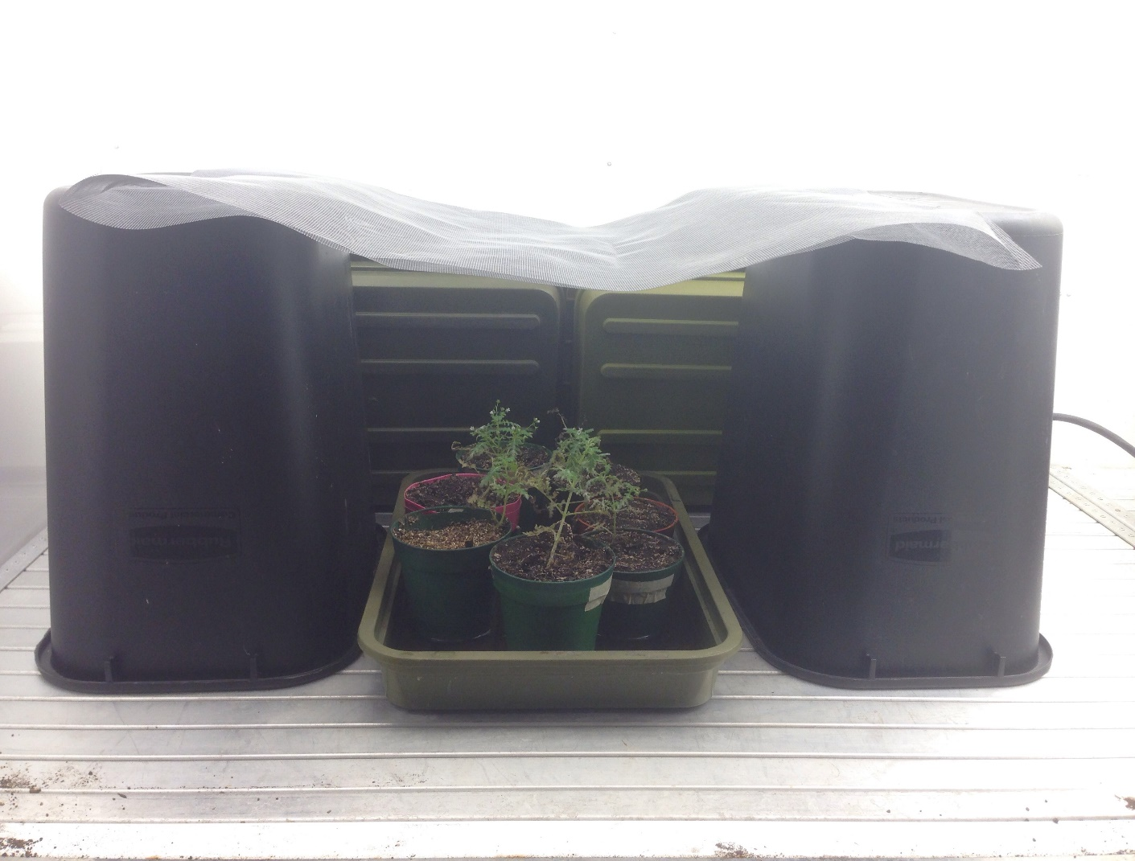
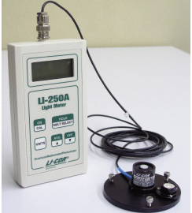
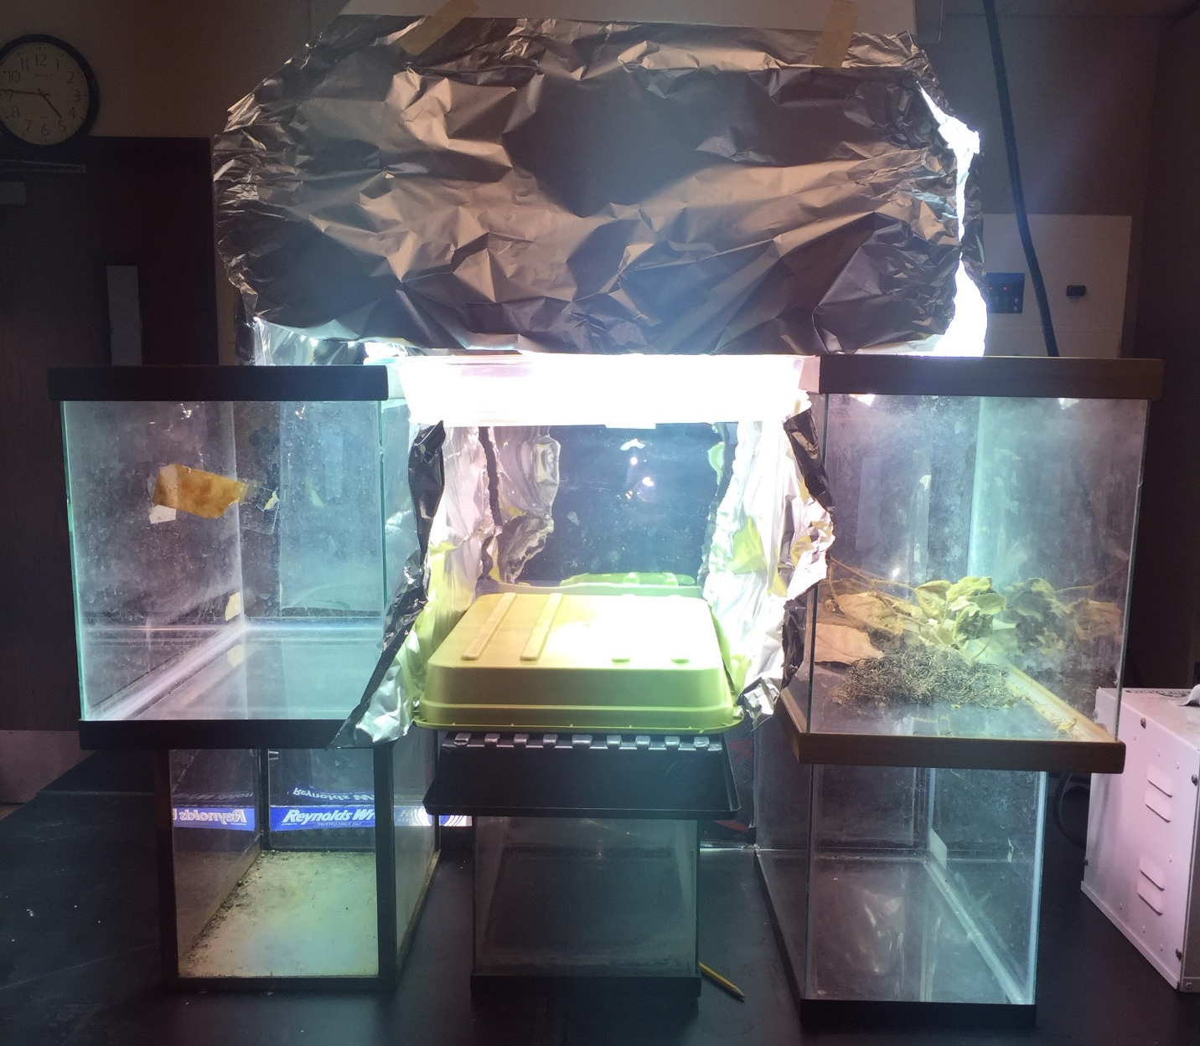
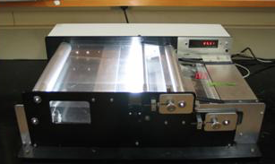
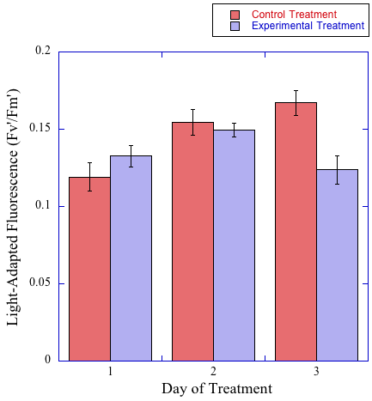
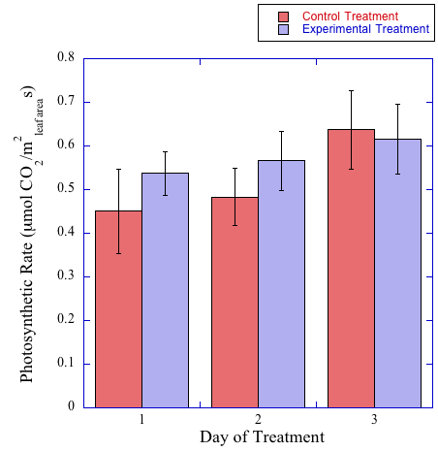
Effects of High Light Exposure on Photosynthetic Rate and Fluorescence of Eucrypta chrysanthemifolia
Alec Flores, Gina Gilderman, and Hannah Dario
Abstract
Materials
Results
In this experiment, we examined how a partial shade plant, Eucrypta chrysanthemifolia, found in the Santa Monica Mountains, responded to predictive models of higher light intensities created by drought. We hypothesized that, with higher levels of light, Eucrypta chrysanthemifolia would respond with a decreased photosynthetic rate, light-adapted, and dark-adapted fluorescence. This was performed by comparing control plants grown in an artificial shade environment to plants exposed to a series of high light intensity treatments. These partial shade plants were found on Piuma Trail in the Santa Monica Mountains. Our data supported our null hypothesis, indicating the photosynthetic rates and light-adapted fluorescence of the experimental plants were not significantly affected by high light intensity treatments; whereas, our hypothesis that dark-adapted fluorescence would decrease in response to these treatments was confirmed.
Introduction
Figure 1. A Bio Chamber was set to specific parameters for a one week duration. In order to replicate daytime activity, the plants were exposed to the following parameters for the first twelve hours: 25° Celsius, 50% humidity, 180 μmol per m²s, and 85% fan speed. In order to replicate nighttime activity, the plants were exposed to the following parameters for the first twelve hours: 20° Celsius, 50% humidity, 0 μmol per m²s and 85% fan speed.
Figure 2. An LI-250 quantum sensor provided constant values of 180 μmol per m²s under all areas where the plants resided.
Life on Earth depends on energy from sunlight for all processes that make survival possible, from photosynthesis to the water cycle. However, an increasing problem around the world, especially in California as evidenced by the 2013-2014 drought, is seasonal water availability^{[1]}.This drought has affected all factors of life, including California’s vegetation, in which a dramatic decrease of water availability has resulted in a high mortality of plant species, including those that grow to tall heights. These tall plants create shade for a variety of different plant species, including Eucrypta chrysanthemifolia. When the population size of tall plant species’ decreases due to harsh drought conditions, an unsuitable environment with little shade is created for shade adapted plants. In this investigation, we aim to determine how a particular shade plant, Eucrypta chrysanthemifolia, will react to these predicted high light level intensities. Thus, we hypothesize that photosynthetic rate, light-adapted, and dark-adapted fluorescence will decrease in shade plants under high light intensity. We hypothesize this because of the little natural exposure these plants typically receive to direct sunlight. We will test this hypothesis by artificially creating an artificial environment of high light intensity and compare these recorded measurements for photosynthetic rate, light-adapted, and dark-adapted fluorescence among a control group and an experimental group.
Figure 7. The above figure shows the results of stress-induced flowering of partial shade plant species, Eucrypta chrysanthemifolia.
Discussion
In the beginning of the investigation, the control and experimental groups showed no statistical significance (P-value = 0.49, n =10) regarding photosynthetic rate. However, there was an important difference in the beginning and end of the investigation as the average photosynthetic rate of the experimental treatment group was greater than that of the control group. Over the three day period, the photosynthetic rate of the control and experimental groups increased until the photosynthetic rate was greater in the control group than in the experimental group. After three days of high light exposure, while no statistical significance between the control and experimental groups (P-value = 0.84, n = 10) was evident, it is important to note that the position of higher photosynthetic rate, belonging to the experimental group, transitions to become a lower photosynthetic rate than that of the control group. This suggests photosystem I (PSI) and photosystem II (PSII) in Eucrypta chrysanthemifolia were damaged by the high light intensities.
Analysis of light-adapted fluorescence for the control and experimental groups at the beginning of the investigation showed no statistical significance (P-value = 0.35, n = 10). However, after the third day of the light exposure treatment, a statistical significance between the control and experimental groups is evident (P-value < 0.05, n = 10). Light-adapted fluorescence is a measure of the maximum efficiency of PSII. Therefore, based on our findings, the high light intensity treatments caused significant damage to the photosynthetic centers of the plant cells. Furthermore, although not displayed, the average dark-adapted fluorescence showed that the high light intensity caused progressive damage to the photosynthetic pathways of the plant cells.
Yet there are partial repair mechanisms in the plant that regenerate damage done to PSI and PSII. However, these mechanisms do not restore the plant to its original efficiency, and the plant’s health will deteriorate with time. The fluorescence data suggest that high light intensities induce stress within the plant and also damage its photosynthetic capabilities. Additionally, this induced stress can be physically exhibited by stress-induced flowering of Eucrypta chrysanthemifolia. As described by Kiyotoshi Takeno, plants that are introduced to unsuitable growth conditions have a greater tendency to flower ^{[2]}. In our results, the experimental plants exhibited evidence of this concept, shown in Figure 7. Most factors, including high light intensities, responsible for the flowering of plants are stress factors, as shown in previous studies. Thus, our data suggests the experimental plants flowered primarily due to stress from the high light intensity treatments.
Figure 3. For each day we recorded these measurements, the surface area of the leaf being measured was determined by cutting off the leaf from the plant, marked by a black Sharpie marker, using a small razor blade to match the size of the LI-6400XT’s cuvette and measured with an LI-3100 Area Meter to proportionalize the values obtained with the actual leaf values.
Figure 4. Using a Hydrofarm Horticulture Products High Intensity Light Bulb, aluminum foil was wrapped to surround and direct the light produced onto the experimental plant group. A glass tray was placed directly beneath the light bulb, supported by the edges of two glass terrariums, and filled with two inches of distilled water. Infrared light radiation in the form of heat was absorbed by the water to protect the plants from unrelated heat induced-dehydration effects.
Methods
Attaining the Plants On April 2nd, 2015, fourteen Eucrypta chrysanthemifolia plants, were obtained from Piuma Trail in Calabasas, California. The plants were removed and potted at the collection site in medium-sized pots with their natural soil. Once the plants were brought back to the laboratory, seven plants were randomly selected to make up the control group, and the remaining seven plants were made up the experimental group. The pots were then placed into their respective bins labeled either “control” or “experimental.” Both bins were then filled with one inch of water to hydrate the soil and plant roots to promote growth and avoid stress-induced death. Preparation of Plant Growth Chamber To recreate the environment and the daily light exposure the plants would receive, we utilized an LI-250 quantum sensor to measure the average light level surrounding the collection site. Figure 1 exhibits the Bio Chamber used to maintain specific parameters of the plants’ natural environment. To produce the parameters of 180 μmol per m²s, we created the apparatus as seen in Figure 2. The plants were watered with an inch of water daily and allowed to adjust to the artificial environment for 48 hours before conducting the experimental light treatment and measurements of various quantitative plant characteristics, including photosynthetic rate, light-adapted fluorescence, and dark-adapted fluorescence. Preparation of Experimental Light Treatment The apparatus used for the experimental light treatment is shown in Figure 4. Analysis of Photosynthetic Rates After 48 hours of plant adaptation to the Bio Chamber presets, the control and experimental groups were transferred into an open space of 400 μmol photons of light per m²s within the Bio Chamber in order to adapt to higher light intensities in the LI-6400XT Portable Photosynthesis System. Presets for the LI-6400XT Portable Photosynthesis System were as follows: flow rate of 100 μmol per second, CO₂ level of 400 μmol per mole, block temperature of 22° Celsius, and PAR of 2000 μmol per m²s. After ten minutes following translocation, measurements of quantitative plant characteristics were measured for both the control and experimental groups. Following measurements of each plant, the leaf under the cuvette was marked with a black Sharpie permanent marker for leaf area measurement. The control group was placed back into the Bio Chamber while the experimental group was moved to the experimental light treatment for one hour. After one hour of high intensity light exposure at 1500 μmol photons per m²s, dark fluorescence measurements were taken for the experimental group after ten minutes of dark adaptation in the leaf and recorded using an Opti-Science, model OS1-FL fluorometer. To proportionalize the values obtained with the actual leaf values, an LI-3100 Area Meter was utilized, as described in Figure 3.
Results
Conclusion
In conclusion, the null hypothesis for our investigation was supported in that the photosynthetic rate and light-adapted fluorescence were not statistically different among the control and experimental groups. However, the hypothesis that dark-adapted fluorescence would decrease in Eucrypta chrysanthemifolia, a partial shade plant, after exposure to high light intensity treatments, was supported with a P-value < 0.05. This data supports the concept of stress-induced flowering and has helped analyze the potential implications of drought in Southern California as tall plant species increase in mortality rates. In future investigations, the next experiment could be to examine these variables in a full shade plant species. This could allow an even greater understanding of the effects of light on various shade-adapted species.
References
Figure 5. Comparison of photosynthetic rate over a three day light treatment period. Comparison is portrayed between control and experimental treatments with the inclusion of a standard error bar. Control exposed to a constant light treatment of 180 µmol photons/m²s, experimental treatment exposed to a high light intensity of 1500 µmol photons/m²s for one hour per day. Using independent samples’ Student’s t-test, no statistical significance was found between treatments for days 1, 2, and 3; based on a sample size (n=10).
Figure 6. Comparison of light-adapted fluorescence over a three day light treatment period. Comparison is portrayed between control and experimental treatments with the inclusion of a standard error bar. Control exposed to a constant light treatment of 180 µmol photons/m²s, experimental treatment exposed to a high light intensity of 1500 µmol photons/m²s for one hour per day. Using independent samples’ Student’s t-test, no statistical significance was found between treatments for days 1 and 2; however, a significant difference was found on day 3 (P-value = 0.01). Based on a sample size (n=10).
[1] Swain, Daniel L., et al. "THE EXTRAORDINARY CALIFORNIA DROUGHT OF 2013/2014:
CHARACTER, CONTEXT, AND THE ROLE OF CLIMATE CHANGE." Bulletin of the American
Meteorological Society (2014): 3-7. Print.
[2] Takeno, Kiyotoshi. “Stress-Induced Flowering.” Abiotic Stress Responses in Plants (2012): 331-
345. Print.
Special Thanks
We would like to give a special thanks to Dr. Davis and our teacher’s assistant, Sawyer McGale, for sharing their wisdom in this subject. We would also like to thank Pepperdine University for providing us with the equipment and laboratory utilized throughout our project.

