Slide 1
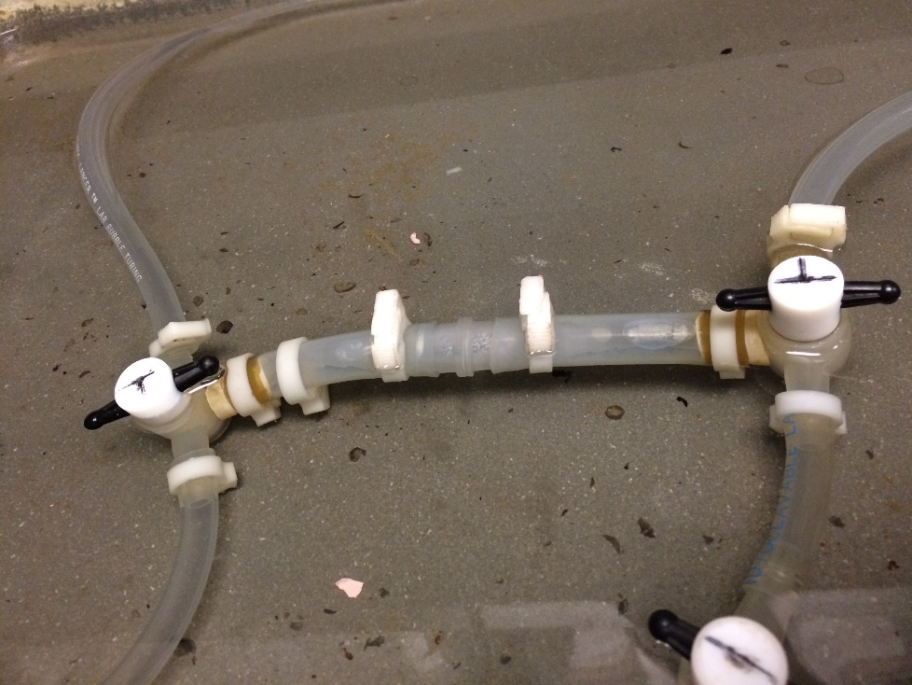
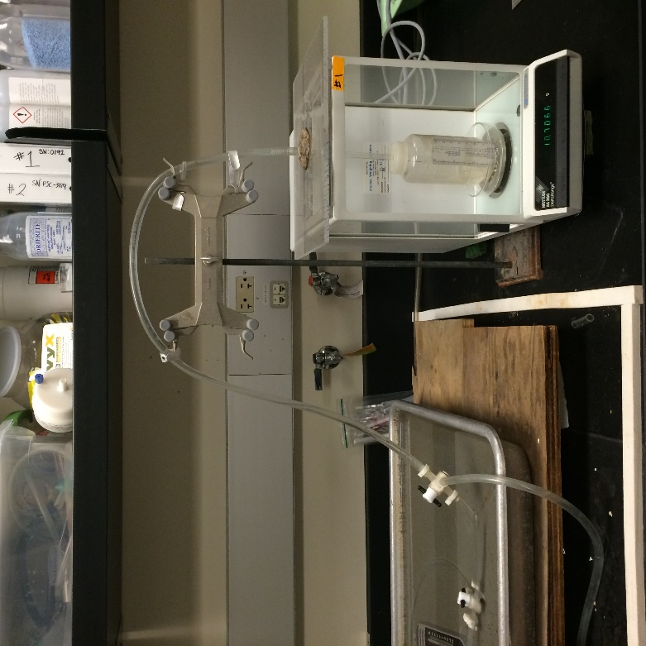
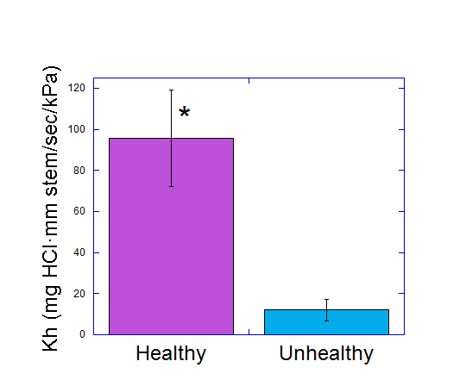
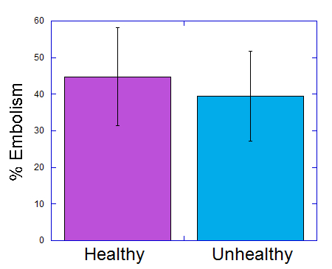
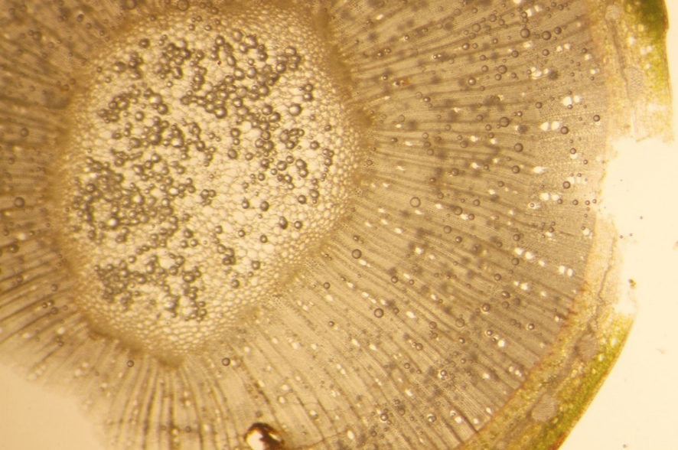
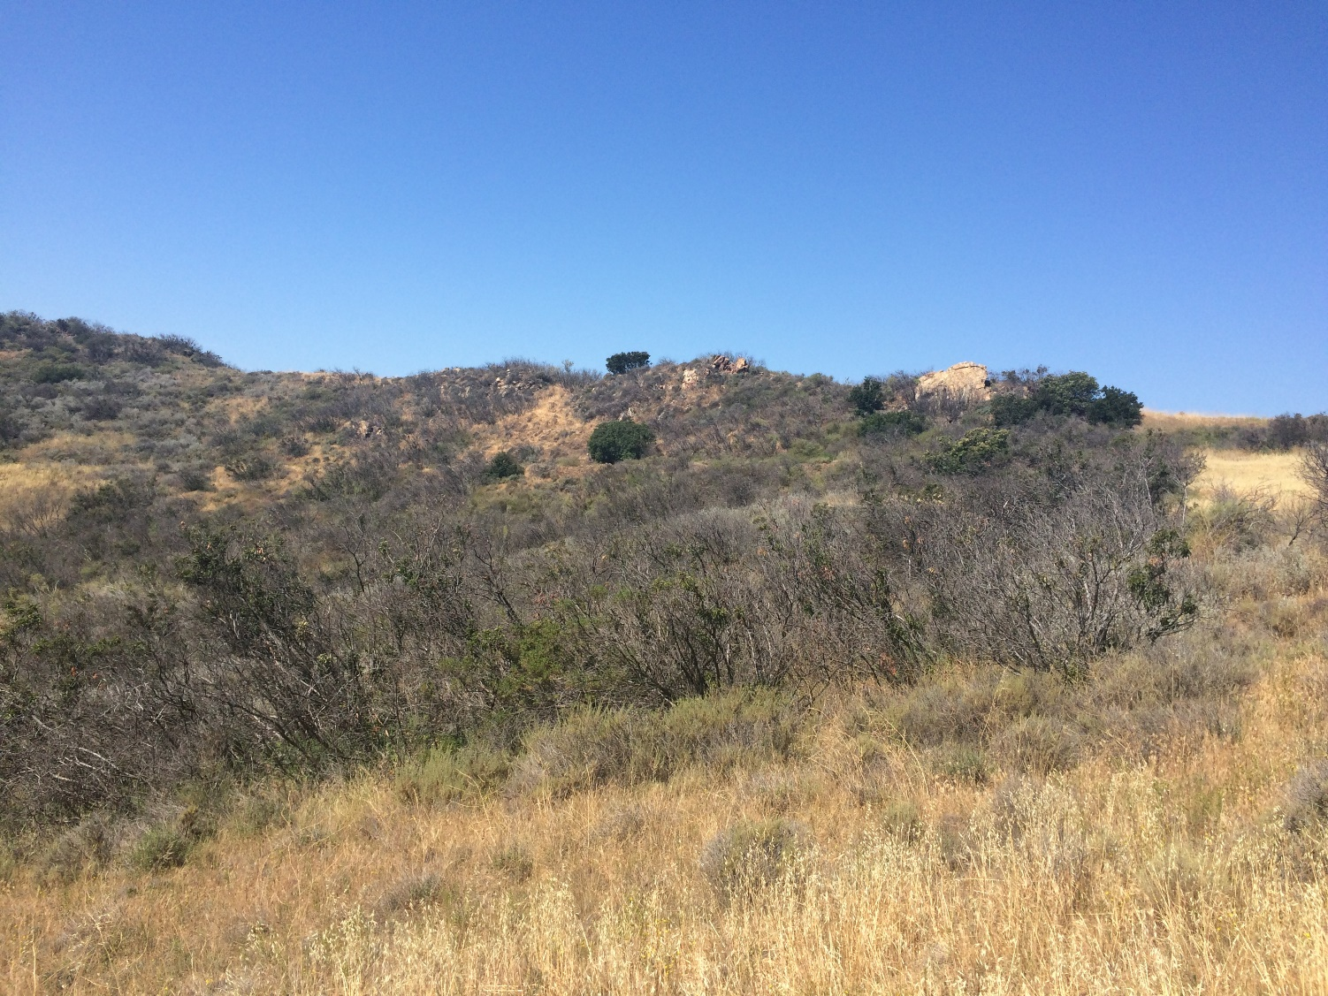
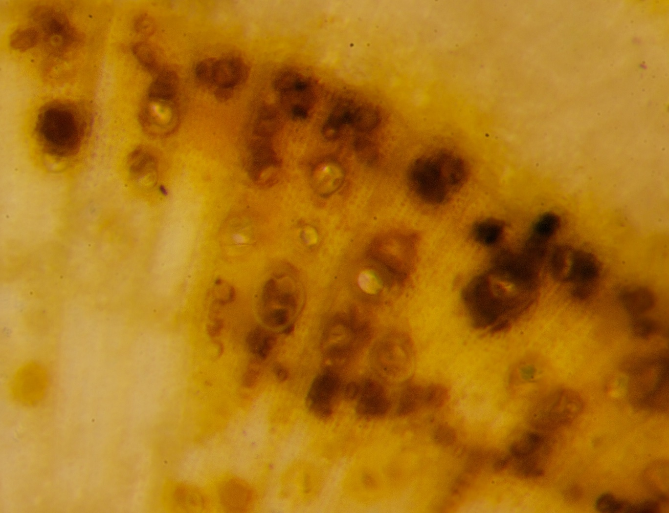
Possible Fungal Infection Leading to Malosma laurina Dieback
Gabriella N. Palmeri, Braden S. Olsen, and Kaitlyn E. Sauer
Mentor: Dr. Stephen D. Davis
Pepperdine University, 24255 Pacific Coast Highway, Malibu, CA 90263
Abstract
There is a significant and apparent dieback of Malosma laurina in the Santa Monica Mountains, some which is found near Pepperdine University. Other areas near Pepperdine show a flourishing growth of M. laurina and our objective was to determine why this difference in M. laurina health exists. We initially hypothesized that in addition to water stress, the unhealthy M. laurina was effected by a pathogen. Under further inspection, the unhealthy plants contained hyphae in some of their xylem vessels, while the healthy ones did not. We sought to determine whether the existence of hyphae in the unhealthy plant’s xylem affected its ability to transport water by measuring the conductance (K_{h}) of both sick and healthy M. laurina. We created an apparatus that measured water flow through a stem when a known hydrostatic pressure was applied. We also used a vacuum to remove embolism from the stem samples to determine whether the decrease in conductance could be attributed to embolism due to cavitation, or xylem obstruction due to hyphae. Our results showed that the conductance, both pre vacuum and post vacuum, was significantly higher in the healthy M. laurina than in the unhealthy M. laurina. This fact, along with the non significant percent embolism values between the healthy and unhealthy plants demonstrates that there is another factor causing decreased xylem flow in the unhealthy M. laurina samples other than embolism due to cavitation. This conclusion supports our hypothesis that a fungus is involved in the apparent M. laurina dieback.
Methods
Six healthy Malosma laurina samples were obtained from the various aforementioned study sites. In order to prevent the introduction of embolism into the xylem of the samples, 1 meter minimum stem samples were obtained using standard cutting shears, placed in a garbage bag to maintain the plant’s hydraulic status, and transported to the laboratory in the Keck Science Center. Sample preparation occurred with the stem submerged under distilled water to prevent xylem embolism. Each stem sample had a length of 100 mm and a diameter between 6-9 mm. Using a standard razor blade, the bark from each stem end (roughly 1 cm) was removed to ease water flow through the system. Each bark end was fashioned with a fitted rubber tubing component to allow for an improved connection between the sample stem and the tubing in the system for measuring hydraulic conductivity. We employed the methodology first described by John Sperry in 1988. A hydrostatic pressure gradient was created by maintaining a reservoir of a solution at a fixed height. We used a pH 2 HCl solution in the system in order to deter microbial growth in the stem samples. At a known pressure, the solution was allowed to run through the system and the stem sample. The solution which passed through the stem was measured on a standard balance, and from the measured initial, final, and stem flow rates, the hydraulic conductivity (K_{h}) of the stem was calculated. After each healthy stem’s native (as it would exist in nature) hydraulic conductivity was determined, each sample was placed in a pH 2 HCl solution in a container connected to a vacuum over night in order to remove embolism. The next day the stem segments were run through the “Sperry apparatus” again with the potential embolism removed, and hydraulic conductivity was again measured.
Seven unhealthy M. laurina samples were collected from the study site above Drescher campus. We deemed unhealthy M. laurina as shrubs which showed severe leaf loss; yet, still maintained a few sections of compromised leaf growth, ensuring that the plant’s xylem were functioning to an extent. The hydraulic conductivity and post vacuum hydraulic conductivity were measured using the same methodology as referenced earlier.
Leaf Area Index (LAI) was determined using a LICOR-3100 Area Meter. The leaf area above each stem sample was calculated. Each leaf was removed from its petiole and placed on the conveyer belt on the machine leaf by leaf.
We calculated the stem area by using the area of an ellipse; measurements were taken using calipers at two different diameters, perpendicular to one another. In order to calculate a normalized value of hydraulic conductance, the pre-embolism removal K_{H} values were divided by the stem area to generate the K_{s}. K_{l} was calculated by dividing pre-embolism removal K_{H} values by the LAI.
Discussion
We initially inspected samples of both healthy and unhealthy Malosma laurina under a microscope and found what appeared to be fungal hyphae in some xylem vessels of the unhealthy plants; yet, we found none in those of the healthy plants. Our results showed a significant difference between the healthy and the unhealthy M. laurina. The average conductance (Kh) of the healthy was shown to be 95.7 compared with an average conductance of 21.2 in the unhealthy plants. After the stems were flushed out using a vacuum system, the healthy stems showed an average Kh of 201.5 while the average Kh of the unhealthy was 32.9. We then calculated that the conductance versus xylem area (Ks) was much larger in the healthy plants than in the unhealthy plants. This, along with the percent embolism of each plant status, led us to conclude that there is another factor causing a decrease in xylem flow other than cavitation due to embolism. Due to the presence of hyphae in the unhealthy M. laurina and not in its healthy counterpart, we conclude that our evidence supports our hypothesis: a fungus is the reason for the lowered xylem flow and provides a probable cause of M. laurina dieback.
An interesting note is that while the Kh and Ks were significantly different for the healthy and unhealthy plants, the conductance versus leaf area was fairly similar across the board. This implies that xylem flow can be estimated, or even compared just by glancing at a plant, or in other words, one can tell if a plant has a high or low xylem flow due to the amount of foliage it has.
There is possible error in our measurements and in our calculations. One of our healthy plant specimens contained a cracked xylem; therefore, that data was removed. There is a small possibility that some xylem vessels were embolized during the harvesting of our samples; but, this is unlikely due to our considerations when obtaining samples.
While this study is certainly correlative, it is in no way causative. Further research is required to investigate whether a fungus is the cause of the M. laurina dieback.
Plant death cannot be attributed to a single cause. Advancing our knowledge of the various factors which influence plant death in necessary in order to prevent wide spread of plant mortality. Our greatest protection against climate change is biodiversity. In order to preserve genetic variation we must preserve each individual plant species to ensure greater diversity within an ecosystem.
Introduction
Water availability is the ultimate limiting factor in the growth and survival of plants. Malosma laurina, an evergreen shrub found in chaparral vegetation throughout Southern and Baja California, is noted as a survivalist due to its recorded root depth of to 45ft and theoretically should be able to tolerate severe water stress despite the historical drought conditions the state of California is experiencing. The prevailing M. laurina dieback within the Santa Monica Mountains is unprecedented, however, not universal throughout the area. M. laurina that are healthy do not appear to be water stressed. These plants are located typically near the bottom of the hill, (plants growing near the bottom of a hill tend to be less water stressed due to the effects of gravity on water and thus have greater access to water), within an irrigated area, or on an “edge” (not immediately surrounded by competing vegetation) and thus would not have to compete with plants for water or soil nutrients (Łuczaj et al. 1997).
Despite its location on the edge, and access to sufficient water and soil sources, (Figure 1) M. laurina located above the Drescher campus are undergoing widespread dieback, which suggests that a pathogen might be effecting the plant’s ability to transport water to its leaves.
Fungi are a large and very common part of plant life but it is possible for them to be harmful to the plant host. Two examples are Aspergillum and Fusarium. These not only release harmful toxins into the plant but can cause blockage in vessels (De Lucca, 2007). This blockage could be happening at the pores of the pit membrane which is the most important part of xylem vessels. As pore size decreases, xylem flow decreases as well (Jarbeau et. al., 1995). It has been speculated that water stress can provide an environment for a pathogen to infect a plant; therefore, the drought most likely has an effect on these plants as far as the fungus is concerned. Our preliminary investigation showed that there was possible fungal hyphae located within the xylem of the unhealthy M. laurina (Figure 7). This led us to hypothesize that a fungus is influencing the dieback, due to its prevalence solely in the unhealthy M. laurina. This problem was to be addressed by measuring the flow of water through different stems of both healthy and unhealthy specimens.
Figure 2. (left) Solution entering from the left originated from an elevated fluid bag which provided the hydrostatic pressure within the system. Water flow in the system mimics water flow within a plant. The bottom of the stem is inserted in the left tube, and the top of the stem inserted in the right tube. Tubing was tightened with grommets.
Figure 3. (right) After the solution passed through the sample stem it entered the balance where the mass of solution its rate of change was measured to calculate hydraulic conductance. The water level in the container on the balance measured about 10 cm, which matched the water level of another tubing component to generate a “no pressure” status which providing the setting for our final and initial flow values, and allowed for a more accurate measurement of hydraulic conductivity.
References
[1] De Lucca, Anthony J. "Harmful fungi in both agriculture and medicine." Revista iberoamericana de micología 24.1 (2007): 3.
[2] Jarbeau J.A., Ewers F.W. & Davis S.D. (1995) The mechanism of water-stress-induced embolism in two species of chaparral shrubs. Plant, Cell and Environment 18, 189–196.
[3] Łuczaj, Łukasz, and Barbara Sadowska. "Edge effect in different groups of organisms: vascular plant, bryophyte and fungi species richness across a forest-grassland border." Folia Geobotanica & Phytotaxonomica 32.4 (1997): 343-353.
[4] Sperry, J. S., J. R. Donnelly, and M. T. Tyree. "A method for measuring hydraulic conductivity and embolism in xylem." Plant, Cell & Environment 11.1 (1988): 35-40.
Results
Measurement | Healthy | Unhealthy | P
K_{h} | 95.7 + 23.4 | 21.2 + 9.34 | * 0.008
K_{l} | 0.092 + 0.021 | 0.062 + 0.024 | 0.400
K_{s} | 3.10 + 0.648 | 0.68 + 0.21 | * 0.002
Leaf area | 1103.2 + 192.1 | 385.6 + 58.9 | * 0.002
% Embolism | 44.8 + 13.4 | 39.5 + 12.2 | 0.780
Table 1. Mean values + one standard error of healthy and unhealthy Malosma laurina found in the Santa Monica Mountains of Southern California. Conductance (K_{h}, units of mg HCl · mm stem/sec/kPa), leaf conductance (K_{l}, units of mg HCl · mm leaf/mm² leaf · sec/kPa), stem conductance (K_{s}, units of mg HCl · mm stem/mm² stem · sec/kPa), leaf area (mm²), and percent embolism were measured. Student’s t-test for unpaired data with unequal variance was used to test for statistical difference. * denotes T-probability is less than 0.05, indicating significance between groups. n = 5 for healthy M. laurina specimens, n = 7 for unhealthy M. laurina specimens.
Acknowledgements
This research was funded by the Natural Science Division of Pepperdine University and the Keck Foundation.
Description of Study Site
Healthy Malosma laurina samples were collected from the area near the water tower above Drescher Campus of Pepperdine University located in the Santa Monica Mountains in Malibu, CA. Additional healthy samples were collected from the hillside adjacent from the Theme Tower at the front of Pepperdine University and across the street from the Drescher apartments. Unhealthy M. laurina samples were collected from Dana Martell Trail above Drescher Campus.
Figure 6. Transverse section showing healthy xylem with no blockage or hyphae.
Figure 1. Location of study site of unhealthy Malosma laurina, as shown by gray patches along Dana Martell Trail. Green patches are other healthy members of Anacardiaceae family, including Rhus ovata and Heteromeles arbutifolia. The ability of other members within the Anacardiaceae family to survive demonstrate this area has sufficient resources to support healthy plant growth.
Figure 4. Differences in conductance, Kh, for healthy and unhealthy Malosma laurina measured in mg H₂O·mm stem/sec/kPa. Purple bar represents healthy M. laurina plants located near the water tower above Drescher Campus of Pepperdine University in the Santa Monica Mountains of Southern California, along the hillside adjacent from the Theme Tower at the front of Pepperdine University, or across the street from the Drescher apartments. Blue bar represents unhealthy M. laurina plants located along the Dana Martell Trail above Drescher Campus. Student’s t-test for unpaired data with unequal variance was used, * denotes T-probability is less than 0.05, indicating significance between groups. Bars represent ± 1 standard error. n = 5 for healthy M. laurina specimens, n = 7 for unhealthy M. laurina.
Figure 5. Differences in % Embolism, for healthy and unhealthy Malosma laurina. Purple bar represents healthy M. laurina plants located near the water tower above Drescher Campus of Pepperdine University in the Santa Monica Mountains of Southern California, along the hillside adjacent from the Theme Tower at the front of Pepperdine University, or across the street from the Drescher apartments. Blue bar represents unhealthy M. laurina plants located along the Dana Martell Trail above Drescher Campus. Student’s t-test for unpaired data with unequal variance was used, there is no statistical significance. Bars represent ± 1 standard error. n = 5 for healthy M. laurina specimens, n = 7 for unhealthy M. laurina.
Figure 7. Transverse section of Malosma laurina showing unhealthy xylem with hyphae present, causing water blockage.
Visible Fungus

