Slide 1

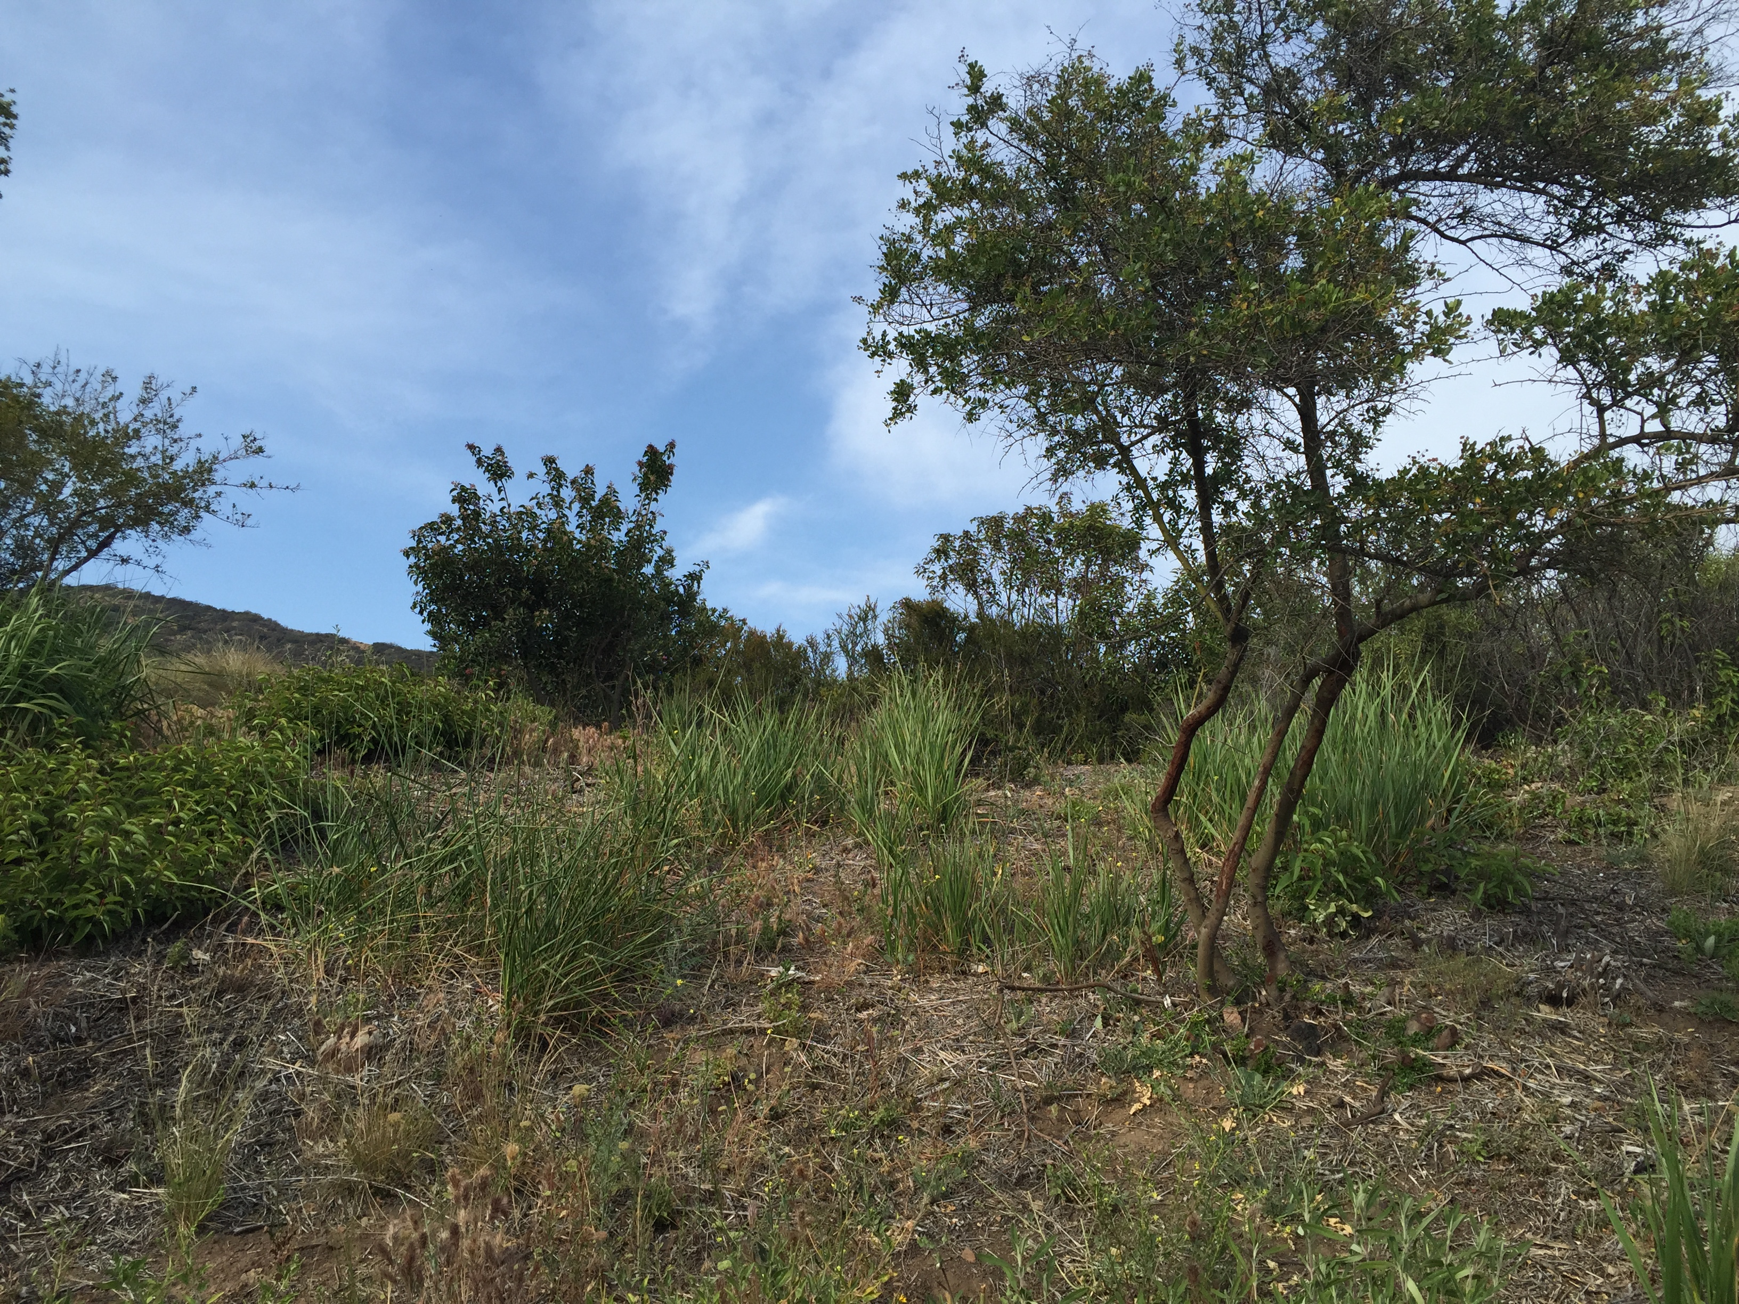
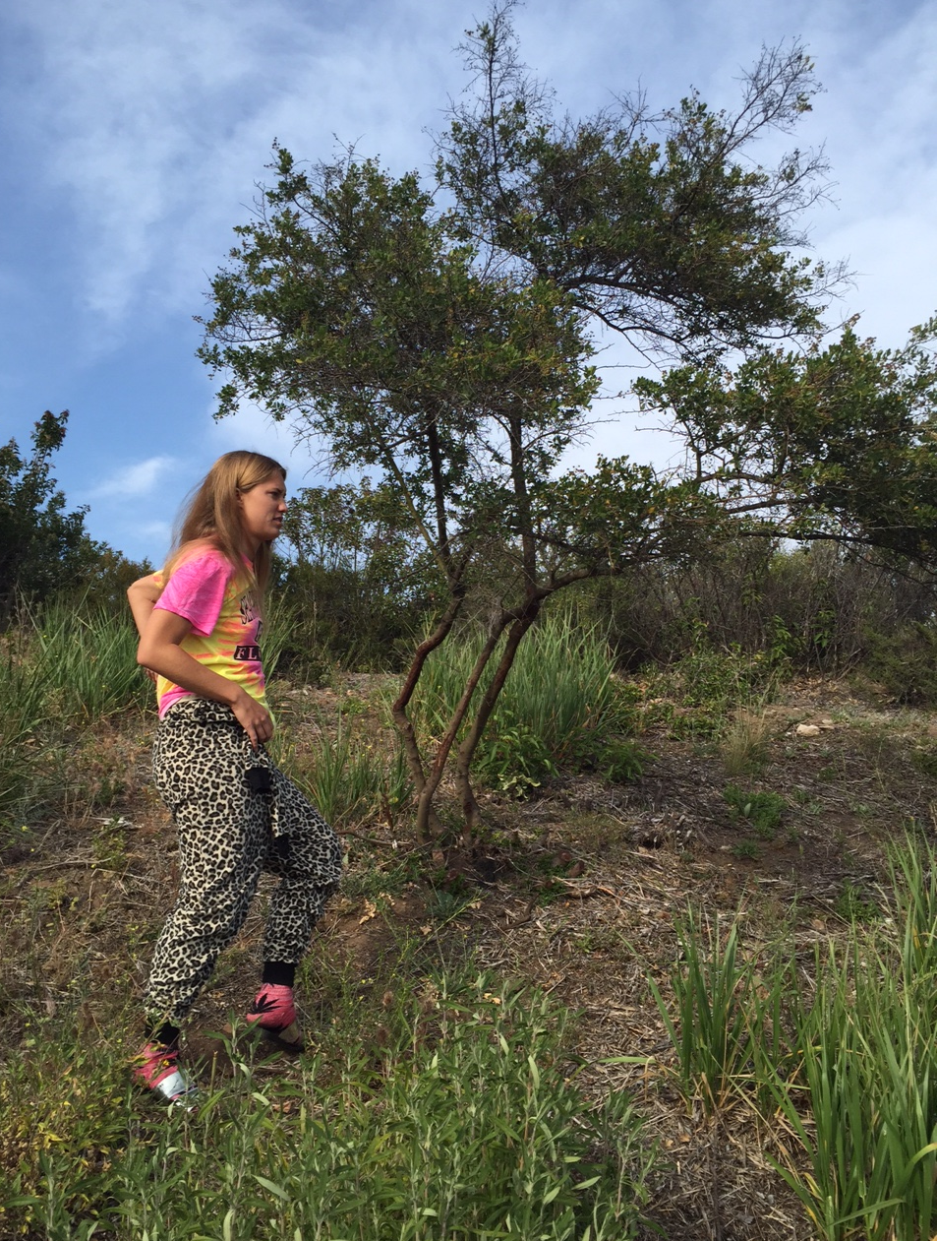
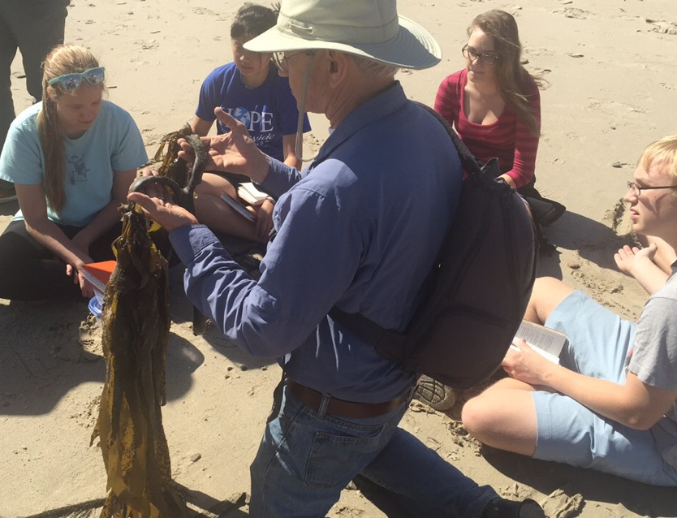
Difference in Chaparral Species Population on the North and South Aspect on Pepperdine University Campus
Abstract
In this experiment, we analyzed the difference in population frequencies of chaparral plants along the north and south aspect of a slope on Pepperdine University campus in the Santa Monica Mountains in Malibu, CA. We began the experiment by hypothesizing the south aspect would receive the most sunlight, and thus would hold the most amount of plants. By using the Point Quarter Sampling Method, we were able to determine if our hypothesis was correct. After analyzing our data, we found no significant difference between the north and south aspect in terms on frequency. During our experiment we also measured the difference in height and crown diameter. We found the two sides of the hill to be significantly different. The south aspect, because of its sun exposure and lack of water, sustains plants that can inhabit these environment, such as Quercus argrifolia and Ceanothus spinosus. On the other hand, the north aspect had smaller chaparral trees. It had a higher population of Malosma laurina, with a relative density of 62.5% on the north aspect in comparison to a relative density of 17.8% on the south aspect. Other plants that were common on the north aspect was Rhus integrefolia and Adenostoma fascultatum. Although hillsides along a north and south aspect are not significant in population frequency, they are significant in the types of chaparral plants that inhabit each area.
Alexandra N. Lozano, Drew N. Rasmussen, Ashlyn L. Rawls
Pepperdine University Malibu, CA 90263
Discussion
In this study we determined through the Point Quarter Sampling Method whether the north or south facing aspect had a higher frequency species and the types of species. The results indicated that the frequency of chaparral on both the north aspect and south aspect was not statistically significant and despite the differences in microclimate, the frequency of chaparral plants was not affected. On the north aspect the percentage of Malosma laurina was high at 62.5%. We observed the leaf surface area was larger this species and thus requires more water because the increased leaf surface area would result in a higher amount of water loss. Therefore because the north aspect receives less sunlight and looses less water species that require larger amounts of water are located on the north aspect. Conversely, larger percentages of Ceanothus megacarpus and Quercus agrifolia were located on the south aspect; because these species are more drought tolerant they are located on the south aspect where there is an increased amount sun exposure and decreased amount of water in the soil. On the north facing aspect there was a greater average crown diameter indicating that there was a greater amount of larger chaparral species such as Ceanothus megacarpus and Quercus agrifolia, which are more drought tolerant and have more widely spread and smaller leaf sizes indicating that there is a less water in the soil because the leaf surface area is smaller in order to decrease the amount of water lost during photosynthesis. The larger crown diameter on the south aspect was shown to be statistically significant from the student t-test conducted and the p<0.05 at p=0.0002281. The results support the past research indicating that obligate-seeding woody chaparral species dominate south-facing slopes, and that plants that require more moisture reside on north-facing slopes (Halsey). This study indicates that chaparral species that are more drought tolerant and have larger crown diameters are predominantly located on south facing slopes, while chaparral species requiring more water are located on north facing slopes.
Study Site
Introduction
The relationship between species distribution and climate is imperative to the understanding of how form relates to function. In the Santa Monica Mountains chaparral is adapted to a Mediterranean-like climate that encompasses summer droughts and mildly-wet winters, with naturally occurring wildfires approximately every 7.5 years. Within the Santa Monica Mountains chaparral dominates vast areas of foothills and mountain slopes ranging in diversity of shrub species. The mixture of species within a hillside community is apparent when observing various slope landscapes on the Pepperdine University Drescher Campus. The varying amount of sun exposure on the south- facing slope of a hillside and a north facing slope of a hillside may influence species diversity on the hill. Aspect, or the direction the slope faces indicates by a compass, can strongly influence the temperature on the slope. Because the aspect can affect the microclimate on the slope we ascertained that the differences in the temperature on the north facing and south facing slopes affected the species diversity of the opposing slopes. In the Northern Hemisphere south facing slopes have increased sunlight exposure which increase the temperatures on the south facing slope. We ascertained that there would be an increase in the amount of drought tolerant chaparral on the south aspect and on the north aspect the chaparral would be more adapted to a relatively moister climate. Using Point Quarter Sampling we observed the diversity of chaparral species within 100 square meters of both the north and south aspect and measured the crown diameter, height, and center point distance of each species in order to ascertain which aspect contains the larger amount of species.
Figure 1. View of the north aspect at Heroes Garden on Pepperdine University Campus in the Santa Monica Mountains in Malibu, CA. The north aspect experienced about even amounts of plant in comparison to the south aspect, but did sustains smaller woody plants with a smaller crown diameter.
Literature Cited
Halsey, R. W. (2007). Chaparral: Pure California. Fremontia, 35(4), 2-7.
Hanes, T. (1971). Succession after Fire in the Chaparral of Southern California. Ecological Monographs, 41(1), 27-52.
D., A., C., K., S., W., K., B., & K., S. (2002). Leaf Size, Specific Leaf Area And Microhabitat Distribution Of Chaparral Woody Plants: Contrasting Patterns In Species Level And Community Level Analyses. Oecologia, 130(3), 449-457.
Baur, H. (n.d.). Moisture Relations in the Chaparral of the Santa Monica Mountains. Ecological Monographs, 6(3), 409-454.
Roberts, D., Gardner, M., Church, R., Ustin, S., Scheer, G., & Green, R. (n.d.). Mapping Chaparral in the Santa Monica Mountains Using Multiple Endmember Spectral Mixture Models. Remote Sensing of Environment, 267-279.
Results
Acknowledgements
Figure 2. Comparison of the mean value of the point distance of the north and south aspect of chaparral species on Pepperdine University in the Santa Monica Mountains in Malibu, California. Statistical comparisons were based by student t-test and assuming significantly different p<0.05, n=31. We found the mean value for the north aspect to be 281.25± 53.847 and the south aspect to be 348.016± 47.9502. In addition p=0.3419 and not significantly different.
Figure 3. Comparison of the crown diameter of the north and south aspect of chaparral species on Pepperdine University in the Santa Monica Mountains in Malibu, California. Statistical comparison were based by student t-test and assumed significantly different at p<0.05, n=31. We found the mean value for the north aspect to be 109.813+-15.167 and the south aspect to be 317.187+-45.0033. In addition p=0.0002281 showing a larger diameter on the south aspect in comparison to the north aspect.
On behalf of this research team, we would like to sincerely thank Dr. Stephen Davis for the opportunity to conduct this research. We would also like to thank Pepperdine University and the Natural Science Division.
Materials and Methods
Point Quarter Sampling Method was used to determine the frequency of various chaparral species. We went into the field located at the Drescher Campus Hero’s Garden at noon day time. On the north aspect we began by facing north and throwing an aluminum foil ball over our shoulder to find a random point. From there we set up our quadrant having the first and second quadrant facing north. The closest plant we saw to the center point in the first quadrant was analyzed by measuring the distance to the point, the height, and the crown diameter. This was repeated for each quadrant. We took a total of ten points on each aspect. We repeated this method on the south aspect by facing south and throwing the aluminum foil ball over our shoulders. We obtained a total of ten points on the south facing aspect. This procedure allowed us to test our hypothesis by determining if there was a statistically significant difference in the amount of species per area. The data was then analyzed by taking the mean values and conducting a student t test to determine statistical significance.
Figure 4. A local Pepperdine student, in its natural habitat, carefully observing the native plant specimen in the field (Heroes Garden).
“Have you thanked a plant today?” – Dr. Stephen Davis

