Slide 1
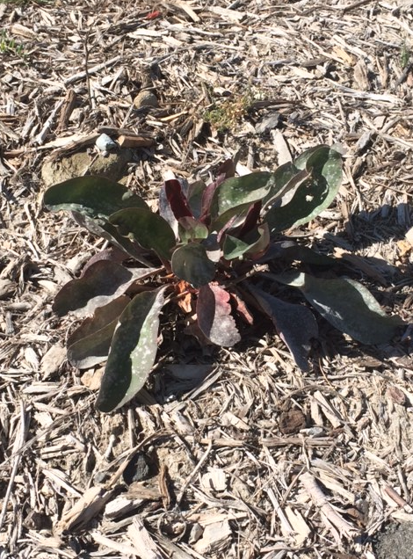
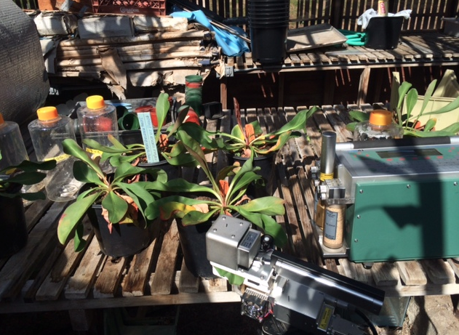
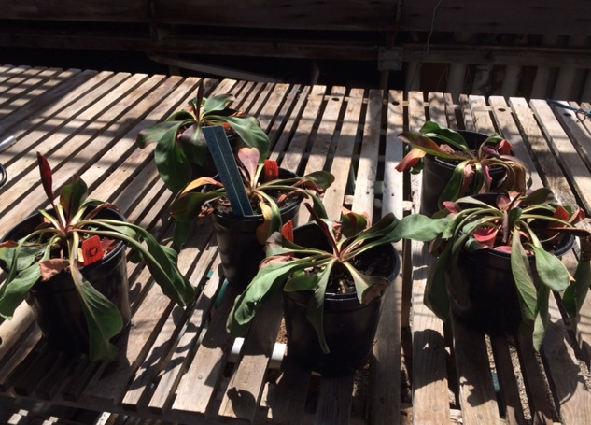
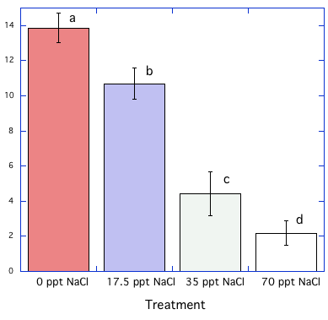
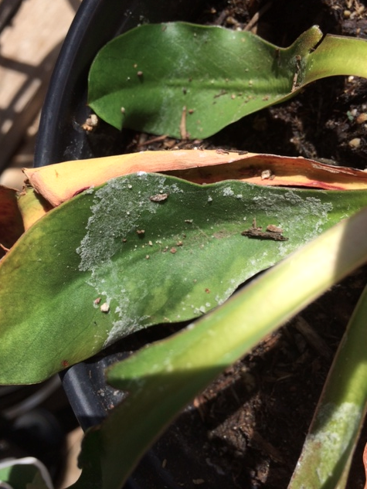
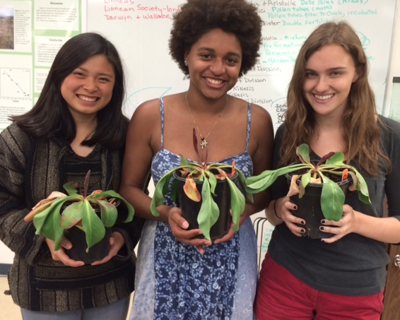
The Effects of Salinity on the Photosynthetic Rate of Limonium californicum
Adriana J. Borges, Elizabeth S. Chau, Justine M. McKitrick
Pepperdine University, Malibu, CA 90263
Limonium californicum
Malibu Lagoon State Beach, Malibu, CA
Abstract
Halophytic plants, unlike most plants, are able to survive in stressful saline environments. Halophytes possess adaptations to osmoregulate, which gives them a competitive edge in saline environments such as coastal salt marshes. Our group analyzed the responses to salinity of the halophytic plant, Limonium californicum, which is present in California’s coastal salt marshes. We hypothesized that the photosynthetic rate of the Limonium californicum plants would decrease with increasing saline water treatments. In order to test this hypothesis, we watered L. californicum plants with solutions of varying salinity over the course of four days. We measured the photosynthetic rates using the LiCor-6400 portable gas exchange system and used a one-way ANOVA statistical test with a Fisher's post-hoc test to analyze our results. We also measured the water potential of the plants with a Scholander-Hammel pressure chamber. We found that the photosynthetic rate of L. californicum decreases significantly as the soil water increases in salinity. However, we also found that the plants still survived and were able to maintain a positive photosynthetic rate even under -4.39 Mega Pascals of pressure. Our results were consistent with our hypothesis and are significant because understanding halophytic plant responses and adaptations to saline environments is important today due to climate change. If we were able to identify more halophyte adaptations to excess salt, in addition to salt glands, this information would help scientists engineer more stress-tolerant crops to withstand the climate changes and effects on water salinity occurring today.
Discussion
As a halophyte, Limonium californicum has several adaptations to enhance fitness in saline environments such as salt glands on its leaves where salt is excreted in order to adjust to varying osmotic conditions (Woodell and Mooney, 1969). Our results show that photosynthetic rate decreases with increasing salinity (Figure 3). While the changes in photosynthetic rate were slight when only half seawater was used, photosynthetic activity drastically declined in the plants when full and double seawater treatments were given to them. This corresponds to earlier studies of L. californicum’s photosynthetic response to saline stress where double seawater treatments resulted in a drastic decrease in photosynthetic activity (Woodell and Mooney. 1969). As we predicted, our results do not agree with the idea that halophytes find low saline environments more stressful than regular levels of salinity (Flowers and Colmer. 2008). There was a significant difference between the photosynthetic rates of the plants of each treatment except between the full and double seawater treatments. This lack of a significant difference indicates that full seawater is approaching L. californicum’s threshold of major damage due to osmotic stress. The results illustrate that L. californicum has some tolerance for salinity, but sacrifices photosynthetic efficiency by using up energy in the ionic transport of Na⁺ and Cl⁻ in order to survive in such saline environments. Furthermore, the high salt levels caused the plant’s water potentials to decrease substantially which resulted in a loss of turgor pressure. Without turgor pressure, stomatal pores cannot stay open and gas exchange is impeded which is necessary for photosynthesis (Woodell and Mooney. 1969). Even though L. californicum is more efficient in freshwater environments, it still has an incredible capacity to survive in saline ones. Our data showing its water potential at -4.39 MPa is a substantially lower water potential than most plants can survive at. Most plants die around -1.0 MPa of water potential. Sea water is -2.5 MPa, so Limonium californicum can handle even lower pressures than the average seawater salinity. Before treating the plants with saline solutions, they looked green and healthy with some red spots on leaves and some wilted crisp brown leaves (Figure 1). We noticed a considerable decline in the health of the plants and dense salt excretions on the leaves after treating them with double seawater (Figure 4). Most leaves were wilted and became a darker red or brown shade (Figure 2). The significant decline in the appearance of the health of the plants corresponds with our decreasing photosynthetic rate measurements with increased salinity. The presence of salt on the leaves after saline treatments supports our belief that Limonium californicum possesses salt glands in order to osmoregulate in extreme saline environments. After we finished treating our plants with saline solutions, we resumed treating them with pure distilled water in order to see if we could rehabilitate the plants. One day later, we noticed a substantial increase in the health and greenness of the plant. The plants’ rapid recovery attests to L. californicum’s incredible capacity to tolerate stress in poor conditions. Understanding the adaptations that account for L. californicum’s high stress tolerance are highly valuable because these traits could potentially be agriculturally engineered to produce more resilient and stable crops (Glenn. 1999). Stable and stress tolerant crops are becoming more essential in our current times of climate change due to global warming (Flowers and Muscolo. 2015).
Figure 1. Limonium californicum plants, prior to saline treatments, being measured by LiCor-6400 portable gas exchange system.
Figure 2. Limonium californicum following the double seawater saline treatment.
Results
The mean photosynthetic rates of the six plants for each treatment were significantly different between all treatments except between 35 ppt NaCl and 70 ppt NaCl according to a statistical one-way ANOVA test and Fisher's LSD post hoc test (Figure 3). Therefore, varying the salinity of water treatment given to Limonium californicum caused significant differences in the plants’ photosynthetic rate. Specifically, increasing the salinity of water treatments to Limonium californicum decreased photosynthetic rate. However, positive photosynthetic rates in the plants were maintained even after 70 ppt NaCl water treatments. We measured an average water potential of -4.39 MPa for the Limonium californicum plants with the Scholander-Hammel Pressure chamber the day after the 70 ppt NaCl treatment.
Introduction
Limonium californicum (California Sea Lavender) is a perennial herb found in coastal salt marshes in California and is a halophytic or “salt-loving plant” which grows in saline environments. Plants in coastal salt marshes undergo extreme variations in the osmotic concentration of soil water, so many have adaptations to handle these extreme salinities (Woodell and Mooney. 1969). However, these adaptations come at the cost of photosynthetic efficiency of the plants. Coastal native plants, such as Limonium californicum, are only at an advantage in saline environments, but are easily outcompeted in circumstances where salinity is not a notable factor (Kuhn and Zedler. 1997). Some sources argue that halophytes grow the best in saline environments and find extremely low or high saline environments stressful (Flowers and Colmer. 2008); however, we believed that all plants, including halophytes, would grow better in low saline environments as opposed to high ones if they are not competing with other species. In our experiment, we tested to see if the photosynthetic rate of Limonium californicum decreases with increasing soil salinity. We expected the plant to divert photosynthetic resources to salt tolerance adaptation mechanisms such as pumping salt out through leaf glands. Furthermore, we believed that the saline environment would cause the plant’s water potential to decrease which would lower guard cell turgor pressure in the stomata leading to a decrease in photosynthesis. In order to test this hypothesis, we varied the soil salinity of Limonium californicum plants and measured their photosynthetic response and final water potentials in order to determine the effects of salinity.Our studies of halophyte tolerance to extreme saline environments are significant due to today’s increasing climate change. Climate changes will cause an increase in salinity through drought and rising sea levels, and plants that can withstand extreme salinity will be favored to survive (Flowers and Muscolo. 2015). Understanding halophytic stress tolerance could lead to agricultural engineering of crops that could reclaim salt-affected soil or survive more stressful climate conditions in the future. Some scientists even believe that at lower salinities, halophytes can outperform conventional crops in yield and water use efficiency (Glenn. 1999). Therefore, studies like this one that help enhance our understanding of natural plant adaptations to saline environments can be used to possibly engineer more resilient agricultural crops for future climate change.
Photosynthetic Rate (μmol / m² s)
Conclusions
Our results demonstrate that Limonium californicum can withstand extreme saline environments, however, its survival comes at the cost of photosynthetic activity. As soil water salinity increases, Limonium californicum’s photosynthetic rate decreases along with its water potential. While the adaptations it possesses to survive, such as salt glands, hurt its photosynthetic efficiency, these adaptations enable it to survive in conditions where most plants cannot. Understanding these adaptations to saline environments and their effects on plant metabolism are becoming increasingly important in a time of extreme climate change. Climate change is predicted to increase water salinity in the future, so engineering plants with adaptations to salinity similar to Limonium californicum would be beneficial. If we had a better understanding of and if further research could be conducted on the underlying adaptations of stress tolerant plants that can survive extremely low water potentials and still be photosynthetically active, like Limonium californicum, numerous possibilities would open up to create more useful crops especially in our current times of climate change.
Materials and Methods
We purchased six healthy and similarly sized Limonium californicum plants from Theodore Payne Nursery in Sun Valley, California. We transported the plants to the air-conditioned Pepperdine greenhouse on the coast of Malibu, California. We began our experiment by marking a large healthy looking leaf on each plant with a sharpie in order to take measurements on the same leaf each day. We produced several solutions of varying salinity (0, 17.5, 35, 70 ppt NaCl) using deionized water. We gave all six Limonium plants 1 liter each of solution per day over the course of four days between 11:00 am and 3:00 pm. On day one, we watered each plant with 1 liter of 0 ppt solution of NaCl. On day two, we measured the photosynthetic rate of the plants with the LiCor-6400 about 24 hours after the plants had been watered. We set the LiCor at 400 ppm CO₂, the temperature at 22 degrees Celsius, and the PAR level at 2000 µmol/s² m¹to match maximum photosynthetic conditions in the greenhouse. We repeated this procedure the next three days but watered our plants with either 17.5 ppt NaCl (half seawater), 35 ppt NaCl (full seawater), and 70 ppt NaCl (double seawater) solutions instead of distilled water. We observed the extent of wilting, leaf color, and leaf salt excretions each day. After the double seawater treatment, we measured the water potential of each of our six Limonium californicum plants using a Scholander-Hammel pressure chamber. We statistically analyzed the data using KaleidaGraph. After we finished treating our plants with saline solutions, we continued to water them with distilled water with no NaCl for two days in order to see if the plants could be rehabilitated by observing their health.
Figure 3. Comparison of photosynthetic rates of Limonium californicum following daily watering treatments with varying salinities (0,17.5, 35 and 70 ppth NaCl) over the course of 5 days. Measurements were made roughly 24 hours after each treatment at midday using a LiCor-6400 portable gas exchange system. Bars represent ∓ 1 standard error. Statistical comparisons were made by a one-way ANOVA test followed by a Fischer’s post-hoc test. Letters a,b, and c that are different indicate significance at P<0.05, n=6.
Literature Cited
Flowers, T. J., and Colmer, T. D. 2008. Salinity Tolerance in Halophytes. New
Phytologist.179:945-963.
Flowers, T. J., and Muscolo, A. 2015. Halophytes in a Changing World. AoB
Plants. 8:45-57.
Glenn, E. P., Brown, J. J., and Blumwald, E. 1999. Salt Tolerance and Crop Potential of
Halophytes. Critical Reviews in Plant Sciences. 18:227-255.
Kuhn, N. L., and Zedler, J. B. 1997. Differential effects of salinity and soil saturation on native
and exotic plants of a coastal salt marsh.Estuaries, 20:391–403.
Woodell, S. R. J., H. A. Mooney. 1969. The Effect of Seawater on Carbon Dioxide Exchange
by the Halophyte Limonium californicum (Boiss.) Heller. Annals of Botany. 34:117-21.
Acknowledgements
Dr. Stephen Davis and Sawyer McGale
Photo Credit to Dr. Stephen Davis
Funding
Pepperdine University Natural Science Division
Figure 4. Limonium californicum leaf with NaCl excretions on surface following double seawater treatment.
Research group members holding Limonium californicum plants. Elizabeth Chau on left, Adrianna Davis in center, and Justine McKittrick on right.

