Slide 1
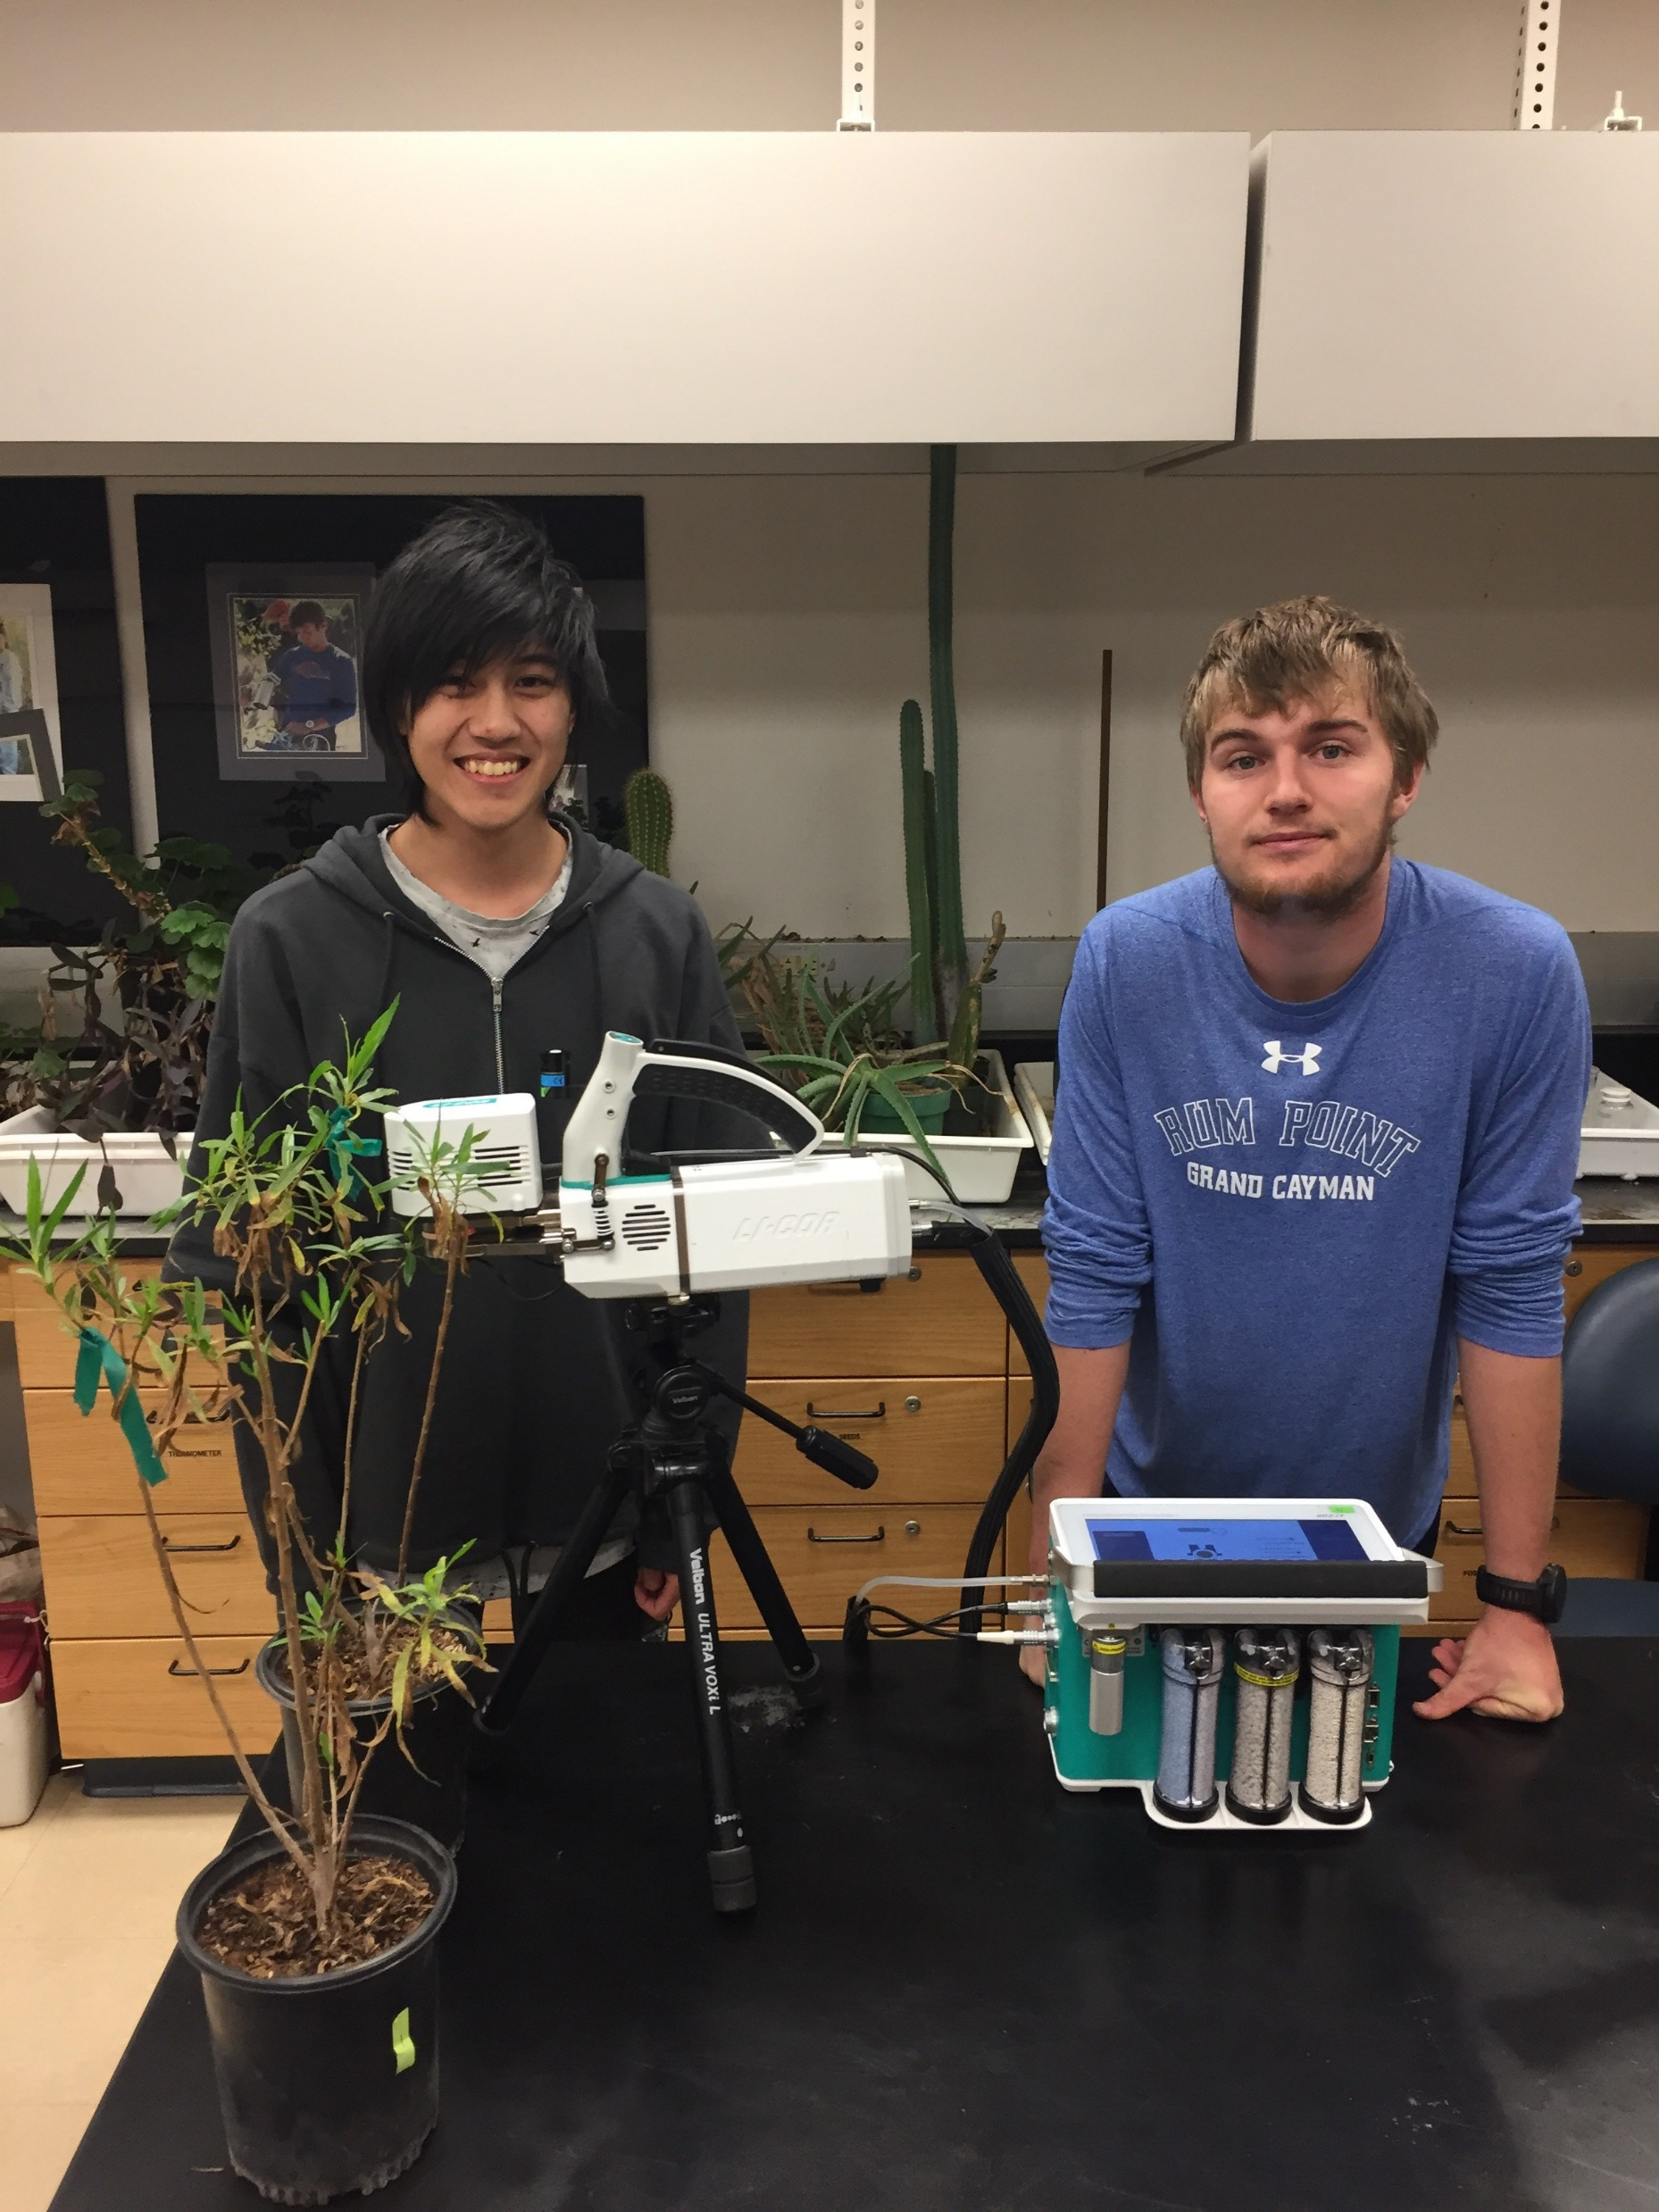
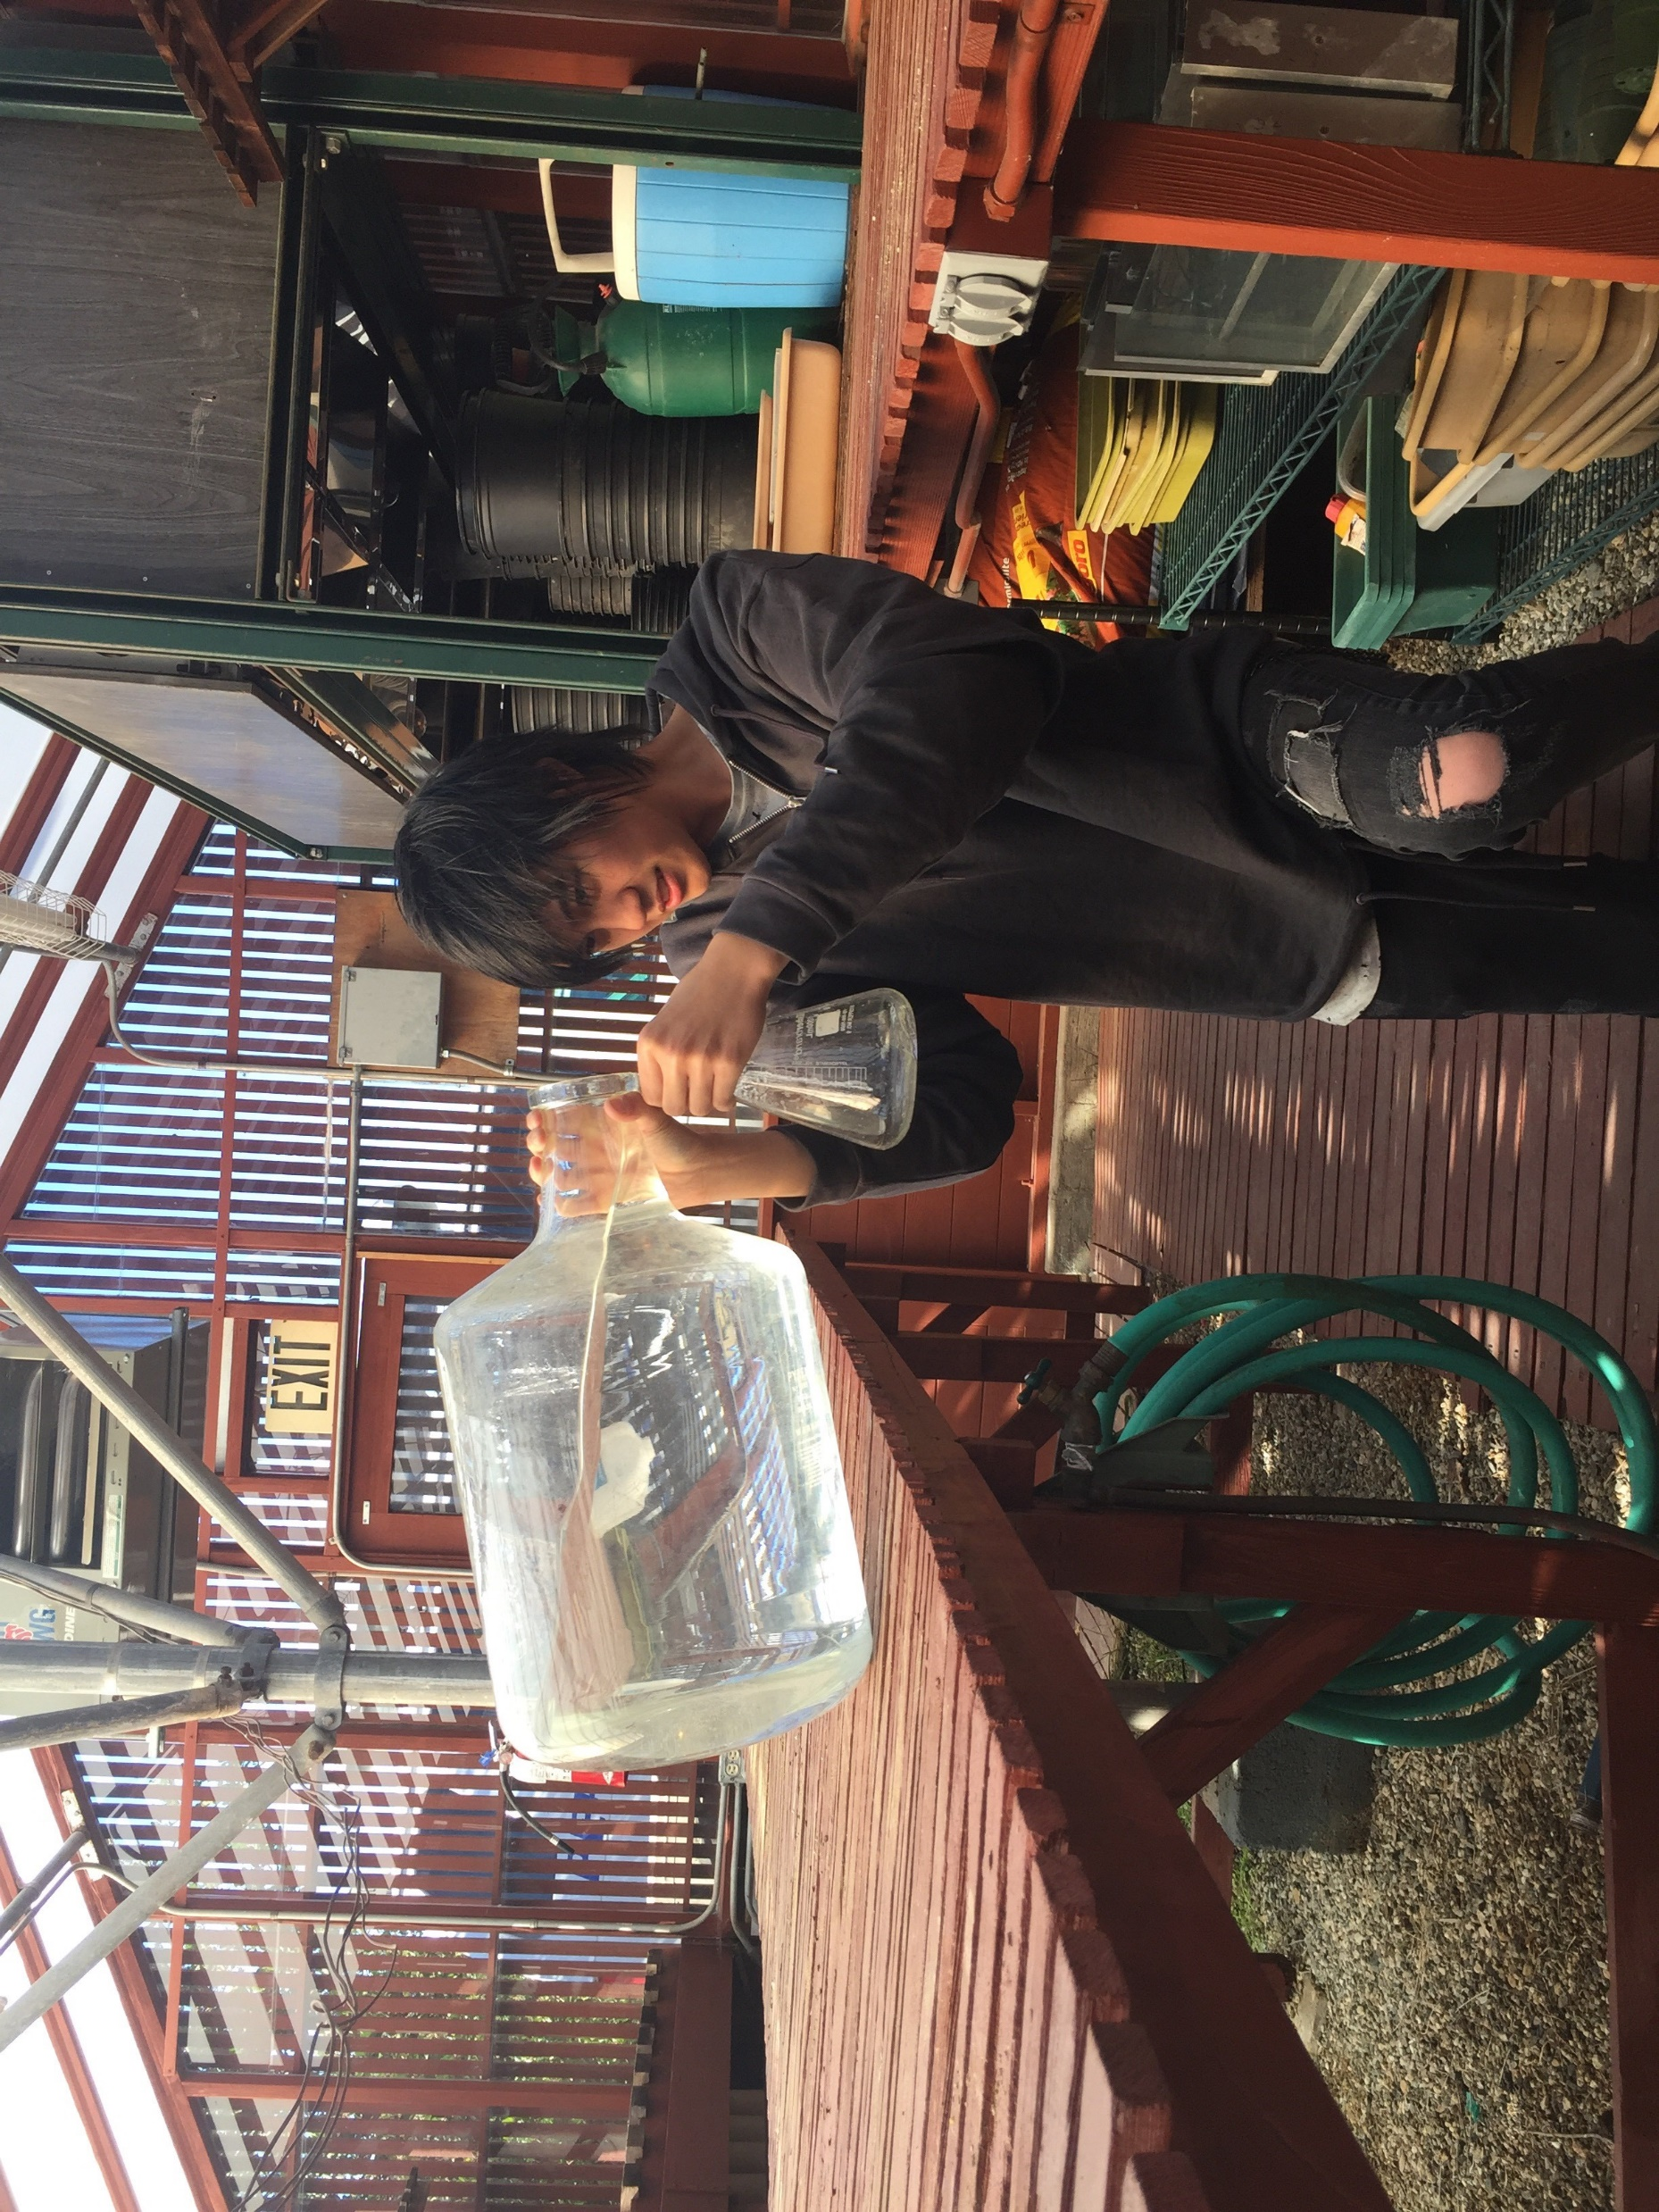
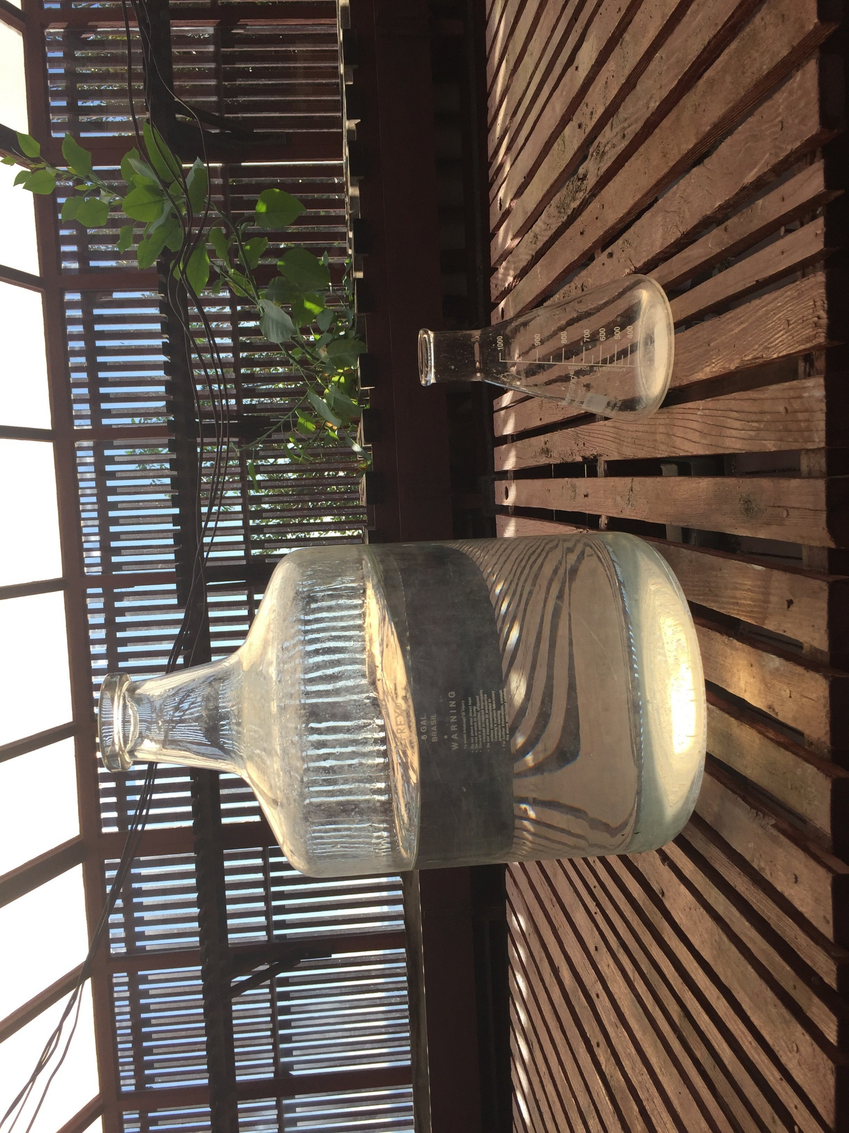
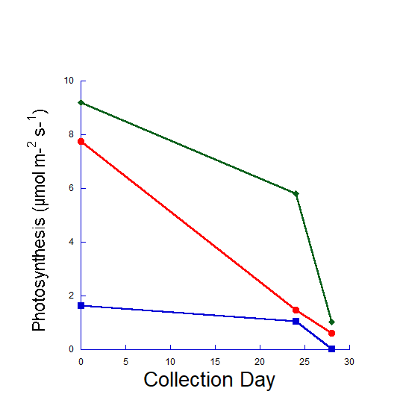
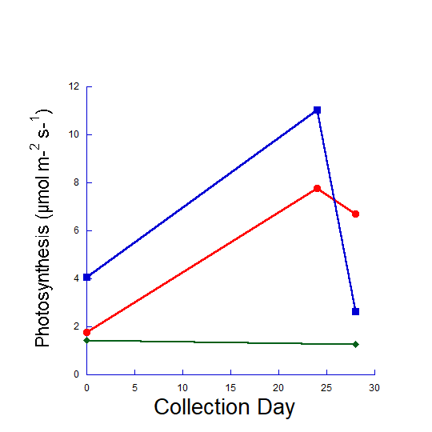
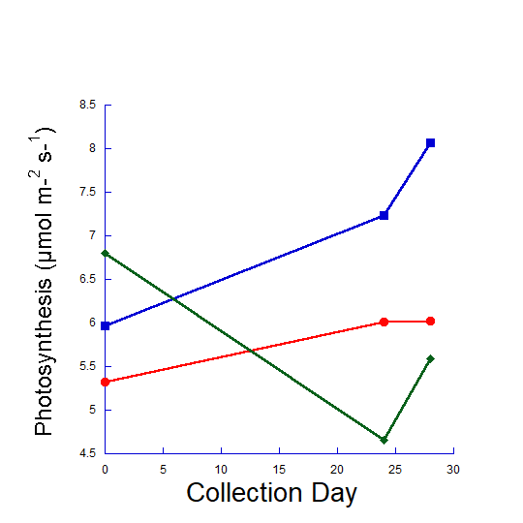
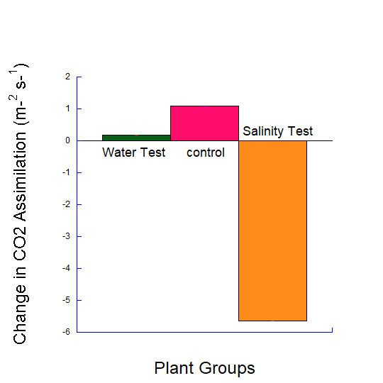
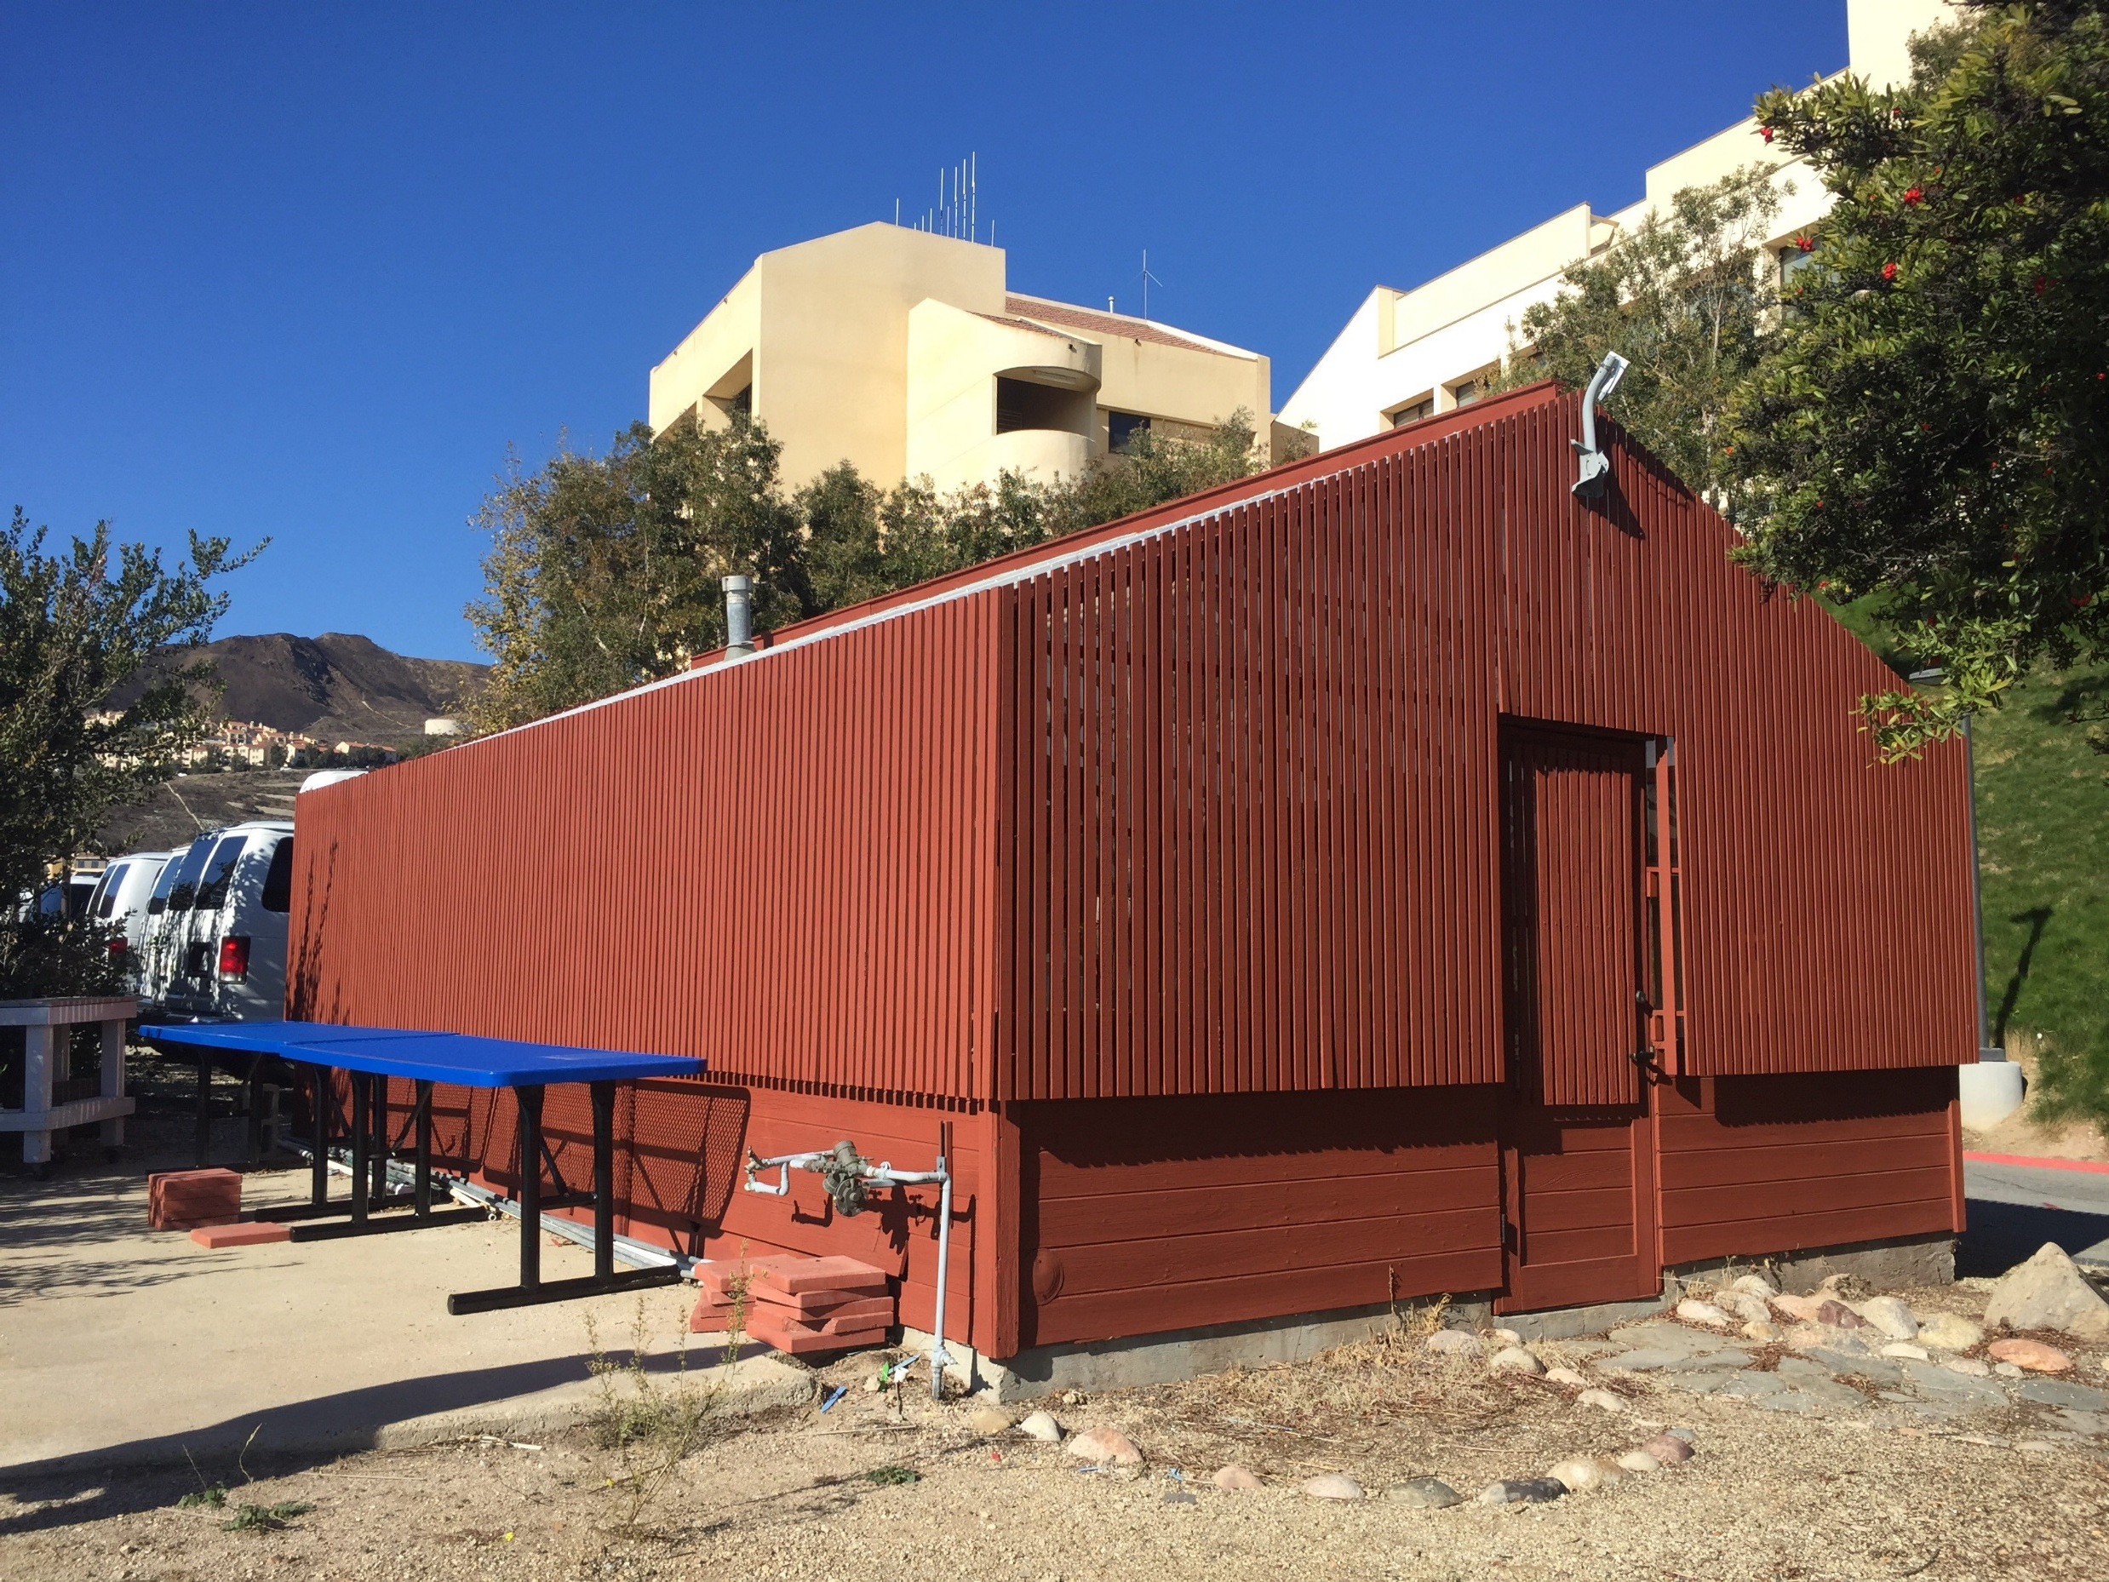
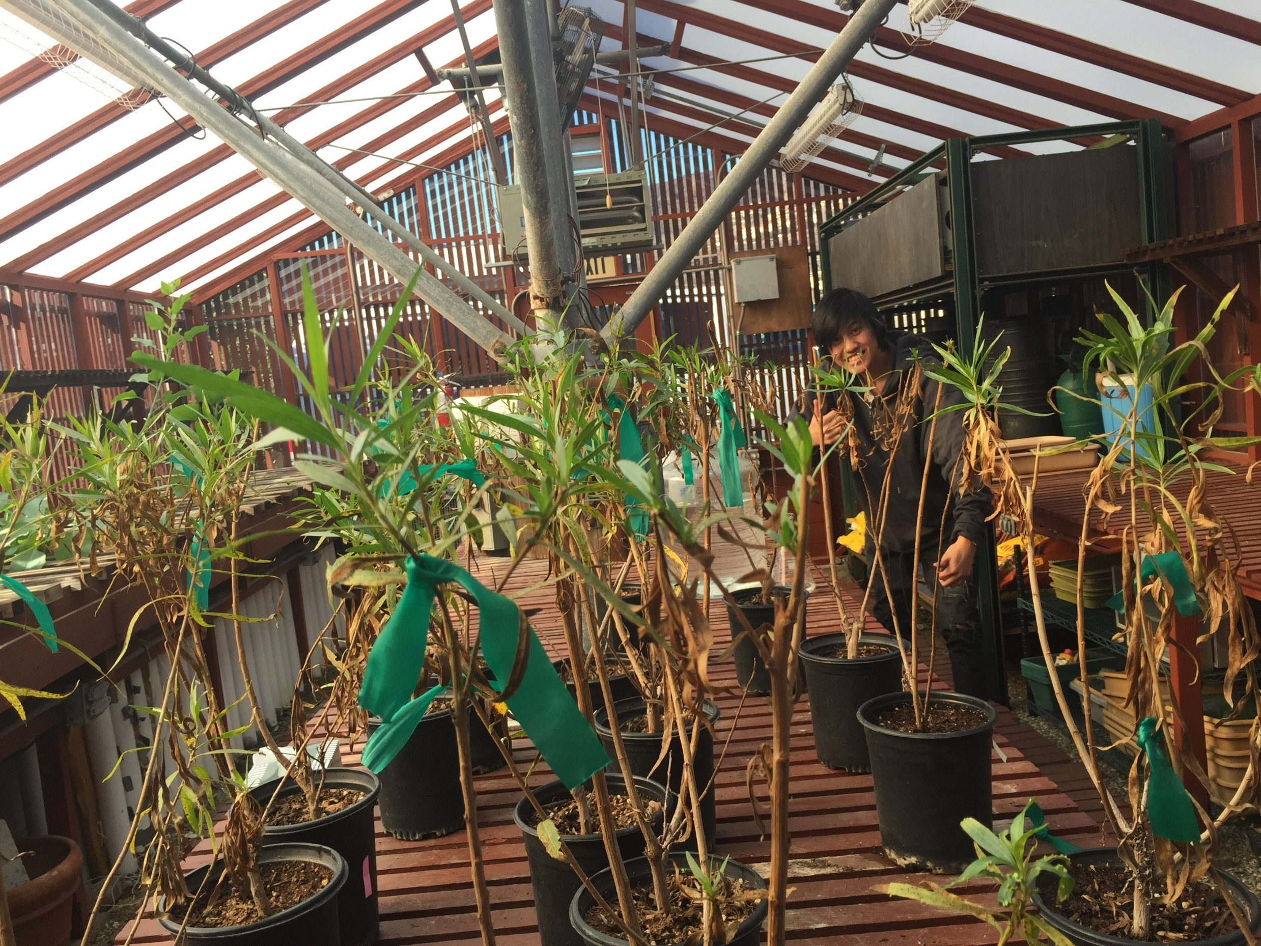
A Comparison of Different Methods of Dehydration on Baccharis salicifolia
Michael Nicholas and Sinjun Hong
Pepperdine University, 24255 Pacific Coast Highway, Malibu, CA, 90623
Abstract
Baccharis salicifolia is a native riparian plant living in many places near to the Santa Monica Mountains. One of these locations is Legacy park, which has had many events effect it that has led to some very unfortunate changes. The park’s soil was tested earlier this year by a group of undergraduate students lead by Dr. Stephen Davis and was found to have a very high salinity level. The plants in the park appeared to be struggling to survive and had signs of dehydration and wilting. This led to us questioning the types of dehydration of the plants. Areas of the park that were very dry and had low access to water seemed to host Baccharis salicifolia that was much healthier than other wetter areas of the park that were tested and determined to have much higher salinity. We questioned which method of dehydration had more of a negative affect on the health of the plant. Being able to answer this question would be able to provide the people that run legacy with vital information of how to fix the struggling plants of Legacy park. To answer this question, we first had to determine what health meant in terms of this experiment. Health was ultimately decided to be the gas exchange of the plant; meaning its photosynthetic rate. A negative impact on the gas exchange would be the decrease in the plants photosynthetic rate, and the greater the decrease the lower the health. We decided that the introduction of salt to the plant would have a greater negative impact on it than the decrease in water given to it. Our next step was to create an experiment. The plants would be separated into three different groups: a control group that was given 600 milliliters of water every day, a water test group that was only given 600 milliliters of water once in every four days, and a salinity test group that was given 600 milliliters of a 25 ppt (parts per thousand) salt solution. Then we measured their gas exchange rates over the course of a month. The results of the final test would determine which of the test groups (water or salinity) would have the greatest negative impact.
Methods
Discussion
Using the data we have collected; the results show that the B. salicifolia that had been treated with salt water had a significantly lower CO2 assimilation in comparison to both the control and the dehydrated B. salicifolia. We also saw that the lower leaves of all three were mostly dead while the ones higher up looked much healthier. This is seen at its most extreme again in the salt water treated B. salicifolia as there were almost no leaves on the plant except for some on the very top, which looked to be the healthiest out of all three treatments.
Fig 4: Shows Sinjun Hong measuring out 600mL of a 25 ppt of salt solution for each of the plants in the Salinity Test Group.
Fig 5: Shows the 25ppt (Parts Per Thousand) of salt solution made in bulk for the Salinity Test Group.
Fig 3: Shows us using the Li-6800 to record the gas exchange of each of the plants.
Conclusion
B
The average difference for the water stress treatment is .52605 m ^-2s ^-1 , for the control is 1.09446 m ^-2s ^-1, and for the saline water treatment is -5.639733 m ^-2s ^-1.
The data we have collected has supported our hypothesis because the saline water treatment caused the greatest decrease in the plants photosynthetic rate (CO2 assimilation) as compared to the other plants.
The CO2 assimilation had taken a significant drop for the salinity test while it had generally increased for both the control and the water test.
This shows that despite being given the proper amount of water, the added salt resulted in a significantly less healthy plant.
Our next steps will be to introduce the data to the people of Legacy Park and give more evidence that the saline water that will be pumped into the park is incredibly detrimental to the plant. This will hurt the plants more in the long run.
A
Introduction
Baccharis salicifolia, a native plant to the Malibu area, is a Costal Sage Scrub grown in Legacy Park. Our class had first learned about the plant during step forward day when we had taken data on it. We were then told how the water treatment facility would be pumping in more water into the park. However, the water would be incredibly saline which would possibly bring unforeseen consequences. Once we had leaned of this, both of us had talked about how badly this would affect the plants. We had then came up with the idea of comparing dehydrating the plants and watering them with highly saline water and seeing which one had a significant effect on the health. We had measured how healthy the Baccharis salicifolia using the LI-6800 which would measure the gas exchange of the plant by creating a controlled environment for the leaf
C
D
Works Cited
Lidia Caño , Teresa Fuertes-Mendizabal, Gonzalo García-Baquero, Mercedes Herrera, and M. Begoña González-Moro 2016. Plasticity to salinity and transgenerational eff ects in the nonnative shrub Baccharis halimifolia : Insights into an estuarine invasion. American Journal of Botany.
S. Miyamoto, I. Martinez, M. Padilla, A. Portillo, and D. Ornelas 2004. Landscape Plant Lists for Salt Tolerance Assessment.
Matthew W. Vandersande, Edward P. Glenn, and James L. Walworth 2001. Tolerance of five riparian plants from the lower Colorado River to salinity drought and inundation. Journal of Arid Environments.
Study Site
Fig 6: Depicts the different graphs created by the data gathered during our experiment. Graphs A,B, and C show the change in each plants CO2 assimilation over time with A being the Salinity test group, B being the control group, and C being the Water test group. Graph D shows the change in each groups CO2 assimilation from Day 0 when we measured the plants original health, and the last day of the experiment (Day 28) to illustrate the overall change that each group experienced.
Acknowledgements
This research was made possible with support fro Dr. Stephen Davis, Samantha Fiallo, and Karagan Smith.
Fig 1: Shows the outside of the campus greenhouse where our experiment took place.
Fig 2: Shows the interior of the campus greenhouse where our plants were kept, and the experiment took place

