Slide 1


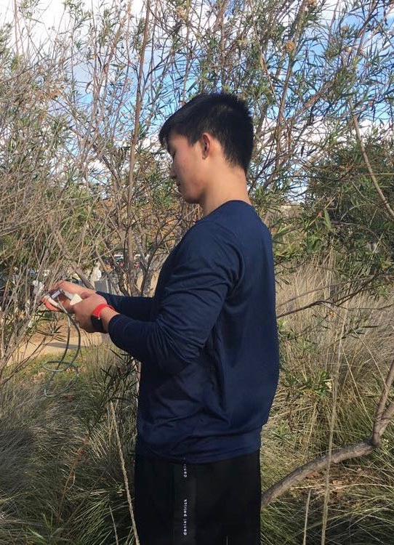
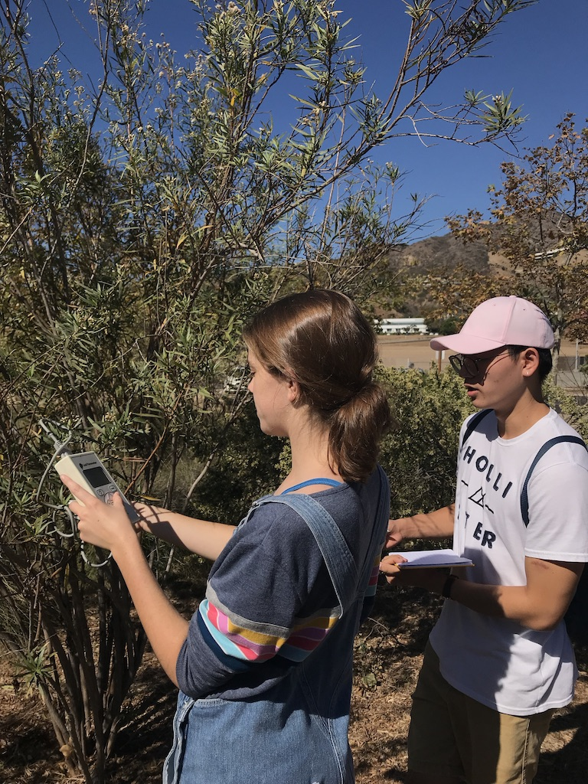
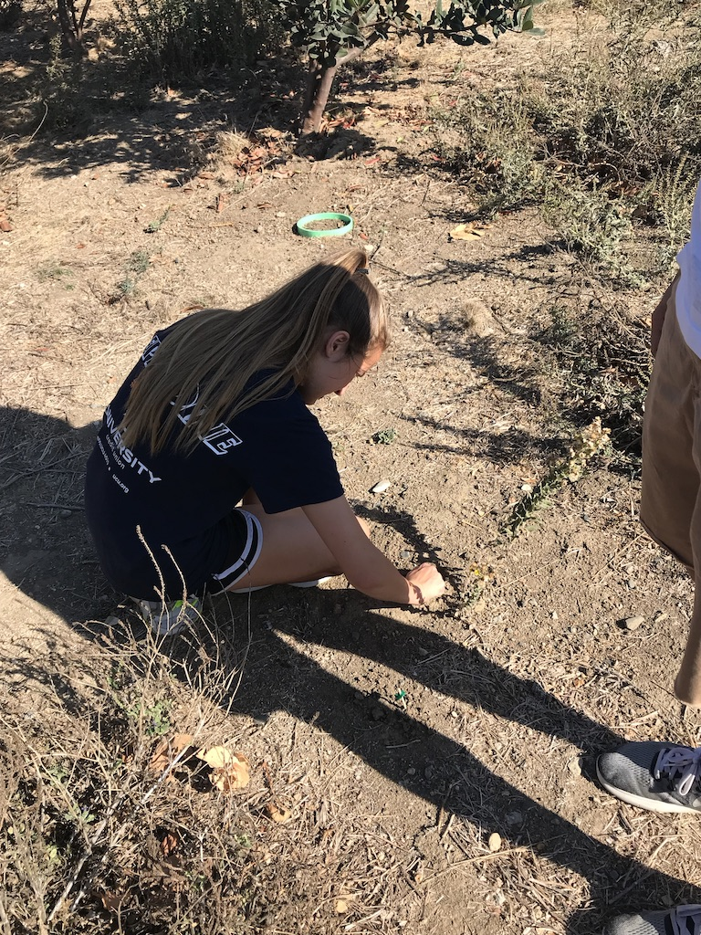
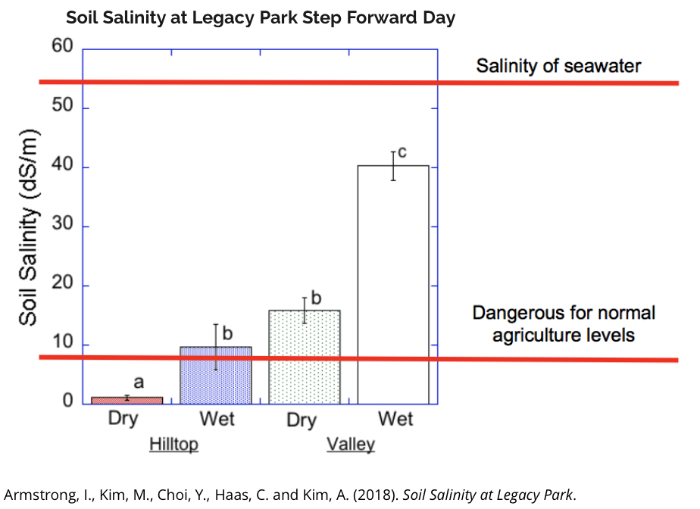
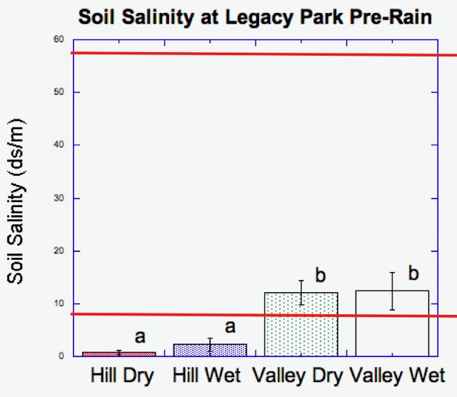
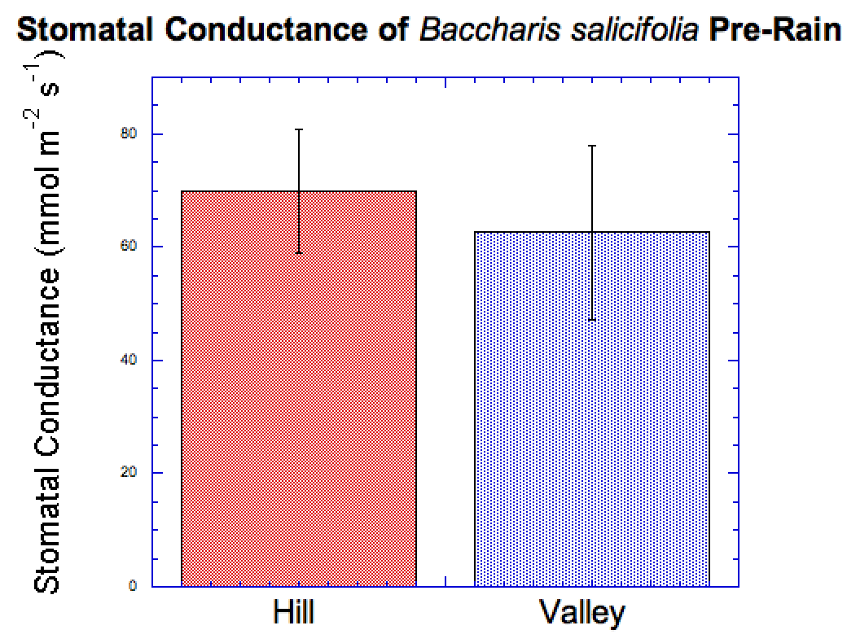
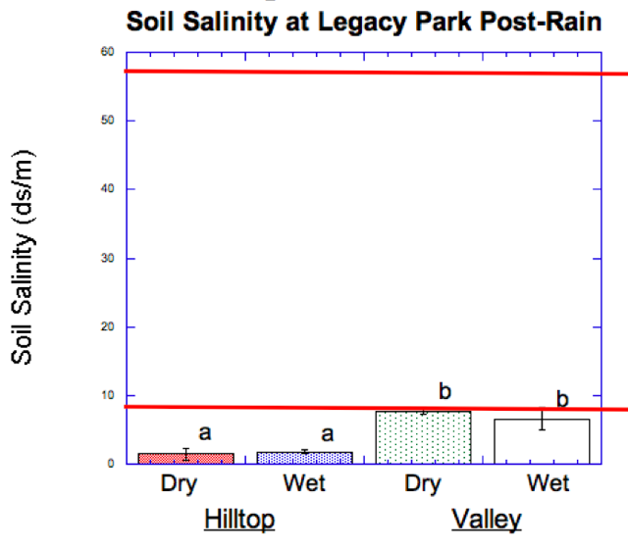
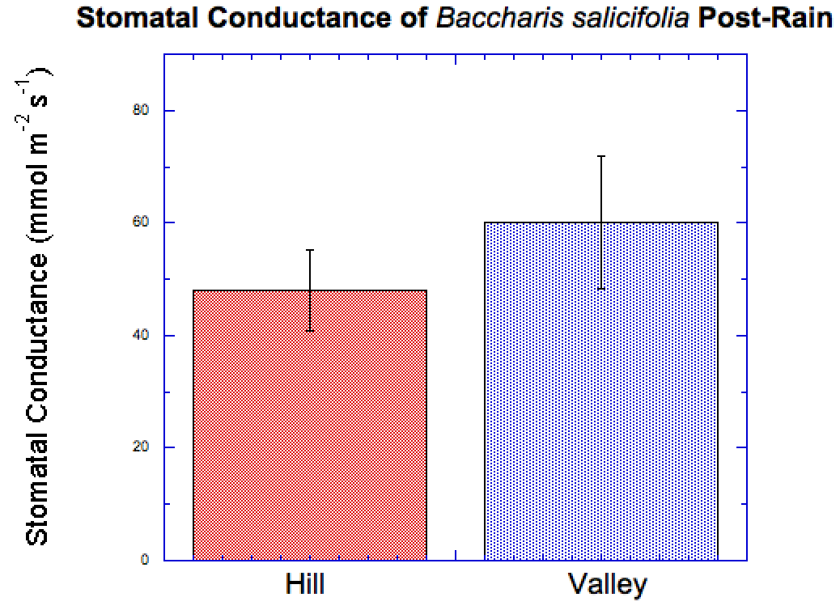
How Soil Salinity affects the Stomatal Conductance
of Baccharis salicifolia (Mulefat/Seepwillow)
Andrew Kim, Caroline Wilkerson, Mahala Bayless, Peter Du
Pepperdine University, 24255 Pacific Coast Highway, Malibu, CA 90263
Abstract
Discussion
This is a poster presentation demonstrating the project our group has been working on. We hypothesize that the stomatal conductance of mulefat will decrease as soil salinity increases in both pre-rain and post-rain conditions because the plant tries to absorb salt water. However, the salt water cannot pass through plant tissue and draws water out of the plant. Since plant requires water for photosynthesis, water being drawn out means less water is available for the plant to do photosynthesis. We have tested our hypothesis by collecting soil samples in Legacy park, and recorded stomatal conductance by using a leaf porometer
The stomatal conductance decreased after rain, and so did the soil salinity. The stomata of Baccharis salicifolia are more closed, which means the plant is losing less water through the leaves. Our preliminary data established that the soil salinity of the valley was higher than the soil salinity of the hill, and that was constant throughout our data. According to research done by Lidia Caño, higher salinity can also affect the biomass of the plant, and not just the stomatal conductance. Each time it rained, the soil salinity of both hill and valley sites decreased. However, we incorrectly anticipated that a higher soil salinity would lead to a lower level of stomatal conductance.. A lower rate of stomatal conductance means there is less water leaving the leaves of Baccharis salicifolia, and less carbon dioxide leaving the plant. Instead, after rain, there was a lower soil salinity, as well as a lower rate of stomatal conductance
Fig. 1: Conducting research at Legacy Park
Results
Introduction
Figure 2: Soil salinity at Legacy Park at Step Forward Day
Legacy Park is an essential part of Malibu. Without it, the beautiful Lagoon Beach would not exist. The park is a nursery ground, a rain garden, and a watershed which cleanses the dirty water and it is the habitat for various animal and plant species. The plants are essential to hold the soil in place, and Baccharis salicifolia(mulefat) is one of the most common California is known for its arid climate which increases soil salinity, and limits plant growth. On our first visit to the Legacy park, we found the yellowing of the leaves on plants that are lacking water. That’s how we came up with the idea to measure how soil salinity affects the stomatal conductance of Baccharis salicifolia. Our initial hypothesis is that the stomatal conductance of mulefat will decrease as soil salinity increases in both pre-rain and post-rain conditions. To test our hypothesis we took take five soil sites of dry and wet soil in hill and valley sites three times: Step-forward day, pre-dawn, and post-rain. Five plants of Baccharis salicifolia were found at hill and valley sites which we measured stomatal conductance twice, pre-rain, and post-rain.
Conclusion
Figure 3: a) soil salinity before rain and b)stomatal conductance before rain
The relationship between stomatal conductance and salinity may be nonexistent. While there was a decrease in stomatal conductance for hill sites, there was almost no decrease for valley sites. A potential reason for this lack of change in valley sites might be that effluent from the sewage systems leached through the soil. The stomata are more likely closed because the plants are severely dehydrated. It is difficult to know why the stomata are closed unless we measure the gas exchange rate for the plant. That would be the best next step for our research. We should also measure the soil salinity after the most recent rain to more fully examine the possibility of a correlation.
a)
b)
References
Figure 4: a) soil salinity after rain and b)stomatal conductance after rain
(1) Caño, L., Fuertes-Mendizabal, T.,García-Baquero, G., Herrera, M., and BegoñaGonzález-Moro, M.. 2016. Plasticity to salinity and transgenerationale ectsin the nonnative shrub Baccharishalimifolia: Insights into an estuarine invasion. American Journal of Botany. 103: 808-820.
(2) Glenn, E., Tanner, R., Mendez, S., Kehret, T., Moore, D., Garcia, J., and Valdez, C.. 1998. Growth rates, salt tolerance and water use characteristics of native and invasive riparian plants from the delta of the Colorado River, Mexico. Journal of Arid Environments. 40: 281-294
(3) Miyamoto, S., Martinez, I., Padilla, M., Portillo, A., and Ornelas, D.. 2004. Landscape Plant Lists for Salt Tolerance Assessment.
(4) Vandersande, M.W., Glenn, E.P., and Walworth, J.L.. 2001. Tolerance of five riparian plants from the lower Colorado River to salinity drought and inundation. Journal of Arid Environments. 49: 147-159.
(5) Young, D.R., Erickson, D.L., and Semones, W.. 1994. Salinity and the small-scale distribution of three barrier island shrubs. Can. J. Bot. 72: 1365-1372.
(6)Armstrong, I., Kim, M., Choi, Y., Haas, C. and Kim, A. (2018). Soil Salinity at Legacy Park.
Methods
a)
b)
We took take five soil samples of dry and wet soil in hill and valley sites at Legacy Park in Malibu, CA. Five plants of Baccharis salicifolia were found at hill and valley sites, without regard for salt salinity. These plants had their stomatal conductance tested using a porometer. This was conducted twice, once pre-rain, and once post-rain. Using a soil salinity meter, we were also able to find the salinities of five 10.0 g samples for each site (Hill Dry and Wet, Valley Dry and Wet) by mixing with water till at 50.0 mL. and submerging the salinity meter in the solution.
Acknowledgements
This research was funded by a grant from the National Science Foundation (NSF IUSE #1525878 and the Natural Science Division of Pepperdine University

