Slide 1
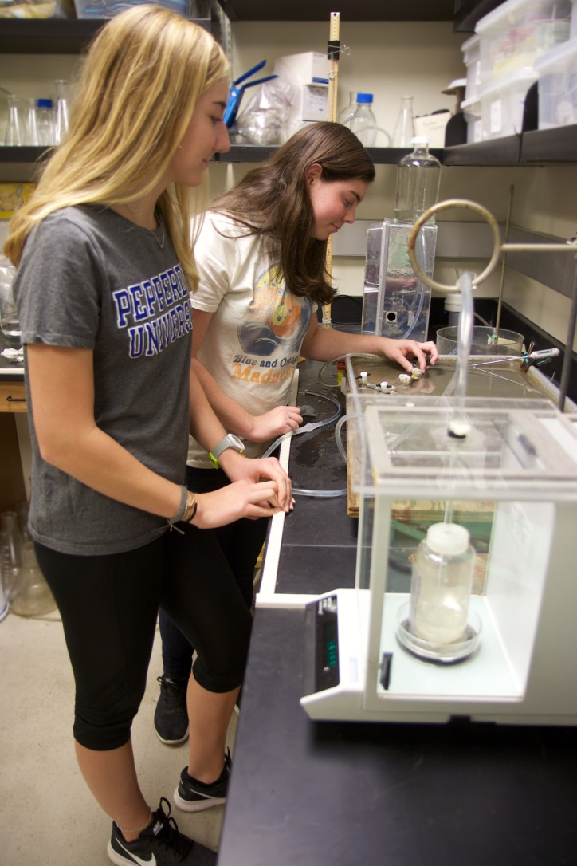
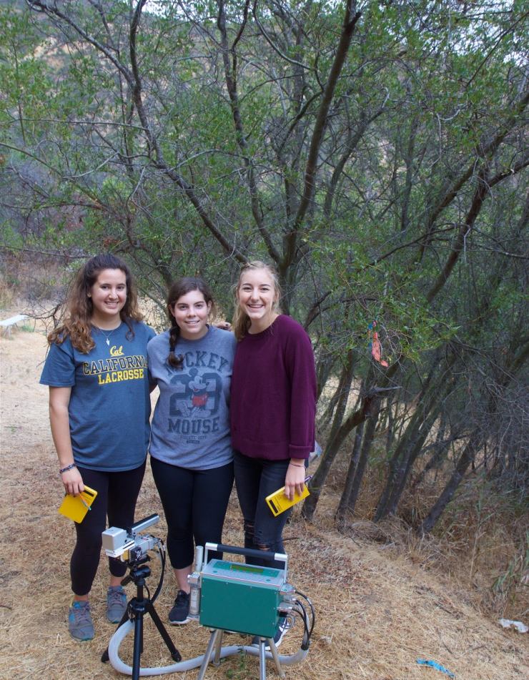
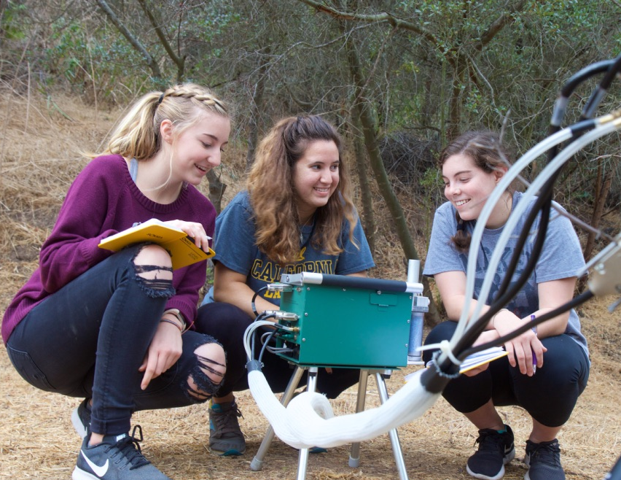
Post-Drought Recovery in the Chaparral Shrub Ceanothus spinosus
Katie C. Lindley, Kylie N. Smith, Nina R. Duchild
Mentors: Stephen D. Davis, Karagan L. Smith, Talia A. Cao
Pepperdine University, Natural Science Division, 24255 Pacific Coast Highway, Malibu, CA, 90263
Abstract
This study investigated the abilities of Ceanothus spinosus, or greenbark ceanothus, to recover after a historic drought. This plant is one of the hardiest in the Santa Monica Mountains, providing soil stabilization and nutrients to other organisms in the ecosystem. In a previous investigation done during the drought, it was found that C. spinosus subjects growing in their natural habitat experienced significant dieback, with predawn water potentials falling as low as -7 MPa and native embolisms at an average of 47.17% (Ross et al., 2016). Other parameters tested were stomatal conductance, photosynthetic rate, and chlorophyll fluorescence. Compared to the values found for C. spinosus subjects unaffected by the drought, the health of naturally occurring C. spinosus was significantly worse. To see if the health of C. spinosus had improved since the drought, this investigation was repeated. Fortunately, this study found that C. spinosus subjects affected by drought made a notable recovery just eight months after the drought ended. Water potentials improved significantly, with the highest recorded being at -1.75 MPa, and embolisms decreased by half since last year, with an average of 23.1% (P<0.05). Values for photosynthetic rate, stomatal conductance, and chlorophyll fluorescence showed improvement in the plant’s health as well. California is likely to experience severe droughts in the future, so it is promising that C. spinosus can make an effective recovery from this environmental stressor.
Methods
To test the hypothesis that non-irrigated C. spinosus had improved since last year’s study during the drought, it was necessary that the methods used in the 2016 study were repeated exactly. The same five irrigated control plants and six non-irrigated experimental plants were studied, and tests were done on all plants. Water potential, an indicator of how hydrated the plant is, was tested at predawn and midday with a Scholander-Hammel pressure chamber. Chlorophyll fluorescence, which indicates the plant’s efficiency at absorbing light, was tested with a chlorophyll meter at predawn. Gas exchange data was taken at the study sites using a LI-6400XT Portable Photosynthesis System. This system tests multiple factors,
Discussion
The hypothesis for this study stated that compared to last year’s values for gas exchange, chlorophyll fluorescence, and hydraulic conductance, this year’s values for the same C. spinosus plants occurring in their natural environment would be significantly improved. Results found supported that hypothesis, showing that C. spinosus can make an effective recovery just eight months after the end of a historic drought. Water potentials and percent embolisms have drastically improved, suggesting that the plant has repaired its embolisms and now can transport water more effectively through the xylem, which is essential for the plant’s ability to photosynthesize. Conductance has also increased, showing that the plant’s main goal isn’t water conservation anymore. It now is allowing more gases into the leaf to photosynthesize. A previous study on the response of Ceanothus species to drought found that the dieback observed in Ceanothus crassifolius indicated a strategy for drought survival. Leaf dieback reduced areas from which water could evaporate, and branch dieback allowed more water to be allocated to the surviving branches (Davis et al., 2001). C. spinosus, which is in the same family as C. crassifolius, seems to be using the same mechanism to survive these extreme conditions, because dieback was still observed this year. This dieback mechanism proposed has allowed C. spinosus to survive the drought and make it better equipped to recover from the drought. Although the water potential, percent embolism, fluorescence, and stomatal conductance values recorded in 2017 showed significant improvement from last year and are much closer to the values for irrigated C. spinosus, the dry C. spinosus still struggle to photosynthesize as effectively as subjects unaffected by drought, as seen in Figure 2. This result is supported by another study on the recovery ability of plants as indicated by photosynthetic rate. If a drought occurs before the plant has recovered from the last one, their ability to photosynthesize can be negatively affected permanently (Schwalm et al., 2017). Despite uncertainties relating to decreased photosynthesis, these results show that C. spinosus can recover after a period of historic drought.
segments but the study focused on photosynthetic rate and stomatal conductance, which is the amount that the stomata of the leaf are open to allow gas flow. Percent embolism and hydraulic conductance was tested using the Sperry Method (Sperry et al., 1996). In this method, C. spinosus branches were cut at predawn, brought back to the lab, and cut into smaller under water, to ensure that additional air did not get into the stems. The bark was shaved down at each end of the segment and a thin slice was cut off the ends so that it could be connected to the tubing on the Sperry apparatus and water could flow through the stem without additional blockages. An one way ANOVA to show statistical significance of the results.
Introduction
The chaparral ecosystem is characterized by a Mediterranean climate, which consists of hot, dry summers and mild winters. Chaparral plants often have woody stems, hard leaves, and are known for being able to survive in extreme conditions. Although chaparral plants can adapt to stressful environments, the historic five year drought in California led to an extreme increase in chaparral dieback. The effects of the drought on chaparral plants were studied by Andrew Palaski and Christopher Ross. During the fall of 2016 they studied the plant water relations of Ceanothus spinosus, a large tree-like chaparral shrub found in southern California. The results of their experiment demonstrated that the plants were under an extraordinary amount of stress, with high negative water potential, high embolism levels, and low photosynthetic rates. Once the drought was officially declared to be over on April 2017, we wanted to study if the Ceanothus spinosus had recovered approximately eight months post drought. We attempted to replicate their earlier experiment by using the same procedures and methods in order to minimize error and keep the variables constant. Our hypothesis is that there will be less negative water potential, a decrease in native embolism levels, an increase in plant gas exchange, and high fluorescence levels in Ceanothus spinosus, showing an overall increase in the health of the plant. It is crucial to understand how plants recover from drought and other stressful environments because as the global temperature rises, the chances of extreme drought and heat waves increases as well.
Results
Conclusion
Dry Ceanothus spinosus in 2017 showed overall improvement in health compared to its condition in 2016 with a lowered water potential (x̅ = -6.59 MPa in 2016 to x̅ = -2.32 MPa in 2017), an increased fluorescence rate (x̅ = 0.73 in 2016 to x̅ = 0.82 in 2017), an increased photosynthetic rate (x̅ = -0.21 μmol m⁻² s⁻¹ in 2016 to x̅ = 1.18 μmol m⁻² s⁻¹ in 2017), and a lowered percentage of air embolism in the xylem (x̅ = 47.17% in 2016 to x̅ = 23.1% in 2017).
Irrigated (control) C. spinosus, stayed consistent with 2016 data with no change in the fluorescence and percentage of air embolism in the xylem. There was a slight increase in water potential (x̅ = -3.4 MPa in 2016 to x̅ = -1.34 MPa in 2017) and the photosynthetic rate (x̅ = 9.02 μmol m⁻² s⁻¹ in 2016 to 11.1 μmol m⁻² s⁻¹ in 2017).
The drought induced dieback of C. spinosus showed a significant change in water potential, gas exchange, fluorescence, and water flow rate. Since the drought, C. spinosus is showing signs of improvement in its health.
Figure 1. Photosynthetic rates of dehydrated and irrigated C. spinosus in 2016 and 2017. Differences in letters indicated significant difference by a one-way ANOVA test with a Fisher’s LSD post-hoc test. P = < 0.0005, n= 5 to 6.
Figure 2. Percent of air embolism of dehydrated and irrigated C. spinosus in 2016 and 2017. Differences in letters indicated significant difference by a one-way ANOVA test with a Fisher’s LSD post-hoc test. P = < 0.0005, n= 5 to 6.
Literature Cited
1. AghaKouchak, A., L. Cheng, O. Mazdiyasni, and A. Farahmand (2014), Global warming and changes in risk of concurrent climate extremes: Insights from the 2014 California drought, Geophys. Res. Lett., 41(24), 8847–8852.
2. Schwalm, C., Anderegg, W., Michalak, A., Fisher, J., Biondi, F., Koch, G., Litvak, M., Ogle, K., Shaw, J., Wolf, A., Huntzinger, D., Schaefer, K., Cook, R., Wei, Y., Fang, Y., Hayes, D., Huang, M., Jain, A., Tian, H. (2017). Global patterns of drought recovery. Nature, 548 (7666), pp. 202. DOI: 10.1038/nature23021
3. Sperry, J. and Tyree, M. (1988). Mechanism of Water Stress-Induced Xylem Embolism. Plant Physiology, 88(3), pp.581-587.
4. Venturas, M., MacKinnon, E., Dario, H., Jacobsen, A., Pratt, R. and Davis, S. (2016). Chaparral Shrub Hydraulic Traits, Size, and Life History Types Relate to Species Mortality during California’s Historic Drought of 2014. PLOS ONE, 11(7), p.e0159145.
Study Site
Our study site was in the Santa Monica Mountains of Pepperdine Universty’s campus. The non irrigated Ceanothus spinosus plants were located at the Pepperdine Drescher Graduate Campus. Our study site for the irrigated plants, which were watered by the sprinklers, was located near the baseball fields at the Pepperdine Seaver College Campus.
Acknowledgements
This research was made possible with the Students as Scholars program and by funding from the National Science Foundation, NSF# 1525878. We would like to give our thanks to our mentor and professor, Dr. Stephen Davis, for all of his time and his heart that he put into helping us with our research. We would also like to thank our teaching mentors, Talia Cao and Karagan Smith, for their helpful guidance throughout our research project.
Figure 4. Pre-dawn water potential of dehydrated and irrigated C. spinosus in 2016 and 2017. Differences in letters indicated significant difference by a one-way ANOVA test with a Fisher’s LSD post-hoc test. P = < 0.0005, n= 5 to 6.
Figure 3. Fluorescence of dehydrated and irrigated C. spinosus in 2016 and 2017. Differences in letters indicated significant difference by a one-way ANOVA test with a Fisher’s LSD post-hoc test. P = < 0.0005, n= 5 to 6.

