Slide 1
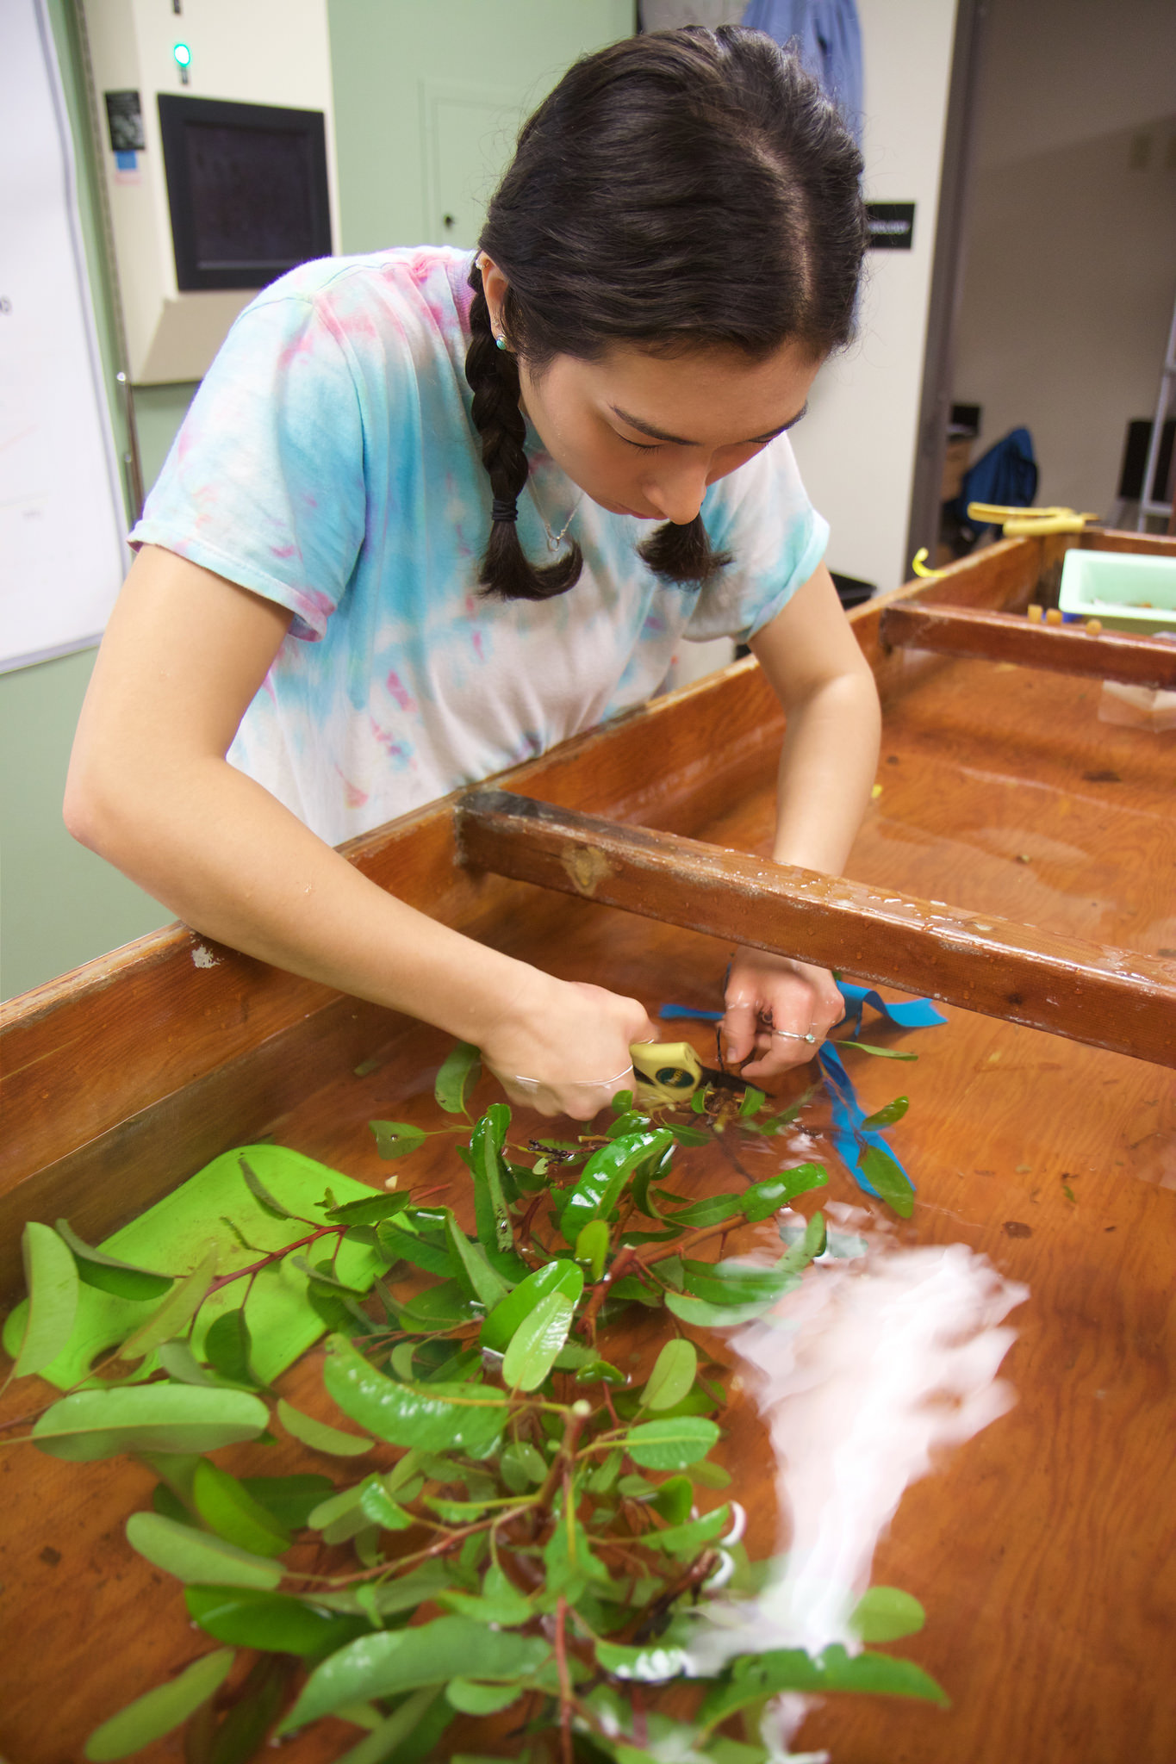
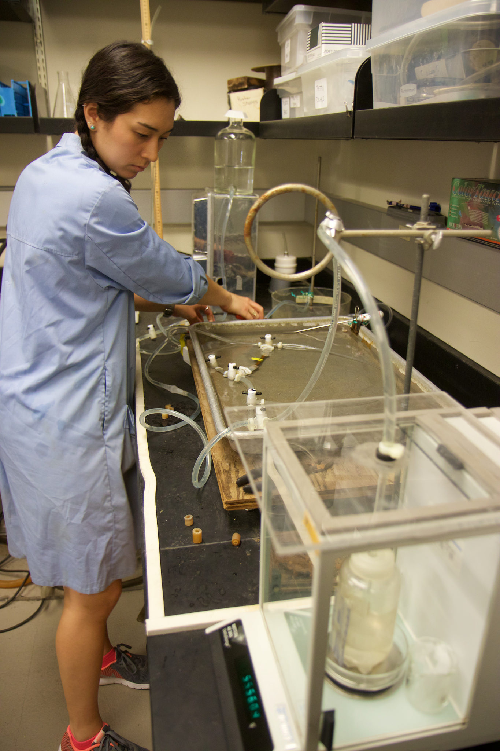
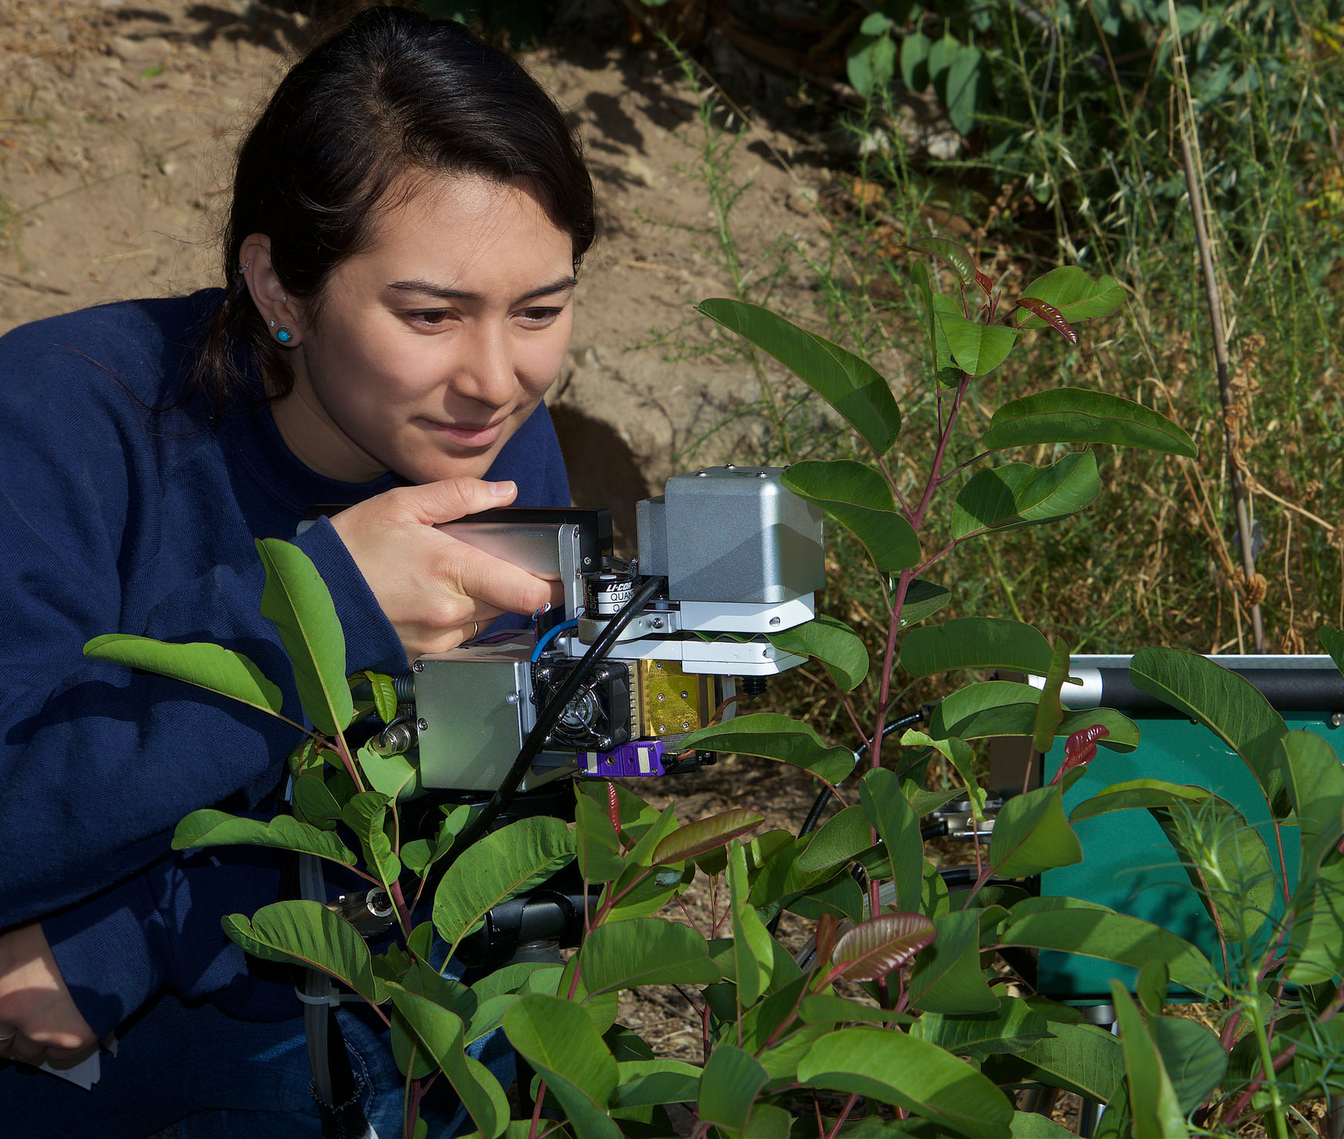
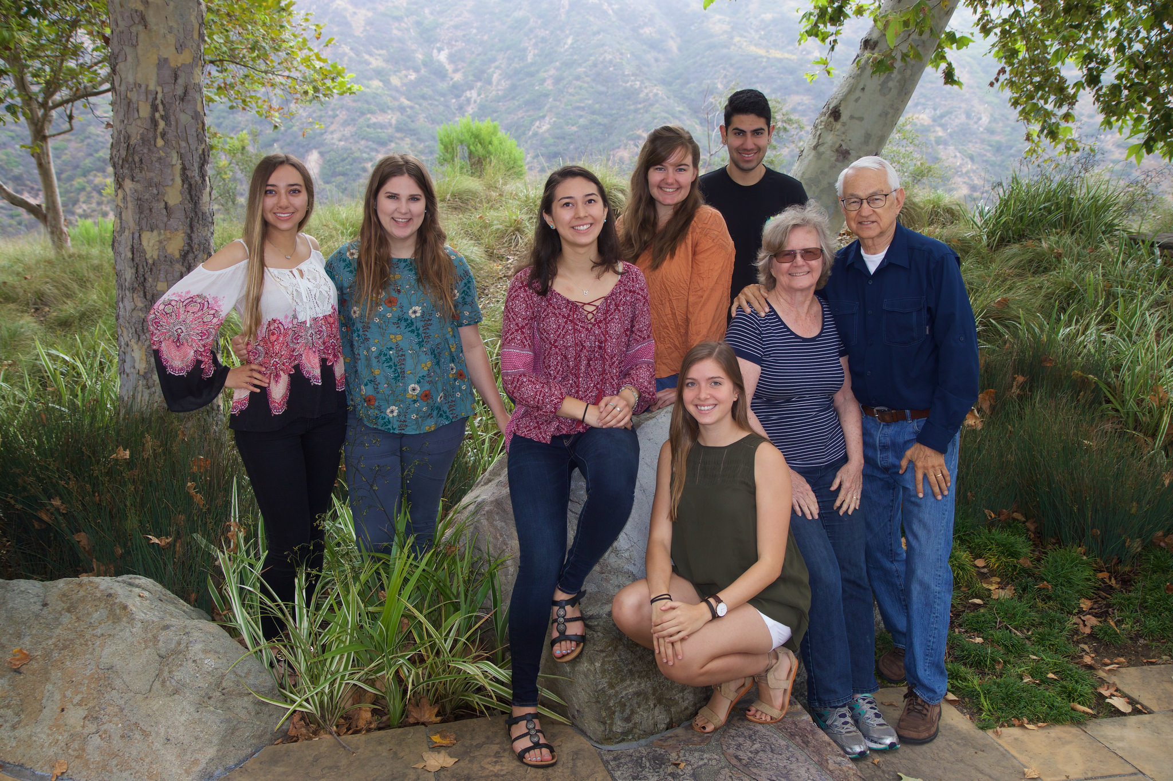
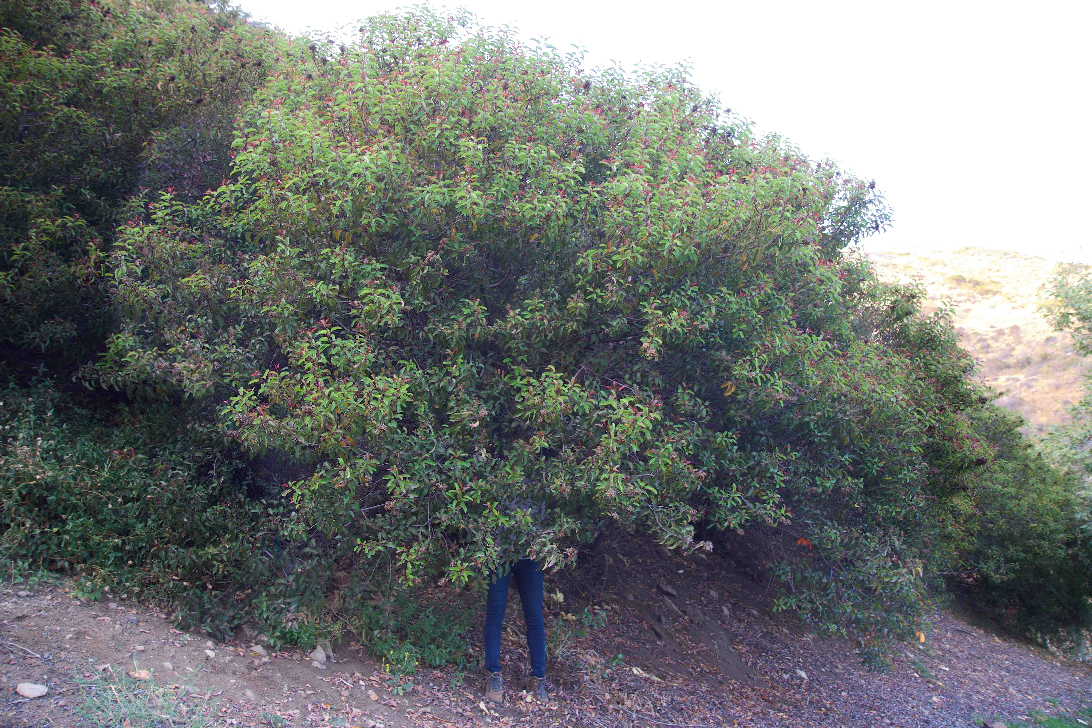
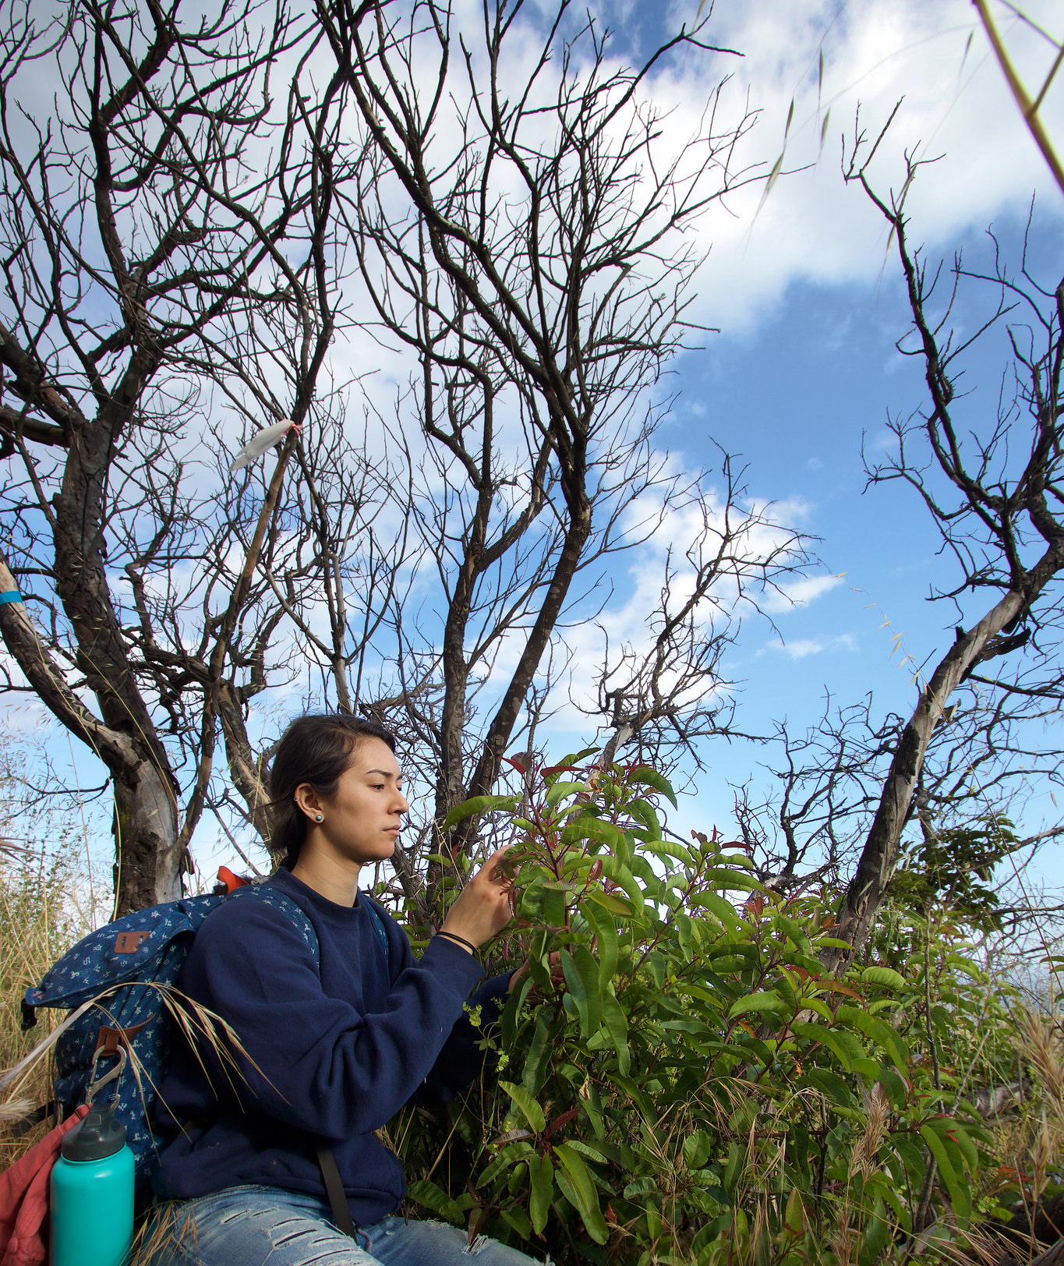
Potential Recovery from Drought-Induced Dieback in a Keystone Chaparral Species, Malosma laurina Guinevere X. Mesh Mentors: Natalie M. Aguirre and Stephen D. Davis Pepperdine University, 24255 Pacific Coast Highway, Malibu, CA 90263
Abstract
After five years of protracted drought and water-related dieback and mortality, the coastal chaparral ecosystems of the Santa Monica Mountains have finally received increased precipitation. As a co-dominant plant species in this region, Malosma laurina (common name Laurel Sumac), provides an important indication of environmental change. This study examines the effect of the increased precipitation of the 2016-2017 rainy season on potential recovery from drought-induced dieback in M. laurina. This study shows a significant increase in tissue hydration levels and photosynthetic production of dieback plants during post-drought recovery (2017) and between irrigated control sites and dieback sites.
Methods
Conclusions
After increased precipitation (Summer 2017), dieback M. laurina was significantly more hydrated than plants during the drought (Summer 2015), and in comparison to control plants, pointing to improved water status after rain (Figure 5).
Post-drought dieback M. laurina had a significantly higher xylem hydraulic conductivity than drought dieback plants, and was not significantly different from the control plants (Figure 6).
There was a marked increase in the rate of photosynthesis for dieback plants between drought and post-drought (Figure 7,8).
Further studies may examine the continued status of dieback resprouts and their susceptibility to secondary infection by pathogen.
A
B
Figure 4. Photosynthetic rate was assessed with the LI-6400XT. Throughout July 2017, between 9:00 AM and 12:00 PM, two LI-6400XT were taken to field sites to measure M. laurina.
Figure 2. Samples were collected at control and dieback sites pre-dawn. They were immediately brought back to the laboratory in iced, sealed bags. Pre-dawn water potential (Ψ_{pd}) was measured there using a pressure bomb.
Figure 3. Xylem specific conductivity (K_{s}) were calculated using the methods of Sperry et al. (1988). (A) shows stems being cut under water to reduce introduction of new air emboli. (B) shows the methods of Sperry et. al. (1988).
Introduction
After five years of unprecedented drought that caused mortality in native trees and shrubs throughout southern California, chaparral vegetation in the Santa Monica Mountains have finally seen adequate rainfall (LAAlmanac 2017). Coastal chaparral species, such as the co-dominant plant Malosma laurina (Laurel Sumac), have responded to changing climatic factors and have proved to be good indicators of environmental change and stress (Palmeri 2016). Though models of recovery have been proposed (Whyte et. al 2016), recovery from environmental stress has not been well documented (Venturas et al. 2017).
These plants present scientists with a valuable system to assess the potential damage and recovery of native species in a rapidly changing climate. Previous studies, conducted during the five-year drought, have documented response to drought-induced stress on M. laurina (Palmeri 2016). In this study, we examined whether heightened rainfall lead to increased soil water availability, efficiency in water transport, and photosynthetic rate. To accomplish this, we measured pre-dawn water potential (Ψ_{pd}), xylem specific conductivity (K_{s}), and photosynthetic rate (A) of adult and resprout control and dieback plants. By making comparisons between drought (2015) and post-drought (2017) conditions, we expect to provide an assessment of Malosma laurina plants post-drought.
Results
Figure 9. Though dieback plants are improving with the increased precipitation of 2016-2017, they are still heavily relying on resprouts.
Literature Cited
LAAlmanac: Total Seasonal Rainfall (Precipitation) Downtown Los Angeles, 1877-2016 [Internet]. 2017. Los Angeles (CA): Los Angeles Almanac: [cited 2017 May 12]. Available from: http://www.laalmanac.com/weather/we13.php
Palmeri, G. 2016. Malosma laurina Dieback Associated with Fungal-induced Loss in Hydraulic Conductivity and Photosynthesis.
Sperry, J.S., J.R. Donnelly, M.T. Tyree. 1988. A method for measuring hydraulic conductivity and embolism in xylem. Plant, Cell & Environment 11: 35-40.
Venturas, M.D., J.S. Sperry, and U.G. Hacke. 2017. Plant xylem hydraulics: what we understand, current research, and future challenges. Journal of Integrative Plant Biology.
Whyte, G., K. Howard, G.E.St.J. Hardy, T.I. Burgess. 2016. The Tree Decline Recovery Seesaw; a conceptual model of the deline and recovery ofdrought stressed plantation trees. Forest Ecology and Management 370: 102-113.
Figure 5. Pre-dawn water potential of drought (2015) and post-drought (2017) adult M. laurina control and dieback branches. Bars on symbols represent ±1 S.E., n = 6-12. Letters on symbols indicate significant differences in mean value at p < 0.05 by one way ANOVA, followed by a Tukey-Kramer HSD test.
Figure 6. Native xylem specific conductivity (K_{s}) of drought (2015) and post-drought (2017) adult M. laurina control and dieback branches. Bars on symbols represent ±1 S.E., n = 12-29. Letters on symbols indicate significant differences in mean value at p < 0.05 by one way ANOVA, followed by a Tukey-Kramer HSD test.
Hypotheses
HI: There will be a significant increase in water status (Ψ_{pd}) in dieback plants when comparing drought (Summer 2015) to post-drought conditions (Summer 2017).
H2: There will be a significant increase in water transport efficiency of stem xylem (K_{s}) in dieback plants when comparing drought (Summer 2015) to post-drought conditions (Summer 2017).
H3: There will be a significant increase in the rate of photosynthesis when comparing drought (Summer 2015) to post-drought conditions (Summer 2017).
Acknowledgments
This research was funded by the National Science Foundation, Research Experience for Undergraduates. REU-Site Award #DBI-1560352 and the Natural Science Division of Pepperdine University. Special thanks to Dr. Stephen Davis, Natalie Aguirre, Karagan Smith, Cristian Garcia, Adam Fahey, and Helen Holmlund, who all helped make this project possible. Additional thanks to all the SURB students and faculty who contributed in one way or another.
Study Sites
Figure 1. Images of M. laurina at control and dieback sites on campus at Pepperdine University. (A) shows the control site the Theme Tower, (B) shows the dieback site on the Dresher Graduate Campus.
Figure 7. Rate of photosynthesis in adult branches of M. laurina. Branches were collected from the Theme Tower (control) and Drescher Graduate Campus (dieback) in both 2015 and 2017. Bars on symbols represent ±1 S.E., n = 6-17. Letters on symbols indicate significant differences in mean value at p < 0.05 by one way ANOVA, followed by a Tukey-Kramer HSD test.
Figure 8. Rate of photosynthesis in resprout branches of M. laurina. Branches were collected from the Theme Tower (control) and Drescher Graduate Campus (dieback) in both 2015 and 2017. Bars on symbols represent ±1 S.E., n = 6-17. Letters on symbols indicate significant differences in mean value at p < 0.05 by one way ANOVA, followed by a Tukey-Kramer HSD test.
A
B
Notes:
***FOR PHOTOSYNTHETIC PRODUCTION→ which tested variable is the most powerful/makes the most sense to put in my presentation? Should I do photosynthesis?
Instead of 2015, 2017, should I label ‘drought’ and ‘post drought?’
Talk more about seesaw model??

