Slide 1
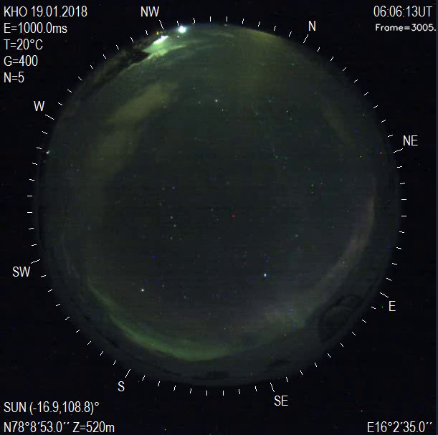
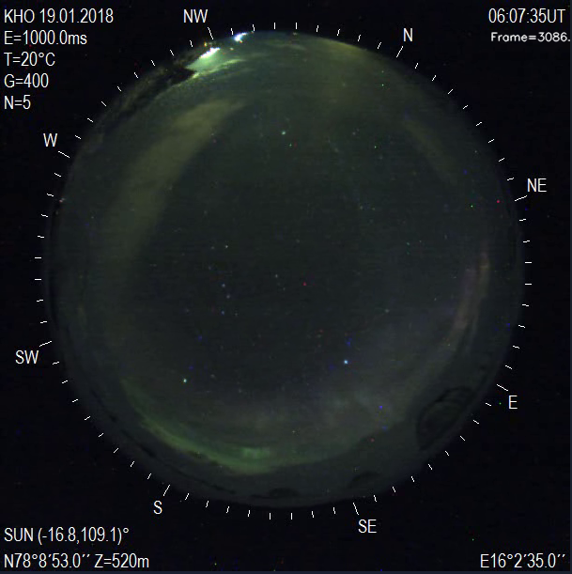
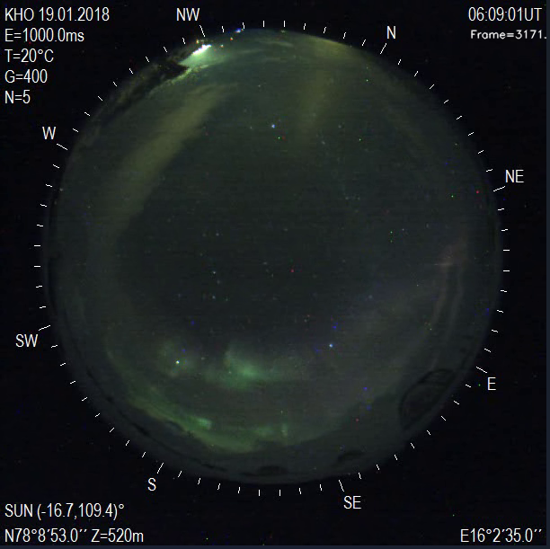
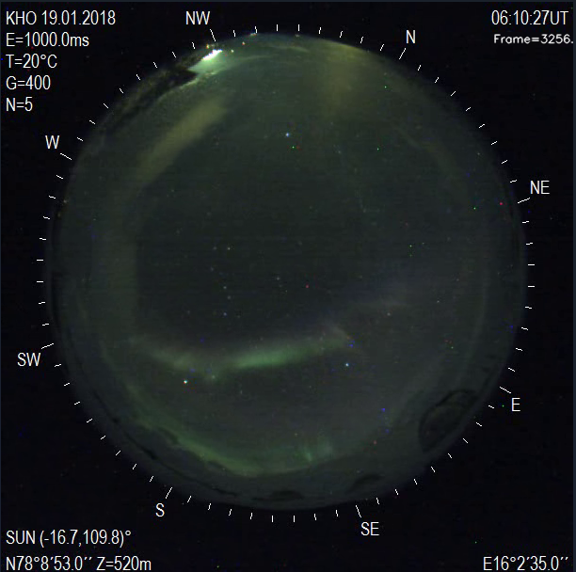
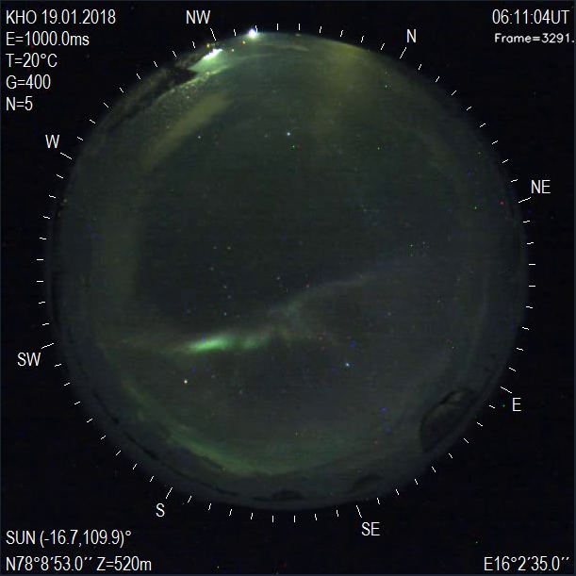
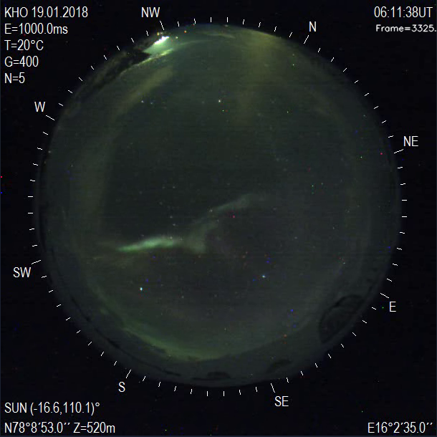
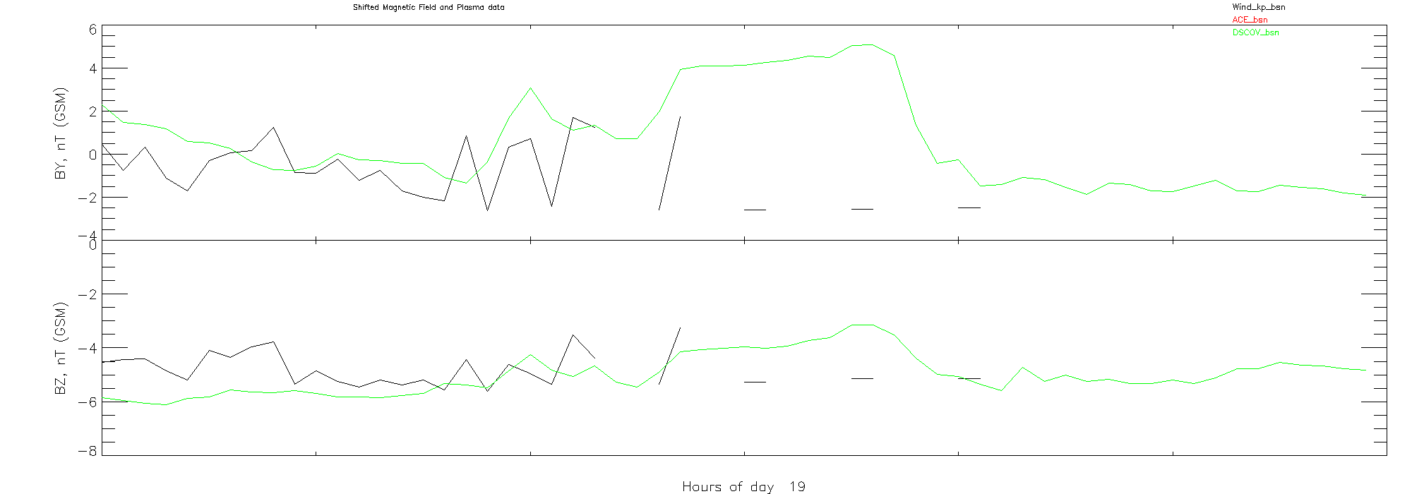
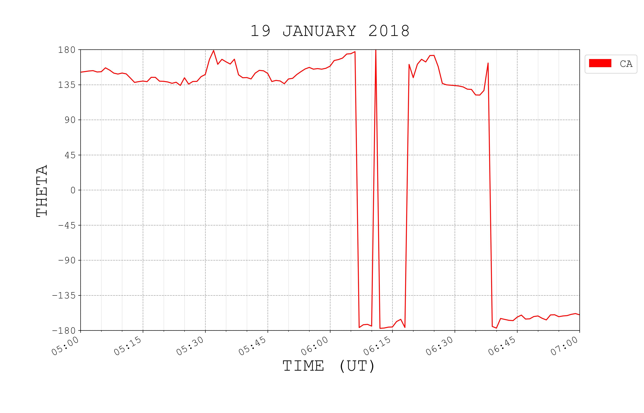
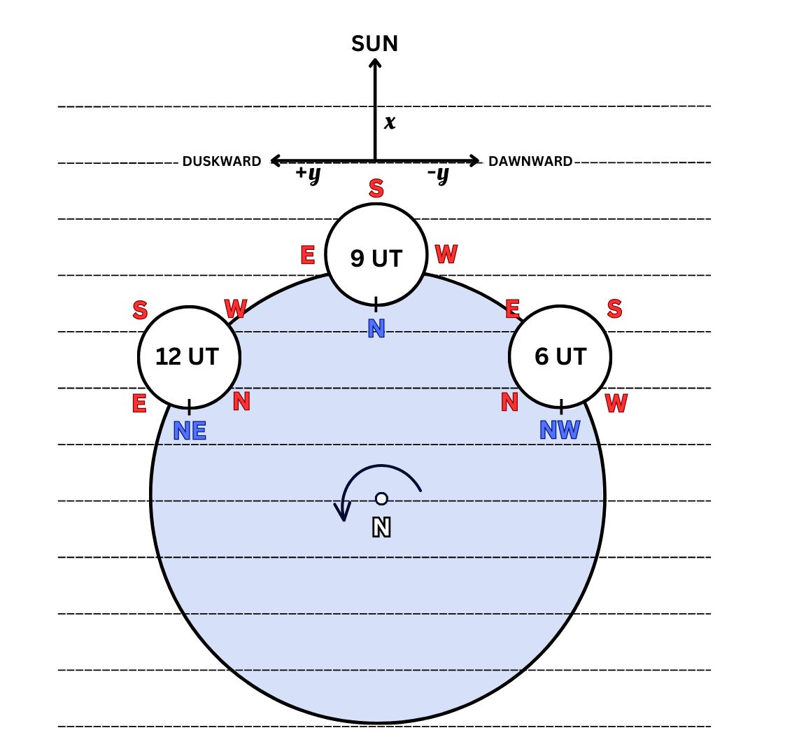
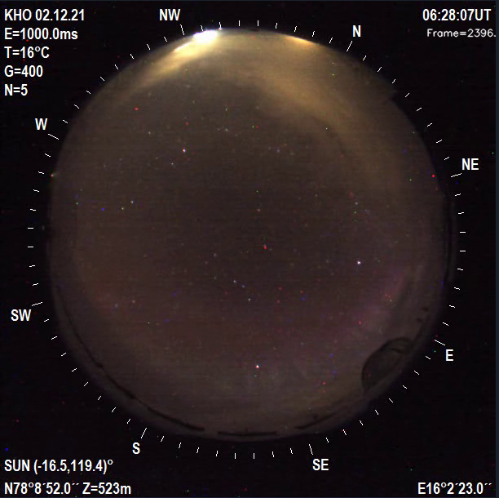
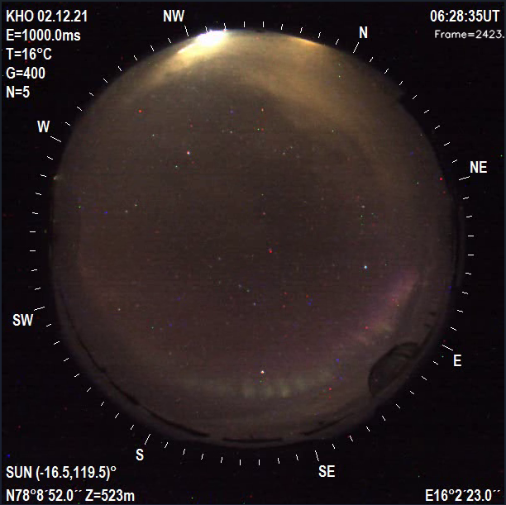
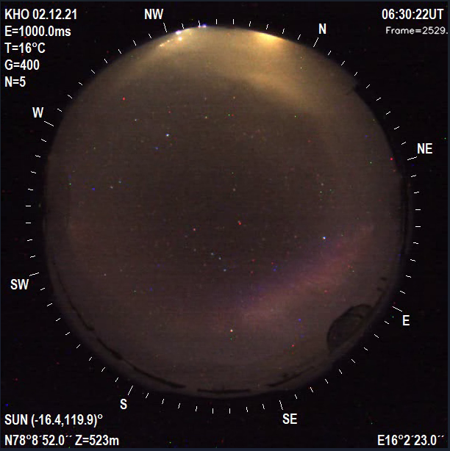
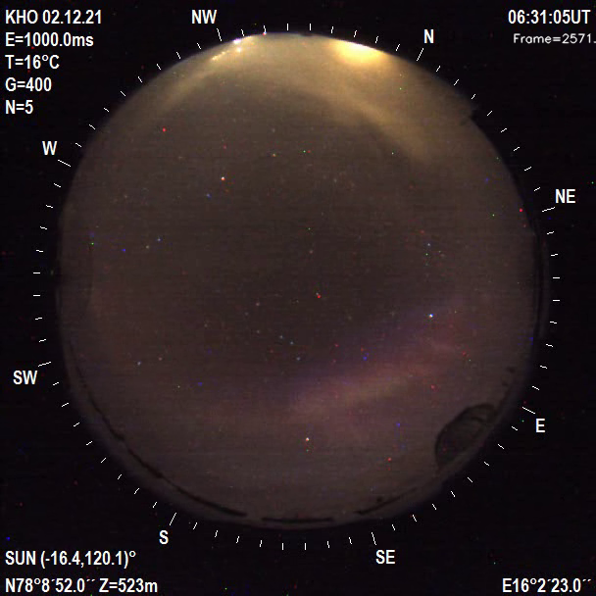
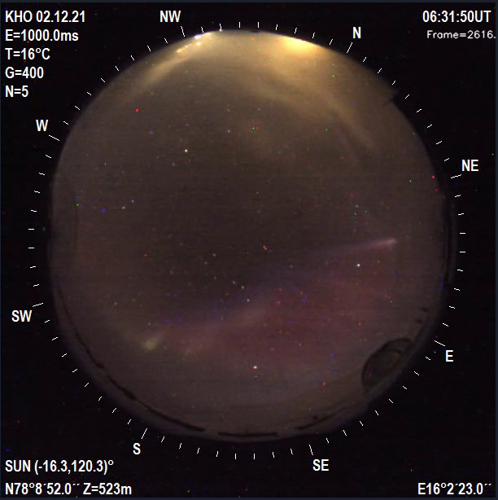
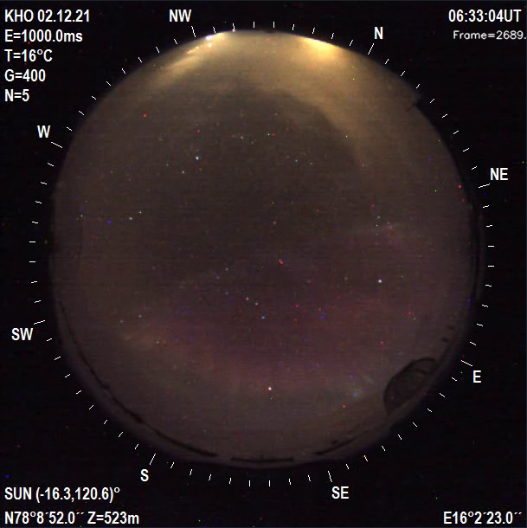
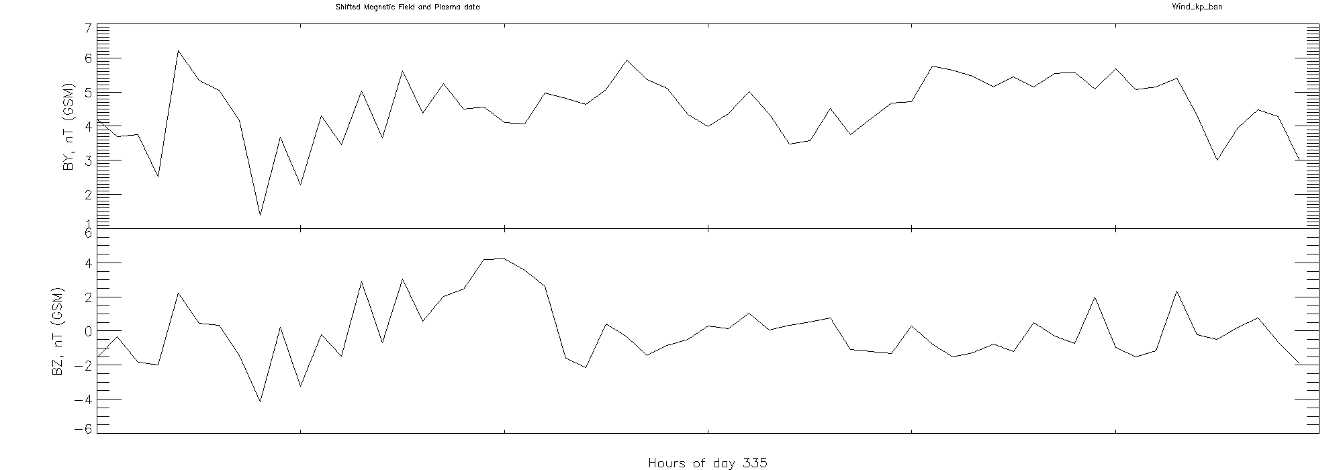
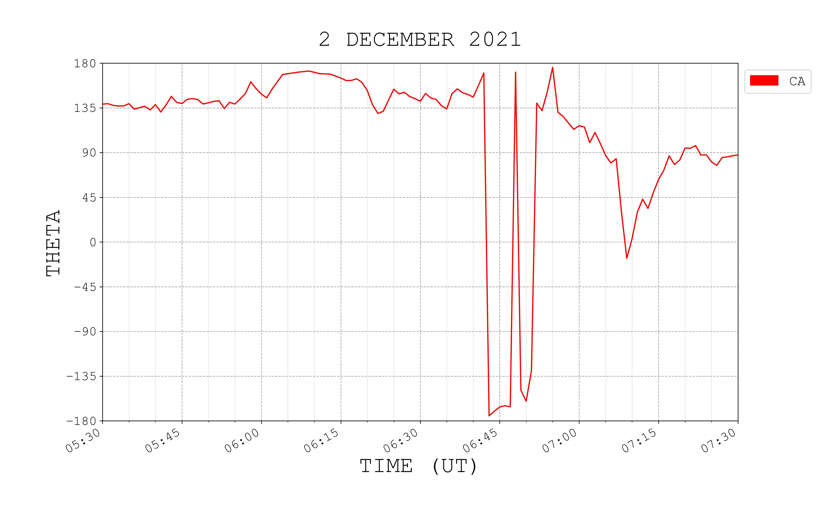
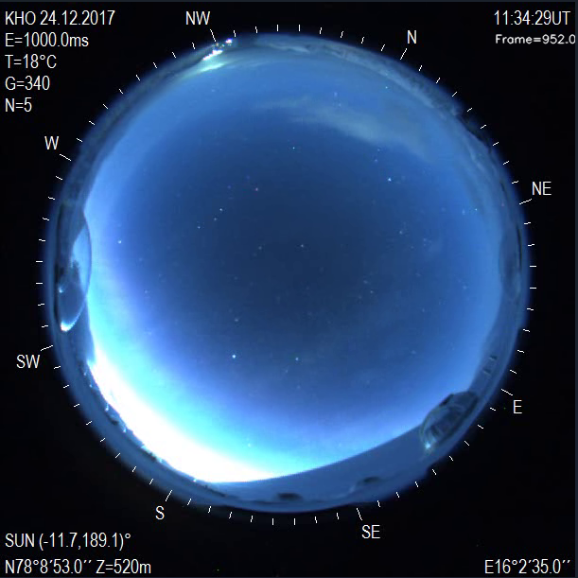
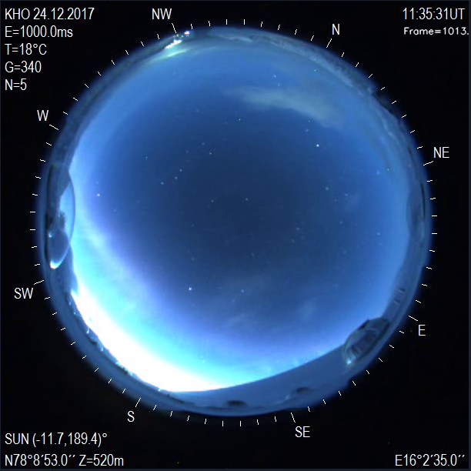
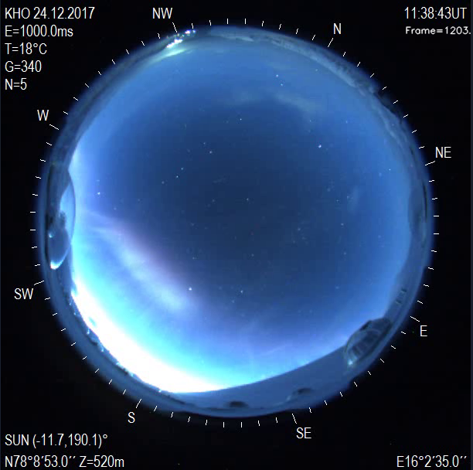
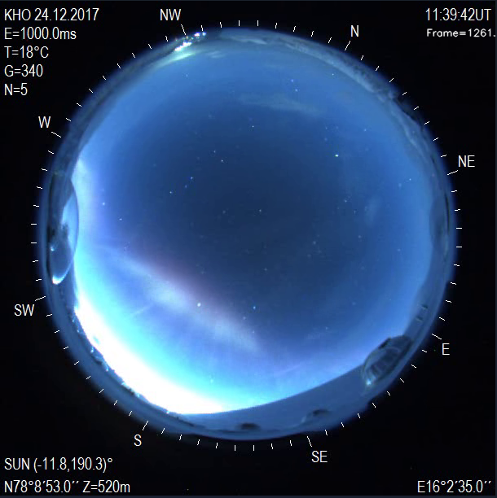
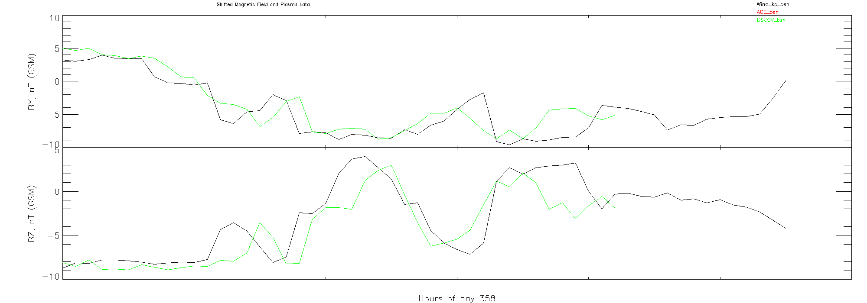
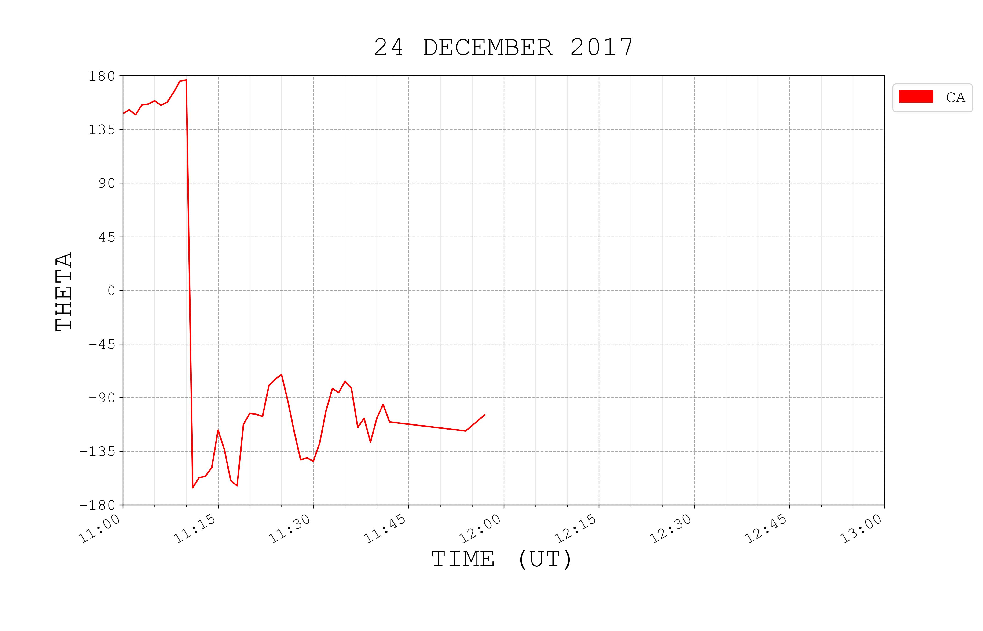
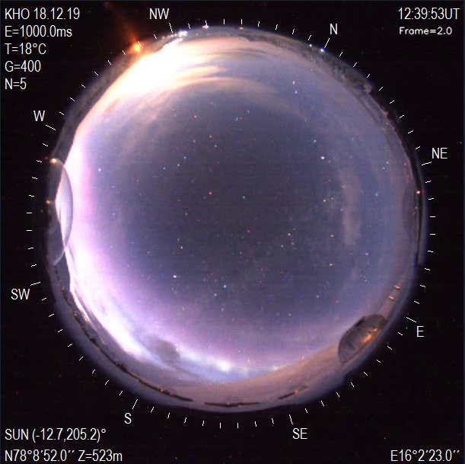
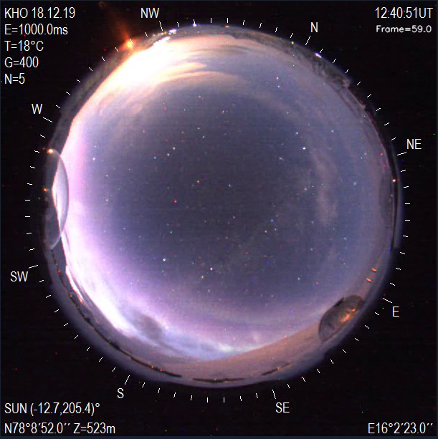
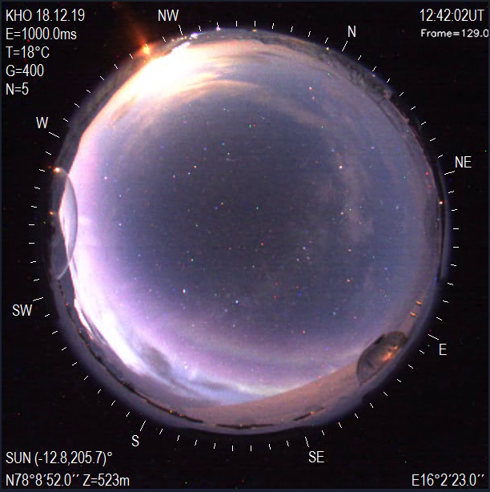
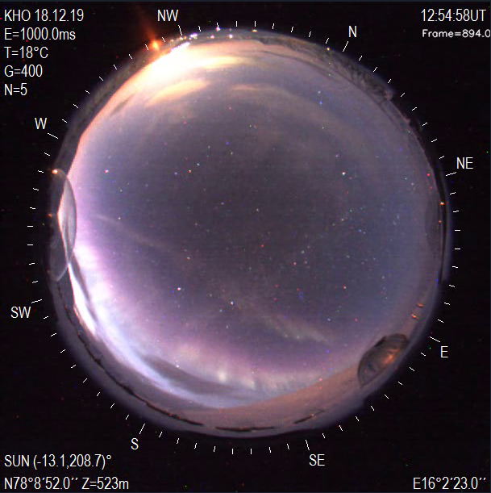
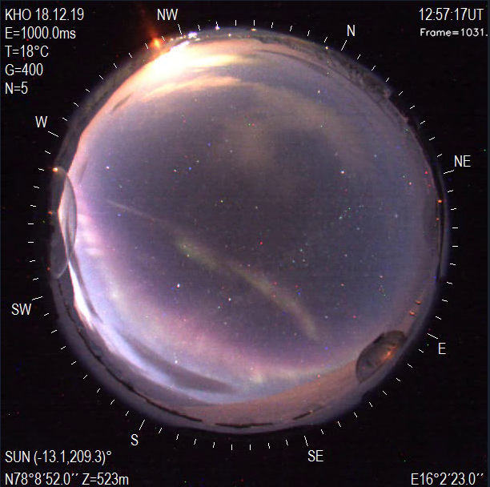
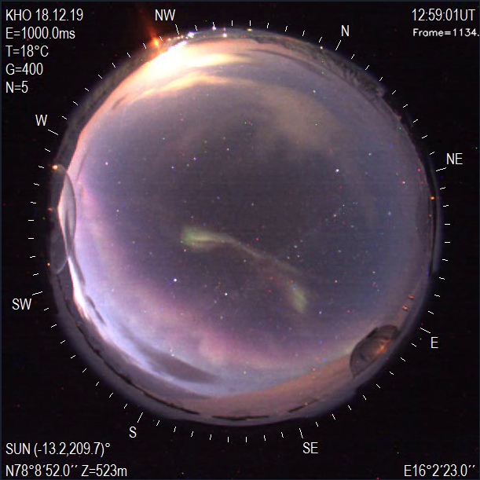
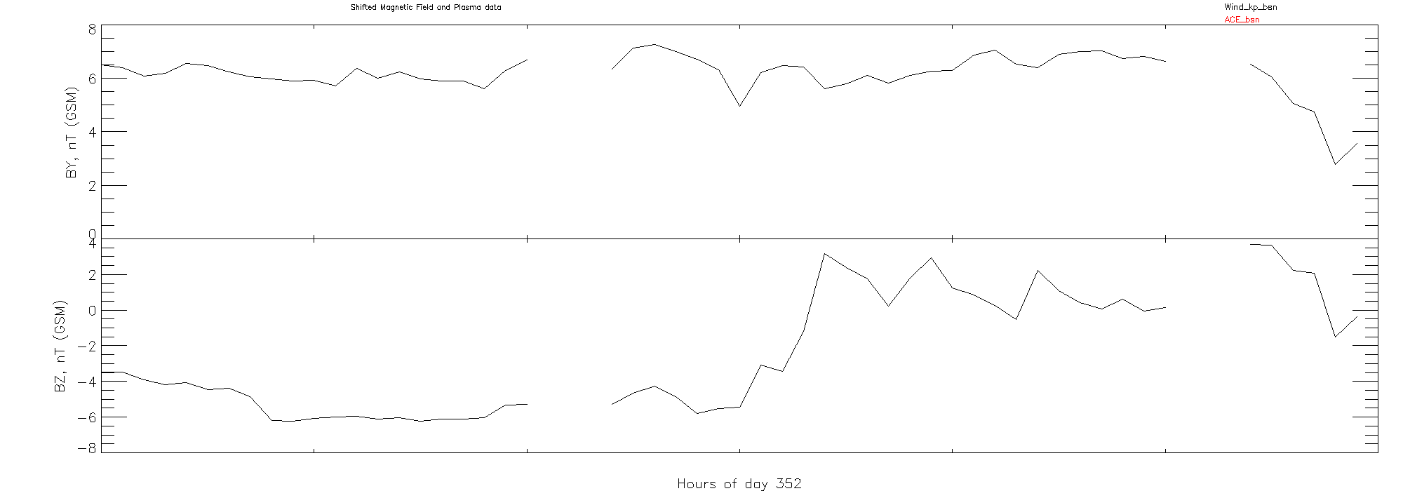
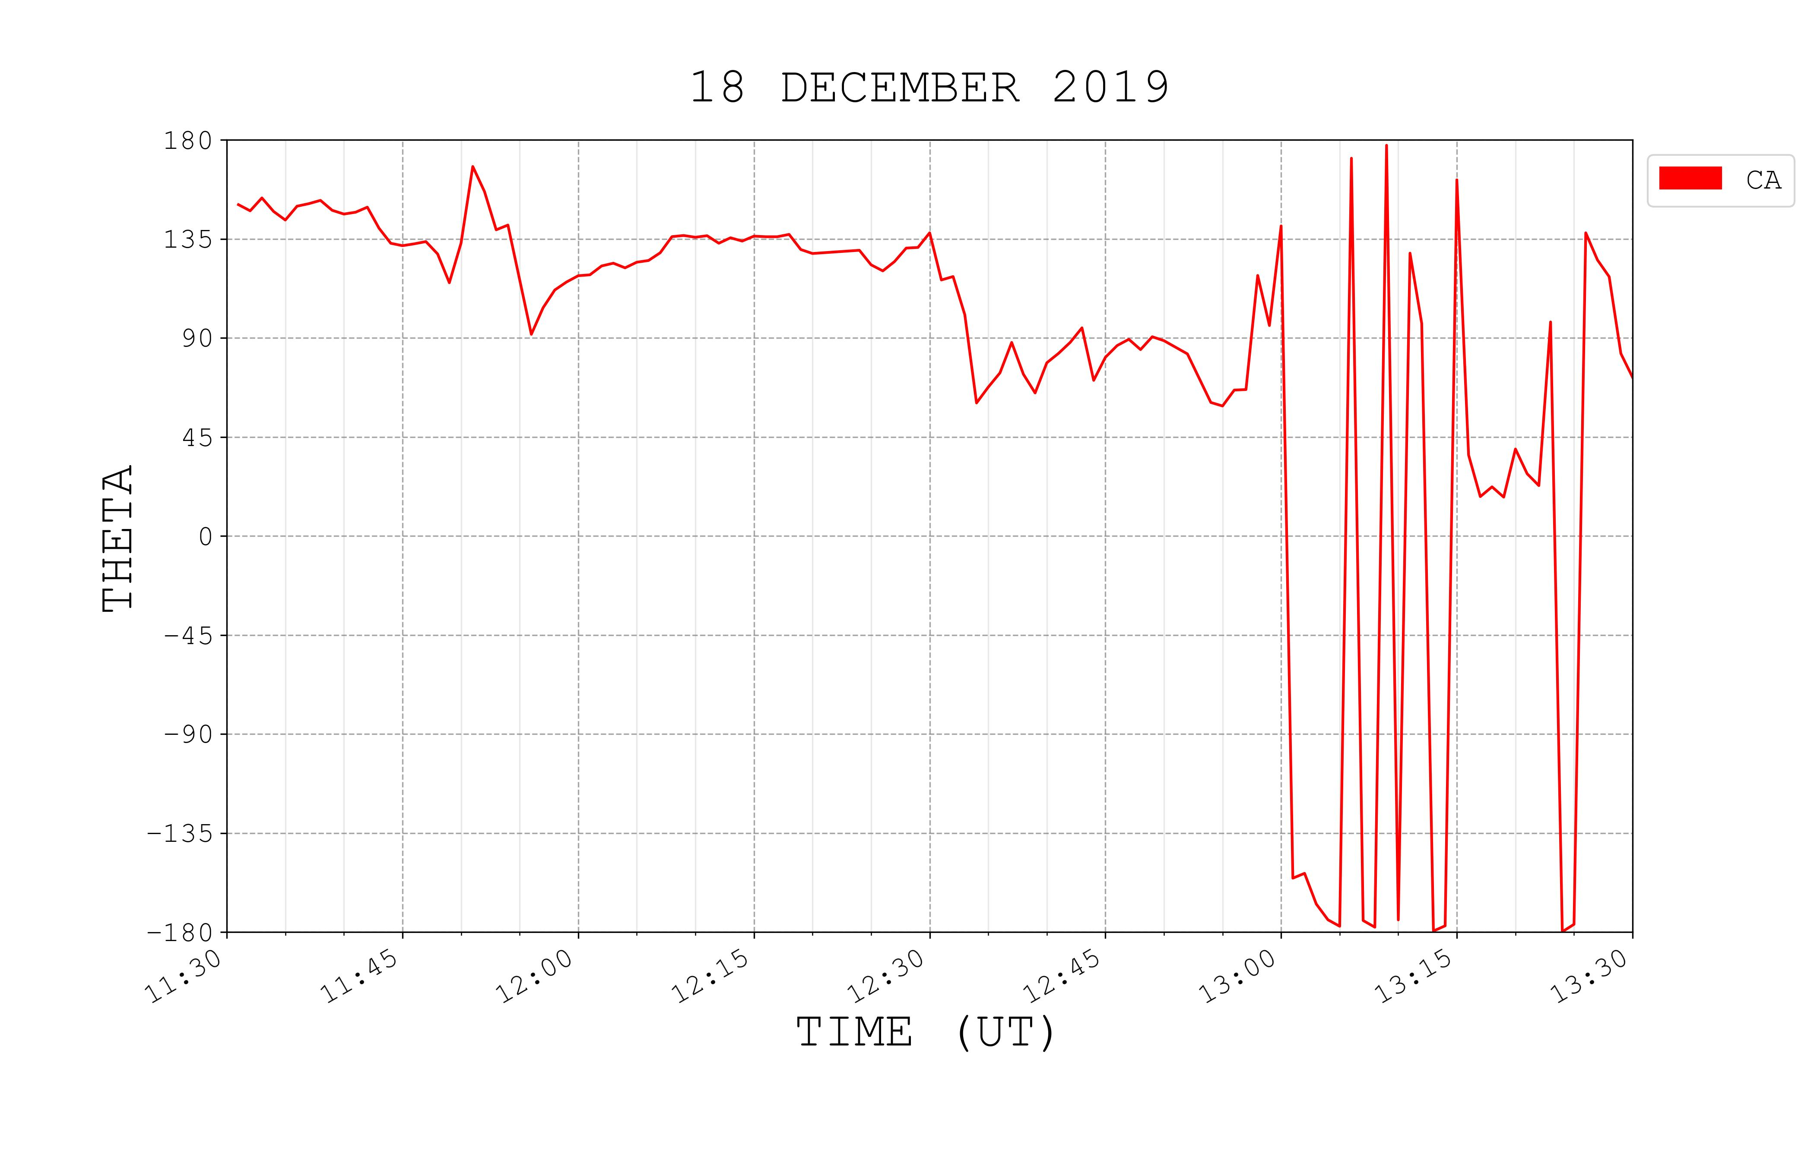
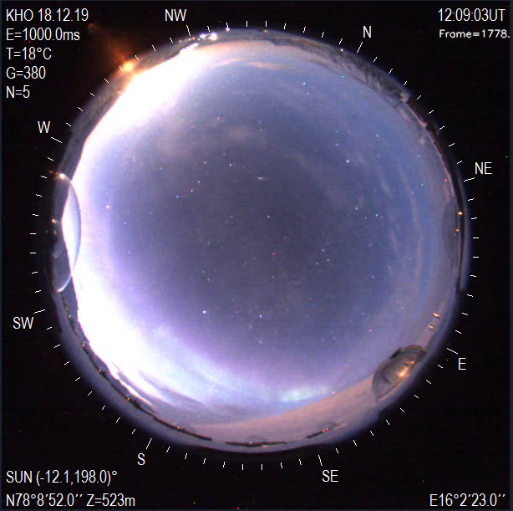
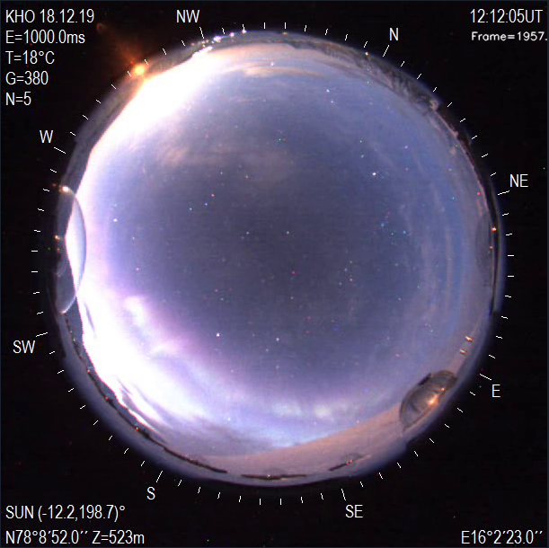
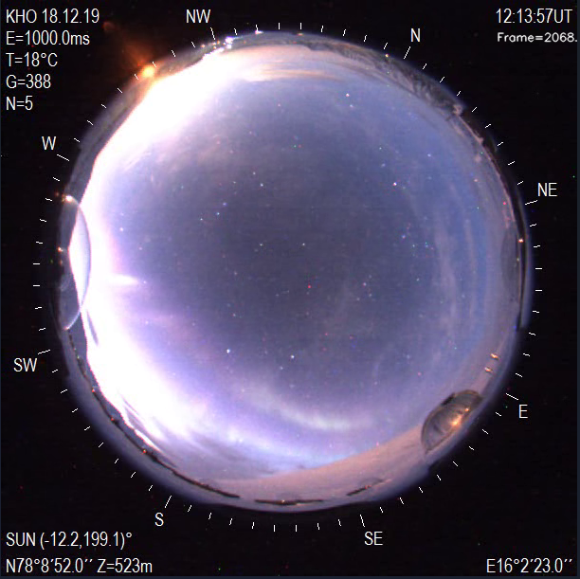
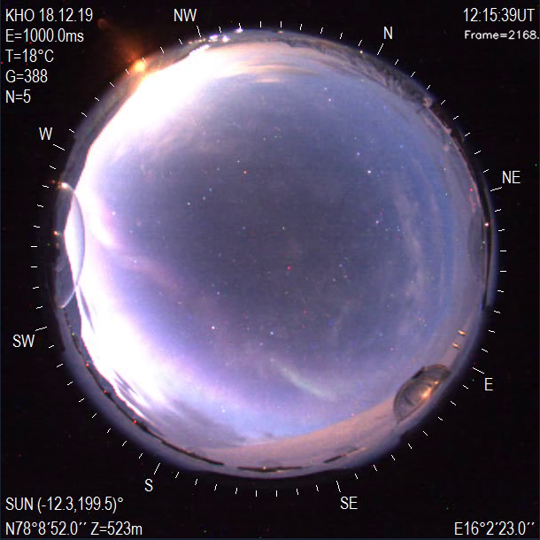
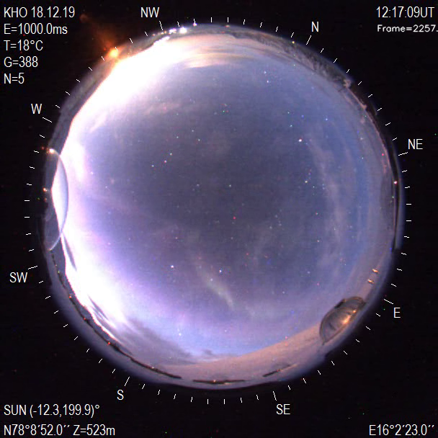
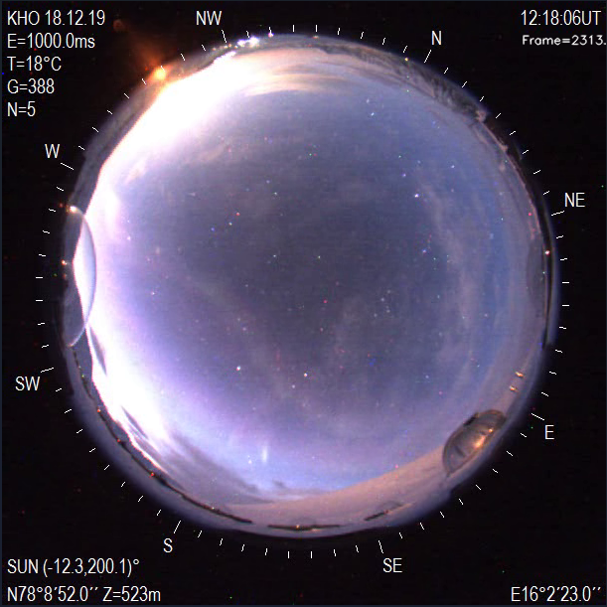
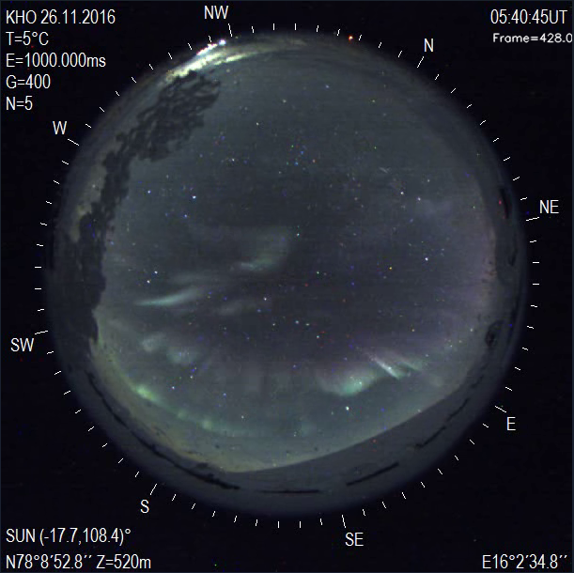
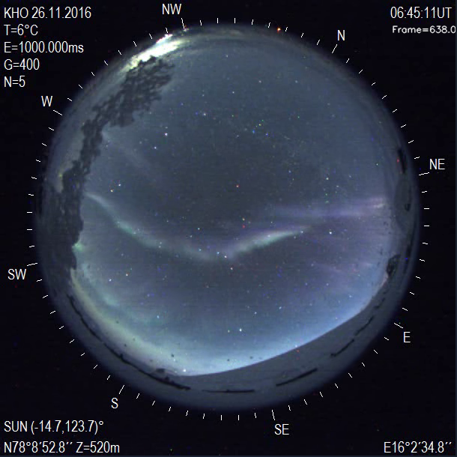
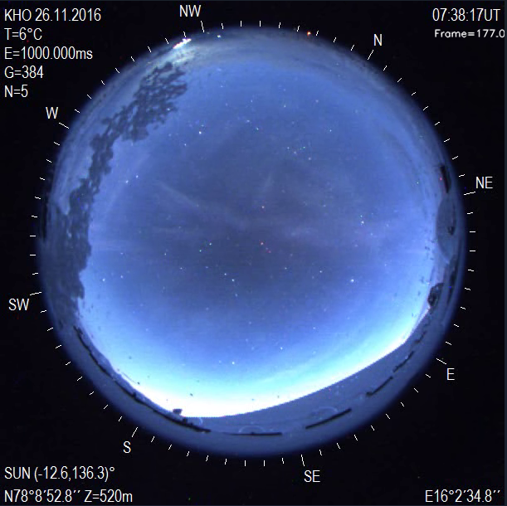
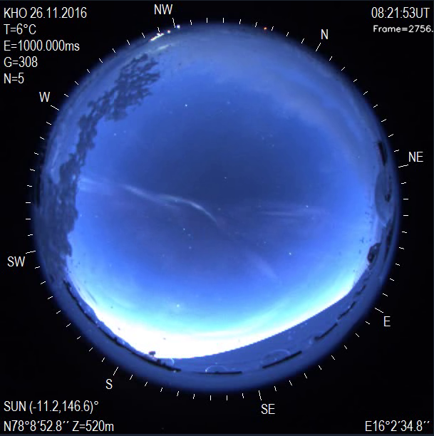
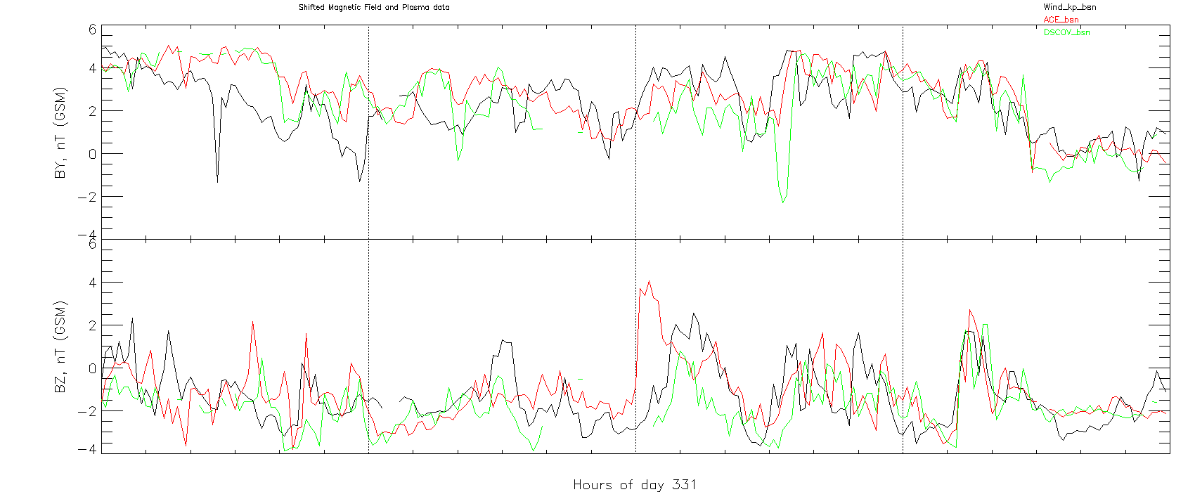
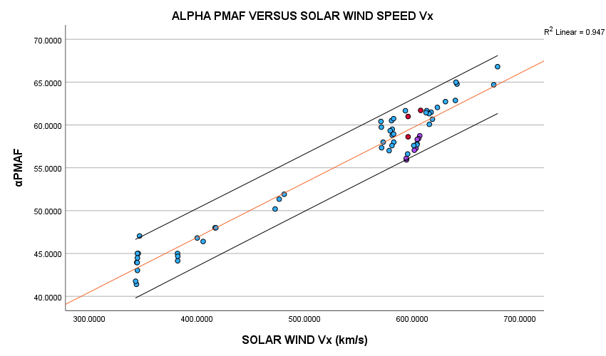
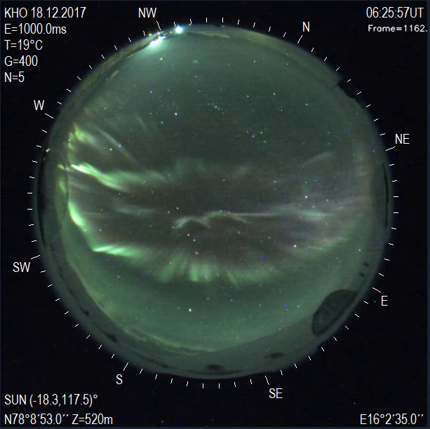
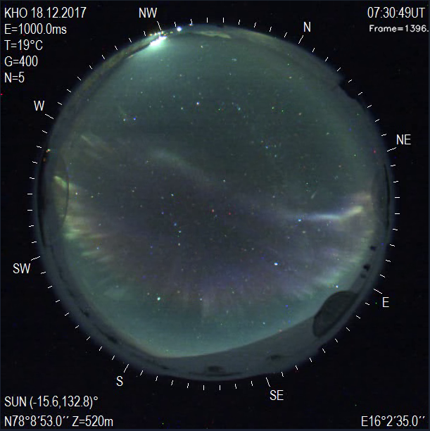
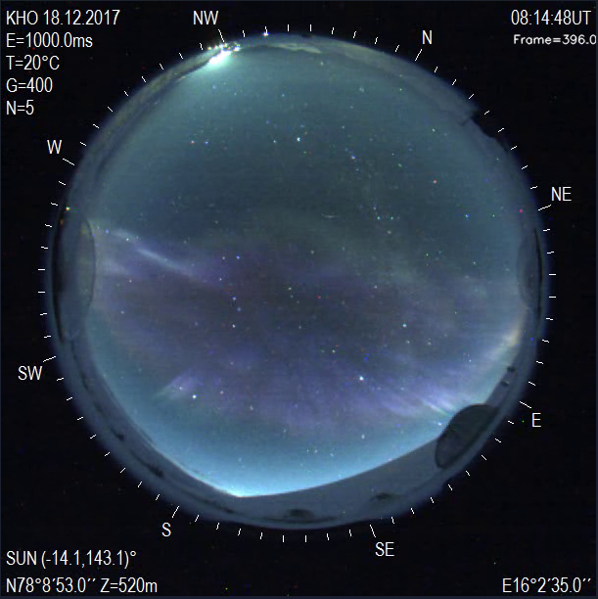
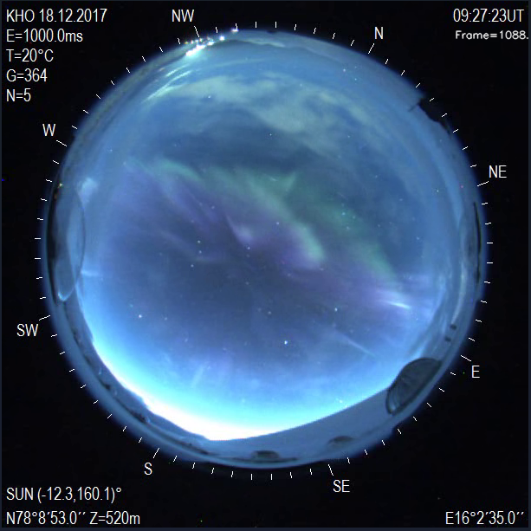
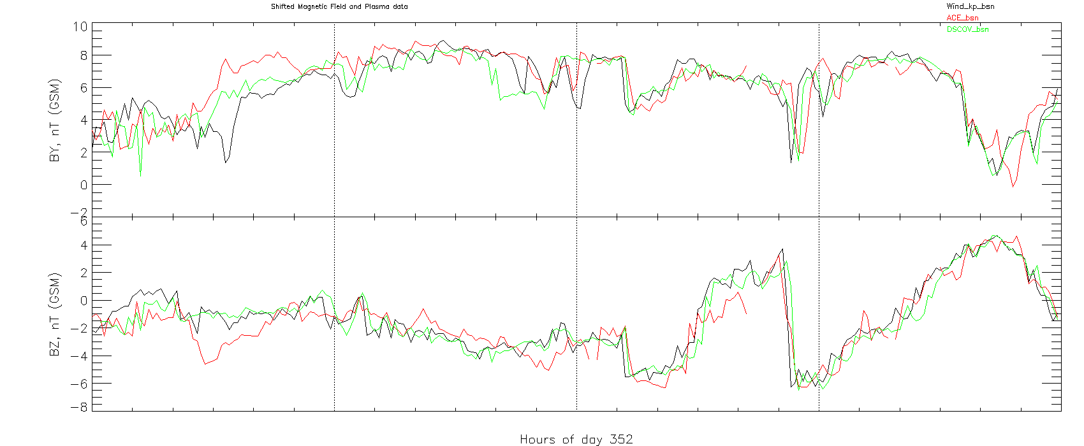
Poleward Moving Auroral Forms and Magnetic Reconnection
Gasia Excel¹, Gerard Fasel¹, Julia Johnson¹, Duo Xu¹, Parker Para¹, Amiel Silbol¹, Rachel Rodriguez¹, John Mann¹, Braden Yonano², Fred Sigernes³, Dag A Lorentzen³
1Pepperdine University, Physics Department, Malibu, CA, USA.
2University of Colorado Boulder, Physics Department, Boulder, CO, USA
3University Centre in Svalbard, Longyearbyen, Norway.
Abstract: Magnetic reconnection on the dayside magnetosphere is one of the main mechanisms for the solar wind to transfer energy and momentum to the terrestrial environment. This process is assumed to be most effective when the interplanetary magnetic field (IMF) is southward. Poleward moving auroral forms (PMAFs) have been identified in past studies as ionospheric signatures of magnetic reconnection on the dayside. The PMAFs occurring for the positive/(negative) IMF y-component first expanded westward(dawn)/eastward(dusk) before propagating poleward. This PMAF study presents a comprehensive set of events where the initial brightening moves through a pre-existing dayside auroral arc westward(dawn)/eastward(dusk) when the IMF y-component is positive/(negative) before moving poleward during the 0500-1200 UT (0800-1500 MLT) interval.
Figure 1. January 19th , 2018, 06:06:13-06:11:38 UT, Longyearbyen, Northwestern propagation
Figure 6. IMF Data (1-minute BSN time-shifted) from DSCOVR ($Y_{GSE}=8 R_{E}$, $Z_{GSE}=−28$ $R_{E}$) and Wind_KP ($Y_{GSE}=101 R_{E}$, $Z_{GSE}=−4$ $R_{E}$), January 19th , 2018
Figure 10. Clock angle obtained from IMF data in Figure 6.
Figure 2. December 2nd , 2021, 06:28:07-06:33:04 UT, Longyearbyen, Northwestern propagation
Figure 7. IMF Data (1-minute BSN time-shifted) from Wind_KP ($Y_{GSE}=95 R_{E}$, $Z_{GSE}=−2$ $R_{E}$), December 2nd , 2021
Figure 11. Clock angle obtained from IMF data in Figure 7.
Figure 21. The Longyearbyen station pre-magnetic noon (6 UT), during magnetic noon (9 UT), and post-magnetic noon (12 UT). Parallel lines represent the anti-sunward movement of the PMAFs.
Figure 3. December 24th , 2017, 11:34:29-11:39:42 UT, Longyearbyen, Northeastern propagation
Summary:
After brightening on the poleward side of the dayside auroral oval:
Pre-magnetic noon PMAFs drift towards the geographic northwest
Post-magnetic noon PMAFs drift towards the geographic northeast
PMAFs close to magnetic noon drift towards the geographic north
$α$PMAFs for each event was strongly correlated with the solar wind $Vx$ - component.
Figure 8. IMF Data (1-minute BSN time-shifted) from DSCOVR ($Y_{GSE}=37 R_{E}$,
$Z_{GSE}=−12$ $R_{E}$) and Wind_KP ($Y_{GSE}=60 R_{E}$, $Z_{GSE}=−10$ $R_{E}$), December 24th, 2017
Figure 12. Clock angle obtained from IMF data in Figure 8.
Figure 4. December 18th , 2019, 12:39:53-12:51:01 UT, Longyearbyen, Northeastern propagation
Figure 5. December 18th , 2019, 12:09:03-12:18:06 UT, Longyearbyen, Northeastern propagation
Figure 9. IMF Data (1-minute BSN time-shifted) from Wind_KP ($Y_{GSE}=89 R_{E}$, $Z_{GSE}=−7$ $R_{E}$), December 18th , 2019
Figure 13. Clock angle obtained from IMF data in Figure 9.
Acknowledgement: PI, J.H. King, N. Papatashvilli at AdnetSystems, NASA GSFC and CDAWeb for generating the IMF plots
26.11.2016
18.12.2017
Figure 14. November 26th , 2016, 05:40:45-08:21:53 UT, Longyearbyen. Over the course of a day, the propagation changes from northwest to northeast and Longyearbyen tilts with the earth.
Figure 15. IMF Data (1-minute BSN time-shifted) from ACE, DSCOVR, and Wind_KP spacecrafts, November 26th , 2016
Figure 16. Meridian-Scanning Photometer Data, 06:00:00-06:55:00 UT,
November 26th , 2016
Figure 17. December 18th , 2017, 06:25:57-09:27:23 UT, Longyearbyen . Over the course of a day, the propagation changes from northwest to northeast and Longyearbyen tilts with the earth.
Figure 18. IMF Data (1-minute BSN time-shifted) from ACE, DSCOVR, and Wind_KP spacecrafts, December 18th , 2019
Figure 19. Meridian-Scanning Photometer Data, 06:00:00-06:55:00 UT,
December 18th, 2019
Figure 20. The horizontal axis of this plot contains the average solar wind speed ($V_{x}$- component). The vertical axis of this plot consists of the angle ($α$PMAF) the PMAF makes with the horizontal axis of the MSP.

