Slide 1
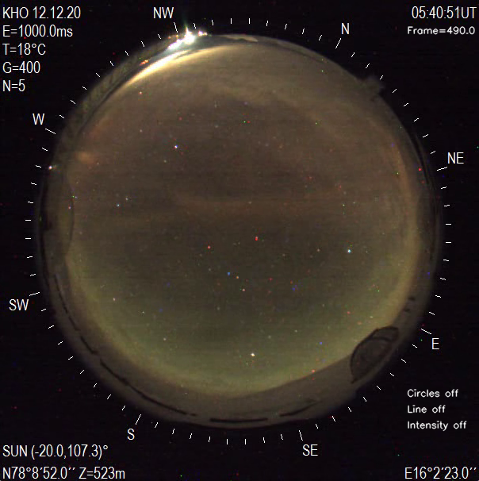
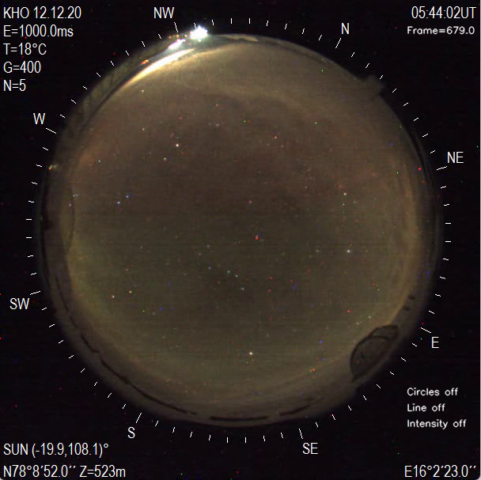
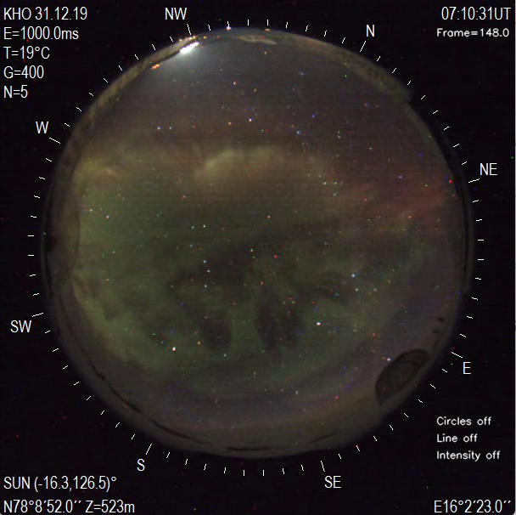
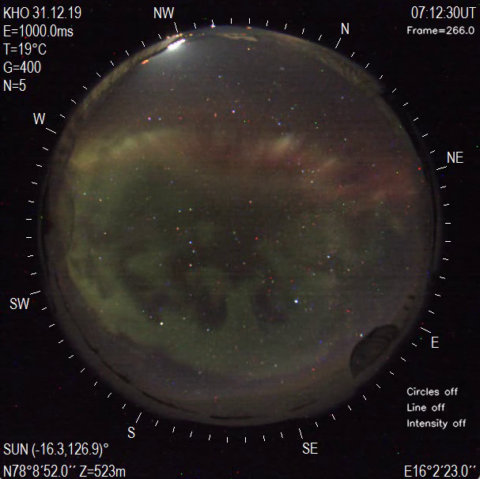
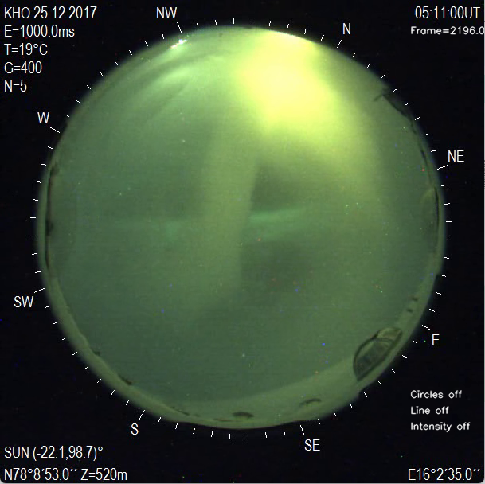
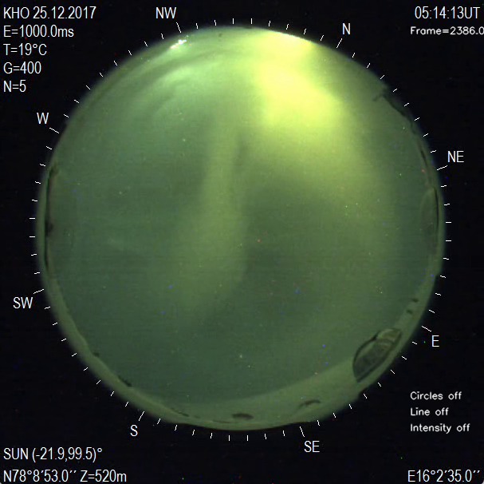
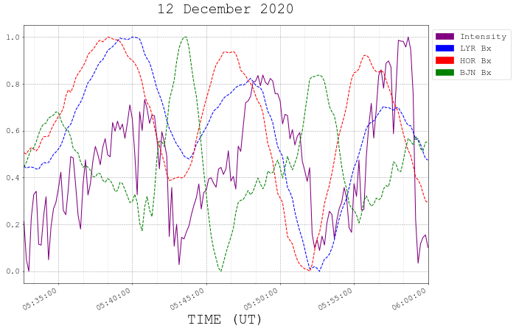
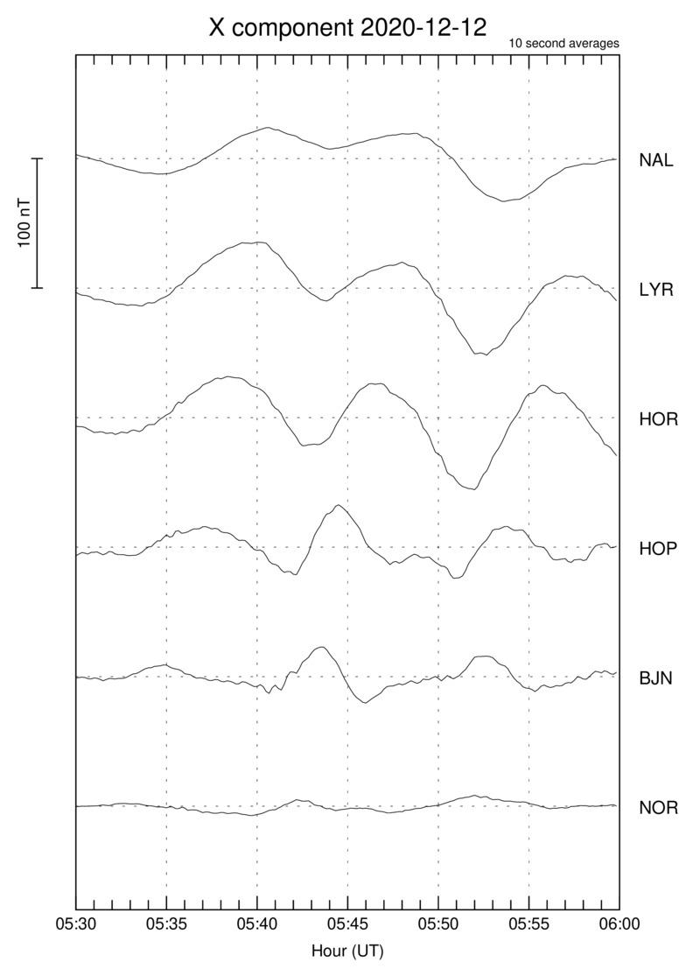
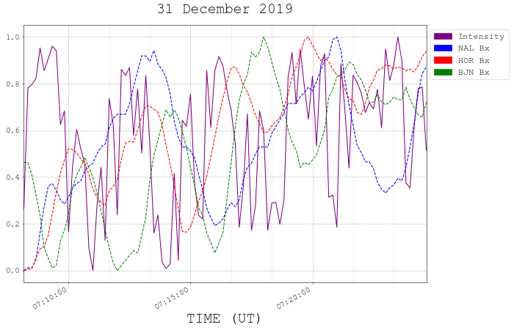
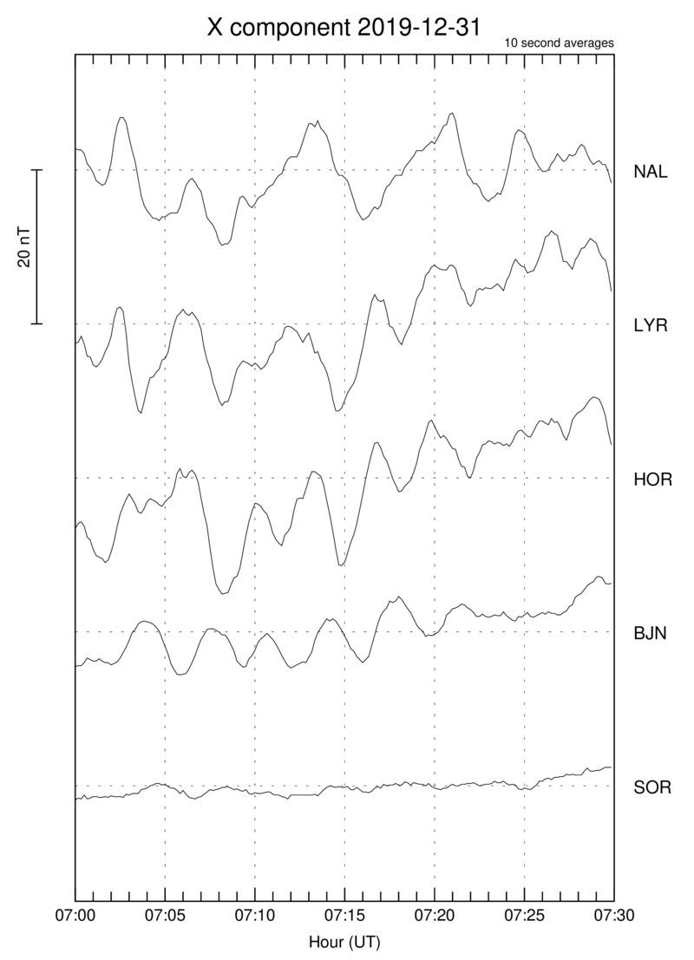
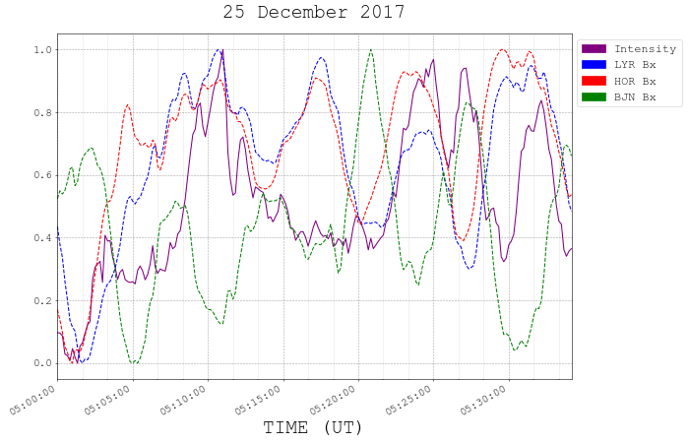
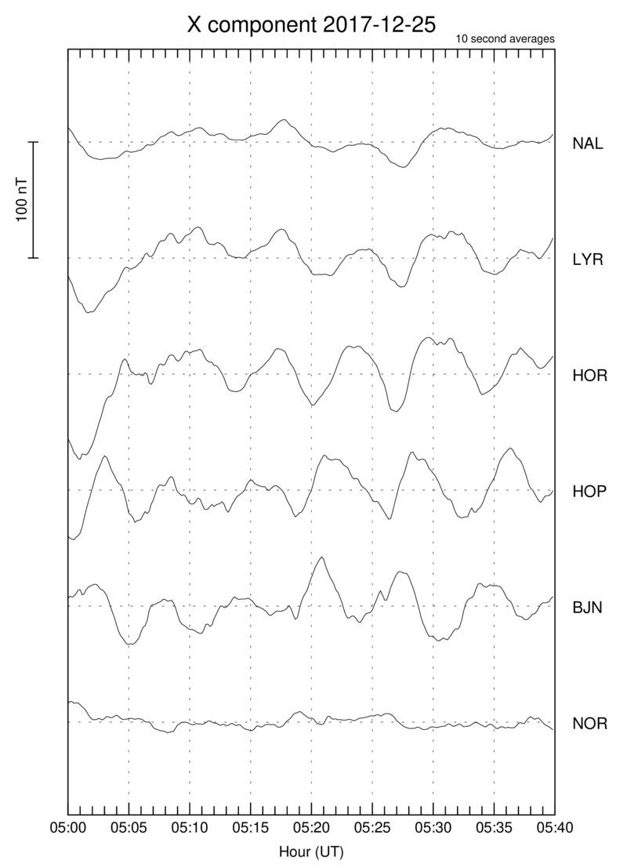
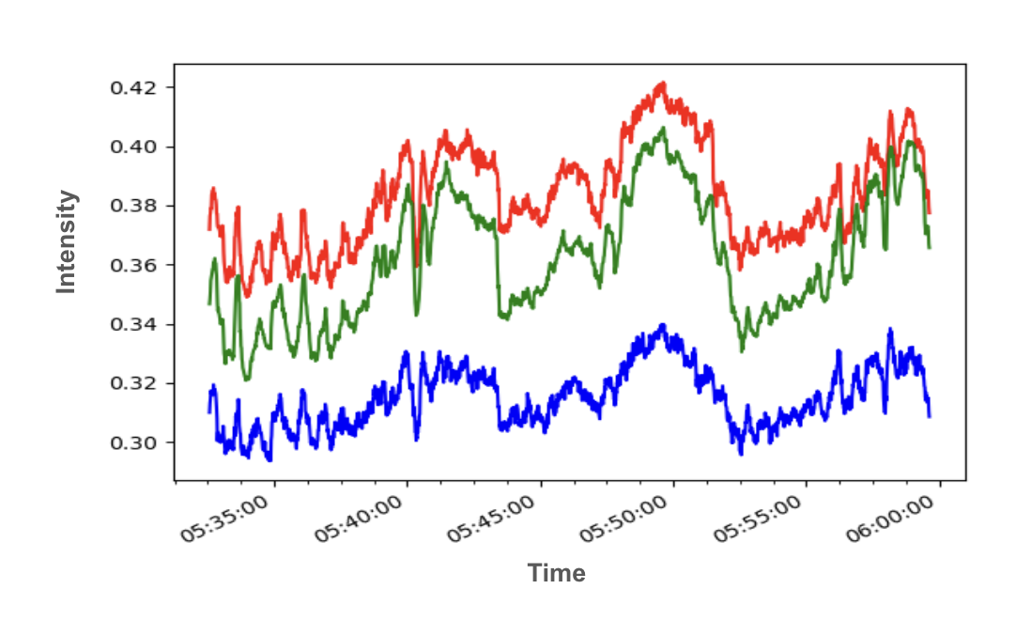
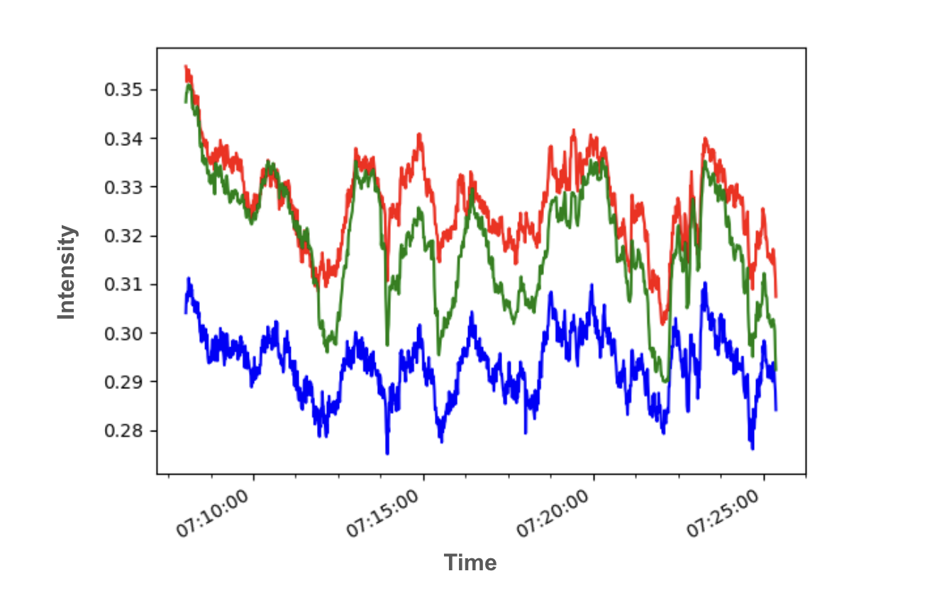
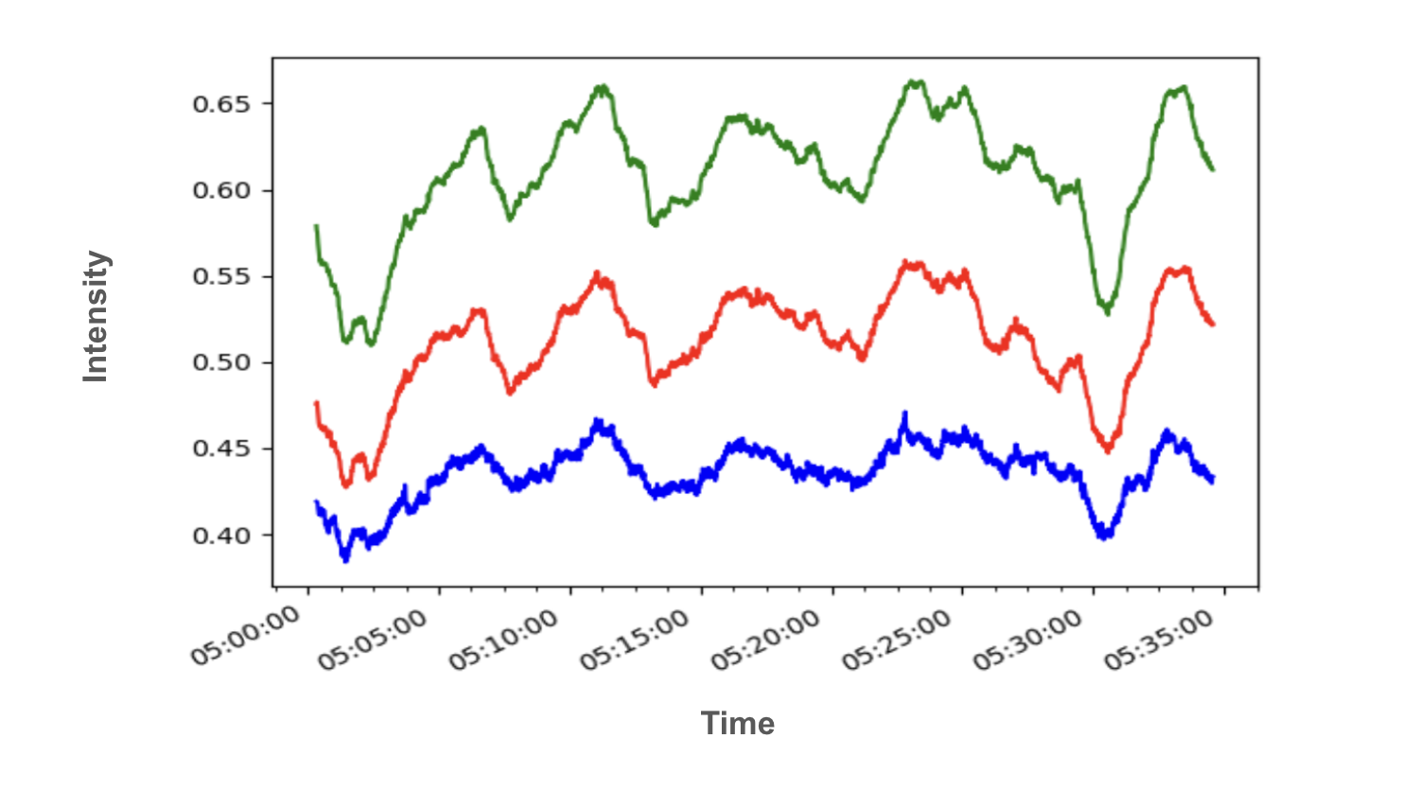
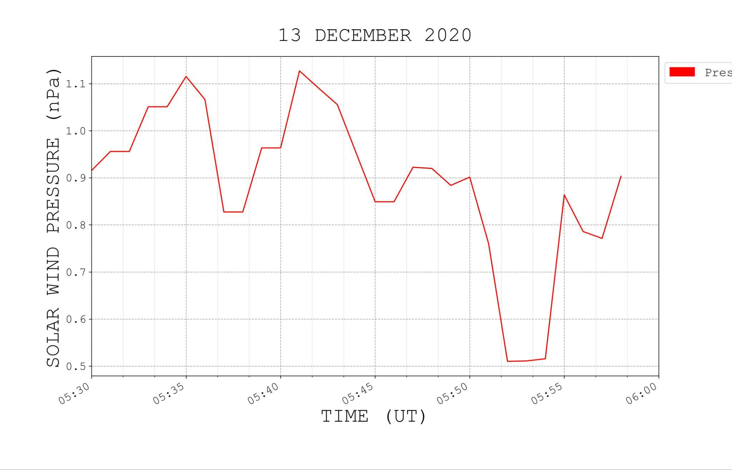
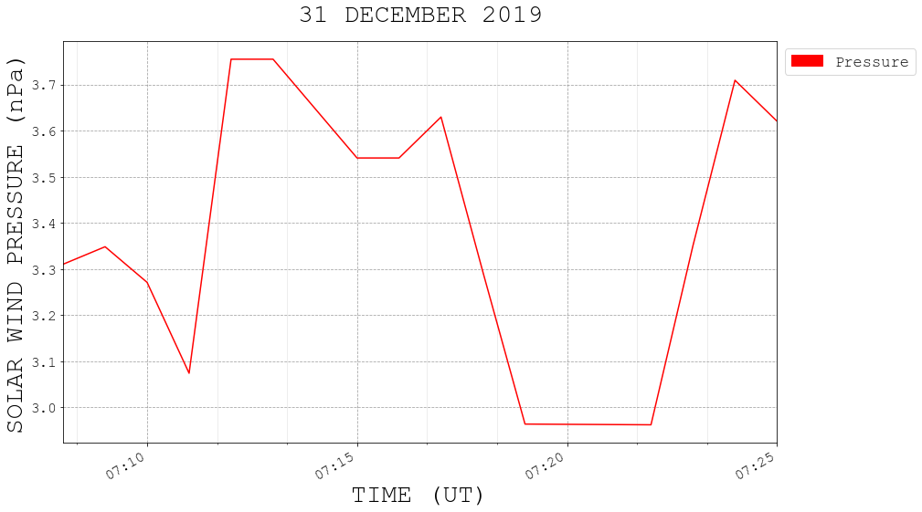
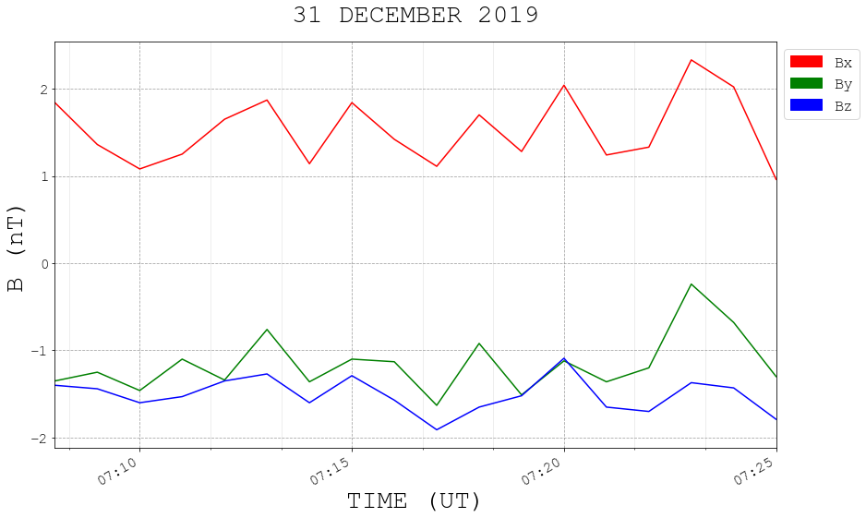
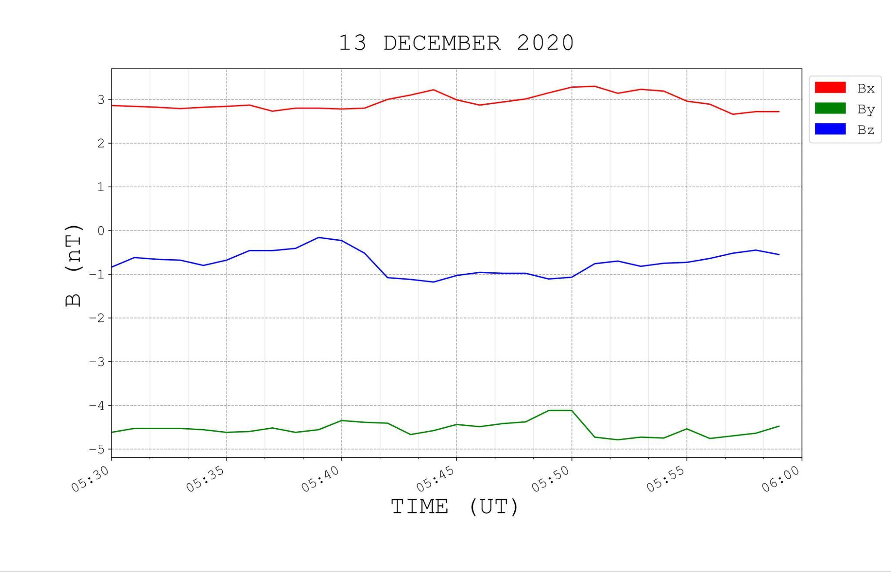
Dayside Pulsating Diffuse Aurora and the Interplanetary Magnetic Field
T. Lewer¹, G. Fasel¹, M. Fargo¹, E. Swonger¹, S. Lee², A. Hulbert¹, B. Weir¹, O. Bradley¹, A. Manookian¹, T. Cleaveland¹, B. Yonano¹, J. Mann¹, F. Sigernes³, D. Lorentzen³
1. Pepperdine University, Physics Department, Malibu, CA, USA. 2. NASA Goddard Space Flight Center, Greenbelt, MD, USA 3. University Centre in Svalbard, Longyearbyen, Norway.
Abstract
Changes in the interplanetary magnetic field (IMF) orientation can affect pulsations in the dayside aurora. It has been reported that multiple dayside arcs(Pc 5 band) were replaced by diffuse pulsating aurora (Pc 3-4 band) when the IMF turned northward. Dayside green (557.7 nm emission) pulsating aurora had been reported to occur between 0800 and 1100 MLT (0500-0800 UT) in patches. The pulsations are normally associated with Pc 3-5 range. This statistical study examines pulsating green aurora using ground-based optical data are obtained from the Kjell Henriksen Observatory (KHO) in Longyearbyen, Svalbard (GEO: N, E; AACGM: N, E). All-Sky Camera images are obtained from the Boreal Aurora Camera Constellation (BACC) and intensities are obtained from the meridian scanning photometer data. Oscillations from the pulsating aurora are obtained from the BACC and compared with the magnetic deflections obtained from the IMAGE magnetometer network. The pulsating events are combined with IMF data. The results of the study show that (i) the pulsating green aurora occur over large area of the BACC field of view, (ii) the period of oscillations are between 5-10 minutes, (iii) very few events occur past 12 MLT.
2020-12-12
2019-12-31
2017-12-25
dark
Figure 1.1 Bright and dark pulsationson from Dec. 12, 2020
Figure 2.1 Bright and dark pulsation frames from Dec. 31, 2019
Figure 3.1 Bright and dark pulsation frames from Dec. 25, 2017
owen overlay
Figure 1.2 Overlay for Magnetometer and All Sky Camera intensity plots from Dec. 12, 2020
Figure 2.2 Overlay for Magnetometer and All Sky Camera intensity plots from Dec. 31, 2019
Figure 3.2 Overlay for Magnetometer and All Sky Camera intensity plots from Dec. 25, 2017
Figure 1.3 Red, green, and blue color intensity plots from All Sky Camera video on Dec. 12, 2020 showing screen intensity against time
Figure 1.4 Magnetometer plots for Dec. 12, 2020 showing nanoTeslas(nT) against time
Figure 2.3 Red, green, and blue color intensity plots from All Sky Camera video on Dec. 31, 2019 showing screen intensity against time
Figure 2.4 Magnetometer plots for Dec. 31, 2019 showing nanoTeslas(nT) against time
Figure 3.3 Red, green, and blue color intensity plots from All Sky Camera video on Dec. 25, 2017 showing screen intensity against time
Figure 3.4 Magnetometer plots for Dec. 25, 2017 showing nanoTeslas(nT) against time
HOR:
T1: 5:38 - 5:47UT
T2: 5:47 - 5:56UT
T = 9min
HOP:
T1: 5:36 - 5:45UT
T2: 5:45 - 5:54UT
T = 9min
BJN:
T1: 5:35 - 5:43UT
T2: 5:43 - 5:52UT
T = 9min
Intensity:
T1: 7:10 - 7:13UT
T2: 7:13 - 7:15UT
T3: 7:15 - 7:16UT
T4: 7:16 - 7:19UT
T5: 7:19 - 7:23:30UT
T = 3min
NAL:
T1: 7:14 - 7:21UT
T2: 7:21 - 7:25UT
T = 5min
LYR:
T1: 7:09 - 7:12UT
T2: 7:12 - 7:17UT
T3: 7:17 - 7:20UT
T4: 7:20 - 7:24UT
T = 4min
HOR:
T1: 7:10 - 7:13UT
T2: 7:13 - 7:17UT
T3: 7:17 - 7:20UT
T = 3min
BJN:
T1: 7:08 - 7:11UT
T2: 7:11 - 7:14UT
T3: 7:14 - 7:18UT
T4: 7:18 - 7:22UT
T = 3min
Intensity:
T1: 5:06 - 5:11UT
T2: 5:11 - 5:16UT
T3: 5:16 - 5:22UT
T4: 5:22 - 5:27UT
T5: 5:27 - 5:32UT
T = 5min
LYR:
T1: 5:11 - 5:18UT
T2: 5:18 - 5:25UT
T3: 5:25 - 5:32UT
T4: 5:32 - 5:37UT
T = 6min
HOR:
T1: 5:05 - 5:10UT
T1: 5:10 - 5:17UT
T2: 5:17 - 5:23UT
T3: 5:23 - 5:29UT
T4: 5:29 - 5:37UT
T = 6min
HOP:
T1: 5:03 - 5:08UT
T2: 5:08 - 5:15UT
T3: 5:15 - 5:21UT
T4: 5:21 - 5:28UT
T5: 5:28 - 5:36UT
T = 7min
BJN:
T1: 5:10 - 5:17UT
T2: 5:17 - 5:23UT
T3: 5:23 - 5:29UT
T4: 5:29 - 5:37UT
T = 7min
Intensity:
T1: 5:41 - 5:49UT
T2: 5:49 - 5:59UT
T = 9min
NAL:
T1: 5:40 - 5:48UT
T2: 5:48 - 6:00UT
T = 10min
LYR:
T1: 5:40 - 5:48UT
T2: 5:48 - 5:57UT
T = 9min
Summary
After examining just over three field seasons of the All Sky Camera data from the Kjell Henriksen Observatory, located in Longyearbyen, Svalbard, between November and February of different years, and analyzing twenty-one events with plots representing auroral intensity and Magnetometer plots (IMAGE), we have come to a preliminary consensus that our data has shown a correlation between the pulsations in the green diffuse aurora and the x-component of the Earth’s magnetic field. The events we have analyzed exhibit periodic pulsations between 2-10 minutes. The pulsating aurora events occur between 5-8UT or 8-11MLT. We also determined that there is a lower latitude cutoff for these pulsations between NOR (71.09N) and BJN (74.5N) geographical latitude. These are preliminary results of an ongoing statistical study.
Figure 1.5 BSN shifted plot of solar wind pressure nanoPascal(nPa) against time on Dec. 12, 2020
Figure 1.6 BSN shifted plot of X, Y, and Z components of the solar wind magnetic field nanoTeslas(nT) against time on Dec. 12, 2020
Figure 2.5 BSN shifted plot of solar wind pressure nanoPascal(nPa) against time on Dec. 31, 2019
Figure 2.6 BSN shifted plot of X, Y, and Z components of the solar wind magnetic field nanoTeslas(nT) against time on Dec. 31, 2019

