Slide 1
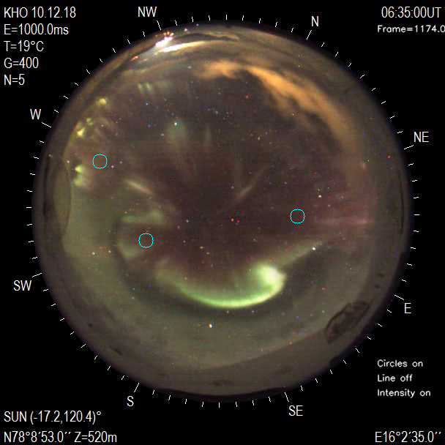
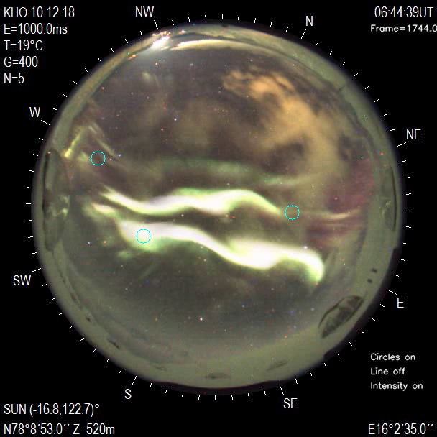
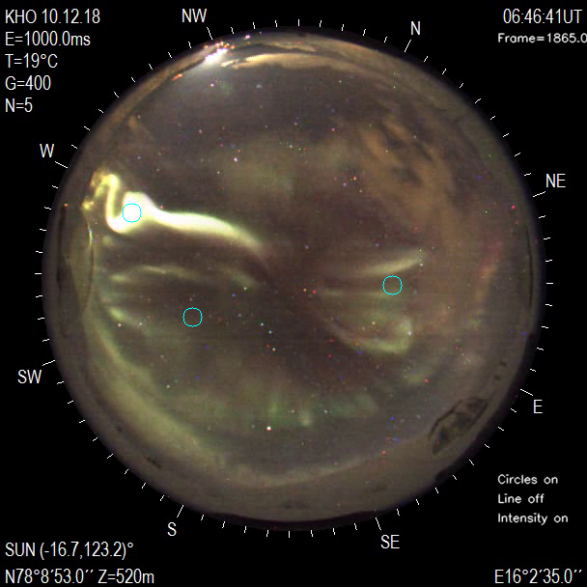
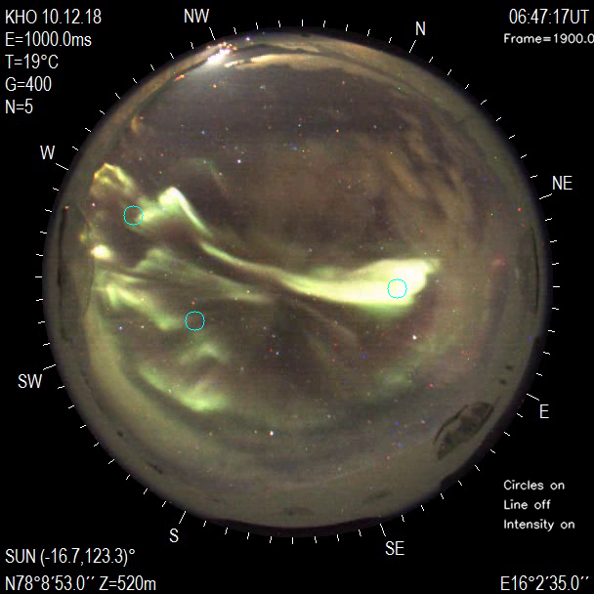
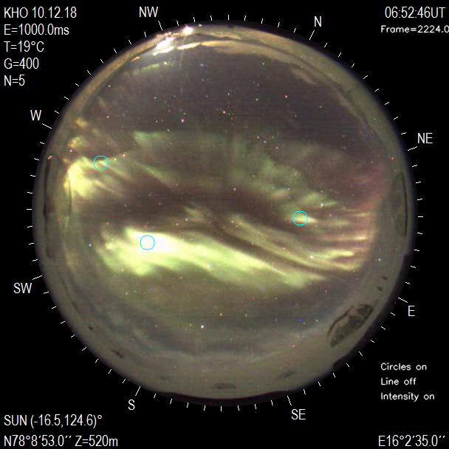
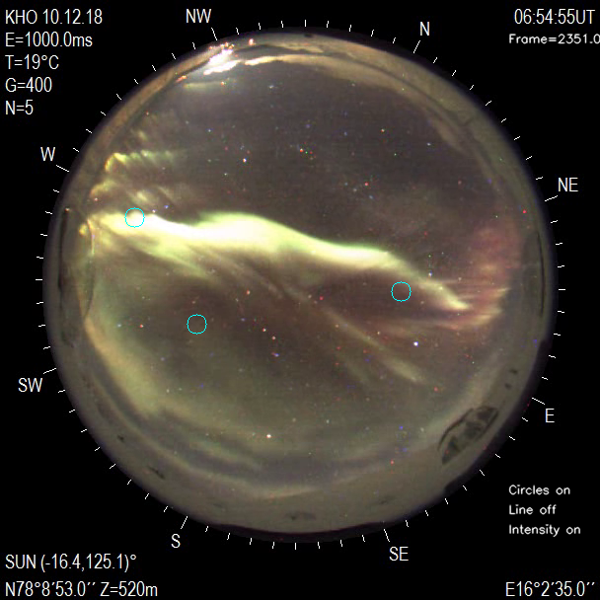
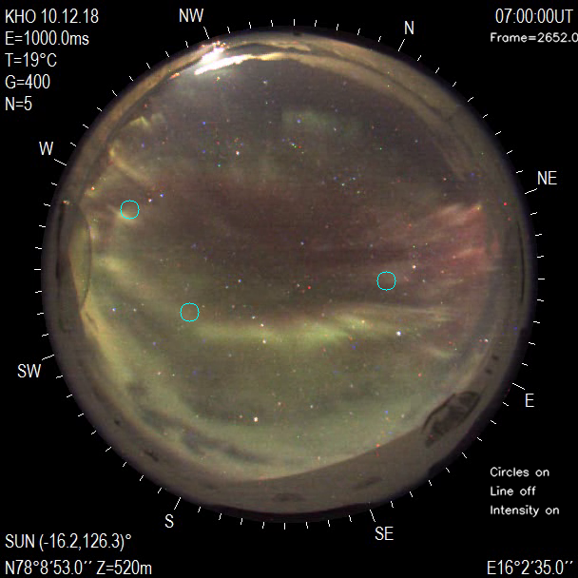
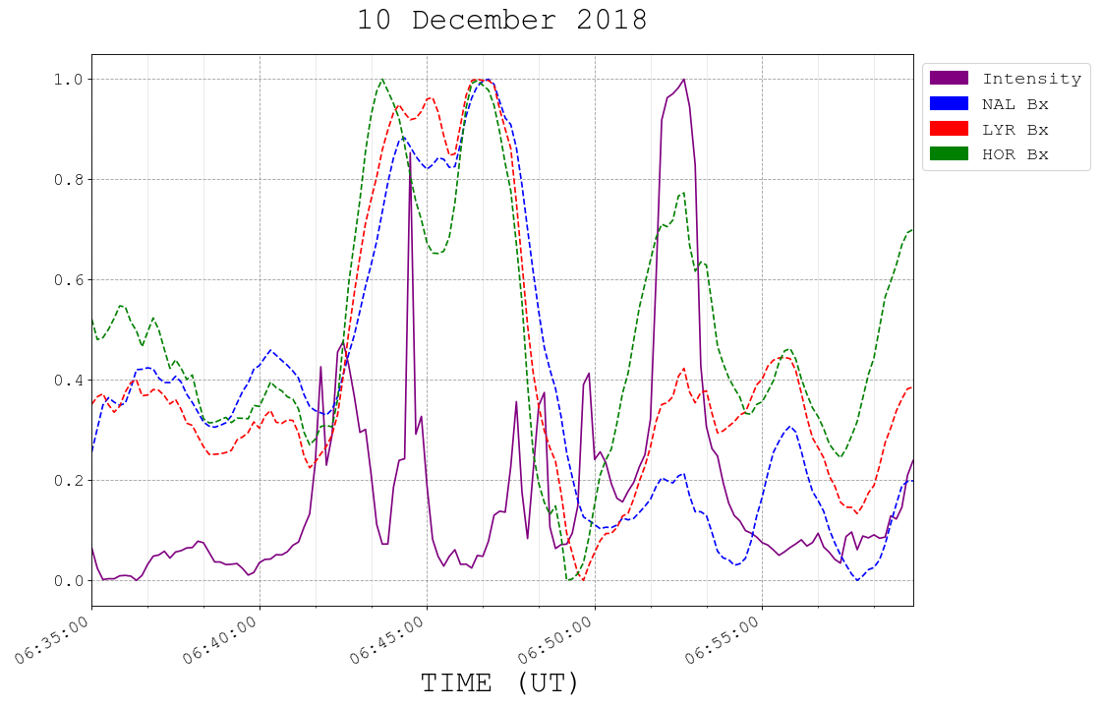
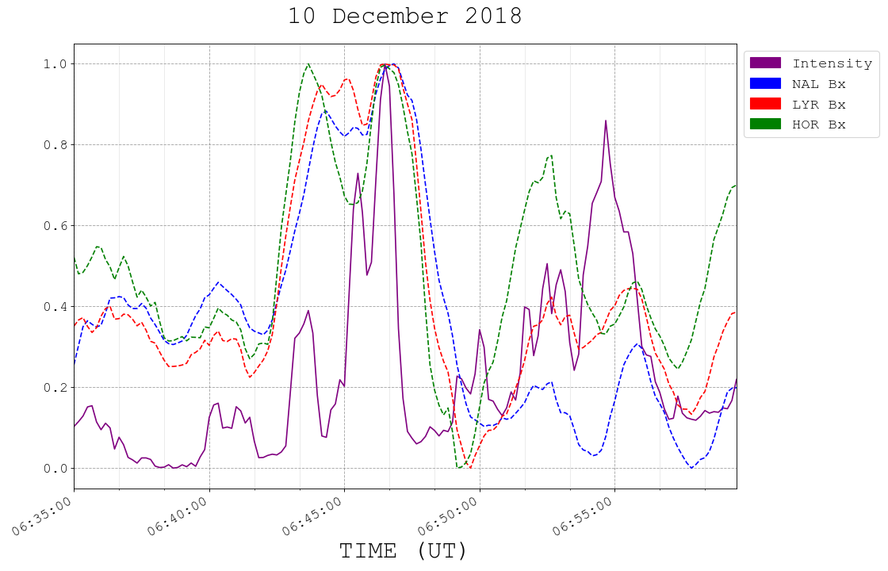
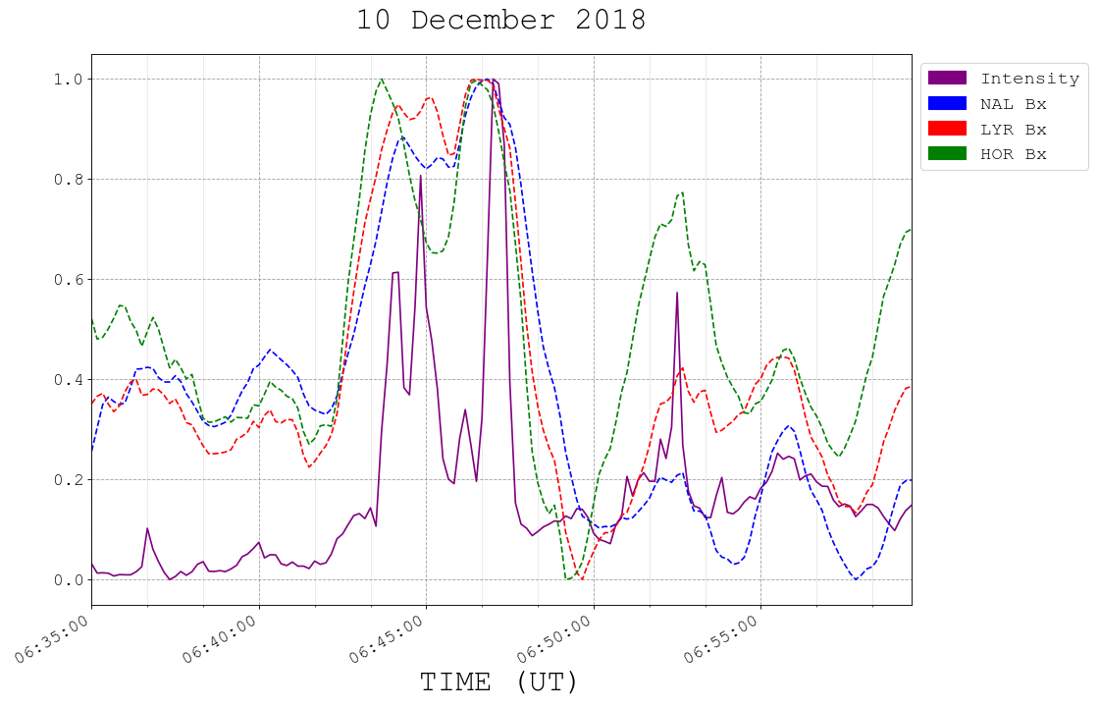
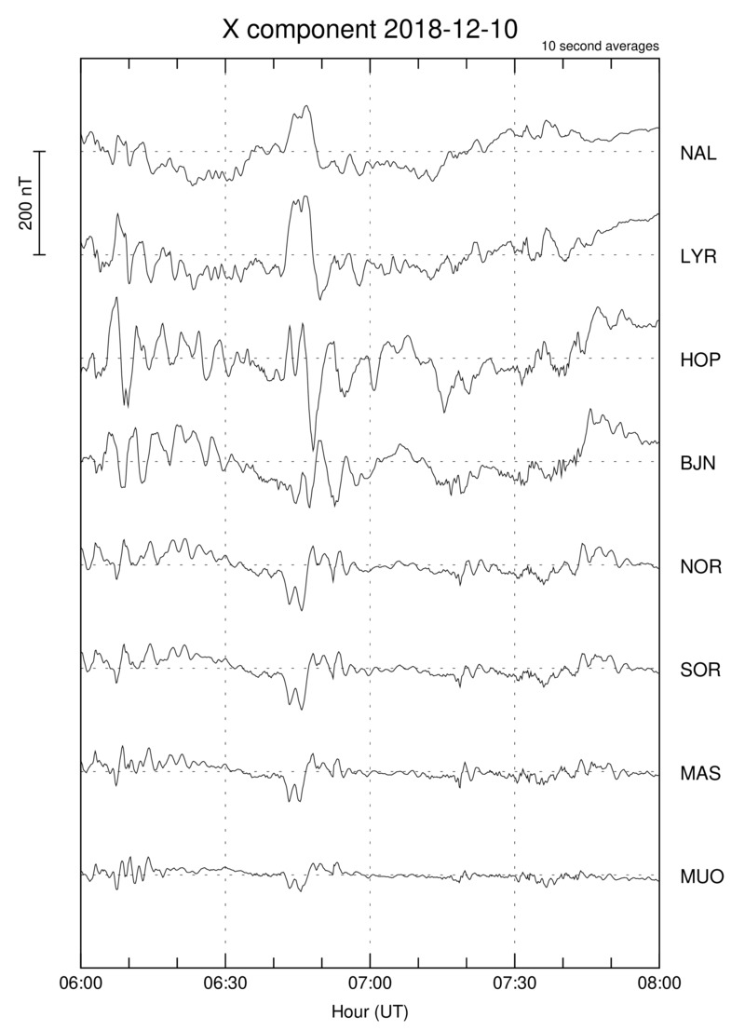
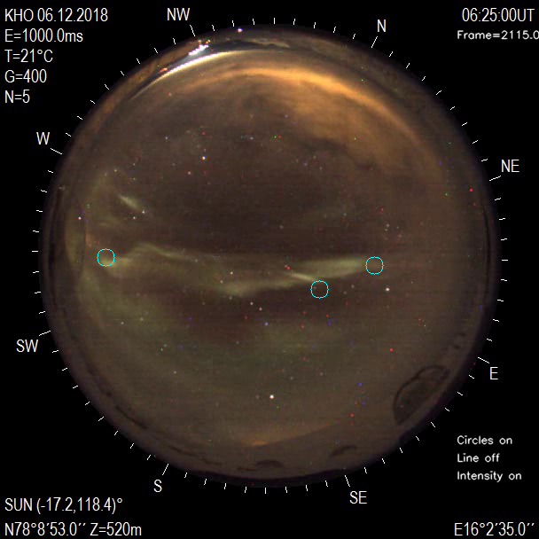
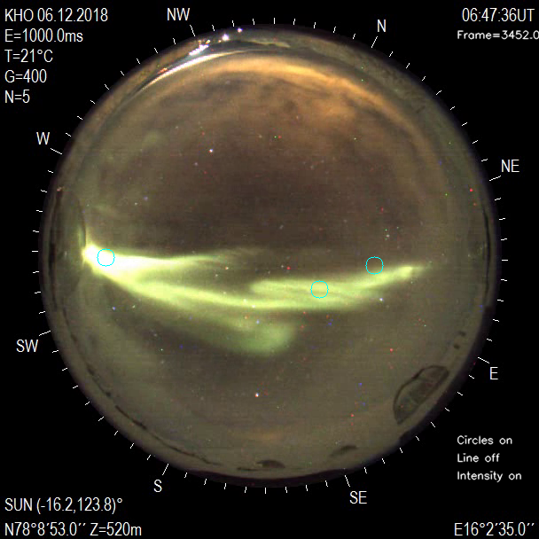
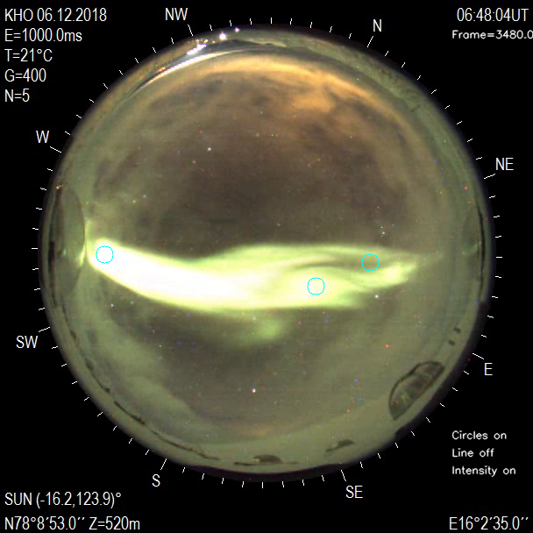
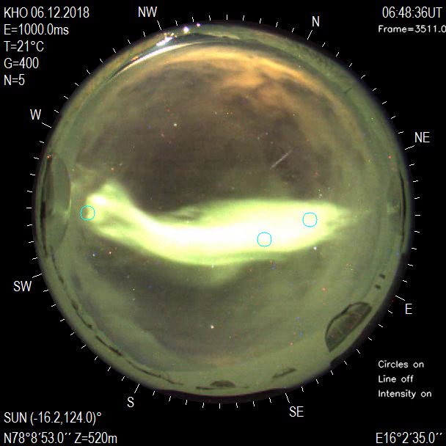
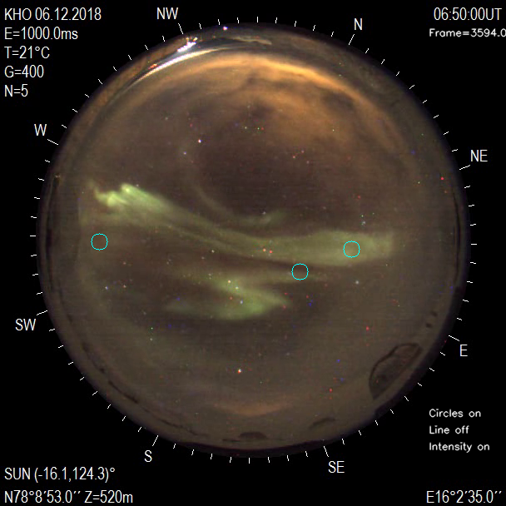
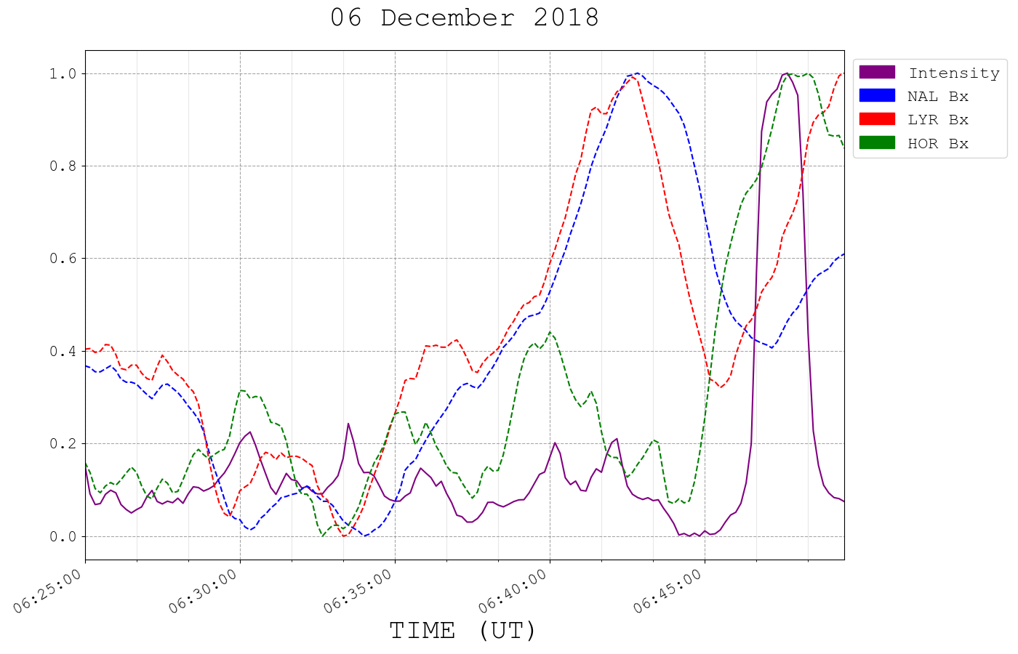
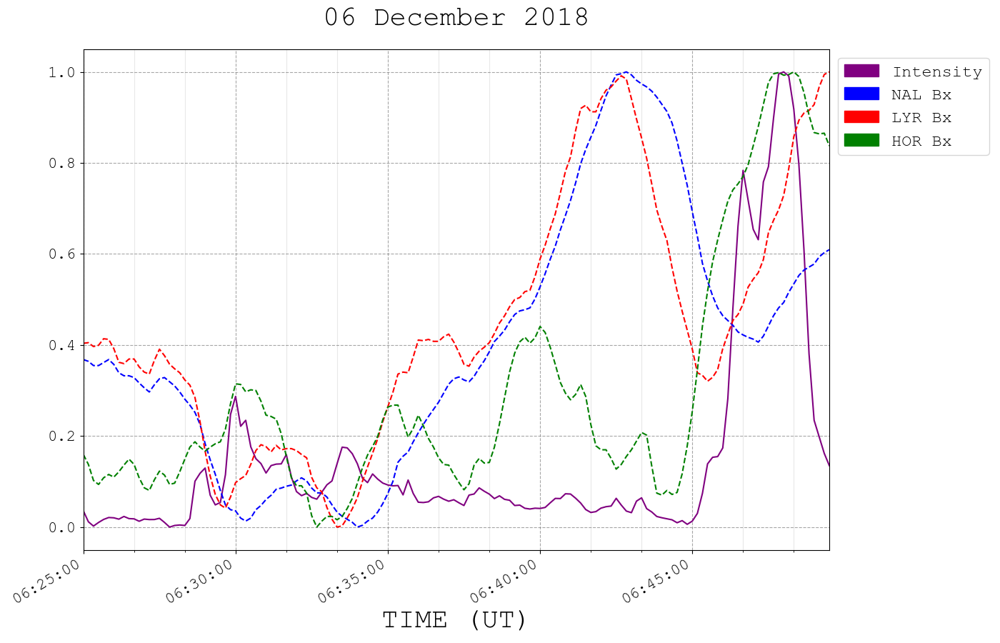
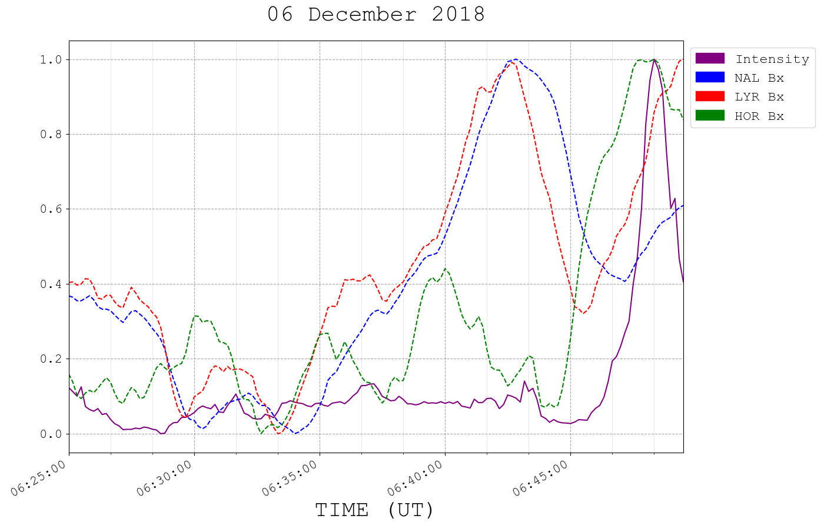
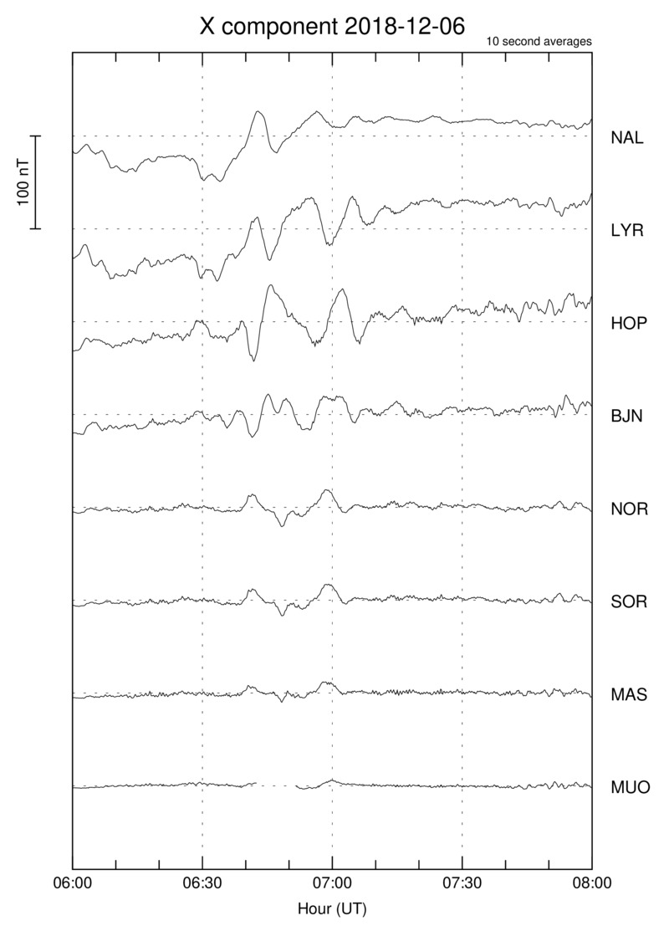
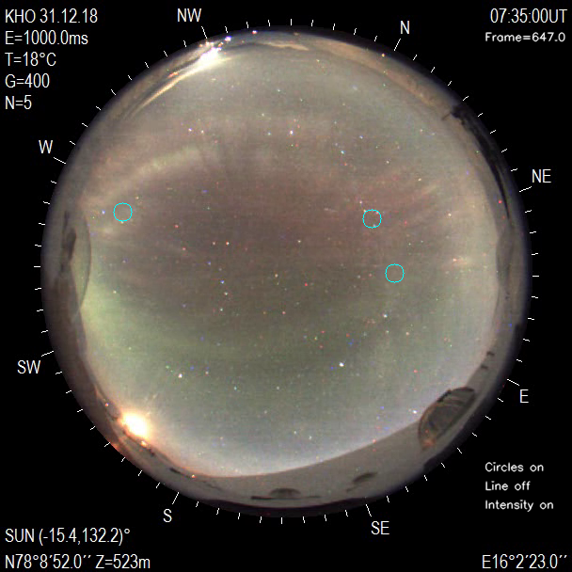
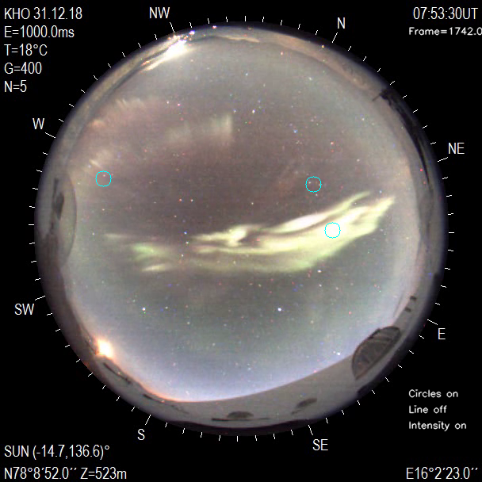
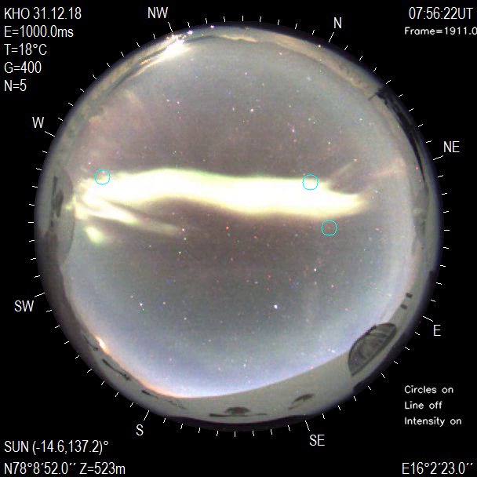
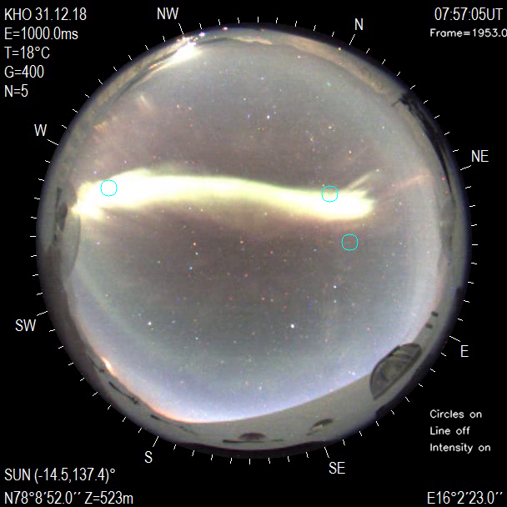
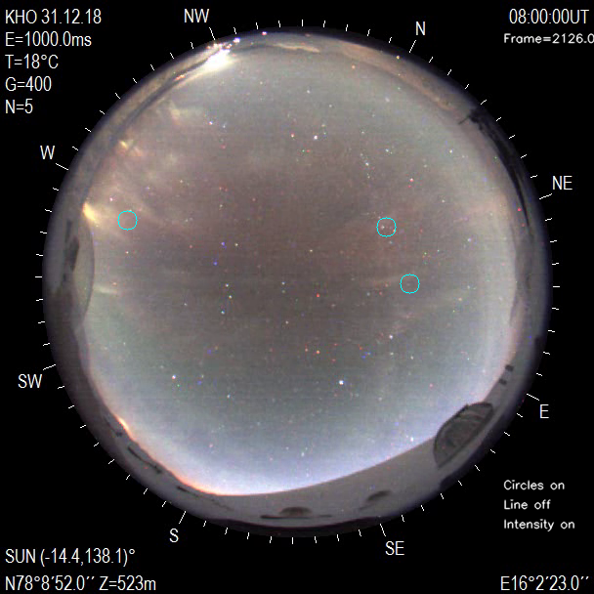
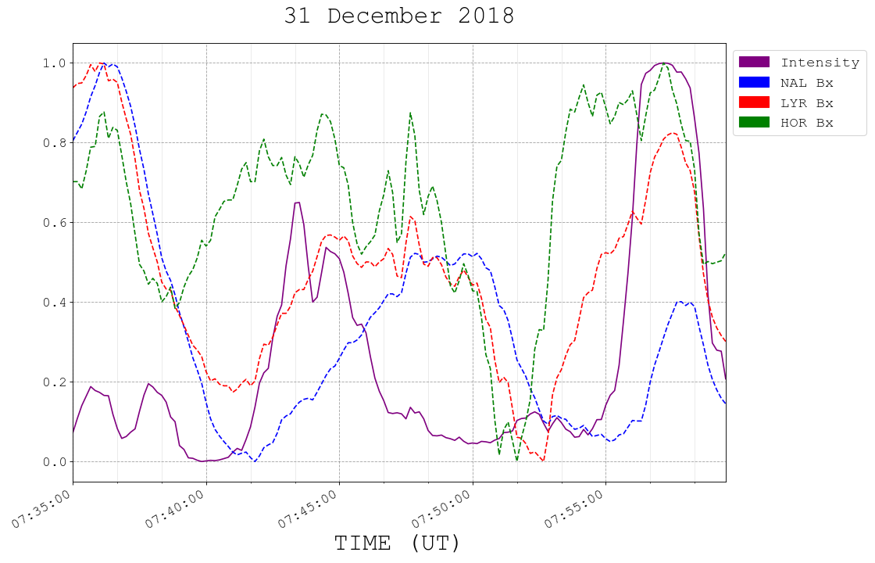
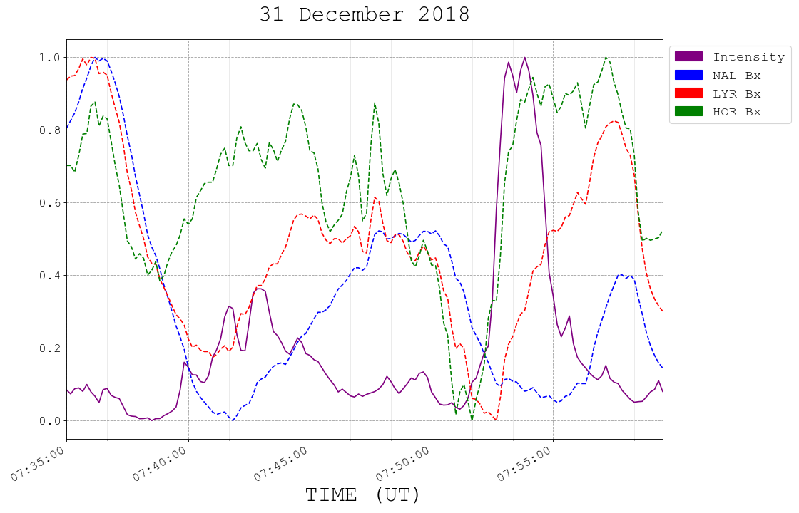
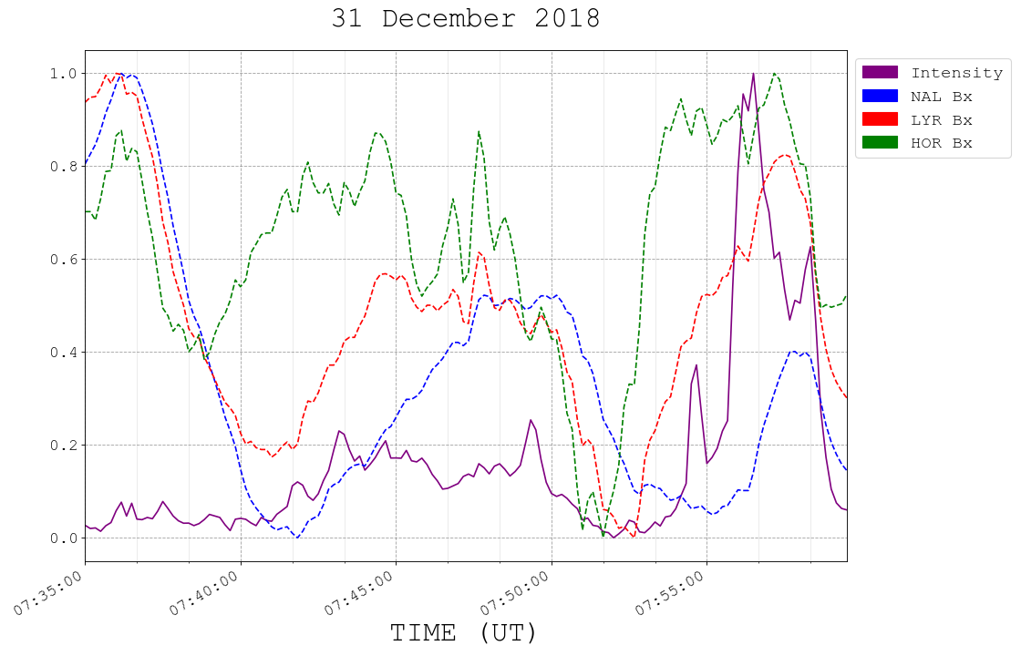
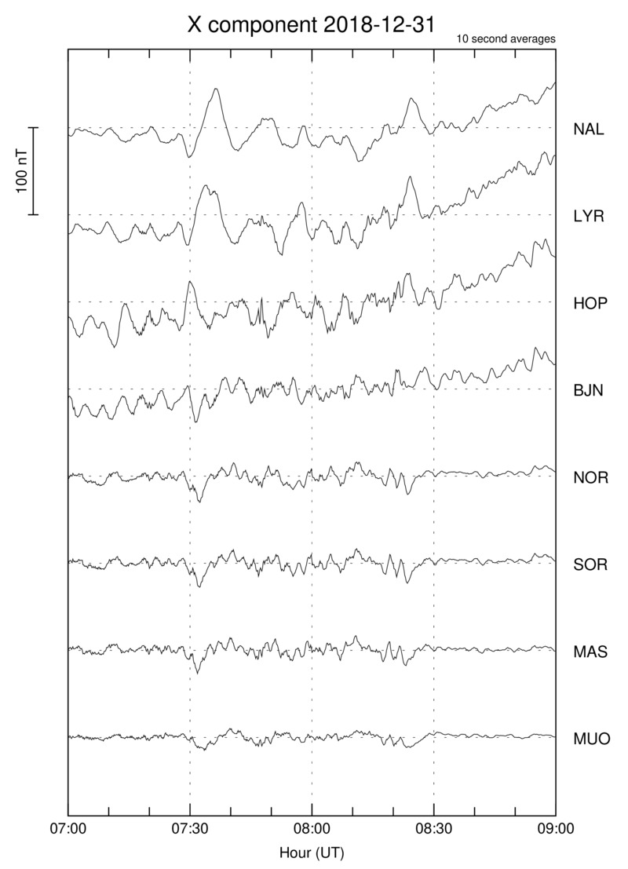
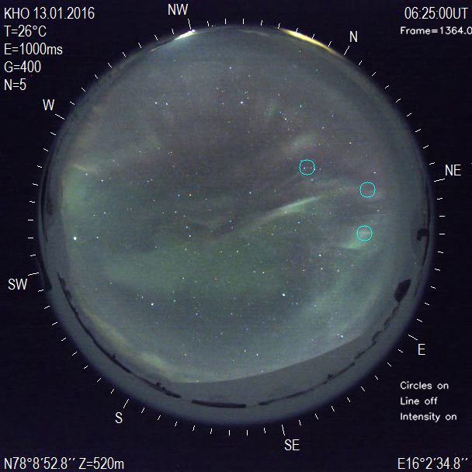
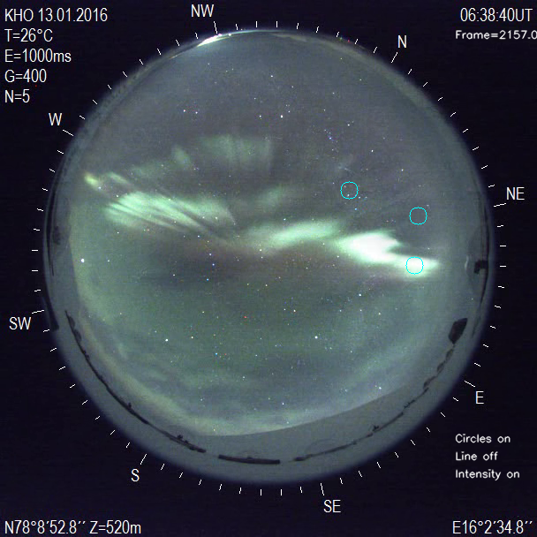
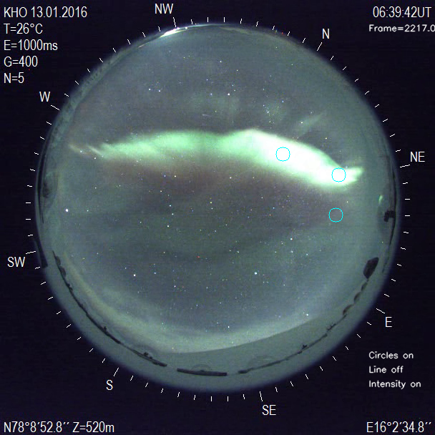
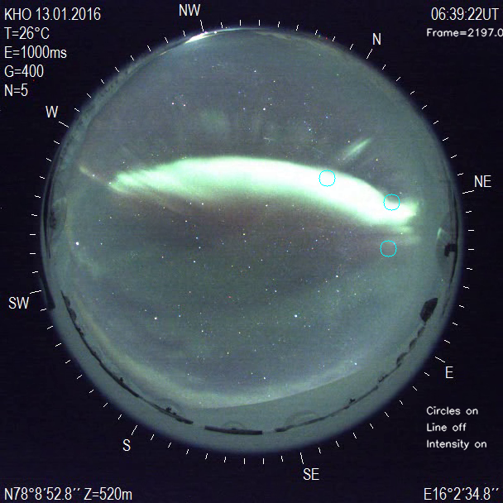
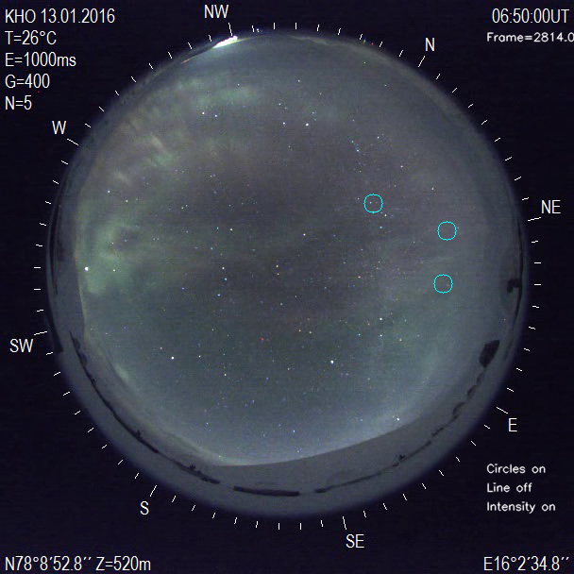
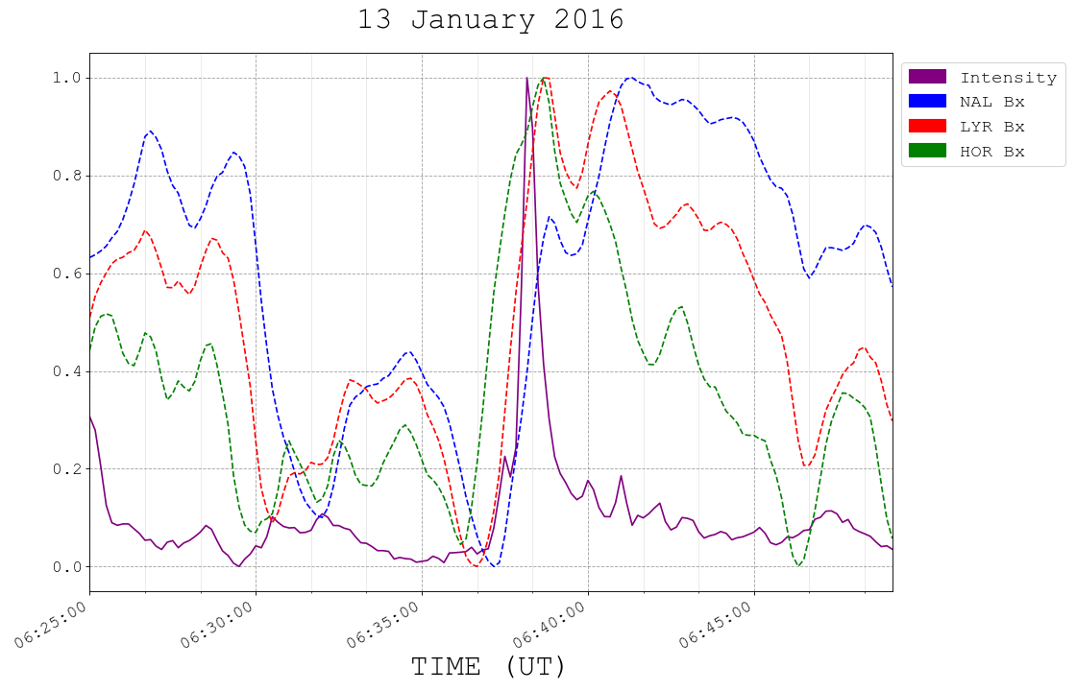
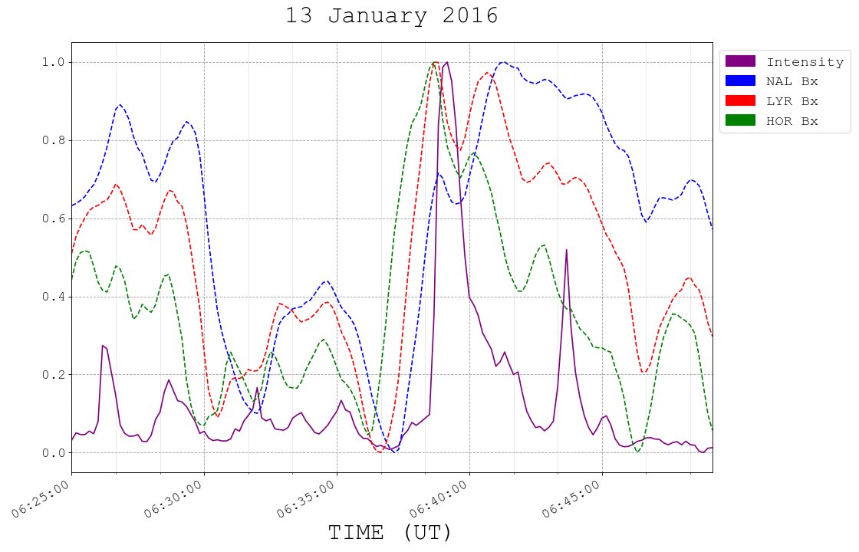
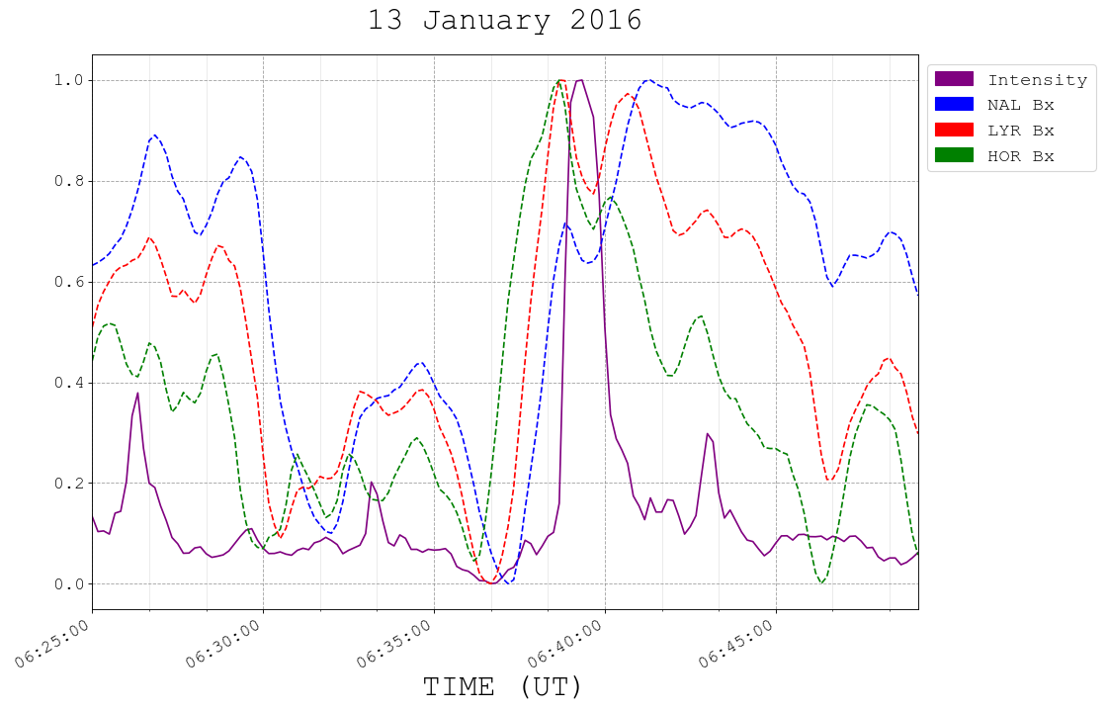
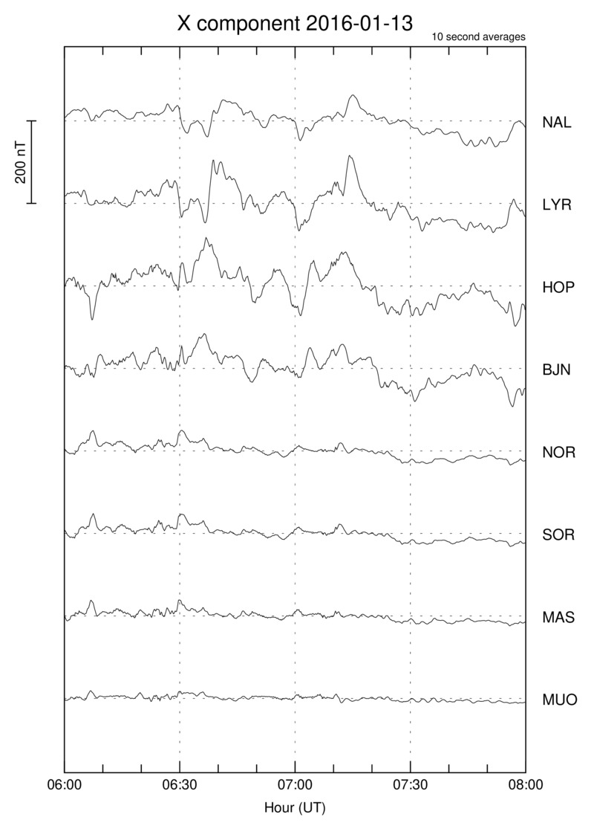
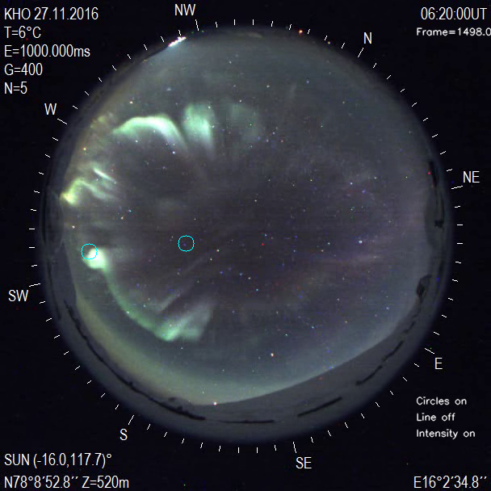
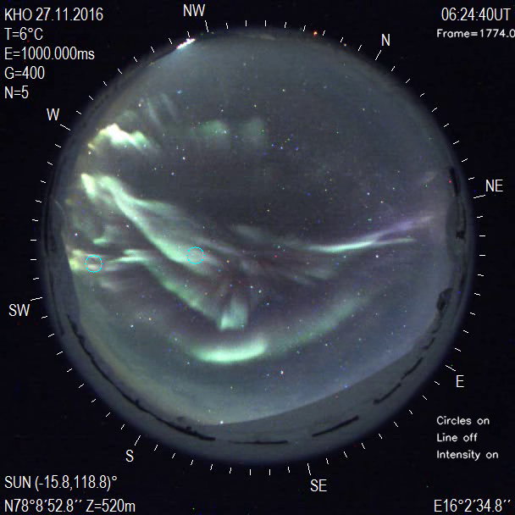
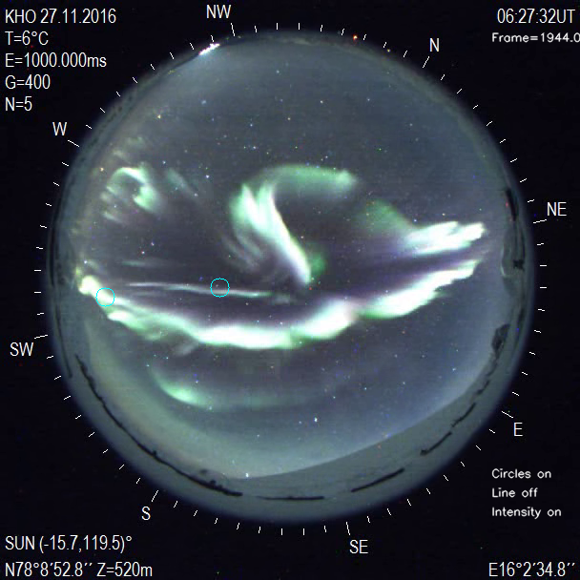
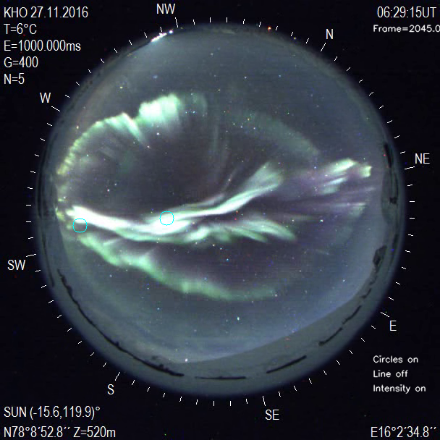
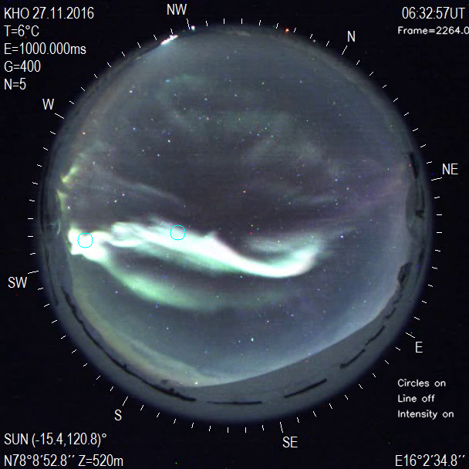
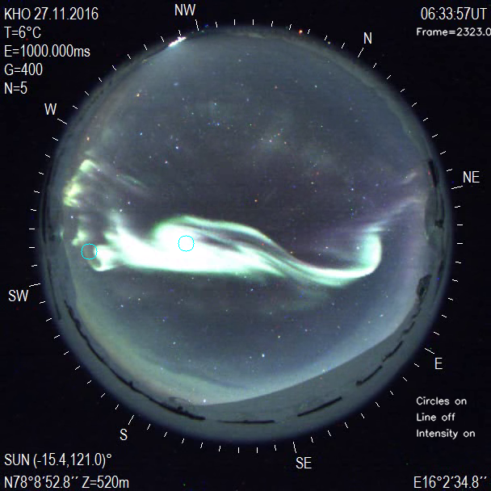
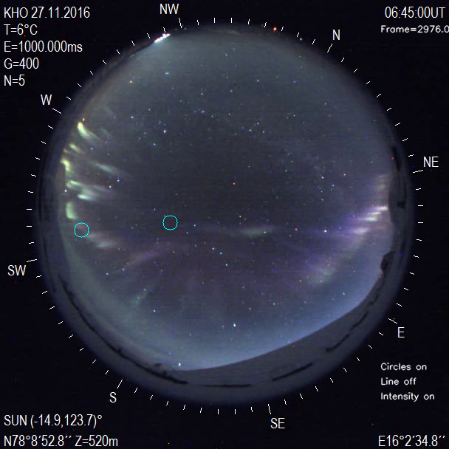
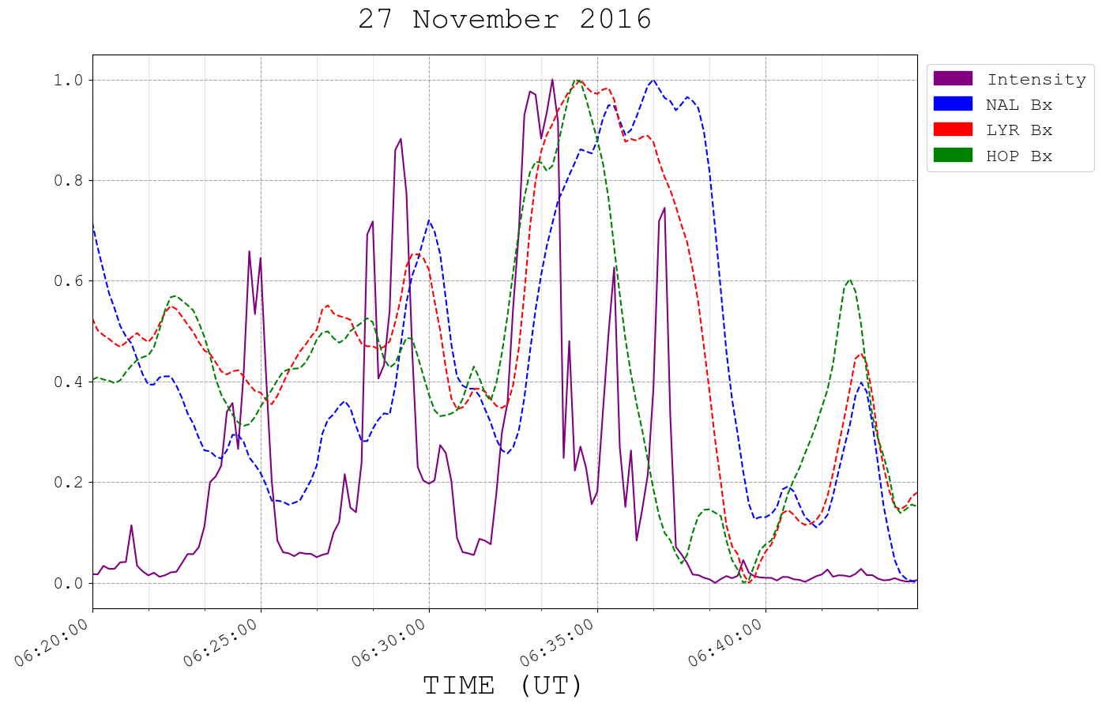
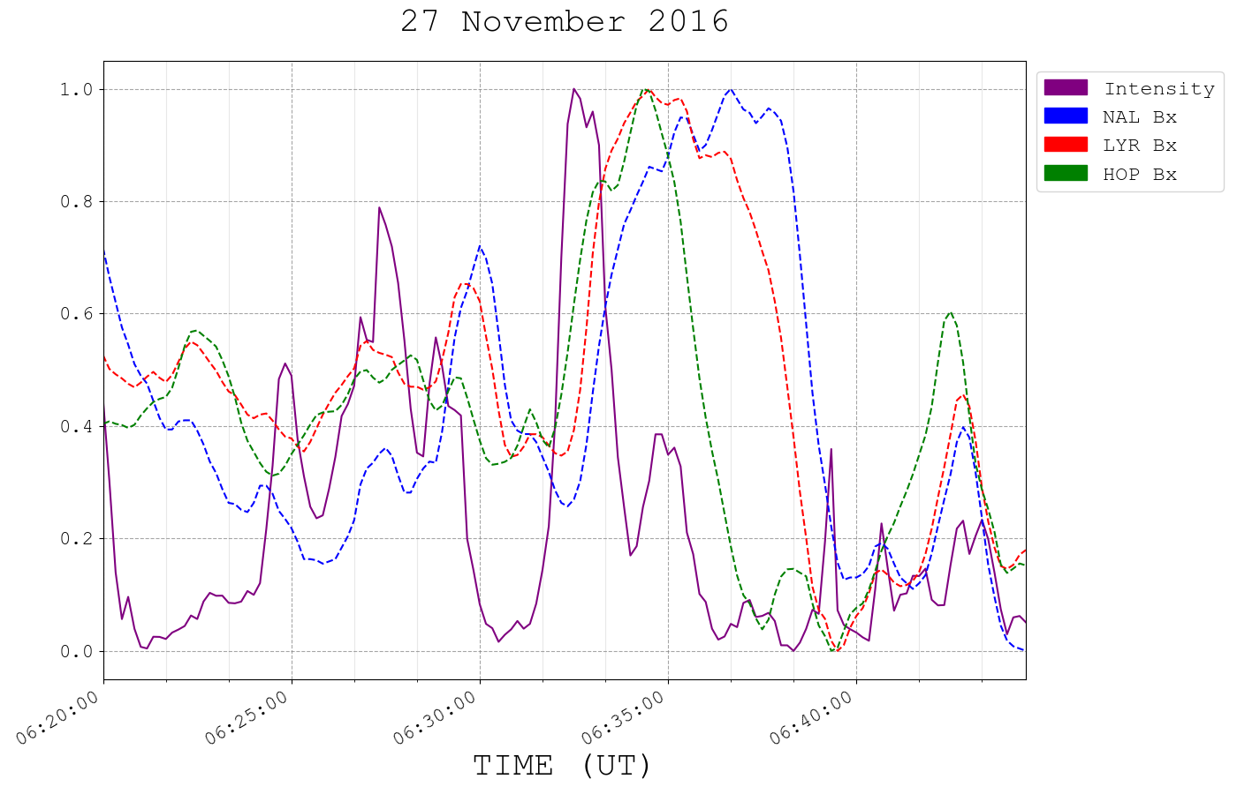
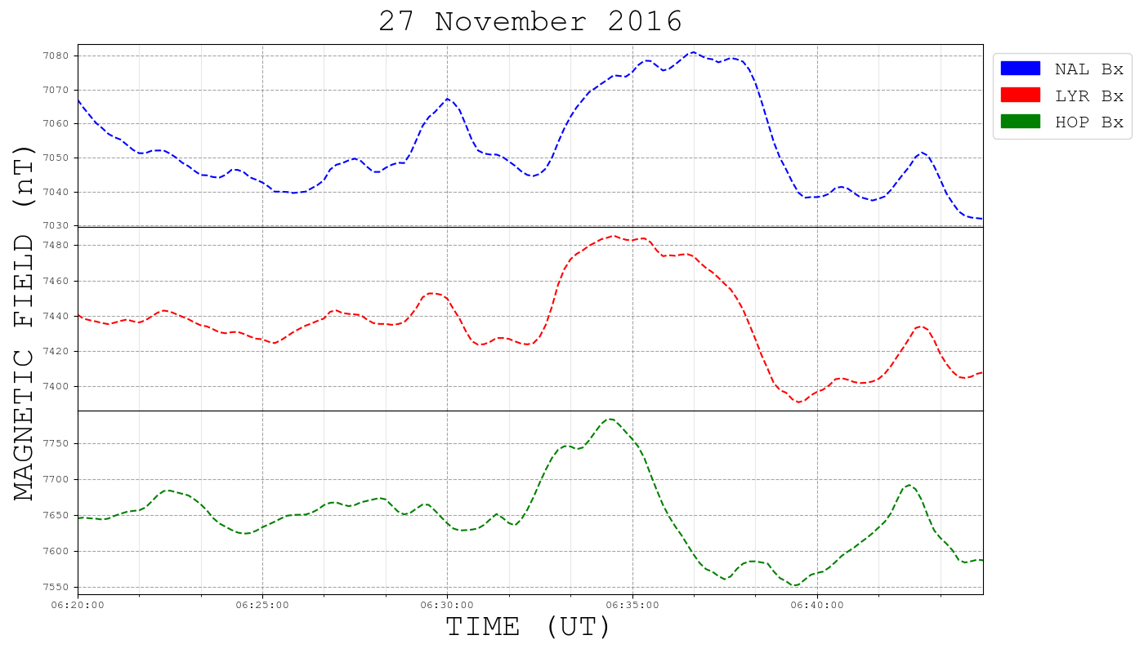
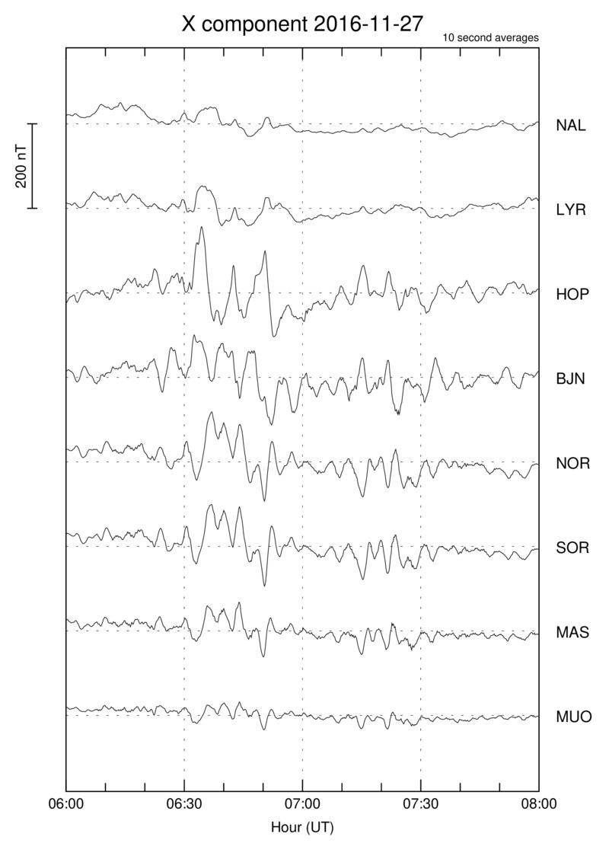
X-Currents and Extreme Brightening in Dayside Aurora
Abrielle Wang¹, Audrey Daucher^{1,} Gerard J. Fasel¹, Andrea Black¹, Makena Swenski¹, Maame Osei-Tutu¹, Braden Yonano¹, John Mann¹, Sun-Hee Lee², Fred Sigernes³, Dag A Lorentzen³
1Pepperdine University, Physics Department, Malibu, CA, USA.
2NASA Goddard Space Flight Center, Greenbelt, USA
3University Centre in Svalbard, Longyearbyen, Norway.
Abstract: The solar-terrestrial interaction is a dynamic process which manifests itself in the ionosphere. Interplanetary (IP) shocks or solar wind dynamic pressure pulses can generate enhanced brightening in dayside aurora. Foreshock transients are capable of inducing pressure changes, larger in magnitude than solar wind pressure pulses, which also contribute to intensifying dayside aurora. These pressure variations can accelerate particles into the ionosphere, generating field-aligned currents that produce magnetic impulse events and enhanced dayside auroral activity with periods of increased brightening. This study presents several dayside auroral brightening events which are not associated with IP shocks or solar wind dynamic pressure pulses. The dayside auroral brightening events are associated with a green (557.7 nm) to red (630.0 nm) ratio which is greater than 10. These Extreme Brightening Events (EBEs) begin on the eastern or western end of a pre-existing dayside auroral arc. Periodic pulses of enhanced brightening’s are correlated with large sharp increases in the X-component from ground magnetometers in the IMAGE network. EBE’s occur predominately before magnetic noon and with X-component signatures from high latitude stations. Ground-based data is obtained from the Kjell Henriksen Observatory in Longyearbyen and the IMAGE magnetometer network.
Data: Ground-based optical data is obtained from the Kjell Henriksen Observatory (KHO) in Longyearbyen, Svalbard (GEO: 78.148° N, 16.043° E, AACGM: 75.24° N, 111.21° E) and the observatory in Ny-Alesund, Svalbard (GEO: 78.9235° N, 11.9099° E; AACGM: 76.19° N, 111.25° E). All Sky Camera images are obtained from the Boreal Aurora Camera Constellation (BACC).
Synopsis: From analysis of extremities in dayside aurora, we identified correspondence between localized peaks in the all sky intensity and sharp impulses in magnetic x-currents. Examining the longitudinal extent of EBE’s on the magnetometer, flattening in southernmost regions indicate solar-terrestrial interactions impact outermost magnetic field lines.
1 2 3
2
1
3
2
1
3
Figure 1. ASC images for December 10th, 2018, for the time interval: 06:35:00 – 07:00:00 UT, Longyearbyen. Green to red line emission ratio: 39.32. Three labeled circles represent high activity regions to compare intensities with magnetic field x-currents.
1
2
3
Figure 2. ASC images for December 6th, 2018, for the time interval: 06:25:00 – 06:50:00 UT, Longyearbyen. Green to red line emission ratio: 33.30.
3
2
1
Figure 3. ASC images for December 31st, 2018, for the time interval: 07:35:00 – 08:00:00 UT, Longyearbyen. Green to red line emission ratio: 12.19.
3
2
1
Figure 4. ASC images for January 13th, 2016, for the time interval: 06:25:00 – 06:50:00 UT, Longyearbyen. Green to red line emission ratio: 18.72.
1
2
Figure 5. ASC images for November 27th, 2016, for the time interval: 06:20:00 – 06:45:00 UT, Longyearbyen. Green to red line emission ratio: 74.42.

