Slide 1
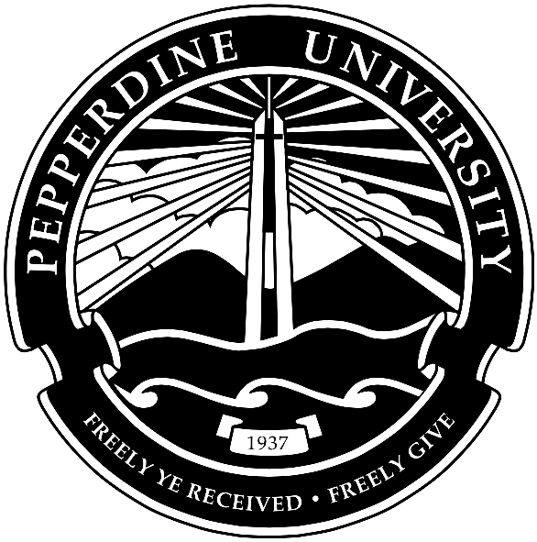
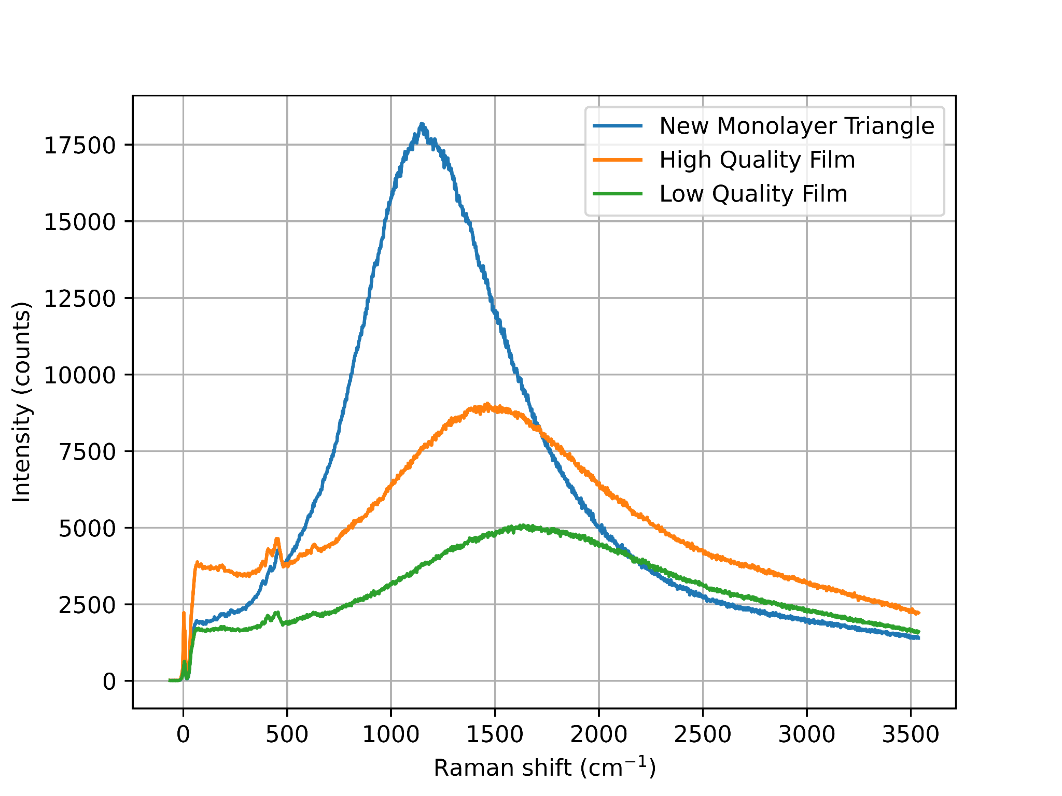
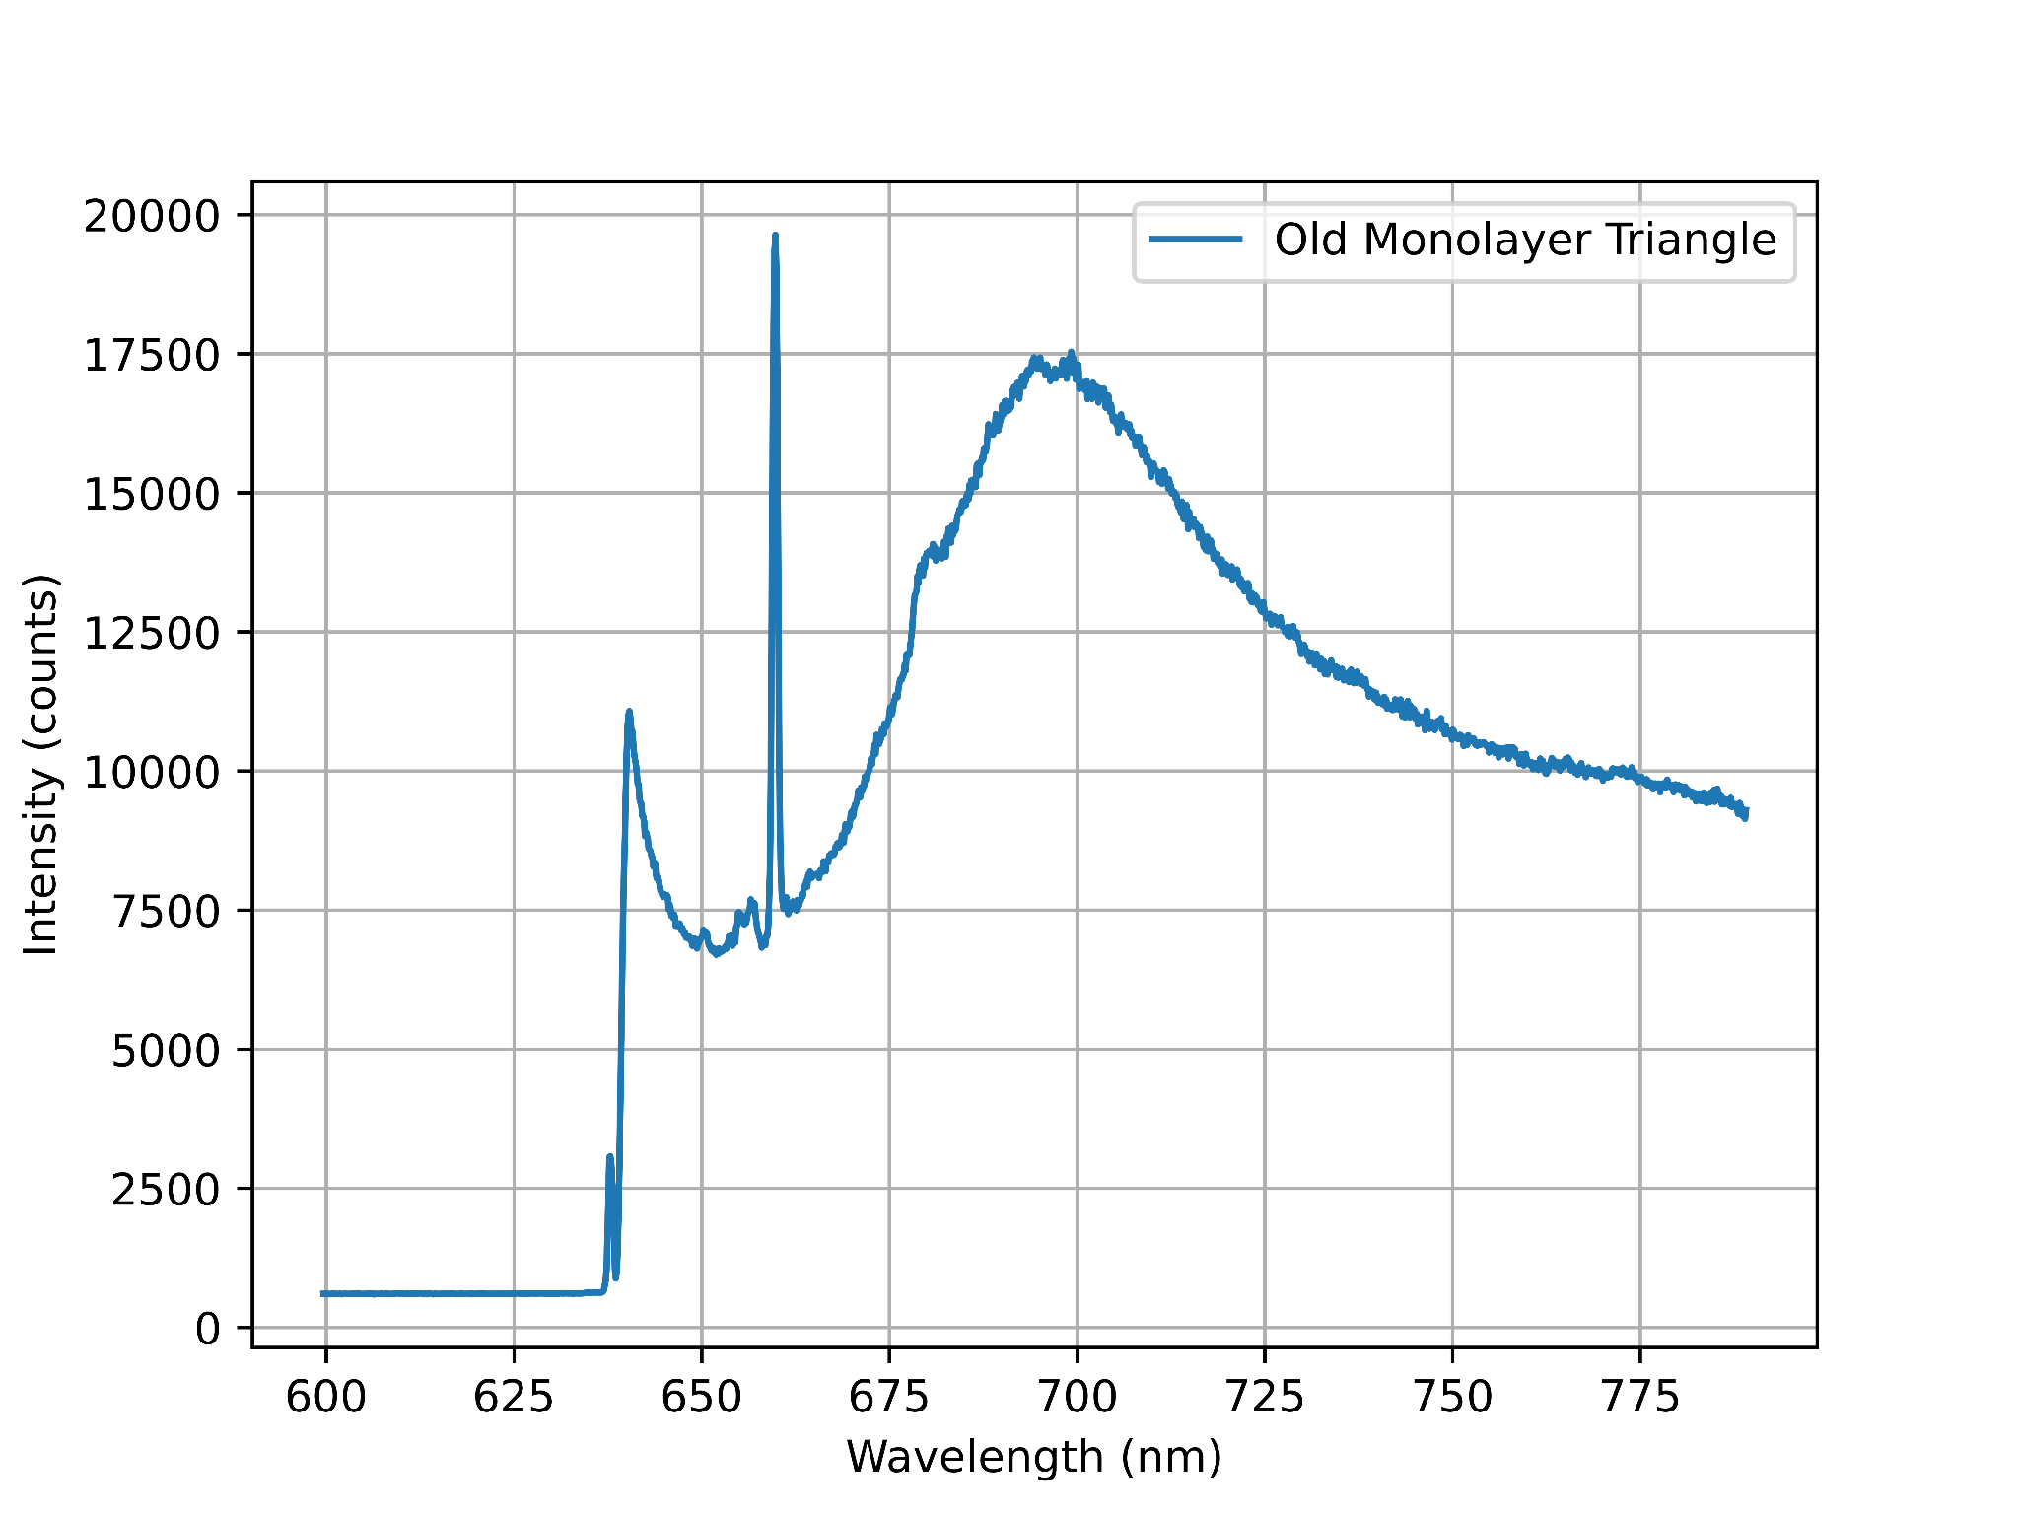
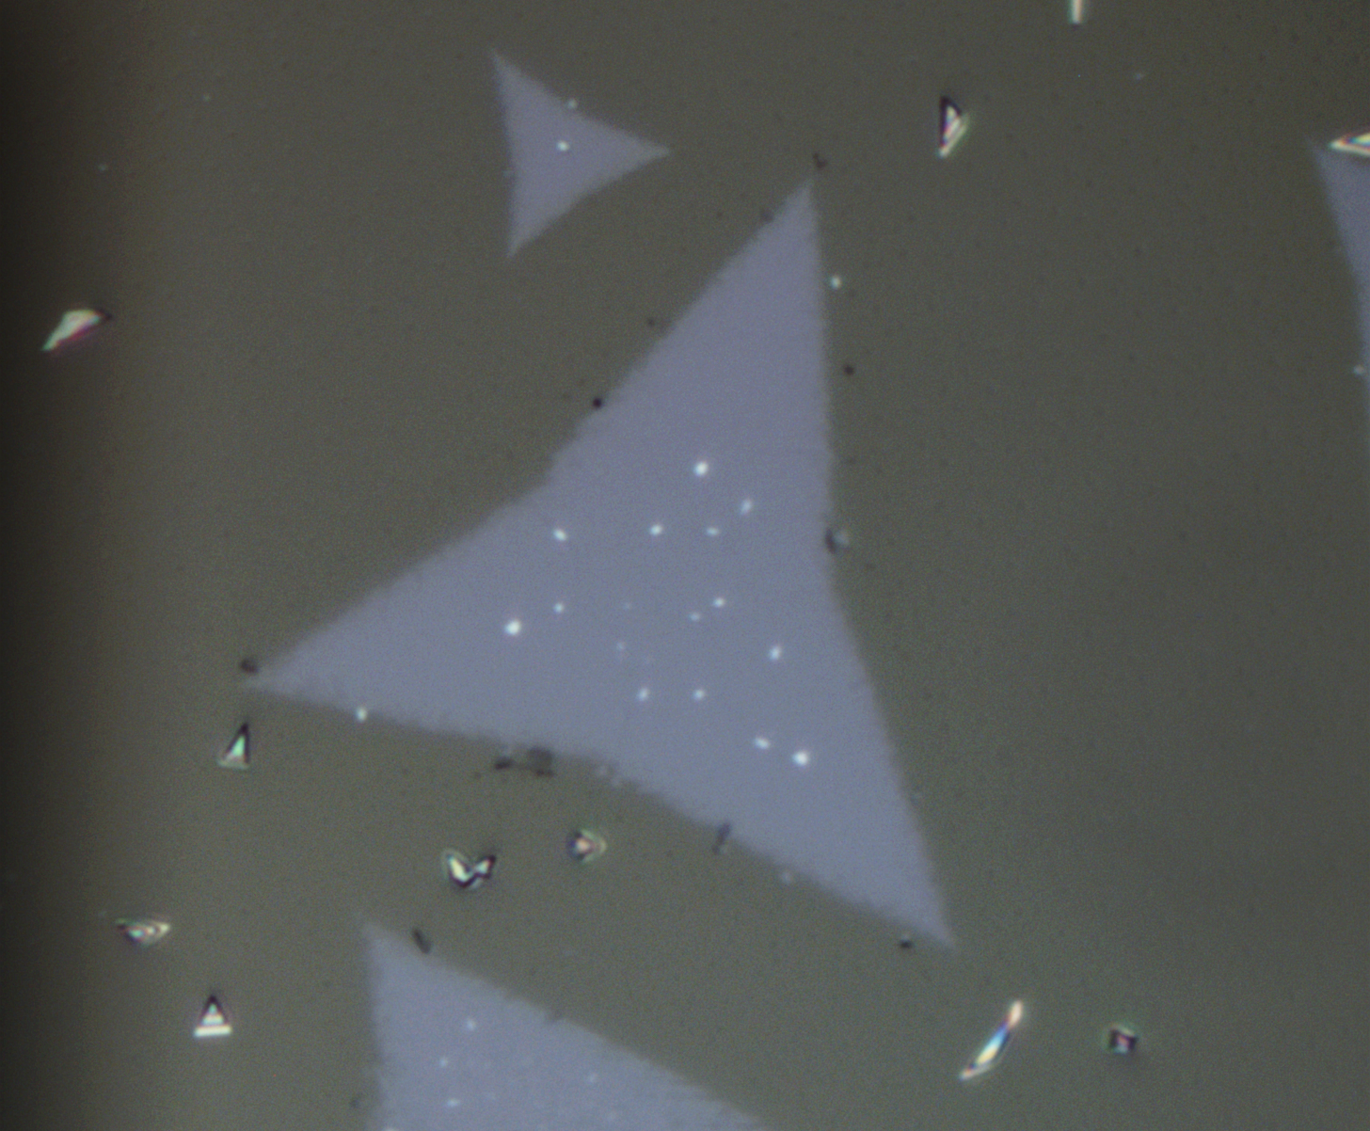
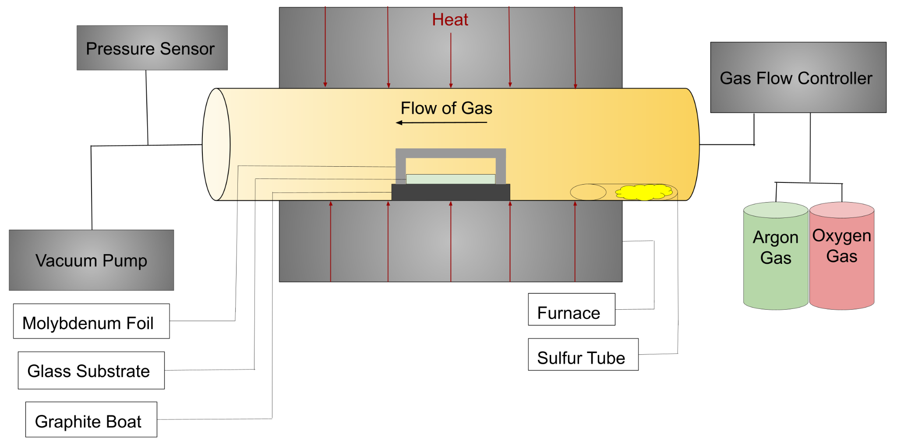
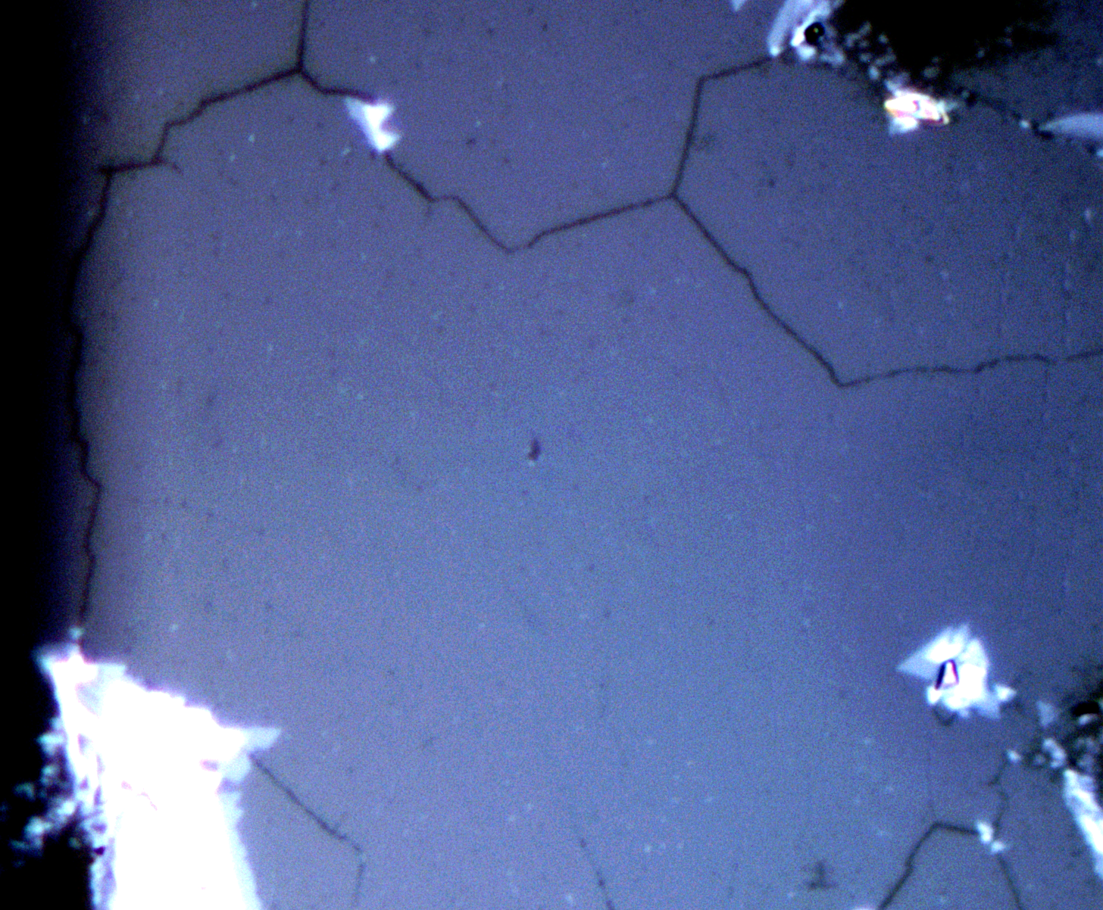
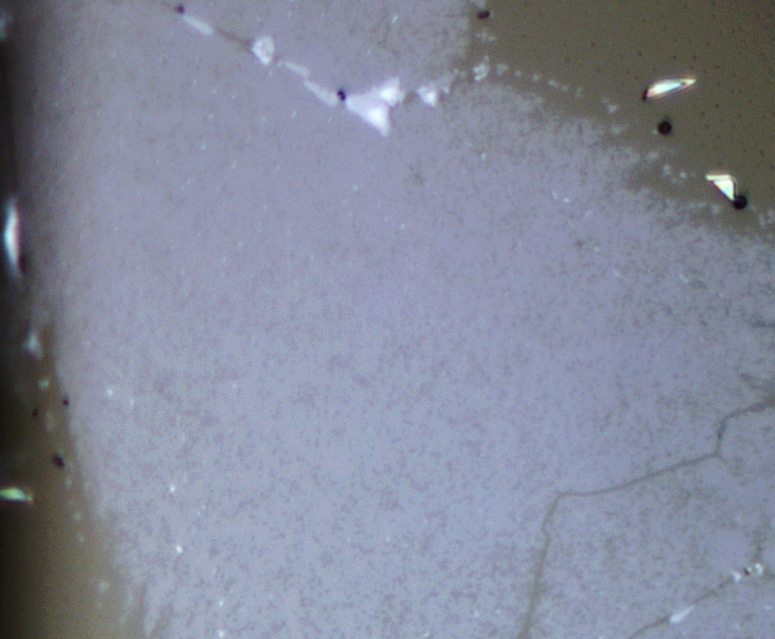
Machine Learning Prediction of Photoluminescence in MoS2: Challenges in Data Acquisition and a Solution via Improved Crystal Synthesis
E. Swonger¹, J. Mann¹, J. Horstman¹, D. Yang¹
1. Pepperdine University, Physics Department, Malibu, CA, USA.
Introduction
Transition metal dichalcogenides (TMDCs), like molybdenum disulfide (MoS2), possess unique electronic and optical properties, making them promising materials for nanotechnology. Photoluminescence (PL) is a key indicator of MoS2 crystal quality. This study aimed to develop a machine-learning model capable of predicting the peak PL wavelength of single MoS2 crystals based on micrograph analysis. Our limited ability to consistently synthesize high-quality MoS2 crystals hampered our ability to create a large set of training data. The project focus shifted towards improving MoS2 crystal synthesis to generate improved training data. We implemented a novel approach utilizing low-pressure chemical vapor deposition (LPCVD) combined with established synthesis techniques to produce MoS2 monolayers with superior quality and surface area. This method achieved high reproducibility, facilitating the collection of improved training data.
Fig. 2: This figure shows a simple set up for raman spectroscopy capable for detecting PL signal from the sample
Results
Methods
To prepare the substrate for growth, a soda-lime silica glass microscope slide is cut into a 2.5 cm x 2.5 cm square. The glass substrate is cleaned with acetone using an ultrasonicator for 5 minutes. Once the sonication process is completed, deionized water is used to rinse off the acetone on the substrate. Pressurized inert gas is used to completely dry off the substrate. To fuel the MoS2 growing process via LPCVD, 800g of sulfur to a glass tube 1 cm in diameter.
Once the substrate and the sulfur are prepared, the substrate is placed onto a graphite block that rests inside of the LPCVD chamber, and molybdenum foil is placed over the substrate. The placement of the substrate is aligned with the center of the heating element in the system. The sulfur tube is then added into the chamber and placed so that the sulfur remains outside of the insulating element of the system.
We created an LPCVD environment by attaching a vacuum pump to the exhaust end of our furnace. The entrance of chamber was connected to a gas flow controller where we were able to add argon and oxygen as the carrier gas. Once the glass substrate and sulfur tube are correctly prepared and placed into the furnace chamber, the chamber is purged via vacuum pump and argon gas at 500 sccm for 5 minutes. The furnace is then linearly heated to 720°C while 60 sccm of argon gas and a leaking amount of oxygen gas is pumped through the system. Once at the desired temperature, the furnace temperature is held for 8 minutes. Once the hold time is completed. The furnace is opened, the oxygen gas turned off, and argon gas is set again to 500 sccm. The system is let to cool down to 40°C before opening the chamber. The MoS2 on the glass is than characterized using a raman spectrometer.
Fig. 9: This figure shows the graph of the PL data from Fig. 5-7. The x-axis is raman shift in cm⁻¹ emitted from the crystal and the y-axis is the intensity of the light emitted in counts.
Fig. 3: This figure shows the monolayer crystal growth on a silicon substrate before improvements were made at 100x magnification.
Fig. 4: This figure shows the graph of the PL data from Fig. 2. The x-axis is wavelength in nm emitted from the crystal and the y-axis is the intensity of the light emitted in counts.
Discussion and Conclusions
Comparing Fig. 4 and Fig. 9, we see that the peak of the PL signal for the monolayer triangles of MoS2 both have an intensity of approximately 17,500 counts. The intensity and the width of the PL signals indicate a similar, high-quality, crystal. Although the x-axis of each of the figures are in different units, we can refer to Fig. 5 to do the unit conversion.
Looking at Fig. 9, we see that there is variation in the crystal quality of our films. There is also a decrease in crystallinity from the monolayer triangles to the films; this could be due to multiple factors, however, the most likely error in our system is from the glass substrate that we grow our crystals in. Typically, the crystal structure of the substrate aids in aligning the crystal structure of the material. However, glass is an amorphous material, meaning that the crystallographic direction of the MoS2 cannot align with the glass substrate, causing the MoS2 film to overlap, decreasing the crystallinity and, ultimately, the PL signal.
Although we initially sought to produce a machine-learning program that could predict the PL signal from a sample of MoS2, our group found that we did not have sufficient training data that a machine-learning program demands; also, the data acquisition cannot be automated considering the spectroscopy instrumentation. Our goal of the project diverged to producing a large, diverse dataset to later train a machine learning program that can detect the peak of the PL signal from the MoS2 crystals. To do this we will use the image classification in the Python TensorFlow library along with approximating the peak PL signal using Lorentzian curve fitting functions. However, due to our group's interest in producing more TMDCs, WS2 in particular, we plan to expand the machine-learning project to distinguish between the monolayer TMDCs that we produce.
Fig. 5: This figure shows the conversion equation to convert from wavelength in nm to raman shift in cm⁻¹.
Fig. 6: This figure shows the monolayer crystal growth on a glass substrate after improvements were made at 100x magnification.
Fig. 7: This figure shows a higher-quality monolayer film crystal growth on a glass substrate after improvements were made at 100x magnification.
Fig. 8: This figure shows a lower-quality monolayer film crystal growth on a glass substrate after improvements were made at 100x magnification.
Acknowledgements
Fig. 1: This figure shows the schematic diagram of our LPCVD system.
We are pleased to thank the W. M. Keck Foundation and Pepperdine University’s Keck Institute for Data Science that funded this research during the 2023 Summer.

