Slide 1
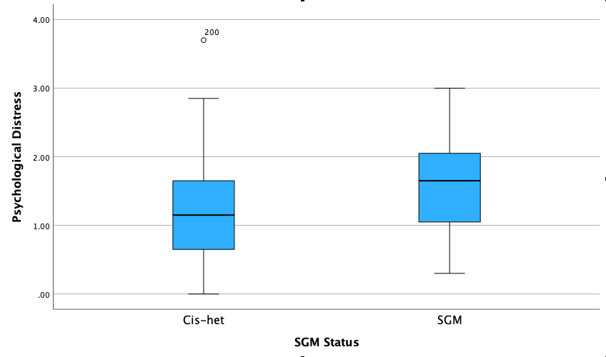
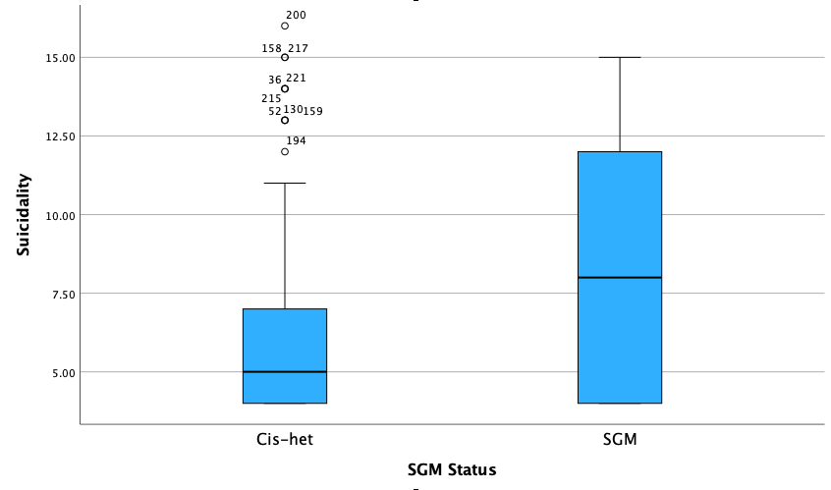
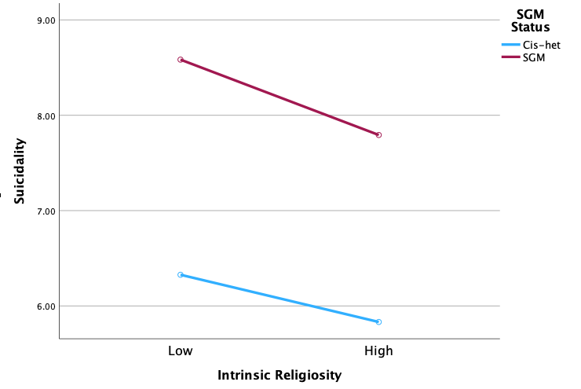
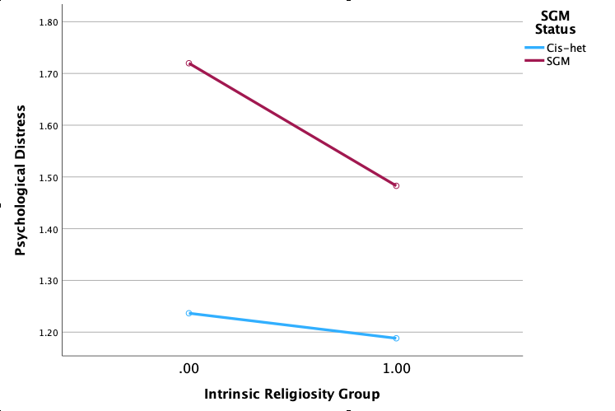
Mental Health and Religiosity Among Sexual and Gender Minority Students at a Religious University
Danica P. Christy, Steven V. Rouse, and Elizabeth J. Krumrei-Mancuso
Department of Psychology, Pepperdine University
Abstract
Sexual and Gender Minorities (SGMs) are vulnerable to psychological distress and suicidality; this is often heightened at nonaffirming religious institutions. We studied mental health and religiosity among undergraduates at a religious university. Our findings suggest that SGMs are at a higher risk of mental illness and highlight the complicated relationship between SGM identity and religiosity.
SGM are vulnerable to psychological distress and suicidality; this is often heightened at nonaffirming religious institutions. We studied mental health and religiosity among undergraduates at a religious university. Our findings suggest that SGMs are at a higher risk of mental illness and highlight the complicated relationship between SGM identity and religiosity.
Results
Hypothesis 1
Psychological distress scores were significantly higher (p < .001) for SGM students (M = 1.61, SD = 0.65) than cis-het students (M = 1.20, SD = 0.69). Additionally, suicidality scores were significantly higher (p < .001) for SGM students (M Rank = 135.73) than cis-het students (M Rank = 98.36)
Conclusion
In accordance with our first hypothesis and the minority stress model (Meyers, 2013), SGM students reported higher levels of psychological distress and suicidality than their cis-het counterparts.
Counter to our second hypothesis, there were no significant differences between SGM students who are involved in the GSA and SGM students who are not involved in the GSA for psychological distress and suicidality scores.
Counter to our third hypothesis, religiosity was not a protective factor for psychological distress. Additionally, religiosity acted as a protective factor for suicidality, but its effects did not differ between SGM and cis-het students.
Finally, counter to our fourth hypothesis, intrinsic religiosity was not correlated with any LGBTQ+ identity concerns. However, religious attendance was associated with more internalized homonegativity and less identity superiority. Private religious practice was also associated with less identity superiority.
Figure 1
Mean Scores on Psychological Distress for SGM status
Note. SGM = Sexual Gender Minority; Cis-het = cisgender and heterosexual
Figure 2
Mean Rank on Suicidality for SGM status
Note. SGM = Sexual Gender Minority; Cis-het = cisgender and heterosexual
Introduction
University students have been reporting increasing rates of mental illness in recent years (Duffy et al., 2019).
SGM students are at a higher risk of negative mental health outcomes than their cisgender heterosexual (cis-het) counterparts (Lipson et al., 2019).
SGM students at religious universities and those with religious beliefs may experience both risk factors and protective factors related to their religiosity (Klundt et al., 2021).
Hypotheses
Based on the Minority Stress Model (Meyers, 2013), SGM students would report higher levels of psychological distress and suicidality than cis-het students.
Similar to previous research (Wolff et al., 2016), SGM students involved in a Gender and Sexuality Alliance (GSA) would report having less difficulty accepting their sexuality and lower levels of incongruence between their religious beliefs and their sexuality than SGM students who aren’t involved in a GSA.
Based on previous research (Klundt et al., 2021), intrinsic religiosity would be predictive of lower levels of psychological distress and suicidality for both SGM and cis-het students, but the relationship would be weaker for SGM students than cis-het students.
Based on the findings of Klundt et al. (2021) intrinsic religiosity would be predictive of higher levels of LGBTQ+ specific concerns, such as internalized homonegativity, for SGM students.
Implications
This study explores the need for increased psychological support for SGM students at religious universities.
This study shows the complex relationship between religiosity and mental health and identity acceptance for SGM individuals, highlighting the importance of offering affirming religious spaces for SGM individuals.
Hypothesis 2
There was no significant difference in difficulty accepting sexual identity (p = .63) or incongruence between religious beliefs and sexuality (p = .76) between students who experience same gender attraction and are involved in the GSA and students who experience same gender attraction and are not involved in the GSA.
Future Research
Future research should explore SGM and cis-het individuals at a large variety of religious universities, ranking religiosity, LGBTQ+ acceptance, and conservatism of these universities to contrast between university atmospheres.
Additionally, future research should explore the impact of intersectional gender, sexual, and racial identities, specifically at predominantly white and religiously affiliated institutions
Hypothesis 3
Intrinsic religiosity did not significantly aid in the prediction of psychological distress. Although intrinsic religiosity was predictive of less suicidality in the full sample, this link was not moderated by SGM versus cis-het identity.
References
Duffy, M. E., Twenge, J. M., & Joiner, T. E. (2019). Trends in mood and anxiety symptoms and suicide-related outcomes among US undergraduates, 2007–2018: Evidence from two national surveys. Journal of Adolescent Health, 65(5), 590–598. https://doi.org/10.1016/j.jadohealth.2019.04.033
Klundt, J. S., Erekson, D. M., Lynn, A. M., & Brown, H. E. (2021). Sexual minorities, mental health, and religiosity at a religiously conservative university. Personality and Individual Differences, 171, 110475. https://doi.org/10.1016/j.paid.2020.110475
Koenig, H. G., & Büssing, A. (2010). The Duke University Religion Index (DUREL): A five-item measure for use in epidemiological studies. Religions, 1(1), 78–85. https://doi.org/10.3390/rel1010078
Lipson, S. K., Raifman, J., Abelson, S., & Reisner, S. L. (2019). Gender minority mental health in the US: Results of a national survey on college campuses. American Journal of Preventive Medicine, 57(3), 293–301. https://doi.org/10.1016/j.amepre.2019.04.025
Meyer, I. H. (2013). Prejudice, social stress, and mental health in lesbian, gay, and bisexual populations: Conceptual issues and research evidence. Psychology of Sexual Orientation and Gender Diversity, 1(S), 3–26. https://doi.org/10.1037/2329-0382.1.s.3
Mohr, J. J., & Kendra, M. S. (2011). Revision and extension of a multidimensional measure of sexual minority identity: The Lesbian, Gay, and Bisexual Identity Scale. Journal of Counseling Psychology, 58(2), 234–245. https://doi.org/10.1037/a0022858
Osman, A., Bagge, C. L., Gutierrez, P. M., Konick, L. C., Kopper, B. A., & Barrios, F. X. (2001). The suicidal behaviors questionnaire-revised (SBQ-R):Validation with clinical and nonclinical samples. Assessment, 8(4), 443–454. https://doi.org/10.1177/107319110100800409
Wolff, J. R., Himes, H. L., Soares, S. D., & Miller Kwon, E. (2016). Sexual minority students in non-affirming religious higher education: Mental health, outness, and identity. Psychology of Sexual Orientation and Gender Diversity, 3(2), 201–212. https://doi.org/10.1037/sgd0000162
Youn, S. J., Castonguay, L. G., Xiao, H., Janis, R., McAleavey, A. A., Lockard, A. J., Locke, B. D., & Hayes, J. A. (2015). The Counseling Center Assessment of Psychological Symptoms (CCAPS): Merging clinical practice, training, and research. Psychotherapy, 52(4), 432–441. https://doi.org/10.1037/pst0000029
Methods
Participants
219 undergraduate participants from Pepperdine University, 68 of which are SGMs.
Measures
Counseling Center of Assessment of Psychological Symptoms - 34 (CCAPS-34)
The CCAPS-34 assesses mental health (Youn et al., 2015).
Cronbach’s alpha coefficient: .73-.90
Duke University Religiosity Index (DUREL)
The DUREL assesses religious attendance, private religious activity, and intrinsic religiosity as independent scales (Koenig & Büssing, 2010).
Cronbach’s alpha coefficient: .91
Lesbian, Gay, and Bisexual Identity Scale (LGBIS)
The LGBIS measures identity-related constructs among lesbian, gay, and bisexual people (Mohr & Kendra, 2011).
Cronbach’s alpha coefficient: .72-.94
Religious Incongruence Scale
This scale measures religious incongruence within lesbian, gay, and bisexual individuals (Wolff et al., 2016).
Cronbach’s alpha coefficient: .79
Suicidal Behavior Questionnaire - Revised (SBQ-R)
The SBQ-R measures suicidality (Osman et al., 2001).
Cronbach’s alpha coefficient: .85
Figure 3
Moderation Model for suicidality
Note. SGM = Sexual Gender Minority; Cis-het = cisgender and heterosexual
Figure 4
Moderation Model for Distress
Note. SGM = Sexual Gender Minority; Cis-het = cisgender and heterosexual
Hypothesis 4
Intrinsic religiosity was not significantly related to any of the LGBIS scales.
Religious attendance was associated with internalized homonegativity (ρ = .35, p = .006) and identity superiority (ρ = -.36, p = .005). Private religious practice was associated with less identity superiority (ρ = -.28, p = .03).
Further Information
For further information, please email danica.christy@pepperdine.edu

