Slide 1
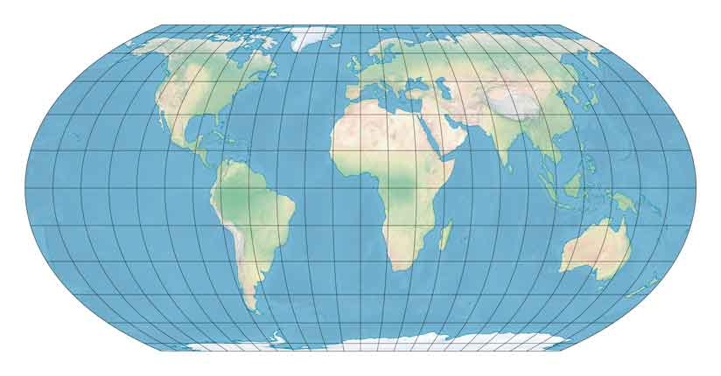
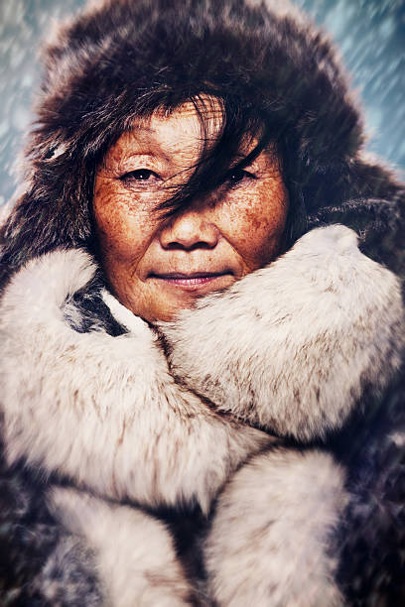
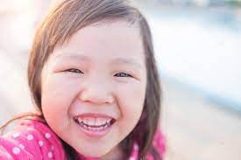
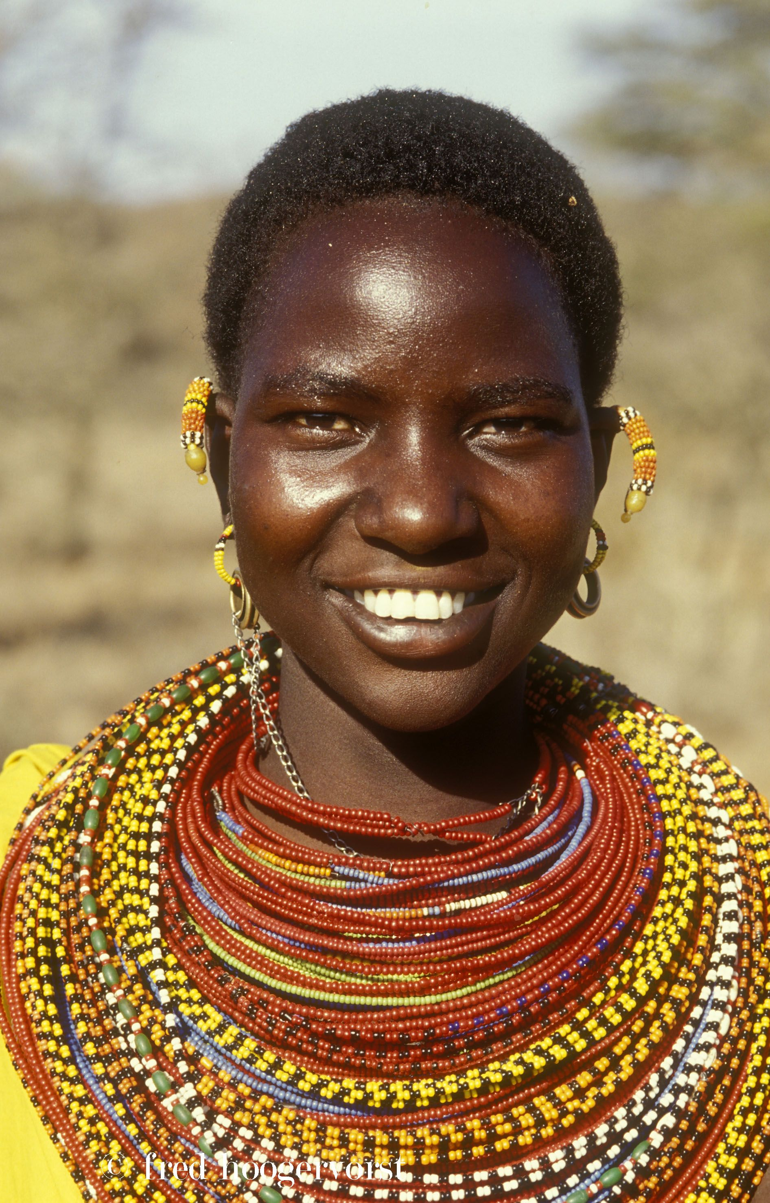
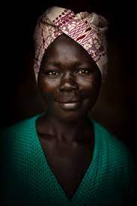
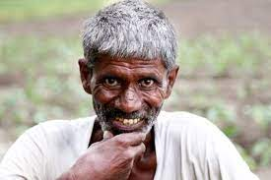
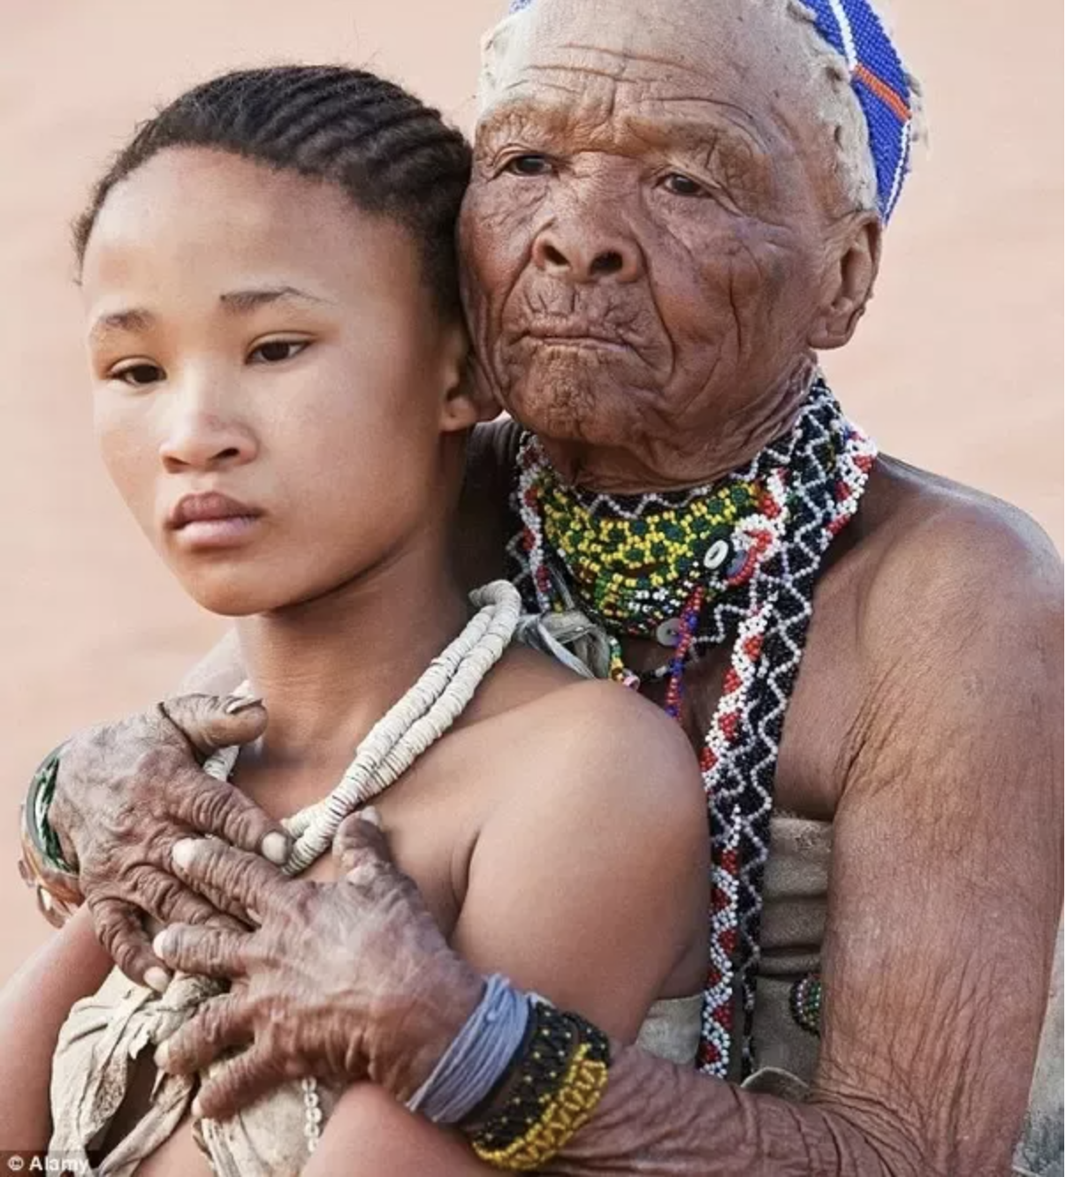
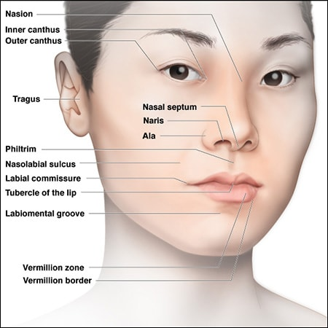
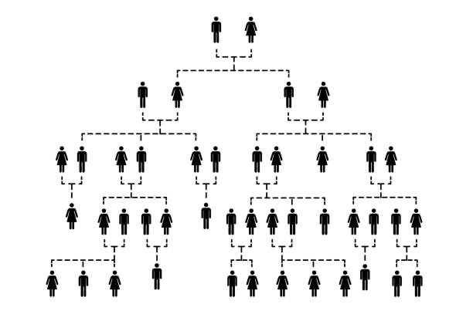
Human Adaptability and Facial Morphology:
The Beyond Face Value project on diversity in human anatomy curriculum
¹Cass, J., ¹Lopes, V., ²McSpadden, T., ¹Paris, H. Ph.D., and ¹Storm, C., Ph.D.
¹Natural Science and ²Social Science, Pepperdine University
INTRODUCTION
The recent and sharp upturn in our nation’s socio-political conversation has fueled greater interest in ensuring that college curricula is both diverse and inclusive. Because human anatomy is nearly ubiquitous across colleges, it may be a valuable avenue for universities to purposefully incorporate topics of diversity in a way that positively impacts our socio-cultural relationships to one another as well as the future of medicine. Providing students with a scientific understanding of our visible differences may mitigate subconscious bias when we see others who have different features than ourselves.
EPICANTHAL FOLD (eyes)
Insulation for eye & sinuses in cold climates.
NARES & NASION (nose shape)
Small, narrow nasal inlets promote warming of cold air, preventing freezing of lower respiratory passages.
Morphological variability, especially of the head and face, are arguably the largest contributor to our unconscious (or even conscious) bias. What our brains often fail to recognize is the biological impetus, and genius, behind such variability. A curriculum that provides students with a scientific understanding of our morphological variability not only will broaden understanding of why people look different but may increase appreciation for human adaptability and our visible differences.
PURPOSE: We investigated the biogeographical factors that contribute to the morphological variability of the face and hair; with the secondary aim of developing new diverse and inclusive content to embed in a college-level human anatomy course
“Standard curriculum in human anatomy may be missing a valuable opportunity to better educate students on the biology behind our visible anatomical differences: from skin color and hair texture to the shape of the eyes and nose.”
MELANIN (skin color)
Increased melanin protects the nucleus of keratinocytes from harmful UV radiation.
DESCRIPTION
VERMILLION ZONE (lip size)
Thick, everted lips tend to radiate more body heat and help cool the body.
Anatomical Facial Landmarks
Although adaptation is a ubiquitous phenomenon across scientific disciplines, these disciplines often offer a different interpretation of the term. Physiologists use the term to represent a variety of responses, be it increases in hemoglobin mass elicited by high altitude or shifts in plasma volume stimulated by hot environments. Adaptation also occurs beyond acute, physiological responses, and may manifest in anatomical traits that promote (or perhaps once promoted) the ability to accommodate for environmental stressors. These traits are often hidden in plain sight, apparent on the human head and face. The skin responds to the sun. The nose replies to the cold. These adaptations create distinguishing facial features, and though familiarity may look upon these traits as quotidian and unremarkable, the adaptations themselves create distinguishing features that hold, not only form, but also function.
HAIR SHAFT (hair curl & texture)
Coiled hair minimizes heat gain from solar radiation.
FINDINGS: The variability of hair and facial features appear to demonstrate a biogeographical relationship; such that the size and shape of a feature shows a functional advantage in one’s ancestral environment. The features that show variation appear to derive from the same germ layer, the neural crest, during development.
Hair shaft (hair shape and texture): The shape of the hair shaft gives rise to its varied appearance, e.g., thin/thick, straight/curly. The phylogenesis of hair shows that from cold, to moderate, to hot humid climates, hair shape and texture varies from straight, to wavy, to tightly coiled, spiraled wool-like hair, respectively (Irmak & Özcan, 1997). This variation appears to regulate the conservation- or removal of body heat accordingly (Johnson, et al., 1993).
Relevant features not pictured here: melanin and hair shaft
©Image: Dentalcare.ca
DISCUSSION
Skin pigmentation (melanin production): Variation in skin pigmentation is related to latitude, such that populations living closer to the equator (where ultraviolet (UV) rays are stronger) have greater melanin production and a darker pigmentation (with the inverse occurring across latitudes closer to the poles) (Johnson, et al., 1993; Irmak & Özcan, 1997). These differences arose as humans’ earliest ancestors evolved to protect themselves against the harmful effects of UVA and UVB radiation; leading to darker or lighter pigmentation in order to regulate vitamin D and folate levels in the body (Jablonski & Chaplin, 2010; Jablonski & Chaplin, 2017).
Biological knowledge
Appreciation for adaptation & diversity
Decrease in subconscious bias towards differences
Summary: Variations in human morphology have enabled humans to adapt to a broad spectrum of diverse environmental conditions (Levontin, 1982). Multiple forces may act on a trait and/or individual to influence appearance. One such factor is physiological adaptation to the environment.
The morphology of hair and facial features appear to demonstrate an ecogeographical relationship; such that the size and shape of a feature shows a functional advantage in one’s ancestral environment. Single features (e.g., epicanthal fold) are not limited to one ethnic/racial group but are prevalent across groups living in similar environmental conditions (e.g., temperature, humidity) or facing similar environmental stressors (UV radiation).
Nasal aperture (nostril size): The size of the nasal aperture (external nares) is strongly dependent on climate. A larger aperture promotes greater volume of (heated) expired air from the lungs while a smaller aperture promotes greater swirling of air in the nasal cavity, allowing for increased warming and humidifying of the air before reaching the delicate tissues of the lungs (Johnson, et al., 1993).
Vermillion zone (lip size): Humans whose ancestors lived in hot, humid climates developed different lip adaptations to cope with their environment compared to humans with ancestors from cold climates. Thicker and everted lips allow heat to be dissipated, thus cooling the body . Conversely, thinner, more inverted lips allow heat to be conserved in colder climates (Johnson, et al., 1993).
Diversity & inclusion in anatomy curriculum: These findings can readily be linked to the established content in a college-level human anatomy course and have the potential to increase appreciation for human adaptability and our visible differences, with concomitant decrease in our subconscious bias towards one another’s differences. This content also has transferability to a comparative anatomy course as the relationship between biology and geography is also evident in other species.
Epicanthal fold (periorbital structure): The presence of an epicanthal fold is denoted by a bulging of the upper medial eyelid (Kwon & Nguyen, 2015) and is often associated with greater deposition of connective tissue (​​Kakizaki & Hirohiko, 2015). The presence of this trait occurs in higher frequency in certain groups/cultures, e.g., Asian, certain parts of India, some Native American tribes, parts of South African, as well as the Aleut and Inuit populations. While these groups hale from diverse environmental conditions, the physiological function of an epicanthal may be the same across these groups -- an adaptation that protects from photokeratitis (Poirier, 2021) (aka, ‘snow blindness’ in cold climates and ‘sand man’s eye’ in desert climates), as a result of overexposure of the eye to UV radiation.
------------
Future directions: Adaptations abound, and the aforementioned list represents a precursory review rather than an exhaustive analysis. There is evidence that other features arising from the neural crest also show adaptation to environmental stressors (e.g., limb length) (Morris, et al., 1993). These features and more, such as the surface area to volume ratio and resting energy expenditure, offer additional areas to explore when attempting to understand variations in the appearance of various human groups. Future research will examine anatomical features beyond the face and head and may incorporate comparisons to other species.
ancestry
Biological mechanism for human diversity
The explanation for the link between anatomical variation and the environment may have an embryological origin. The neural crest, arising from the ectoderm, is a population of migratory cells that differentiate into a prodigious number of diverse cell types (Gilbert, 2000), including melanocytes and mesenchymal cells of the face (e.g., craniofacial chondrocytes and osteocytes) (Morris, et al., 1993). The anatomical variables that arise from these neural crest derivatives appear to be susceptible to the influence of environmental stressors like UV rays, temperature, and humidity. Other anatomical/physiological variables that show variation by climate (e.g., body proportions, blood pressure) are also derivatives of the neural crest.
temperature
See ancillary material for complete list of cited references.
humidity
Presented at the Southern California Conference for Undergraduate Research
California State University, San Bernardino, California. November 2021
via Symposium-ForagerOne
Acknowledgements:
Seaver Diversity Council & Center for Teaching Effectiveness
Seaver College, Pepperdine University
Notes:
Irmak, M. K., & Özcan, O. (1997). Human diversity, environmental adaptation and neural crest. Medical hypotheses, 48(5), 407-410.
Johnson
Johnson, E. F., McClure, J., Herron, P., & Baskerville, K. A. (1993). Anatomical variation, human diversity, and environmental adaptation. Journal of the National Medical Association, 85(5), 337.
Gilbert SF. Developmental Biology. 6th edition. Sunderland (MA): Sinauer Associates; 2000. The Neural Crest.
Kwon, B., & Nguyen, A. H. (2015). Reconsideration of the Epicanthus: Evolution of the Eyelid and the Devolutional Concept of Asian Blepharoplasty. Seminars in plastic surgery, 29(3), 171–183. https://doi.org/10.1055/s-0035-1556849
Kakizaki, Hirohiko M.D., Ph.D.; Ichinose, Akihiro M.D., Ph.D.; Nakano, Takashi M.D., Ph.D.; Asamoto, Ken M.D., Ph.D.; Ikeda, Hiroshi M.D., Ph.D. Anatomy of the Epicanthal Fold, Plastic and Reconstructive Surgery: September 2012 - Volume 130 - Issue 3 - p 494e-495e
doi: 10.1097/PRS.0b013e31825dc611
Poirier, Frank (13 October 2021). "Origin and evolution of the epicanthic fold remains a puzzle for scientists". Chicago Tribune.
Levontin, R. (1982). Human variety. Human Diversity. Scientific American Books, WH Freeman and Company, San Francisco, CA, 1-13.
HarrisonGA, TannerJM, PilbeamDR, BakerPT. Human Biology.Oxford:OxfordUniversityPress,1988:305-507.
Morris K G, RuberteE, Fukiishi Y. Mammalianneural crest and neural crest derivatives. Anat Anz 1993; 175:501-507.

