Slide 1
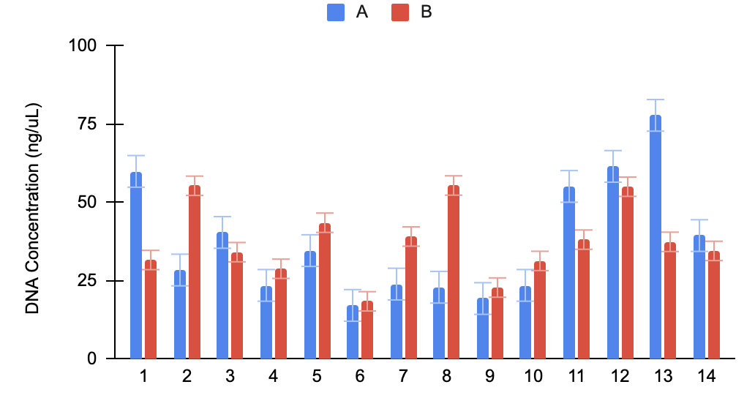
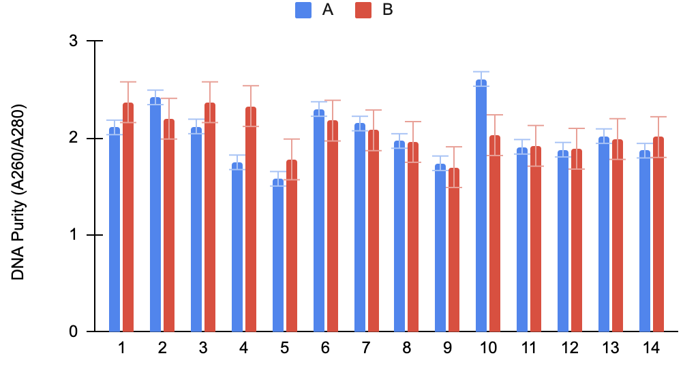
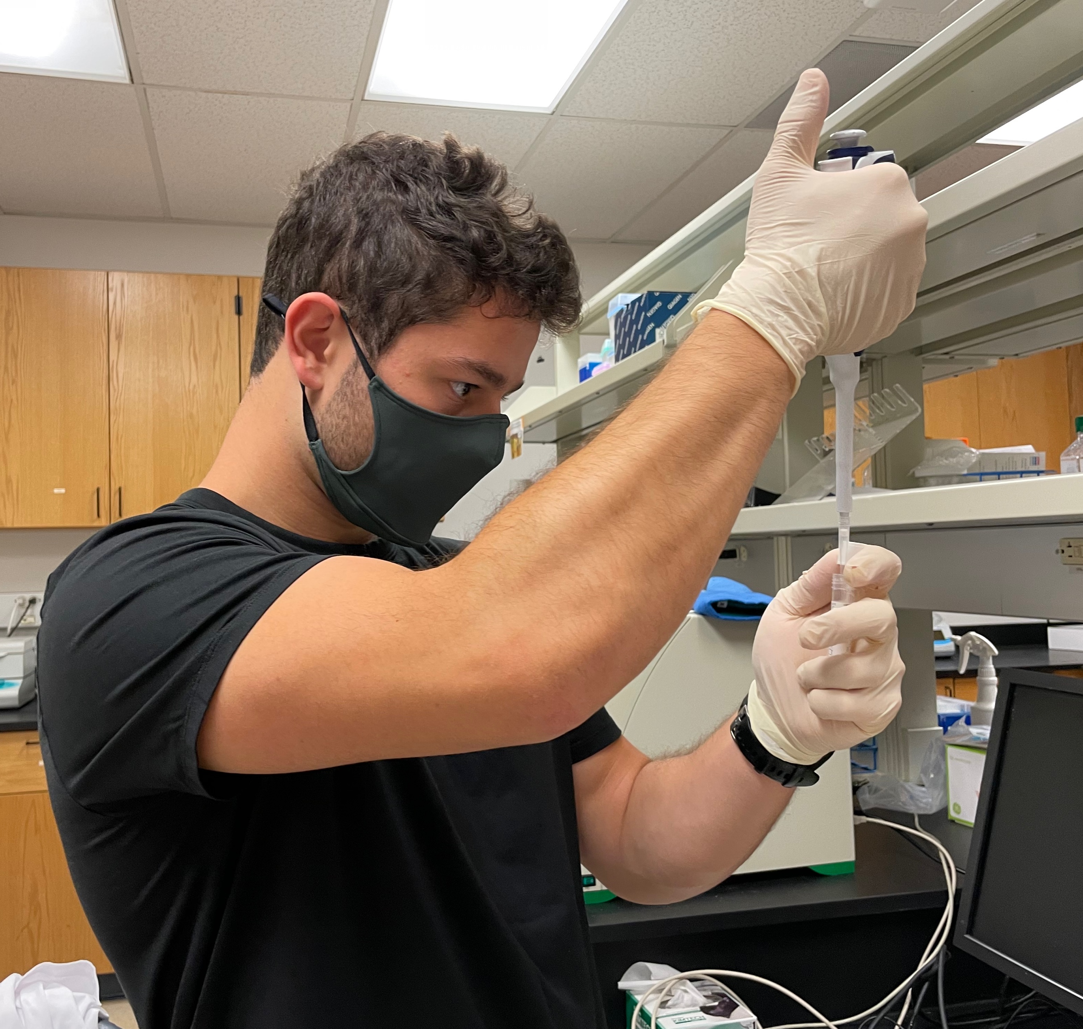
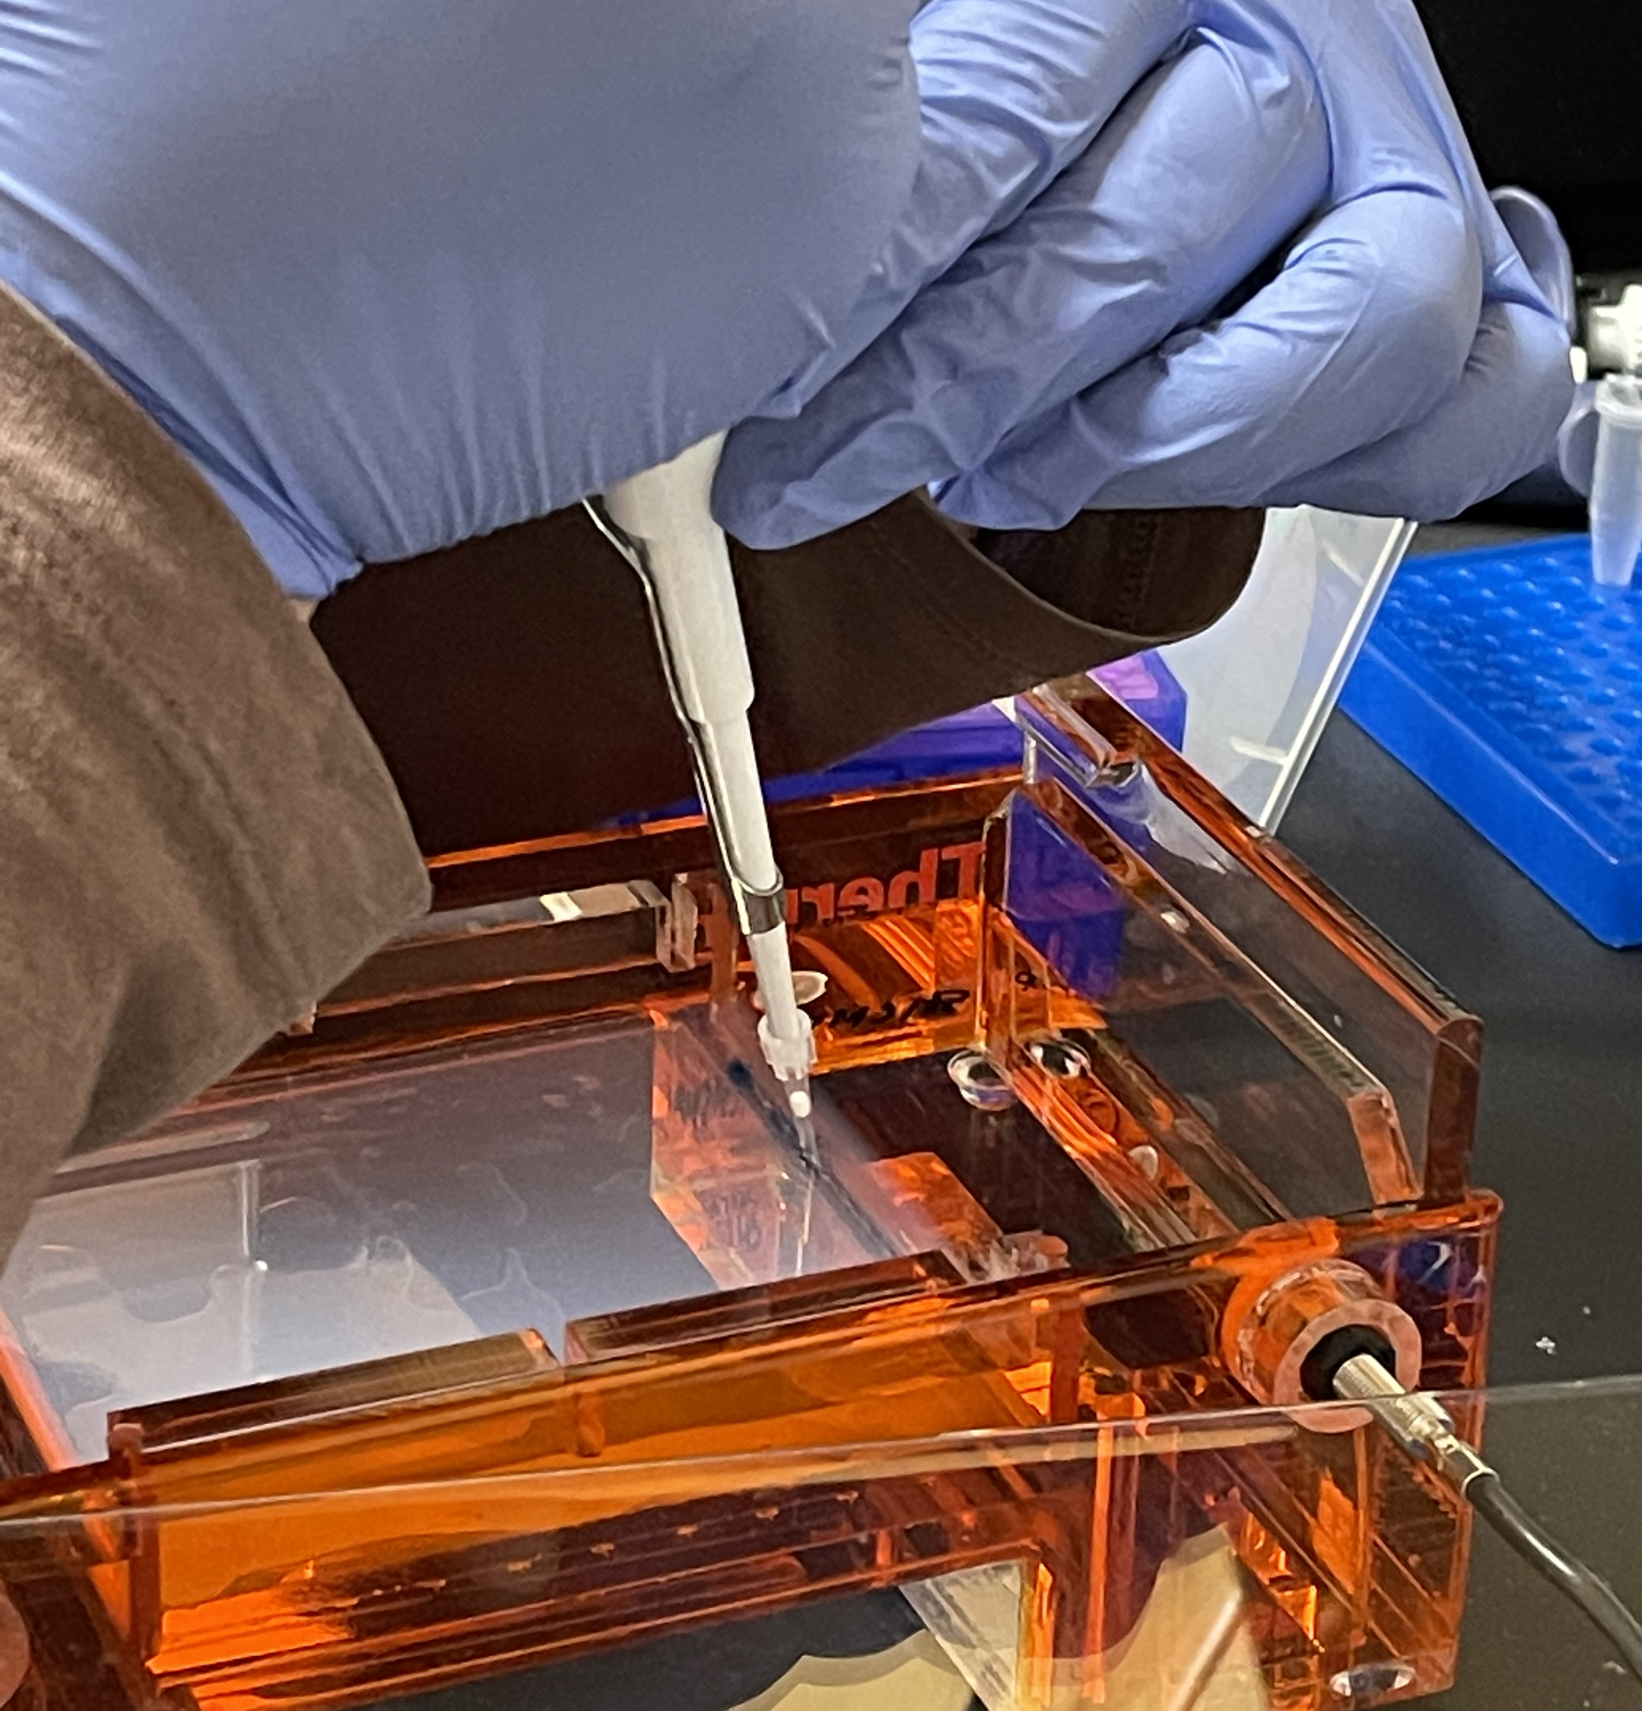
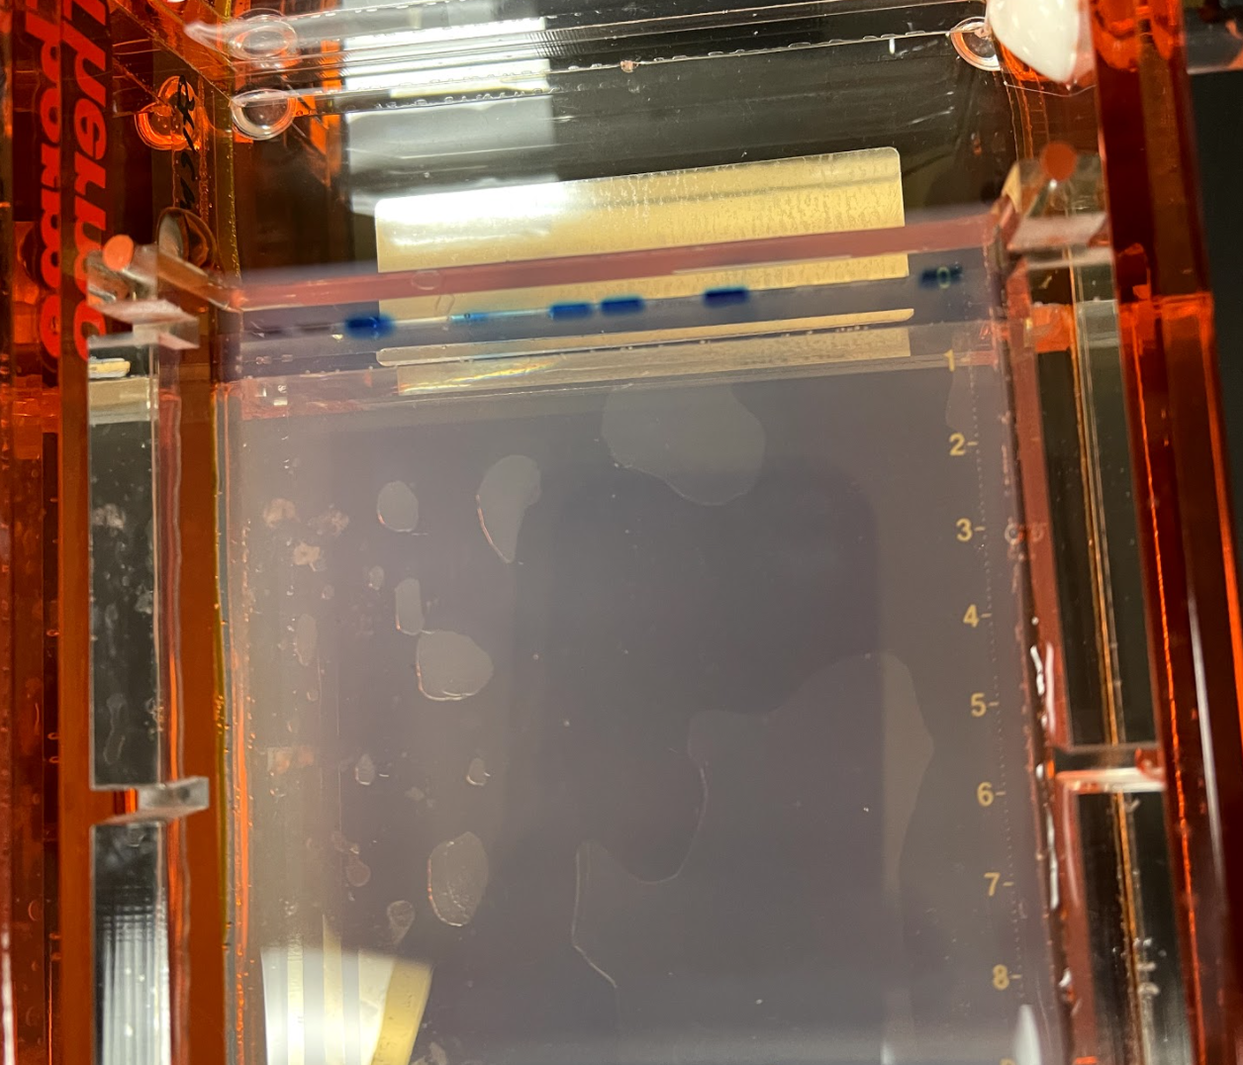
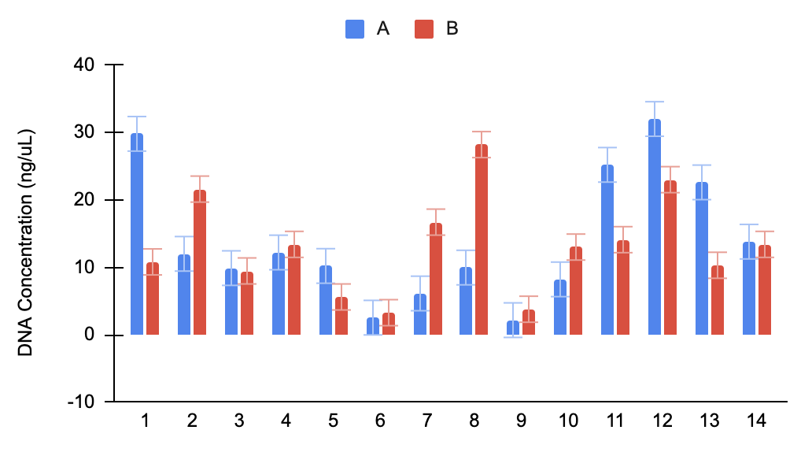
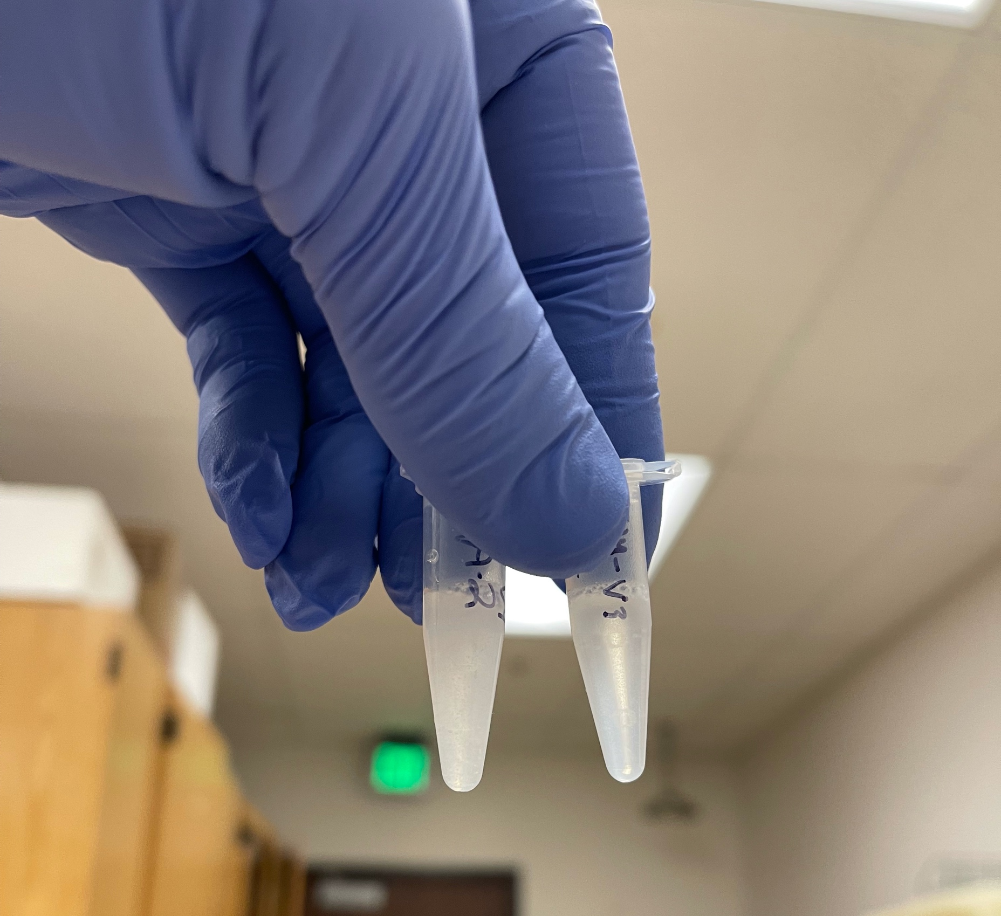
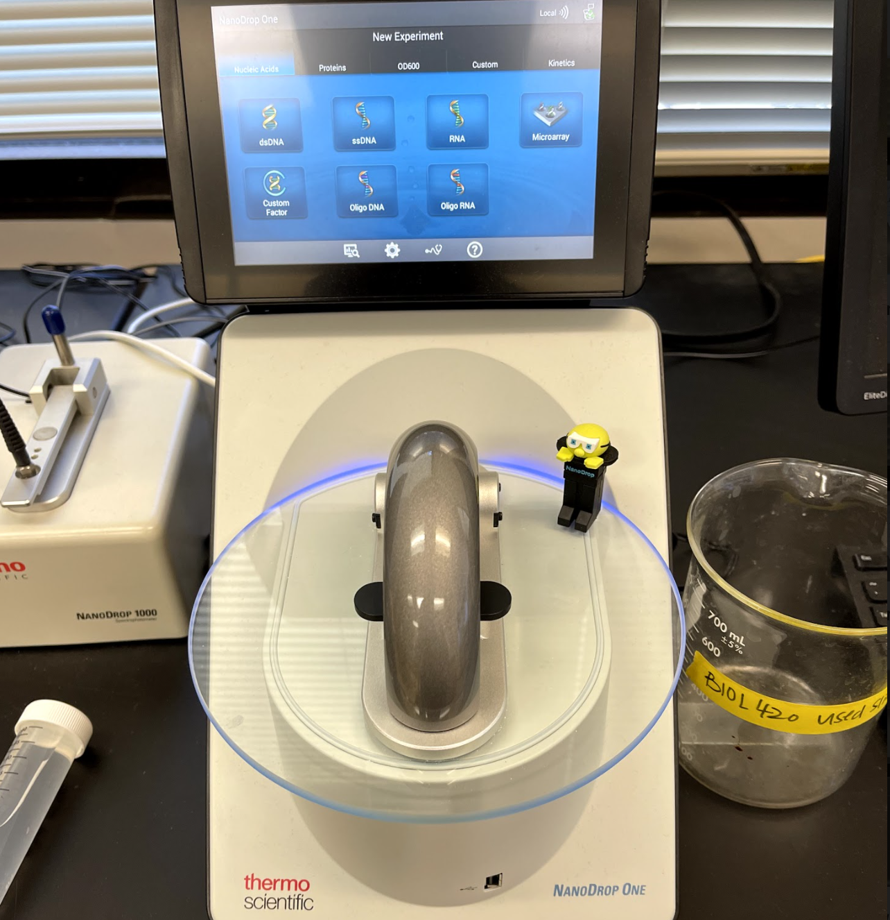
Isolation of Oral Bacterial DNA for 16S rRNA Sequencing to Determine Nitrate-Sensitive Oral Microbiota Following Acute Beetroot Supplementation
Luka Sharabidze¹, Leah Stiemsma², Chandler F. Riley¹, Maya Hammer¹, Ryan Kenney¹, Alyssa Riley¹, Courtney Merrill³, Rachel Tan¹
¹Department of Sports Medicine, Pepperdine University, Malibu, CA ²Department of Natural Sciences, Pepperdine University, Malibu, CA
³Department of Nutritional Sciences, Pepperdine University, Malibu, CA
Abstract
Methods
Results
Dietary nitrate (NO₃⁻) supplementation, provided as beetroot juice, improves cardiovascular, cognitive, and contractile function by augmenting nitric oxide (NO) biosynthesis. The intermediate step in NO production involves the sequential reduction of NO₃⁻ to nitrite (NO₂⁻) via the oral microbiome; however, the specific taxa responsible, and whether NO₃⁻ ingestion can promote a microbial composition to produce NO is yet to be established. Purpose: To determine whether acute NO₃⁻ supplementation is associated with specific microbial taxa in females. Methods: In a double-blind, randomized crossover design, 15 healthy adult females consumed an acute dose of NO₃⁻-depleted beetroot juice (PL) and NO₃⁻-rich beetroot juice (BR) 2.5-h prior to performing a cheek swab for obtaining buccal cell samples, with a washout period of 7 days. Bacterial DNA from the buccal cells were isolated using a commercially available kit in preparation for subsequent 16s DNA sequencing to identify bacterial populations. DNA concentrations were assessed using nanodrop analysis (quantity of genetic material in isolated samples and DNA purity) and Qubit analysis (quantity of isolated DNA for future polymerase chain reaction (PCR) analysis) methods for future library sequencing. Results: Due to ongoing data collection, the experimental conditions remain blinded and are represented as Condition A and B instead of PL and BR. DNA isolations were completed for a subsample of n=14. In the isolated samples, the Nanodrop analysis revealed adequate DNA concentrations (Condition A: 37.66 ± 18.92; vs Condition B: 37.52 ± 11.54 ng/μL) and adequate DNA purity (Condition A: 2.03 ± 0.28; vs Condition B: 2.06 ± 0.21). The Qubit analysis revealed DNA concentrations lower than values considered adequate (Condition A: 14.05 ± 9.59; vs Condition B: 13.33 ± 7.22 ng/μL); however, the next step is to amplify the isolated DNA using the PCR method which would cause replication of the DNA in v3-v4 regions for sequencing. As such, the concentration is more of a concern if concentrations remain low following PCR. Conclusion: DNA was successfully isolated from human buccal cell samples with or without acute NO₃⁻ supplementation. Upon completion of data collection for n=40 and DNA isolation of all samples, DNA will be amplified using PCR and sequenced to determine whether specific microbial taxa are associated with NO₃⁻ ingestion and elevation in plasma NO₂⁻ concentrations in blood. These data have implications for dietary NO₃⁻ supplementation as a probiotic treatment to promote an oral microbiome to support NO₃⁻ reduction, elevate NO bioavailability, and thus induce cardiovascular benefits in females.
14 healthy females consumed nitrate-rich beetroot juice (~6.2 mmol nitrate per 70 mL) or nitrate-depleted beetroot juice (negligible nitrate) 2.5 h prior to performing a battery of exercise tests for power, speed, and cognitive function, with a washout period of 7 days between conditions.
Resting blood and cheek swabs were obtained to determine plasma [nitrate], [nitrite] and specific microbial taxa. DNA isolations from buccal cell samples (n=14) were performed using a commercially available kit to break the cell wall then lyse, stabilize, precipitate and store isolated DNA.
The nanodrop analysis determined DNA concentration and purity. Concentration of DNA was in units of ng/μL,, ng of DNA per μL of solution. Purity was assessed through an absorbance spectra using the ratio A260/A280. Absorbance of ~1.8-2.0 was considered pure.
Using gel electrophoresis, we assessed our PCR’s efficacy, where an electric current allows DNA to travel through an agar gel in order to test if we are isolating the correct region of DNA. The goal with PCR is to amplify (i.e. increase the volume through replication) the V3-V4 regions of 16s bacterial DNA since these regions are variable between species.
The nanodrop analysis revealed DNA concentrations (Condition A: 37.66 ± 18.92; vs Condition B: 37.52 ± 11.54 ng/μL) and DNA purity (Condition A: 2.03 ± 0.28; vs Condition B: 2.06 ± 0.21) to be adequate quantities. The Qubit analysis revealed DNA concentrations lower than values considered adequate (Condition A: 14.05 ± 9.59; vs Condition B: 13.33 ± 7.22 ng/μL).
Despite low Qubit DNA concentrations, subsequent PCR should amplify the volume of DNA to concentrations adequate for library sequencing.
A.
B.
A.
B.
C.
C.
Introduction
D.
E.
Dietary nitrate is found in leafy green vegetables and beetroot. In humans, nitrate is converted into nitric oxide, a signaling molecule that regulates vascular and muscle function.
The absorption and metabolism of nitrate from beetroot juice is reliant on bacteria that reside in the human oral cavity (i.e. the oral microbiome). Microbial activity may be different between men and women which has implications for the efficacy of beetroot juice between sexes but limited data exist including women.
Beetroot juice may alter oral microbiome composition to increase the abundance of nitrate-metabolizing microbiota. It is unknown how the microbial population responds to nitrate ingestion in women or which specific taxa are responsible for converting nitrate into nitrite for absorption.
The purpose of this study was to determine the genetic sequence of the oral microbiome from human buccal cell samples, with or without beetroot juice ingestion in women.
Figure 2. Nanodrop DNA concentration (a), DNA purity and Qubit DNA concentration (c) for each subject in condition A (blue bars) and condition B (orange bars) for future amplification of DNA via PCR and determination of specific taxa via library sequencing with and without nitrate ingestion.
Conclusions
Figure 1. DNA isolation (a), gel electrophoresis (b, c), DNA mixed in solution (e) nanodrop analysis for DNA concentration.
In conclusion, successful DNA isolations had strong purities (A260/A280), which are adequate to sequence, especially following amplification.
The next step is to amplify the DNA through PCR, sequence the DNA, and identify the bacterial populations responsible for nitrate reduction.
These data have implications for dietary nitrate as a probiotic treatment for health and exercise performance.
Experimental Design
Washout
Visit 1
7 days
Visit 2:
Familiarization
7 days
Visit 3: Experimental Trial 1
7 days
Visit #4: Experimental Trial 2
References
Informed consent, screening procedures VO_{2max} and cognitive testing.
Subjects will ingest their supplements ~2.5 h prior to performing the hand grips tests, jumps, med ball throws, 20m sprints, cognitive tests, and the Yo-Yo IR1, as well as blood draw and buccal swabs.
Vanhatalo et al. (2021). Network analysis of nitrate-sensitive oral microbiome reveals interactions with cognitive function and cardiovascular health across dietary interventions. Redox Biology.
Zhurakivska et al. (2019). Do Changes in Oral Microbiota Correlate With Plasma Nitrite Response? A Systematic Review. Frontiers in Physiology.
Kapil V. et al. Sex differences in the nitrate-nitrite-NO• pathway: role of oral nitrate-reducing bacteria. Free Radic Biol Med. 2018.
Familiarization with Yo-Yo IR1 test and distribution of supplement beverages.

