Slide 1
The Effects of News Media Bias on Affective Polarization
A Thesis Presentation by Timothy Song

Slide 2
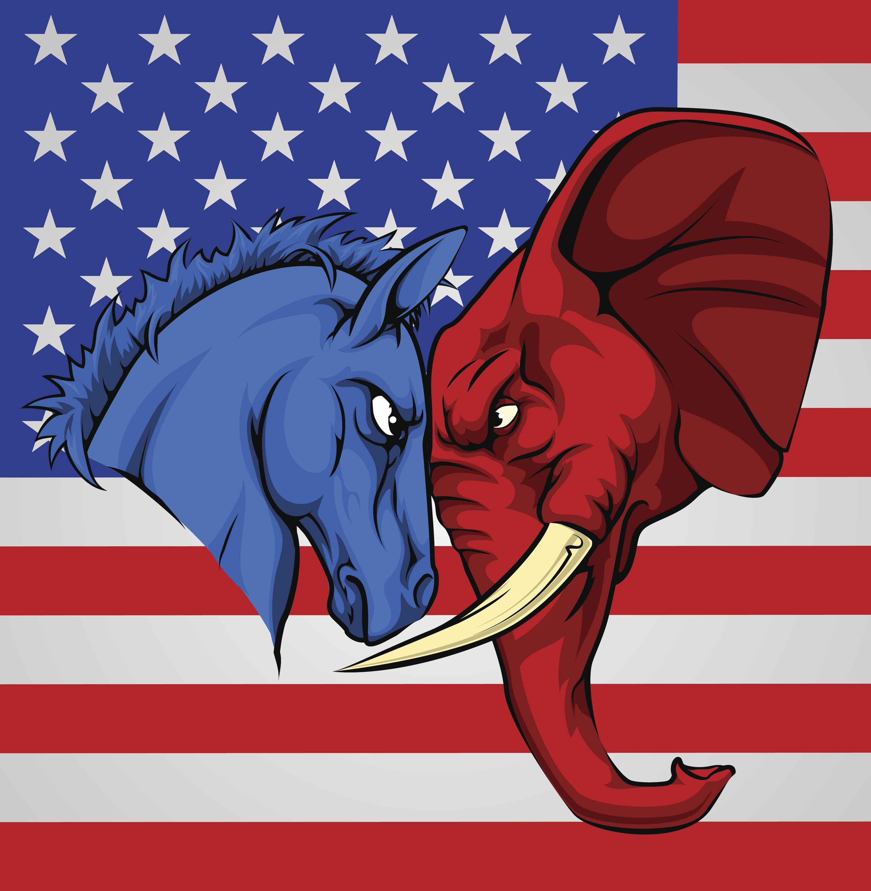
What is Affective Polarization?
Affective polarization is a measure of how hostile partisans are to members of the out-party.
Republicans and Democrats don’t want to talk with, live with, associate with, do business with, and date each other
There is even evidence that affective polarization impacts views on politicians’ pets

Slide 3
News media bias and affective polarization?
Three dominant theories:
Exposure to biased news may create and gradually increase levels of affective polarization.
Biased news coverage may exacerbate existing affective polarization.
Existing affective polarization in the consumers compel news sources to produce biased media, meaning biased news may not impact affective polarization at all.

Slide 4
Does Biased News Coverage Inflame Affective polarization?
I hypothesized that biased news coverage inflames affective polarization, but that coverage presenting two sides of an issue would decrease levels of affective polarization.

Slide 5
Experimental Design
Participants were randomly assigned to one of four groups:
Pro-Republican
Ex. “In August … Vicky Osterweil … argued that rioting and looting were legitimate acts of protest”
Pro-Democrat
Ex. “[Donald Trump] took a different tone … when he called overwhelmingly peaceful protesters for racial justice "thugs," "agitators" and "looters.””
Pro-Republican and Pro-Democrat
Control (summary of January 6th)
Participants all read the same summary as the control group.
Participants in treatment groups then read an article about the events of January 6th at Capital Hill.

Slide 6
Measures
After reading the article, participants answered questions measuring their levels of affective polarization.
There were two measures of affective polarization:
Feeling thermometer
A composite measurement (based on one’s willingness to date, work with, or discuss politics with individuals with a different political orientation)
Participants were also asked about their levels of distrust of the media.

Slide 7
Data
I surveyed 222 college students from Pepperdine University.
Thanks to all the faculty at the social science division who made this possible (7 professors teaching 10 sections of POSC and SOC)!
Of the 222 responses, 26 had to be discarded for various reasons.
In total, 196 responses were analyzed.
Of the 196 participants I analyzed, 50.3% leaned towards or identified as Democrats, 35% leaned towards or identified as Republicans, and 16% were pure independents.

Slide 8
Feeling Thermometer

Slide 9
Affective Polarization

Slide 10
Media Distrust

Slide 11
Limitations
Weak treatment. Given that most participants likely have years of exposure to biased news coverage, it was unlikely one biased news article could significantly shift levels of affective polarization.
Weak measurement and analysis of the levels of media distrust in college aged students. My hypothesis did not prioritize this measurement.
Relatively small sample size. Because the trends were not very strong, and because many of the results were not sufficiently statistically significant to rule out the possibility of chance errors, it may have been more helpful to have had a larger number of participants in the study.
This study looked only to college age students to measure the impact of the treatments on levels of affective polarization.

Slide 12
Conclusions
College aged students in the United States are already affectively polarized by the time they enter adulthood.
It may be increasingly difficult for groups such as political parties to find moderates to align with them.
A balance of right-leaning and left-leaning news may be able to decrease levels of affective polarization in voters, even if just by a bit
If balanced news has the potential to lower affective polarization, even if by a little bit, we can encourage news outlets to produce this kind of news or encourage people to consume news that reflects both left and right leaning perspectives.

Slide 13
Thank You for Listening

