Slide 1
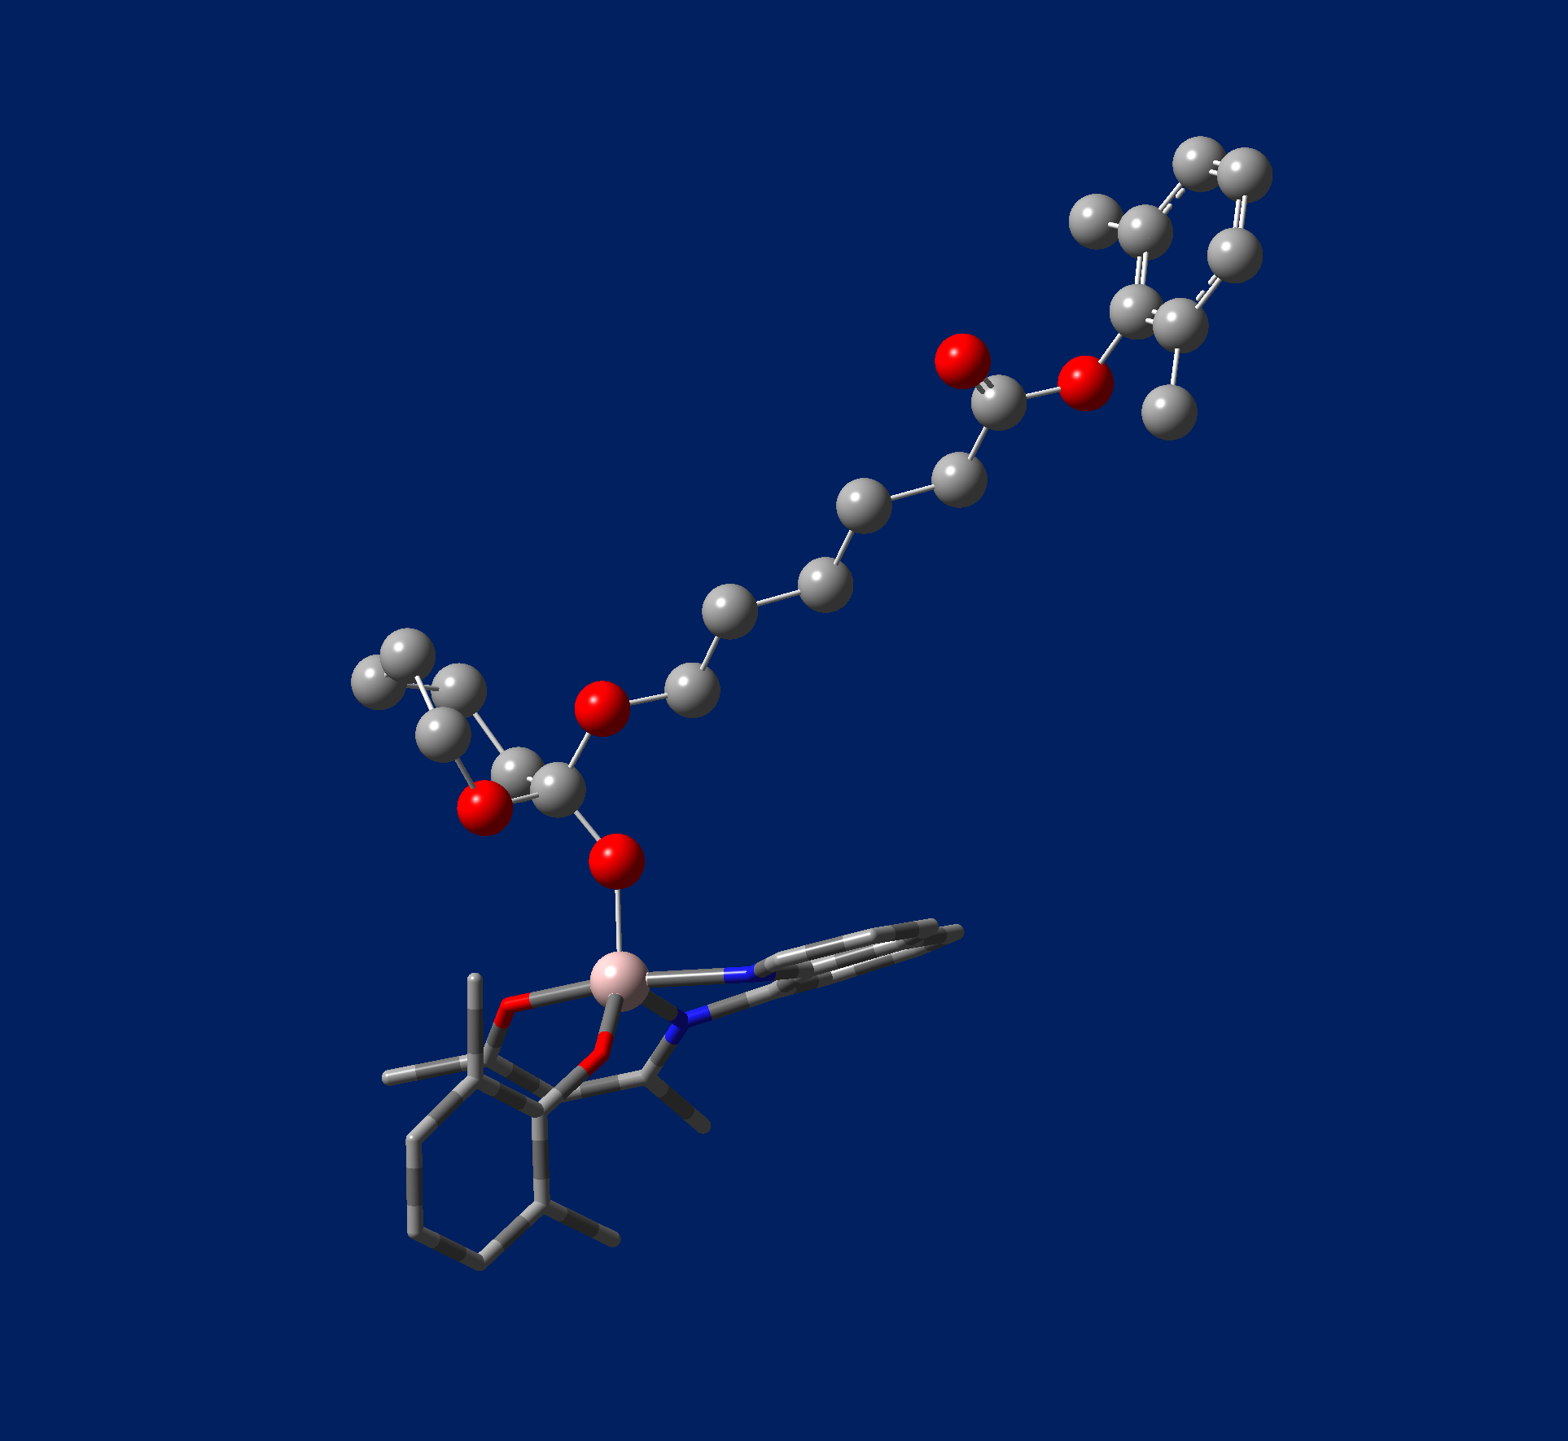
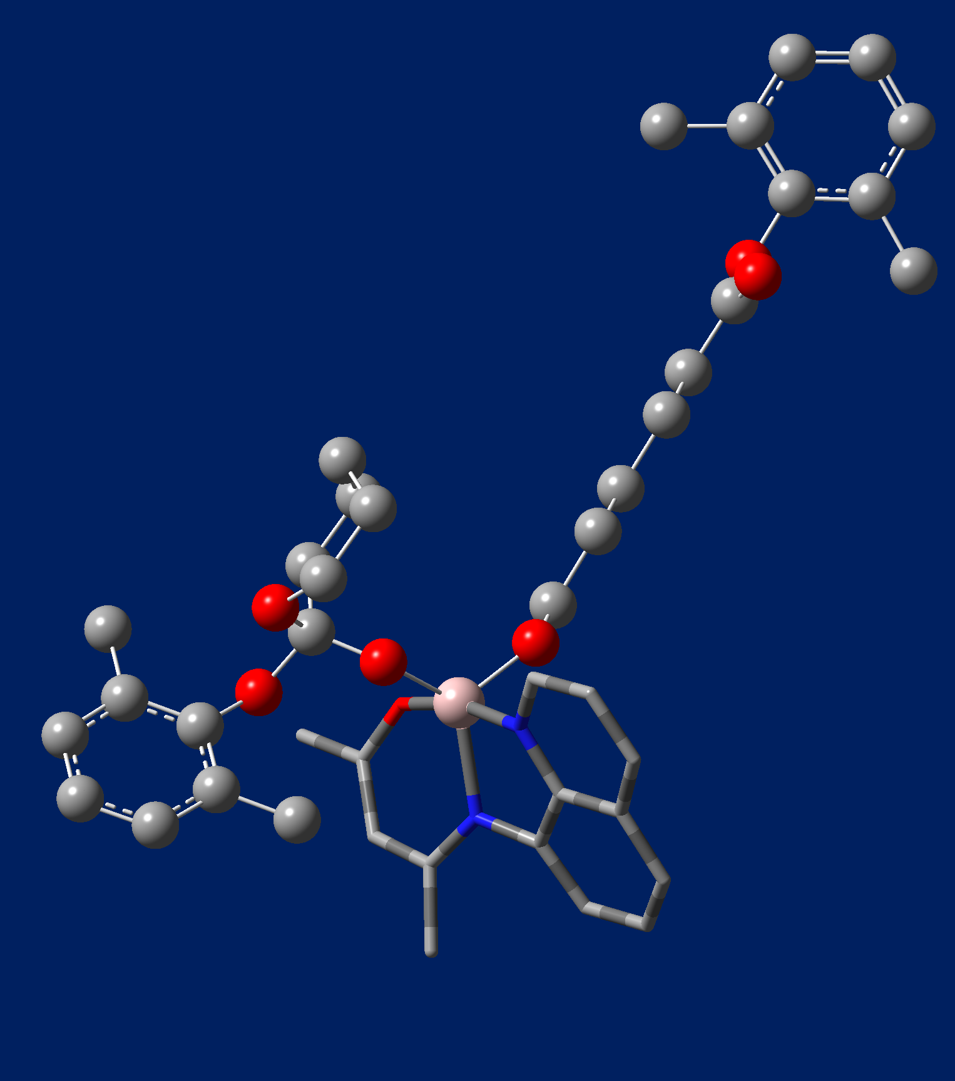
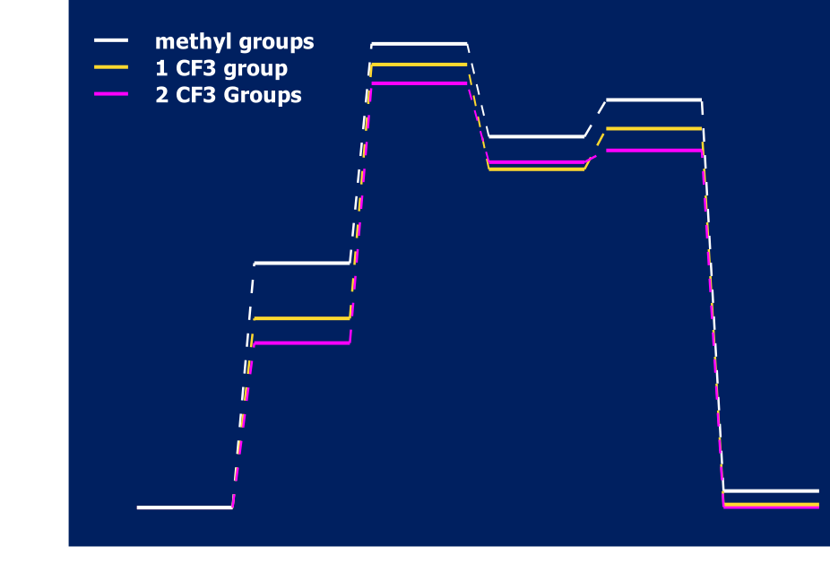
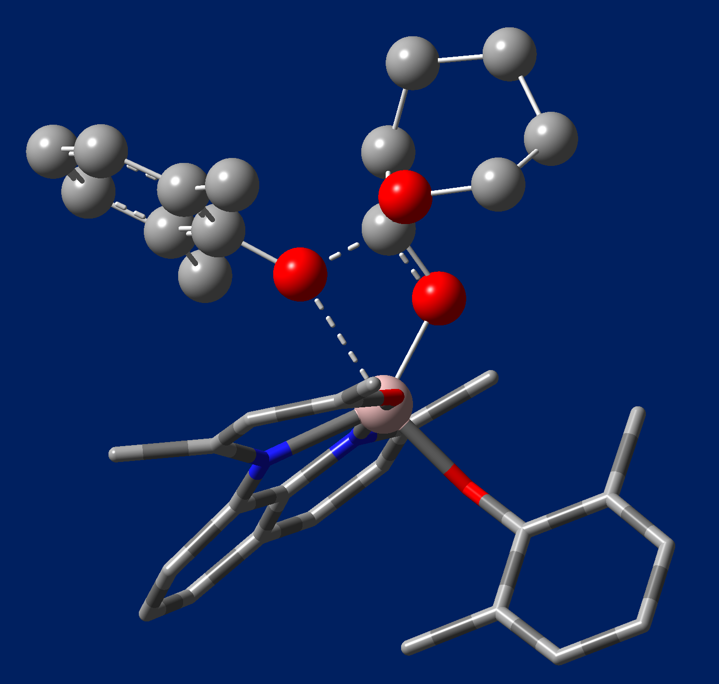
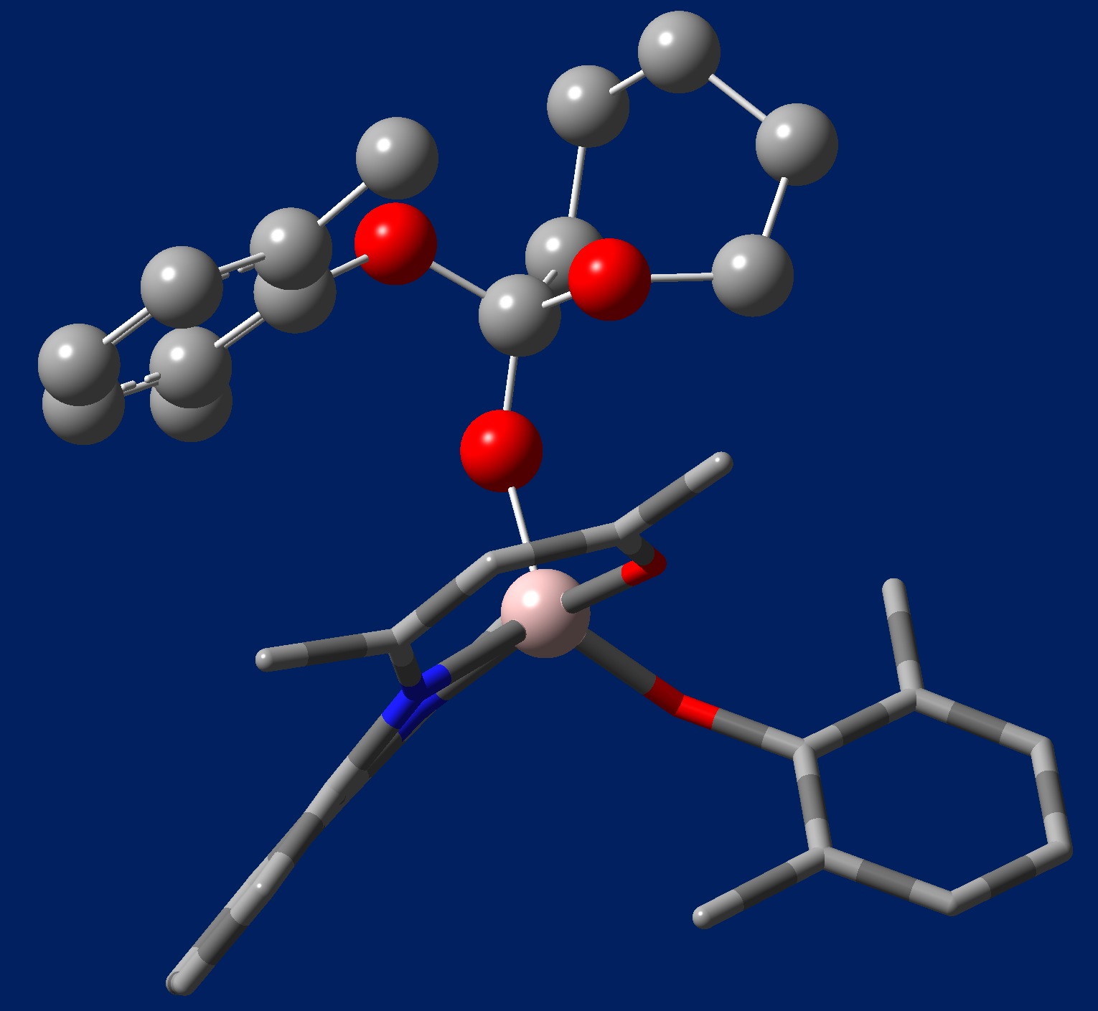
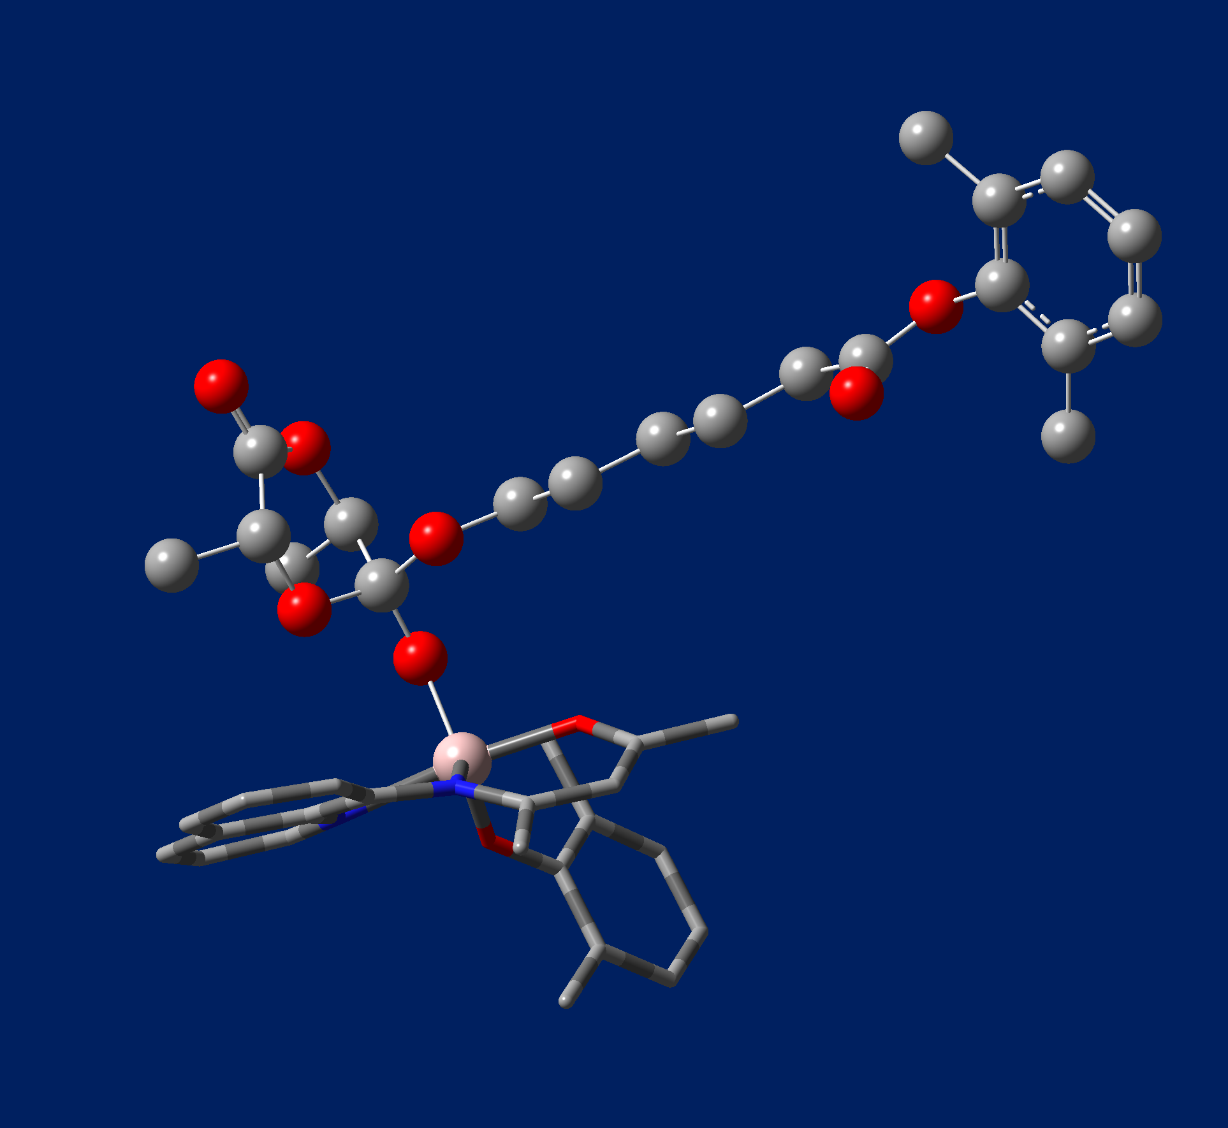
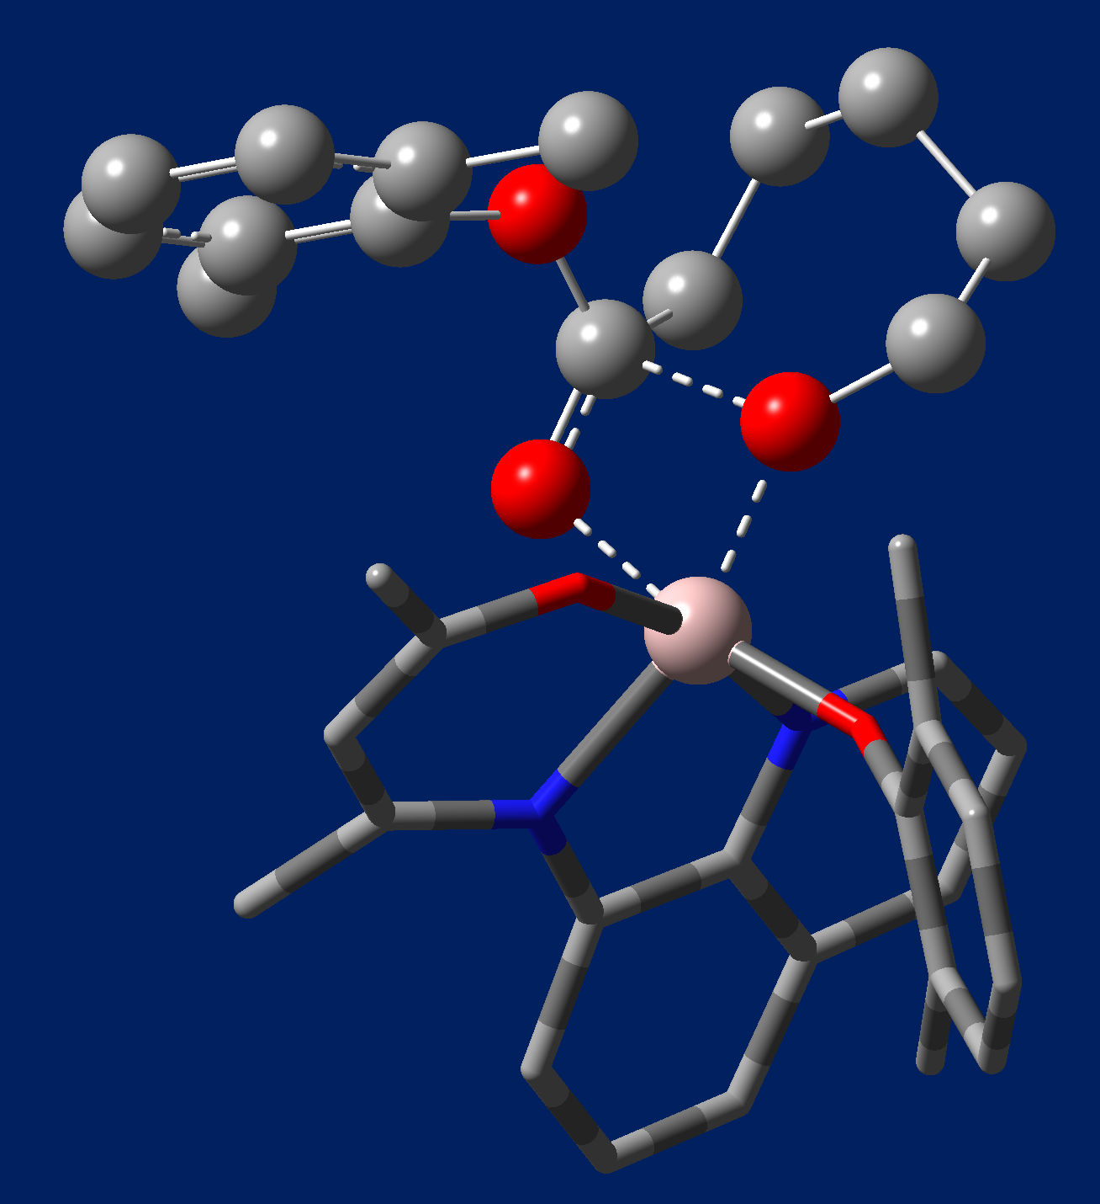
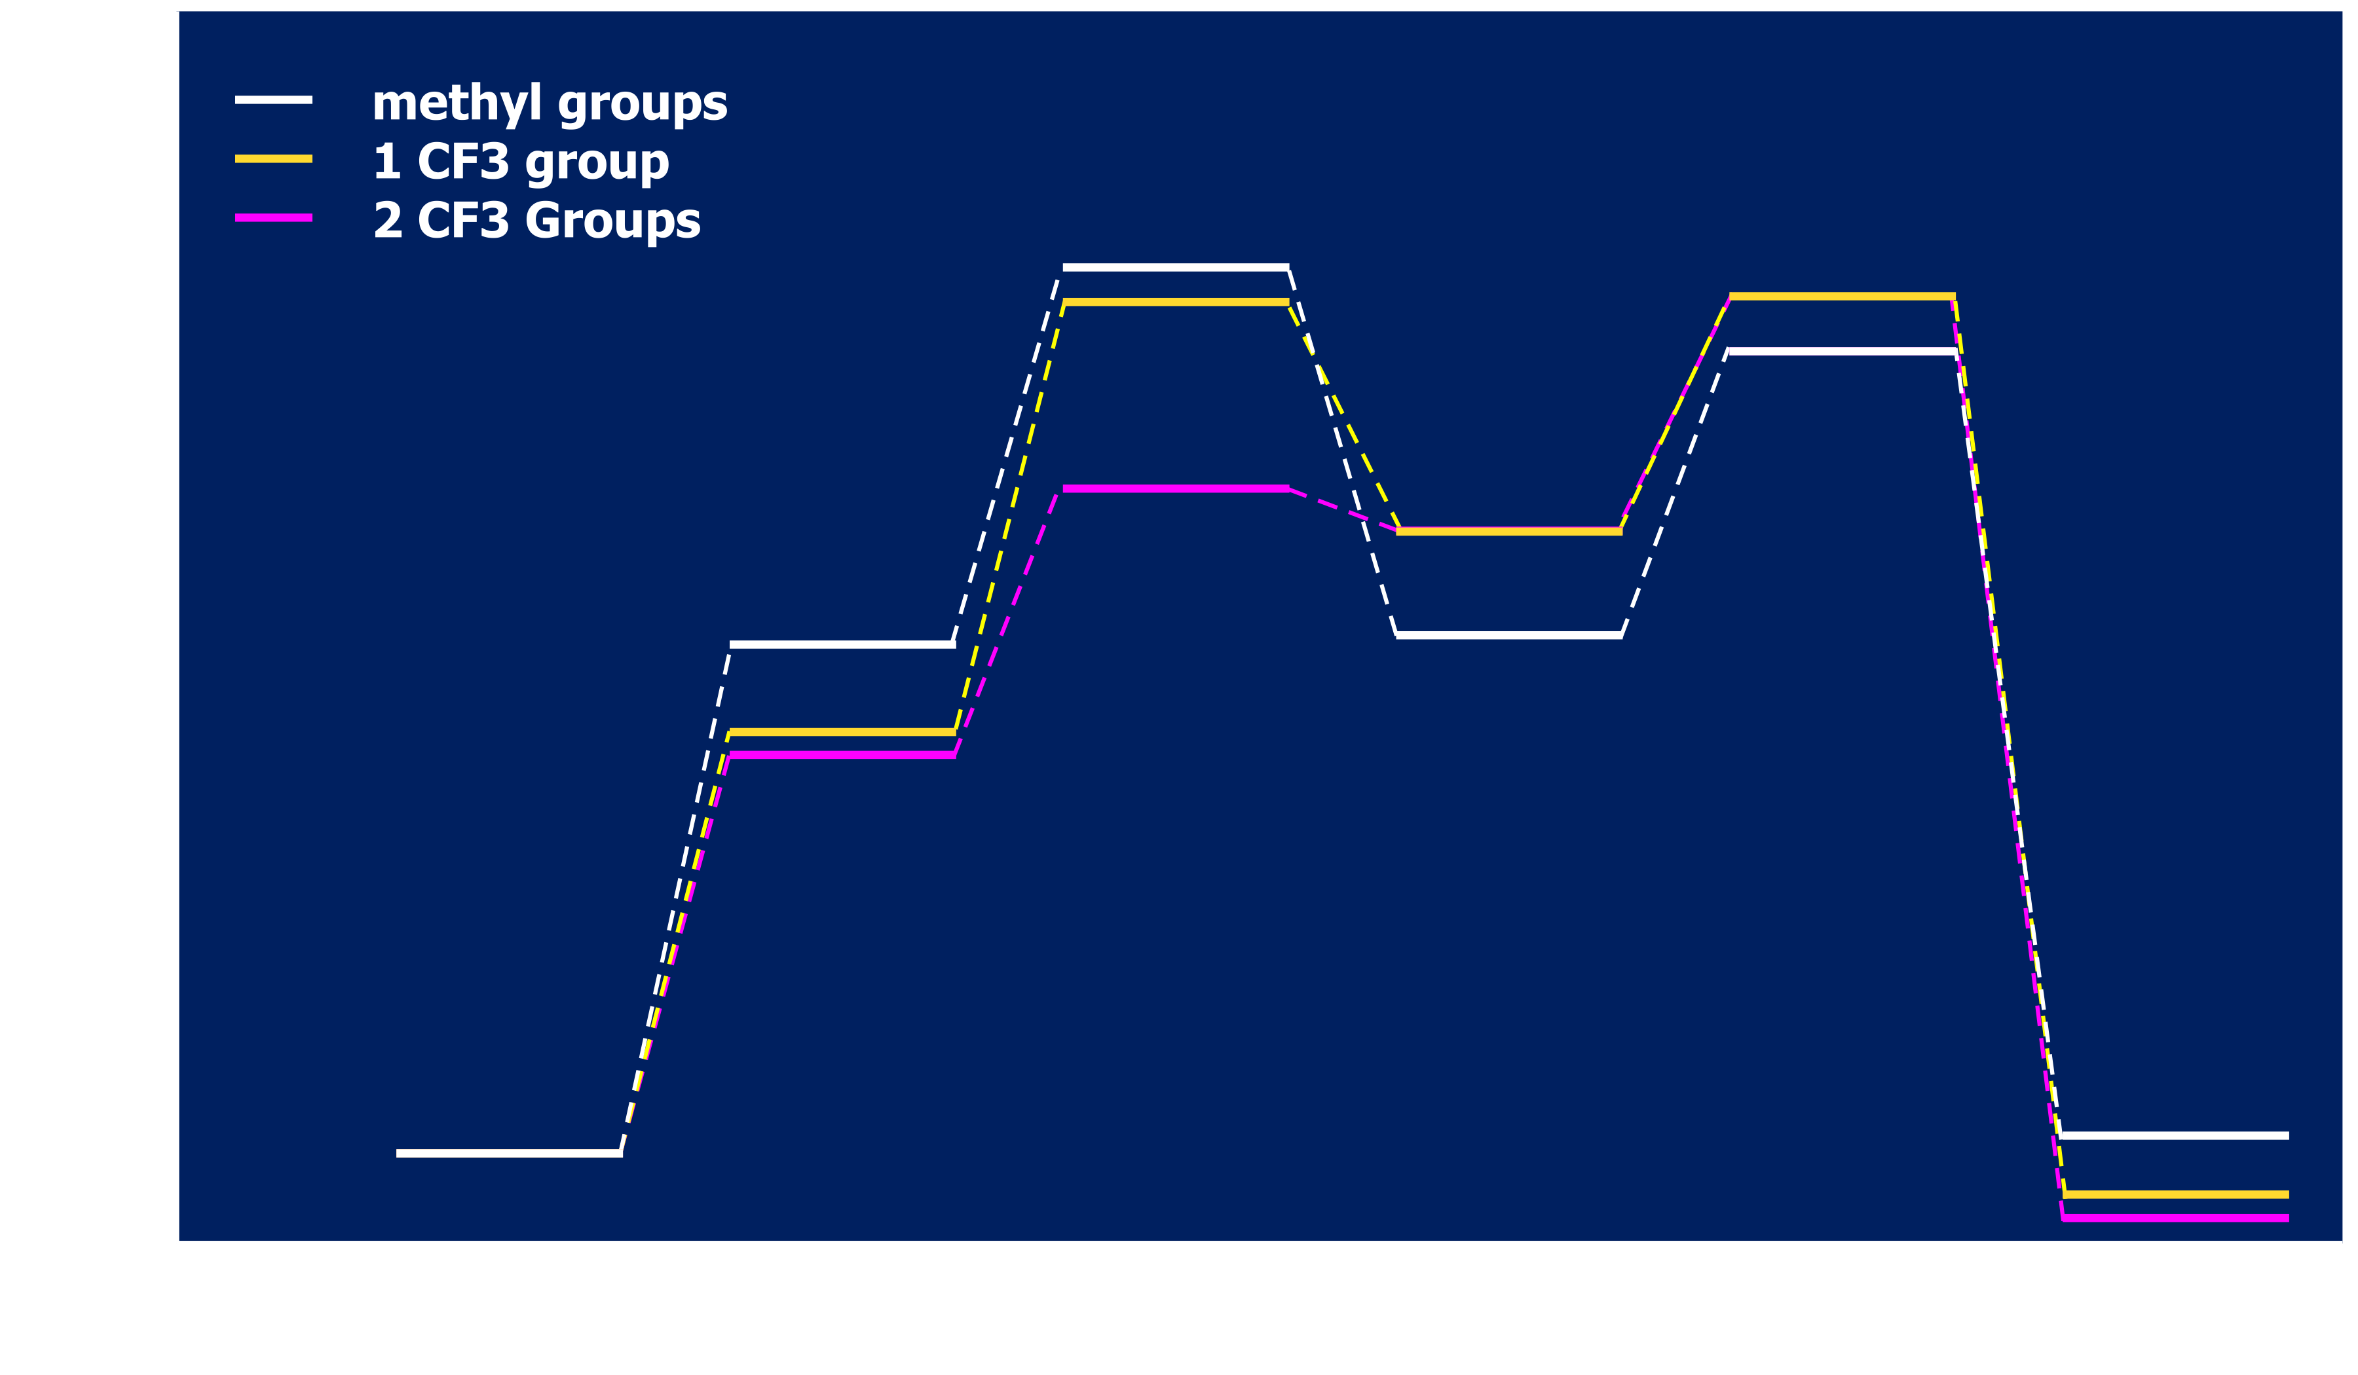
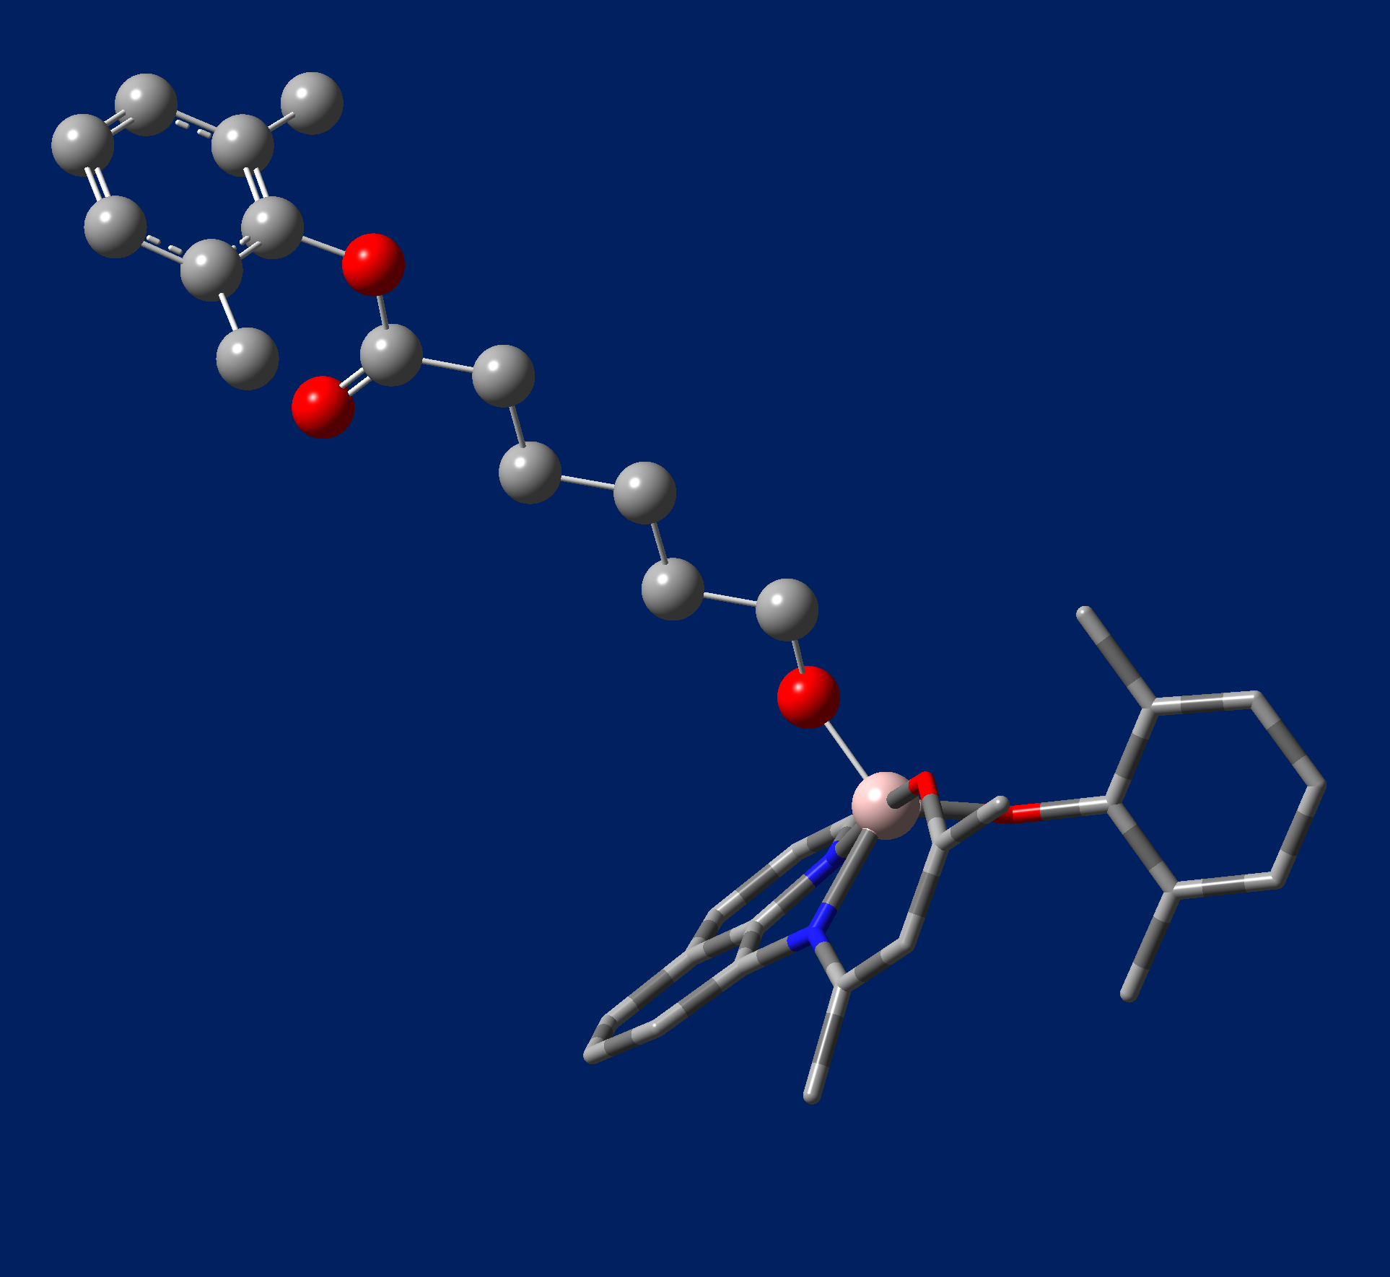
Computational Investigation of the Ring-opening Homo-
and Co-Polymerizations of Lactide and ε-Caprolactone
Diego E. Garcia, Joseph M. Fritsch and Benjamin P. Wilson
Pepperdine University Malibu, CA 90263
Abstract
The mechanism for the ring-opening polymerization of lactide and ε-caprolactone is presented here with an aluminum-centered catalyst featuring a tridentate ligand and two alkoxide initiating ligands. In each homopolymerization, the addition of electron-withdrawing groups on the tridentate ligand lowers the activation energy of the reaction by increasing the electrophilicity of the central Aluminum. We further investigated the polymerizations by comparing the energy difference between copolymerization and homopolymerization following the initial ring opening as well as the potential for dual polymer chains from the insertion of both initiating ligand. Single chain polymerization is favored in every case, due to lower bond strength between the initial polymer and the Al center compared to strength of the bond between the Al center and the additional initiating ligand. This helps to explain the narrow polydispersity observed experimentally. Without the presence of EWG on the tridentate ligand, homopolymerization is favored for both polycaprolactone and polylactide. The addition of EWG, however, results in potential energy surfaces that favor the addition of lactide and single chain polymerization, regardless of the initial coordinated polymer.
Reaction Pathway
ROP ε-Caprolactone
Dispersity
Reactants: Al –centered catalyst and caprolactone. All geometries in this section are optimized in Gaussian.
The energy of the single chain polymer is lower in energy than a multiple chain polymer. This is because the oxygen bond to the aluminum center is much weaker than bond formed by the insertion of the monomer into the primary chain.
Intermediate State A
Single Chain Caprolactone
Dual Chain Caprolactone
This table compares the calculated energies of the single chain and dual chain polymers of caprolactone. The single chain polymer is favored in every case as the energy is always lower. This is also the case for lactide.
Dispersity | Catalyst | Energy (Ha)
Single Chain | methyl groups | -2509.70
 | 1 CF3 | -2807.53
 | 2 CF3 | -3105.35
Dual Chain | methyl groups | -2509.69
 | 1 CF3 | -2807.52
 | 2 CF3 | -3105.34
Transition State 1
The figure above shows the energy of the ring-opening polymerization of ε-Caprolactone as the reaction proceeds. As more electron withdrawing groups are added to the Al-centered catalyst, the energy at each stage of the reaction is lowered.
Gaussian09¹ and GaussView were used for all calculations
Geometry optimizations/frequency analyses:
DFT B3LYP² 6-31G³
Initial geometries based on previous mechanistic studies⁴
Frequency analysis confirmed structures were minima on PES
Energy Calculations:
DFT B3LYP 6-311(+) G (d,p)
SMD⁵ solvent method – toluene
Charges taken from ESP fit
Homo- vs copolymerization
Methods
Intermediate State B
The two figures depict the homopolymerization (left) and copolymerization (right) when caprolactone is the initially coordinated polymer in a single chain. The homopolymerization is favored for both polylactide and polycaprolactone when there are no EWG on the catalyst. However, as EWG are added the addition of lactide is favored regardless of the initially coordinated monomer.
ROP R-lactide
Transition State 2
Homopolymerization
Copolymerization
Caprolactone | Catalyst | Energy (Ha)
Homopoly | methyl groups | -2509.70
 | 1 CF3 | -2807.53
 | 2 CF3 | -3105.35
Copoly | methyl groups | -2659.02
 | 1 CF3 | -2956.85
 | 2 CF3 | -3254.66
Catalysts
This table shows the calculated energies of both the homopolymerization and copolymerization of polycaprolactone. As mentioned above the addition of lactide is favored with increasing EWG.
Product
The figure above shows the energy of the ring-opening polymerization of R-lactide as the reaction proceeds. The energy at each step of the reaction is lowered as more electron withdrawing groups are added to the Al-centered catalyst.
An optimized geometry of the Al-centered catalyst with 2 methyl groups (highlighted green) in the substitution sites on the tridentate ligand. For purposes of clarity, the dimethylphenoxy groups are faded. The catalyst referred to in this paper as “one CF₃ group” appears similar to this displayed catalyst; however, the hydrogens on the bottom-most methyl group are replaced with fluorine atoms. The catalyst referred to as “two CF₃ groups” retains the fluorine substitutions on the bottom-most methyl group and has fluorine substitutes on the next highlighted group going from bottom to top.
References
and Acknowledgments
monomer | catalyst | Al – O bond length (Å)
caprolactone | methyl groups | 2.071
 | 1 CF3 | 2.043
 | 2 CF3 | 2.029
lactide | methyl groups | 2.117
 | 1 CF3 | 2.062
 | 2 CF3 | 2.037
This table shows the calculated bond lengths between the Al center and the coordinated O in Int A. As the number of EWG is increased, the electrophilicity of the Al center increases and the coordinated monomer is drawn in close. This results in a lower energy in the Int A, as shown in the PES for the polymerization of caprolactone and lactide above.
Funding provided by the Natural Science Division, Seaver College, Pepperdine University.
Frisch et al. Gaussian09, Gaussian, Inc., Wallingford, CT, 2010.
Stevens et al., J. Phys. Chem. 1994, 98, 11623
Hehre et al., Ab Initio Molecular Orbital Theory; Wiley: New York, 1986
Ling et al., Polymer 2009, 50, 3575
Merenich et al., J. Phys. Chem. B 2009, 113, 18
Cahard et al., Chem. Soc. Rev., 2014, 43, 135
Sarazin et al., Chem. Rev., 2015, 115 (9), 3564

