Slide 1
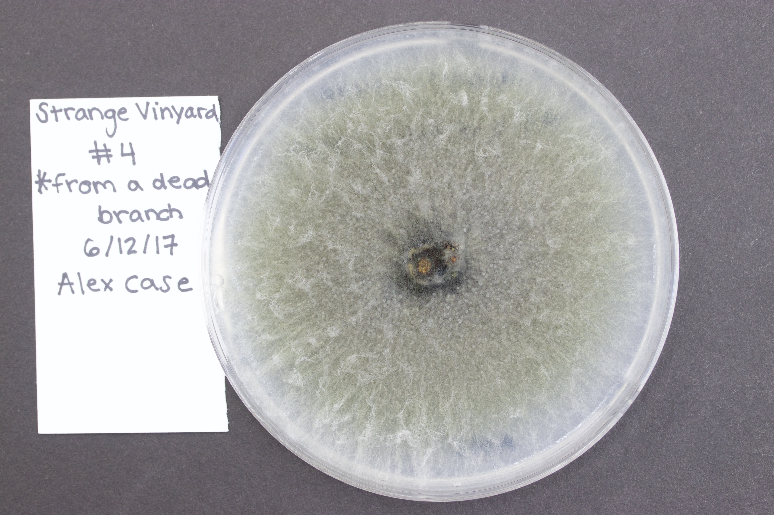
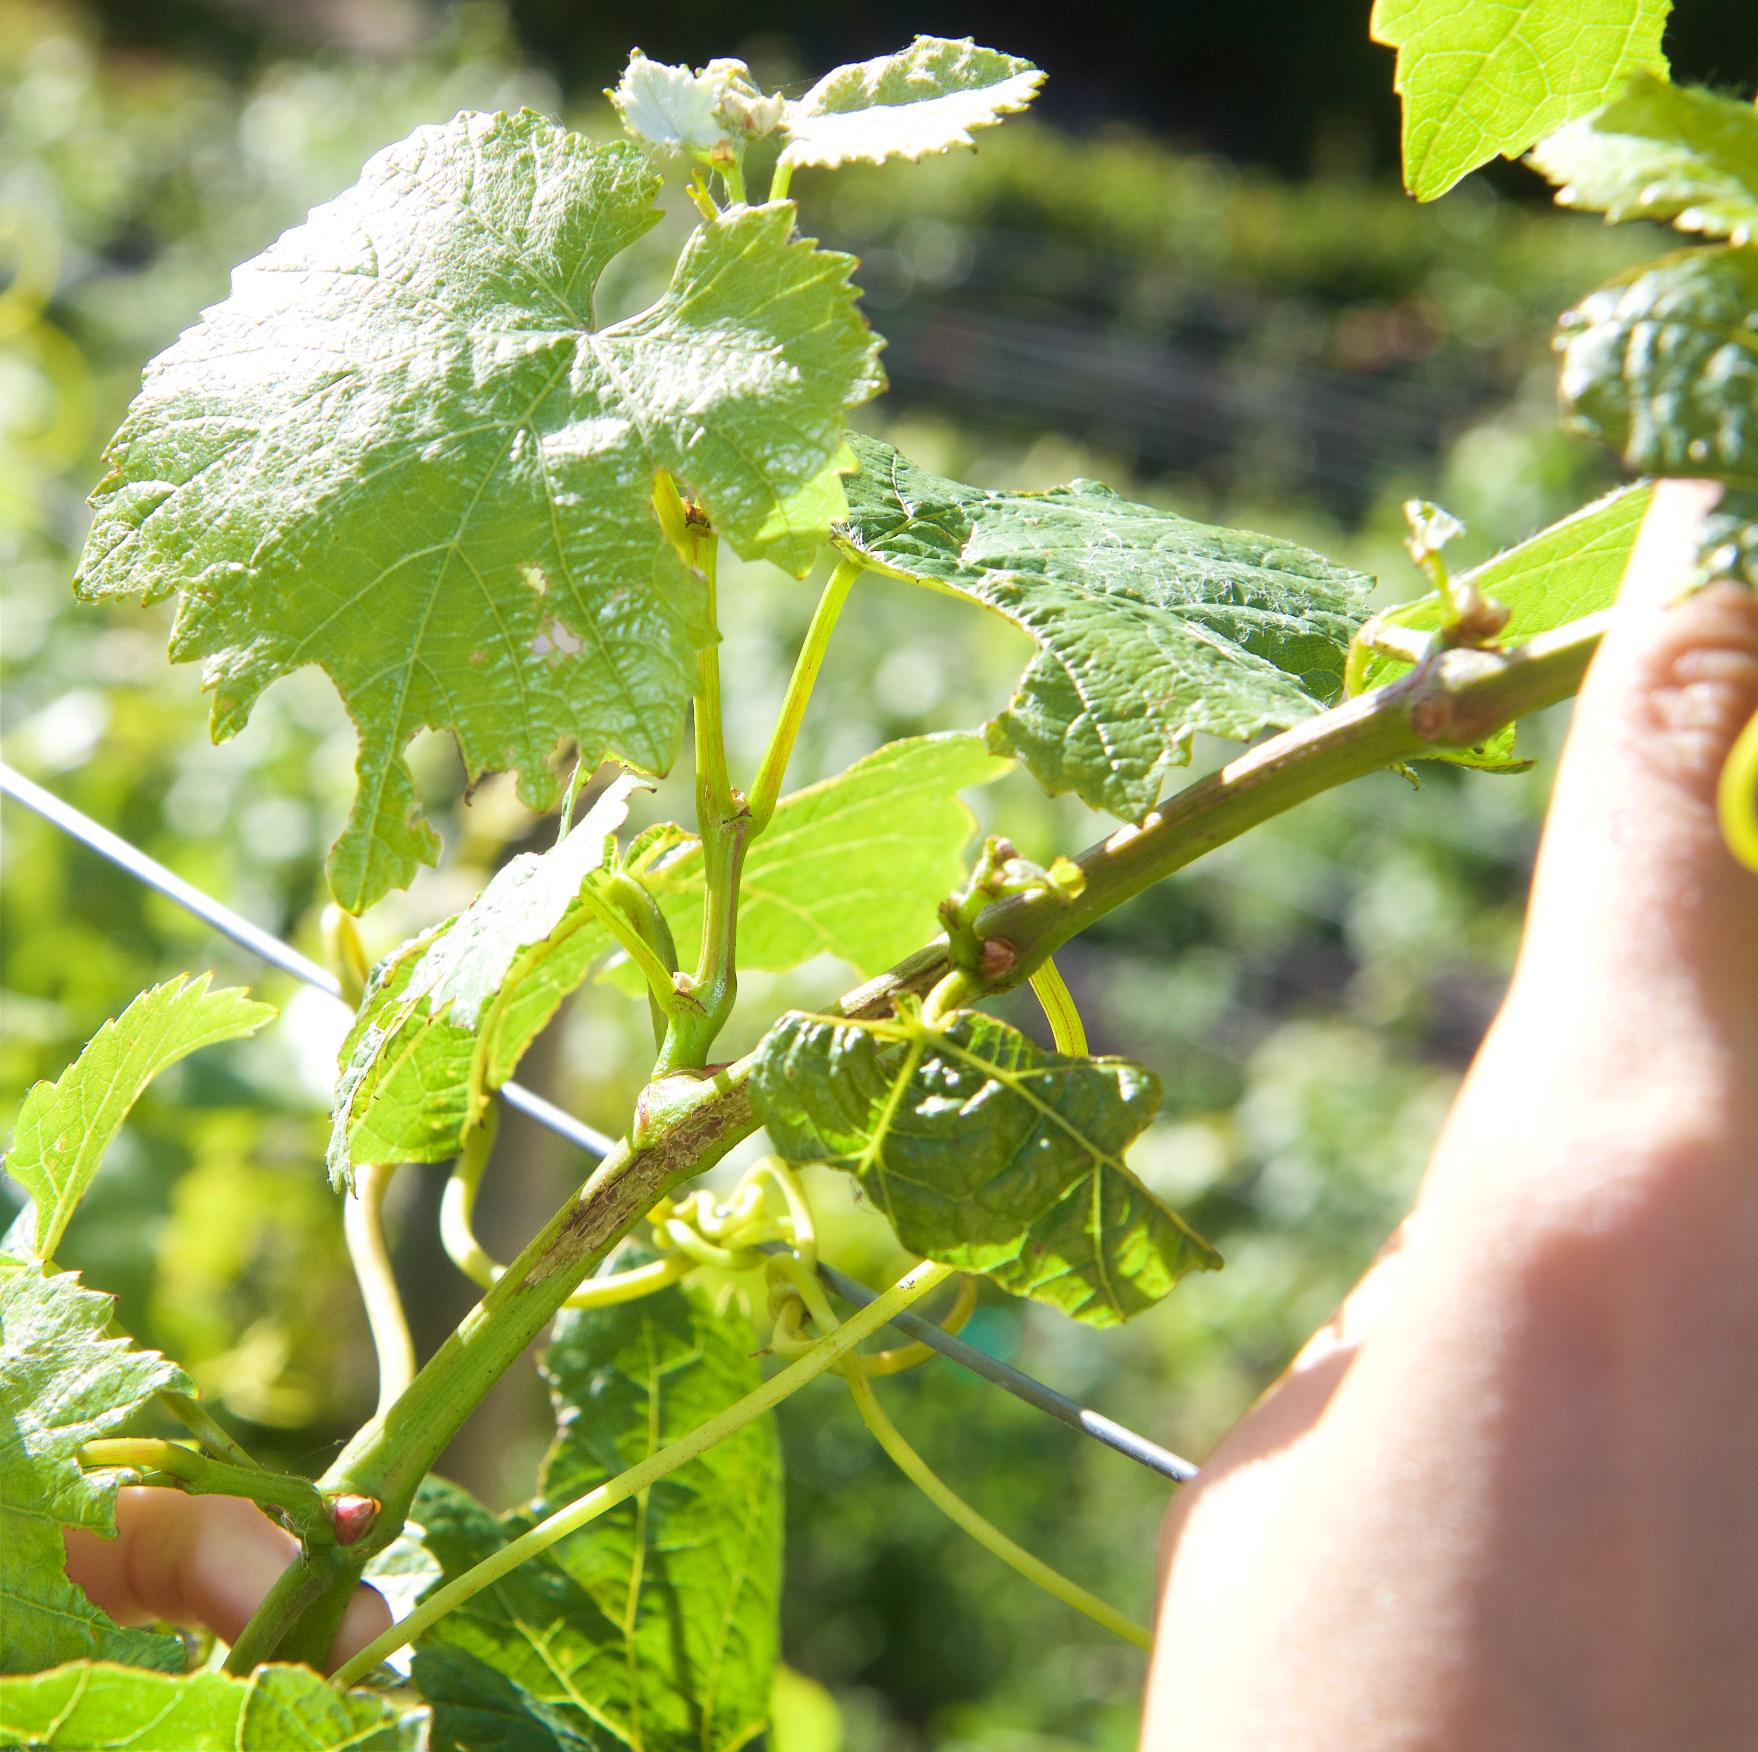
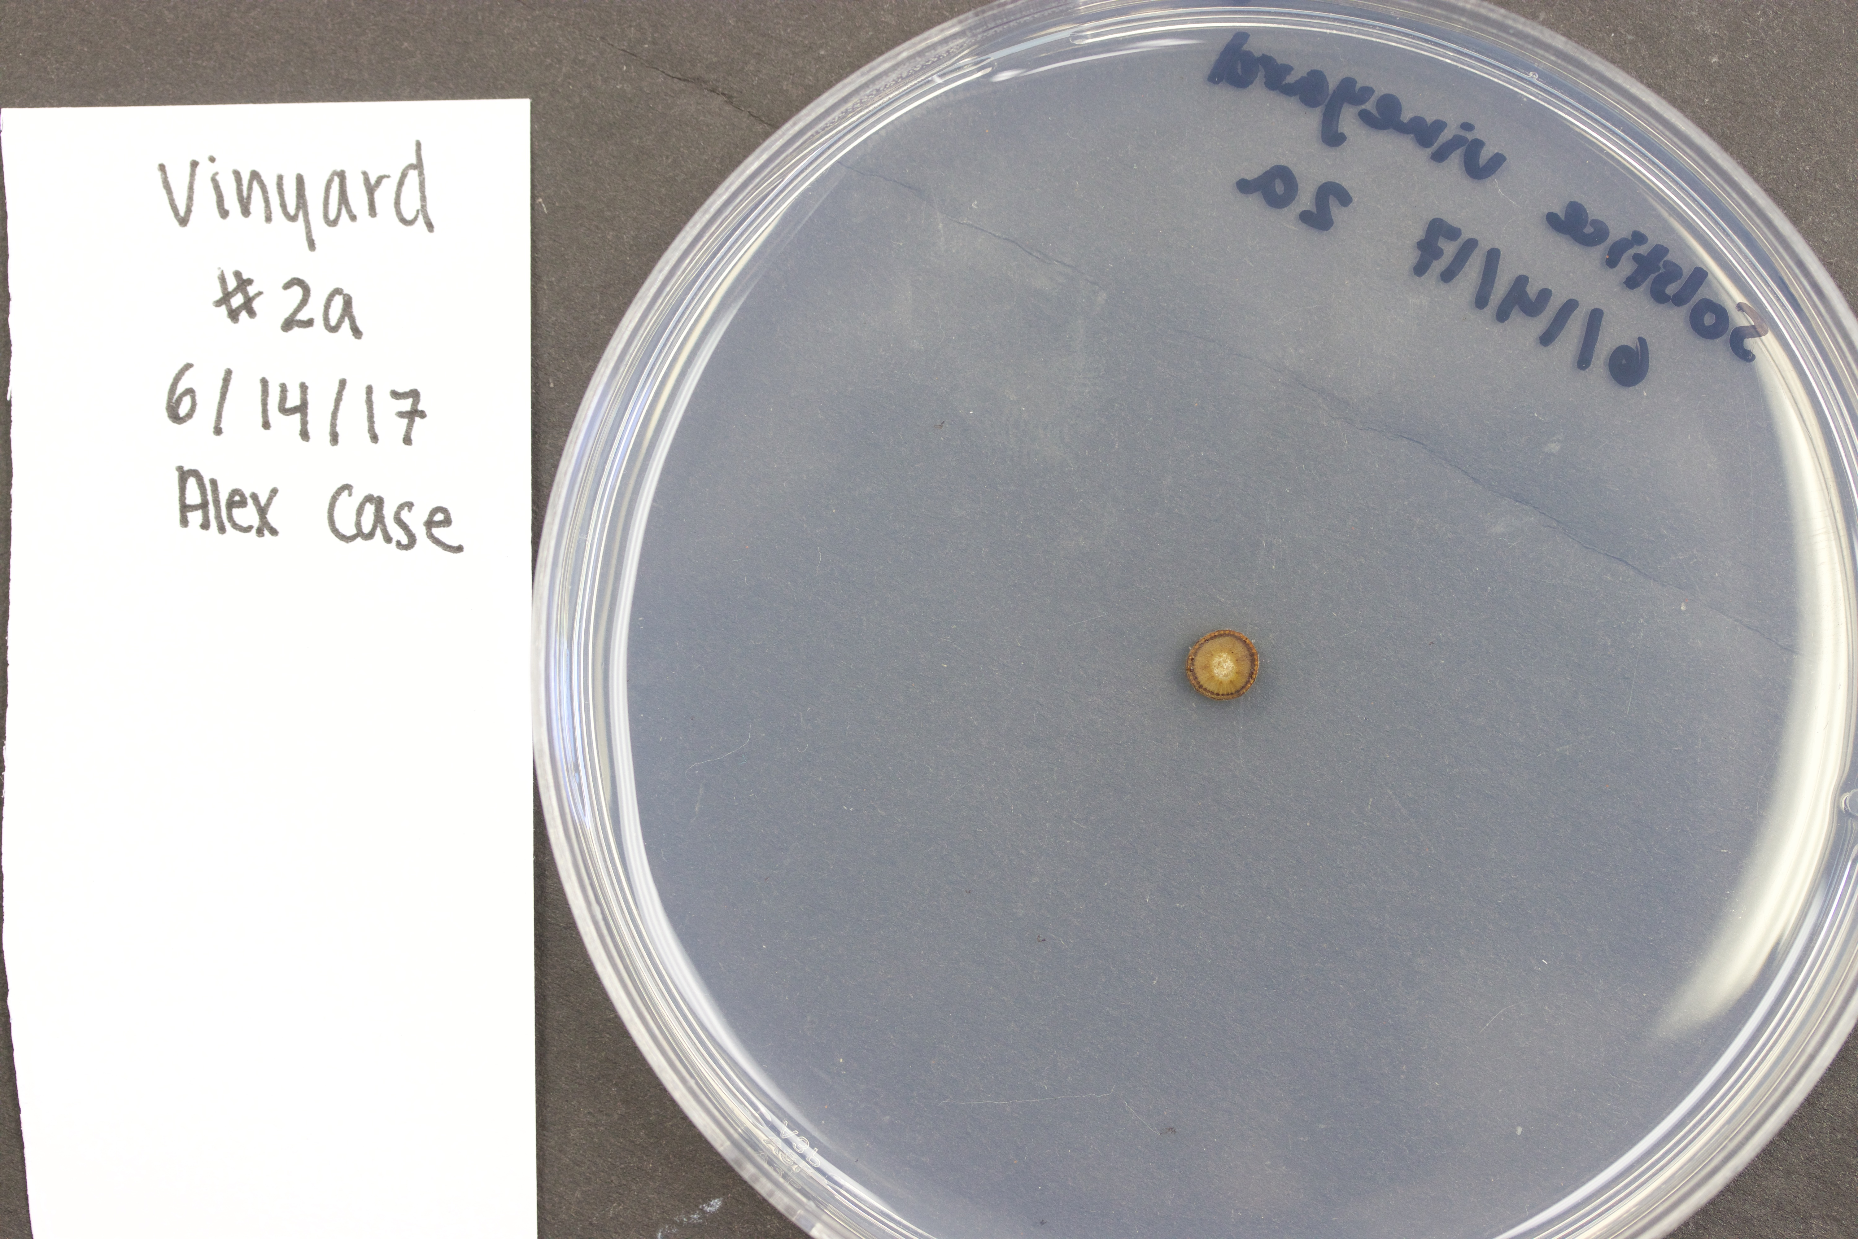
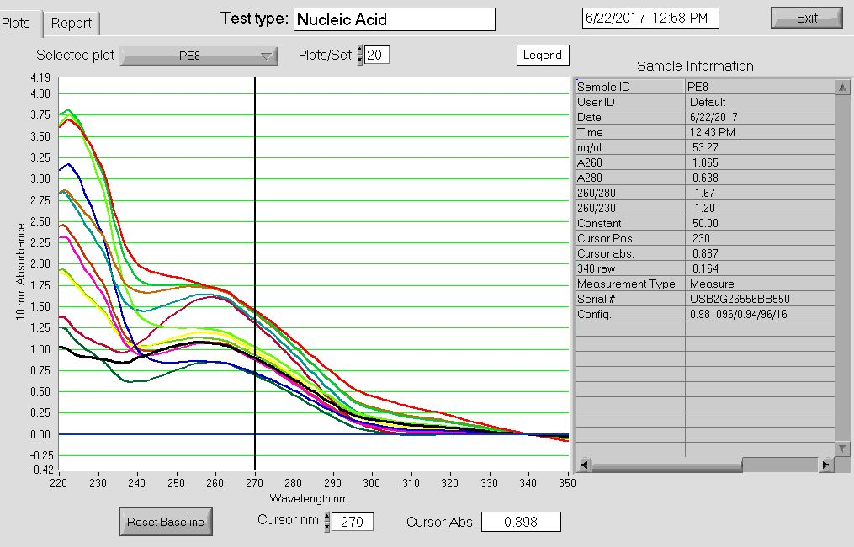
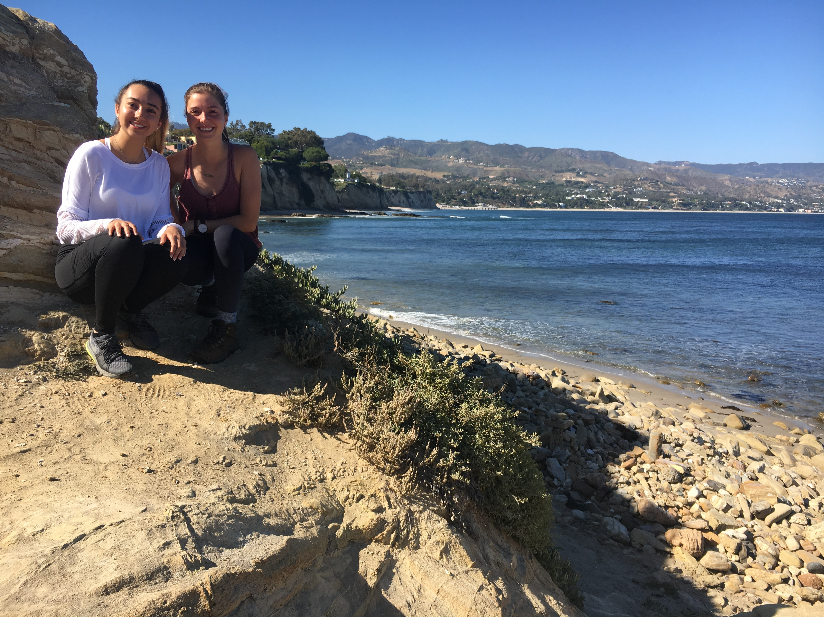
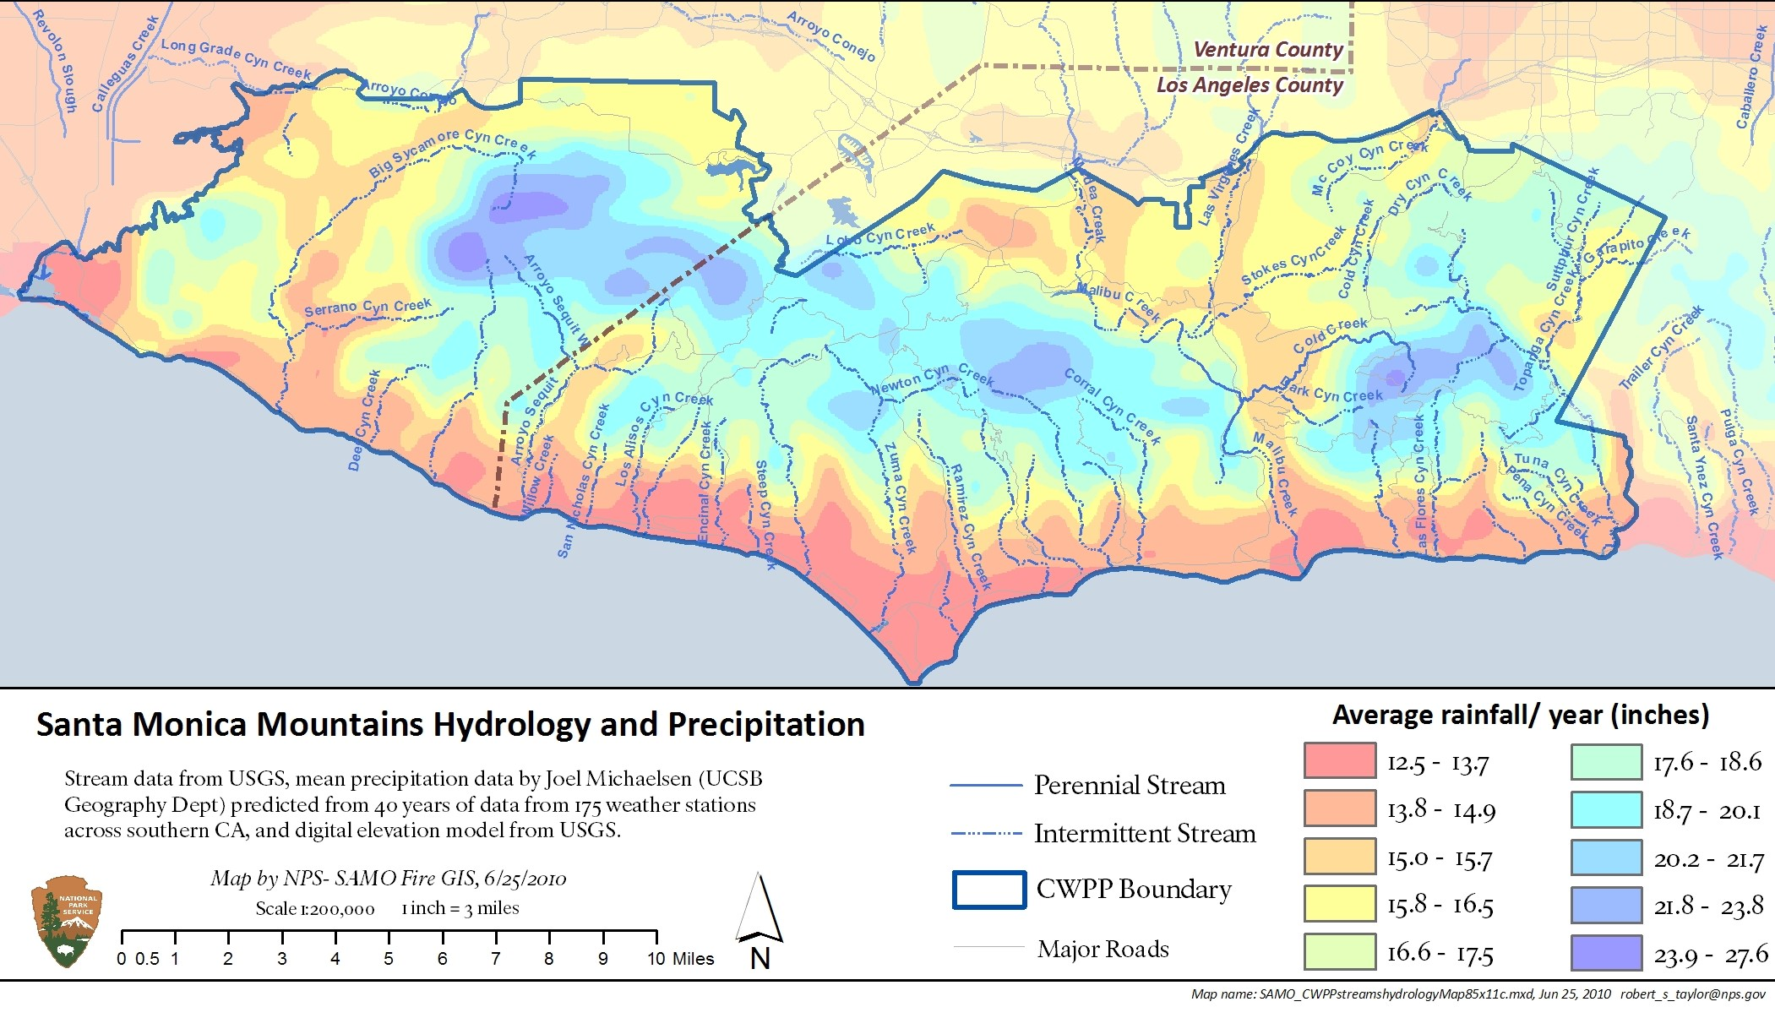
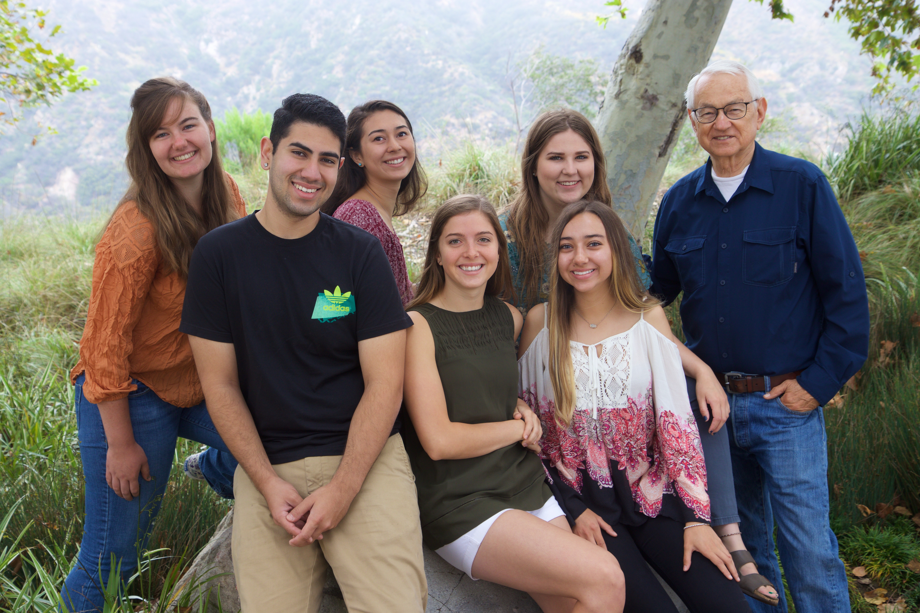
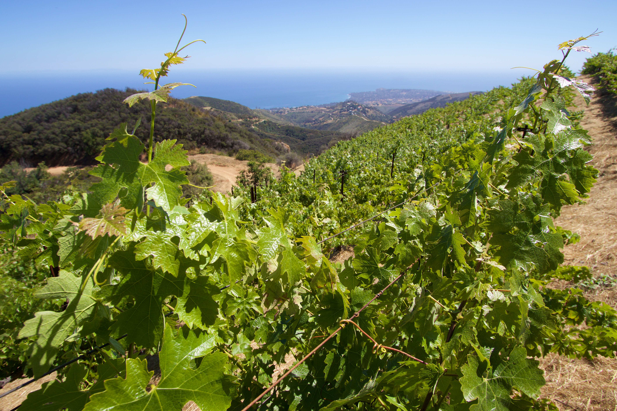
Potential Spread of the Fungal Pathogen Botryospharea dothidea from Chaparral Shrubs to Grape Vineyards in the Santa Monica Mountains
Alexandra N. Case
Mentors: Natalie M. Aguirre, Rodney L. Honeycutt, and Stephen D. Davis. Pepperdine University, 24255 Pacific Coast Highway, Malibu, CA 90263
Abstract
We tested the hypothesis that an opportunistic endophytic fungus, Botryosphaeria dothidea, that frequently infects and causes dieback in species of chaparral shrubs in the Santa Monica Mountains during drought events, may spread to grape vineyards in the Santa Monica Mountains. Recently a dominant chaparral species in coastal exposures of the Santa Monica Mountains, Malosma laurina, has undergone extensive dieback in low elevation, dry sites, in response to historic drought in California, but less dieback in high elevation moist sites. M. laurina frequently grows adjacent grape vineyards. Thus we hypothesized that fungal isolates from a low elevation, dry vineyard would have higher incidence of B. dothidea, than a high elevation, moist vineyard. We tested this hypothesis by isolating the fungus from twelve samples at each location. Greater than 75% of the samples produced fungal growth on potato dextrose agar. We found two cultures from the low elevation vineyard and one from the high elevation vineyard, to have colony morphology similar to B. dothidea. We isolated DNA from each culture and used genetic markers of internal transcribed spacer (ITS), elongation factor 1α (EF1), and beta tubulin 2 (BT2) to identify the fungus. None of these three samples were B. dothidea. However all three samples are considered close relatives of B. dothidea and the sample at the low elevation dry site was Diplodia seriata, an anamorph of Botryosphaeria obtusa. We interpret this to mean that Botryosphaeria dothidea has not jumped from native chaparral species to grape vineyards, at least at the two sites examined in the Santa Monica Mountains. One possibility is that the standard irrigation of grape vineyards in the Santa Monica Mountains has maintained their ability to ward off Botryosphaeria infestation during historic drought in California whereas this has not been the case for non-irrigated Malosma laurina.
Method
Discussion
In order to determine the potential spread of the fungus, Botryosphaeria dothidea, from native chaparral plants to grapevines, I found that three of the primers did not match B. dothidea. However, two of three markers have the same bands as the ones morphologically the same to B. dothidea. The sample from the Santa Monica Mountains, the two samples from Strange Vineyard all had the same primers, ITS and EF1, as samples known to be B. dothidea. All three samples varied for the BT2 primer.
It was surprising that B. dothidea was not in any of the samples because the location of all three samples were in dryer areas (as indicated from the star in the previous figure). However, the grapevines are more irrigated than the native chaparral plants and experience less dieback. Thus, they are less susceptible to the growth of the fungal pathogen.
Figure 2: Botryosphaeria dothidea sample
Figure 3: Strange Vineyard sample, similar to Botryosphaeria dothidea
Conclusion
The hypothesis was not supported because none of the samples had traces of B. dothidea
Strange Vineyard (SV4) was Diplodia seriata
Strange Vineyard (SV6) was Alternata tenuissima
The Santa Monica Mountain Vineyard (MSV1) was Alternata tenuissima
Although the samples were not B. dothidea, all of the samples were related to B. dothiea and were in the same family
I predict that fungus will eventually spread to grapevines in the Santa Monica Mountain region
In the future, I would like to test more grapvines during prime grape growing season
Figure 4: Grapevine symptoms: Cankers, spots, fuzzy leaves, leaf and stem discoloration
Figure 5: Collected 10 samples from each vineyard, put the stem in ethanol for 15 – 20 seconds and let the stems dry for 15 – 20 sec. Isolated the fungus from the stems by cutting two segments in the middle of each stem with a razor blade, put the stems in the middle of PDA (potato dextrose agar). Refrigerate them for approximately one week.
Introduction
The state of California is experiencing a historic drought, impacting native plants and crops. The effects of the drought have been detrimental to the Santa Monica Mountain region, especially impacting the native chaparral species like Malosma laurina. Due to the drought, the region is experiencing severe dieback in native and crop plants, which is further heightened by a fungal disease in native plants. The fungus most abundant among native chaparral species is Botryosphaeria dothidea. The fungus seems to be able to withstand the drought and studies have shown that the fungus can spread to other agricultural plants.
In these native chaparral plants, a fungal pathogen, Botryosphaeria dothidea has inhibited the plants and heightened dieback. In a previously conducted study, we attempted to trap spores, but we were unable to identify Botryosphaeria dothidea. Additional studies have shown that the pathogen is dispersed in the air and moved from spores in rain or wind events. Research has indicated that Botryosphaeria dothidea has spread to Vitis vinifera and other agricultural plants, but the research conducted was limited. I wondered if spores containing B. dothidea, or the fungus itself, could disperse or jump from native M. laurina to vitis. Specifically, if the same genetic variation of B. dothidea seen in plants on Pepperdine’s campus are the same as the the fungus found in Vitis vinifera at Point Dume and Santa Monica Mountains .
I predict that the fungal pathogen, Botryosphaeria dothidea, causing dieback in native chaparral plants will be growing in grapevines in the SMM.
Literature Cited
Marsberg, A., Kemler, M., Jami, F., Nagel, J.H., Postma‐Smidt, A., Naidoo, S., Wingfield, M.J., Crous, P.W., Spatafora, J.W., Hesse, C.N. and Robbertse, B., 2017. Botryosphaeria dothidea: a latent pathogen of global importance to woody plant health. Molecular plant pathology, 18(4), pp.477-488.
Úrbez-Torres, J.R., Leavitt, G.M., Voegel, T.M. and Gubler, W.D., 2006. Identification and distribution of Botryosphaeria spp. associated with grapevine cankers in California. Plant Disease, 90(12), pp.1490-1503.
Úrbez-Torres, J.R., Battany, M., Bettiga, L.J., Gispert, C., McGourty, G., Roncoroni, J., Smith, R.J., Verdegaal, P. and Gubler, W.D., 2010. Botryosphaeriaceae species spore-trapping studies in California vineyards. Plant Disease, 94(6), pp.717-724.
Úrbez-Torres, J.R., Leavitt, G.M., Voegel, T.M. and Gubler, W.D., 2006. Identification and distribution of Botryosphaeria spp. associated with grapevine cankers in California. Plant Disease, 90(12), pp.1490-1503.
Úrbez-Torres, J.R. and Gubler, W.D., 2009. Pathogenicity of Botryosphaeriaceae species isolated from grapevine cankers in California. Plant Disease, 93(6), pp.584-592.
Úrbez-Torres, J.R., Battany, M., Bettiga, L.J., Gispert, C., McGourty, G., Roncoroni, J., Smith, R.J., Verdegaal, P. and Gubler, W.D., 2010. Botryosphaeriaceae species spore-trapping studies in California vineyards. Plant Disease, 94(6), pp.717-724.
Figure 6: Isolated DNA, Ran a gel using 3 primers ITS, ET, BT2 add 1 micro liter to each mix and spin eac, Sequenced the DNA, using the Quick DNA Fungal/Bacterial Miniprep Kit and Bead basher. Test tubes in bead beater and use the basher at maximum speed for greater than 5 minutes. Process allowed us to measure optical density using UV to break bonds for DNA.
Results
Acknowledgements
This research was funded by the National Science Foundation, NSF IUSE DUE 1525878, NSF REU site DBI 1560352, and the Natural Science Division at Pepperdine University. Thank you to Dr. Davis, Dr. Honeycutt and Dr. Monzón.
Plant Mortality
(%)
Control | 0.0 | 25 | 3 | 0.0 | 0.0 | 0.0 | 0.0 | 0.0 | 0.0 | 0.0
Dieback | 12 | 19 | 56 | 39 | 39 | 18 | 44 | 52 | 26 | 41
Study Sites
A
C
C) Santa Monica Mountains precipitation map and sample sites. Note: star is location of Strange Vineyard, circles represent B. dothidea samples on M. laurina.
ITS
BT2
MSV 1
SV4
MSV 1
SV4
SV6
Figure 7: The gel with three primers ( ITS, BT2, EF1)
SV6
1
EF1
2
3
MSV 1
SV4
4
5
6
7
8
9
10
SV6
B
Figure 1: A) Strange Vineyard: Elevation: 50 ft., Rainfall: 12 inches, B)Vineyard in Santa Monica Mountains: Elevation: 2,200 ft., Rainfall: 28.5 inches,

