Slide 1

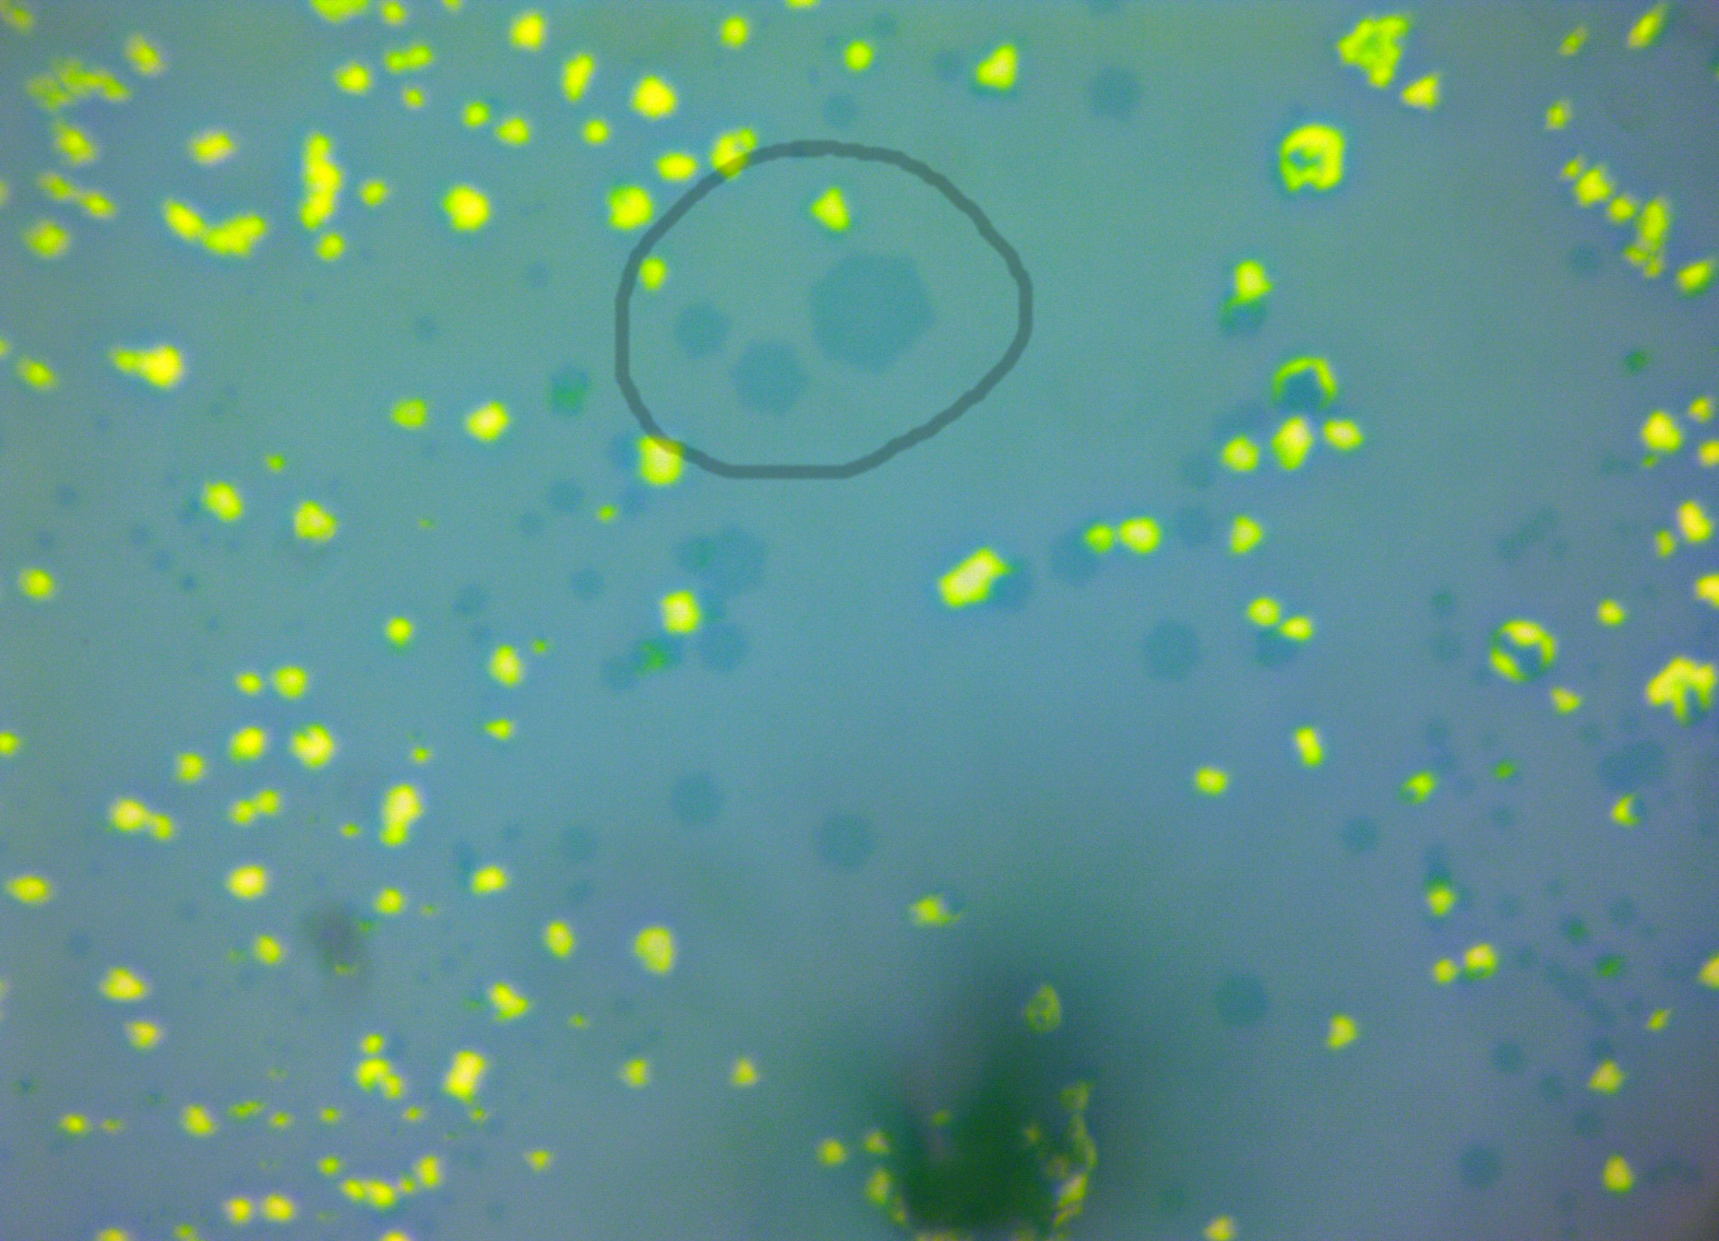
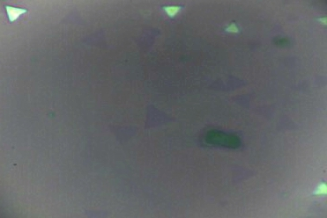
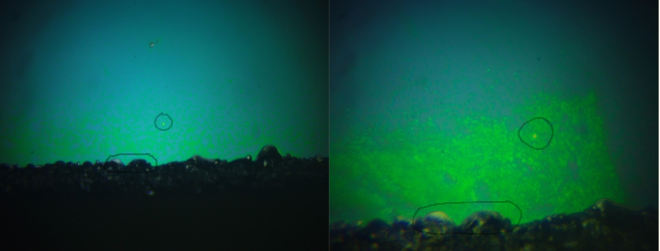
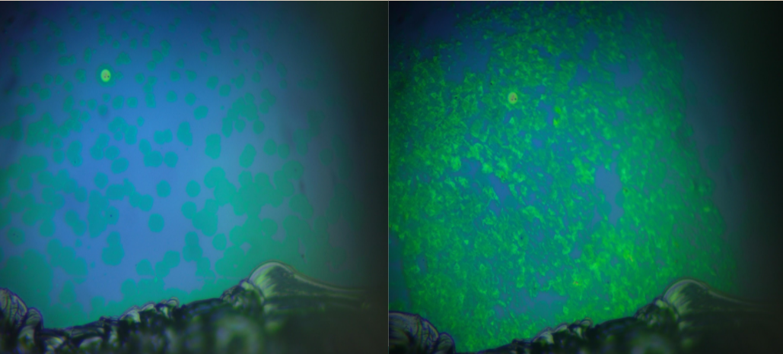
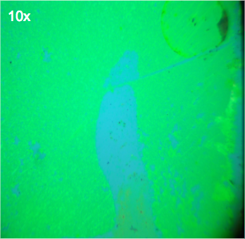
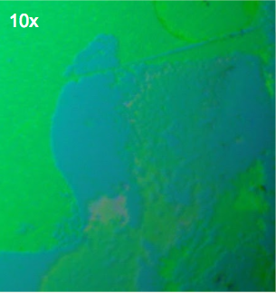
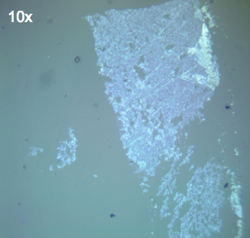
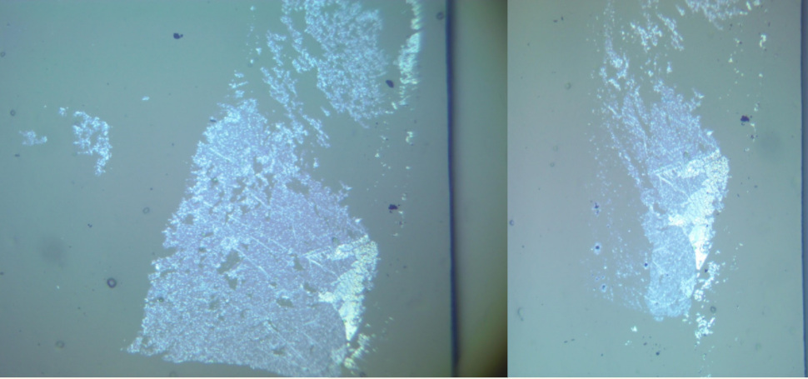
Stacking of Quasi 2D Transition Metal Dichalcogenides
Michael Hernandez and John Mann
Pepperdine University
Abstract
Monolayer Transition Metal Dichalcogenides are atomically thin semi-conductors that are considered quasi 2D materials due to their extremely small thickness. It has been observed that atomically thin crystals exhibit different physical properties than their bulk counterparts due to quantum confinement effects. We are attempting discover new physical properties by developing a technique to stack two different monolayer crystals, MoS2 and MoSe2.
Introduction
9) Before and after stack 10x
The isolation of single layer graphite in 2004^{[1]} and its astonishing properties has sparked great interest in the scientific community in 2D materials. Molybdenum disulfide (MoS₂), and molybdenum diselenide (MoSe₂), are members of one class of 2D materials called the the transition metal dichalcogenides (TMDs). These materials have shown promising physical characteristics with possible applications in transistors^{[2]}, material sensors^{[3]}, catalysis^{[4]}, and for use in flexible electronics^{[5]}. However, these characteristics are only present in single to few molecular layers of these substances. Each monolayer material has unique physical and electrical properties that can be altered and changed based on stacking monolayer crystals on top of each other. As long as the crystalline structure of the materials are different, or not aligned, differences should be observed. A heterojunction can be created by stacking MoS₂ on top of MoSe₂, which has been the primary focus of our research this year.
Figure 1) MoSe₂ growth at 60x.
Figure 2) MoS₂ growth at 100x
10) Before and after stack 50x
Materials and Methods
Figure 3) MoSe₂ raman at 50x
Figure 4) MoS₂ raman at 50x.
Conclusion
We first synthesize MoS₂ and MoSe₂ on separate substrates using chemical vapor deposition (CVD). Once complete, an optical microscope and a Raman spectrometer are used to find regions of thin flakes (ideally no thicker than 1 nm) and to verify the material composition, figures 1-4. MoS₂ crystals typically form triangles and similar geometric variations, and MoSe₂ crystals typaically form hexagonally, figures 1-2. Pictures are taken at various objective settings (10X, 40X, 100x) to compare to later stages of the stacking process. An AFM is used to measure the height profiles of the synthesized flakes. The previous method of transfer was to simply place this polymer onto our target substrate, and peel off the film of interest. Then the polymer was placed on an inverse microscope to see through our polymer and stack our materials using a micro manipulator. This is the method demonstrated in figures 5-10. The current method of transferring these 2D crystals consists of placing polydimethylsiloxane (polymer) on top of our substrate over our desired area. Then placing this pair on top of a hot plate set at 70º Celsius for one hour. Once heated, this pair is placed in a potassium hydroxide (KOH) solution over night, to etch away the oxide layer of our silicon oxide substrate. Once the monolayer crystals have been transferred over to the polymer, we proceed to place this polymer onto a second substrate of interest. Once it is confirmed that this process is consistently repeatable we will attempt to stack our crystals with a redesigned micro manipulator.
Our initial stacking technique has a very low success rate. Figures 5-10 depict one of our successful attempts to transfer and stack MoS₂ films. We are developing a modified technique involving heating the substrate to 70º Celsius and etching in KOH. While transfer of monolayer MoS₂ has been achieved using our improved technique, the success rate of our second technique is still being determined. Our long term goal is to stack individual monolayer crystals to observe the change in their physical properties and ultimately to create a super lattice.
References
5)MoS₂ growth
6) MoS₂ after transfer to polymer
7) MoS₂ on polymer
[1] K. S. Novoselov , A. K. Geim , S. Morozov , D. Jiang , Y. Zhang ,S. Dubonos , I. Grigorieva , A. Firsov , Science 2004 , 306 , 666 .
[2] B. Radisavljevic , A. Radenovic , J. Brivio , V. Giacometti , A. Kis , Nat. Nanotechnol. 2011 , 6 , 147 .
[3] S. Wu , Z. Zeng , Q. He , Z. Wang , S. J. Wang , Y. Du , Z. Yin , X. Sun , W. Chen , H. Zhang , Small 2012 , 8 , 2264.
[4] X. Huang , Z. Zeng , S. Bao , M. Wang , X. Qi , Z. Fan , H. Zhang , Nat. Comm. 2013 , 4 , 1444 .
[5] A. Castellanos-Gomez , M. Poot , G. A. Steele , H. S. J. van der Zant , N. Agraït , G. Rubio-Bollinger , Adv. Mater. 2012 , 24 , 772 .
Results
Acknowledgements
Currently we have successfully created a technique to synthesize monolayer MoS₂ and MoSe₂ crystals viable for stacking, figure 1-2. We have also been able to stack thin layer films of MoS₂ on top of each other using the first technique described above (figures 9-10).
Pepperdine Undergraduate Research Fellowship
8) Polymer Before and after stack

