Slide 1
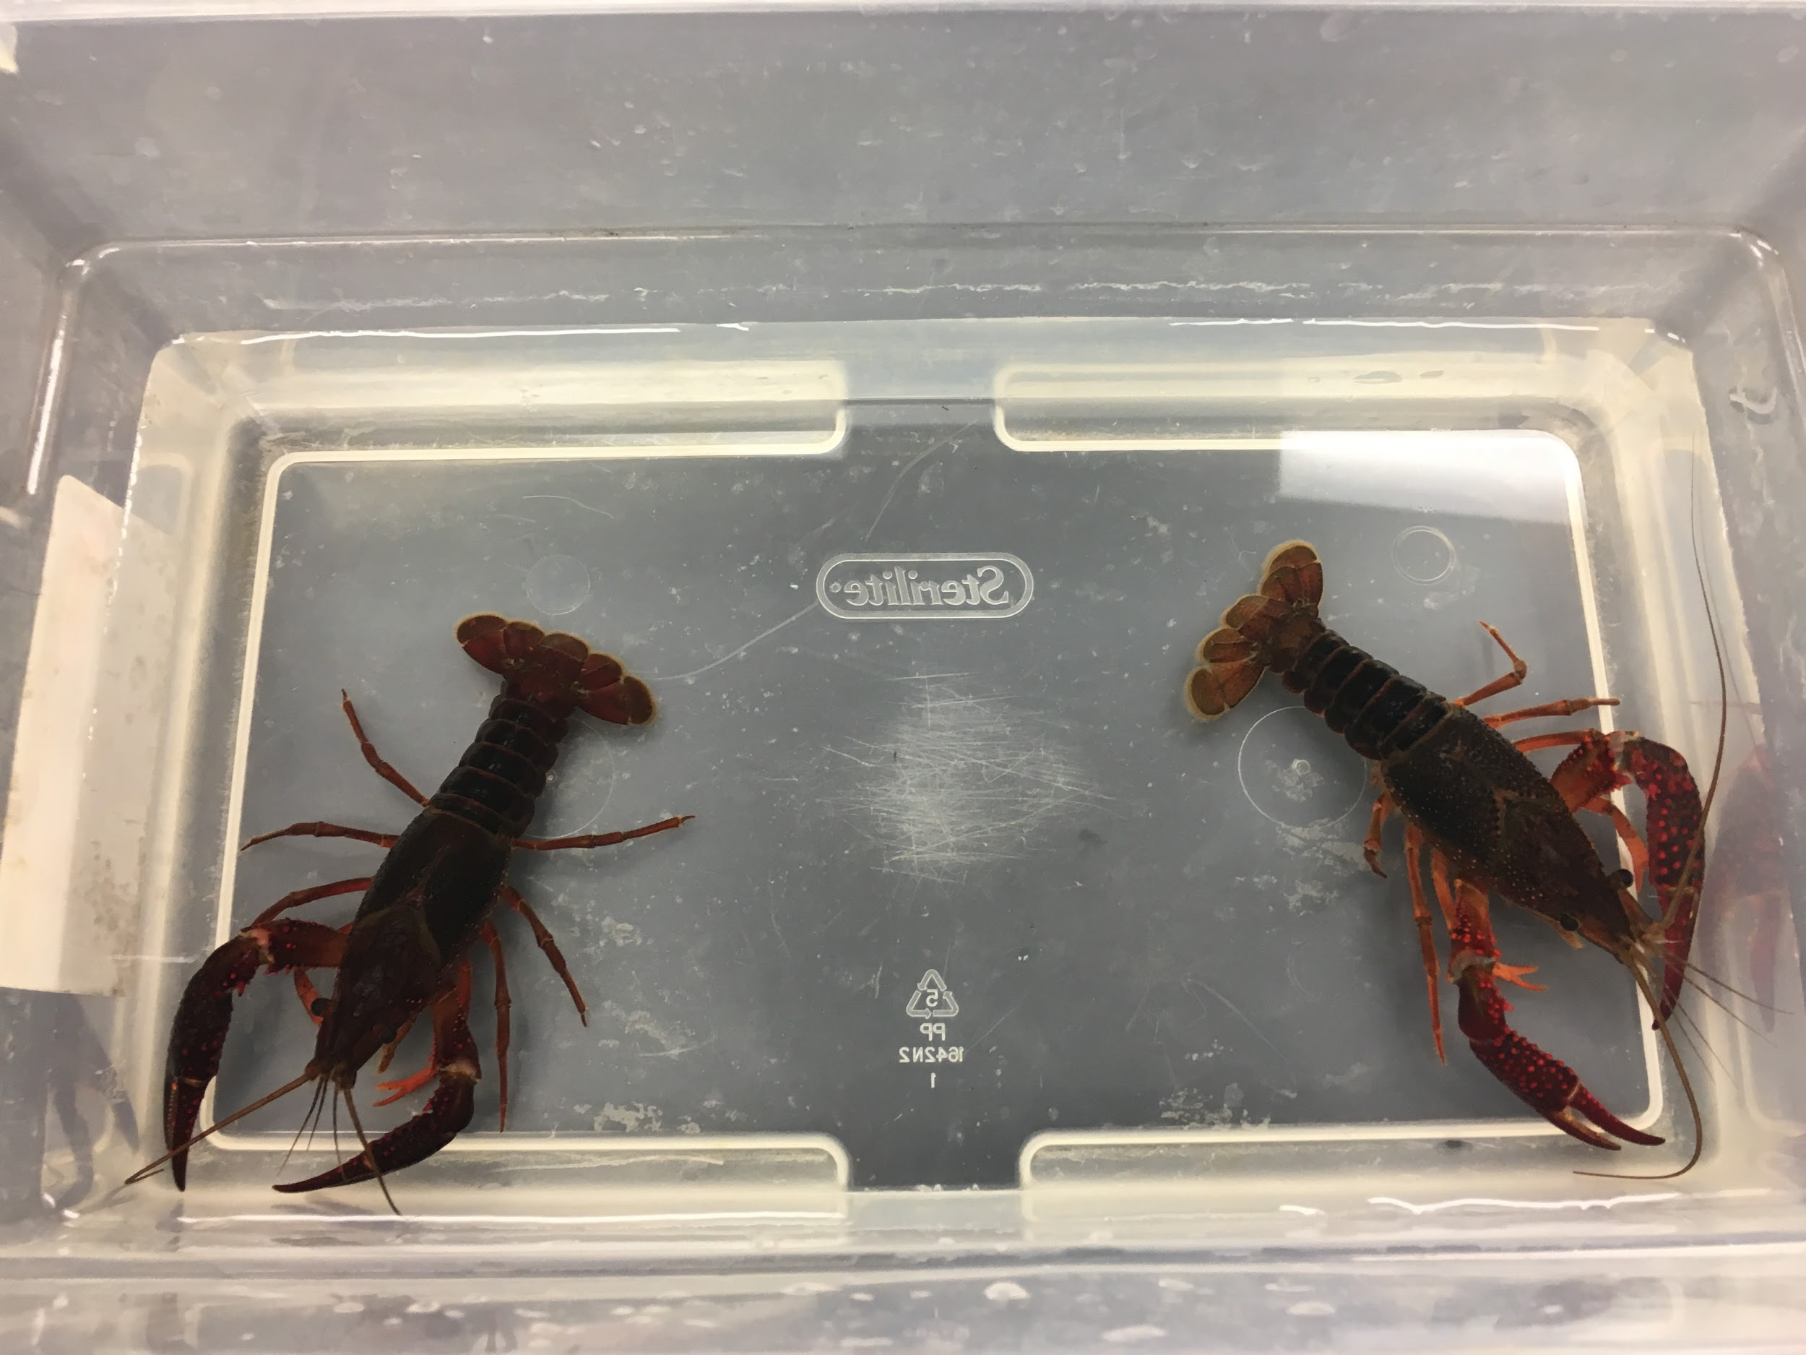
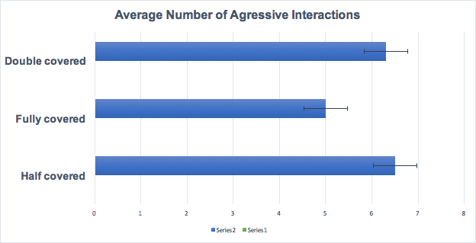
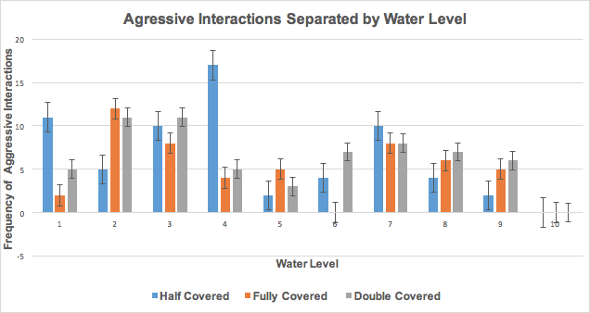
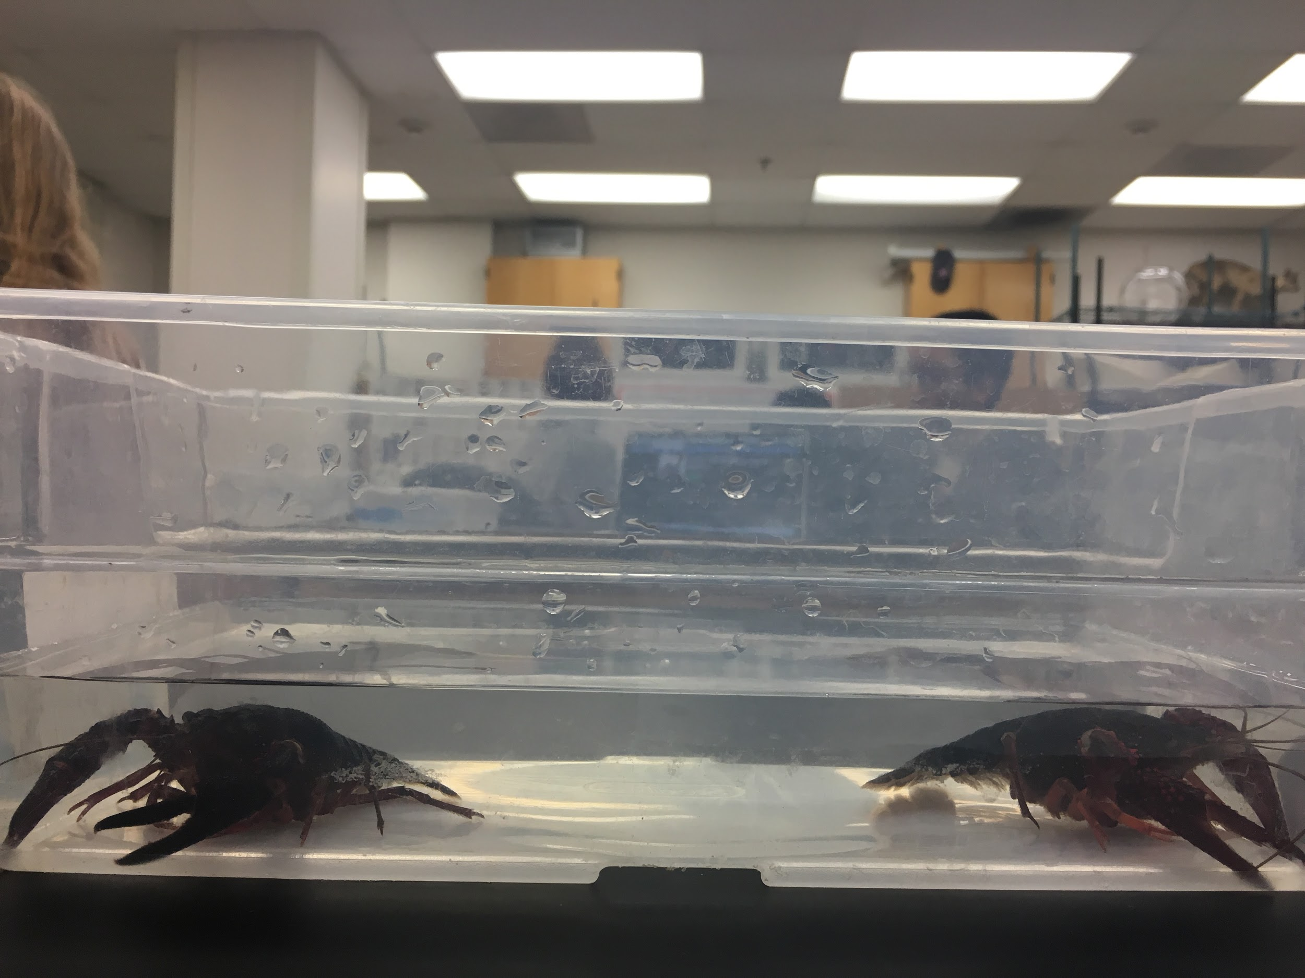
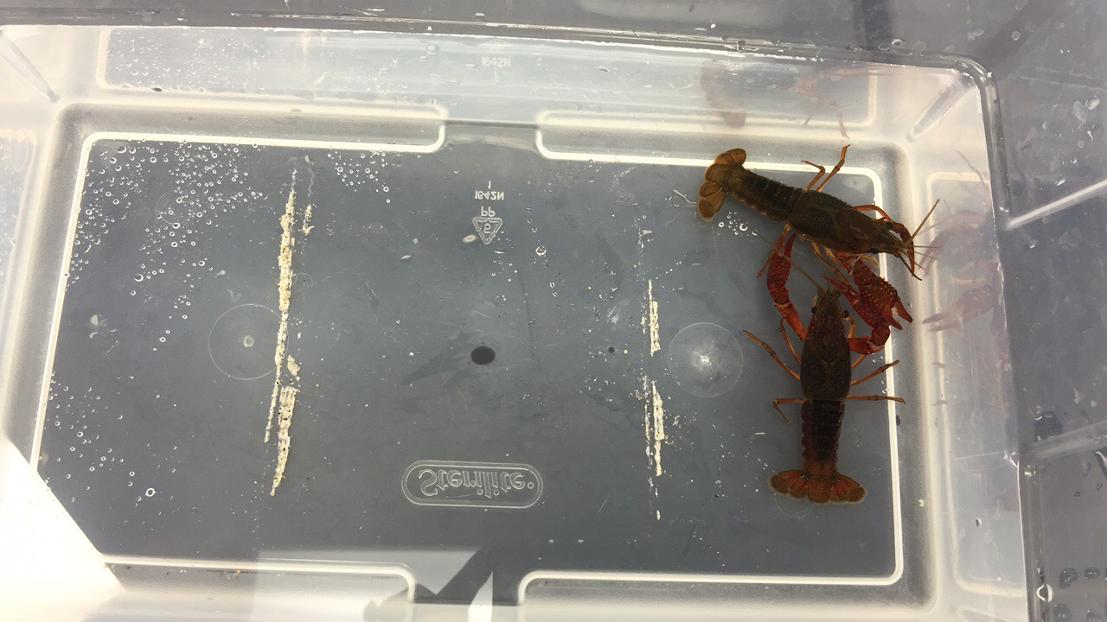
The Effect of Water Levels on Crayfish Aggression
Presented by: Sarah Blase, Emory Johnson, Bessie Yang
Pepperdine University, Malibu, CA
Abstract
Crayfish, Procambarus clarkii are an invasive species that have currently taken a foothold in the Santa Monica mountains and are threatening the native stream species. There is currently a severe drought occurring in the Santa Monica mountains. This drought is causing the reshaping of many aquatic environments in the area. The crayfish are a very aggressive species and adversely affect the habitat they inhabit, and because of this it is important to understand how these environmental changes affect crayfish behavior. It is expected that crayfish aggression will increase in lower water levels due to competition for space. We tested this by exposing crayfish pairs to different water levels and measuring their aggressive activity. It was found that water levels do not affect aggressive activity, so the water levels brought on by the drought will not alter the behavior of the crayfish.
Introduction
The Santa Monica Mountains are located in southern California where there is currently a drought.The geological and weather factors significantly affect the local streams water level. When there is a drought, the water level will be low. Some researchers show that crayfish prefer to make their habitats in slow moving streams with the standard water level (Baird,2006). Therefore, the changes in water level could affect the behavior, specifically the aggression levels of crayfish. A major component of aggression arises from territoriality (Figler, 1999). With a lower water level, crayfish may feel stress from the environment which can lead them to fight with the other crayfish for more space. Crayfish aggression also reduces as the complexity of the environment increases (Bovbjerg, 1956). Flooding may bring vegetation, rocks, and sand from upstream, therefore, increasing the complexity of the habitat. When the environment becomes non-ideal, it could cause them to act more aggressively and lead to more damages for the ecosystem.
Results
Figure 1: The average number of aggressive interactions in our containers
To quantify our data we used a One-Way ANOVA test
F = 0.37 the corresponding p = 0.69
p =0.69 > 0.05= Α
Therefore we reject the alternate hypothesis and fail to reject the null
The null states that water level will have no difference on aggressive behavior of crayfish
Figure 2: This graph depicts the number of trials for each water level, and the aggressive interactions for each level
Hypotheses
Null Hypothesis: Water level will have no effect on crayfish aggression
Alternate Hypothesis: Water level will have an effect on crayfish aggression
Discussion
By understanding the connections between crayfish aggression and environmental factors, we can develop a way of controlling the growing population of crayfish, and, therefore, lower their role in destruction of biodiversity. If we can stumble upon the crucial limiting habitual reagent on crayfish behavioral patterns, we can take advantage of the discovery and use it for our benefits. We can develop a way to reduce the population growth of Procambarus clarkii and rebuild the ecosystems. The understanding of the relationship between changes in habitual factors and the changes in invasive species behavioral patterns would work towards biodiversity damage control and help regulate the environment. Once we know the habitual limiting factors, we can modify the environment to control the invasive species. For example, if the experiment shows that the amount of precipitation will directly change the behavioral patterns of Procambarus clarkii, we can lower the water level in currently occupied streams to draw out aggressive behavior between crayfish or any other outcome that we desire. We can apply this connection to develop technologies to make the ecosystem more suitable for certain endangered species. We can also use this link for the recreation of inhabitable environments that have been heavily disfigured by invasive species. In conclusion, this experiment will help further advance us in the path of building a safer, more stable biodiverse community.
Methods
10 pairs of same size and sex crayfish
Each pair has a different size compared to other pairs
3 containers with different water levels corresponding to amount of crayfish covered: half covered, covered, and double covered
Observe and record the number of aggressive interactions between each pair of crayfish at different water levels
Compare the data from the observations
Literature Cited
¹Figler, Michael, et. al. Shelter competition in juvenile red swamp crayfish (Procambarus clarkii): The influences of sex differences, relative size, and prior
residence. (1999, July 15.). Retrieved November 22, 2016
² Baird, Helena, et al.Reducing aggression between freshwater crayfish (Cherax destructor Clark: Decapoda, Parastacidae) by increasing habitat complexity. (2006, August 31). Retrieved November 22, 2016
³ Bovbjerg, Richard. V. (1956). Some Factors Affecting Aggressive Behavior in Crayfish. Physiological Zoology, 29(2), 127-136. doi:10.1086/physzool.29.2.30152201
Image # 2 (below) : Crayfish exhibiting aggressive behavior
Image #1 (above) : Crayfish in “covered” environment
Notes:
Discussion
The connection between crayfish aggression behaviors and habitual factors
Crayfish-invasive species cause damage in ecosystem
Knowing the limiting habitual factors can be for our benefits
Modify the environment based on the link to control crayfish activities
In our lab, if there is a link we can modify the water level to draw out desire behaviors
Real life application, 1)modify environment for endangered species 2)creation of inhabitable environments 3)Regulate invasive species population

