Slide 1
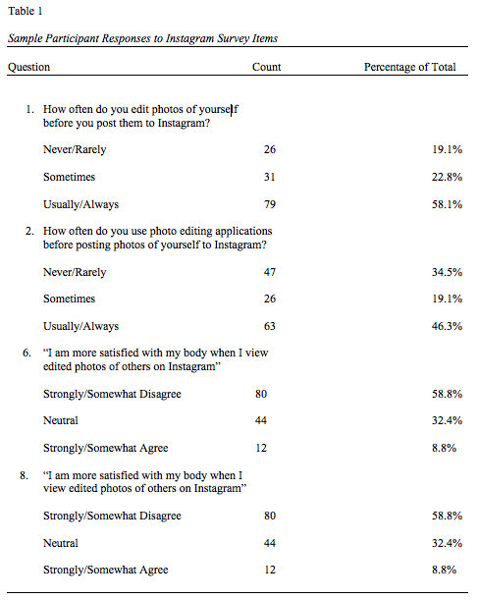
The Relationship Between Instagram Photo Editing and Undergraduate College Women’s Body Dissatisfaction
Madeline Wick, Cindy Miller-Perrin, & Jennifer Harriger
Pepperdine University, Malibu, CA
ABSTRACT:
The current study examined the role of Instagram photo editing on the body dissatisfaction of undergraduate college women in terms of the difference between posting an edited photo of oneself (n=136) and viewing edited photos of others (n=69). High levels of editing personal photos on Instagram was found to be significantly correlated with increased body dissatisfaction, while no significant difference was found between viewing edited photos of others on Instagram and viewing a series of control photographs. This differs from participants’ self-reported body dissatisfaction as it relates to Instagram photo editing, in which the majority reported less body dissatisfaction after posted edited photos of themselves and more body dissatisfaction after viewing edited photos of others on Instagram. Future research on the topic is warranted in order to better understand the relationship between body dissatisfaction and Instagram photo editing.
Procedure
All participants completed a demographic form, the Body Dissatisfaction subscale of the EDI-2, and the Instagram survey online.
Those participants who responded with ‘more than 51%’ to the Instagram survey question “How many of those you follow on Instagram do you think edit photos of themselves before they post them” were invited to participate in the experimental portion of the study (N=69).
Participants were randomly assigned to either view their own Instagram feed for 10 minutes (N=35) or to view National Geographic’s animal gallery for 10 minutes (N=34).
After 10 minutes had passed, all participants took the Body Dissatisfaction subscale of the EDI-2 a second time.
DISCUSSION:
We hypothesized that frequency of editing one’s own Instagram photos would be negatively associated with body dissatisfaction, while individuals who view edited photos of others on Instagram would experience increased body dissatisfaction compared to controls.
- Both of these hypotheses received mixed support.
A significant positive correlation between Instagram self-photo editing and body dissatisfaction was found, contrary to our hypothesis of an inverse relationship between the two variables.
State body dissatisfaction was positively correlated with self-reported satisfaction with one’s body after posting an edited photo of oneself on Instagram, suggesting that Instagram self-photo editing might be used to compensate for an already existent body dissatisfaction.
- This would explain the seeming discrepant finding between participant’s
self-reported body dissatisfaction after posting an edited photo of
themselves on Instagram and the positive correlation between body
dissatisfaction and Instagram self-photo editing.
Mean Body Dissatisfaction scores for the experimental portion were larger for the Instagram exposure group compared to the National Geographic exposure group, although the difference was not statistically significant, contrary to the majority of participants self-reporting an increase in body dissatisfaction after viewing edited photos of others on Instagram.
Suggestions for future research include using an experimental design to assess the cause and effect in the relationship between Instagram self-photo editing and body dissatisfaction, using pre-determined edited photos in assessing for the impact of viewing edited photos of others on body dissatisfaction, exposing participants to the manipulation for a longer period of time, and using a more diverse sample.
Understanding of the relationship between Instagram photo editing and undergraduate college women’s body dissatisfaction is important in preventing the risk of increased body dissatisfaction and the potential onset of an eating disorder (Stice, 2002).
INTRODUCTION:
There has been no research to date examining Instagram photo editing and body dissatisfaction. However, existing media literature suggests the following:
Women who watch plastic surgery television may see changing their appearance as a way to increase their body satisfaction (Markey & Markey, 2012). It is possible that Instagram photo editing may be seen in the same way.
Posting photos of oneself on social media carries positive rewards, including decreased body dissatisfaction (Ridgway & Clayton, 2016).
Many studies suggest that social media browsing yields increased body dissatisfaction (Pepin & Endresez, 2015).
There seems to be a discrepancy between the experience of the poster and the viewer on social media, so that posters experience increased body satisfaction and viewers experience decreased body satisfaction. In light of this knowledge, we hypothesized the following:
Frequency of editing photos of oneself prior to posting to Instagram will be negatively correlated with body dissatisfaction.
Regular users of Instagram will experience greater body dissatisfaction after viewing edited photos of others on Instagram compared to those who view control photos.
RESULTS:
Participants’ Responses to Sample Items on Instagram Survey
Participants reported frequent Instagram self-photo editing, in addition to decreased body dissatisfaction after posting edited photos of themselves to Instagram and increased body dissatisfaction after viewing edited photos of others on Instagram. Response distributions for particular items on the Instagram survey are displayed in Table 1.
Instagram Self-Photo Editing, Body Dissatisfaction, & Past Eating Disorder Diagnosis
A moderate, positive correlation between Instagram Self-Photo Editing scores and Body Dissatisfaction scores was found, r(133) = .368, p< .01.
Viewing Edited Photos of Others & Body Dissatisfaction
An independent samples t-test was used to assess differences in Body Dissatisfaction scores between the Instagram exposure group (M= 8.5143, SD= 6.12) and the National Geographic exposure group (M= 7.3824, SD= 5.88) and no significant difference between the two groups was observed, t(67)= -.783, p= .436.
Self-Reported Body Dissatisfaction and Body Dissatisfaction Scores
One’s self-reported “satisfaction with their body after posting an edited photo of themselves on Instagram” was positively correlated with Body Dissatisfaction scores, r(132) = .354, p< .01.
One’s self-reported ”satisfaction with their body after viewing an edited photo of others on Instagram” was not found to be significantly correlated with Body Dissatisfaction scores at baseline, r(133)= .065, p= .436.
REFERENCES:
Garner, D. M. (1991). Eating Disorder Inventory-2. Professional Manual. Odessa, FL:
Psychological Assessment Resources, Inc.
Markey, C. N., & Markey, P. M. (2012). Emerging adults' responses to a media
presentation of idealized female beauty: An examination of cosmetic surgery in
reality television. Psychology of Popular Media Culture, 1(4), 209-219.
doi:10.1037/a0027869
Pepin, G., & Endresz, N. (2015). Facebook, Instagram, Pinterest and co.: Body image
and social media. Journal of Eating Disorders, 3(Suppl 1). doi:10.1186/2050-2974-
3-s1-o22
Ridgway, J. L., & Clayton, R. B. (2016). Instagram unfiltered: Exploring associations of
body image satisfaction, Instagram #selfie posting, and negative romantic
relationship outcomes. Cyberpsychology, Behavior, and Social Networking, 19(1),
2-7. doi:10.1089/cyber.2015.0433
Stice, E. (2002). Risk and maintenance factors for eating pathology: A meta-analytic
review. Psychological Bulletin, 128(5). doi:10.1037//00332909.128.5.825
METHOD:
Participants
136 participants.
All participants were undergraduate college women.
The average age of the participants was 18.7 (SD= 1.09).
All participants were required to have an active Instagram account to participate in the study.
A total of 69 participants took part in the experimental portion of the study.
Measures
Instagram Survey:
Nine questions were developed by researchers in order to create an Instagram Self-Photo Editing score, to assess participants’ eligibility for the experimental portion, and to collect information about self-perceived changes in body dissatisfaction as it relates to Instagram photo editing. Six of these items were summed to create an Instagram Self-Photo Editing score (α = .724). Internal consistency reliability for the current sample was acceptable (α = .709).
Body Dissatisfaction Subscale of the Eating Disorder Inventory-2 (EDI-2):
This 9-item scale was used to assess body dissatisfaction in participants. This subscale includes statements about the participants’ physical appearance that the participants rate their agreement with on a 6-point Likert scale. Higher scores indicate greater body dissatisfaction (Garner, 1991). Internal consistency reliability for the current sample was strong (α = .871).
FURTHER QUESTIONS:
For further information on this research, please contact Madeline Wick at madelinewick@gmail.com

