Slide 1
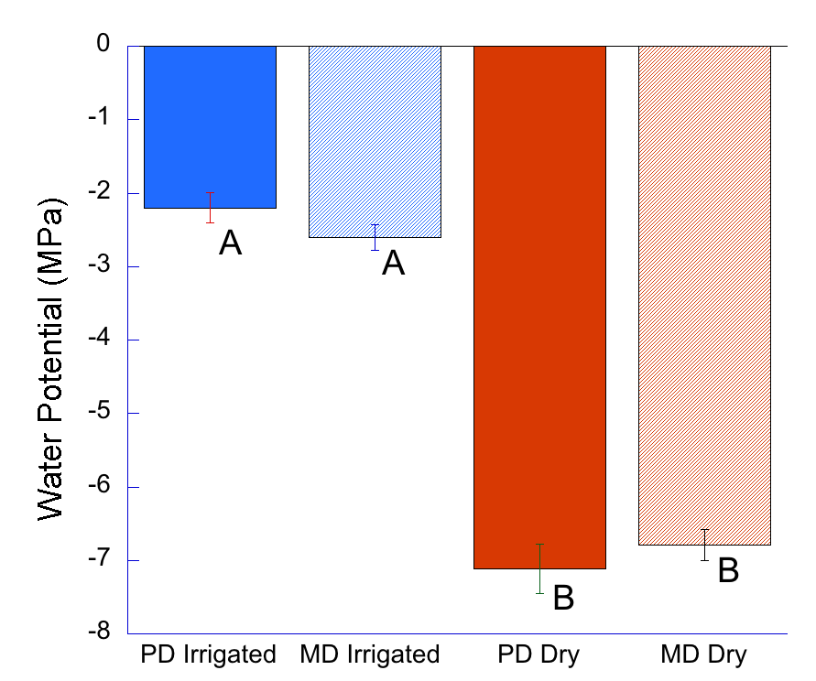
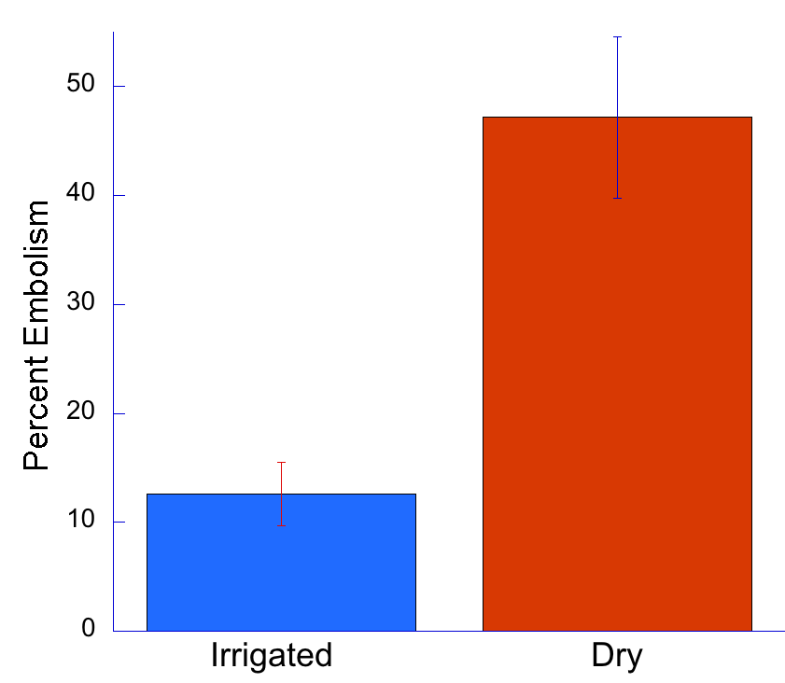
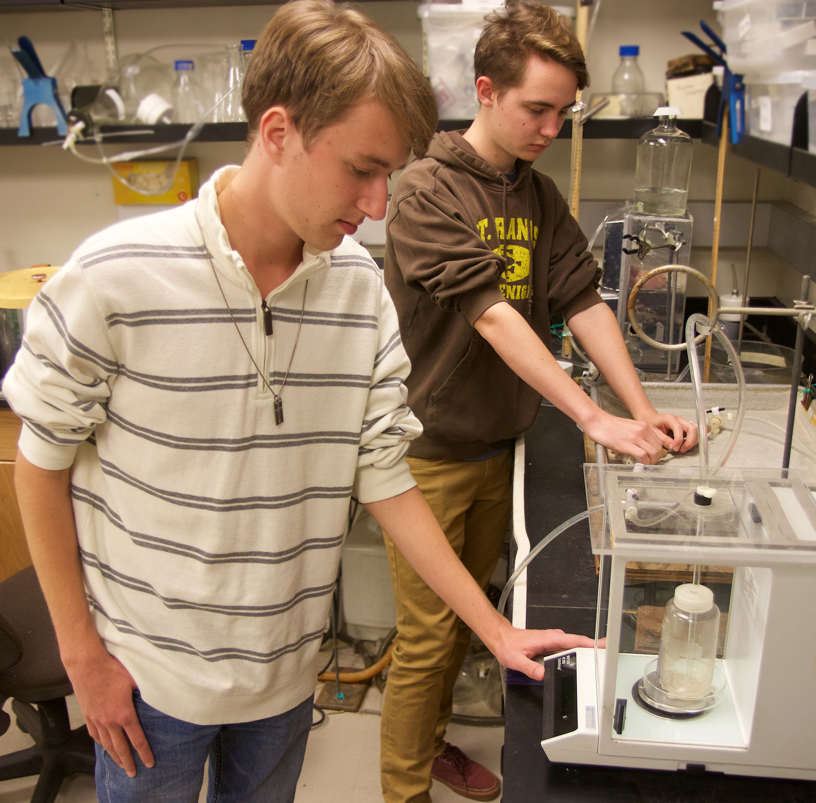
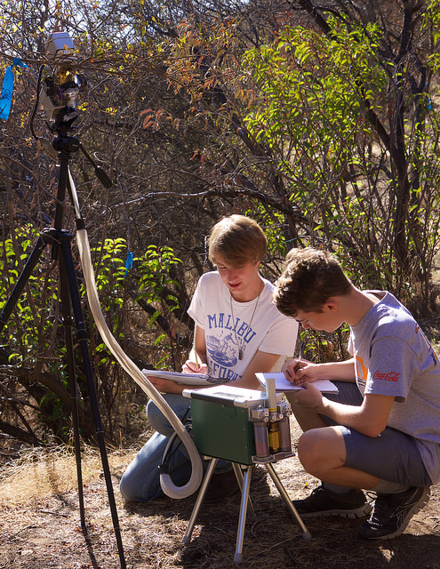
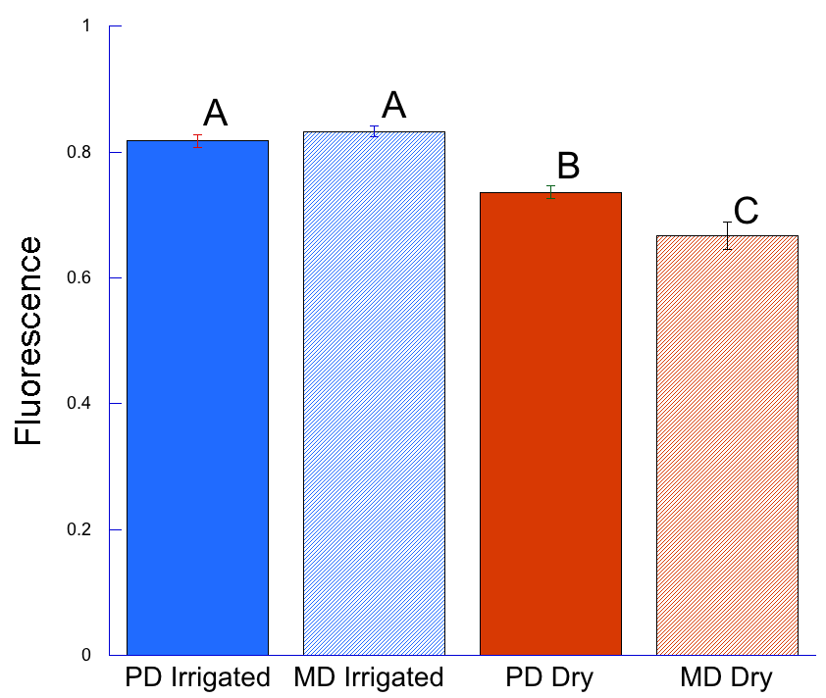
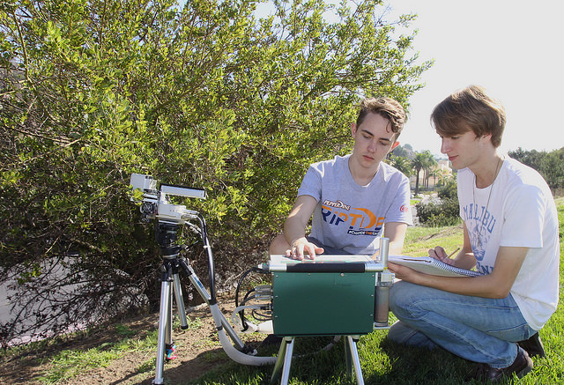
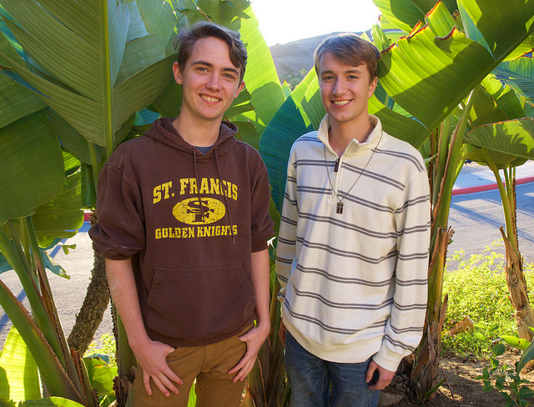
Plant Water Relations During Drought Induced Dieback of Greenbark Ceanothus, Ceanothus spinosus
Christopher F. Ross, Andrew J. Palaski, and Stephen D. Davis
Pepperdine University, Natural Science Division, 24255 Pacific Coast Highway, Malibu, CA, 90263
Abstract
Methods
Discussion
NSF#
This experiment investigated Ceanothus spinosus dieback by measuring and obtaining data for gas exchange rates, water potential, fluorescence, and percentage of xylem embolism for both an irrigated control sample, and a naturally occurring dehydrated sample. The water potentials for naturally occurring C. spinosus (with an average water potential of -6.593 MPa) was much lower than that of the irrigated control (with an average water potential of -3.4 MPa). showing water stress on the dehydrated C. spinosus. This water stress induced a high 47.17% xylem embolism within the dehydrated C. spinosus, as compared to the lower value of 12.6% embolism in irrigated C. spinosus. With this increase in xylem embolism and decrease in water potential seen in the dehydrated C. spinosus, came a decrease in fluorescence values and photosynthetic activity. This ultimately is leading to massive C. spinosus dieback within the Santa Monica Mountains.
In this experiment, we characterized the Ceanothus spinosus dieback through a variety of methods. We found two locations on Pepperdine campus, one irrigated and one non irrigated, that contained the plant species we looked to investigate. Two of our measurements, fluorescence (light absorption) and water potential (water content) were taken predawn and at midday. We took the fluorescence measurements with a chlorophylometer after dark adapting the leaves. Water potential was measured using a Scholander-Hammel Pressure chamber. Gas exchange data was taken at the sites of C. spinosus using an LI-6400XT Portable Photosynthesis System. This allowed us to measure, in the environment, photosynthesis, stomatal conductance, Ci (internal CO₂), VPDL, PSII (photosystem II), and electron transport rate. In order to measure hydraulic conductance, we cut a branch from each sample, brought it back to the lab, and cut the branch down, under water, to a 10 cm stem segment without offshoots. We next shaved a thin slice at the end to make sure we had a clean cut. We also removed bark from arounds the ends and connected it to a hydraulic conductance system, and used the Sperry Method to get the hydraulic conductance, of C. spinosus (Sperry et al. 1996). This hydraulic conductance gave us the water flow. We then performed the method a second time after vacuuming the stems, which allowed us to calculate the percent embolism. We did this for both the irrigated and dry plants.
The purpose of our experiment was to characterize C. spinosus dieback in the Santa Monica Mountains. Previous studies by Venturas et al. have shown that C. spinosus is dying at a higher rate than other chaparral species. To better understand this phenomenon, we performed a series of experiments to determine the water potential, fluorescence, gas exchange rates, and percentage of air emboli inside the xylem of the plants.
Water potential shows the potential energy of water within the plant; this effectively allows us to know the how dry each plant is. The further negative the water potential value is, the more dry the plant is. As expected, the dehydrated (natural) species that is facing California’s unprecedented drought had a significantly lower (more negative) water potential (Figure 1). The irrigated plants were not facing water stress as shown by their high (less negative) water potential (Figure 1.). To understand more about why dry plants appeared less healthy than irrigated ones, we seeked to understand what was happening physiologically in the plant. A major factor we looked at was water flow through the plant’s xylem. The process of water transport is being blocked through a concept known as an embolism. Similar to humans, if plants circulatory systems are blocked, the species survival is inhibited. The dry plants C. spinosus are believed to be embolized as a result of extreme water stress caused by the drought. When subject to water stress, air can be aspirated into functional vessels from other embolized vessels through pores via intervessel pit membranes (Sperry et al. 1988). On naturally occurring (dry) plants with very low water potential values, the percent embolism in plant stems was higher than expected with values of 60.42% embolism all the way up to 72.2% embolism, averaging out to be 47.17% embolism across all C. spinosus tested (Figure 2). There was a correlation between high embolism and low photosynthetic rates and fluorescence values (Figure 4) and slightly lower than healthy (0.8) fluorescence rates (Figure 3).
The high embolism in dry plants was not allowing enough water for the plant to carry out photosynthesis in the dieback species. We compared these values with the irrigated plants. Irrigated C. spinosus have very high water potentials, showing they are not water stressed. The plants with lower water stress were not aspirating embolisms at high rates as seen in dehydrated C. spinosus. Irrigated plants showed lower percentage embolism, ranging between 6.3% to 19.7% embolism, averaging out to 12.6% embolism. These plants with low percentage embolism also had very high photosynthetic and fluorescence rates (Figures 3, and 4). The photosynthetic rates were likely inhibited as a result of the embolism.
The cause of chaparral dieback is important information to understand because it can have massive implications, economically, environmentally, and also from a public health standpoint. Dead plants such as the ones caused by drought can be easily combustible and cause an increase in fire frequency. This is dangerous to local residents health, and also important to the Malibu economy as fire can destroy many homes and businesses. Chaparral growing on the Santa Monica mountains also help prevent mudslides. The roots hold the soil on the steep hills in place preventing erosion from damaging property, covering roads, or have other negative implications on the environment.
Introduction
There is an unprecedented drought currently affecting many of the plant species of the Santa Monica Mountains. One very prevalent dieback in the mountains is occurring in Greenbark Ceanothus, Ceanothus spinosus. Presented by Venturas et al., C. spinosus dies at a higher mortality rate than most other chaparral species. This experiment looks to analyze the plant water relations of C. spinosus by comparing the dieback of the plant with irrigated control plants. We look to test and analyze factors such as the water potential, gas exchange, light reactions, and water flow of the plants. These measurements will help
Results
characterize as to why the plant showing this dieback, and will explain how a predominant chaparral species is being affected by the drought. Knowing how the chaparral species is being affected reveals a valuable insight to how the drought is affecting the plant communities in California as a whole.
Conclusion
Figure 1. Predawn and midday water potentials of irrigated, healthy C. spinosus, and of dehydrated C. spinosus on the Pepperdine University campus. The two bars on the left are the water potentials of the irrigated control group of C. spinosus. The two bars on the right show the water potentials of the dehydrated C. spinosus in the Santa Monica Mountains. Irrigated and dry values were significantly different by a one-way ANOVA test with a Fisher’s LSD post-hoc test. The difference between predawn and midday water potentials were not determined significantly different. The letters “A” and “B” of the graph denote which values were considered significantly different. P < 0.0001 between predawn dry and predawn irrigated, predawn dry and midday irrigated, midday dry and midday irrigated, and midday dry and predawn irrigated. P = 0.2914 between midday and predawn irrigated plats and P = 0.3581 between midday and predawn dry plants.
Figure 2. Figure 2. Percent of air embolism within xylem of irrigated and dry C. spinosus on the Pepperdine University campus. The two data sets were determined significantly different by a student’s t-test, this is denoted with an asterisk on the graph. P = 0.0041.
Dry Ceanothus spinosus had lower water potential values (x̅ = -6.593 MPa), lower fluorescence rates (x̅ = 0.73), lower photosynthetic rates (x̅ = -0.21 μmol m⁻² s⁻¹), and a higher percentage of air embolism in the xylem (x̅ = 47.17%).
Irrigated (control) C. spinosus, had opposite values with a higher water potential (x̅ = -3.4 MPa), fluorescence (x̅ = 0.82), and photosynthetic rate (x̅ = 9.02 μmol m⁻² s⁻¹). It also had a lower percentage of air embolism (x̅ = 12.6%) within the xylem
The drought induced dieback of C. spinosus shows significant change in water potential, gas exchange, fluorescence, and water flow rate.
Drought caused dieback of chaparral species can cause negative effects to species diversity, erosion, and fire frequency. These things can cause public safety and economic damage.
Measuring Hydraulic Conductance
Study Site
Literature Cited
The locations of the C. spinosus plants that we used for this study are both on the Pepperdine University campus. Our first study area is on the hill leading down from the Drescher graduate campus towards the lacrosse field. This area contained naturally growing (without human irrigation) C. spinosus as well as other unirrigated plant species. This was our test
1. Venturas, M., MacKinnon, E., Dario, H., Jacobsen, A., Pratt, R. and Davis, S. (2016). Chaparral Shrub Hydraulic Traits, Size, and Life History Types Relate to Species Mortality during California’s Historic Drought of 2014. PLOS ONE, 11(7), p.e0159145.
2. Kolb, K., Sperry, J. and Lamont, B. (1996). A method for measuring xylem hydraulic conductance and embolism in entire root and shoot systems. Journal of Experimental Botany, 47(11), pp.1805-1810.
3.Sperry, J. and Tyree, M. (1988). Mechanism of Water Stress-Induced Xylem Embolism. PLANT PHYSIOLOGY, 88(3), pp.581-587.
group. Our control group for this study is found on the lawn along John Tyler Blvd. This group of plants was irrigated by the sprinkler system that Pepperdine University uses to maintain healthy grass on Pepperdine Campus.
Dieback Site
Acknowledgements
Figure 3 Predawn and midday chlorophyll fluorescence of irrigated and dehydrated C. spinosus. The irrigated and naturally occurring fluorescence values are significantly different from each other, after being subjected to a one-way ANOVA test with Fisher’s LSD post-hoc test. The significant difference is displayed by using the letters “A”, “B”, and “C”. The comparison between midday dry and midday irrigated and predawn irrigated and midday dry had P < 0.0001. P = 0.0019 between midday irrigated and predawn dry. P = 0.6086 between midday irrigated and predawn irrigated. P = 0.0064 between predawn irrigated and predawn dry, and finally P = 0.0141 between predawn and midday dry.
Figure 4. Average photosynthetic rates of irrigated and dry C. spinosus on the Pepperdine University campus. The photosynthetic rates of irrigated C. spinosus are greater than that of the naturally occurring plants. The two values have been determined significantly different by a student’s t-test using an asterisk to display this. P = 0.08103.
This research could not be made possible without the Students as Scholars program, and funding of the National Science Foundation. We would also like to give credit to our mentor Dr. Stephen Davis for his
support for our project, working early mornings and late nights to help us collect and analyze data. We would also like to thank our teaching mentors Katie Sauer and Natalie Aguirre for their helpful guidance throughout our research project.
Irrigated Control

