Slide 1
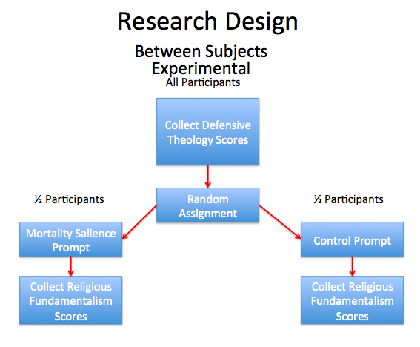
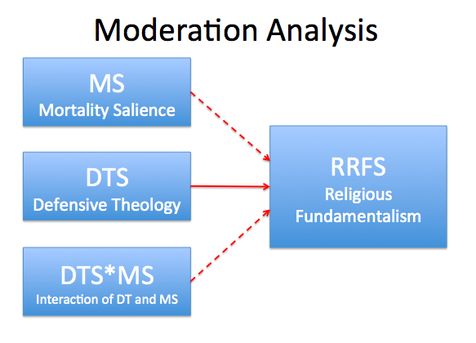
Seeking the Shield of Faith: The Influence of Defensive Theology on the Development of Religious Fundamentalism Following Mortality Salience
Brian Lammert, Cindy Miller-Perrin, Steven V. Rouse
Pepperdine University
ABSTRACT
METHOD
RESULTS
DISCUSSION
This study examined religious fundamentalism in a sample of 88 undergraduate students attending a private, Christian university. After completing a measure of defensive theology, participants were randomly assigned to either a mortality salience or control condition and then assessed using a religious fundamentalism measure. A moderation analysis was performed in order to test the hypothesis that defensive theology moderates the relationship between mortality salience and religious fundamentalism. Results indicated that only defensive theology significantly predicted post-manipulation fundamentalism (p<0.001). Neither the mortality salience condition (p=0.426) nor its interaction with defensive theology (p=0.619) significantly predicted religious fundamentalism. Findings suggest that defensive theology does not moderate the influence of mortality salience on religious fundamentalism, and further that the influence of certain mortality salience manipulations on religious fundamentalism may be limited.
Participants
Correlation Between RRFS and DTS Measures
Pearson Product-Moment correlations were calculated between scores on the DTS and RRFS measures, revealing a moderate statistically significant correlation, r(86) = .40, p<.01. A point-biserial correlation between the mortality salience condition and DTS and RF scores revealed a weak and nonsignificant correlation between the mortality salience condition assignment and DTS scores, r(86) = .20, p=.61, as well as mortality salience condition assignment and RFFS scores, r(86) = -.095, p=.38. All correlations are represented in Table 1.
This study sought to explore whether fundamentalist religious convictions develop following mortality salience as a function of an individual’s level of DT. It was hypothesized that high levels of DT would predispose participants to display stronger reactions to mortality salience, resulting in the development of stronger fundamentalist convictions relative to individuals with a less theologically defensive orientation.
Although DT appears to be significantly related to RF, it does not appear to moderate the relationship between the experience of mortality salience and RF.
RF does not appear to be significantly influenced by mortality salience.
Levels of religious fundamentalism may not be particularly malleable in this context
The mortality salience manipulation may not be very effective in eliciting existential anxiety in highly fundamentalist individuals
Perhaps RF successfully addresses the threat of mortality salience within the context of its worldview without needing to engage in worldview defense (Jonas & Fischer, 2006)
A cultural threat might assist in eliciting a worldview defense reaction in a highly fundamentalist population
Perhaps cultural threats could be addressed within the context of the fundamentalist worldview, thereby reducing worldview defense reactions through worldview accommodation (Harding et al., 2005)
Future directions:
Explore alternative MS manipulations in relation to RF
Consider quantifying level of interaction with the MS manipulation
Investigate worldview accommodation in relation to relief from existential anxiety
This study included 117 participants, 88 of whom met the inclusion criteria, 33 male and 55 female. Although participants from multiple faith backgrounds provided responses to the study, only results from participants self-identifying as Christian have been included in this report due to the limited validity of the DTS and RRFS for non-Christian participants. These participants were recruited from introductory psychology and statistics courses at a small Christian liberal arts university. The age range of participants was 18 to 21 years (M=18.71).
Materials
Religious fundamentalism. Altemeyer and Hunsberger’s (2004) revised 12-item Religious Fundamentalism Scale (RRFS) was used to measure religious fundamentalism. Participants responded to 12 items with scores ranging from 12 to 108, with a high score indicating strong fundamentalist tendencies. Internal consistency reliability for the current sample was strong (α=.88).
Defensive theology. The 22 items on Beck’s (2006) Defensive Theology Scale (DTS) were used to assess defensive theology. Scores range from 22 to 154, with high scores indicating strong feelings of God’s protection, solicitousness, and control over everyday life. Internal consistency reliability for the current sample was strong (α=.89).
Mortality salience (MS) manipulation. Participants in the mortality salience condition received writing prompts designed to elicit reflection on the subject of their own death. Participants in the control condition received neutral writing prompts. All writing prompts were drawn from existing research on TMT and DT (Beck, 2006).
INTRODUCTION
What are some of the reasons that cross-cultural and interfaith interaction might be prone to generate conflict?
Terror Management Theory (TMT)
Prejudicial attitudes are a form of worldview defense wherein foreign cultural symbols and ideas can serve as an implicit threat to the cultural or religious structures that an individual relies on to relieve anxiety (Schimel et al., 1999)
Individuals react to implicit threat through derogation of worldview-threatening others (McGregor et al., 1998)
Religious Fundamentalism (RF)
Predicts outgroup prejudice (Brandt & Van Tongeren, 2015)
Common characteristics associated with RF are very consistent with worldview defense reactions predicted by TMT (Altemeyer & Hunsberger, 2004)
Appears to effectively buffer against existential anxiety (McGregor et al., 1998)
Defensive Theology (DT)
Describes extent to which religious belief provides sense of comfort or protection
High DT in Christians predicts greater bias in those who are faced with cultural out-groups relative to a less defensive orientation (Beck, 2006)
Given the particular vulnerability of highly theologically defensive individuals to engage in worldview defense in response to a worldview-threatening other, it is likely that religious fundamentalism is in some way related to defensive theology. Therefore, this study sought to investigate the effect of mortality salience on religious fundamentalism as a function of one’s level of defensive theology. It was hypothesized that exposure to mortality salience will result in a greater increase in religious fundamentalism for individuals high in defensive theology. Such a relationship would provide insight into the link between defensive theology and religious fundamentalism.
Moderation Analysis
A moderation analysis was conducted in order to determine whether prediction of RRFS scores based on DTS scores and participation in either the Mortality Salience or Control group is improved by including the interaction of these two independent variables. DTS scores, mortality salience condition, and the interaction between DTS scores and mortality salience condition were found to be related to RRFS scores with statistical significance, r²_{Adj}=0.168, F(86)=6.873, p<.001. The β weight of mortality salience condition was found to be -0.478 (p=.426), the β weight of DTS scores was found to be 0.458 (p<.001), and the β weight of the variable representing the interaction between mortality salience condition and DTS scores was found to be 0.295 (p=.619). These results indicate that DTS scores aid in the prediction of post-manipulation RRFS scales with statistical significance, but neither the mortality salience condition nor the interaction of DTS scores with the mortality salience condition predict RRFS scores with statistical significance. There is no apparent moderating effect of DTS scores on the relationship between mortality salience condition and post-manipulation RRFS scores. Results are summarized in Table 2.
Procedure
Participants were provided with a packet containing the DTS, either the mortality salience condition prompts or the control condition prompts, and the RRFS. Packets containing either the mortality salience writing prompts or the control writing prompts were administered to participants at random, thus randomly assigning half of the participants to the experimental condition of mortality salience and half to the control condition of no mortality salience.
REFERENCES
Altemeyer, B., & Hunsberger, B. (2004). A revised religious fundamentalism scale: The short and sweet of it. The International Journal of Psychology of Religion, 14, 47-54. doi:10.1207/s15327582ijpr1401_4
Beck, R. (2006). Defensive versus existential religion: Is religious defensiveness predictive of worldview defense? Journal of Psychology and Theology, 34, 143-153.
Brandt, M. J., & Van Tongeren, D. R. (2015). People both high and low on religious fundamentalism are prejudiced toward dissimilar groups. Journal of Personality and Social Psychology. 47, 33-41.
Harding, S. R., Flannelly, K. J., Weaver, A. J., & Costa, K. G. (2005). The influence of religion on death anxiety and death acceptance. Mental Health, Religion & Culture, 8, 253-261.
Jonas, E., & Fischer, P. (2006). Terror management and religion: Evidence that intrinsic religiousness mitigates worldview defense following mortality salience. Journal of Personality and Social Psychology, 91, 553-567.
McGregor, H. A., Lieberman, J. D., Greenberg, J., Solomon, S., Arndt, J., Simon, L., & Pyszczynski, T. (1998). Terror management and aggression: Evidence that mortality salience motivates aggression against worldview-threatening others. Journal of Personality and Social Psychology, 74, 590-605.
Schimel, J., Simon, L., Greenberg, J., Pyszczynski, T., Solomon, S., Waxmonsky, J., & Arndt, J. (1999). Stereotypes and terror management: Evidence that mortality salience enhances stereotypic thinking and preferences. Journal of Personality and Social Psychology, 77, 905-926.
CONTACT
Please contact brian.lammert@pepperdine.edu for more information. A link to an online PDF version of the poster is available upon request.
Presented at the 2017 Conference of the Society for Personality and Social Psychology

