Slide 1
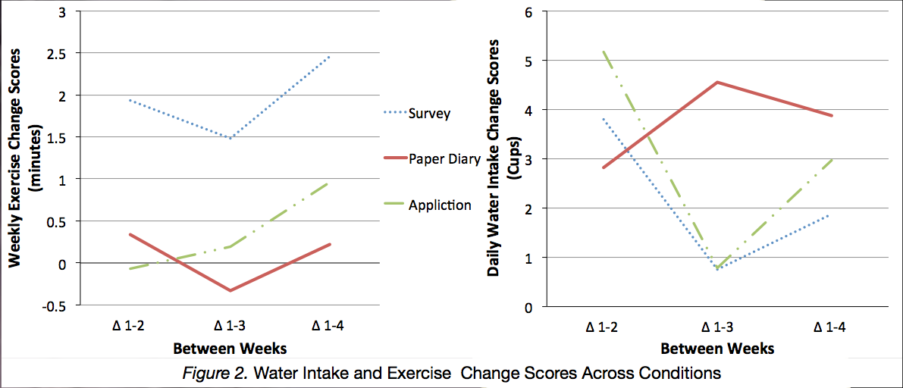
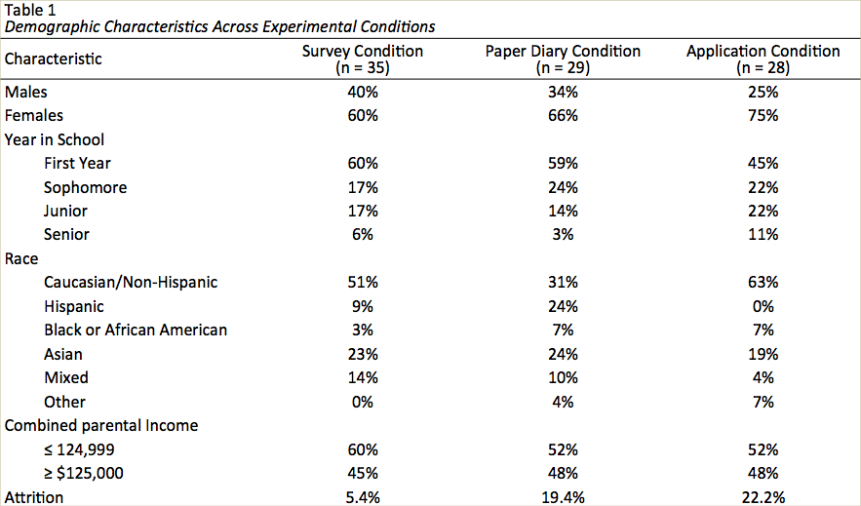
The Effect of Mobile Health Applications on Health Behaviors: A Pilot Study
Danielle Shilling, Cindy Miller-Perrin, and Elizabeth Mancuso
Pepperdine University, Malibu, CA
Abstract
The present research examined the effectiveness of mobile Health (mHealth) fitness and nutrition applications where effectiveness was defined as eliciting behavior changes towards national guidelines. This study hypothesized that an mHealth Application condition using the MyFitnessPal application would be more effective at altering water consumption and exercise behaviors when compared to a Survey condition and a Paper Diary condition. All 92 participants of this randomized control trial participated in one-week of baseline collection and three-weeks of intervention for a total of four weeks of data collection. Results indicated that there were no significant differences in behavior change scores across conditions. The results of this study suggest that the MyFitnessPal application is not effective at eliciting behavior changes and that further randomized control trials are still needed to explore fitness and nutrition application effectiveness.
Procedure
The design of this between-subjects study is summarized in Figure 1. All participants were instructed to utilize the assigned condition to alter two specific health behaviors towards recognized guidelines. The first guideline they were asked to meet was the 8 by 8 guideline or the consumption of 8, 8-ounce glasses of water daily (Mayo Foundation for Medical Education and Research, 2015). The second guideline they were asked to meet was the national standard that encourages at least 150 minutes of moderate physical activity per week. This study included pre-baseline and post-intervention surveys which were given to all participants. Data for any participant missing more than 3 days of tracking per week was excluded from those weeks’ respective analyses.
Introduction
Nutrition and fitness mHealth application research that is currently available consists of content analyses and, in particular, the study of applications’ content adherence to behavioral change theories, such as Social Cognitive Theory and the Transtheoretical Model (Azar et al., 2013; Conroy, Yang, & Maher, 2014; Cowan et al., 2012; West et al., 2012). The overwhelming conclusion of these studies assessing mHealth fitness and nutrition application content on the basis of behavior change theories is that mHealth applications alone may not be effective in changing fitness and nutrition health behaviors.
Two randomized control trials (RCTs) have attempted to address the question of whether fitness and nutrition applications are effective in altering users’ health behaviors and health statuses (Carter et al., 2013; Glynn et al., 2014). The first found applications to be feasible and effective at increasing weight loss, and the second found applications to be effective at increasing participants daily number of steps.
In an effort to examine the effectiveness of mHealth applications among populations other than those already studied, and in an effort to extend the reach of the two previous RCTs, the goal of this study was to assess the effectiveness of the MyFitnessPal application. The current study assessed intervention-facilitated behavior change on two health-oriented behaviors: water consumption and exercise. The hypothesis of this study was that the mHealth Application would be more effective in changing daily water intake and in increasing physical activity among participants than a Paper Diary and Survey condition.
All Participants:
1. Agreed to eligibility criteria and registered online
2. Took the Initial Survey (RAND-36 & demographics)
3. Completed 7 days of baseline data collection through the Monitoring Survey
4. Were then randomly assigned to a condition (Survey, Paper Diary, or mHealth Application)
5. Met with the researcher as condition groups to: go over the health guidelines they were being asked to meet and receive instructions on their respective intervention strategy.
Survey:
This condition was asked to continue the daily Monitoring Survey in order to meet the health guidelines.
Paper Diary: This condition was given the paper diary and asked to utilize this intervention to meet the health guidelines. A demonstration of how to log a day of data in the diary was given.
mHealth Application:
This condition was asked to utilize the MyFitnessPal application to meet the health guidelines. The researcher went through the downloading and set up process with all participants. Then a demonstration of how to log water and exercise data in the application each day was given.
Discussion
The current study hypothesized that the MyFitnessPal application would be more effective at changing health behaviors than both a paper diary and control condition.
The results of the current RCT, however, are inconclusive and do not strongly support this hypothesis.
The results actually indicate that the control condition elicited greater changes in behavior than either of the two experimental interventions.
The sample size of the study overall, however, was small and the largest attrition rates occurred among application users.
Strengths of this study, however, include the study as a U.S.-based RCT and assessment of multiple health behaviors, which is consistent with the design of fitness and nutrition applications.
Future RCTS with larger sample sizes are certainly needed in order to assess application effectiveness, in addition to further explorations regarding the factors that might contribute to application effectiveness.
After 3 weeks of intervention data collection, all participants took the final survey (RAND-36).
Figure 1. Study
Further Information
Please contact: Danielle.Shilling@pepperdine.edu
Method
Participants
Participants included 92 undergraduate students randomly assigned to each of the three experimental conditions. Of the 92 participants, 34% were male and 66% were female. The age range of participants was 18-27 (M = 19.01, SD = 1.47). Table 1 summarizes the demographic information of participants across experimental conditions.
Measures and Materials
MyFitnessPal Application. The mHealth application condition utilized the MyFitnessPal application. This application is a free smartphone application with a website extension that tracks diet and exercise.
Paper Diary. A hard copy of the paper diary was developed to allow participants to record health behaviors in a simple format which tracked a week’s worth of health behaviors including the number of 8-ounce cups of water consumed daily and daily minutes of exercise.
Monitoring Survey. The Monitoring Survey was sent daily to all participants during the first week of the study in order to collect baseline data, and the Monitoring Survey was sent daily to the Survey condition participants as their intervention for the last 3 weeks of the study. The survey was sent through participants email, and each daily survey was active for 24 hours. The Monitoring Survey asked participants two questions: how many cups of water have you consumed today and how many minutes of moderate physical activity have you participated in today.
RAND 36-Item Short Form Health Survey. An edited version of the Research and Development (RAND) Short Form Health Survey (RAND-36) was included to assess participants’ self-reported health. Items included yes or no response options as well as various Likert responses (i.e., How much bodily pain have you had during the past 3 weeks?) Higher RAND-36 scores are indicative of better health.
Results
Sample and Condition Changes Towards Guidelines
T-tests were conducted to assess whether the sample as a whole changed their water consumption and exercise behaviors towards the guideline given. Among all three conditions collectively, the average daily water consumption of week 1 was notably though not significantly less than week 2, t(91) = -1.843, p = 0.069, the average daily water consumption of week 1 was significantly less than week 4, t(91) = -2.117, p = 0.037, and the total minutes of exercise executed during week 1 was significantly less than week 2, t(91) = -2.123, p = 0.036.
Comparing Change Scores Across Conditions
To assess changes in average daily water consumption, weekly minutes of exercise, RAND-36 General Health subscale scores, and BMI across experimental groups, four repeated measures ANOVAs were conducted. Change scores were calculated between week 1 and 2, week 1 and 3, and week 1 and 4. These change scores were compared across groups for average daily water consumption, weekly minutes of exercise (see Figure 2), and pre-baseline scores compared to post-intervention scores for General Health and BMI scores. There were no significant differences between the conditions on: the amount of change in average daily water consumption, F(2.72, 89) = 1.141, p = 0.322, change in minutes of weekly exercise, F(3.84,89) = 0.440, p = 0.150, or BMI change, F(2, 86) = 0.033, p = 0.967. There was, however, a significant difference in RAND-36 General Health change scores, specifically between the Survey condition and the Paper Diary condition, F(2, 89) = 3.750, p = 0.027. The Survey condition experienced an average increase of 5.13 points while the Paper Diary condition experienced an average decrease of 5.87 points.
References
Azar, K. M. J., Lesser, L. I., Laing, B. Y., Stephens, J., Aurora, M. S., Burke, L. E., & Palaniappan, L. P. (2013). Mobile applications for weight management. American Journal of Preventive Medicine, 45(5), 583–589. http://doi.org/10.1016/j.amepre.2013.07.005
Carter, M. C., Burley, V. J., Nykjaer, C., & Cade, J. E. (2013). Adherence to a smartphone application for weight loss compared to website and paper diary: pilot randomized controlled trial. Journal of Medical Internet Research, 15(4). Retrieved from http://www.ncbi.nlm.nih.gov/pmc/articles/PMC3636323/
Conroy, D. E., Yang, C.-H., & Maher, J. P. (2014). Behavior change techniques in top-ranked mobile apps for physical activity. American Journal of Preventive Medicine, 46(6), 649–652. http://doi.org/10.1016/j.amepre.2014.01.010
Cowan, L. T., Van Wagenen, S. A., Brown, B. A., Hedin, R. J., Seino-Stephan, Y., Hall, P. C., & West, J. H. (2012). Apps of steel: Are exercise apps providing consumers with realistic expectations? A content analysis of exercise apps for presence of behavior change theory. Health Education & Behavior. Retrieved from http://heb.sagepub.com/content/early/2012/09/17/1090198112452126.abstract
Glynn, L. G., Hayes, P. S., Casey, M., Glynn, F., Alvarez-Iglesias, A., Newell, J., … Murphy, A. W. (2014). Effectiveness of a smartphone-based intervention to promote physical activity in primary care: the SMART MOVE randomised control trial. Trials, 64(624), e384–391.
Hays, R. D., Sherbourne, C. D., & Mazel, R. M. (1993). The rand 36-item health survey 1.0. Health Economics, (2), 217–227.
Mayo Foundation for Medical Education and Research. (2015). Healthy Lifestyle. Retrieved April 14, 2015, from http://www.mayoclinic.org/healthy-lifestyle/nutrition-and-healthy-eating/in-depth/water/art-20044256

