Slide 1
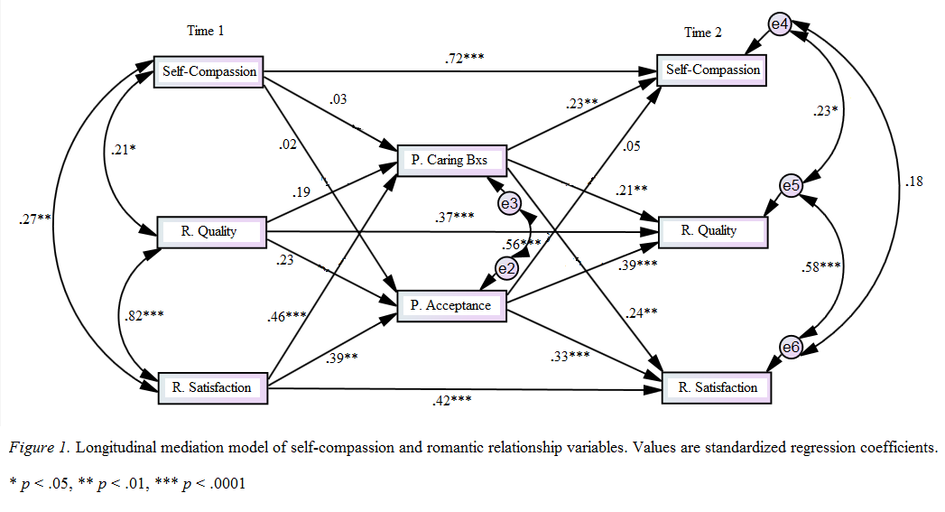
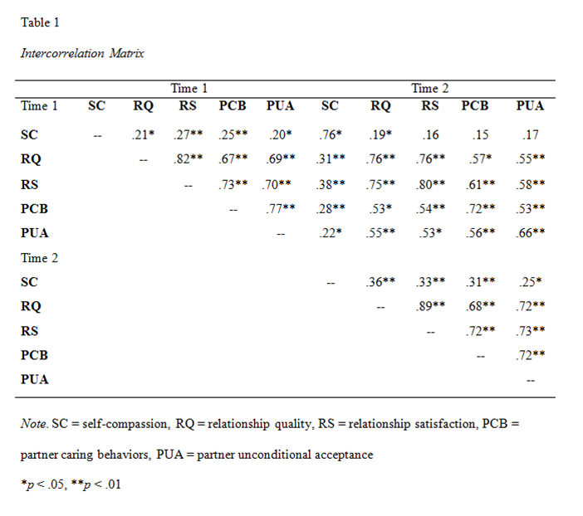
The Reciprocal Relations Between Self-Compassion and Romantic Relationship Variables
Sarah Zhang, Khanh Bui, Elizabeth Mancuso, and Cindy Miller-Perrin
Pepperdine University, Malibu, California
Abstract
This study examined the reciprocal relations between self-compassion and romantic relationship variables longitudinally. Participants included a community sample of 107 U.S. adults (46% female, 54% male, M_{age} = 34.53 years) who were in the same romantic relationship at both data-collection points. Cross-sectional correlational analyses demonstrated that at both time-points, self-compassion was positively associated with both relationship quality and satisfaction. Structural equation modeling was used to test a longitudinal mediation model, which represented a good fit to the data (χ² = 28.49, df = 13, χ²/df = 2.19, p = .008; GFI = .95; CFI = .98; NFI = .96). Path analysis results suggested that romantic relationships, through increasing partner affirmation, facilitate growth in self-compassion beyond temporal stability; however, self-compassion was not found to contribute to greater partner affirmation over time.
Measures
All study variables were measured using standardized assessments rated on Likert-scales. Self-compassion was assessed using the 26-item Self-Compassion Scale. Relationship outcomes were assessed using measures of relationship quality (6-item short form of the Perceived Relationship Quality Components Inventory) and relationship satisfaction (7-item Relationship Assessment Scale). Partner affirmation was assessed using measures of partner caring behaviors (24-item Intimate Bond Measure) and partner unconditional acceptance (8-item Reflected Appraisals Scale).
Analytic Strategy
In order to test the study hypotheses, a preliminary longitudinal mediation model of self-compassion and relationship variables was developed and tested using structural equation modeling (SEM). We used SEM in order to determine the presence and strength of cross-lagged mediation effects (i.e., mediation effects across time) beyond temporal stability.
Introduction
In romantic relationships, individuals often engage in meaningful, intimate interactions with their partners that may have the potential to influence self-change. For instance, the Michelangelo phenomenon theory of interpersonal change postulates that partner affirmation shapes individuals to increasingly resemble their ideal selves (Rusbult, Finkel, & Kumashiro, 2009). Self-compassion—an accepting and interdependent way of relating to oneself when facing difficulty—is one aspect of the self that may respond to relational influences (Neff, 2003). Because self-compassion has been tied to numerous benefits, including reduced psychopathology and greater life satisfaction, it is important to explore the ways in which relational variables may interact with self-compassion within romantic relationships (Benedict-Montgomery, 2014; Macbeth & Gumley, 2012).
However, relatively few studies have examined self-compassion within a relational context, and the ones that have are primarily correlational (Neff & Beretvas, 2013). This study examined the reciprocal relations between self-compassion and romantic relationship variables longitudinally. Based on relevant theories, the limited previous research on self-compassion in relational contexts, and logical reasoning, we hypothesized that:
1. Cross-sectionally, self-compassion would be associated with positive
relationship outcomes.
2. Self-compassion, through increasing partner affirmation, would
contribute to growth in relationship quality and satisfaction over time.
3. Romantic relationships, through encouraging greater partner
affirmation, would facilitate growth in individual self-compassion over time.
Results
The intercorrelation matrix, which includes the correlations among all study variables at both time-points, is presented in Table 1. Time 1 (T1) values of variables were highly correlated with their respective Time 2 (T2) levels, emphasizing the importance of controlling for autoregressive effects in the subsequent model. In addition, cross-sectionally partner affirmation variables were highly intercorrelated and relationship outcomes variables were highly intercorrelated, futher justifying the correlations between variables and/or their residual variances specified in the model. The cross-sectional correlational analyses demonstrated that at both time-points, self-compassion was significantly positively associated with relationship quality (r₁ = .21, p = .03; r₂ = .36, p = .0001) and relationship satisfaction (r₁ = .27, p = .005; r₂ = .33, p = .001).
Conclusions
In support of our first hypothesis and consistent with prior research, self-compassion was significantly positively associated with both relationship satisfaction and quality at both time-points. Because the pathways from self-compassion to partner affirmation were insignificant, our second hypothesis was not supported. Further research could examine other variables that may better explain how self-compassion contributes to relational well-being longitudinally. In support of our third hypothesis, the path analysis results suggested that romantic relationships, through increasing partner caring behaviors, facilitated growth in self-compassion over time, beyond temporal stability.
This finding offers additional support for the Michelangelo phenomenon and expands prior research by demonstrating that self-compassion may be another aspect of the self that responds to relational factors. From an applied standpoint, these findings can be employed to enhance individual and relational well-being. For instance, by utilizing existing relationships as a vehicle for self-change, clinicians may be better able to increase self-compassion—and subsequent psychological benefits—as well as relational health (e.g., by encouraging greater partner affirmation). However, given the preliminary nature of our model, further research is needed to examine these relationships as well as those not well explained by our model.
References
Benedict-Montgomery, M. M. (2014). Our spirits, ourselves: The relationships between
spiritual intelligence, self-compassion, and life satisfaction. Dissertation Abstracts
International, 75, 103-112.
MacBeth, A., & Gumley, A. (2012). Exploring compassion: A meta-analysis of the association
between self-compassion and psychopathology. Clinical Psychology, 32(6), 545-552.
Neff, K. D. (2003). Self-compassion: An alternative conceptualization of a healthy attitude
toward oneself. Self & Identity, 2(2), 85.
Neff, K. D., & Beretvas, S. (2013). The role of self-compassion in romantic relationships. Self
& Identity, 12(1), 78-98.
Rusbult, C. E., Finkel, E. J., & Kumashiro, M. (2009). The Michelangelo phenomenon.
Current Directions in Psychological Science (Wiley-Blackwell), 18(6), 305-309.
Method
Participants
Paricipants consisted of a community sample of U.S. adults, all of whom were in the same romantic relationship throughout the study. The final sample included 107 participants (49 females and 58 males, M_{age} = 34.53 years), after 92 of the original 199 participants dropped out before the second survey administration. At the second survey administration, participants had an average relationship length of 94 months, with 49% of participants being married, 41% dating, 5% cohabitating, and 6% engaged.
Procedure
Participants were recruited through Mechanical Turk (MTurk), an online recruitment website that provides access to a large and diverse participant pool. Participants initially completed an online, self-report survey that assessed self-compassion, relationship outcomes, and perceived partner affirmation. After approximately three months, participants who completed the initial survey were invited to complete a second, identical survey only if they were still in the same romantic relationship.
The longitudinal mediation model of self-compassion and romantic relationship variables is shown in Figure 1; included are the specified cross-sectional correlations, the autoregressive paths, the cross-lagged mediation paths, and their respective standardized regression coefficients (βs). Model fit indexes suggested that the model represented a good fit to the data (χ² = 28.49, df = 13, χ²/df = 2.19, p = .008; GFI = .95; CFI = .98; NFI = .96). Path analysis results demonstrated that relationship satisfaction at T1 significantly predicted partner caring behaviors, which significantly predicted self-compassion at T2 beyond auto-regressive effects. However, self-compassion was not found to significantly increase partner affirmation over time.
For further information
If you would like to receive additional information about this study, please contact Sarah Zhang at sarahz94@yahoo.com.
Notes:
- Edited 11/18 based on Dr. Perrin + class’ feedback

