Slide 1
Water Poverty in California’s Rural disadvantaged Communities
By Alyssa Galik
Political Science Honors Program
Pepperdine University

Slide 2
“Water flows uphill towards money.”
History that favored irrigation and powerful interests above universal domestic production (Jepson & Brown 2013)
Nearly 1 million CA lack daily access to clean drinking water (Francis & Firestone 2011)
AB 683: CA declares water a human right in 2013

Slide 3
Overview
Background of case study
Literature Review
Research Design
Findings
Policy Implications

Slide 4
Research Question
How does community integration affect water poverty in disadvantaged communities in California?

Slide 5
Why the San Joaquin Valley?
Majority of contamination violations in CA (Francis & Firestone 2011)
One of the poorest regions in US (Cowan 2005)
Fastest growing region in CA (Serrano 2010)
Most agriculturally productive area in US (Serrano 2010)

Slide 6
A brief history of SJV communities
Formed from Dust Bowl migrants
Westlands Water district
Municipal underbounding (Aiken 1987)
1 in 4 residents of SJV live in
Rural, unincorporated communities
Underserved (Rubin 2007)

Slide 7
Literature Review
Water Poverty Index (WPI) (Molle & Molinga 2003, Sullivan & Meigh 2007).
Human right to water (Flores, Jimenez, Perez-Foguet 2013)
Community participation in development
Water Poverty in U.S. Colonias
Texas’ Economic Distressed Areas Program (1989)
Cranston-Gonzalez National Affordable Housing Act (1990)

Slide 8
Research Design
Theoretical exploration of case studies (George & Bennett 2005, Lijphart 1971)
“structured, focused comparison of cases” (George & Bennett 2005)
“Provide some leverage for policymakers… to influence outcomes.” (George & Bennett 1971)

Slide 9
Case Selection
Survey of about 20 questions
80 participants (75 residents, 5 non-profit leaders)
5 communities in western Fresno County

Slide 10
Water Poverty Index for California
Availability
Physical Accessibility
Affordability
Quality
Infrastructure

Slide 11
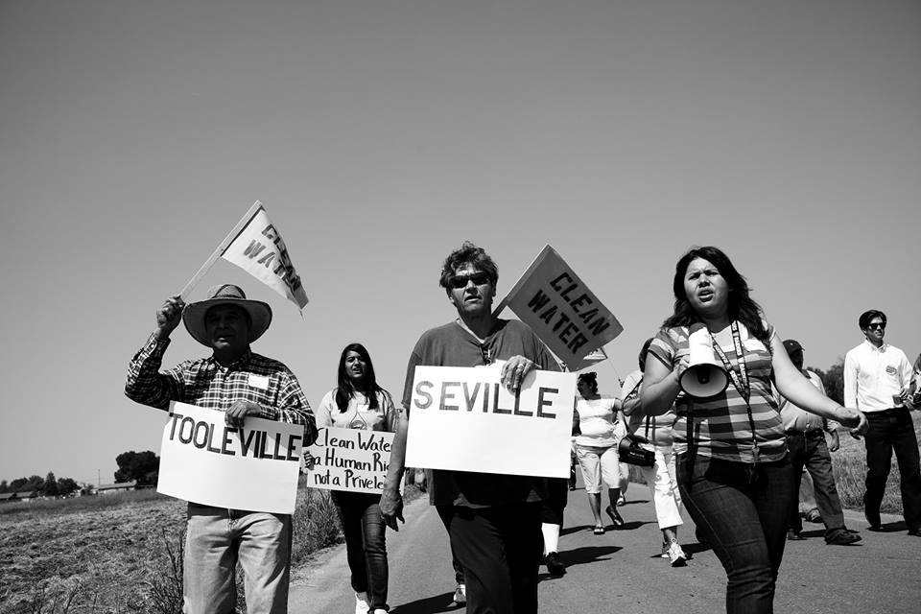
Explanatory Factors for WPI
Public funding (Carter and Ortolano 2004, Korc and Ford 2013)
Horizontal integration (Ward 1999)
Vertical integration (Ward 1999)
Access to information (Flores, Jimenez, and Perez-Foguet 2013)
(CWC 2015)

Slide 12
Findings for WPI
Affordability
3 of 5 communities were over 3 times limit of 2 percent
Price of surface water had tripled due to drought

Slide 13
Findings for WPI
Quality
Surface water (CA Aqueduct)
Westlands Water sells untreated water to Fresno County
Contaminated with Disinfect Byproducts (Trihalomethanes)
Groundwater
Raisin City: new well provided clean water to most people
Lanare: Arsenic

Slide 14
Summary of WPI Findings

Slide 15
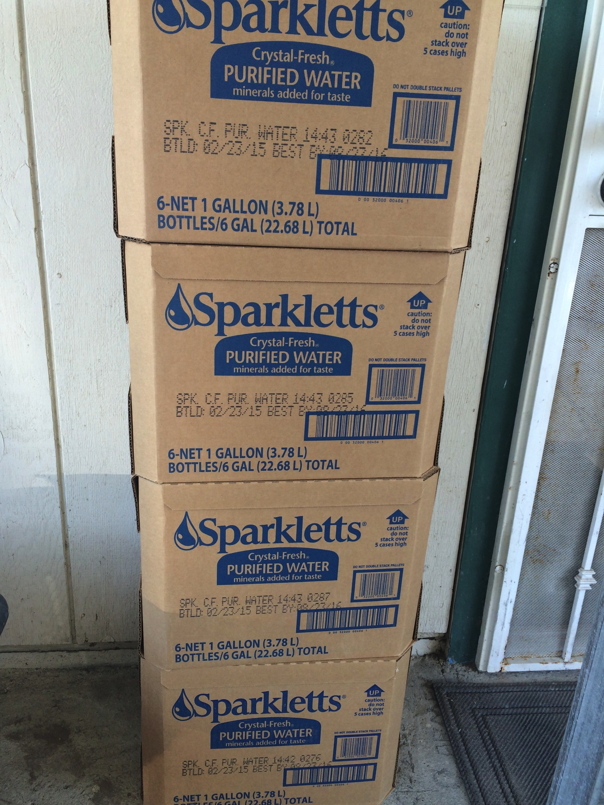
Lanare
Low WPI, High community integration
Free water deliveries and grants
Community Groups
Interaction with non-profits, state, water board
Residents knowledgeable about water

Slide 16
Cantua Creek and Three Rocks
2. High WPI, emerging community integration
Public funding (tentative)
Inter-community collaboration
County & non-profit interaction
Westlands Water Board
Community information was provided in Spanish

Slide 19
Summary of Explanatory Variables

Slide 20
Policy Implications
Need long-term solutions
Implementation of water bonds
Office of Sustainable Water Solutions
Information provided completely in language of community

Slide 21
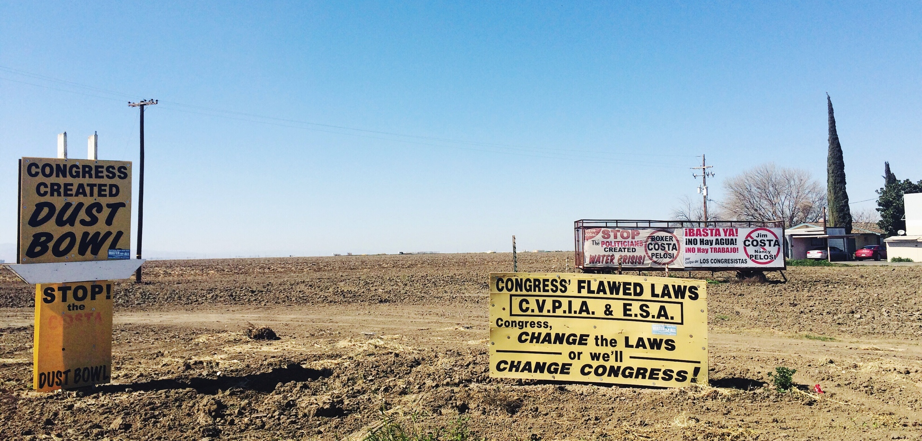
Conclusion
How is our water use affecting the most disadvantaged in California?

