Slide 1



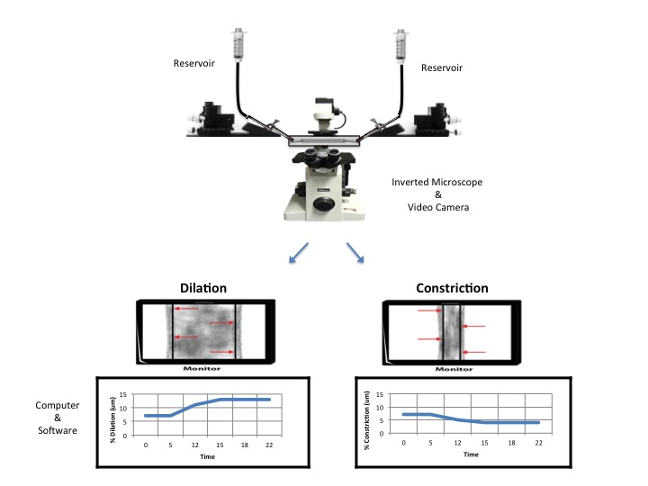

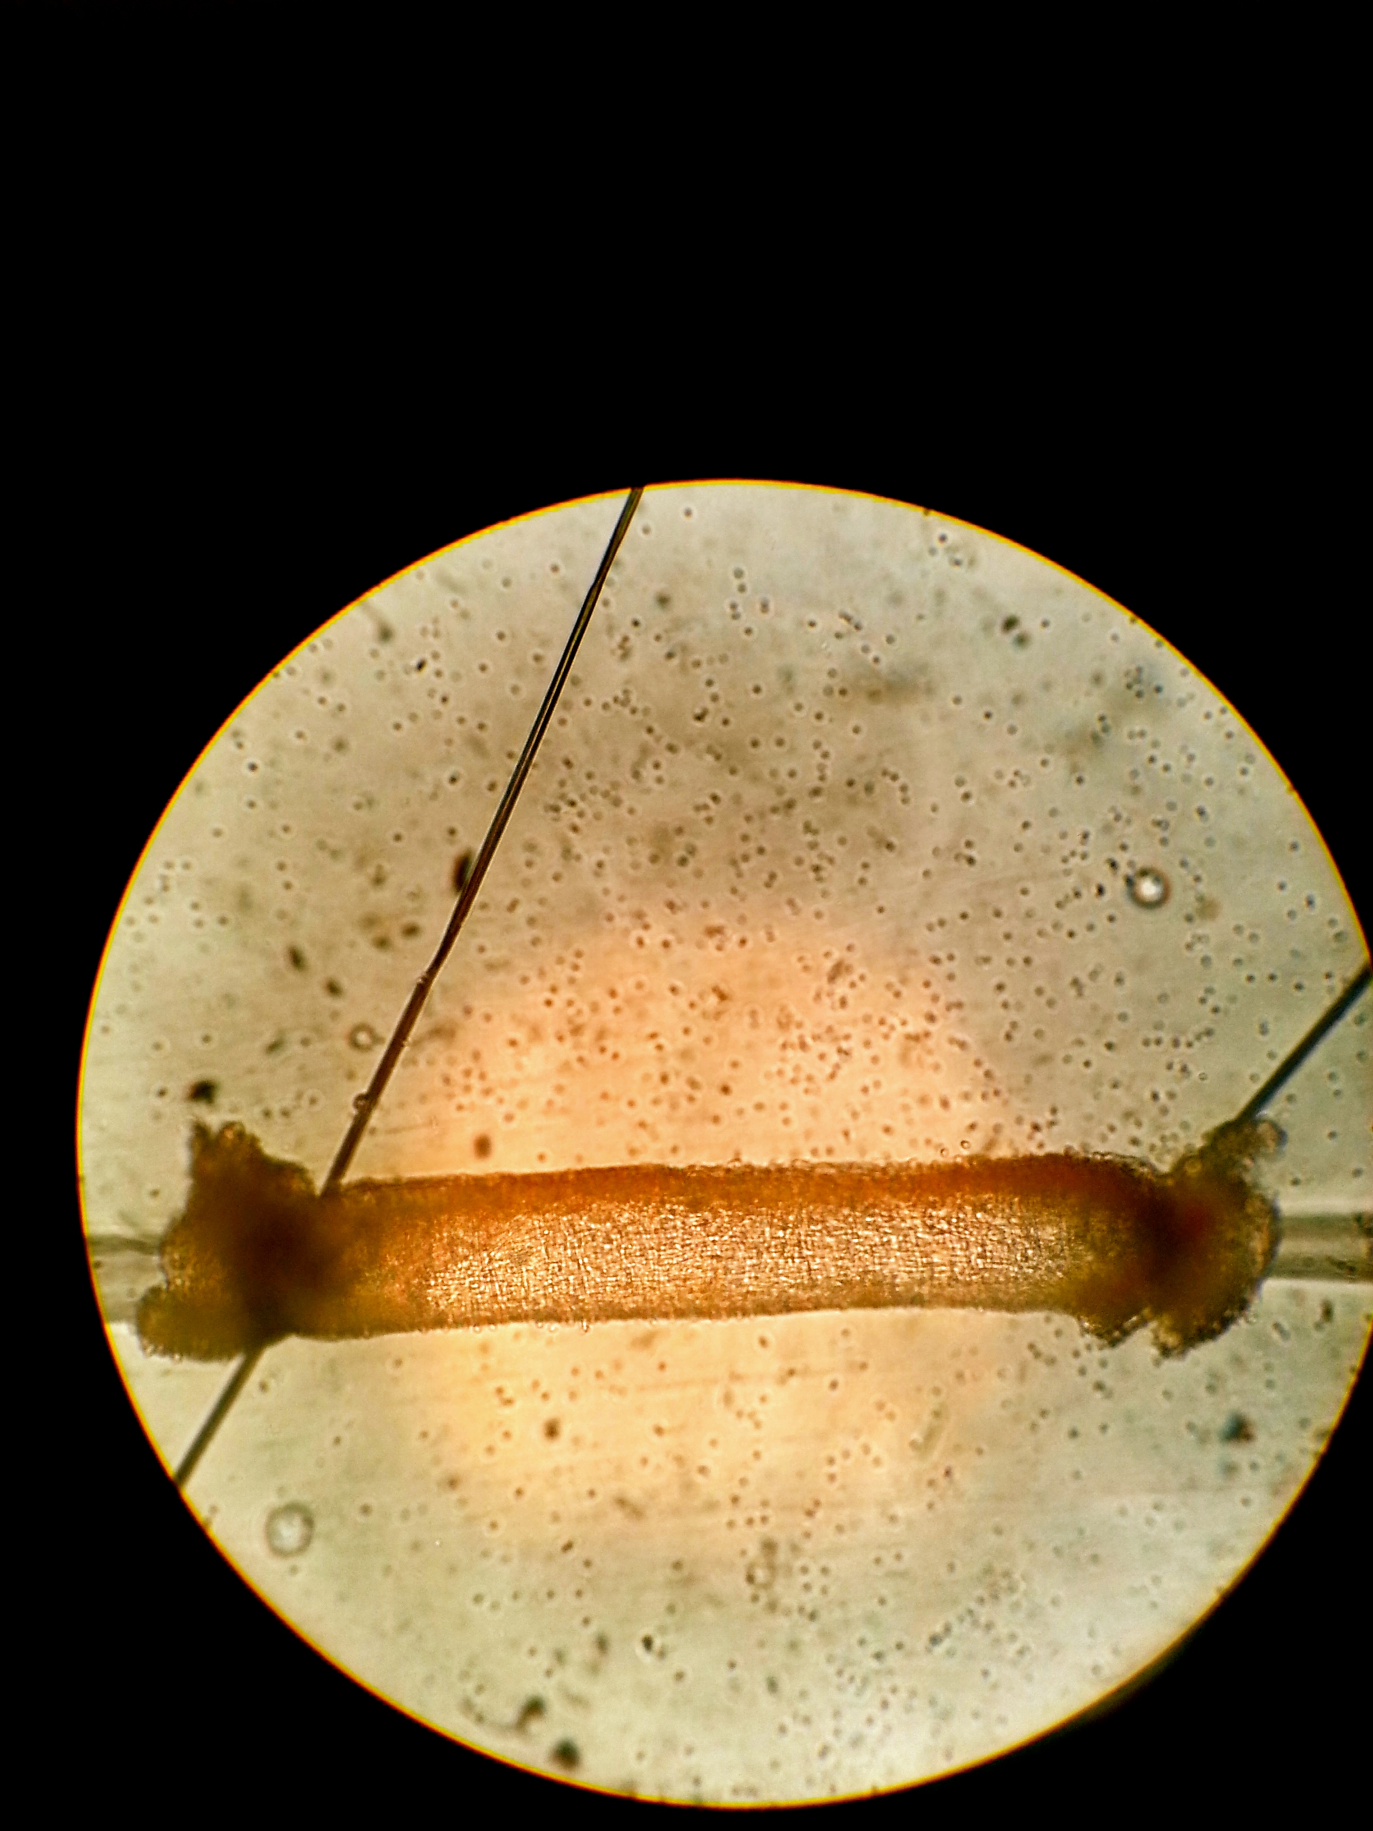
Flow-induced dilation of skeletal muscle feed arteries: relevance to exercise hyperemia
Brittni N. Moore and Jeffrey L. Jasperse
Pepperdine University, Malibu, CA
Introduction
Results
Conclusion
During exercise, an increase in blood flow to working skeletal muscle is accomplished by dilation of arteries and arterioles supplying the muscle. Arterioles, located within contracting muscle, are exposed to dilatory metabolites released by the muscle; however, the mechanism by which feed arteries, located external to the muscle, dilate is still unknown.
One potential mechanism for feed artery dilation is flow-induced dilation, occurring when arteries dilate in response to increased vascular wall shear stress. Shear stress is the frictional force between blood and the arterial wall, which increases when blood flow velocity increases. Data from previous in vitro experiments (8) indicate that flow-induced dilation in rat soleus feed arteries occurs at blood flow levels that are far less than normal resting blood flow in conscious rats. This data led to the conclusion that flow-induced dilation was not a plausible mechanism to explain the increase in blood flow during exercise.
Furthermore, the soleus muscle is primarily composed of slow-oxidative fibers and used in maintaining posture; thus, it receives a substantial amount of blood flow at rest. We sought to test whether flow-induced dilation could contribute to exercise hyperemia in rat extensor digitorum longus muscle, primarily composed of fast-glycolytic fibers, and rat gastrocnemius, a muscle of mixed fiber type (4). The differences in fiber type of each muscle may be a factor in how the feed arteries dilate during exercise.
The purpose of this study was to determine if flow-induced dilation potentially contributes to exercise hyperemia in rat extensor digitorum longus and gastrocnemius muscle feed arteries, EDLFA and GFA, respectively. In this study, blood flow was induced through the arteries and corresponding flow measurements (µl/min) were collected. The flow values were used to calculate intraluminal wall shear stress in the arteries and then compared to calculated in vivo shear stress values from previously published studies (1,2,3,7,10,11,12,13,14,15). We hypothesized that flow-induced dilation in GFA and EDLFA occurs at shear stress values lower than the shear stress normally present in non-exercising rats. This would preclude flow-induced dilation from causing the dilation of feed arteries to gastrocnemius and EDL muscles in exercise.
Extensor digitorum longus feed arteries
Flow-induced dilation does not contribute significantly to exercise hyperemia. Although the shear stress values from our in vitro experiments were in the same range as shear stress values observed at various activity levels in vivo (2,3,7,12,13,15), feed arteries did not dilate significantly to increasing flow.
Gastrocnemius feed arteries
Flow-induced dilation does not contribute to exercise hyperemia. Shear stress values to which GFA dilated were much lower than shear stress values observed in vivo (1,2,3,7,10,12,14,15) in resting or exercising rats.
These data support our hypothesis that flow-induced dilation in EDLFA and GFA does not to contribute to exercise hyperemia.
Figure 4: EDLFA had little dilation to flow. Maximal feed artery diameter was 142.4 ± 1.0 µm. Maximal flow-induced dilation occurred at a flow 41 µl/min and a diameter of 106 µm.
Figure 5: GFA dilated to higher levels of flow. Maximal feed artery diameter was 274.0 ± 1.7 µm. Maximal flow-induced dilation occurred at a flow of 127 µl/min and a diameter of 226 µm.
References
Armstrong RB, Hayes DA, Delp MD. Blood flow distribution in rat muscles during preexercise anticipatory response. J Appl Physiol. 67: 1855–1861, 1989.
Armstrong RB, Laughlin MH. Blood flows within and among rat muscles as a function of time during high speed treadmill exercise. J Physiol. 344: 189–208, 1983.
Armstrong RB, Laughlin MH. Exercise blood flow patterns within and among rat muscles after training. Am J Physiol Heart Circ Physiol. 246:H59–H68, 1984.
Armstrong RB, Phelps RO. Muscle fiber type composition of the rat hindlimb. Am J Anat. 171: 259–272
Clifford PS, Kluess HA, Hamann JJ, Buckwalter JB, Jasperse JL. Mechanical compression elicits vasodilatation in rat skeletal muscle feed arteries. J Physiol. 572: 561–567, 2006.
Clifford PS, Madden JA, Hamann JJ, Buckwalter JB, Valic Z. Absence of flow-mediated vasodilation in the rabbit femoral artery. Physiol Res. 2010;59:331–338.
Copp SW, Holdsworth CT, Ferguson SK, Hirai DM, Poole DC, Musch TI. Muscle fibre-type dependence of neuronal nitric oxide synthase-mediated vascular control in the rat during high speed treadmill running. J Physiol. 591: 2885–2896, 2013.
Jasperse JL, Laughlin MH. Flow-induced dilation of rat soleus feed arteries. Am J Physiol 273: H2423-H2427, 1997.
Kuo L, Davis MJ, Chilian WM. Endothelium- dependent, flow-induced dilation of isolated coronary arterioles. Am J. Physiol. 259: H1063-H1070, 1990.
Laughlin MH, Armstrong RB. Rat muscle blood flows as a function of time during prolonged slow treadmill exercise. Am J Physiol Heart Circ Physiol. 244: H814–H824, 1983.
Laughlin MH, Armstrong RB, White J, Rouk K. A method for using microspheres to measure muscle blood flow in exercising rats. J Appl Physiol. 52: 1629–1635, 1982.
Laughlin MH, Korthuis RJ, Sexton WL, Armstrong RB. Regional muscle blood flow capacity and exercise hyperemia in high-intensity trained rats. J Appl Physiol. 64:2420–2427, 1998.
Milkiewicz M, Brown MD, Egginton S, Hudlicka O. Association between shear stress, angiogenesis, and VEGF in skeletal muscles in vivo. Microcirc. 8:229–241, 2001.
Musch T. I., Terrell J. A., Hilty M. R.. Effects of high-intensity sprint training on skeletal muscle blood flow in rats. J. Appl. Physiol. 71, 1387–1395, 1991.
Peterson DF, Armstrong RB & Laughlin MH. Sympathetic neural influences on muscle blood flow in rats during submaximal exercise. J Appl Physiol. 65, 434–440, 1998.
Saito Y, Eraslan A, Lockard V, Hester RL. Role of venular endothelium in control of arteriolar diameter during functional hyperemia. Am J Physiol. 267(3 Pt 2):H1227–31, 1994.
Segal SS, Duling BR. Flow control among microvessels coordinated by intercellular conduction. Science 234:868–870, 1986.
Figure 6: EDLFA maximal flow-induced dilation occurred at a shear stress value of 63 dynes/cm².
Figure 7: GFA maximal flow-induced dilation occurred at a shear stress value of 16.5 dynes/cm².
Methods
Rat EDLFA and GFA were isolated and cannulated on two glass micropipettes. Internal diameter of the feed artery was measured using an inverted microscope and video camera (Figure 1).
After cannulation, feed arteries were bathed in warm physiological saline solution (WPSS) at 37℃ and pH of 7.4. WPSS with albumin (WPSSA), closely resembling blood plasma, was used inside the artery.
EDLFA had a maximum diameter of 142.4 ± 1.0 µm and developed spontaneous tone of 33.4 ± 0.7%. (N=13)
GFA had a maximum diameter of 274.0 ± 1.7 µm and developed spontaneous tone of 35.7 ± 0.8%. (N= 16)
Each feed artery was allowed to develop spontaneous tone (a minimum of 20%) during the equilibration period. Once tone was established, flow was induced by elevating one reservoir while lowering the other an equal distance (see Figure 1). This induces flow through the vessel without changing intraluminal arterial pressure (9).The arteries were allowed approximately 3 minutes at each flow step. Corresponding flow (µl/min) and internal diameter were measured. Shear stress values were calculated using the equation:
Ƭ= 4ŋQ/ ⫪r³ (8)
where ŋ is blood viscosity (0.008 poise at 37℃), Q is perfusate flow (µl/min), and
r is internal radius of each feed artery.
Pressure gradients of 2,4,6,8,10,15,20,30, and 40 cmH₂O (8) were used.
Figure 8: EDLFA maximal flow-induced dilation occurred at 63 dynes/cm². With the exception of running at 56m/min, calculated shear stress values at maximal flow-induced dilation exceeded shear stress values observed at rest or various exercise levels.
Figure 9: GFA maximal flow-induced dilation occurred at 16.5 dynes/cm². Calculated shear stress values at maximal flow-induced dilation were lower than shear stress values observed at rest or various exercise levels.
Discussion
Acknowledgements
  Although our findings show that the range of EDLFA shear stress values were higher than the range of shear stress values observed at various activity levels (2,3,7,12,13,15)-- leading to the assumption that flow-induced dilation could contribute to exercise hyperemia–EDLFA did not show significant dilation to increasing levels of flow. In fact, the artery dilated only 7.0 µm to a flow range of 0-60 µl/min. Thus, flow-induced dilation does not account for the dilation seen during exercise.
  Furthermore, our findings show that the values of shear stress at which dilation occurred in gastrocnemius feed arteries were much lower than in vivo values found in previous studies (1,2,3,7,10,12,14,15) at different activity levels. With the exception of anesthetized rat shear stress values, these data demonstrate that flow-induced dilation does not contribute to the dilation that occurs during exercise.
  These data are consistent with that of Jasperse and Laughlin (8) who found that shear stress values at which dilation occurred in soleus feed arteries was lower than the shear stress values during exercise. Clifford et al. (6) extended the findings of Jasperse and Laughlin, finding that rabbit femoral arteries constricted at higher levels of flow, which indicated that flow-induced dilation is not a plausible mechanism for the dilation occurring during exercise. Our data, taken together with those of Jasperse and Laughlin (8) and Clifford et al. (6), strongly support the hypothesis that flow-induced dilation does not contribute to exercise hyperemia in muscles of different fiber types.
  There have been other proposed mechanisms to explain the dilatory response of feed arteries during exercise. Segal and Duling (17) propose that propagated dilation, in which signals are conducted through gap junctions between cells, can pass signals from arterioles within contracting muscle to feed arteries. Additionally, Saito et al. (16) found evidence that venous-arterial communication can explain the increase in arterial diameter during exercise . Lastly, Clifford et al. (5) proposed that compression from muscular contraction can cause arterial dilation. They found that external pressure on feed arteries elicited an immediate dilatory response that may explain dilation during hyperemia. In short, the mechanism by which feed arteries dilate during the onset of exercise is still unknown. Perhaps a satisfactory explanation will include a combination of multiple mechanisms.
This research was made possible by the National Science Foundation, Research Experience for Undergraduates, REU-Site Grant, and the Natural Science Division of Pepperdine University.
I would like to thank Dr. Jeffrey Jasperse for his academic and spiritual mentorship. Additionally, I would like to thank Dr. Jasperse, Blanca Perez (MSU-Billings C/O 2015), and Samara Jasperse (Pepperdine University C/O 2016) for their admirable attitudes, inspirational work ethic, and relentless moments of laughter.
Figure 1: The experimental apparatus
Figure 3: EDLFA and GFA flow (µl/min) and pressure gradient values. With increasing pressure gradient, flow was increased, in both feed arteries.
Figure 2: EDL feed artery cannulated between two micropipettes.

